Slide 1
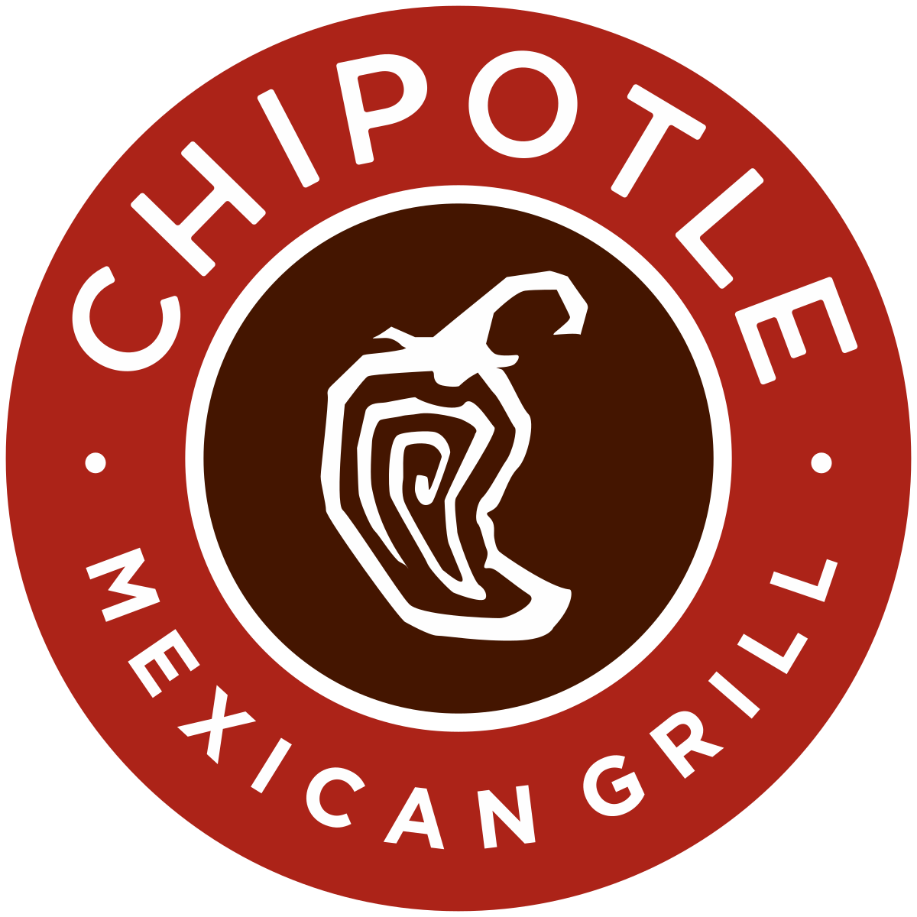
Infobip
&
Chipotle
Solution Presentation
March 18, 2025
Jay Sibel

Slide 2

Use Case
Chipotle Mexican Grill would like to market and increase its customer base by promoting free products and discount codes, while increasing usage of the Chipotle app.
Target users via SMS text via Infobip API from a promotional page with a special generated promo code.

Slide 3


How?
Offer new and existing customers with a promotional giveaway where they have a chance to win free food and discount coupons on future orders.
Offer a grand prize of Chipotle for life to 5 lucky users.
Provide a Promotional Giveaway to increase customer base
Drive traffic and usage to the Chipotle app

Slide 4

Solution
Marketing
Sign Up
SMS Channel
Chipotle App
QR Code and Website
Website Form
Opt in via Text
Register Code
Create a QR code and webpage to target users to sign up for a giveaway promotion.
Allow customers to sign up and register for a chance to win free food and discount coupons.
Customers can opt in by providing their SMS number, agreeing to the terms, and receive a promo code via SMS to enter in the app.
Enter promo code to see what prize they won. Grand prize gives a free Chipotle meal each month for life via coupon in the app.

Slide 5

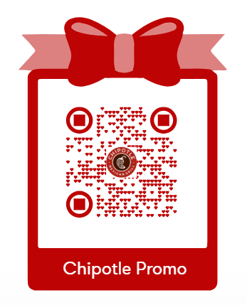
Demo
&
Q&A
https://jaythesuperman.github.io/Infobip/Chipotle.html
https://jaythesuperman.github.io/Infobip/Infobip.pptx

