Slide 1
CIS 3296: Software Design
Requirement Variants

Slide 2
Outline
Product Requirement Variants
Four Development Models

Slide 3
Outline
Product Requirement Variants
Four Development Models

Slide 4
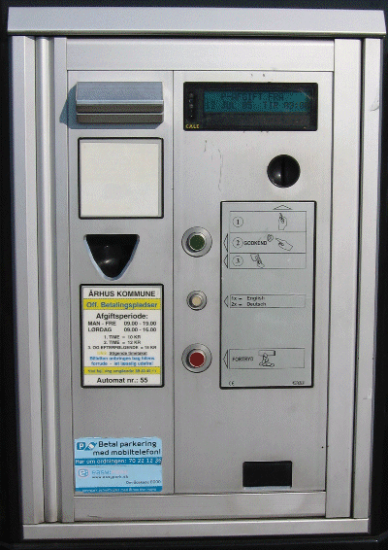
Customer – Alphatown county
Customer – Alphatown county:
The pay station requirements:
accept coins for payment
show time bought
print parking time receipts
US: 2 minutes cost 5 cent
handle buy and cancel
maintenance (empty it)

Slide 5
New Customer
The Alphatown county is very satisfied!
So – our parking machine software is now required by the Betatown county – but with a twist ☹
New requirements, add-ons, special cases and “wouldn’t it be nice if...”

Slide 6
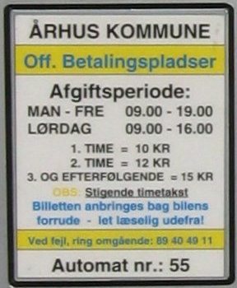
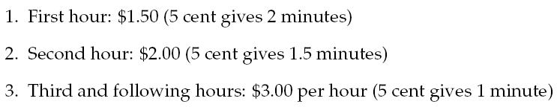
New requirement
Betatown’s new progressive price model:
Maybe we will see future changes in pricing models ???
How can we handle these two products in code development and maintenance?

Slide 7
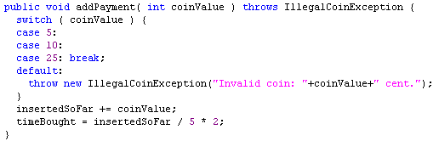
The present code
This is the spot where things may change: variability point

Slide 8
Problem !
Many models to handle this.
Consider:
Most of the code is the same in the two products
What about real success in the future? 20 product variants?
Focus:
find many models, not just an “optimal” one.

Slide 9
Outline
Product Requirement Variants
Four Development Models

Slide 10
Four Models
Model 1:
Make a copy of the source tree
Throw away some code, add some new code
Throw away unit tests, add new unit tests
Model 2:
Parameterization: Throw in some ‘if’-statements
Model 3:
Polymorphic proposal: Variation through inheritance
Model 4:
Compositional proposal: Factor out rate model responsibility

Slide 11
Model 1: Source Code Copy
Solution at OS level

Slide 12
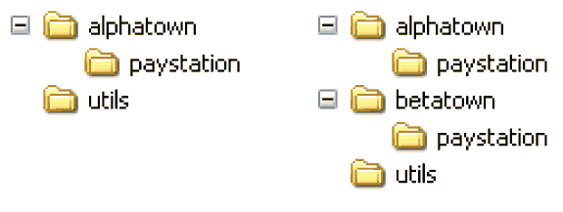
Model 1: Source tree copying
Idea: Deep copy production code source tree
Code the new variant by replacing the code at the variability point.

Slide 13
Benefits
Benefits:
It is simple!
no special skill set required in developer team
easy to explain idea to new developers
It is fast!
< 5 minutes?
It provides perfect variant decoupling
defects introduced in variant 2 does not reduce reliability of variant 1
easy to distinguish variants (consult folder hierarchy)

Slide 14
Liabilities
Multiple maintenance problem 
Changes in common code must be propagated to all copies
Usually manual process (or tedious SCM operation)
Example:
4 pay station variants (different rate policies)
request: pay station keeps track of earning ☹
Experience: Variants drift apart, becoming different products instead of variants...

Slide 15
Liabilities
If you have many copies you easily get mixed up
thus the benefit of easily identifying which variant you are working on is actually not true
Example:
Fixing the same bug in 5 nearly identical SAVOS production code bases at the same time ☹

Slide 16
Code Release
Configuration Management
Decide how to release a specialized version of code for a particular customer, e.g. Alphatown or betatown customers

Slide 17
Model 2: Parametric Solution

Slide 18

Parametric
Idea:
It is only a single “behavioural unit” in the addPayment method that varies
I can simply make a conditional statement there
Introduce a parameter (Which town)
Switch on the parameter each time town specific behaviour is needed.

Slide 19
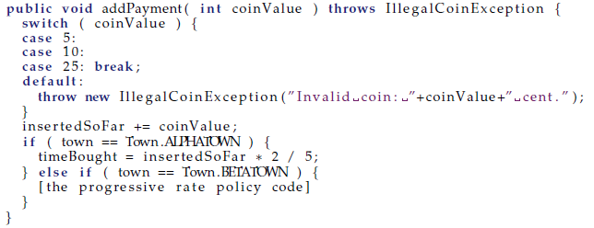
Code View

Slide 20
Instantiation
PayStation ps = new PayStationImpl( Town.ALPHATOWN );
OR
PayStation ps = new PayStationImpl( Town.BETATOWN );

Slide 21
Benefits
Simple
A conditional statement is one of the first aspects learned by programmers, used widely, and thus easy to understand for any skill level developer team
Avoid multiple maintenance problem
Yeah!!! Common defects/requirements are handled once and for all.

Slide 22
Liabilities
Liabilities:
Reliability concerns
Readability concerns
Responsibility erosion
Composition problem

Slide 23
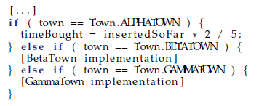
Liability: Reliability
Reliability/quality problem
Each time we must add a new rate model (sell in a new town) we must modify code to the existing PayStationImpl class.
This means potential of introducing errors in old code.
This means complete regression testing (and test case review) of all product variants!
Change by modification is costly !!!

Slide 24
Liability: Readability
Readability: Code bloat
If we must handle 43 different price models, then the switching code becomes long and winding, and the original algorithm almost drowns...
Switch creep
Throwing in “if” often leads to more “if”
if ( Town == ALPHATOWN ) {
if ( databaseServer == ORACLE && OptimizingOn ){
if ( DEBUG ) { Console.WriteLine( “...” ); }
...
} else { if ( IsMobilePayment() ) {
discountFactor = 0.9;
XXX
} else { ... }
Tell me what options are set in the XXX code ? Difficult, huh?

Slide 25
Liability: Responsibility
Responsibility erosion (“feature creep”)
Let us review what the responsibilities of the parking machine really is now:
<<interface>>
PayStation
Wait a few month and
the machine is also responsible for parsing XML files, printing
debug statements in the
console, updating a database, and handle transactions over mobile SMS network !
Responsibility
Accept payment
Handle transactions
Know time bought
Print recipt
Handle variations for Alphatown and Betatown

Slide 26
Liability: Composition Problem
Composition problem
A rate model that is a combination of existing ones leads to code duplication [can be avoided by making private methods in the class]
Example of much worse situation will be dealt with later...

Slide 27
Conditional compilation
In C and C++ you may alternatively use #ifdef’s
The analysis is basically the same as for parameterization, except that there is no performance penalty --- but choice of which model to be used cannot be made at run-time.
Note: Embedded software where memory footprint of code is important this may be the solution far superior to a pattern based solution!

Slide 28
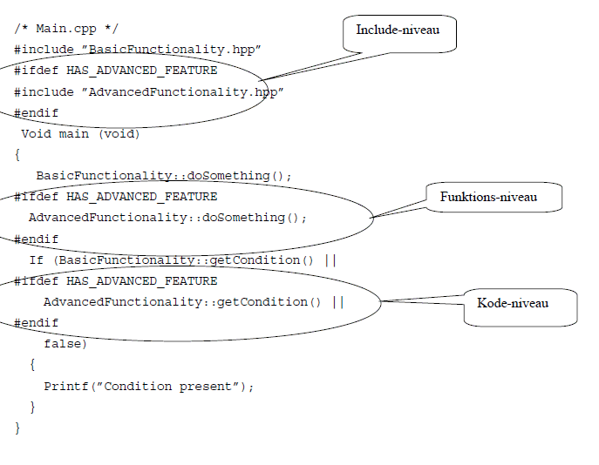
Example

Slide 29
Example
Data from ”reality”
600.000 lines of C++
1.300 classes
2.400 files
60.000 staff-days for development
3 sites of development
432 parameters (”compile-flags”) must be set to determine the specific variant of the product
All defined in a make-file (~ build.xml)

Slide 30
Model 3: Polymorphic Solution

Slide 31

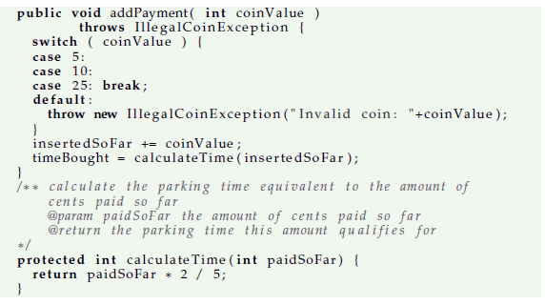
Model 3: Polymorphic proposal
Subclass and override!

Slide 32
Instantiation
Functionality selection + implementation:
public class PayStationProgressivePrice : PayStationImpl {
public PayStationProgressivePrice() : base() {}
override protected int calculateTime(int insertedSoFar) {
}
Instantiation:
PayStation ps_subclass =
new PayStationProgressivePrice();

Slide 33
Analysis
Benefits
Avoid multiple maintenance
Reliability concern
Code readability
Liabilities
Increased number of classes
Inheritance relation spent on single variation type
Reuse across variants difficult
Compile-time binding

Slide 34
Benefits
☺ Reliability concern
The first time I add a new rate policy I change by modification!
I have to refactor the code to introduce the new private method calculateTime
Change by addition, not by modification
All following new requirements regarding rate policies can be handled by adding new subclasses, not by modifying existing classes.
Thus, no fear of introducing defects in existing software; no regression testing, no reviews.

Slide 35
Benefits
☺ Readability
There is no code bloating from introduction conditional statements
I simply add new classes instead

Slide 36
Liabilities
☹ Increased number of classes
I have to add one new class for each rate policy variant
thus instead of 43 if statements in one class I get 43 subclasses to overview

Slide 37
Liabilities
☹ Spent inheritance on single variation type
You have “wasted” your single implementation-inheritance capability on one type of variation!
The name is odd – isn’t it? “PayStationProgressivePrice”
What is next: “PayStationProgressivePriceButLiniarInWeekendsWithOracleDataBaseAccessDebuggingVersionAndBothCoinAndMobilePhonePaymentOptions” ???

Slide 38
Liabilities
☹ Inheritance is a compile time binding
you literally write “extends / :” in your editor !!!
Thus you cannot change rate model except by rewriting code!
Sorts of similar to “change by modification ☺”
Impossible to dynamically change rate policy at run-time or at start-up time.

Slide 39
Liabilities
☹ Reuse across variants is difficult
Gammatown
“We want a rate policy similar to Alphatown during weekdays but similar to Betatown during weekends.”
but some code is in one superclass and some in another subclass...
combining them will lead to a pretty odd design
or I have to refactor into an abstract superclass that contains the rate policies... But what do they do there?

Slide 40
Model 4: Compositional Solution
A fresh and new look at the problem

Slide 41
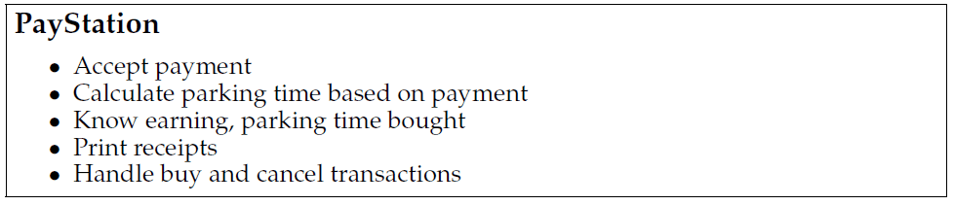
Proposal 4: Composition
Golden rule: No abstraction should have too many responsibilities. Max 3 is a good rule of thumb…
(Facade objects are an exception)

Slide 42
Serving too many responsibilities
The reason that we have to modify code to handle the new requirement instead of adding code is because
The change revolves around a responsibility (calculate parking time) that is buried within an abstraction and mixed up with many other responsibilities (print receipt, handle buy, etc.) !!!
So: What do we do???

Slide 43
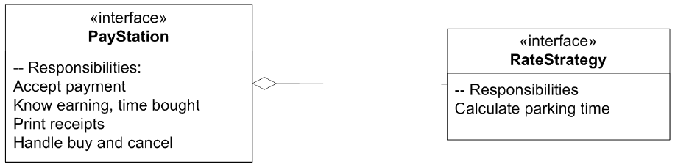
Divide responsibilities - compose them
A proposal is simply to Put the responsibility in its own abstraction / object

Slide 44
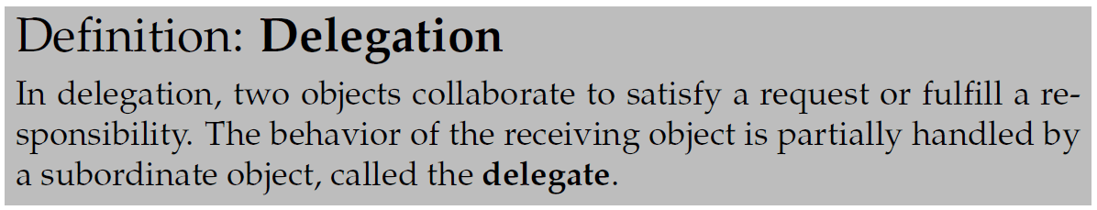
Delegation
The basic principle is simple but powerful:
Instead of one object doing it all by itself, it asks another object to help out. Some of the job is handled by another “actor” – the delegate
This principle has a name:

Slide 45
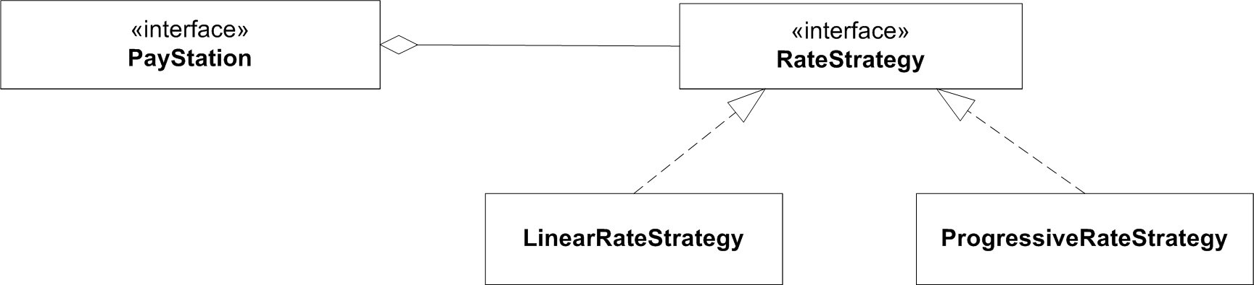
Concrete behaviours
Responsibilities must be served by concrete behaviour in objects...

Slide 46
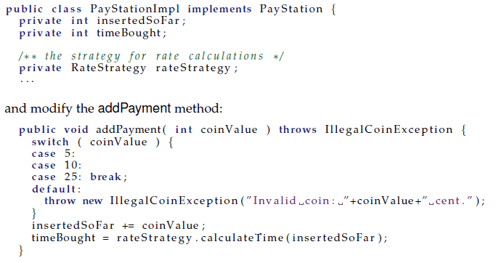
Code View

Slide 47
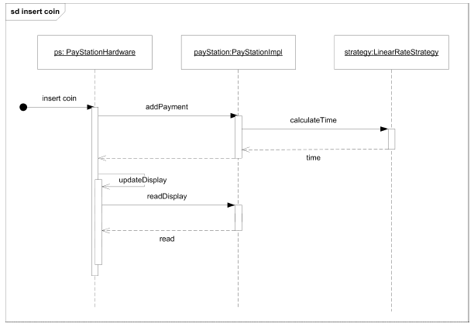
Behaviour

Slide 48
Problem
The pay station needs to know which rate strategy object to use, of course!
How do we tell it ???

Slide 49
Choosing pricing
Several possibilities
Constructor
Set-method
Functionality selection:
// The rate calculation strategy used
RateStrategy rateStrategy;
public PayStationImpl( RateStrategy rs ) : base() {
rateStrategy = rs;
}

Slide 50
Analysis
Constructor
Compiler will tell you that you have forgotten to make it!
Early binding that cannot be changed at run-time
Set-method
You might forget to set it !!!
but you can change your mind at run-time !

Slide 51
Analysis
☺ Readability
no code bloat of conditional statements
☺ Run-time binding
I can actually change the rate policy while the system is running. Leads to lower maintenance costs as no shut down required

Slide 52
Benefits
☺ Responsibilities clearly stated in interfaces
Leads to No Odd Naming:
PayStation and RateStrategy: The responsibilities
LinearRateStrategy ect: Concrete behaviour fulfilling responsibilities
The pay station has “lost some fat”
by separating responsibilities the cohesion of the code within each abstraction is higher
Note though that from the GUI/hardware’s perspective, the pay station still has the ‘formal’ responsibility to calculate rates!

Slide 53
Benefits
☺ Variant selection localized
There is only one place in the code where I decide which rate policy to take
namely in the configuration/main code where I instantiate the pay station!
contrast to the parametric solution where selection and decision code is smeared all over the place
No variant handling code at all in the pay station code !

Slide 54
Change by addition
Change by addition, not modification
addition
little to test, little to review
little chance of introducing ripple-effects
modification
more to test, more to review
high risk of ripples leading to side effects (bugs!)

