Slide 1
Assignment #2: High aspect ratio MEMS Marc Johannes Aslan, Thomas Kötzner

Slide 2
Assignment
state the assignment
General remarks:
when using images which are not yours, state the source (either directly underneath the image or in the foot of the page)
stick to the font size
avoid over-crowding the page
the total length of the presentation should be 10 minutes (usually around 5-6 content slides)
cold run your presentation before you give the take in the plenum to make sure you stick to the time and that the presentation works

Slide 3
Assignment
high aspect ratio MEMS devices are required for a number of common applications
name a few of the applications where high-aspect ratio structures are required
what methods are available to make high aspect ratio MEMS structures
in metals
in polymers
in semiconductor materials

Slide 4
High aspect ratio
Definition: ratio between the depth and minimal lateral expansion
Bigger 10:1
Advantages:
High packaging density
Flexibility in 3 dimensions
Structures of different shapes and varying heights or widths
Thick high mass elements
Released features
Increased capacities
Limitations:
Depending on fabrication process
mechanical effects (e.g weight, inertial, angles etc.)
Costs, design and planning

Slide 5
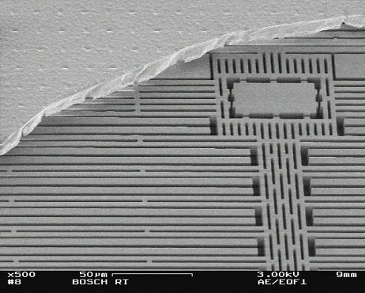
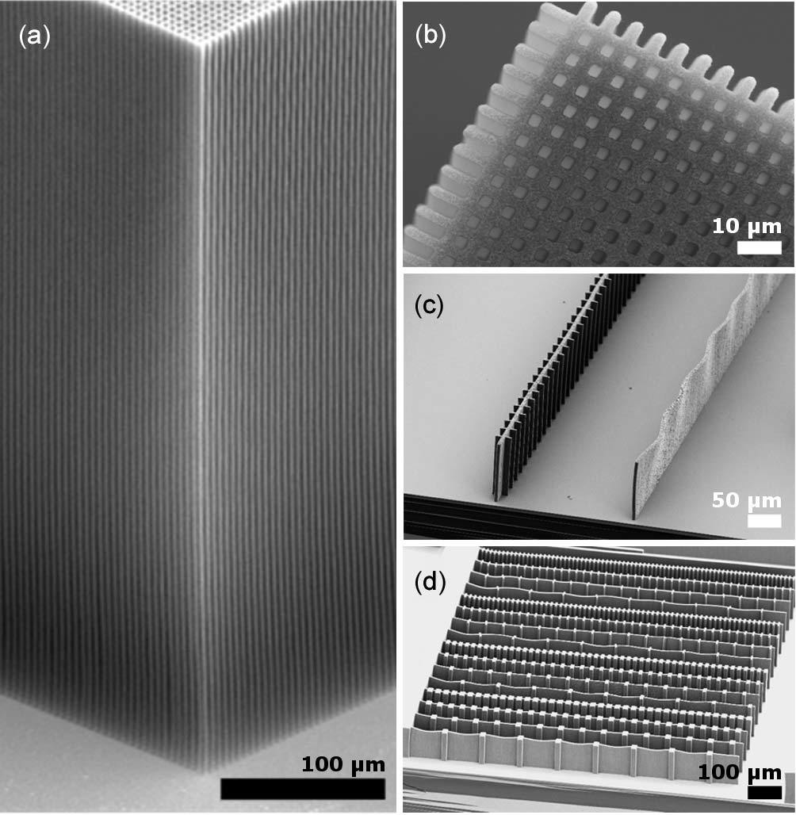
Applications
Micro inertial sensors:
Gyroscopes
Accelerometers
Angular rate sensors
Nano tubes
3D circuit integration
Plenty of further applications
Notes:
Ende: Überleitung nicht alles Prozesse werden vorgestellt

Slide 6
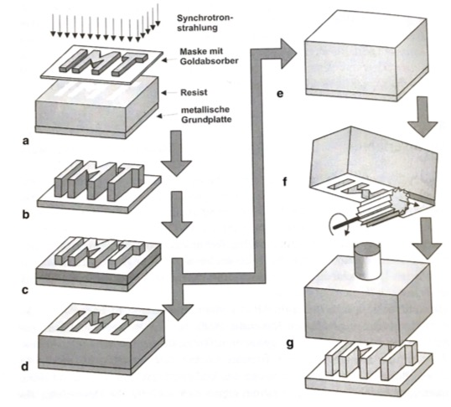
Fabrication Methods - Metals
Lithographie, Galvanik und Abformung (LIGA)
X-ray LIGA (high aspect ratio) and UV-LIGA
Lithography
Exposure
Development
Electroplating
Stripping
Also applicable to polymeres and semiconductor materials
Aspect ratios > 100:1 possible

Slide 7
Fabrication Methods - Polymers
Hot embossing
Prdoucing Embossing master by LIGA or DRIE
Heating up Polymer
Embossing
Cooling down
Specialised for Polymers
Applications e.g. for medicine
Very cheap process

Slide 8
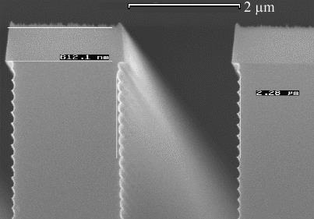
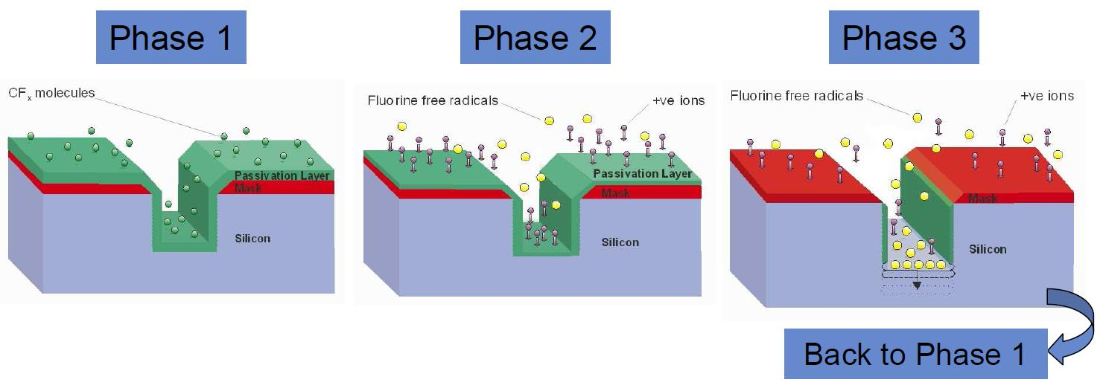
Fabrication Methods - Semiconductors
Deep Reactive Ion Etching (DRIE)
Passivation with polymers
Open the passivation layer at the bottom
Etching silicon at the bottom
UV LIGA
SCREAM

