Slide 1
Assignment #2: High aspect ratio MEMS Marc Johannes Aslan, Thomas Kötzner

Slide 2
Assignment
high aspect ratio MEMS devices are required for a number of common applications
name a few of the applications where high-aspect ratio structures are required
what methods are available to make high aspect ratio MEMS structures
in metals
in polymers
in semiconductor materials

Slide 3
High aspect ratio
Definition: ratio between the depth and minimal lateral expansion
Bigger 10:1
Advantages:
High packaging density
Flexibility in 3 dimensions
Structures of different shapes and varying heights or widths
Thick high mass elements
Released features
Increased capacities
Limitations:
Depending on fabrication process
mechanical effects (e.g weight, inertial, angles etc.)
Costs, design and planning

Slide 4
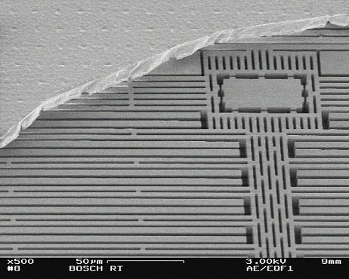
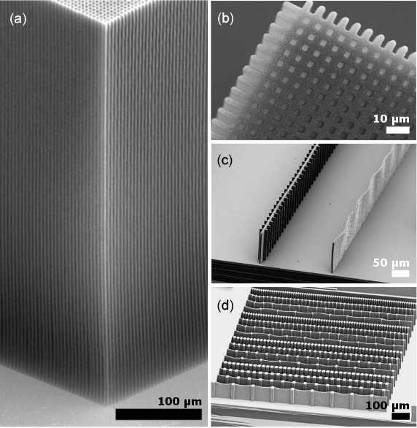
Applications
Micro inertial sensors:
Gyroscopes
Accelerometers
Angular rate sensors
Nano tubes
3D circuit integration
Plenty of further applications
Hutchison et al., Carbon nanotubes as a framework for high-aspect-ratio mems fabrication, Journal of Microelectromechanical Systems, 2010
Notes:
Johannes
There are so many different applications for microstructures with High aspect ratio
One big area of applications is micro inertial sensors
Application in automotive, smartphone etc.
With high aspect ratio it is possible to increase the sensivity of those sensors
Nanotubes: framework for builing microstructures with HAR
3d circuit integration: high aspect ratio for circuit paths
And so on
Ende: Überleitung nicht alles Prozesse werden vorgestellt

Slide 5
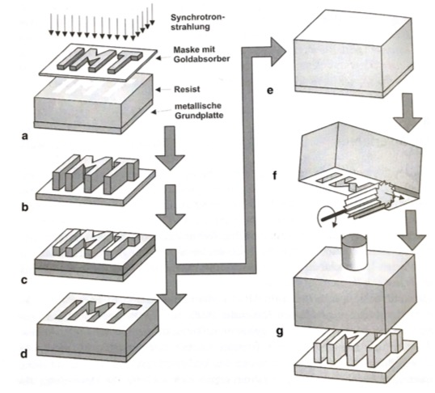
Fabrication Methods - Metals
Lithographie, Galvanik und Abformung (LIGA)
X-ray LIGA (high aspect ratio) and UV-LIGA
Exposure
Development
Electroplating
Stripping
Also applicable to polymeres and semiconductor materials
Aspect ratios > 100:1 possible
Menz et al., Mikrosystemtechnik für Ingenieure, John Wiley & Sons, 2012
Notes:
Johannes
German Name, developed in Germany: Lithography, Galvanik und Abformung
Steps are:
Lithography
Application conductive seed layer on substrate (any metals, if needed: adhesive) _> sputtering or evaporation
Adding photoresistive material
exposure with X-ray by synchrotron source
Developing the resist
Electroplating
Filling remaining resist upwards from seedlayer with metal
Stripping
Remove remaining resist chemical
Also usable for polymers and semiconductor materials
High aspect ratios over 100:1 possible

Slide 6
Fabrication Methods - Polymers
Hot embossing
Producing Embossing master by LIGA or DRIE
Heating up Polymer
Embossing
Cooling down
Specialised for Polymers
Applications e.g. for medicine
Very cheap process
Becker et al., Hot embossing as a method for the fabrication of polymer high aspect ratio structures, Sensors and Actuators A: Physical, 2000
Notes:
Process special for polymers
Hot embossing:
Produce embossing master by Liga or DRIE, works like a stamp, must be high quality
Then heating up the polymer
Embossing the polymer, embossing tool borught to contact with preheated polymer and embossed into it
Remove tool
Cooling down polymer
Possible to use all advantages of polymers for MEMS
Example BioMEMS, Medicine
High aspect ratios possible
Very cheap compared to other processes

Slide 7
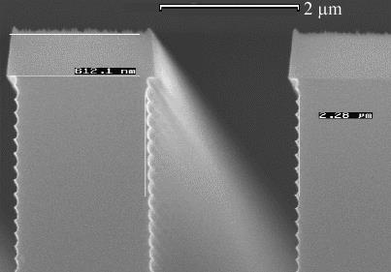
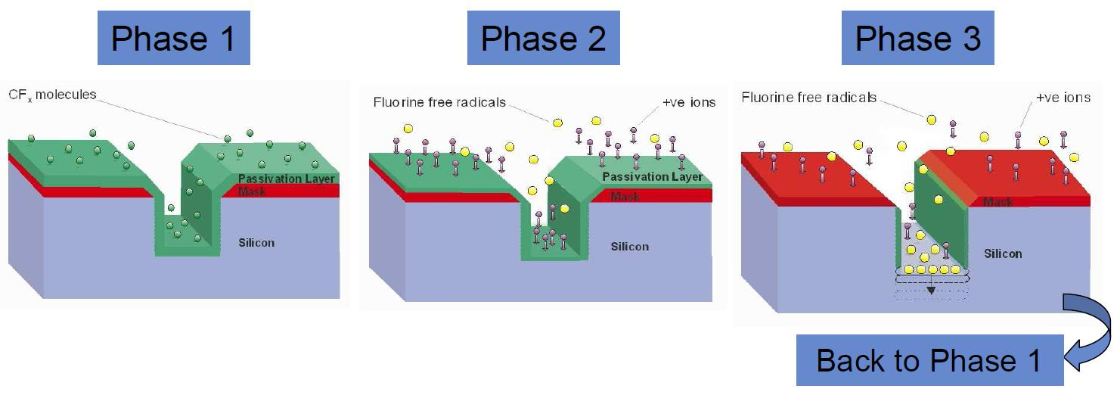
Fabrication Methods - Semiconductors
Deep Reactive Ion Etching (DRIE)
Passivation with polymers
Open the passivation layer at the bottom
Etching silicon at the bottom
UV LIGA
SCREAM

