Slide 1




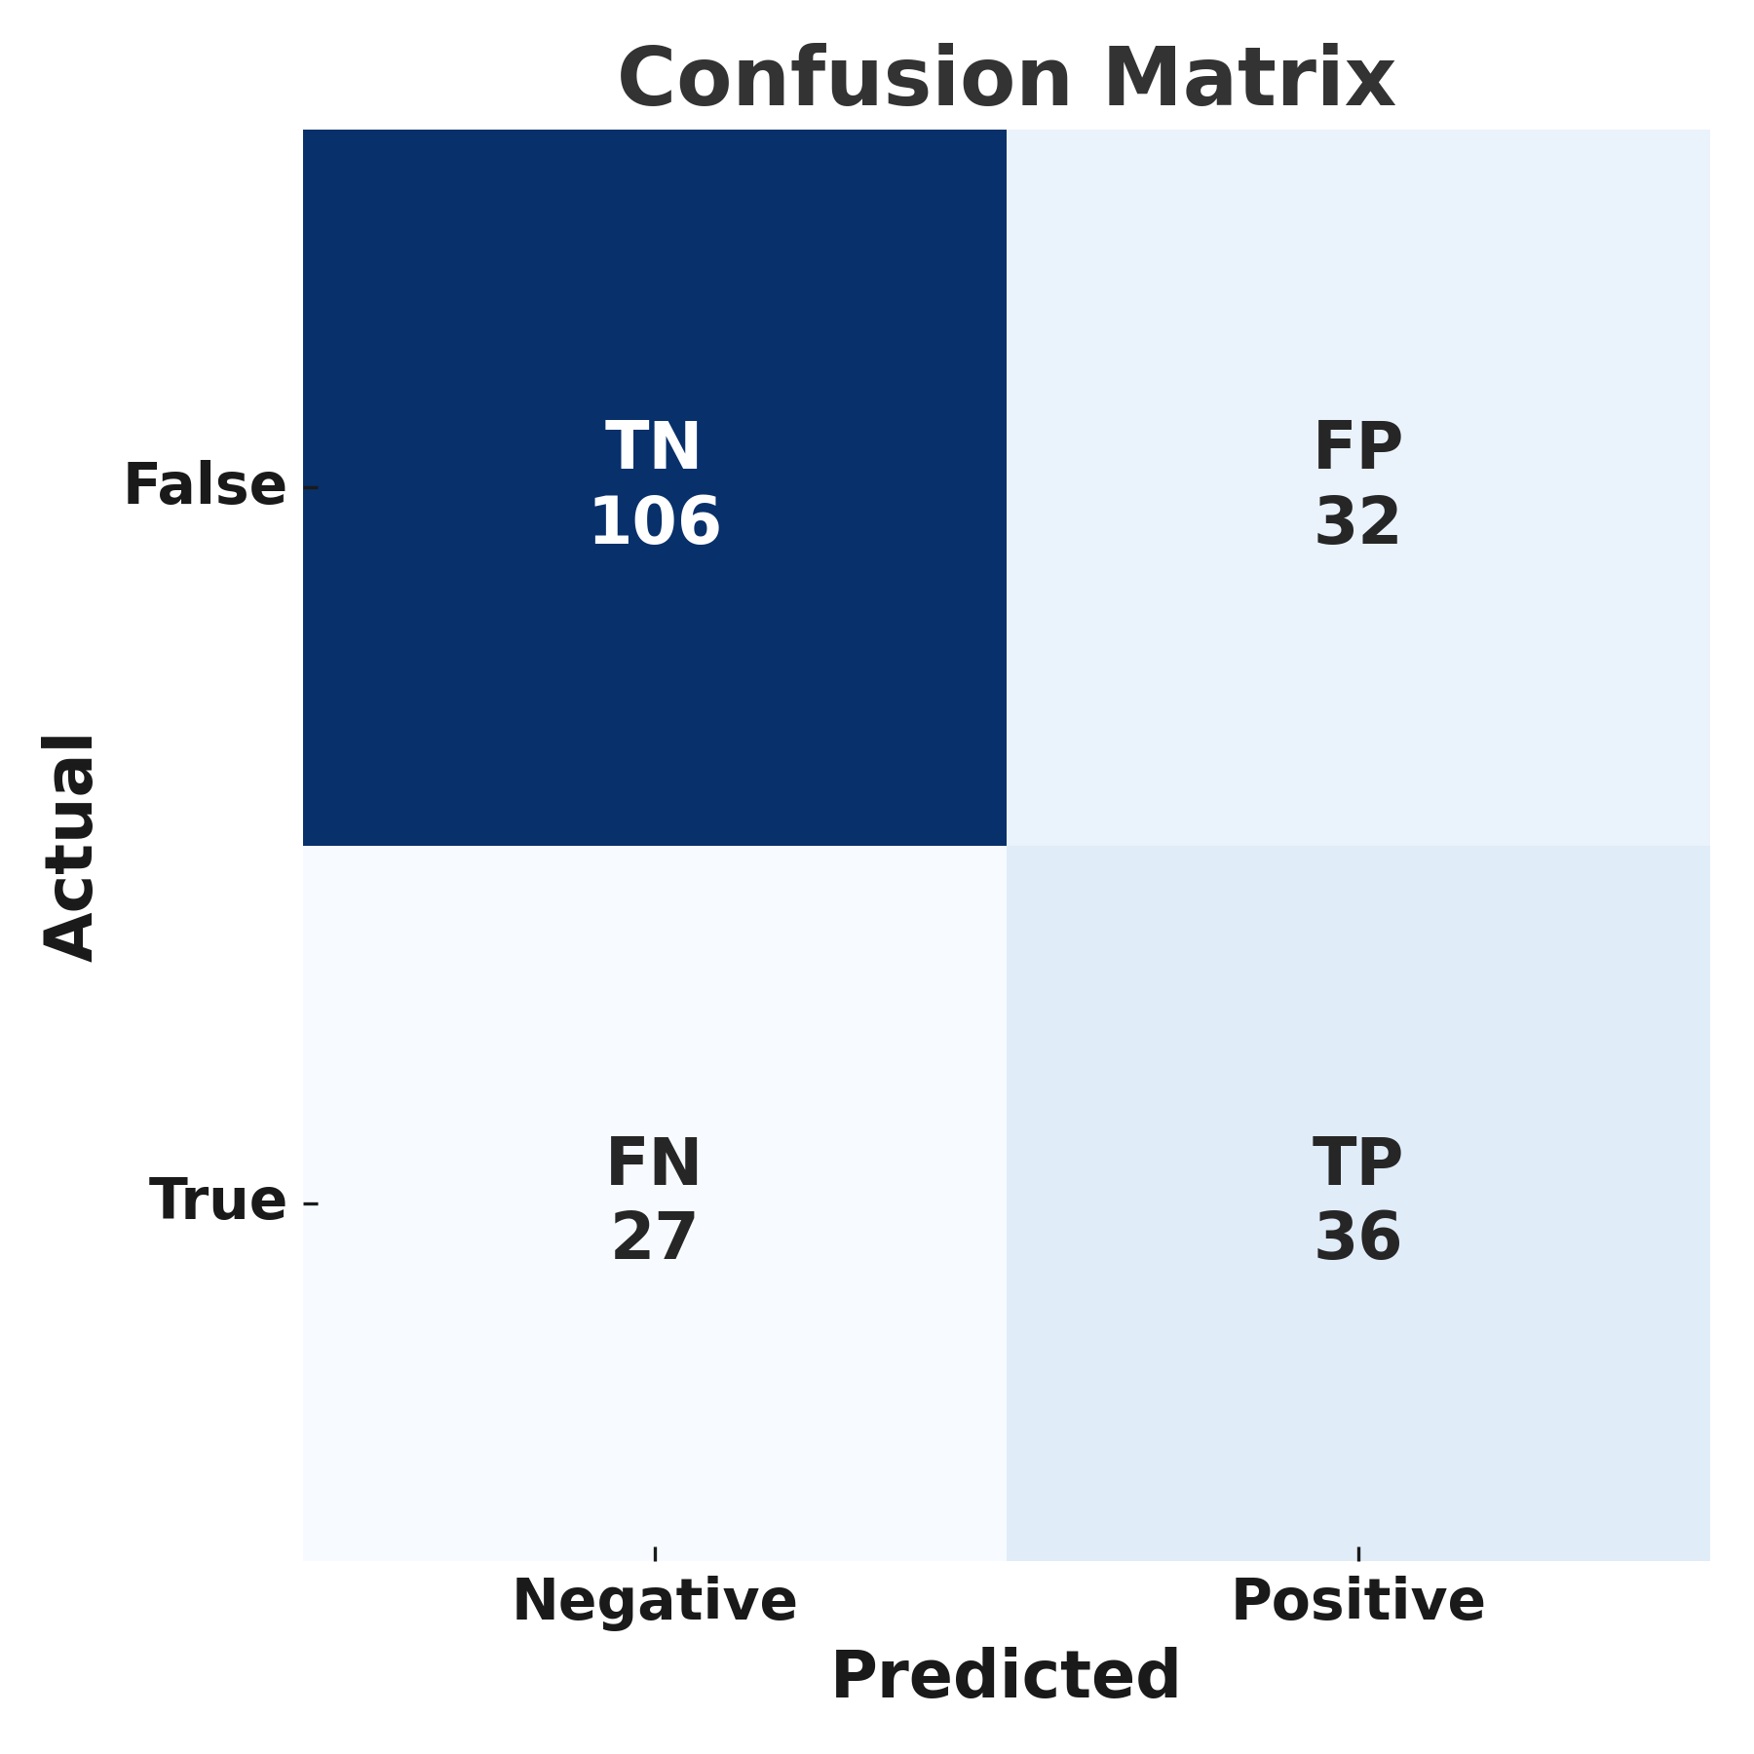
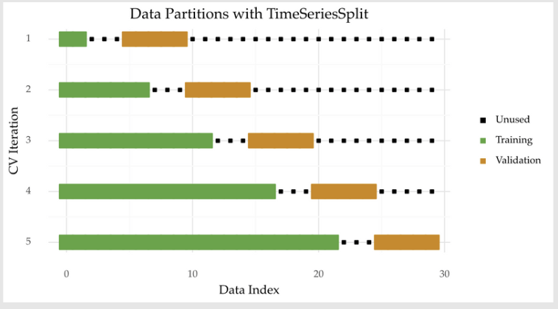

FinScope3D: Data Retrieval x Document Analysis x Data-Driven Prediction
Members: Jay Wu, Ray Chang, Yu-Ting Chen, Ingrid Tseng Mentor: Jerry Liao, Ti-Wen Chen
Introduction
Methodology and Results
Discussion and Conclusion
Financial questions are often complex and require integrating multiple sources like reports, transcripts, and predictions. FinScope3D helps simplify this process.
From the user's perspective, we aim to extract meaningful entities and understand intent behind financial questions. From the system’s perspective, we choose the right model or data to generate precise answers.
Our system combines NER, structured and unstructured data search, and machine learning predictions—forming a comprehensive financial QA pipeline.
We used Named Entity Recognition (NER) to extract key entities (e.g., companies, time, executives, financial metrics, events) from query and earnings transcripts using flair and custom rules. The extracted entities were used to classify query intent or structure into a knowledge graph for enhanced retrieval.
We implemented HybridRAG by combining vector search for semantic retrieval and knowledge graph for structured reasoning, aiming to improve query relevance and response accuracy
Results: NER improves the ability to classify user query intents. Hybrid retrieval reduced hallucination, improving factual consistency in generated responses
HybridRAG reduces hallucination and improves the relevance of financial answers by combining vector search with knowledge graphs.
NER helps clarify user intent, making it easier to route questions to the right model or data source.
Prediction model performs well, achieving an F1 score of 0.55 and AUC of 0.67.
In the predictive analysis, we label a stock as 1 if its performance exceeds that of the Nasdaq Index and 0 if it underperforms the Nasdaq Index
Because of time series data, we use expanding-window cross-validation method to train the model
We use LightGBM for predictions and leverage Optuna to tune the optimal parameters
The results are: F1 Score is 0.5486 and AUC is 0.6693
Future Work
Improve model accuracy by integrating more real-time and high-frequency financial data.
Expand to more tasks, such as event analysis or sentiment prediction.
Dataset
The sources of structured data include SEC EDGAR and the Yahoo Finance API
The sources of unstructured data include SEC EDGAR and companies
In the prediction part,
firm-specific financial data is obtained from Bloomberg and Yahoo Finance (https://finance.yahoo.com/)
macroeconomic data is sourced from FRED (https://fred.stlouisfed.org/)
References
[1]Bhaskarjit Sarmah, Benika Hall, Rohan RaoSunil Patel, Stefano Pasquali, Dhagash Mehta HybridRAG: Integrating Knowledge Graphs and Vector Retrieval Augmented Generation for Efficient Information Extraction. (2024).
[2]https://medium.com/aimonks/mastering-the-waves-of-time-enhancing-predictive-accuracy-with-time-series-cross-validation-4eaccdaaa5e2

