Slide 1
Machine Learning for Signal Processing Predicting and Estimation from Time Series
Bhiksha Raj

Slide 2
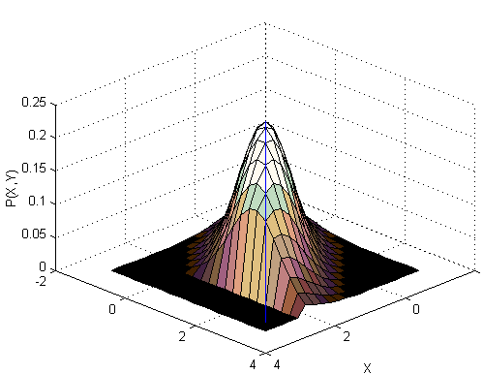
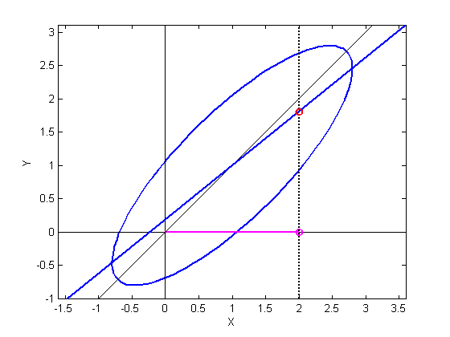
Preliminaries : P(y|x) for Gaussian
If P(x,y) is Gaussian:
The conditional probability of y given x is also Gaussian
The slice in the figure is Gaussian
The mean of this Gaussian is a function of x
The variance of y reduces if x is known
Uncertainty is reduced

Slide 3
Preliminaries : P(y|x) for Gaussian
Best guess for Y
when X is not known

Slide 4
Preliminaries : P(y|x) for Gaussian
Update guess of Y based on information in X
Correction is 0 if X and Y are uncorrelated, i.e C_{yx} = 0
Correction of Y using information in X
Best guess for Y
when X is not known
Mean of Y given X
Given X value

Slide 5
Preliminaries : P(y|x) for Gaussian
Correction to Y = slope * (offset of X from mean)
Correction of Y using information in X
Best guess for Y
when X is not known
Mean of Y given X
Given X value
offset
Slope

Slide 6
Preliminaries : P(y|x) for Gaussian
Correction of Y using information in X
Best guess for Y
when X is not known
Uncertainty in Y
when X is not known

Slide 7
Preliminaries : P(y|x) for Gaussian
Shrinkage of variance is 0 if X and Y are uncorrelated, i.e C_{yx} = 0
Correction of Y using information in X
Reduced uncertainty from knowing X
Best guess for Y
when X is not known
Uncertainty in Y
when X is not known
Shrinkage of uncertainty from knowing X

Slide 8
Preliminaries : P(y|x) for Gaussian
Knowing X modifies the mean of Y and shrinks its variance
Variance of Y when X is known
Overall variance of Y when X is unknown
Mean of Y given X (MAP estimate of Y)
Given X value

Slide 9

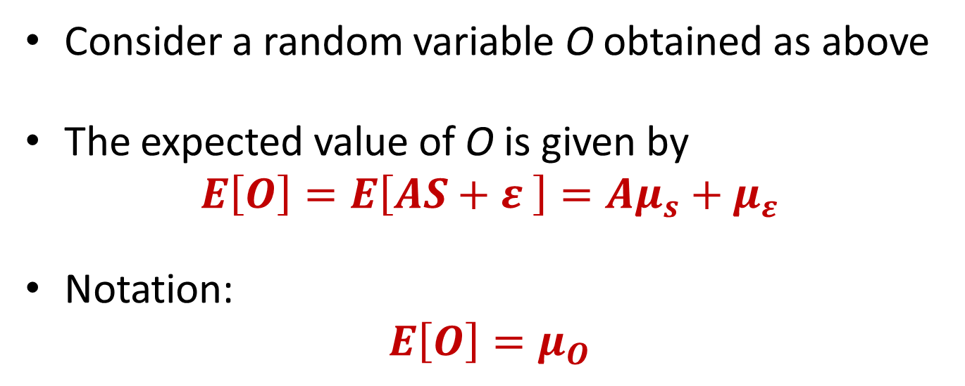


Background: Sum of Gaussian RVs
$$O=AS+ε$$
$$S \sim N(μ_{s},Θ_{s})$$
$$ε \sim N(μ_{ε},Θ_{ε})$$
Consider a random variable O obtained as above
The expected value of O is given by
$$E\left[O\right]=E\left[AS+ε \right]=Aμ_{s}+μ_{ε}$$
Notation:
$$E\left[O\right]=μ_{O}$$

Slide 10
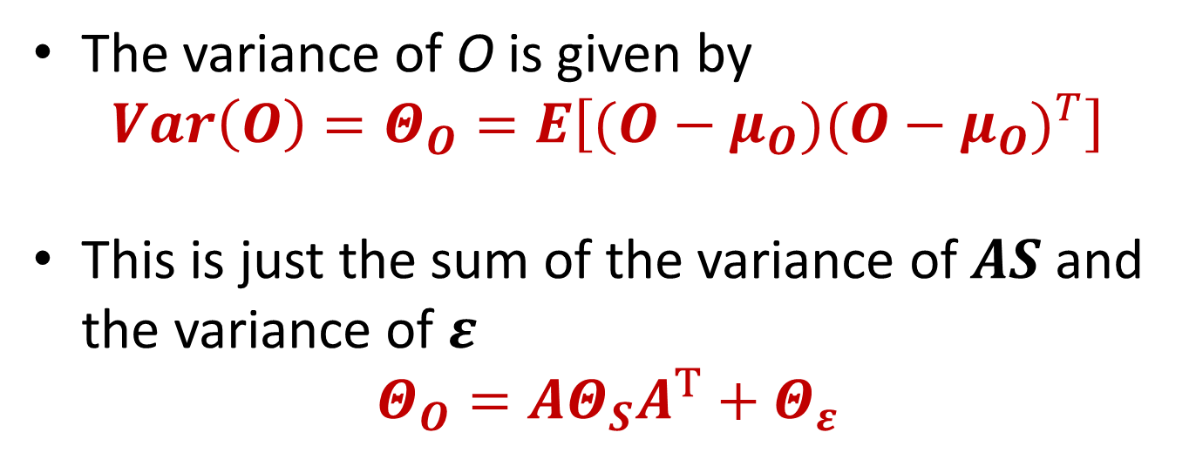
Background: Sum of Gaussian RVs
$$O=AS+ε$$
$$S \sim N(μ_{s},Θ_{s})$$
$$ε \sim N(μ_{ε},Θ_{ε})$$
The variance of O is given by
$$Var\left(O\right)=Θ_{O}=E\left[(O−μ_{O}){(O−μ_{O})}^{T}\right]$$
This is just the sum of the variance of $AS$ and the variance of $ε$
$$Θ_{O}={AΘ}_{S}A^{T}+Θ_{ε}$$

Slide 11
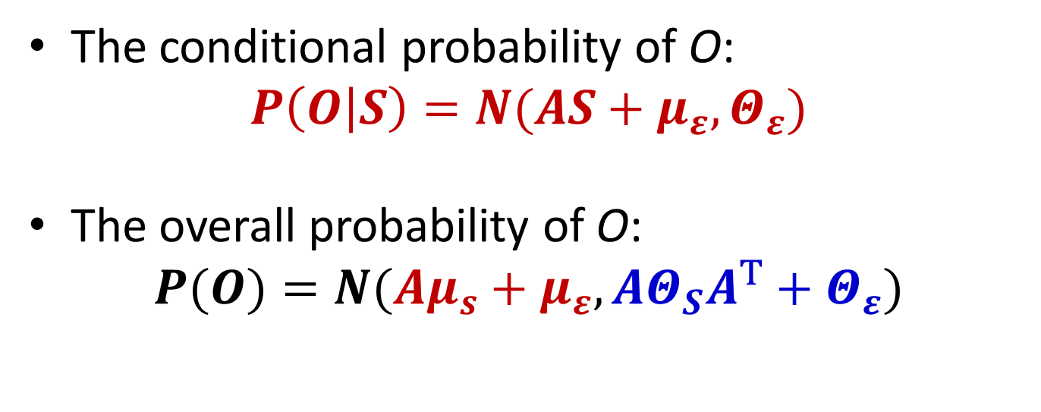
Background: Sum of Gaussian RVs
$$O=AS+ε$$
$$S \sim N(μ_{s},Θ_{s})$$
$$ε \sim N(μ_{ε},Θ_{ε})$$
The conditional probability of O:
$$P\left(O | S\right)=N(AS+μ_{ε},Θ_{ε})$$
The overall probability of O:
$$P(O)=N(Aμ_{s}+μ_{ε},{AΘ}_{S}A^{T}+Θ_{ε})$$

Slide 12
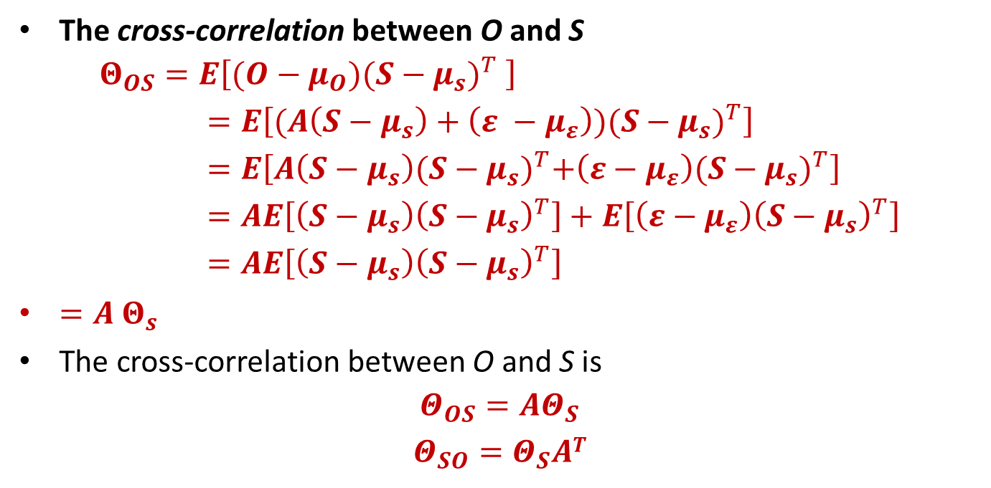
Background: Sum of Gaussian RVs
$$O=AS+ε$$
$$S \sim N(μ_{s},Θ_{s})$$
$$ε \sim N(μ_{ε},Θ_{ε})$$
The cross-correlation between O and S
$$Θ_{OS}=E\left[(O−μ_{O}){(S−μ_{s})}^{T} \right]=E\left[(A\left(S−μ_{s}\right)+\left(ε −μ_{ε}\right)){(S−μ_{s})}^{T}\right]=E\left[A\left(S−μ_{s}\right){(S−μ_{s})}^{T}+\left(ε−μ_{ε}\right){(S−μ_{s})}^{T}\right]=AE\left[\left(S−μ_{s}\right){\left(S−μ_{s}\right)}^{T}\right]+E\left[\left(ε−μ_{ε}\right){\left(S−μ_{s}\right)}^{T}\right]=AE\left[\left(S−μ_{s}\right){\left(S−μ_{s}\right)}^{T}\right]$$
$=A$ $Θ_{s}$
The cross-correlation between O and S is
$$Θ_{OS}=AΘ_{S}$$
$$Θ_{SO}=Θ_{S}AT$$

Slide 13

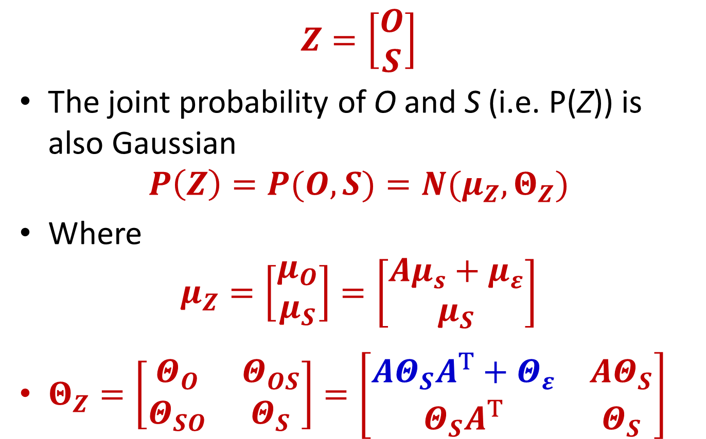
Background: Joint Prob. of O and S
$$O=AS+ε$$
$$Z=\left[\begin{matrix}O \\ S\end{matrix}\right]$$
The joint probability of O and S (i.e. P(Z)) is also Gaussian
$$P\left(Z\right)=P(O,S)=N(μ_{Z},Θ_{Z})$$
Where
$$μ_{Z}=\left[\begin{matrix}μ_{O} \\ μ_{S}\end{matrix}\right]=\left[\begin{matrix}Aμ_{s}+μ_{ε} \\ μ_{S}\end{matrix}\right]$$
$Θ_{Z}=\left[\begin{matrix}Θ_{O} & Θ_{OS} \\ Θ_{SO} & Θ_{S}\end{matrix}\right]=\left[\begin{matrix}{AΘ}_{S}A^{T}+Θ_{ε} & {AΘ}_{S} \\ Θ_{S}A^{T} & Θ_{S}\end{matrix}\right]$

Slide 14

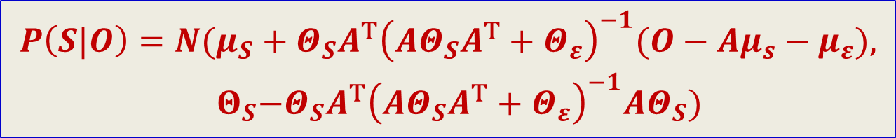
Preliminaries : Conditional of S given O: P(S|O)
$$O=AS+ε$$
$$P\left(S|O\right)=N(μ_{S}+Θ_{SO}Θ_{O}^{−1}(O−μ_{O}),{ Θ}_{S}−Θ_{SO}Θ_{O}^{−1}Θ_{OS})$$
$$P\left(S|O\right)=N(μ_{S}+{Θ_{S}A^{T}\left({AΘ}_{S}A^{T}+Θ_{ε}\right)}_{}^{−1}(O−Aμ_{s}−μ_{ε}),$$
$${ Θ}_{S}−{Θ_{S}A^{T}\left({AΘ}_{S}A^{T}+Θ_{ε}\right)}_{}^{−1}AΘ_{S})$$

Slide 15


The little parable
You’ve been kidnapped
And blindfolded
You can only hear the car
You must find your way back home from wherever they drop you off

Slide 16
Kidnapped!
Determine by only listening to a running automobile, if it is:
Idling; or
Travelling at constant velocity; or
Accelerating; or
Decelerating
You only record energy level (SPL) in the sound
The SPL is measured once per second

Slide 17
What we know
An automobile that is at rest can accelerate, or continue to stay at rest
An accelerating automobile can hit a steady-state velocity, continue to accelerate, or decelerate
A decelerating automobile can continue to decelerate, come to rest, cruise, or accelerate
A automobile at a steady-state velocity can stay in steady state, accelerate or decelerate

Slide 18
What else we know
P(x|idle)
P(x|decel)
P(x|cruise)
P(x|accel)
45
60
65
70
The probability distribution of the SPL of the sound is different in the various conditions
As shown in figure
In reality, depends on the car
The distributions for the different conditions overlap
Simply knowing the current sound level is not enough to know the state of the car

Slide 19
The Model!
P(x|accel)
0.33
70
Accelerating state
P(x|idle)
0.5
0.33
0.33
0.5
0.25
0.33
0.33
Idling state
Cruising state
0.25
65
45
0.25
0.25
 | I | A | C | D
I | 0.5 | 0.5 | 0 | 0
A | 0 | 1/3 | 1/3 | 1/3
C | 0 | 1/3 | 1/3 | 1/3
D | 0.25 | 0.25 | 0.25 | 0.25
0.33
Decelerating state
60
The state-space model
Assuming all transitions from a state are equally probable
This is a Hidden Markov Model!

Slide 20

Estimating the state at T = 0-
0.25
0.25
0.25
0.25
Idling
Declerating
Cruising
Accelerating
A T=0, before the first observation, we know nothing of the state
Assume all states are equally likely

Slide 21

The first observation: T=0
P(x|idle)
P(x|decel)
P(x|cruise)
P(x|accel)
45
60
65
70
68dB
At T=0 you observe the sound level x₀ = 68dB SPL
The observation modifies our belief in the state of the system

Slide 22
The first observation: T=0
P(x|idle)
P(x|decel)
P(x|cruise)
P(x|accel)
45
60
65
70
68dB
P(x|idle) | P(x|deceleration) | P(x|cruising) | P(x|acceleration)
0 | 0.0001 | 0.5 | 0.7
These don’t have to sum to 1
Can even be greater than 1!
0.7
0.5
0
0.0001
Idling
Declerating
Cruising
Accelerating

Slide 23



The first observation: T=0
P(x|idle)
P(x|decel)
P(x|cruise)
P(x|accel)
45
60
65
70
68dB
0.7
$$P(x_{0}|state)$$
0.5
0
0.0001
Idling
Declerating
Cruising
Accelerating
$$Prior: P(state)$$
Remember the prior
0.25
0.25
0.25
0.25
Idling
Declerating
Cruising
Accelerating

Slide 24
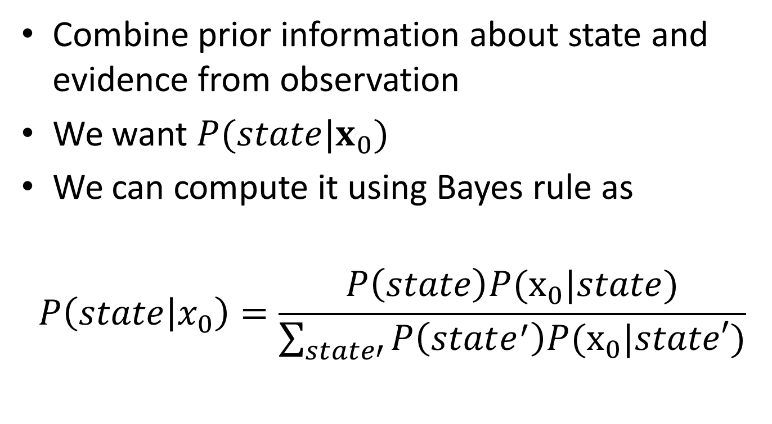
Estimating state after at observing x₀
Combine prior information about state and evidence from observation
We want $P(state|x_{0})$
We can compute it using Bayes rule as
$$P\left(state | x_{0}\right)=\frac{P\left(state\right)P(x_{0}|state)}{\sum_{state′}{P\left(state^{′}\right)P(x_{0}|state′)}}$$

Slide 25


The Posterior
0.7
$$P(x_{0}|state)$$
0.5
0
0.0001
Idling
Declerating
Cruising
Accelerating
$$Prior: P(state)$$
0.25
0.25
0.25
0.25
Idling
Declerating
Cruising
Accelerating
Multiply the two, term by term, and normalize them so that they sum to 1.0

Slide 26


Estimating the state at T = 0+
$$P(S_{T=0}|x_{0})$$
0.57
0.42
0.0
8.3 x 10⁻⁵
Idling
Decelerating
Cruising
Accelerating
At T=0, after the first observation x₀, we update our belief about the states
The first observation provided some evidence about the state of the system
It modifies our belief in the state of the system

Slide 27

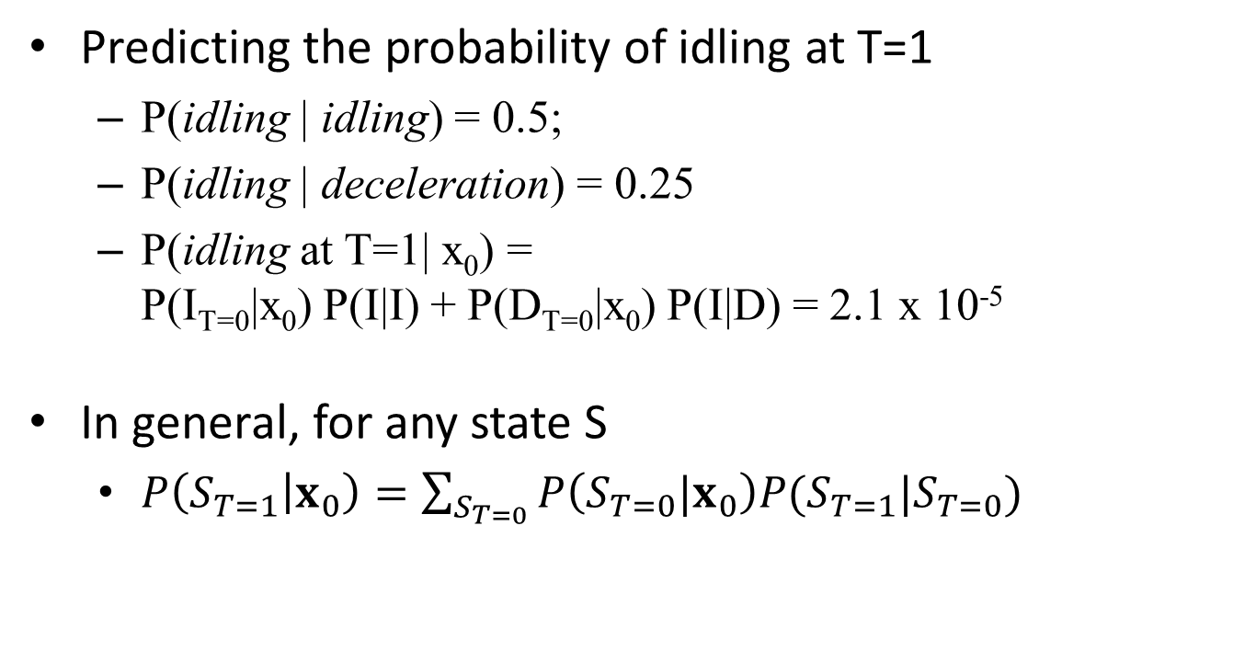
Predicting the state at T=1
A
 | I | A | C | D
I | 0.5 | 0.5 | 0 | 0
A | 0 | 1/3 | 1/3 | 1/3
C | 0 | 1/3 | 1/3 | 1/3
D | 0.25 | 0.25 | 0.25 | 0.25
0.57
0.42
0.0
8.3 x 10⁻⁵
I
C
Idling
Decel
Cruising
Accel
D
Predicting the probability of idling at T=1
P(idling | idling) = 0.5;
P(idling | deceleration) = 0.25
P(idling at T=1| x₀) = P(I_{T=0}|x₀) P(I|I) + P(D_{T=0}|x₀) P(I|D) = 2.1 x 10⁻⁵
In general, for any state S
$P\left(S_{T=1} | x_{0}\right)=\sum_{S_{T=0}}{P\left(S_{T=0}|x_{0}\right)P(S_{T=1}|S_{T=0})}$

Slide 28

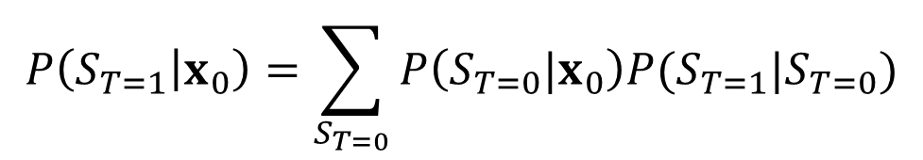

Predicting the state at T = 1
$$P(S_{T=0}|x_{0})$$
0.57
0.42
0.0
8.3 x 10⁻⁵
Idling
Decelerating
Cruising
Accelerating
$$P\left(S_{T=1} | x_{0}\right)=\sum_{S_{T=0}}{P\left(S_{T=0}|x_{0}\right)P(S_{T=1}|S_{T=0})}$$
$$P(S_{T=1}|x_{0})$$
0.33
0.33
0.33
Rounded. In reality, they sum to 1.0
2.1x10⁻⁵

Slide 29
Updating after the observation at T=1
P(x|idle)
P(x|decel)
P(x|cruise)
P(x|accel)
45
60
65
70
63dB
At T=1 we observe x₁ = 63dB SPL

Slide 30

Updating after the observation at T=1
P(x|idle)
P(x|decel)
P(x|cruise)
P(x|accel)
45
60
65
70
63dB
P(x|idle) | P(x|deceleration) | P(x|cruising) | P(x|acceleration)
0 | 0.2 | 0.5 | 0.01
$$P(x_{1}|state)$$
0.5
0.2
0
0.02
Idling
Declerating
Cruising
Accelerating

Slide 31


The second observation: T=1
P(x|idle)
P(x|decel)
P(x|cruise)
P(x|accel)
45
60
65
70
63dB
$$P(x_{1}|state)$$
0.5
0.2
0
0.02
Idling
Declerating
Cruising
Accelerating
$$Prior: P(state|x0)$$
Remember the prior
0.33
0.33
0.33
2.1x10⁻⁵
Idling
Declerating
Cruising
Accelerating

Slide 32
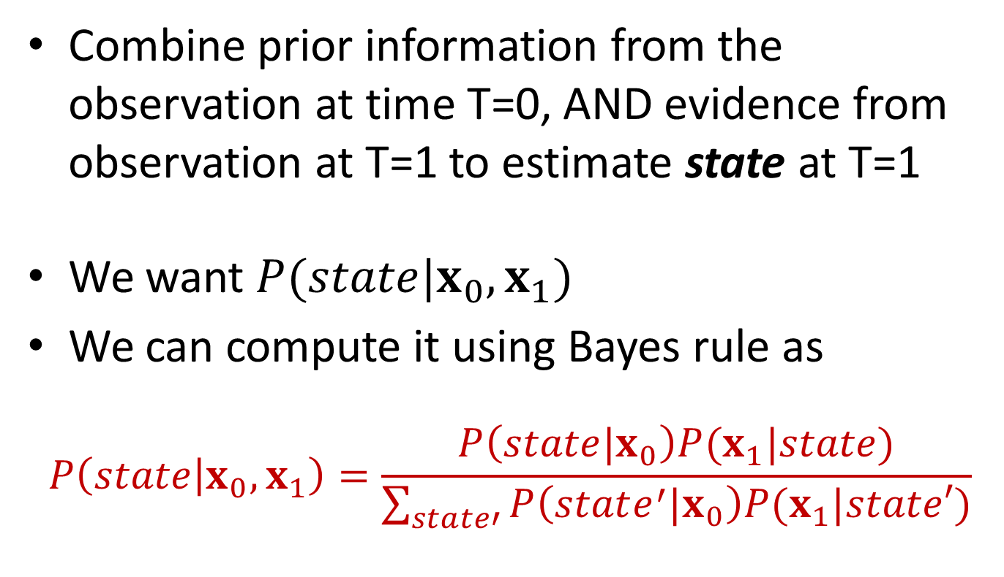
Estimating state after at observing x₁
Combine prior information from the observation at time T=0, AND evidence from observation at T=1 to estimate state at T=1
We want $P(state|x_{0},x_{1})$
We can compute it using Bayes rule as
$$P\left(state | x_{0},x_{1}\right)=\frac{P\left(state|x_{0}\right)P(x_{1}|state)}{\sum_{state′}{P\left(state^{′}|x_{0}\right)P(x_{1}|state′)}}$$

Slide 33


The Posterior at T = 1
$$P(x_{1}|state)$$
0.5
0.2
0
0.02
Idling
Declerating
Cruising
Accelerating
$$Prior: P(state|x0)$$
0.33
0.33
0.33
2.1x10⁻⁵
Idling
Declerating
Cruising
Accelerating
Multiply the two, term by term, and normalize them so that they sum to 1.0

Slide 34
Estimating the state at T = 1+
0.713
0.285
0.0
0.0014
Idling
Decelerating
Cruising
Accelerating
The updated probability at T=1 incorporates information from both x₀ and x₁
It is NOT a local decision based on x₁ alone
Because of the Markov nature of the process, the state at T=0 affects the state at T=1
x₀ provides evidence for the state at T=1

Slide 35
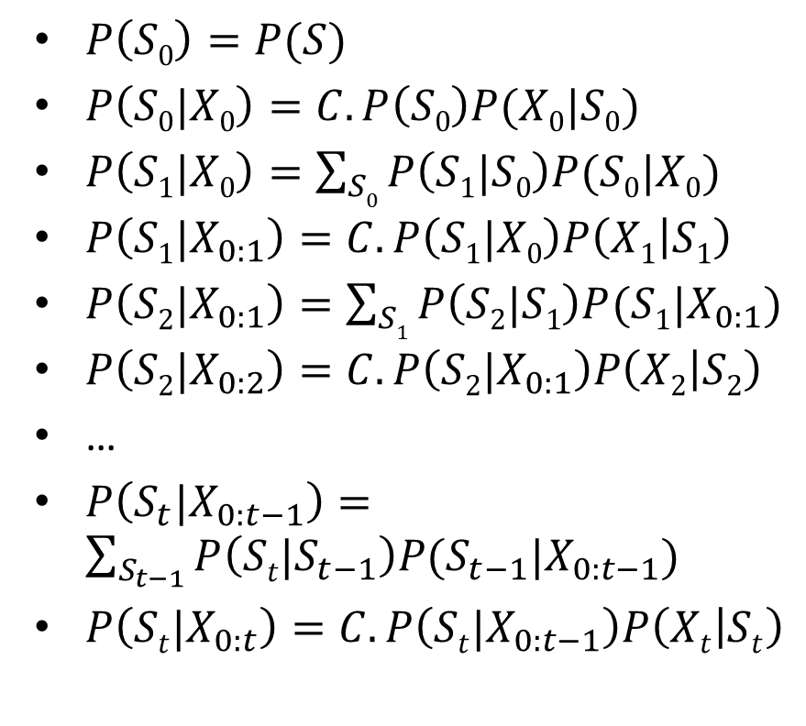
Overall Process
Time
Computation
T=0- : A priori probability
T = 0+: Update after X₀
T=1- (Prediction before X₁)
T = 1+: Update after X₁
T=2- (Prediction before X₂)
T = 2+: Update after X₂
…
T= t- (Prediction before X_{t})
T = t+: Update after X_{t}
$P\left(S0\right)=P(S)$
$P\left(S0|X0\right)=C.P\left(S0\right)P(X0|S0)$
$P\left(S1|X0\right)=\sum_{S0}{P\left(S1|S0\right)P(S0|X0)}$
$P\left(S1|X_{0:1}\right)=C.P\left(S1|X0\right)P\left(X1 | S1\right)$
$P\left(S2|X_{0:1}\right)=\sum_{S1}{P\left(S2|S1\right)P(S1|X_{0:1})}$
$P\left(S2|X_{0:2}\right)=C.P\left(S2|X_{0:1}\right)P\left(X2 | S2\right)$
…
$P\left(S_{t}|X_{0:t−1}\right)=\sum_{S_{t−1}}{P\left(St|S_{t−1}\right)P(S_{t−1}|X_{0:t−1})}$
$P\left(St|X_{0:t}\right)=C.P\left(St|X_{0:t−1}\right)P\left(Xt | St\right)$

Slide 36

Overall procedure
T=T+1
P(S_{T} | x_{0:T-1}) = Σ_{ST-1} P(S_{T-1} | x_{0:T-1}) P(S_{T}|S_{T-1})
P(S_{T} | x_{0:T}) = C. P(S_{T} | x_{0:T-1}) P(x_{T}|S_{T})
Predict the distribution of the state at T
Update the distribution of the state at T
after observing x_{T}
PREDICT
UPDATE
At T=0 the predicted state distribution is the initial state probability
At each time T, the current estimate of the distribution over states considers all observations x₀ ... x_{T}
A natural outcome of the Markov nature of the model
The prediction+update is identical to the forward computation for HMMs to within a normalizing constant

Slide 37
Comparison to Forward Algorithm
T=T+1
P(S_{T} | x_{0:T-1}) = Σ_{ST-1} P(S_{T-1} | x_{0:T-1}) P(S_{T}|S_{T-1})
P(S_{T} | x_{0:T}) = C. P(S_{T} | x_{0:T-1}) P(x_{T}|S_{T})
Predict the distribution of the state at T
Update the distribution of the state at T
after observing x_{T}
PREDICT
UPDATE
Forward Algorithm:
P(x_{0:T},S_{T}) = P(x_{T}|S_{T}) Σ_{ST-1} P(x_{0:T-1}, S_{T-1}) P(S_{T}|S_{T-1})
Normalized:
P(S_{T}|x_{0:T}) = (Σ_{S’T} P(x_{0:T},S’_{T}))⁻¹ P(x_{0:T},S_{T}) = C P(x_{0:T},S_{T})
PREDICT
UPDATE

Slide 38
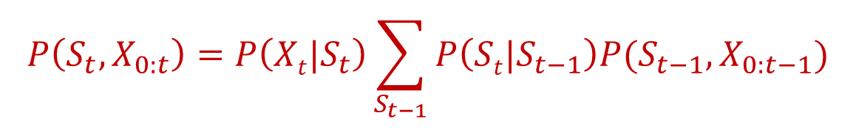
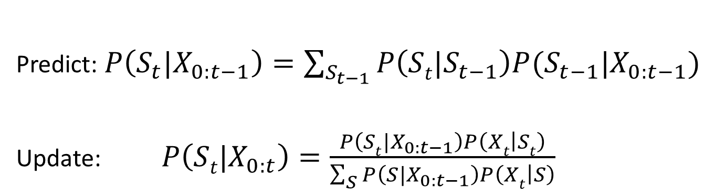
Decomposing the Algorithm
$$P\left(S_{t},X_{0:t}\right)=P\left(Xt|S_{t}\right)\sum_{S_{t−1}}{P\left(St|S_{t−1}\right)P(S_{t−1},X_{0:t−1})}$$
Predict: $P\left(S_{t}|X_{0:t−1}\right)=\sum_{S_{t−1}}{P\left(St|S_{t−1}\right)P(S_{t−1}|X_{0:t−1})}$
Update:$P\left(St|X_{0:t}\right)=\frac{P\left(St|X_{0:t−1}\right)P\left(Xt | St\right)}{\sum_{S}{P\left(S|X_{0:t−1}\right)P\left(Xt | S\right)}}$

Slide 39
Estimating a Unique state
What we have estimated is a distribution over the states
If we had to guess a state, we would pick the most likely state from the distributions
State(T=0) = Accelerating
State(T=1) = Cruising
0.57
0.42
0.0
8.3 x 10⁻⁵
Idling
Decelerating
Cruising
Accelerating
0.713
0.285
0.0
0.0014
Idling
Decelerating
Cruising
Accelerating

Slide 40
Estimating the state
T=T+1
P(S_{T} | x_{0:T-1}) = Σ_{ST-1} P(S_{T-1} | x_{0:T-1}) P(S_{T}|S_{T-1})
P(S_{T} | x_{0:T}) = C. P(S_{T} | x_{0:T-1}) P(x_{T}|S_{T})
Predict the distribution of the state at T
Update the distribution of the state at T
after observing x_{T}
Estimate(S_{T}) = argmax _{ST}P(S_{T} | x_{0:T})
Estimate(S_{T})
The state is estimated from the updated distribution
The updated distribution is propagated into time, not the state

Slide 41
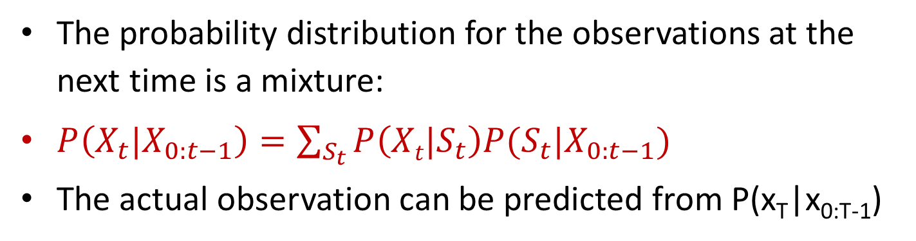
Predicting the next observation
T=T+1
P(S_{T} | x_{0:T-1}) = Σ_{ST-1} P(S_{T-1} | x_{0:T-1}) P(S_{T}|S_{T-1})
P(S_{T} | x_{0:T}) = C. P(S_{T} | x_{0:T-1}) P(x_{T}|S_{T})
Predict the distribution of the state at T
Update the distribution of the state at T
after observing x_{T}
Predict P(x_{T}|x_{0:T-1})
Predict x_{T}
The probability distribution for the observations at the next time is a mixture:
$P\left(X_{t}|X_{0:t−1}\right)=\sum_{S_{t}}{P\left(Xt|S_{t}\right)P(S_{t}|X_{0:t−1})}$
The actual observation can be predicted from P(x_{T}|x_{0:T-1})

Slide 42
Predicting the next observation
Can use any of the various estimators of x_{T} from P(x_{T}|x_{0:T-1})
MAP estimate:
argmax_{xT} P(x_{T}|x_{0:T-1})
MMSE estimate:
Expectation(x_{T}|x_{0:T-1})

Slide 43
Difference from Viterbi decoding
Estimating only the current state at any time
Not the state sequence
Although we are considering all past observations
The most likely state at T and T+1 may be such that there is no valid transition between S_{T} and S_{T+1}

Slide 44
A continuous state model
HMM assumes a very coarsely quantized state space
Idling / accelerating / cruising / decelerating
Actual state can be finer
Idling, accelerating at various rates, decelerating at various rates, cruising at various speeds
Solution: Many more states (one for each acceleration /deceleration rate, crusing speed)?
Solution: A continuous valued state

Slide 45
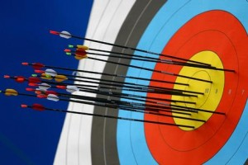

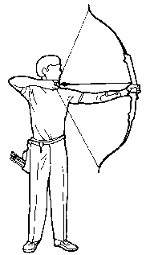

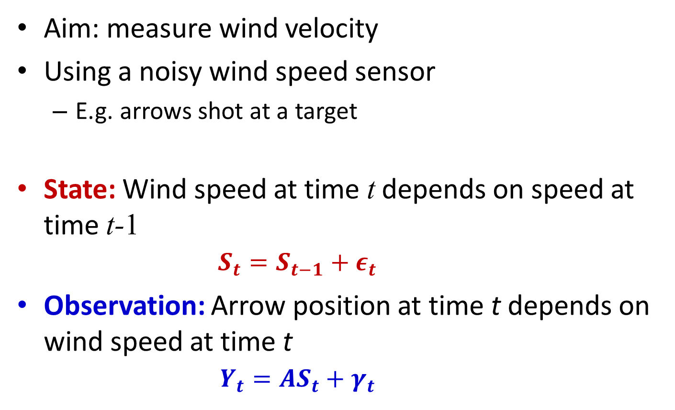
Tracking and Prediction: The wind and the target
Aim: measure wind velocity
Using a noisy wind speed sensor
E.g. arrows shot at a target
State: Wind speed at time t depends on speed at time t-1
$$S_{t}=S_{t−1}+ε_{t}$$
Observation: Arrow position at time t depends on wind speed at time t
$$Y_{t}={AS}_{t}+γ_{t}$$

Slide 46
The real-valued state model
A state equation describing the dynamics of the system
s_{t} is the state of the system at time t
ε_{t} is a driving function, which is assumed to be random
The state of the system at any time depends only on the state at the previous time instant and the driving term at the current time
An observation equation relating state to observation
o_{t} is the observation at time t
γ_{t} is the noise affecting the observation (also random)
The observation at any time depends only on the current state of the system and the noise

Slide 47
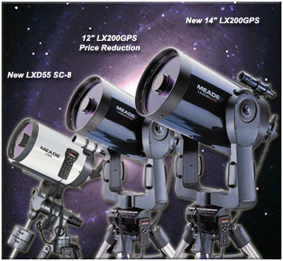
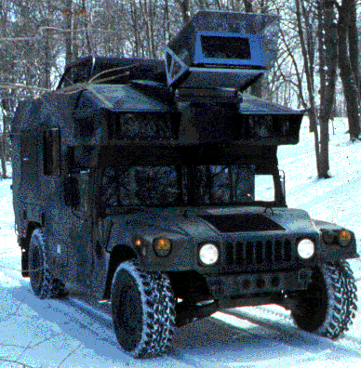
States are still “hidden”
The state is a continuous valued parameter that is not directly seen
The state is the position of the automobile or the star
The observations are dependent on the state and are the only way of knowing about the state
Sensor readings (for the automobile) or recorded image (for the telescope)

Slide 48
Statistical Prediction and Estimation
Given an a priori probability distribution for the state
P₀(s): Our belief in the state of the system before we observe any data
Probability of state of navlab
Probability of state of stars
Given a sequence of observations o₀..o_{t}
Estimate state at time t

Slide 49
Prediction and update at t = 0
Prediction
Initial probability distribution for state
P(s₀) = P₀(s₀)
Update:
Then we observe o₀
We must update our belief in the state
P(s₀|o₀) = C.P₀(s₀)P(o₀|s₀)

Slide 50
Prediction and update at t = 0
Prediction
Initial probability distribution for state
P(s₀) = P₀(s₀)
Update:
Then we observe o₀
We must update our belief in the state
P(s₀|o₀) = C.P₀(s₀)P(o₀|s₀)

Slide 51
The observation probability: P(o|s)
This is a (possibly many-to-one) stochastic function of state s_{t} and noise γ_{t}
Noise γ_{t} is random. Assume it is the same dimensionality as o_{t}
Let P_{γ}(γ_{t}) be the probability distribution of γ_{t}
Let {γ:g(s_{t},γ)=o_{t}} be all γ that result in o_{t}

Slide 52
The observation probability
P(o|s) = ?
The J is a Jacobian
For scalar functions of scalar variables, it is simply a derivative:

Slide 53
Predicting the next state at t=1
Given P(s₀|o₀), what is the probability of the state at t=1
State progression function:
ε_{t} is a driving term with probability distribution P_{ε}(ε_{t})
P(s_{t}|s_{t-1}) can be computed similarly to P(o|s)
P(s₁|s₀) is an instance of this

Slide 54
And moving on
P(s₁|o₀) is the predicted state distribution for t=1
Then we observe o₁
We must update the probability distribution for s₁
P(s₁|o_{0:1}) = CP(s₁|o₀)P(o₁|s₁)
We can continue on

Slide 55



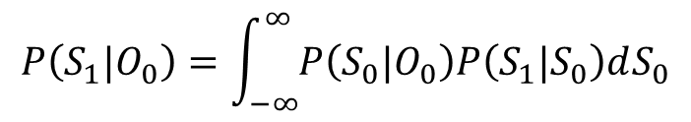
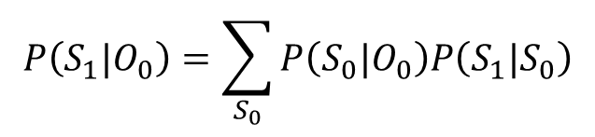



Discrete vs. Continuous state systems
1
2
0.3
0.4
π =
0.1
0.2
P₀(s)
0
1
2
3
s
0
3
Prediction at time 0:
$$P\left(S_{0}\right)=π(S_{0})$$
$$P\left(S_{0}\right)=P_{0}(S_{0})$$
Update after O₀:
$$P\left(S_{0}|O_{0}\right)=C.π(S_{0})P\left(O_{0}|S_{0}\right)$$
$$P\left(S_{0}|O_{0}\right)=C.P(S_{0})P\left(O_{0}|S_{0}\right)$$
Prediction at time 1:
$$P\left(S_{1}|O_{0}\right)=\sum_{S_{0}}{P\left(S_{0}|O_{0}\right)P\left(S_{1}|S_{0}\right)}$$
$$P\left(S_{1}|O_{0}\right)=\int_{−∞}^{∞}{P\left(S_{0}|O_{0}\right)P\left(S_{1}|S_{0}\right)dS_{0}}$$
Update after O₁:
$$P\left(S_{1}|O_{0:1}\right)=C.P(S_{1}|O_{0})P\left(O_{1}|S_{1}\right)$$
$$P\left(S_{1}|O_{0:1}\right)=C.P(S_{1}|O_{0})P\left(O_{1}|S_{1}\right)$$

Slide 56
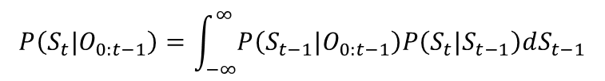
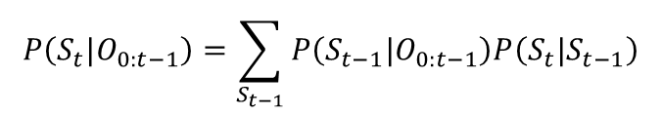


Discrete vs. Continuous State Systems
1
2
0.3
0.4
π =
0.1
0.2
0
1
2
3
0
3
Prediction at time t:
$$P\left(S_{t}|O_{0:t−1}\right)=\sum_{S_{t−1}}{P\left(S_{t−1}|O_{0:t−1}\right)P\left(S_{t}|S_{t−1}\right)}$$
$$P\left(S_{t}|O_{0:t−1}\right)=\int_{−∞}^{∞}{P\left(S_{t−1}|O_{0:t−1}\right)P\left(S_{t}|S_{t−1}\right)dS_{t−1}}$$
Update after observing O_{t}:
$$P\left(S_{t}|O_{0:t}\right)=C.P(S_{t}|O_{0:t−1})P\left(O_{t}|S_{t}\right)$$
$$P\left(S_{t}|O_{0:t}\right)=C.P(S_{t}|O_{0:t−1})P\left(O_{t}|S_{t}\right)$$

Slide 57






Discrete vs. Continuous State Systems
1
2
0.3
0.4
π =
0.1
0.2
0
1
2
3
0
3
Parameters
Initial state prob.
$$π$$
$$P(s)$$
Transition prob
$$P(s_{t}=j|s_{t−1}=i)$$
$$P(s_{t}|s_{t−1})$$
Observation prob
$$P(O|s)$$
$$P(O|s)$$

Slide 58

Special case: Linear Gaussian model
A linear state dynamics equation
Probability of state driving term ε is Gaussian
Sometimes viewed as a driving term μ_{ε} and additive zero-mean noise
A linear observation equation
Probability of observation noise γ is Gaussian
A_{t}, B_{t} and Gaussian parameters assumed known
May vary with time

Slide 59
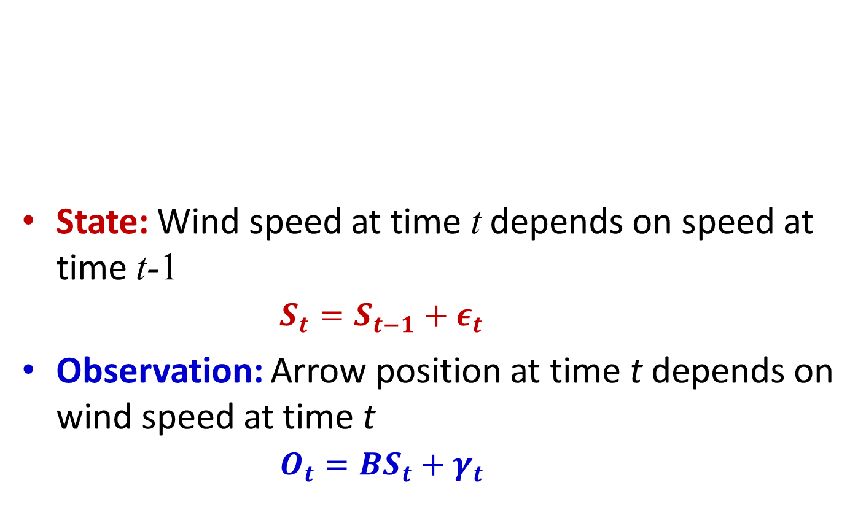
Linear model example The wind and the target
State: Wind speed at time t depends on speed at time t-1
$$S_{t}=S_{t−1}+ε_{t}$$
Observation: Arrow position at time t depends on wind speed at time t
$$O_{t}={BS}_{t}+γ_{t}$$

Slide 60
Model Parameters: The initial state probability
We also assume the initial state distribution to be Gaussian
Often assumed zero mean

Slide 61
Model Parameters: The observation probability
The probability of the observation, given the state, is simply the probability of the noise, with the mean shifted
Since the only uncertainty is from the noise
The new mean is the mean of the distribution of the noise + the value of the observation in the absence of noise

Slide 62
Model Parameters: State transition probability
The probability of the state at time t, given the state at t-1, is simply the probability of the driving term, with the mean shifted

Slide 63


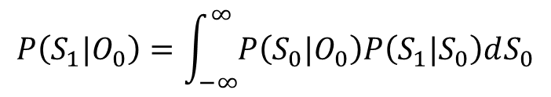

Continuous state systems
P₀(s)
s
Prediction at time 0:
$$P\left(S_{0}\right)=P_{0}(S_{0})$$
Update after O₀:
$$P\left(S_{0}|O_{0}\right)=C.P(S_{0})P\left(O_{0}|S_{0}\right)$$
Prediction at time 1:
$$P\left(S_{1}|O_{0}\right)=\int_{−∞}^{∞}{P\left(S_{0}|O_{0}\right)P\left(S_{1}|S_{0}\right)dS_{0}}$$
Update after O₁:
$$P\left(S_{1}|O_{0:1}\right)=C.P(S_{1}|O_{0})P\left(O_{1}|S_{1}\right)$$

Slide 64

Continuous state systems
P₀(s)
s
Prediction at time 0:
$$P\left(S_{0}\right)=P_{0}(S_{0})$$
Update after O₀:
$$P\left(S_{0}|O_{0}\right)=C.P(S_{0})P\left(O_{0}|S_{0}\right)$$
Prediction at time 1:
$$P\left(S_{1}|O_{0}\right)=\int_{−∞}^{∞}{P\left(S_{0}|O_{0}\right)P\left(S_{1}|S_{0}\right)dS_{0}}$$
Update after O₁:
$$P\left(S_{1}|O_{0:1}\right)=C.P(S_{1}|O_{0})P\left(O_{1}|S_{1}\right)$$

Slide 65
Model Parameters: The initial state probability
We assume the initial state distribution to be Gaussian
Often assumed zero mean

Slide 66

Continuous state systems
P₀(s)
s
a priori probability distribution of state s
Prediction at time 0:
$$P\left(S_{0}\right)=P_{0}(S_{0})$$
$$=N(\overline{s}0,R0)$$
Update after O₀:
$$P\left(S_{0}|O_{0}\right)=C.P(S_{0})P\left(O_{0}|S_{0}\right)$$
Prediction at time 1:
$$P\left(S_{1}|O_{0}\right)=\int_{−∞}^{∞}{P\left(S_{0}|O_{0}\right)P\left(S_{1}|S_{0}\right)dS_{0}}$$
Update after O₁:
$$P\left(S_{1}|O_{0:1}\right)=C.P(S_{1}|O_{0})P\left(O_{1}|S_{1}\right)$$

Slide 67


Continuous state systems
P₀(s)
s
Prediction at time 0:
$$P\left(S_{0}\right)=N(\overline{s}0,R0)$$
Update after O₀:
$$P\left(S_{0}|O_{0}\right)=C.P(S_{0})P\left(O_{0}|S_{0}\right)$$
Prediction at time 1:
$$P\left(S_{1}|O_{0}\right)=\int_{−∞}^{∞}{P\left(S_{0}|O_{0}\right)P\left(S_{1}|S_{0}\right)dS_{0}}$$
Update after O₁:
$$P\left(S_{1}|O_{0:1}\right)=C.P(S_{1}|O_{0})P\left(O_{1}|S_{1}\right)$$

Slide 68

Recap: Conditional of S given O: P(S|O) for Gaussian RVs
$$O=BS+γ$$
$$P\left(S|O\right)=N(μ_{S}+Θ_{SO}Θ_{O}^{−1}(O−μ_{O}),{ Θ}_{S}−Θ_{SO}Θ_{O}^{−1}Θ_{OS})$$

Slide 69


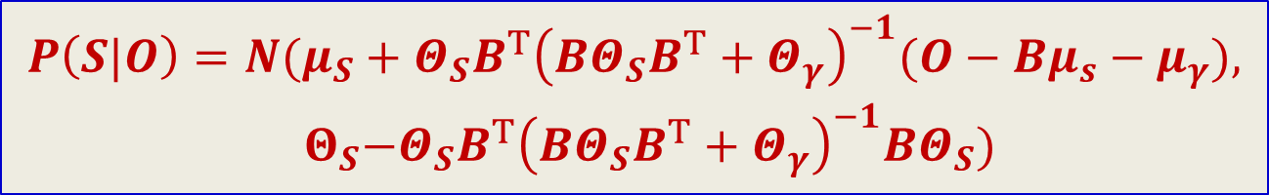
Recap: Conditional of S given O: P(S|O) for Gaussian RVs
$$O=BS+γ$$
$$Θ_{SO}=Θ_{S}B^{T}$$
$$Θ_{O}={BΘ}_{S}B^{T}+Θ_{γ}$$
$$P\left(S|O\right)=N(μ_{S}+Θ_{SO}Θ_{O}^{−1}(O−μ_{O}),{ Θ}_{S}−Θ_{SO}Θ_{O}^{−1}Θ_{OS})$$
$$P\left(S|O\right)=N(μ_{S}+{Θ_{S}B^{T}\left({BΘ}_{S}B^{T}+Θ_{γ}\right)}_{}^{−1}(O−Bμ_{s}−μ_{γ}),$$
$${ Θ}_{S}−{Θ_{S}B^{T}\left({BΘ}_{S}B^{T}+Θ_{γ}\right)}_{}^{−1}BΘ_{S})$$

Slide 70
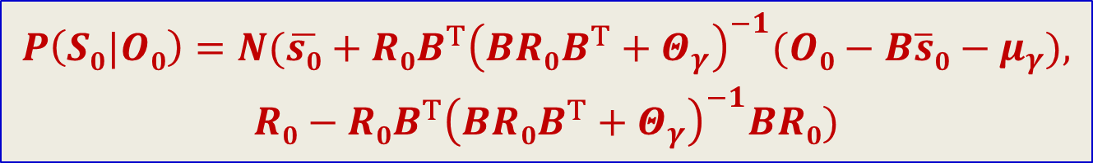


Recap: Conditional of S given O: P(S|O) for Gaussian RVs
$$O=BS+ε$$
$$for P(S)=N(\overline{s}0,R0)$$
$$P\left(S0|O0\right)=N(\overline{s0}+{R0B^{T}\left(BR0B^{T}+Θ_{γ}\right)}_{}^{−1}(O0−B\overline{s}0−μ_{γ}),$$
$$R0−{R0B^{T}\left(BR{0B}^{T}+Θ_{γ}\right)}_{}^{−1}BR0)$$

Slide 71


Continuous state systems
P₀(s)
s
Prediction at time 0:
$$P\left(S_{0}\right)=N(\overline{s}0,R0)$$
Update after O₀:
$$P\left(S_{0}|O_{0}\right)=C.P(S_{0})P\left(O_{0}|S_{0}\right)$$
$$P\left(S_{0}|O_{0}\right)=N({\hat{s}}_{0},{\hat{R}}_{0})$$
Prediction at time 1:
$$P\left(S_{1}|O_{0}\right)=\int_{−∞}^{∞}{P\left(S_{0}|O_{0}\right)P\left(S_{1}|S_{0}\right)dS_{0}}$$
Update after O₁:
$$P\left(S_{1}|O_{0:1}\right)=C.P(S_{1}|O_{0})P\left(O_{1}|S_{1}\right)$$

Slide 72





Continuous state systems
P₀(s)
s
Prediction at time 0:
$$P\left(S_{0}\right)=N(\overline{s}0,R0)$$
Update after O₀:
$$K_{0}={R0B^{T}\left(BR0B^{T}+Θ_{γ}\right)}_{}^{−1}$$
$$P\left(S_{0}|O_{0}\right)=N({\hat{s}}_{0},{\hat{R}}_{0})$$
$${\hat{s}}_{0}=\overline{s}0+K_{0}(O0−B\overline{s0}−μ_{γ})$$
$${\hat{R}}_{0}=(I−K_{0}) R0$$
Prediction at time 1:
$$P\left(S_{1}|O_{0}\right)=\int_{−∞}^{∞}{P\left(S_{0}|O_{0}\right)P\left(S_{1}|S_{0}\right)dS_{0}}$$
Update after O₁:
$$P\left(S_{1}|O_{0:1}\right)=C.P(S_{1}|O_{0})P\left(O_{1}|S_{1}\right)$$

Slide 73
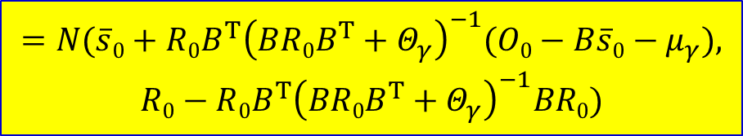
Continuous state systems
P₀(s)
s
Prediction at time 0:
$$P\left(S_{0}\right)=N(\overline{s}0,R0)$$
Update after O₀:
$$=N(\overline{s}0+{R{0B}^{T}\left(BR{0B}^{T}+Θ_{γ}\right)}_{}^{−1}(O0−B\overline{s}0−μ_{γ}),$$
$$R0−{R{0B}^{T}\left(BR0B^{T}+Θ_{γ}\right)}_{}^{−1}BR0)$$
$$P\left(S_{0}|O_{0}\right)=C.P(S_{0})P\left(O_{0}|S_{0}\right)$$
Prediction at time 1:
$$P\left(S_{1}|O_{0}\right)=\int_{−∞}^{∞}{P\left(S_{0}|O_{0}\right)P\left(S_{1}|S_{0}\right)dS_{0}}$$
Update after O₁:
$$P\left(S_{1}|O_{0:1}\right)=C.P(S_{1}|O_{0})P\left(O_{1}|S_{1}\right)$$

Slide 74
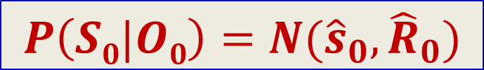
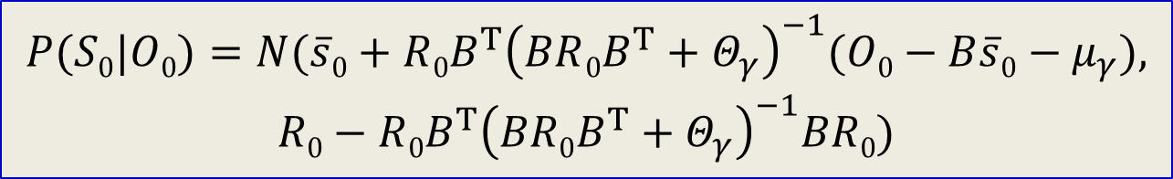
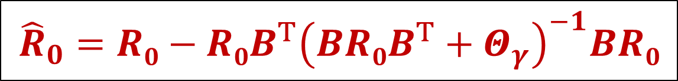
Introducting shorthand notation
$$P(S0|O0)=N(\overline{s}0+{R{0B}^{T}\left(BR{0B}^{T}+Θ_{γ}\right)}_{}^{−1}(O0−B\overline{s}0−μ_{γ}),$$
$$R0−{R{0B}^{T}\left(BR0B^{T}+Θ_{γ}\right)}_{}^{−1}BR0)$$
$${\hat{s}}_{0}=\overline{s}0+{R0B^{T}\left(BR0B^{T}+Θ_{γ}\right)}_{}^{−1}(O−B\overline{s}0−μ_{γ})$$
$${\hat{R}}_{0}=R0−{R{0B}^{T}\left(BR0B^{T}+Θ_{γ}\right)}_{}^{−1}BR0$$
$$P\left(S0|O0\right)=N({\hat{s}}_{0},{\hat{R}}_{0})$$

Slide 75
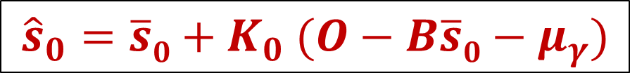

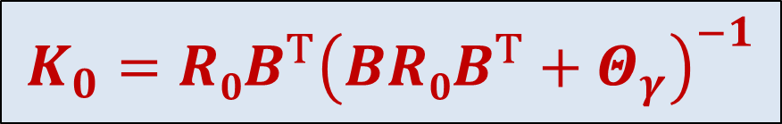

Introducting shorthand notation
$$P(S0|O0)=N(\overline{s}0+{R{0B}^{T}\left(BR{0B}^{T}+Θ_{γ}\right)}_{}^{−1}(O0−B\overline{s}0−μ_{γ}),$$
$$R0−{R{0B}^{T}\left(BR0B^{T}+Θ_{γ}\right)}_{}^{−1}BR0)$$
$$K_{0}={R0B^{T}\left(BR0B^{T}+Θ_{γ}\right)}_{}^{−1}$$
$${\hat{s}}_{0}=\overline{s}0+K_{0} (O−B\overline{s}0−μ_{γ})$$
$${\hat{R}}_{0}=(I−K0B)R0$$
$$P\left(S0|O0\right)=N({\hat{s}}_{0},{\hat{R}}_{0})$$

Slide 76
Continuous state systems
P₀(s)
s
Prediction at time 0:
$$P\left(S_{0}\right)=N(\overline{s}0,R0)$$
Update after O₀:
$$K_{0}={R0B^{T}\left(BR0B^{T}+Θ_{γ}\right)}_{}^{−1}$$
$$P\left(S_{0}|O_{0}\right)=N({\hat{s}}_{0},{\hat{R}}_{0})$$
$${\hat{s}}_{0}=\overline{s}0+K_{0}(O0−B\overline{s0}−μ_{γ})$$
$${\hat{R}}_{0}=(I−K_{0}) R0$$
Prediction at time 1:
$$P\left(S_{1}|O_{0}\right)=\int_{−∞}^{∞}{P\left(S_{0}|O_{0}\right)P\left(S_{1}|S_{0}\right)dS_{0}}$$
Update after O₁:
$$P\left(S_{1}|O_{0:1}\right)=C.P(S_{1}|O_{0})P\left(O_{1}|S_{1}\right)$$

Slide 77



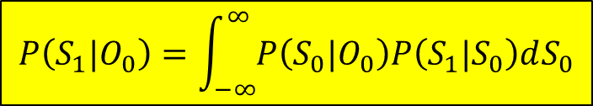

Continuous state systems
P₀(s)
s
Prediction at time 0:
$$P\left(S_{0}\right)=N(\overline{s}0,R0)$$
Update after O₀:
$$K_{0}={R0B^{T}\left(BR0B^{T}+Θ_{γ}\right)}_{}^{−1}$$
$$P\left(S_{0}|O_{0}\right)=N({\hat{s}}_{0},{\hat{R}}_{0})$$
$${\hat{s}}_{0}=\overline{s}0+K_{0}(O0−B\overline{s0}−μ_{γ})$$
$${\hat{R}}_{0}=(I−K_{0}) R0$$
Prediction at time 1:
$$P\left(S_{1}|O_{0}\right)=\int_{−∞}^{∞}{P\left(S_{0}|O_{0}\right)P\left(S_{1}|S_{0}\right)dS_{0}}$$
Update after O₁:
$$P\left(S_{1}|O_{0:1}\right)=C.P(S_{1}|O_{0})P\left(O_{1}|S_{1}\right)$$

Slide 78
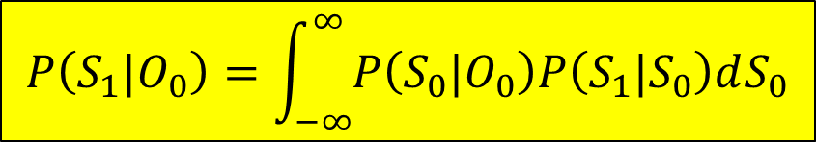

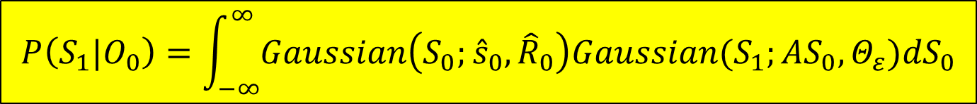

The prediction equation
$$P\left(S_{1}|O_{0}\right)=\int_{−∞}^{∞}{P\left(S_{0}|O_{0}\right)P\left(S_{1}|S_{0}\right)dS_{0}}$$
$$P\left(S_{0}|O_{0}\right)=N({\hat{s}}_{0},{\hat{R}}_{0})$$
$$P\left(S_{1}|S_{0}\right)=N(AS_{0}+μ_{ε},Θ_{ε})$$
The integral of the product of two Gaussians
$$P\left(S_{1}|O_{0}\right)=\int_{−∞}^{∞}{Gaussian\left(S_{0};{\hat{s}}_{0},{\hat{R}}_{0}\right)Gaussian(S_{1};AS_{0},Θ_{ε}){dS}_{0}}$$

Slide 79
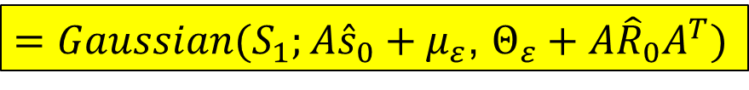
The Prediction Equation
The integral of the product of two Gaussians is Gaussian!
$$P\left(S_{1}|O_{0}\right)=\int_{−∞}^{∞}{Gaussian\left(S_{0};{\hat{s}}_{0},{\hat{R}}_{0}\right)Gaussian(S_{1};AS_{0}+μ_{ε},Θ_{ε}){dS}_{0}}$$
$$=\int_{−∞}^{∞}{C_{1}exp\left(−0.5\left(S_{0}−{\hat{s}}_{0}\right){\hat{R}}_{0}^{−1} {\left(S_{0}−{\hat{s}}_{0}\right)}^{T}\right).C_{2}exp(−0.5(S_{1}−AS_{0}−μ_{ε}){Θ_{ε}^{−1}(S_{1}−AS_{0}−μ_{ε})}^{T}){dS}_{0}}$$
$=Gaussian(S_{1};A{\hat{s}}_{0}+μ_{ε}$, $Θ_{ε}+A{\hat{R}}_{0}A^{T})$
$$P\left(S_{1}|O_{0}\right)=N(A{\hat{s}}_{0}+μ_{ε}\text{, }Θ_{ε}+A{\hat{R}}_{0}A^{T})$$

Slide 80


Continuous state systems
P₀(s)
s
Prediction at time 0:
$$P\left(S_{0}\right)=N(\overline{s}0,R0)$$
Update after O₀:
$$K_{0}={R0B^{T}\left(BR0B^{T}+Θ_{γ}\right)}_{}^{−1}$$
$$P\left(S_{0}|O_{0}\right)=N({\hat{s}}_{0},{\hat{R}}_{0})$$
$${\hat{s}}_{0}=\overline{s}0+K_{0}(O0−B\overline{s0}−μ_{γ})$$
$${\hat{R}}_{0}=(I−K_{0}) R0$$
Prediction at time 1:
$$P\left(S_{1}|O_{0}\right)=\int_{−∞}^{∞}{P\left(S_{0}|O_{0}\right)P\left(S_{1}|S_{0}\right)dS_{0}}$$
$$=N(A{\hat{s}}_{0}+μ_{ε}\text{, }Θ_{ε}+A{\hat{R}}_{0}A^{T})$$
Update after O₁:
$$P\left(S_{1}|O_{0:1}\right)=C.P(S_{1}|O_{0})P\left(O_{1}|S_{1}\right)$$

Slide 81
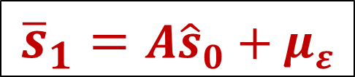
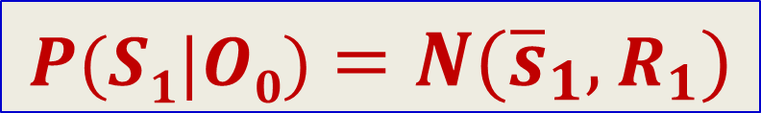

More shorthand notation
$$P(S1|O0)=N(A{\hat{s}}_{0}+μ_{ε}\text{, }Θ_{ε}+A{\hat{R}}_{0}A^{T})$$
$${\overline{s}}_{1}=A{\hat{s}}_{0}+μ_{ε}$$
$$R_{1}=Θ_{ε}+A{\hat{R}}_{0}A^{T}$$
$$P(S1|O0)=N({\overline{s}}_{1},R_{1})$$

Slide 82




Continuous state systems
P₀(s)
s
Prediction at time 0:
$$P\left(S_{0}\right)=N(\overline{s}0,R0)$$
Update after O₀:
$$K_{0}={R0B^{T}\left(BR0B^{T}+Θ_{γ}\right)}_{}^{−1}$$
$$P\left(S_{0}|O_{0}\right)=N({\hat{s}}_{0},{\hat{R}}_{0})$$
$${\hat{s}}_{0}=\overline{s}0+K_{0}(O0−B\overline{s0}−μ_{γ})$$
$${\hat{R}}_{0}=(I−K_{0}) R0$$
Prediction at time 1:
$${\overline{s}}_{1}=A{\hat{s}}_{0}+μ_{ε}$$
$$P\left(S_{1}|O_{0}\right)=N({\overline{s}}_{1},R_{1})$$
$$R_{1}=Θ_{ε}+A{\hat{R}}_{0}A^{T}$$
Update after O₁:
$$P\left(S_{1}|O_{0:1}\right)=C.P(S_{1}|O_{0})P\left(O_{1}|S_{1}\right)$$

Slide 83




Continuous state systems
P₀(s)
s
Prediction at time 0:
$$P\left(S_{0}\right)=N(\overline{s}0,R0)$$
Update after O₀:
$$K_{0}={R0B^{T}\left(BR0B^{T}+Θ_{γ}\right)}_{}^{−1}$$
$$P\left(S_{0}|O_{0}\right)=N({\hat{s}}_{0},{\hat{R}}_{0})$$
$${\hat{s}}_{0}=\overline{s}0+K_{0}(O0−B\overline{s0}−μ_{γ})$$
$${\hat{R}}_{0}=(I−K_{0}) R0$$
Prediction at time 1:
$${\overline{s}}_{1}=A{\hat{s}}_{0}+μ_{ε}$$
$$P\left(S_{1}|O_{0}\right)=N({\overline{s}}_{1},R_{1})$$
$$R_{1}=Θ_{ε}+A{\hat{R}}_{0}A^{T}$$
Update after O₁:
$$P\left(S_{1}|O_{0:1}\right)=C.P(S_{1}|O_{0})P\left(O_{1}|S_{1}\right)$$

Slide 84





Continuous state systems
P₀(s)
s
Prediction at time 0:
$$P\left(S_{0}\right)=N(\overline{s}0,R0)$$
Update after O₀:
$$K_{0}={R0B^{T}\left(BR0B^{T}+Θ_{γ}\right)}_{}^{−1}$$
$$P\left(S_{0}|O_{0}\right)=N({\hat{s}}_{0},{\hat{R}}_{0})$$
$${\hat{s}}_{0}=\overline{s}0+K_{0}(O0−B\overline{s0}−μ_{γ})$$
$${\hat{R}}_{0}=(I−K_{0}B) R0$$
Prediction at time 1:
$${\overline{s}}_{1}=A{\hat{s}}_{0}+μ_{ε}$$
$$P\left(S_{1}|O_{0}\right)=N({\overline{s}}_{1},R_{1})$$
$$R_{1}=Θ_{ε}+A{\hat{R}}_{0}A^{T}$$
Update after O₁:
$$K_{1}={R1B^{T}\left(BR1B^{T}+Θ_{γ}\right)}_{}^{−1}$$
$$P\left(S_{1}|O_{0:1}\right)=C.P(S_{1}|O_{0})P\left(O_{1}|S_{1}\right)$$
$$=N({\hat{s}}_{1},{\hat{R}}_{1})$$
$${\hat{s}}_{1}=\overline{s}1+K_{1}(O1−B\overline{s1}−μ_{γ})$$
$${\hat{R}}_{1}=(I−K_{1}B) R1$$

Slide 85

Continuous state systems
P₀(s)
s
Prediction at time 0:
$$P\left(S_{0}\right)=N(\overline{s}0,R0)$$
Update after O₀:
$$K_{0}={R0B^{T}\left(BR0B^{T}+Θ_{γ}\right)}_{}^{−1}$$
$$P\left(S_{0}|O_{0}\right)=N({\hat{s}}_{0},{\hat{R}}_{0})$$
$${\hat{s}}_{0}=\overline{s}0+K_{0}(O0−B\overline{s0}−μ_{γ})$$
$${\hat{R}}_{0}=(I−K_{0}B) R0$$
Prediction at time 1:
$${\overline{s}}_{1}=A{\hat{s}}_{0}+μ_{ε}$$
$$P\left(S_{1}|O_{0}\right)=N({\overline{s}}_{1},R_{1})$$
$$R_{1}=Θ_{ε}+A{\hat{R}}_{0}A^{T}$$
Update after O₁:
$$K_{1}={R1B^{T}\left(BR1B^{T}+Θ_{γ}\right)}_{}^{−1}$$
$$P\left(S_{1}|O_{0:1}\right)=N({\hat{s}}_{1},{\hat{R}}_{1})$$
$${\hat{s}}_{1}=\overline{s}1+K_{1}(O1−B\overline{s1}−μ_{γ})$$
$${\hat{R}}_{1}=(I−K_{1}B) R1$$

Slide 86

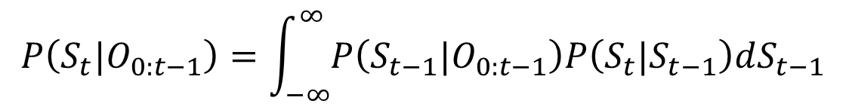

Gaussian Continuous State Linear Systems
P₀(s)
s
Prediction at time t:
$$P\left(S_{t}|O_{0:t−1}\right)=\int_{−∞}^{∞}{P\left(S_{t−1}|O_{0:t−1}\right)P\left(S_{t}|S_{t−1}\right)dS_{t−1}}$$
Update after observing O_{t}:
$$P\left(S_{t}|O_{0:t}\right)=C.P(S_{t}|O_{0:t−1})P\left(O_{t}|S_{t}\right)$$

Slide 87







Gaussian Continuous State Linear Systems
P₀(s)
s
Prediction at time t:
$${\overline{s}}_{t}=A{\hat{s}}_{t−1}+μ_{ε}$$
$$P\left(S_{t}|O_{0:t−1}\right)=N({\overline{s}}_{t},R_{t})$$
$$R_{t}=Θ_{ε}+A{\hat{R}}_{t−1}A^{T}$$
Update after observing O_{t}:
$$K_{t}={R1B^{T}\left(BR1B^{T}+Θ_{γ}\right)}_{}^{−1}$$
$$P\left(S_{t}|O_{0:t}\right)=N({\hat{s}}_{t},{\hat{R}}_{t})$$
$${\hat{s}}_{t}={\overline{s}}_{t}+Kt (Ot−B{\overline{s}}_{t}−μ_{γ})$$
$${\hat{R}}_{t}=(I−KtB) Rt$$

Slide 88
Gaussian Continuous State Linear Systems
P₀(s)
s
Prediction at time t:
KALMAN FILTER
$${\overline{s}}_{t}=A{\hat{s}}_{t−1}+μ_{ε}$$
$$P\left(S_{t}|O_{0:t−1}\right)=N({\overline{s}}_{t},R_{t})$$
$$R_{t}=Θ_{ε}+A{\hat{R}}_{t−1}A^{T}$$
Update after observing O_{t}:
$$K_{t}={R1B^{T}\left(BR1B^{T}+Θ_{γ}\right)}_{}^{−1}$$
$$P\left(S_{t}|O_{0:t}\right)=N({\hat{s}}_{t},{\hat{R}}_{t})$$
$${\hat{s}}_{t}={\overline{s}}_{t}+Kt (Ot−B{\overline{s}}_{t}−μ_{γ})$$
$${\hat{R}}_{t}=(I−KtB) Rt$$

Slide 89
The Kalman filter
Prediction (based on state equation)
Update (using observation and observation equation)

Slide 90
Explaining the Kalman Filter
Prediction
Update
The Kalman filter can be explained intuitively without working through the math

Slide 91
The Kalman filter
Prediction
Update
The predicted state at time t is obtained simply by propagating the estimated state at t-1 through the state dynamics equation

Slide 92
The Kalman filter
Prediction
Update
This is the uncertainty in the prediction. The variance of the predictor = variance of ε_{t} + variance of As_{t-1}
The two simply add because ε_{t} is not
correlated with s_{t}

Slide 93

The Kalman filter
Prediction
Update
We can also predict the observation from the predicted state using the observation
equation

Slide 94
The Kalman filter
Prediction
Update
Actual observation

Slide 95
MAP Recap (for Gaussians)
If P(x,y) is Gaussian:

Slide 96
MAP Recap: For Gaussians
If P(x,y) is Gaussian:
“Slope” of the line

Slide 97
The Kalman filter
Prediction
Update
This is the slope of the MAP estimator that predicts s from o
RB^{T} = C_{so}, (BRB^{T}+Θ) = C_{oo}
This is also called the Kalman Gain

Slide 98
The Kalman filter
Prediction
Update
We must correct the predicted value of the state after making an observation
The correction is the difference between the actual observation and the predicted observation, scaled by the Kalman Gain

Slide 99
The Kalman filter
Prediction
Update
We must correct the predicted value of the state after making an observation
The correction is the difference between the actual observation and the predicted observation, scaled by the Kalman Gain

Slide 100
The Kalman filter
Prediction
Update:
Update
The uncertainty in state decreases if we observe the data and make a correction
The reduction is a multiplicative “shrinkage” based on Kalman gain and B

Slide 101
The Kalman filter
Prediction
Update:
Update

Slide 102
The Kalman Filter
Very popular for tracking the state of processes
Control systems
Robotic tracking
Simultaneous localization and mapping
Radars
Even the stock market..
What are the parameters of the process?

Slide 103
Kalman filter contd.
Model parameters A and B must be known
Often the state equation includes an additional driving term: s_{t} = A_{t}s_{t-1} + G_{t}u_{t} + ε_{t}
The parameters of the driving term must be known
The initial state distribution must be known

Slide 104
Defining the parameters
State state must be carefully defined
E.g. for a robotic vehicle, the state is an extended vector that includes the current velocity and acceleration
S = [X, dX, d²X]
State equation: Must incorporate appropriate constraints
If state includes acceleration and velocity, velocity at next time = current velocity + acc. * time step
St = AS_{t-1} + e
A = [1 t 0.5t²; 0 1 t; 0 0 1]

Slide 105
Parameters
Observation equation:
Critical to have accurate observation equation
Must provide a valid relationship between state and observations
Observations typically high-dimensional
May have higher or lower dimensionality than state

Slide 106
Problems
f() and/or g() may not be nice linear functions
Conventional Kalman update rules are no longer valid
ε and/or γ may not be Gaussian
Gaussian based update rules no longer valid

Slide 107
Linear Gaussian Model
P(s) =
P(s_{t}|s_{t-1}) =
P(O_{t}|s_{t}) =
a priori
Transition prob.
State output prob
P(s₀) = P(s)
P(s₀| O₀) = C P(s₀) P(O₀| s₀)
P(s₁| O_{0:1}) = C P(s₁| O₀) P(O₁| s₀)
P(s₂| O_{0:2}) = C P(s₂| O_{0:1}) P(O₂| s₂)
All distributions remain Gaussian

Slide 108
Problems
Nonlinear f() and/or g() : The Gaussian assumption breaks down
Conventional Kalman update rules are no longer valid

Slide 109
The problem with non-linear functions
Estimation requires knowledge of P(o|s)
Difficult to estimate for nonlinear g()
Even if it can be estimated, may not be tractable with update loop
Estimation also requires knowledge of P(s_{t}|s_{t-1})
Difficult for nonlinear f()
May not be amenable to closed form integration

Slide 110
The problem with nonlinearity
The PDF may not have a closed form
Even if a closed form exists initially, it will typically become intractable very quickly

Slide 111
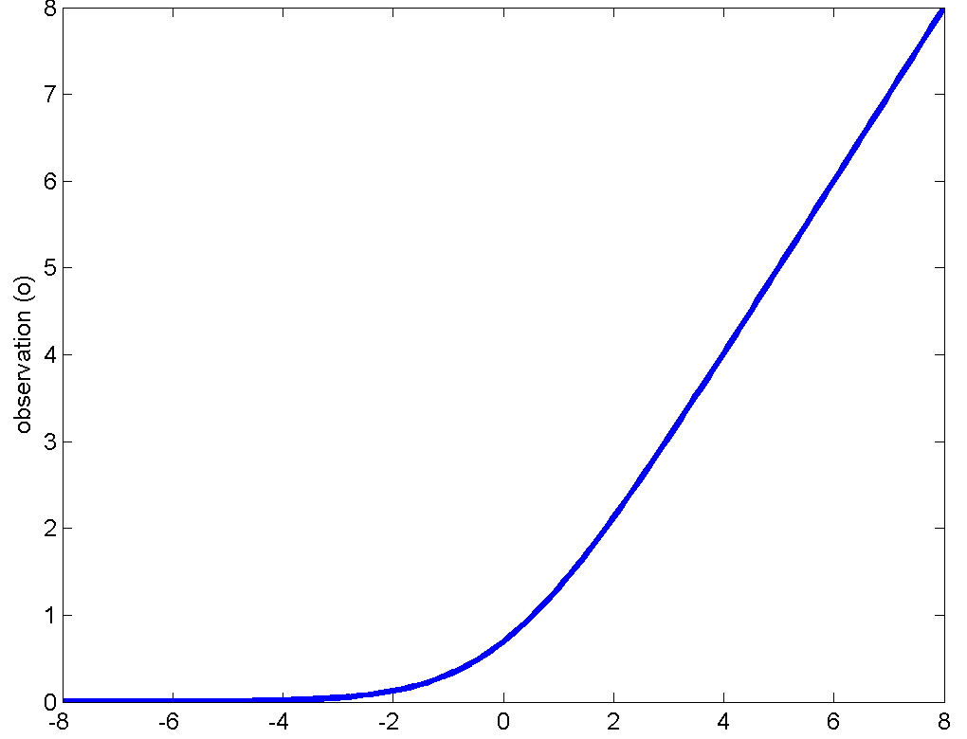
Example: a simple nonlinearity
γ=0 ; s
P(o|s) = ?
Assume γ is Gaussian
P(γ) = Gaussian(γ; μ_{γ}, Θ_{γ})

Slide 112
Example: a simple nonlinearity
P(o|s) = ?
γ=0 ; s

Slide 113
Example: At T=0.
γ ; s=0
Assume initial probability P(s) is Gaussian
Update

Slide 114
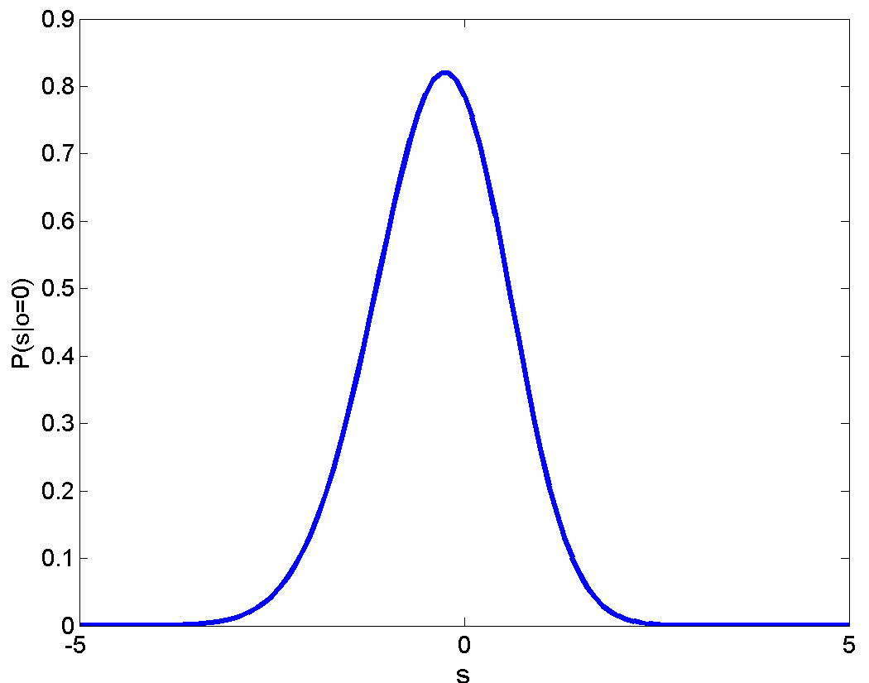
UPDATE: At T=0.
γ ; s=0
= Not Gaussian

Slide 115
Prediction for T = 1
Trivial, linear state transition equation
Prediction
= intractable

Slide 116
Update at T=1 and later
Update at T=1
Intractable
Prediction for T=2
Intractable

Slide 117
The State prediction Equation
Similar problems arise for the state prediction equation
P(s_{t}|s_{t-1}) may not have a closed form
Even if it does, it may become intractable within the prediction and update equations
Particularly the prediction equation, which includes an integration operation

Slide 118
Simplifying the problem: Linearize
s
The tangent at any point is a good local approximation if the function is sufficiently smooth

Slide 119
Simplifying the problem: Linearize
s
The tangent at any point is a good local approximation if the function is sufficiently smooth

Slide 120
Simplifying the problem: Linearize
s
The tangent at any point is a good local approximation if the function is sufficiently smooth

Slide 121
Simplifying the problem: Linearize
s
The tangent at any point is a good local approximation if the function is sufficiently smooth

Slide 122
Linearizing the observation function
Simple first-order Taylor series expansion
J() is the Jacobian matrix
Simply a determinant for scalar state
Expansion around current predicted a priori (or predicted) mean of the state
Linear approximation changes with time

Slide 123
Most probability is in the low-error region
Most probability mass close to mean
s
P(s_{t}) is small where approximation error is large
Most of the probability mass of s is in low-error regions

Slide 124
Linearizing the observation function
With the linearized approximation the system becomes “linear”
The observation PDF becomes Gaussian

Slide 125
The state equation?
Again, direct use of f() can be disastrous
Solution: Linearize
Linearize around the mean of the updated distribution of s at t-1
Converts the system to a linear one

Slide 126
Linearized System
Now we have a simple time-varying linear system
Kalman filter equations directly apply

Slide 127
The Extended Kalman filter
Prediction
Update
Jacobians used in Linearization
Assuming ε and γ are 0 mean for
simplicity

Slide 128
The Extended Kalman filter
Prediction
Update
The predicted state at time t is obtained simply by propagating the estimated state at t-1 through the state dynamics equation

Slide 129
The Extended Kalman filter
Prediction
Update
Uncertainty of prediction. The variance of the predictor = variance of ε_{t} + variance of As_{t-1}
A is obtained by linearizing f()

Slide 130
The Extended Kalman filter
Prediction
Update
The Kalman gain is the slope of the MAP estimator that predicts s from o
RBT = C_{so}, (BRB^{T}+Θ) = C_{oo}
B is obtained by linearizing g()

Slide 131
The Extended Kalman filter
Prediction
Update
We can also predict the observation from the predicted state using the observation
equation

Slide 132
The Extended Kalman filter
Prediction
Update
We must correct the predicted value of the state after making an observation
The correction is the difference between the actual observation and the predicted observation, scaled by the Kalman Gain

Slide 133
The Extended Kalman filter
Prediction
Update
The uncertainty in state decreases if we observe the data and make a correction
The reduction is a multiplicative “shrinkage” based on Kalman gain and B

Slide 134
The Extended Kalman filter
Prediction
Update

Slide 135
EKFs
EKFs are probably the most commonly used algorithm for tracking and prediction
Most systems are non-linear
Specifically, the relationship between state and observation is usually nonlinear
The approach can be extended to include non-linear functions of noise as well
The term “Kalman filter” often simply refers to an extended Kalman filter in most contexts.
But..

Slide 136
EKFs have limitations
If the non-linearity changes too quickly with s, the linear approximation is invalid
Unstable
The estimate is often biased
The true function lies entirely on one side of the approximation
Various extensions have been proposed:
Invariant extended Kalman filters (IEKF)
Unscented Kalman filters (UKF)

Slide 137
Conclusions
HMMs are predictive models
Continuous-state models are simple extensions of HMMs
Same math applies
Prediction of linear, Gaussian systems can be performed by Kalman filtering
Prediction of non-linear, Gaussian systems can be performed by Extended Kalman filtering

