Slide 1
Time series prediction
Prakarsh Yadav

Slide 2
Contents:
Introduction to time series and forecasting
Stationarity and Wold Representation
Autoregressive and Moving Average processes
Autoregressive moving average processes and forecasting
Non-stationary processes

Slide 3
Contents:
Introduction to time series and forecasting
Stationarity and Wold Representation
Autoregressive and Moving Average processes
Autoregressive moving average processes and forecasting
Non-stationary processes

Slide 4
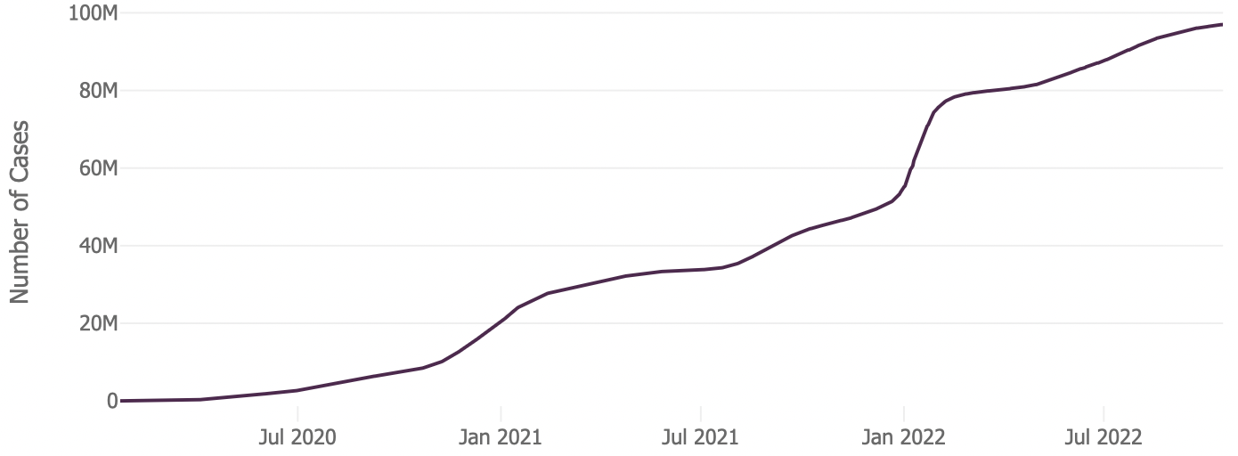
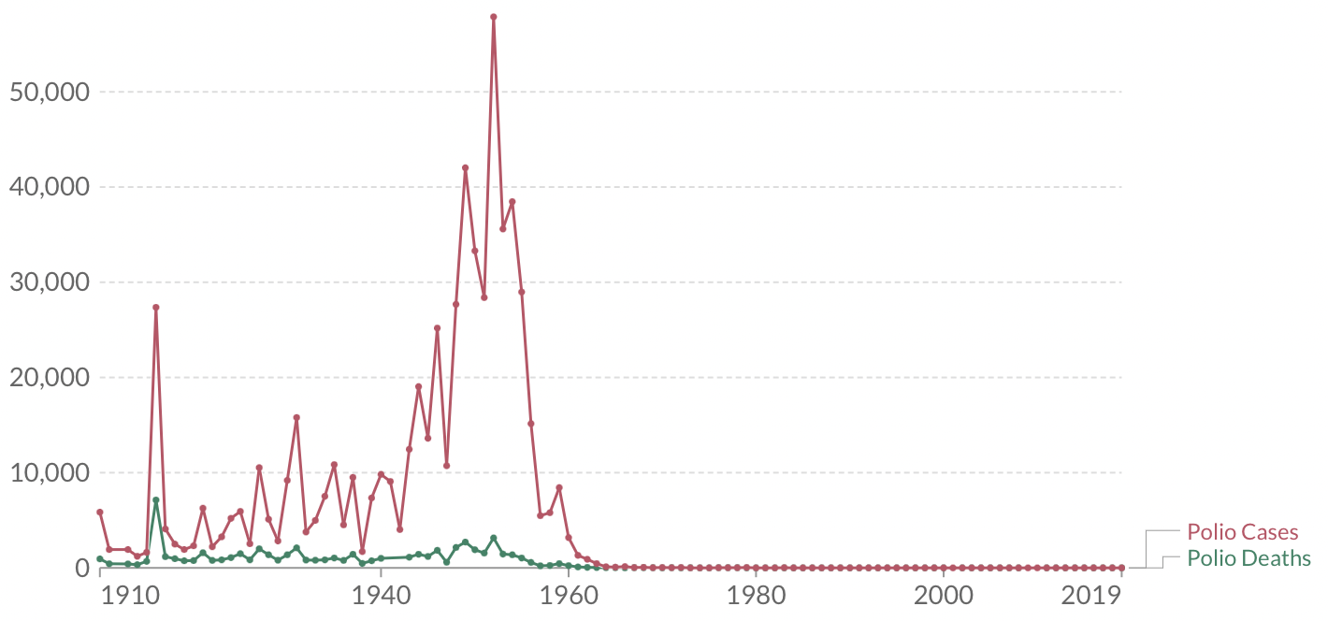
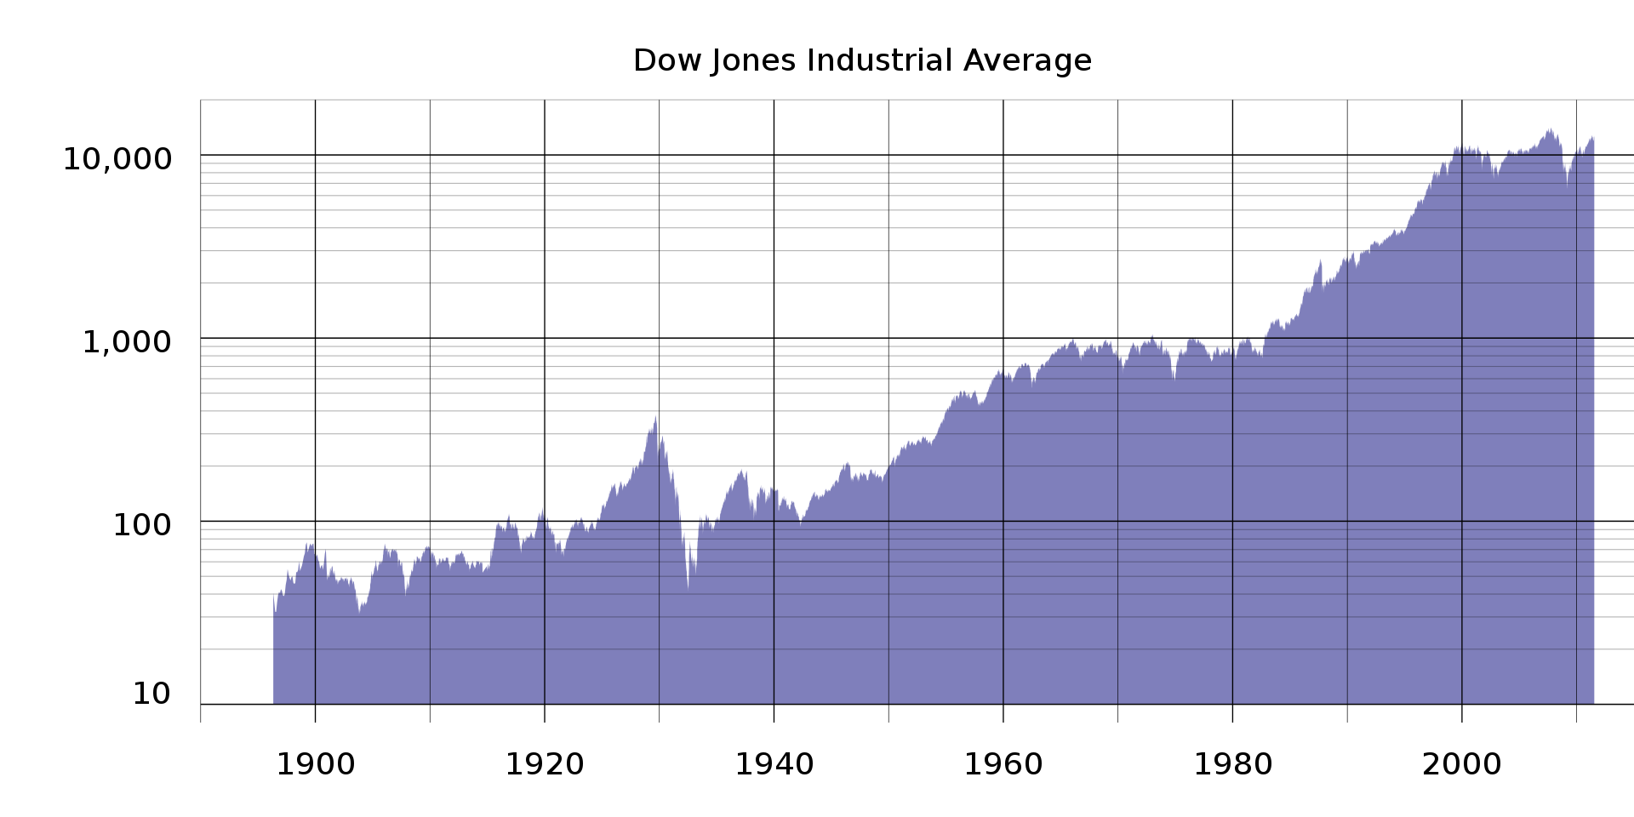
What is a time series?
COVID-19 cases in the USA
Time series: A collection of data which is indexed in time order
Any measurement we make at timed intervals can be considered as a time series
But given a time series, What can we say about it?
Increasing?
Decreasing?
Can we forecast?
Polio cases in the world

Slide 5
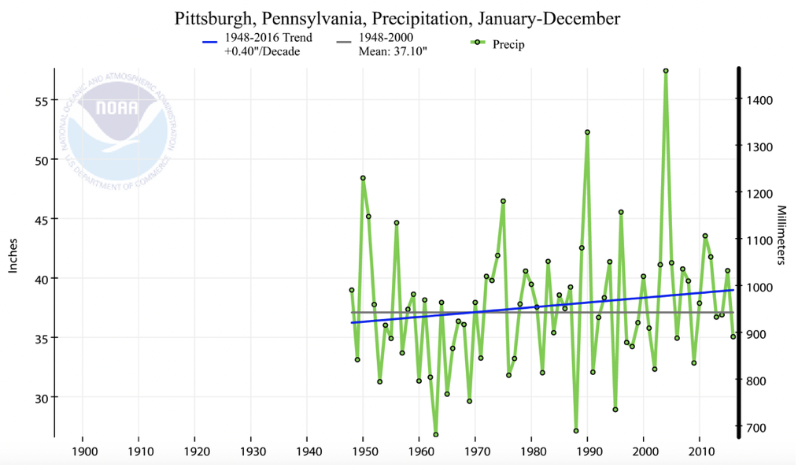
Time series and forecasting
A time series can comprise of any measurements:
Daily high/low temperatures
Stock prices
Lecture duration in 11755
Weekly precipitation
This leads us to …
Given a time series, can we predict the most likely next measurement?
Forecasting!
Notes:
Talk about challenges in forecasting and how stationary processes are helpful

Slide 6
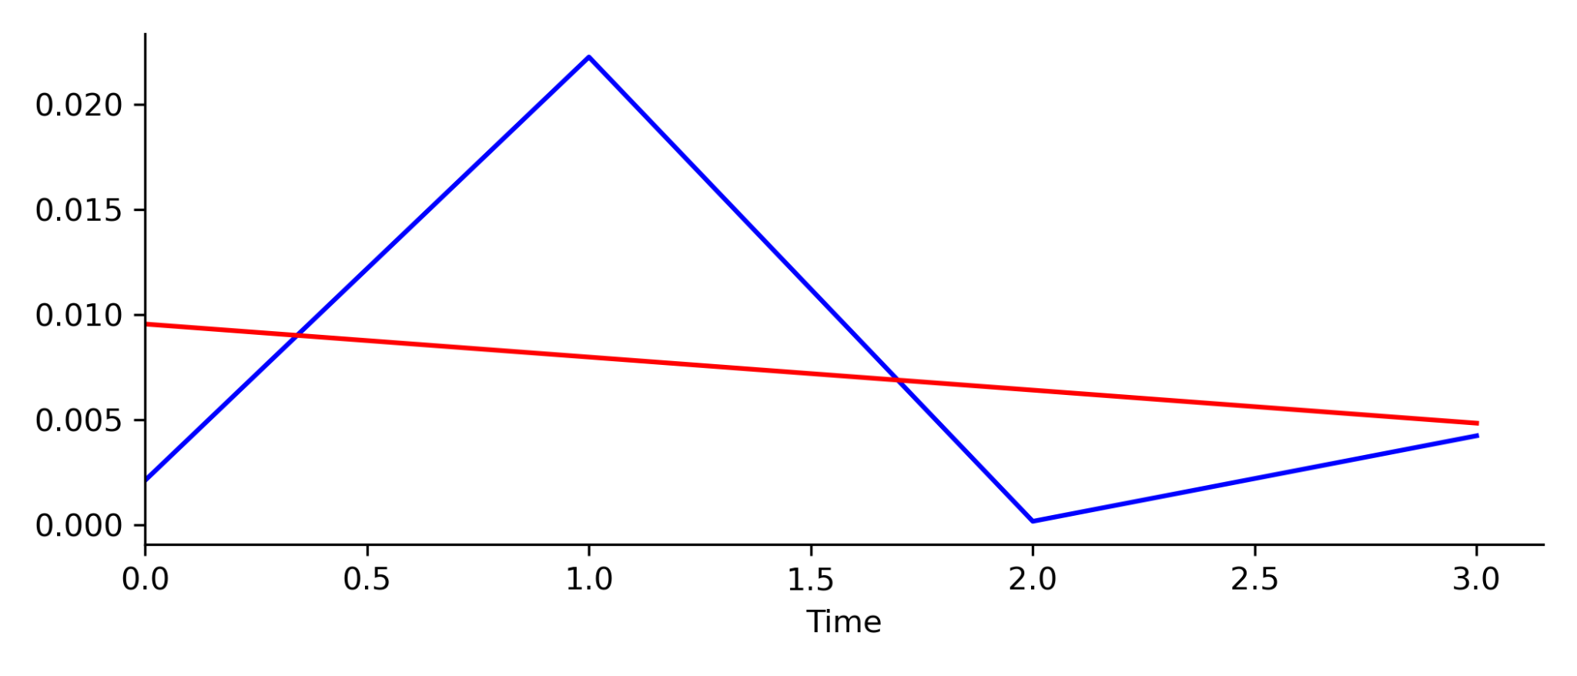
Forecasting
Say we just started recording a time series and we assume it has a linear relationship with time
We got 4 measurements, and fit a line to it
We are just getting started!
Slope: -0.00156
Notes:
Talk about challenges in forecasting and how stationary processes are helpful

Slide 7
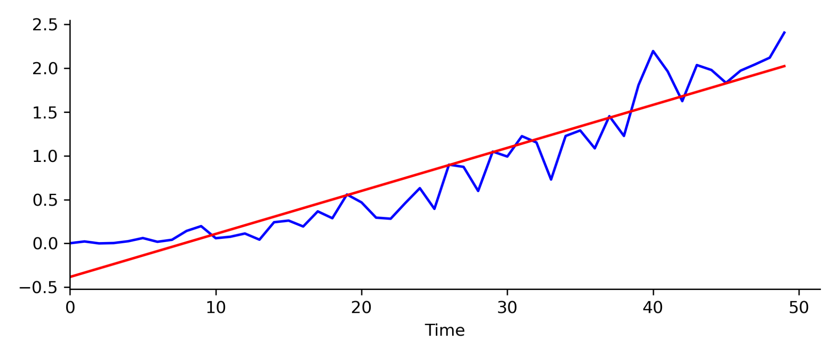
Forecasting
We are confident in our linear model of the time series
We got ambitious and collected next 50 measurements
The slope changed but still not a bad fit!
Slope: 0.04912
Notes:
Talk about challenges in forecasting and how stationary processes are helpful

Slide 8
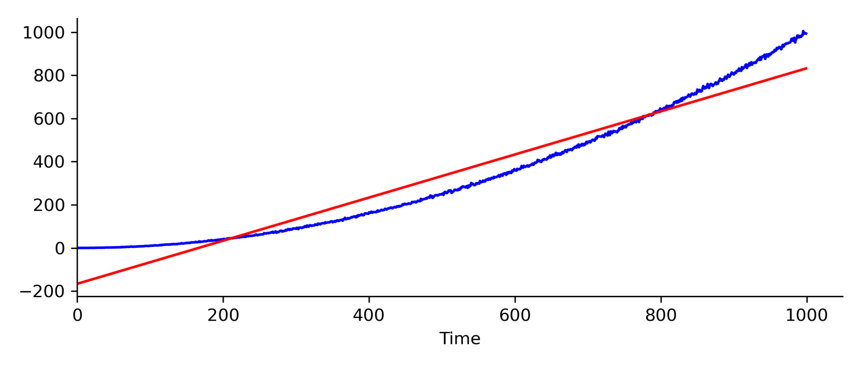
Forecasting
Like diligent grad students we get started on data collection!
We collect 1000 measurements!
Maybe linear is not a valid assumption, what if we assume it quadratic?
Slope: 0.9992
Notes:
Talk about challenges in forecasting and how stationary processes are helpful

Slide 9
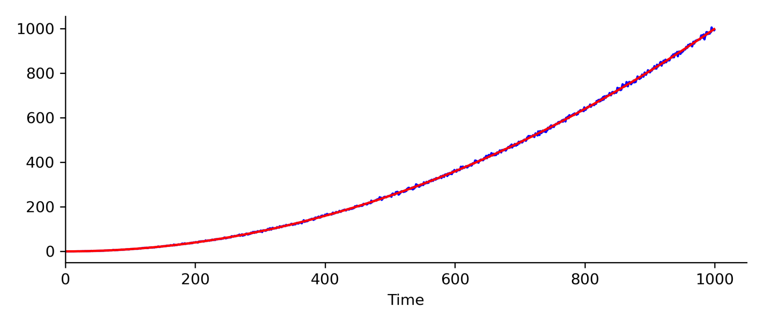
Forecasting
Quadratic assumption is looking good now and we are even happier!
Notes:
Talk about challenges in forecasting and how stationary processes are helpful

Slide 10
Forecasting
Quadratic assumption is looking good now and we are even happier!
Now we are getting tired of data collection.
With this understanding, can we forecast the next measurements?
Notes:
Talk about challenges in forecasting and how stationary processes are helpful

Slide 11
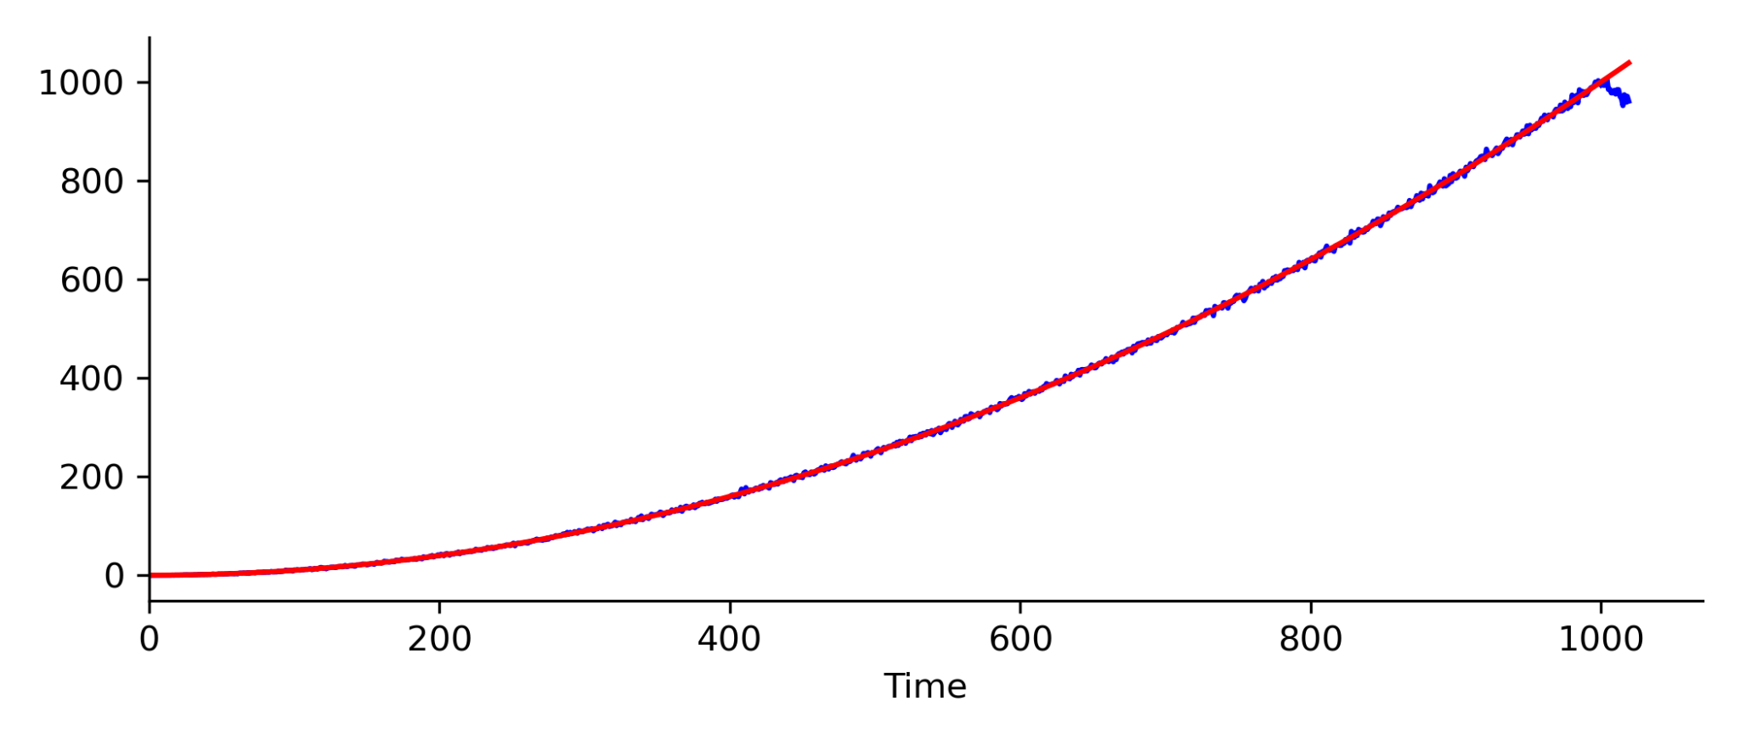
Forecasting
We predict the next 20 values but as a validation we also collect measurements
It seems like we are maybe getting an outlier, but we have faith in our model and well continue with it
Notes:
Talk about challenges in forecasting and how stationary processes are helpful

Slide 12
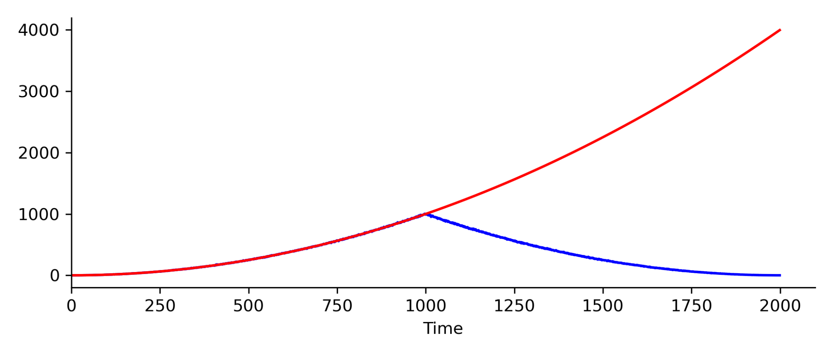
Forecasting
We get ambitious and predict the next 1000 values
Looks like we made an oopsie! We did not expect this to have happened.
Notes:
Talk about challenges in forecasting and how stationary processes are helpful

Slide 13
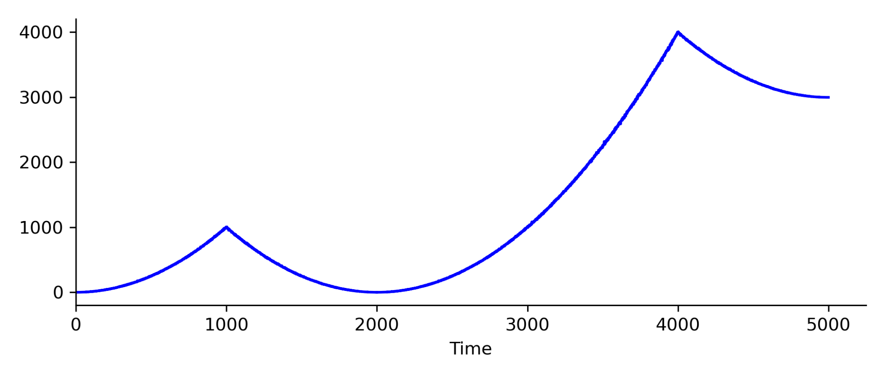
Forecasting
Now we dial down out predictions and measure a lot more more before forecasting
So the time series is doing its own thing and neither linear nor quadratic models would work!
In forecasting, our assumptions regarding the time series are critical!
We will now discuss how to make valid assumptions and where they will hold true!
Notes:
Talk about challenges in forecasting and how stationary processes are helpful

Slide 14
Contents:
Introduction to time series and forecasting
Stationarity and Wold Representation
Autoregressive and Moving Average processes
Autoregressive moving average processes and forecasting
Non-stationary processes

Slide 15
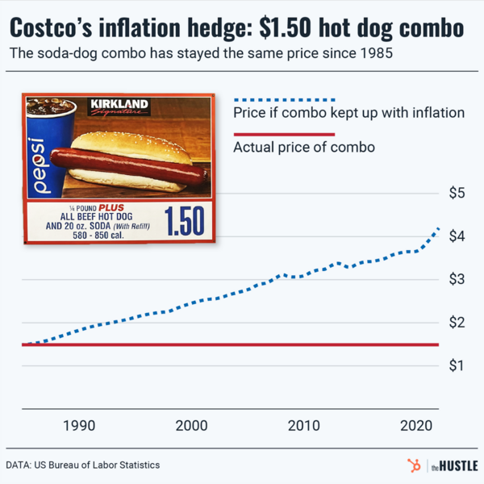
Wouldn’t it be nice if the properties of time series do not change?
Assume: The time series we are measuring is being sampled from a distribution whose parameters do not change with time.
Then, the process can be considered to be “stationary” in time
Parameters such as mean and variance are not a function of time
Assuming that the time series is stationary confers some advantages:
We do not violate any statistical analysis assumptions
Law of large number and central limit theorem still apply
Easier to model and forecast such processes
Consider Costco hot dog pricing, very likely it is going to be $1.5 for tomorrow
Notes:
Introduce types of stationarity

Slide 16
Strictly stationary time series
Let {X_{t}} be a time series, and Fx is the cumulative distribution function of {X_{t}}
The {X_{t}} is strictly stationary if
Fx(x_{t1}, …,x_{tn}) = Fx(x_{t1+𝛕}, …,x_{tn+𝛕})
For all 𝜏, t₁, t_{n} ∈ℝ and for all n∈ℕ
Then the mean and variance of the time series will not change with time!
Examples,
Constant function; X_{t} = Y, for all t; X_{t} = cos (t+Y), for all t∈ℝ
Is it useful? (a question for later)
How far from reality is this? (Very much so!)
Notes:
But this may not violate any assumptions that we made during analysis

Slide 17
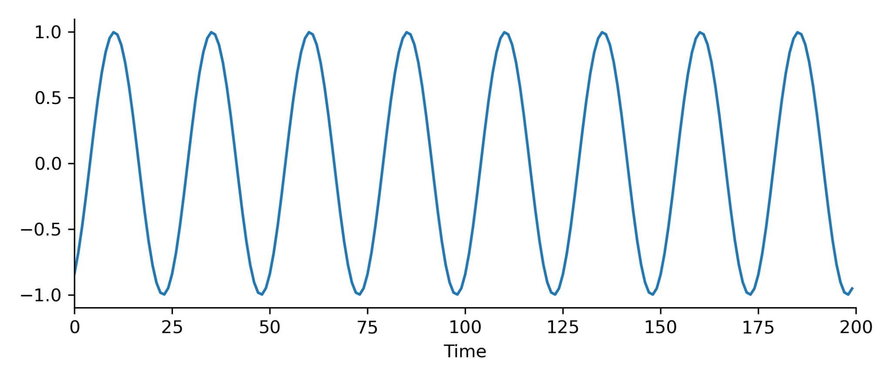
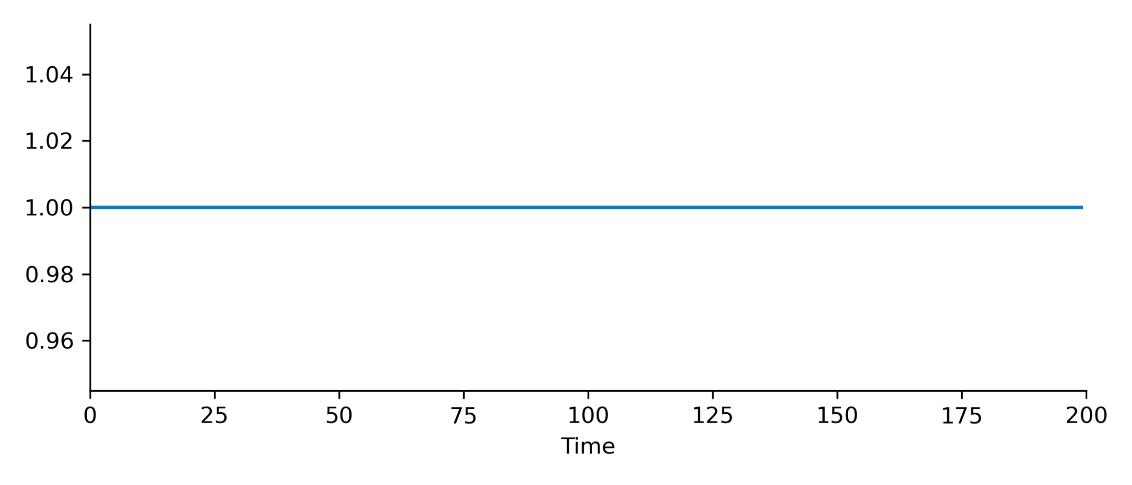
Strictly stationary time series
Examples:
X_{t} = cos (t+10)
X_{t} = Y ; Y= 1
Very restrictive view of the world!

Slide 18
N^{th} order stationary time series
Let {X_{t}} be a time series, and Fx is the cumulative distribution function of {X_{t}}
The {X_{t}} is N^{th} order stationary if
Fx(x_{t1}, …,x_{tn}) = Fx(x_{t1+𝛕}, …,x_{tn+𝛕})
For all 𝜏, t₁, t_{n} ∈ℝ and for all n∈ {1, …, N)
Then the mean and variance of the time series will not change within the time window!
Another view: the time series is stationary within the period we observe
Note: some definitions in literature refer to PDF instead of CDF

Slide 19
Going further: Covariance stationary processes
A weaker constraint on stationarity requirement
A time series {X_{t}} is Covariance stationary if
E(X_{t}) = µ
Var(X_{t}) = σ²_{X}
Cov(X_{t},X_{t+𝛕}) = 𝛾(𝛕)
Note: All are independent of t
Advantages?
We assume covariance only depends on 𝜏 and is not a constant
Model more complex time series

Slide 20
Autocorrelation function (ACF)
Autocorrelation Function (ACF) of a time series is defined as
R_{t,t+𝛕} = Cov(X_{t},X_{t+𝛕}) [√Var(X_{t})√Var(X_{t+𝛕})]⁻¹
Useful properties:
R_{t,t} = Var(X_{t})
For covariance stationary processes, R_{t,t+𝛕} = R_{t-𝛕, t},i.e. ACF is a function of 𝛕 only
For covariance stationary processes,Cov(X_{t},X_{t+𝛕}) = Cov(X_{t-𝛕},X_{t})

Slide 21
Why stationarity?
Stationary time series are convenient to work with
Easier parameter discovery and optimization
Existing literature and methodologies that readily translates
A reasonable compromise between what is (real data) and what we can work with (our model)
An interesting perspective,
The more informed and less constrained stationary model we have, the less deviation it will have from the real series
Example, in case of stock prices,
Case 1: The future price is the running mean of previous price and plus stochastic noise
Case 2: The future price is multivariate (depends on previous prices, profits, geopolitical scenario, etc.) and what is still unknown is stochastic noise
Are either of the models perfectly accurate? NO!
Is one better than the other? YES!

Slide 22
How do we view the world: Wold Representation theorem
Any zero-mean covariance stationary time series {X_{t}} can be decomposed as the sum of two time series, one deterministic and one stochastic
X_{t} = V_{t} + S_{t}
Here {V_{t}} a linear deterministic process,
A linear combination of of previous values of V_{t}, with constant coefficients
S_{t} is an infinite moving average process of error terms (stochastic)
S_{t} = ∑∞_{i=0}𝜓_{i}η_{t-i}
𝜓 is the moving average weights, and {η_{t}} is the linear white noise
Named after Herman Wold

Slide 23
Wold Representation theorem: Properties
X_{t} = V_{t} + S_{t}
S_{t} = ∑∞_{i=0}𝜓_{i}η_{t-i}
Weights are stable, ∑∞_{i=0}𝜓_{i}² <∞ (square summable)
Conventionally, 𝜓₀ = 1
White noise {η_{t}}~ iid N(0,σ²) has, E(η_{t}) = 0, E(η_{t}²) = σ², E(η_{t}η_{s}) = 0,
White noise {η_{t}} is uncorrelated with {V_{t}}, E(η_{t}V_{s}) = 0

Slide 24
Wold Representation theorem
Why is this representation useful?
We just modelled a time series, X_{t}, as a sum of two linear variables!
We can estimate the variables!
It forms the basis of moving average (MA) and autoregressive (AR) models to explain time series (discussed later)
It is a MA(∞) and AR(∞) representation
Challenge:
It needs infinite number of parameters to represent the time series
But they decay rapidly in practice

Slide 25
Contents:
Introduction to time series and forecasting
Stationarity and Wold Representation
Autoregressive and Moving Average processes
Autoregressive moving average processes and forecasting
Non-stationary processes

Slide 26
A slight detour to Lag operator
The lag operator L() shifts a time series back by one time increment
Basically, a short hand to manipulate time series data
For {X_{t}}, L(X_{t}) = X_{t-1}
We can also have different orders of lag operator,
Or recursive application L(L(X_{t})= L²(X_{t})
L⁰(X_{t}) = X_{t}; L¹(X_{t}) = X_{t-1}; L²(X_{t}) = X_{t-2}; …; L^{n}(X_{t}) = X_{t-n};
Inverse also exists,
L^{-n}(X_{t}) = X_{t+n}

Slide 27
Wold Representation theorem with Lag operator
Defining some notation and setup
X_{t} = V_{t} + S_{t}
X_{t} = ∑∞_{i=0}𝜓_{i}η_{t-i} + V_{t}
X_{t} = ∑∞_{i=0}𝜓_{i}L^{i}(η_{t}) + V_{t}
X_{t} = 𝜓(L)η_{t} + V_{t},
where 𝜓(L) = ∑∞_{i=0}𝜓_{i}L^{i}

Slide 28
Wold Representation theorem with Lag operator
Now, assume 𝜓(L) is invertible
𝜓⁻¹(L) = ∑∞_{i=0}𝜓*_{i}L^{i}, s.t.
𝜓⁻¹(L) 𝜓(L) = I = L⁰
Also, we assume V_{t} = 0, i.e. X_{t} = X_{t} - V_{t}
X_{t} = 𝜓(L)η_{t}
𝜓⁻¹(L)X_{t} = 𝜓⁻¹(L)𝜓(L)η_{t}
Then, if 𝜓⁻¹(L) exists, {X_{t}} is also invertible, and can be represented as
X_{t} = (∑∞_{i=0}𝜓*_{i}X_{t-i}) + η_{t}
Note: This is an autoregressive representation of X_{t}
Notes:
Check the inverse of Xt

Slide 29
What if the time series has persistence?
The data future measurements are dependent on the previous measurement, s.t. they can be described as a function of previous value
Recall, X_{t} = (∑∞_{i=0}𝜓*_{i}X_{t-i}) + η_{t}
X_{t} = 𝜓X_{t-1} + η_{t},
where η_{t}~ iid N(0,σ²)
This is an autoregressive process of first order AR(1)
Recall Wold representation is AR(∞)
Think of Markov processes and their orders!
Notes:
Link with markov processes

Slide 30
What if the time series has persistence on p values?
The data future measurements are dependent on the previous measurements, s.t. they can be described as a function of previous values
Recall, X_{t} = (∑∞_{i=0}𝜓*_{i}X_{t-i}) + η_{t}
X_{t} = 𝜓₁X_{t-1} +𝜓₂X_{t-2} + … + 𝜓_{p}X_{t-p} + η_{t},
where η_{t}~ iid N(0,σ²)
This is an autoregressive process of order p, AR(p)
It is a linear combination of previous values (explanatory variables)

Slide 31
AR(1) process representation
Solving AR with recursion:
X_{t} = 𝜓X_{t-1} + η_{t},
X_{t} = 𝜓(𝜓X_{t-2} + η_{t-1}) + η_{t},
X_{t} = 𝜓^{j+1}X_{t-(j+1)} + 𝜓^{j}η_{t-j} + … + 𝜓²η_{t-2} + 𝜓η_{t-1} + η_{t},
Note:
if |𝜓| <1, then 𝜓^{j+1}X_{t-(j+1)}→0, for large enough j (important relation with MA(∞))
if |𝜓| >1, then 𝜓^{j+1}X_{t-(j+1)}→ ∞, for large enough j (not summable, hence non-stationary)

Slide 32
AR(1) Properties X_{t} = 𝜓X_{t-1} + η_{t},
Given an AR(1),X_{t} = 𝜓^{j+1}X_{t-(j+1)} + 𝜓^{j}η_{t-j} + … + 𝜓²η_{t-2} + 𝜓η_{t-1} + η_{t},
E[X_{t}] = μ
Now, if data is mean centered, X_{t} = X_{t} - μ
Var[X_{t}] = E[X_{t}-E[X_{t}]]² = E[η_{t}+ 𝜓η_{t-1}+ 𝜓²η_{t-2}+...+𝜓^{j}η_{t-j}]²
Var[X_{t}] = Var[η_{t}] + 𝜓²Var[η_{t}] + 𝜓⁴Var[η_{t}] + … = (1 + 𝜓²+ 𝜓⁴+...)σ²
Var[X_{t}] = σ²(1 - 𝜓²)⁻¹, as, η_{t}~ iid N(0,σ²)

Slide 33
AR(1) Properties X_{t} = 𝜓X_{t-1} + η_{t},
Given an AR(1),X_{t} = 𝜓^{j+1}X_{t-(j+1)} + 𝜓^{j}η_{t-j} + … + 𝜓²η_{t-2} + 𝜓η_{t-1} + η_{t},
Cov[X_{t},X_{t-1}] = E[(X_{t}-E[X_{t}]) (X_{t-1} -E[X_{t-1}])]; X_{t} = X_{t} - μ
Cov[X_{t},X_{t-1}] = E[(η_{t}+ 𝜓η_{t-1}+ 𝜓²η_{t-2}+...) (η_{t-1}+ 𝜓η_{t-2}+ 𝜓²η_{t-3}+...) ]
Cov[X_{t},X_{t-1}]= (𝜓¹+ 𝜓³+ 𝜓⁵+...)σ² = 𝜓(1 + 𝜓²+ 𝜓⁴+...)σ²
Cov[X_{t},X_{t-1}] = 𝜓σ²(1 - 𝜓²)⁻¹ = 𝜓Var[X_{t}]

Slide 34



AR(2) process representation
Given a AR(2), X_{t} = 𝜓₁X_{t-1} +𝜓₂X_{t-2} + η_{t},
We define
Such that,
This is matrix representation of AR(2)
Also, referred to as Yule-Walker equations

Slide 35

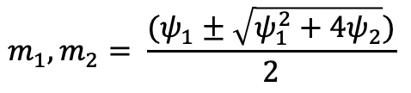
AR(2) process stationarity test
To find roots of the equation
We can compute eigenvalues (m₁,m₂) of
Which satisfy the characteristic equation x² - 𝜓₁x - 𝜓₂ = 0
Then,

Slide 36
AR(2) process stationarity test
For stationarity eigenvalues have less than 1 absolute value,
i.e. |m₁|,|m₂| <1
Which will be the case if,
𝜓₁ + 𝜓₂ < 1
- 𝜓₁ + 𝜓₂ < 1
𝜓₂ > -1

Slide 37
AR(2) process stationarity test: an alternate view
Write the characteristic equation as 1- x² - 𝜓₁x - 𝜓₂ = 0, Hamilton (1994)
In this representation, the roots of this equation must lie outside the unit circle, for the AR process to be stationary
The roots are the inverse of 𝜓₁ and 𝜓₂,
so their magnitude is >1 to ensure |𝜓₁| and |𝜓₂| <1
Hamilton, J. D.: Time Series Analysis, Princeton University Press (1994).

Slide 38
What if the error terms (η) varies with time?
Then we have a Moving Average (MA) process
X_{t} = µ + η_{t}+ θη_{t-1}, MA(1)
Here, µ is a constant, η_{t} and η_{t-1}, are iid N(0,σ²)
Additionally,
E[X_{t}] = E[µ+ η_{t}+ θη_{t-1}] = E[µ] + E[η_{t}]+ E[θη_{t-1}] = µ
Var[X_{t}] = E[X_{t}-E[X_{t}]]² = E[(µ+ η_{t}+ θη_{t-1}) - µ]² = E[η_{t}]²+ E[θη_{t-1}]²+ 2θE[η_{t}η_{t-1}]
Var[X_{t}] = σ²+θ²σ² +0
Var[X_{t}] = (1+θ²)σ² Note: Both quantities are independent of t

Slide 39
MA Covariance
We have an MA(1) process, X_{t} = µ + η_{t}+ θη_{t-1},
Cov[X_{t}, X_{t-1}] = E[(X_{t}-E[X_{t}])(X_{t-1}-E[X_{t-1}])] = E[(η_{t}+ θη_{t-1})(η_{t-1}+ θη_{t-2})]
Cov[X_{t}, X_{t-1}] = E[η_{t}η_{t-1}] + θE[η_{t-1}²] + θE[η_{t}η_{t-2}] + θ²E[η_{t-1}η_{t-2}] = 0 + θσ² + 0 + 0
Cov[X_{t}, X_{t-1}] = θσ²
Generally, for MA(q) process, X_{t} = µ + θ₀η_{t}+ θ₁η_{t-1}+ … + θ_{q}η_{t-q},
Cov[X_{t}, X_{t-q}] = E[(X_{t}-E[X_{t}])(X_{t-q}-E[X_{t-q-1}])] = E[(η_{t}+ θη_{t-1})(η_{t-q}+ θη_{t-q-1})]
Cov[X_{t}, X_{t-q}] = 0, for q>1
Note: With constant E[X_{t}], Var[X_{t}] and Cov[X_{t}, X_{t-q}] independent of t,
MA processes are covariance stationary!

Slide 40
Call back to Wold Representation Theorem
X_{t} = V_{t} + S_{t}
Here {V_{t}} a linear deterministic process,
A linear combination of of previous values of V_{t}, with constant coefficients
S_{t} is an infinite moving average process of error terms (stochastic)
S_{t} = ∑∞_{i=0}𝜓_{i}η_{t-i}
Now we know what AR(p) and MA(q) processes look like,
We can appreciate that WRT represents time series as a linear combination of MA(∞) and AR(∞) processes

Slide 41
Contents:
Introduction to time series and forecasting
Stationarity and Wold Representation
Autoregressive and Moving Average processes
Autoregressive moving average processes and forecasting
Non-stationary processes

Slide 42
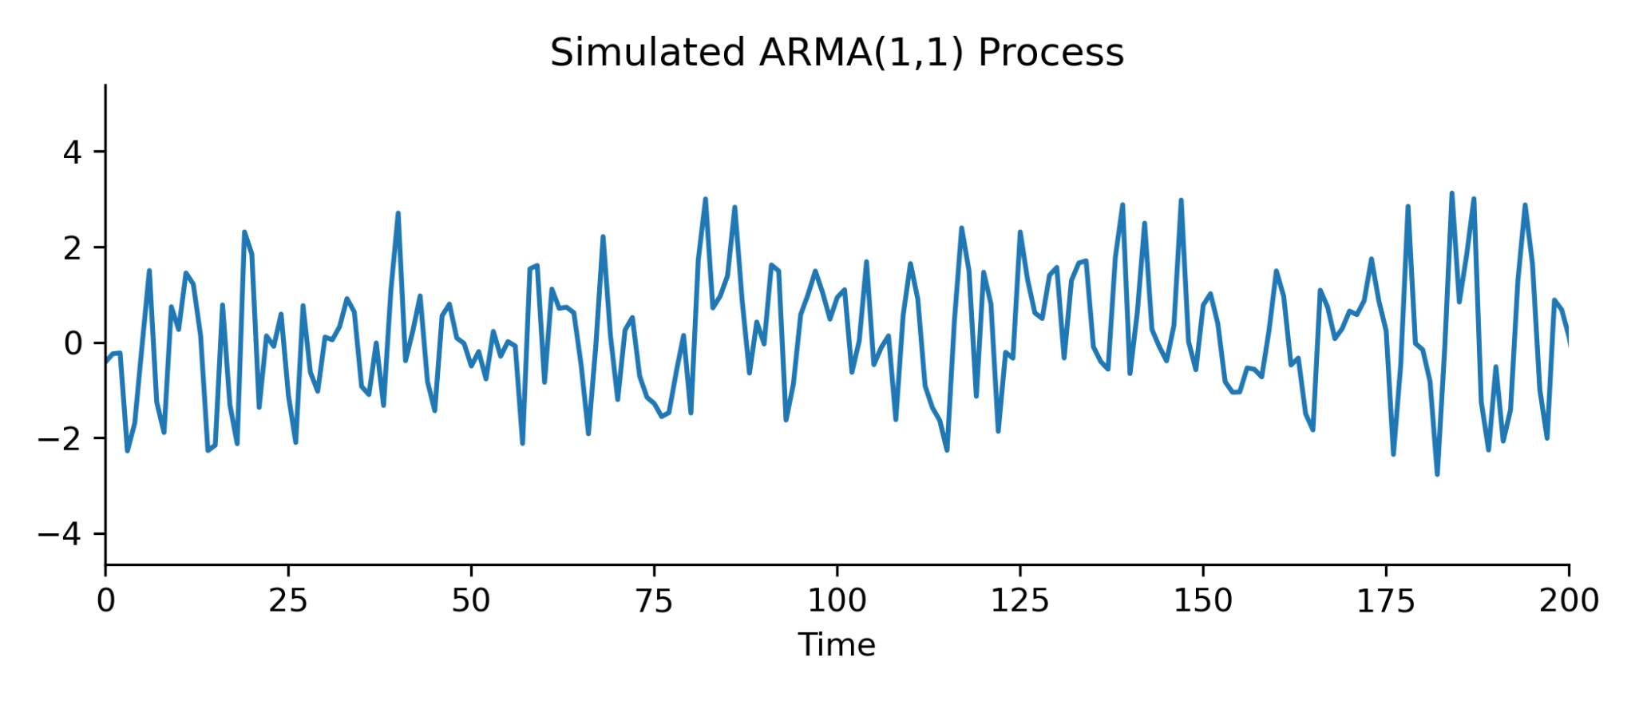
Auto Regressive Moving Average (ARMA) processes
A linear combination of AR and MA processes
Simplest ARMA,
ARMA(1,1), X_{t} = 𝜓X_{t-1} + η_{t}+ θη_{t-1},
As lag operator, 𝜓(L)X_{t} = θ(L)η_{t},
Where, 𝜓(L) = 1 - ∑^{p}_{i=0}𝜓_{i}L^{i}, and θ(L) = 1 - ∑^{q}_{i=0}θ_{i}L^{i},
Note: With these definitions we can construct ARMA(2,1) or generally ARMA(p,q)

Slide 43
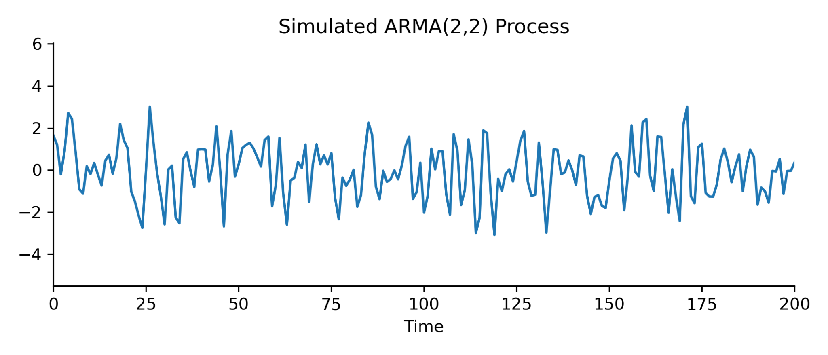
ARMA (p,q)
A process is ARMA(p,q) if it is autoregressive with order p and moving average with order q
ARMA(p,q), X_{t} = 𝜓₁X_{t-1} + 𝜓₂X_{t-2} +...+𝜓_{p}X_{t-p} + η_{t}+ θ₁η_{t-1}+ θ₂η_{t-2}+...+ θ_{q}η_{t-q},
As lag operator, 𝜓(L)X_{t} = θ(L)η_{t},
Where, 𝜓(L) = 1 - ∑^{p}_{i=0}𝜓_{i}L^{i}, and θ(L) = 1 + ∑^{q}_{i=0}θ_{i}L^{i},
Wold decomposition of ARMA(p,q)
X_{t} = [𝜓(L)]⁻¹θ(L)η_{t},

Slide 44
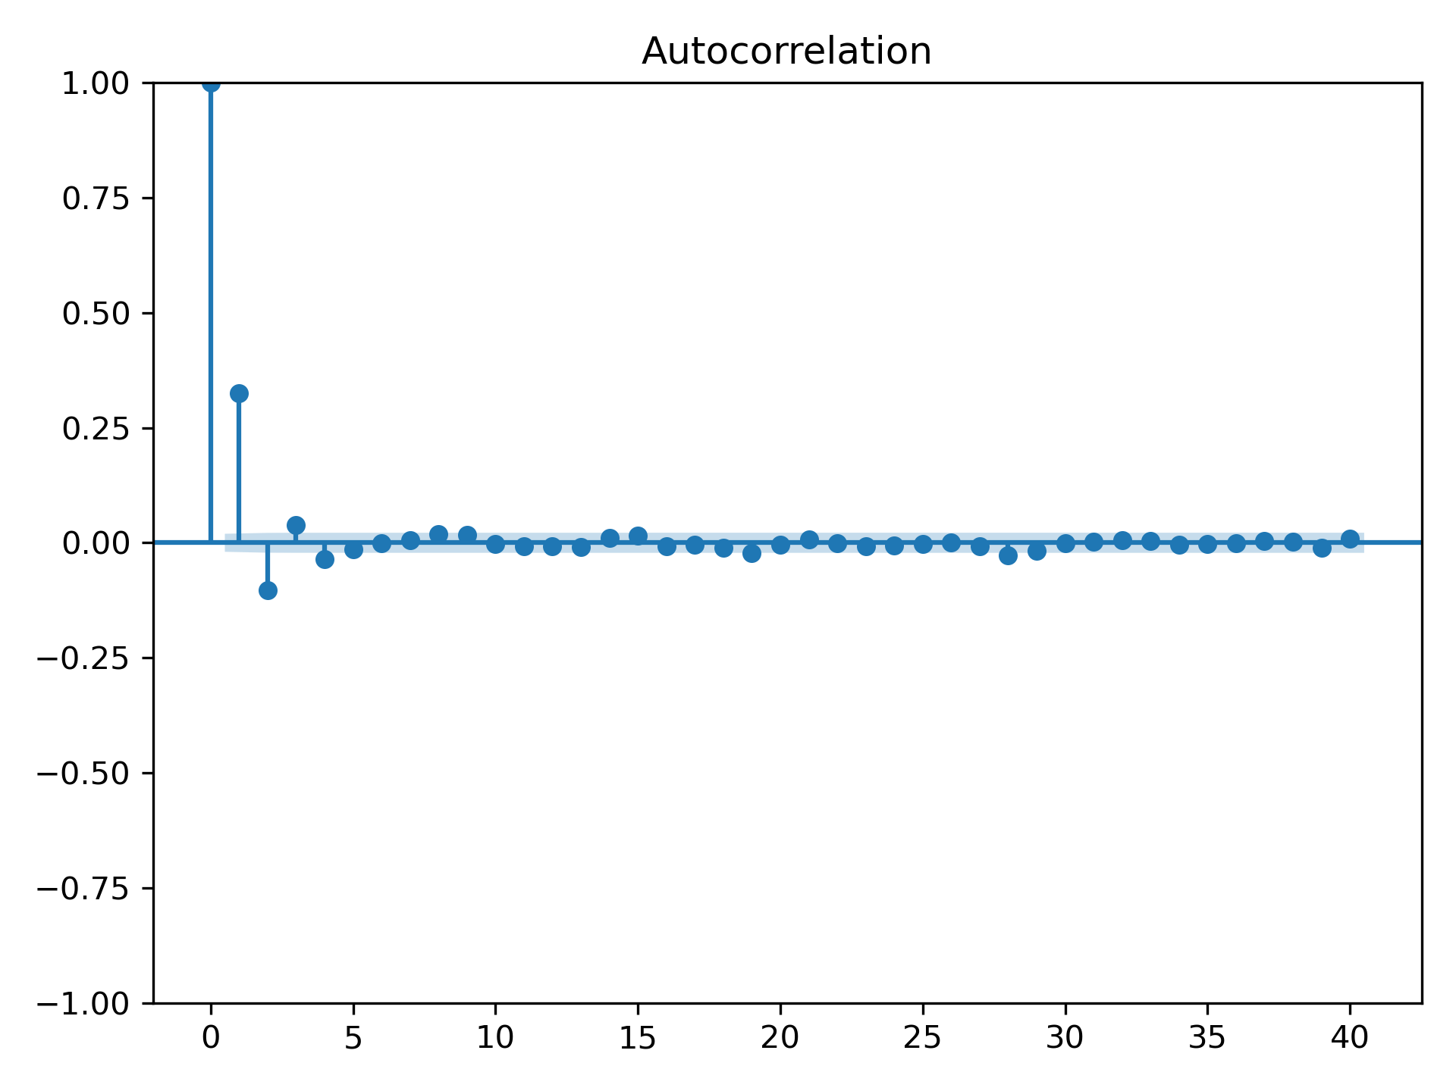
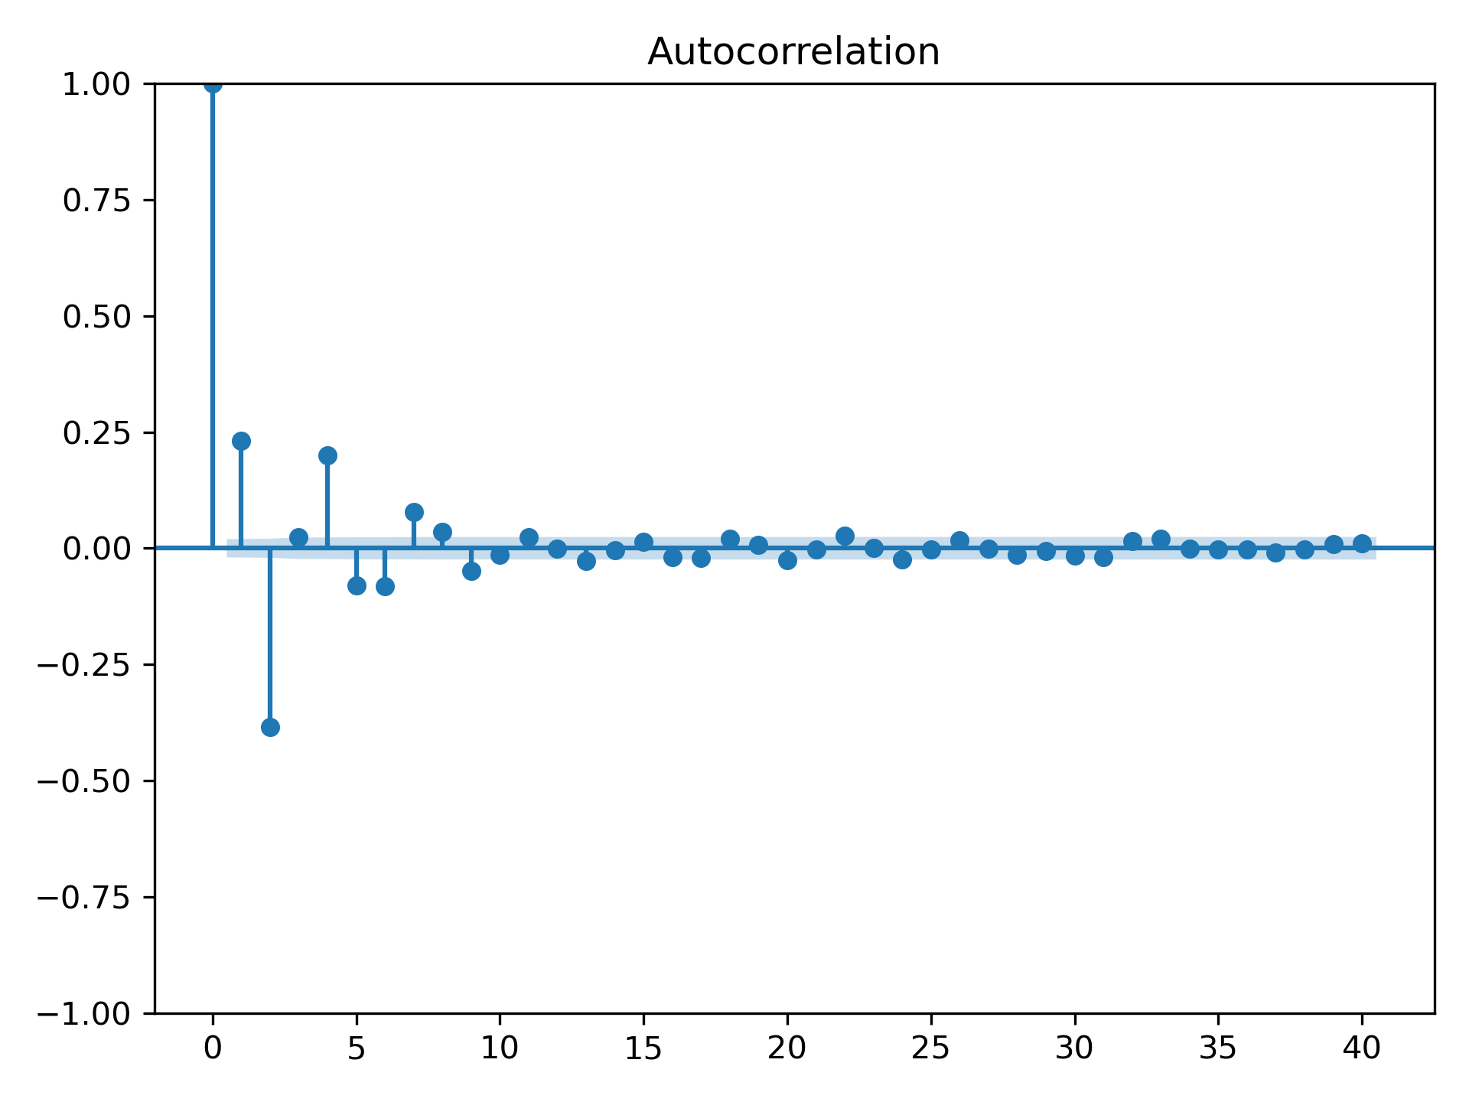
ARMA comparison
Autocorrelation Function (ACF), R_{t,t+𝛕} = Cov(X_{t},X_{t+𝛕}) [√Var(X_{t})√Var(X_{t+𝛕})]⁻¹

Slide 45
Recall ARMA(1,1) process
(1 - 𝜓(L))X_{t} = (1 + θ(L))η_{t},
We can approximate the lag operator inverse as,
X_{t} = [(1 - 𝜓(L))]⁻¹(1 + θ(L))η_{t}
X_{t} = [(1 - 𝜓(L))]⁻¹η_{t} + [(1 - 𝜓(L))]⁻¹θ₁η_{t-1}
Expressing this as a Geometric Progression,
X_{t} = ∑∞_{j=0}(𝜓L)^{j}η_{t} + θ∑∞_{j=0}(𝜓L)^{j}η_{t-1}
X_{t} = η_{t} +∑∞_{j=1}𝜓^{j}η_{t-j} + θ∑∞_{j=1} 𝜓^{j-1}η_{t-j}
X_{t} = η_{t} +∑∞_{j=1}(𝜓^{j} + θ𝜓^{j-1})η_{t-j}
if |𝜓| < 1, weights are summable and Var[X_{t}] and Cov[X_{t} ,X_{t-1}] are finite

Slide 46
AR model parameter estimation
Assume AR(1), with μ mean; X_{t} = μ + 𝜓X_{t-1} + η_{t}, alternatively,η_{t}= X_{t} - μ - 𝜓X_{t-1}
where, η_{t}~N(0,σ²),
MLE formulation is: Find θ*, such that L(θ|X) is maximized
L(θ|X) = ∏^{N}_{i=1} p(x_{i}|θ)
Alternatively we can minimize the negative log likelihood function (NLL)
NLL = -log(L(θ|X))

Slide 47
AR model parameter estimation
For η_{t}= X_{t} - μ - 𝜓X_{t-1} and η_{t}~N(0,σ²),
We can estimate p(X₁,...,X_{t}|X₀,θ) as,
p(X₁,...,X_{t}|X₀,θ) = (2𝜋σ²)^{-T/2} exp(-1/(2σ²) * ∑^{T}_{t=1} η_{t}²
p(X₁,...,X_{t}|X₀,θ) = (2𝜋σ²)^{-T/2} exp(-1/(2σ²) * ∑^{T}_{t=1} (X_{t} - μ - 𝜓X_{t-1})²
NLL is
-log(L(θ|X)) = ½(T*log σ²) + 1/(2σ²)*∑^{T}_{t=1} (X_{t} - μ - 𝜓X_{t-1})² + const.
Note: This is quadratic in X and can be minimized by…

Slide 48
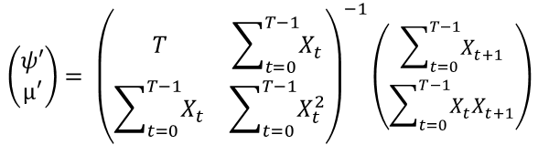
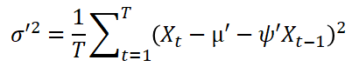
AR model parameter estimation
-log(L(θ|X)) = ½(T*log σ²) + 1/(2σ²)*∑^{T}_{t=1} (X_{t} - μ - 𝜓X_{t-1})² + const.
Note: This is quadratic in X and can be minimized by…

Slide 49
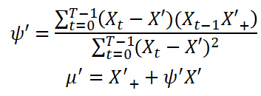
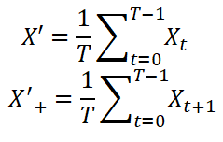
AR model parameter estimation
Rewriting,
as,
where,

Slide 50
MA model parameter estimation
Assume MA(1), with μ mean; X_{t} = µ + η_{t}+ θη_{t-1},, alternatively,η_{t}= X_{t} - µ - θη_{t-1}
The PDF of X_{t}, is p(X_{t}|X_{t-1},...,X₁, η₀=0, θ) = (2𝜋σ²)^{-1/2} exp(-η_{t}² / (2σ²))
NLL is
-log(L(θ|X,η₀=0)) = ½(T*log σ²) + 1/(2σ²)*∑^{T}_{t=1} η_{t}² + const.

Slide 51
Forecasting with ARMA(p,q)
Problem statement: Given X_{1:t} = X₁, … X_{t}, what is the best estimate (X*_{t+1}) of X_{t+1}?
Equivalent to, minimizing Mean Squared Error (MSE)
min E((X*_{t+1}- X_{t+1})²)
To prove the minimization of MSE is indeed forecasting,
Say Z is any random variable measurable with respect to the information
set generated by X_{1:t}, then
E((X_{t+1}- Z)²) = E((X_{t+1}- E(X_{t+1}) + E(X_{t+1}) - Z)²)
E((X_{t+1}- Z)²) = E((X_{t+1}- E(X_{t+1}))²) + E((E(X_{t+1}) - Z)²) + 2E((X_{t+1}- E(X_{t+1}))( E(X_{t+1}) - Z))

Slide 52
Forecasting with ARMA(p,q)
E((X_{t+1}- Z)²) = E((X_{t+1}- E(X_{t+1}))²) + E((E(X_{t+1}) - Z)²) + 2E((X_{t+1}- E(X_{t+1}))(E(X_{t+1}) - Z))
Here, E((X_{t+1}- E(X_{t+1}))( E(X_{t+1}) - Z)) = E((X_{t+1}- E(X_{t+1}))(E(X_{t+1}) - Z))
= (E(X_{t+1}) - E(E(X_{t+1})))(E(X_{t+1}) - Z))
= 0*(E(X_{t+1}) - Z)) , as E(E(X_{t+1})) = E(X_{t+1})
then, E((X_{t+1}- Z)²) = E((X_{t+1}- E(X_{t+1}))²) + E((E(X_{t+1}) - Z)²)
which is minimum at, Z = E(X_{t+1})= E(X*_{t+1})

Slide 53
Contents:
Introduction to time series and forecasting
Stationarity and Wold Representation
Autoregressive and Moving Average processes
Autoregressive moving average processes and forecasting
Non-stationary processes

Slide 54
How do we tell if a process is stationary?
We conduct statistical test: (Null Hypothesis)
Given AR(1), X_{t} = 𝜓X_{t-1} + η_{t},
We assume, H₀: 𝜓 = 1 (unit root, non-stationarity) OR H₁: |𝜓| < 1 (stationarity)
This is, Autoregressive Unit Root Test

Slide 55
Additional Stationarity tests
Unit Root test (H₀: non-stationarity)
Dickey-Fuller (DF) test - Dickey and Fuller (1979)
Augmented Dickey-Fuller (ADF) test - Said and Dickey (1984)
Unit Root (PP) test - Phillips and Perron (1988)
Efficient Unit (ERS) Root Test - Elliot, Rothenberg, and Stock (2001)
Stationarity test (H₀: stationarity)
KPSS test - Kwiatkowski, Phillips, Schmidt, and Shin (1992)

Slide 56
What if a process is non stationary?
Consider the example of Random Walk, X_{t} = X_{t-1} + η_{t},
where η_{t}~ N(0,σ²)
Var[X_{t}] = Var[X_{t-1} + η_{t}] = Var[X_{t-1}] + σ² = Var[X_{t-2} + η_{t}] + σ² =Var[X_{t-3} + η_{t}] + 2σ²
Var[X_{t}] =Var[X₀] + tσ²
Why is this not stationary?

Slide 57
Violations of stationarity
A time series {X_{t}} is Covariance stationary if
E(X_{t}) = µ
Var(X_{t}) = σ²_{X}
Cov(X_{t},X_{t+𝛕}) = 𝛾(𝛕)
If any of these are a function of time, then process may be non-stationary!

Slide 58
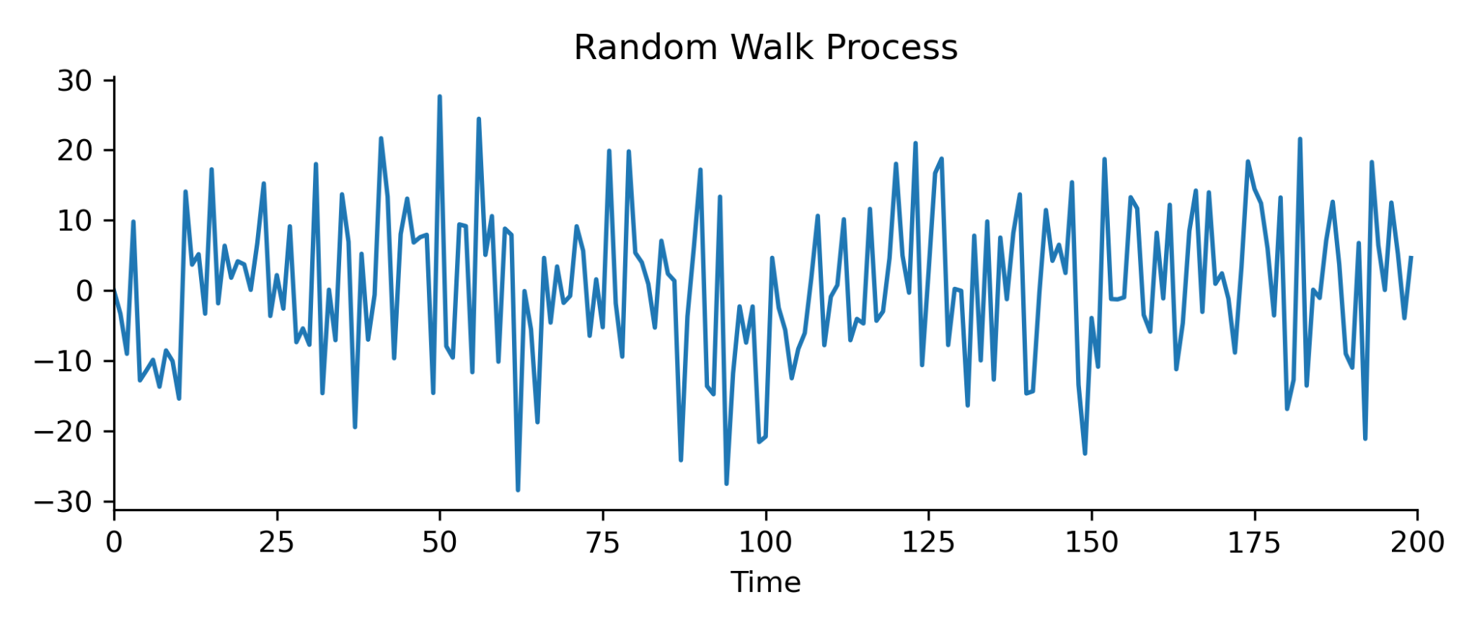
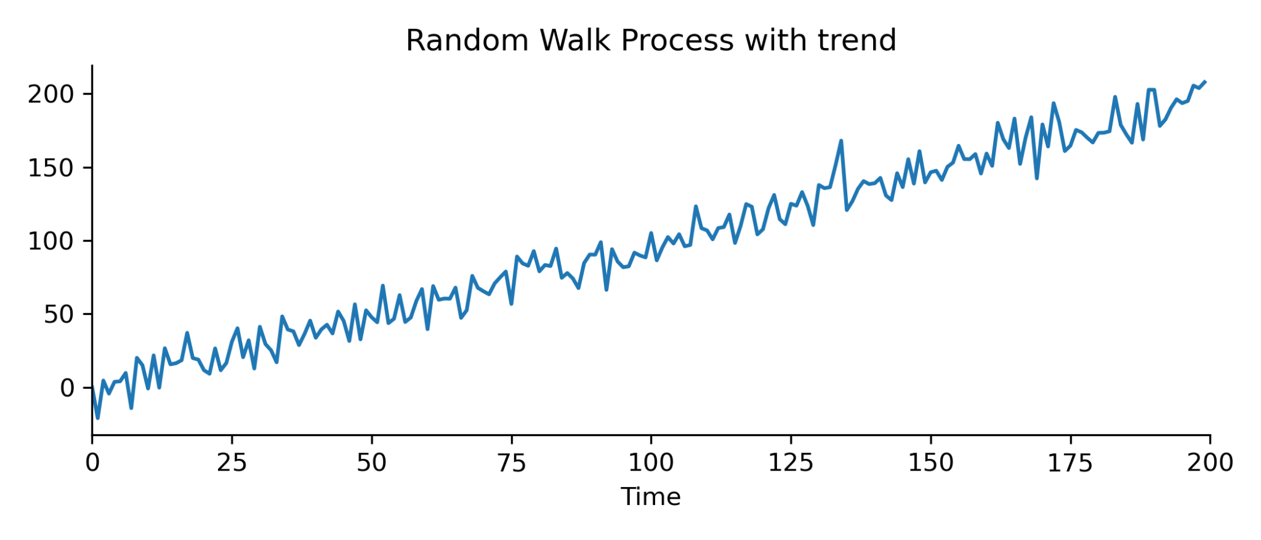
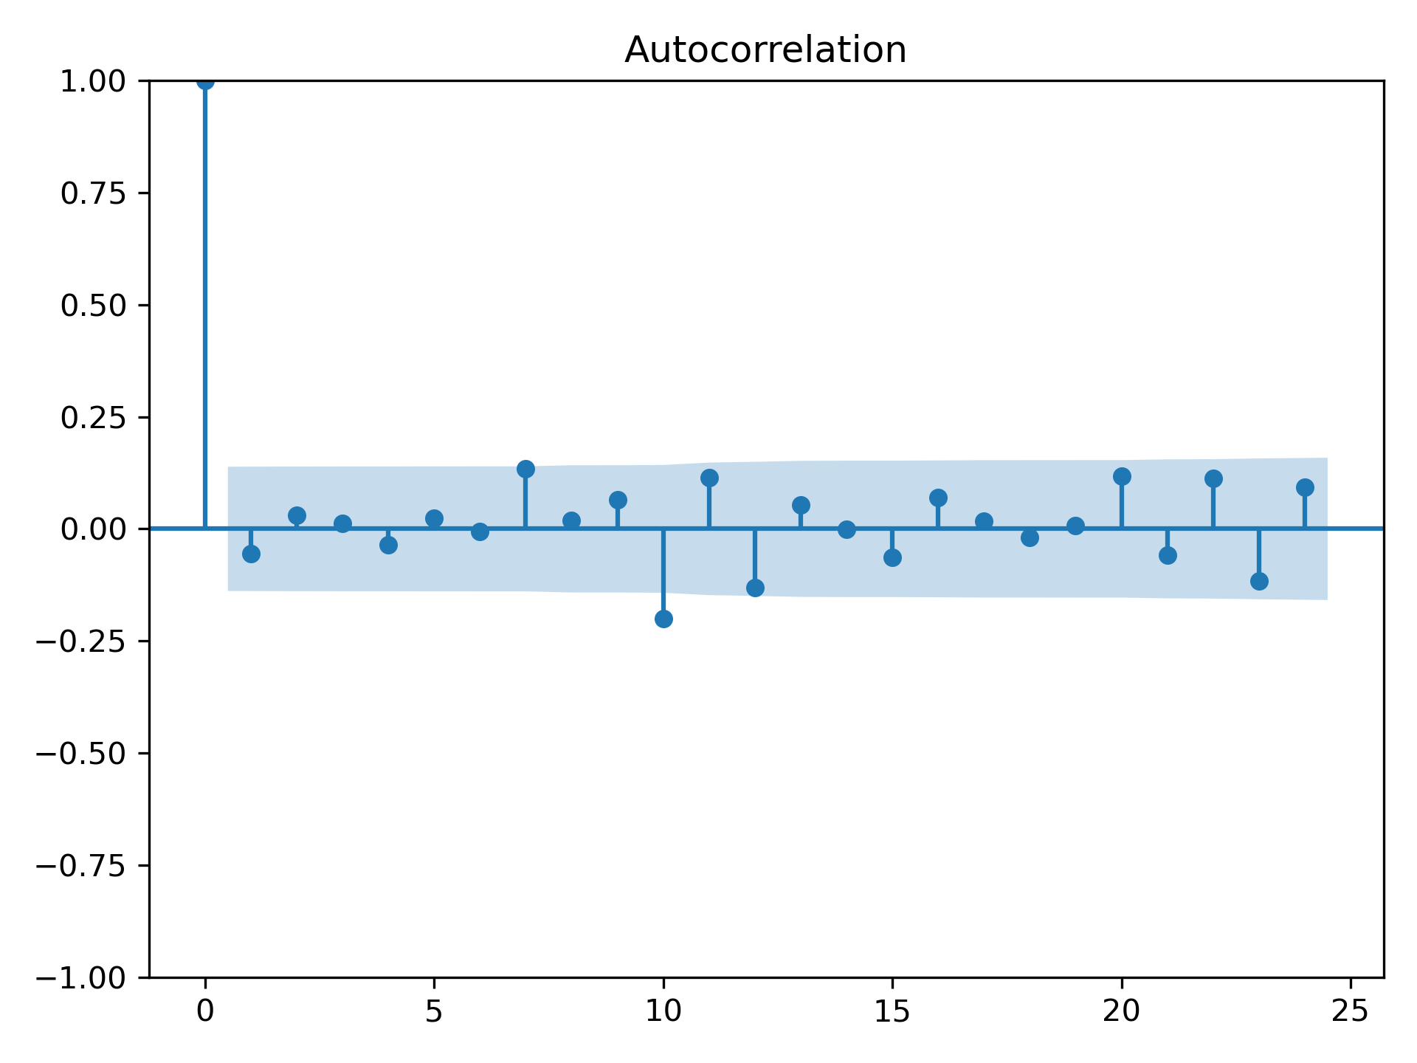
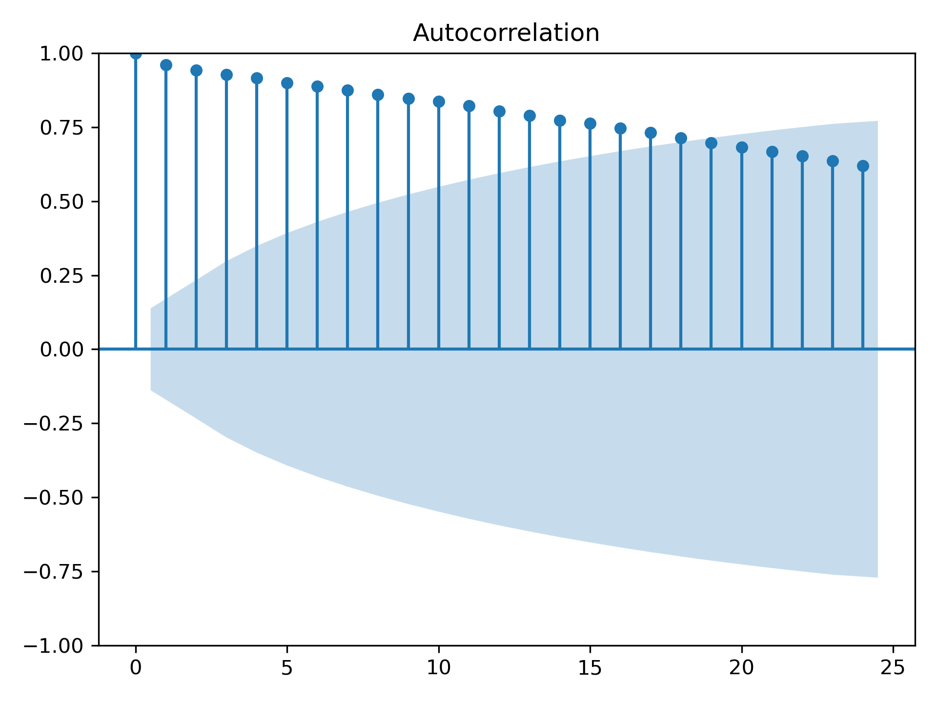
Examples of non-stationary processes

Slide 59
How do we deal with non stationary processes?
We can remove the non stationary trend behavior from the data! (Box-Jenkins method)
How do we do this?
By differencing method,
Assume,
If the process {X_{t}} has a linear trend in time, then by transformation we can obtain a process {∆X_{t}} that has no trend.
If the process {X_{t}} has a quadratic trend in time, then by transformation we can obtain a second order process {∆²X_{t}} that has no trend.

Slide 60
Differencing operators
For X_{t} = 𝜓X_{t-1} + η_{t},
The first order difference operator is,
∆X_{t} = X_{t} - X_{t-1} , alternatively, ∆X_{t} = (1- L)X_{t}, where L is lag operator
The second order difference operator is,
∆(∆X_{t}) = ∆X_{t} - ∆X_{t-1}, ∆²X_{t} = (1- L)∆X_{t} = (1- L)(1- L)X_{t}
∆²X_{t} = (1- L)²X_{t}
Generally, the i^{th} order difference operator is
∆^{i}X_{t} = (1- L)^{i}X_{t}
Notes:
Binomial extension of i^{th} power

Slide 61
Trend removal by differencing
A trend is a time dependent variation in the time series {X_{t}}
i.e. X_{t} = TD_{t} + η_{t}, where TD_{t} = a + bt (deterministic linear trend)
also, η_{t} ~ AR(1), i.e. η_{t} = 𝜓η_{t-1} - ε_{t}, where |𝜓| <1 and ε_{t} is WN(0,σ²)
Then moments of X_{t} are , E[X_{t}] = E[TD_{t}] + E[η_{t}] = a +bt
and Var[X_{t}] = Var[η_{t}] = σ²/(1-𝜓)
∆X_{t} = X_{t} - X_{t-1} , where X_{t} = TD_{t} + η_{t},
∆X_{t} = TD_{t} + η_{t} - TD_{t-1} + η_{t-1} = a + bt - a - b(t-1) +∆η_{t} = b+∆η_{t}
∆X_{t} = b+(η_{t} - η_{t-1}) = b + (1-L)η_{t} = b + (1-L)(1-𝜓L)ε_{t-1},
∆X_{t} = b + (1-L)(1-𝜓L)ε_{t-1}

Slide 62
Incorporating i^{th} order difference and ARMA: ARIMA
The time series {X_{t} } follows an ARIMA(p, q, d) model (“Integrated ARMA”), if
{∆^{d}X_{t}} is stationary (and non-stationary for lower-order differencing)
In d order differencing it follows an ARMA(p, q) model
Practical Challenges:
Determining the order of differencing required to remove time trends (deterministic or stochastic).
Estimating the unknown parameters of an ARIMA(p, q, d) model.
Model Selection: choosing among alternative models with different (p, q, d) specifications

Slide 63
Limitations of Differencing: trend removal in Random Walk
X_{t} = X_{t-1} + η_{t}, where η_{t} is WN(0,σ²) (also called a Pure Integrated Process I(1))
then, ∆X_{t} = (1-L)X_{t} + η_{t}
Given X₀, we can rewrite this as, X_{t} = X₀ + TS_{t}, where TS_{t} = ∑^{t}_{j=0}η_{t}
then, TS_{t} is a Stochastic Trend process,
TS_{t}= TS_{t-1} + η_{t}, where η_{t} is WN(0,σ²)
Note:
As a consequence of η_{t}, the Stochastic trend processes are not perfectly predictable (non-stationary)
Differencing operator cannot remove trend associated with η_{t}

Slide 64
Application of Time series forecasting in context of 11755 projects
The data is a time series (stock prices, voting trends, match results)
We can model the time series with ARMA, ARIMA model (for trend removal)
Considerations:
Parameter estimation can be carried out by MLE
The ARMA series can be represented as matrices through Yule-Walker equations
The prediction will not be accurate
We have partial information and decomposition is not accurate
The discussed variations of ARMA and ARIMA are for the univariate case, explore multivariate ARMA or Vectorized ARMA (VARMA)
Careful determination of the deterministic and stochastic variable decomposition of time series
Do not model stochastic components as deterministic

Slide 65
Additional sources for time series forecasting
MIT OCW: Topics in mathematics with applications in finance (18.S096) by Peter Kempthorne
Kevin Kotzé’s notes on time series prediction

