Slide 1
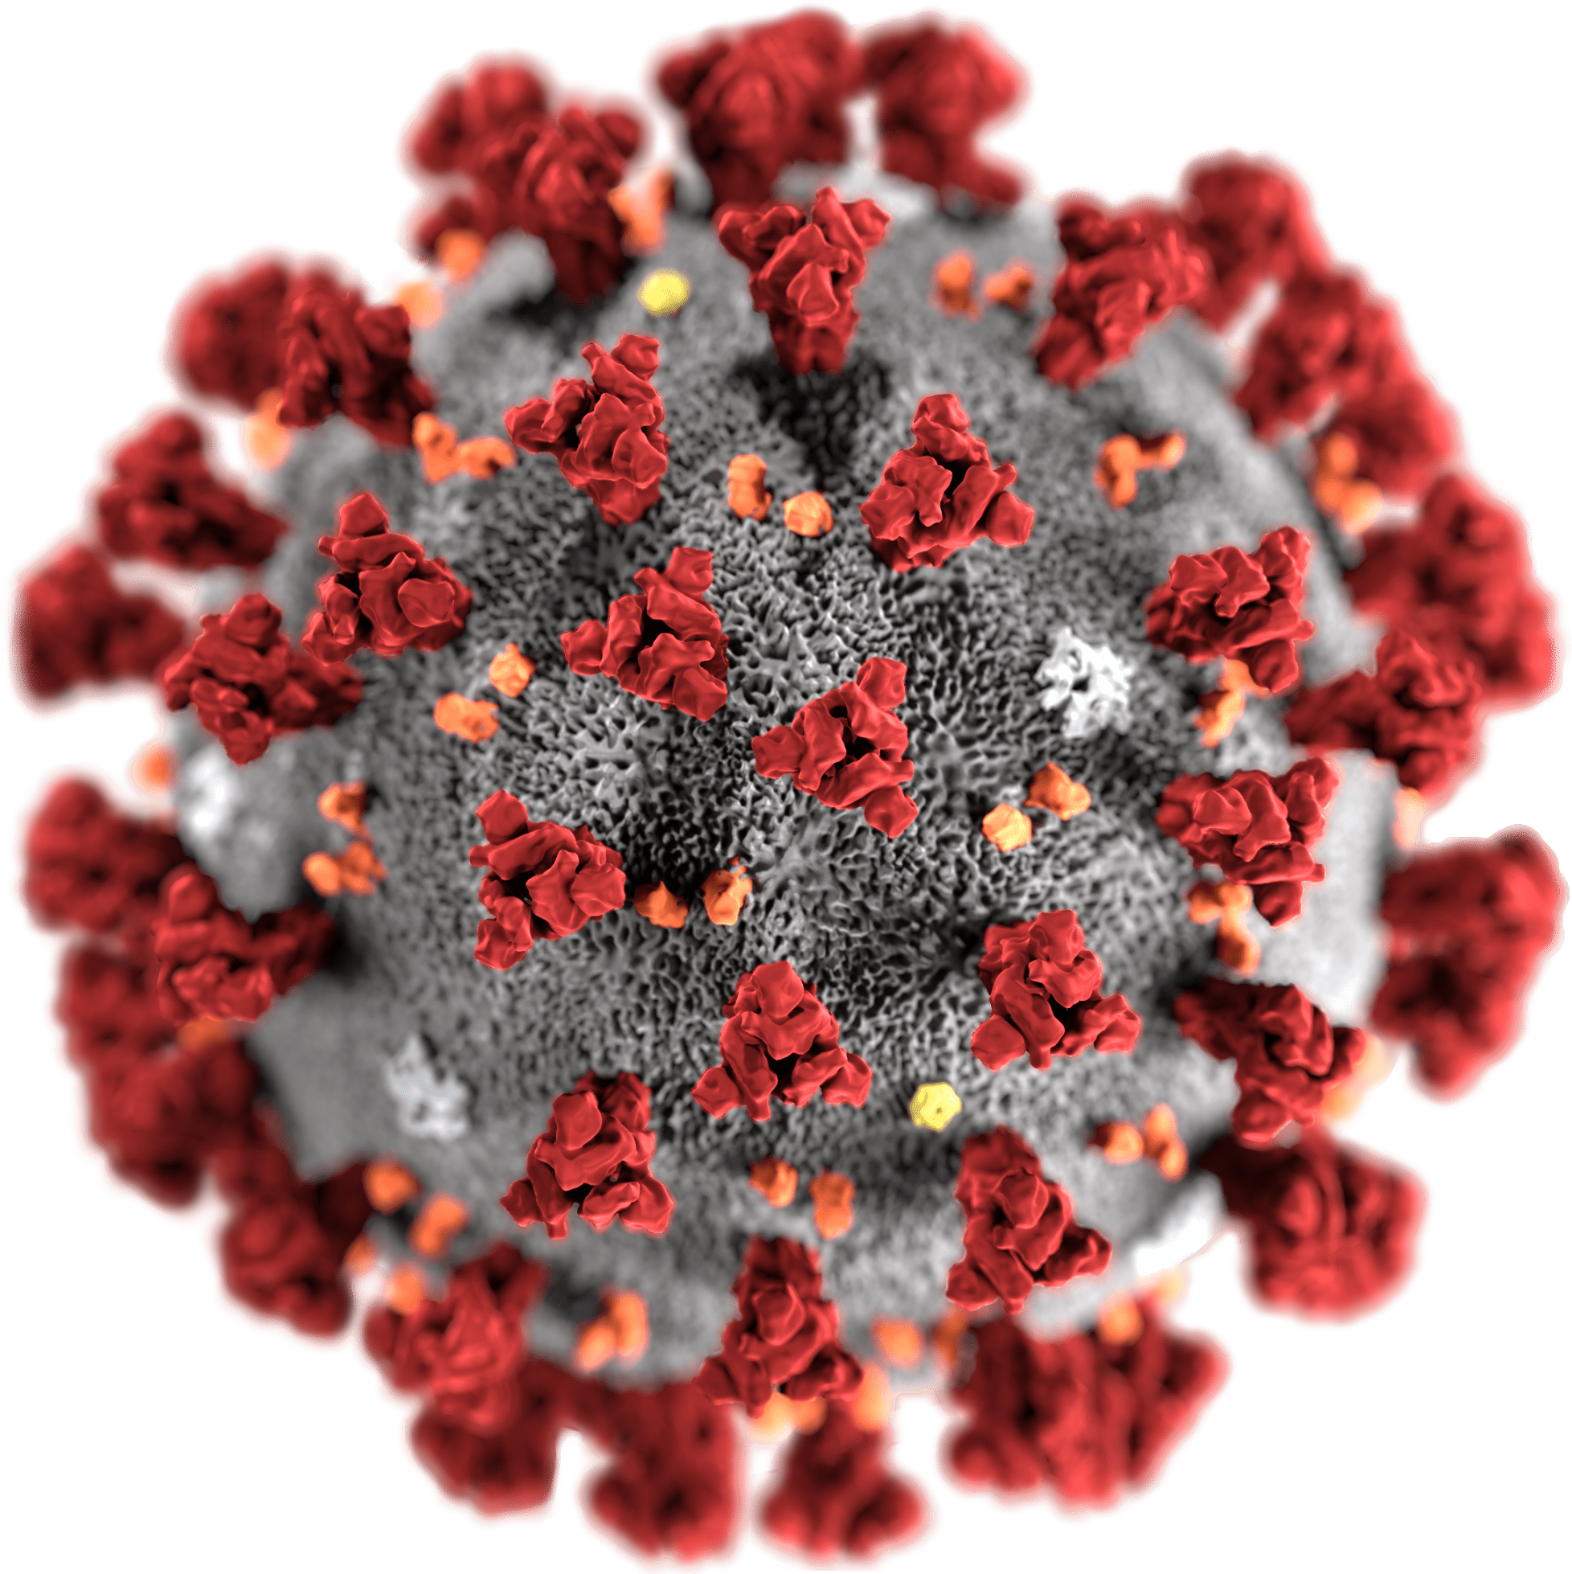
COVID-19 Analytics Using SAS
By Team Datametic Jyoti Prasad Jaya Bisht

Slide 2
EXECUTIVE SUMMARY
Coronavirus disease 2019 (COVID-19) remains an ongoing global pandemic at present, leading to tens of millions of cases reported in more than 210 countries and territories. Over 1 million people died in the USA due to this pandemic. For our analysis, we chose to analyze the number of deaths in the USA against the other variables such as the number of cases, people hospitalized, and people vaccinated during the entire period of Covid-19. Through our analysis, we have concluded that the number of deaths has a positive correlation with the number of people being hospitalized for the covid-19 and a negative correlation with the number of people being vaccinated against covid-19. Through our analysis, we also concluded that each state was differently impacted from the covid-19 though being in the same geographical region.

Slide 3
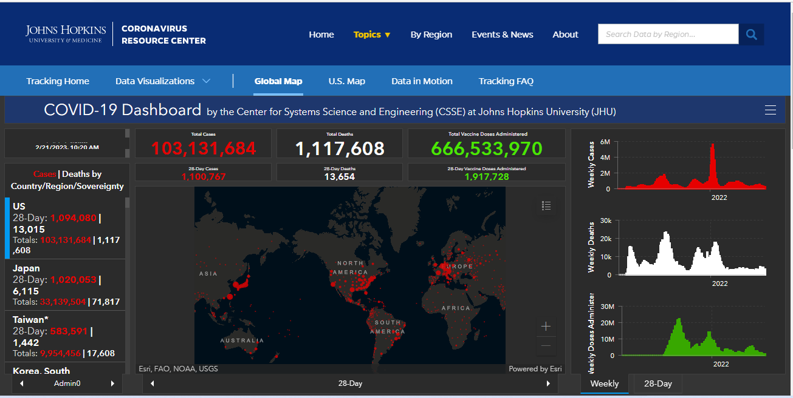
Covid-19 Statistics in the USA | Trusted resource for information

Slide 4
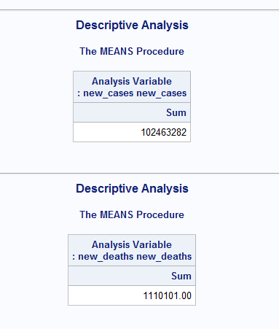
Covid-19 Summary Statistics using SAS

Slide 5
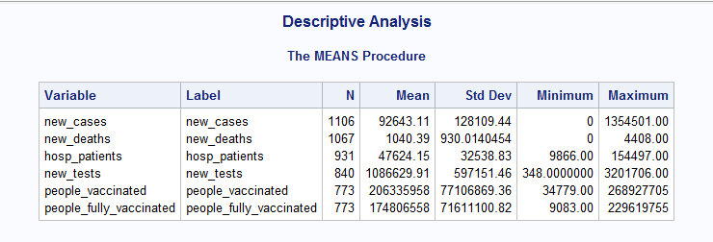
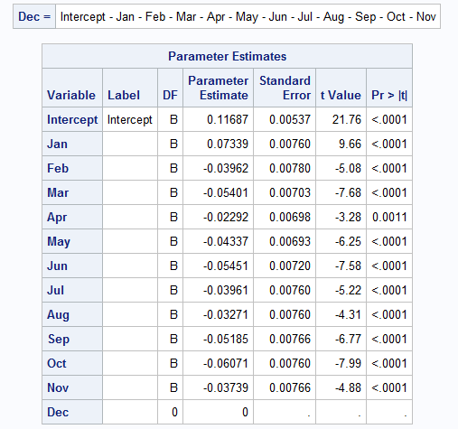
DESCRIPTIVE ANALYSIS
On Jan 10, 2022
On Jan 20, 2021

Slide 6
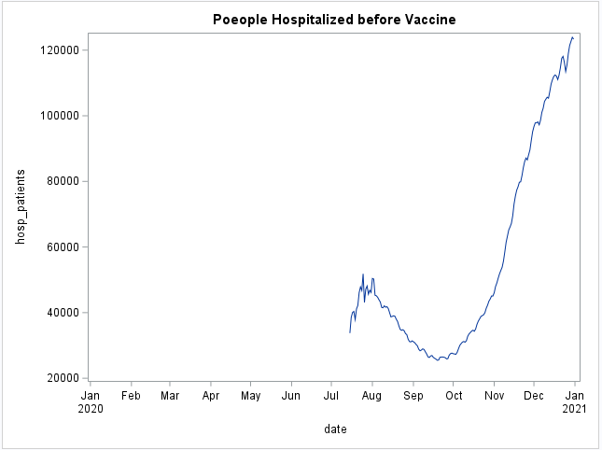
DATA VISUALIZATION
Hospitalization started after Jul 2020
Exponential Surge in Hospitalization during winter months
Lockdown gave some relief but was not enough

Slide 7
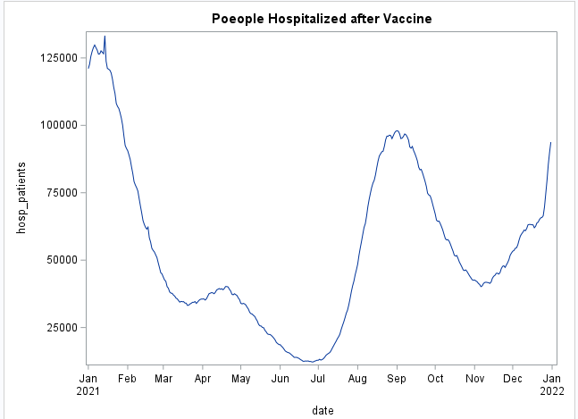
DATA VISUALIZATION
Sudden drop in hospitalization seen after the vaccine’s arrival in the USA
A new surge was observed in July 2021
A new delta variant of Coronavirus

Slide 8
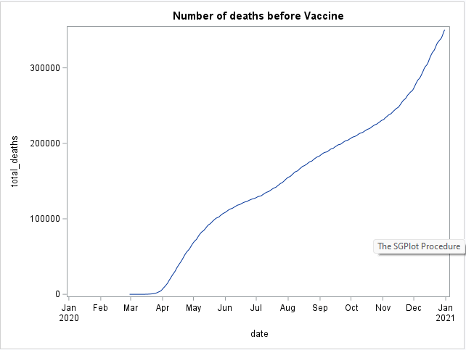
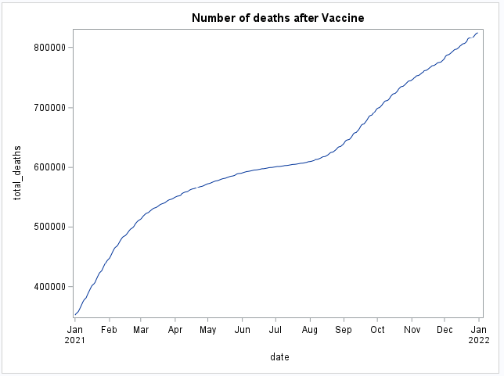
DATA VISUALIZATION
Huge surge in the number of death cases in the year 2020
Curve is almost exponential during the winter months
The curve started to flatten after the vaccine arrived
A new surge in August 2021 due to the new variant of Coronavirus

Slide 9
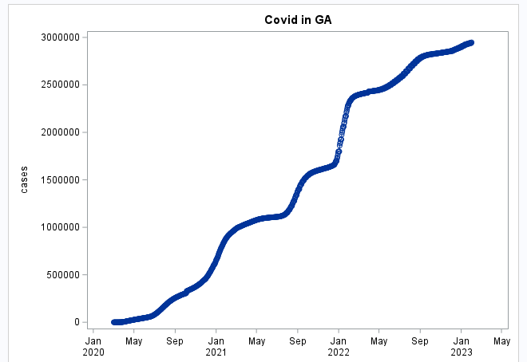
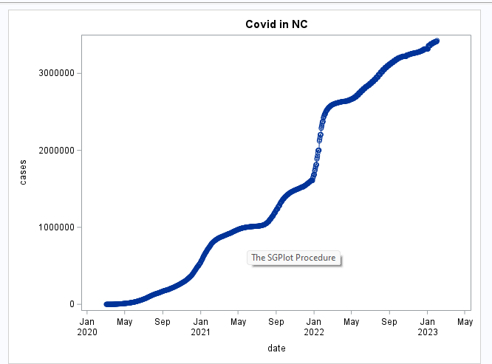
STATES COMPARISON
Georgia and North Carolina have similar population of about 10 million each
Number of report Covid cases differ significantly (2.9 million vs 3.5 million)
Our research suggested that the number of tourists had an impact of the cases
NC annual tourism stands at about 30 million compared to 10 million in GA

Slide 10
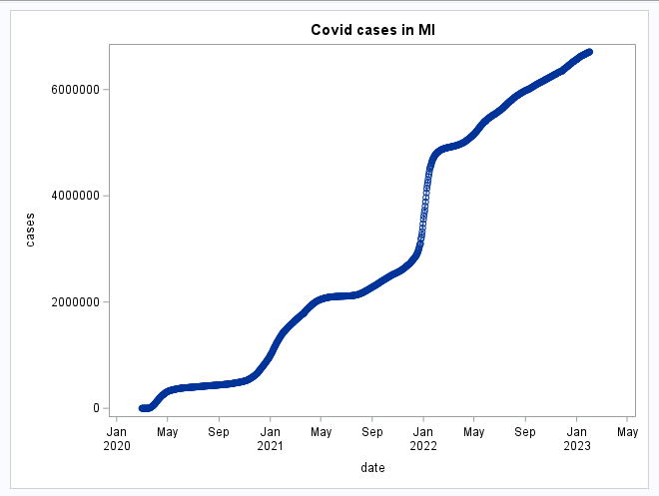
SPECIAL CASE OF MICHIGAN
MI has a population of about 10 million
Reported covid cases are over 6 million
Our Analysis shows that vaccination has significant impact on covid cases
A non-vaccinated person spreads the coronavirus 3 times more than others
MI only has 50-50% population vaccinated
Cold weather is another factor in such a huge number of cases

Slide 11
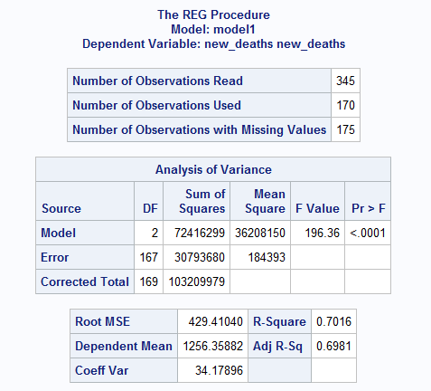
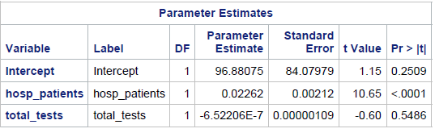
MODEL 1 ESTIMATION AND RESULTS
Model: New_deaths = β0 + β1*hosp_patients + β2*total tests
Null Hypothesis: Number of deaths are independent of number of people hospitalized and total tests
the F value 196.36 -> The model is Stat. Significant
For people hospitalized reject the null hypothesis and for numbers of tests we failed to reject the null
For every 100 people hospitalized, number of people dying from covid increases by 2.3

Slide 12
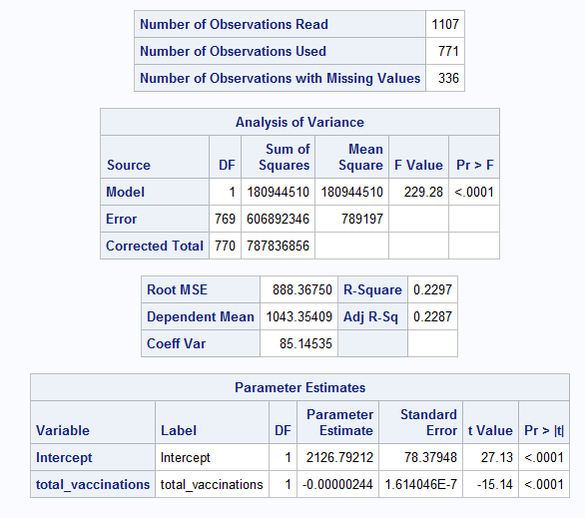
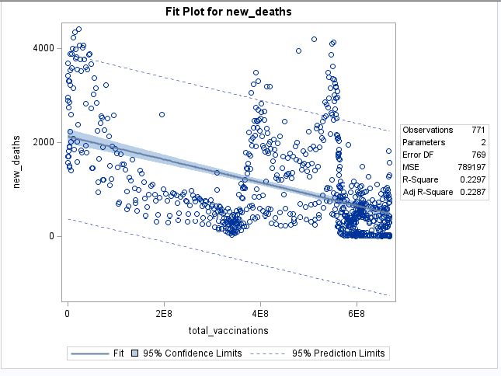
MODEL 2 ESTIMATION AND RESULTS
Model: New_deaths = β0 + β1*total_vaccinations
Null Hypothesis: Number of deaths are independent of number of people vaccinated
the F value 229.28 -> The model is Stat. Significant
p<.0001, therefore we reject the null hypothesis
Co-efficient is negative which is also reflected in the scatter plot
Coefficient value very less means we need to vaccinate lot of people to see the effect (ties into MI case)

Slide 13
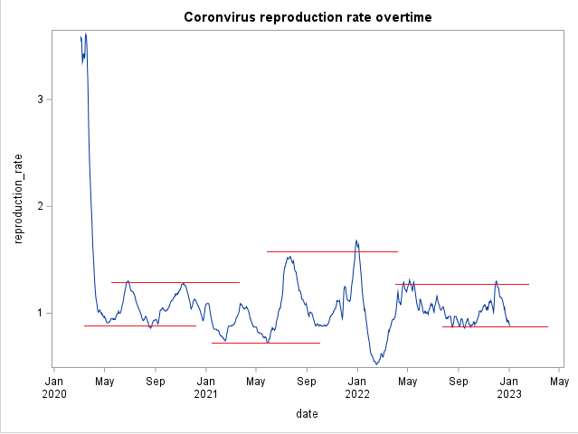
INTERESTING OBSERVATION
Reproduction rate is the average number of secondary infections produced by a single infected person
The rate exhibits stochastic behavior
We observed the similarity with the random stock price behavior with support and resistance levels
If our observations are correct, we shall see another surge in covid cases in the coming months (not desired)
Resistance
Support

Slide 14
MANAGERIAL TAKEAWAYS
Vaccination and Boosters should be available and used widely to prevent the spike in number of cases.
Proper checks should be in place for the tourist hubs.
Hospital facilities should be properly sanitized ,managed and equipped to treat covid patients.
Government restrictions for safety of people should be implemented not seasonally but throughout the end cycle of virus.

