Slide 1

PresenteD.Jayalakshmi Registerno:122204257
Username:asunm168322ugccs040
College: Government Arts & Science

Slide 2

3. End Users
Problem Statement
Project Overview
Our Solution And Proportion
Dataset Description
Modelling Approach
Results And Description
Conclusion

Slide 3

Sales Department Wise sala
calculation

Slide 4

The aim of a "Sales Department Wise” analysis is to evaluate and the performance of individual sales departments within an organi This involves examining each department's specific metrics, strat challenges to improve overall efficiency and effectiveness.

Slide 5

The inconsistent performance across sales departments is leading to suboptimal overall organizational performance and customer experi§ Specifically, some departments are underperforming compared to the targets, while others are excelling. This disparity affects overall profits resource allocation, and strategic decision-making.

Slide 6


Filtering- remove missing values
Conditional Formating-blanks
Pivot table- Summary Of The Sales Department Wise Formulas — IFS
Graphs— FINAL REPORT

Slide 7
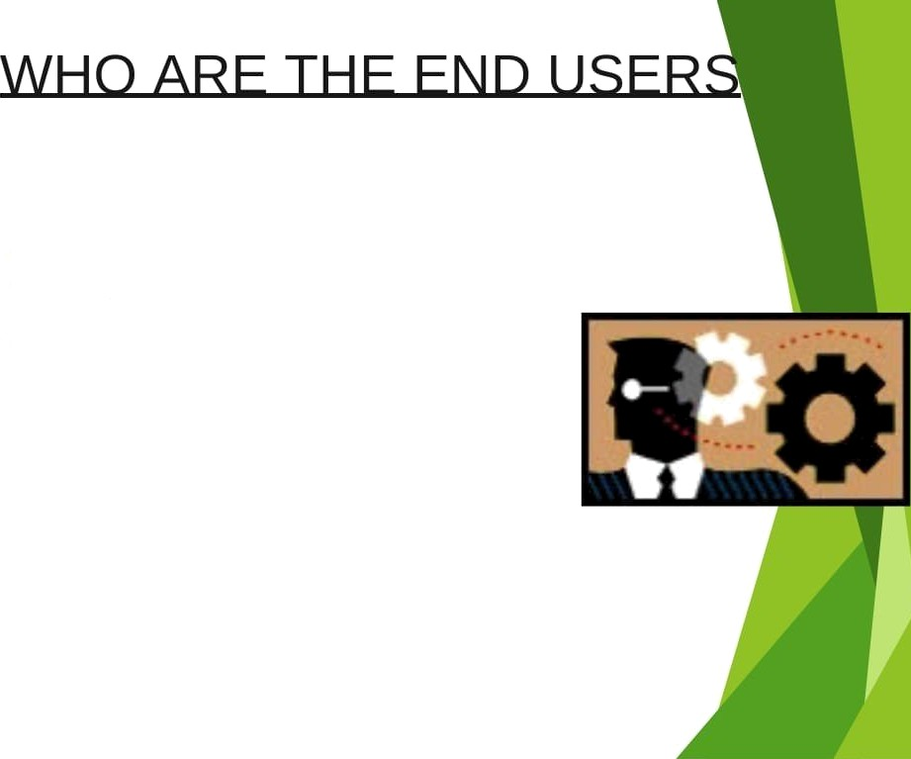
Employees
Employers
Organization
Business people

Slide 8

Seller: Salesperson's name.
Department: Department to which the salesperson belongs. Revenue: Revenue generated by the salesperson on the respective da Revenue Goal: Salesperson's revenue goal for the respective day.
Margin: Gross profit margin achieved by the salesperson on the resp§
day.
Margin Goal: Salesperson's profit margin goal for the respective day. Date: Date on which the sales were recorded.
Sales Quantity: Number of customers who actually made a purchase
Customers: Total number of customers served.

Slide 9

Date Set: Kaggle, Sales Department Wise Feature Selection:
Data Cleaning: Missing Values Irrelevant
Formula: Performance Calculation, Low, Med, High
Pivot Table: Summary, Business Unit, Gender , Employment Type, EQ Id, Performance
Chart Report: Slicer

Slide 10
SALES
Employee type
Fixed Term A
Accounting BuslnessDevelopment Englneering HumanResources
B 210,O26.99
In 282,340.75
B 183,397.77
IB 338,51B.BS
Marketing
Product Management Research and Development
Sales Services Support Training
B 31,816.57
IB 2B1,368.42
B 99,683.67
Iz 84,598.88
BI 1ZZ,134.11
B 299,127.31
B 499,439.95

Slide 11

The sales department's performance has been instrumental i our company's growth and profitability. Each team within thd department has demonstrated strengths in various areas customer acquisition to account management and strategic sale initiatives. The analysis reveals that while there have been nota’ successes there are also areas requiring improvement.
To sustain and build on our successes it is essential to address identified challenges and leverage the opportunities for grown Enhancing training programs, optimizing sales processes at increasing cross-departmental collaboration will be critical achieving our sales targets and improving overall performa

