Slide 1
PYTHON
By Neil Gogte

Slide 2
Python is a general-purpose high-level programming language. Its design philosophy emphasizes code readability.
Python claims to "combine remarkable power with very clear syntax", and its standard library is large and comprehensive.
Its use of indentation for block delimiters is unusual among popular programming languages.

Slide 3
Python supports object-oriented programming, but do not force the use of object-oriented features.
Like other dynamic languages, Python is often used as a scripting language.
Python allows you to split up your program in modules that can be reused in other Python programs.
Python is an interpreted language, which can save your considerable time during program development because no compilation and linking are necessary.

Slide 4
Python allows writing very compact and readable programs. Programs written in Python are typically much shorter than equivalent C or C++ programs, for several reasons:
the high-level data types allow you to express complex operations in a single statement
statement grouping is done by indentation instead of beginning and ending brackets
no variable or argument declarations are necessary

Slide 5
Applications of Python
GUI-Based Desktop Applications
Web Frameworks and Web Applications
Enterprise and Business Applications
Prototyping

Slide 6
Comments and Literals
Comments: Any text to the right of # symbol is mainly used as notes for the readers.
Statements on right side of # doesn’t get executed. It gives us more information about function
Bulk Comments: Enclose the code in triple quoted strings(“””)
#Comment
‘ ‘ ‘
Bulk Comments
Multiline Comments
‘ ‘ ‘

Slide 7
Taking input()
Developers often have a need to interact with users, either to get data or to provide some sort of result.
Python provides us with inbuilt function to read the input from the keyboard.
input ( prompt )

Slide 8
How the input function works in Python
When input() function executes program flow will be stopped until the user has given an input.
The text or message display on the output screen to ask a user to enter input value is optional i.e. the prompt, will be printed on the screen is optional.
Whatever you enter as input, input function convert it into a string. if you enter an integer value still input() function convert it into a string.
You need to explicitly convert it into an integer in your code using typecasting.

Slide 9
typecasting
The process of converting one data type to another data type is called Typecasting
Ex:
a = int(input())
b=float(input())

Slide 10
Printing Output
We use the print() function to output data to the standard output device (screen).
Syntax of print function
print(*objects, sep=' ', end='\n', file=sys.stdout, flush=False)
Here, objects is the value(s) to be printed.
The sep separator is used between the values. It defaults into a space character.
After all values are printed, end is printed. It defaults into a new line.
The file is the object where the values are printed and its default value is sys.stdout (screen).

Slide 11
type() method
type() method returns class type of the argument(object) passed as parameter.
It is mostly used for debugging purposes.
Two different types of arguments can be passed to type() function
Syntax :
type(object) - returns the type of the object.
type(name, bases, dict) - used to create a class dynamically on the fly.

Slide 12
type() method
type(object):
When a single argument is passed to the type() function, it returns the type of the object.
Example:
x = 10
print(type(x))
s = 'abc'
print(type(s))
Output:
<class 'int'>
<class 'str'>

Slide 13
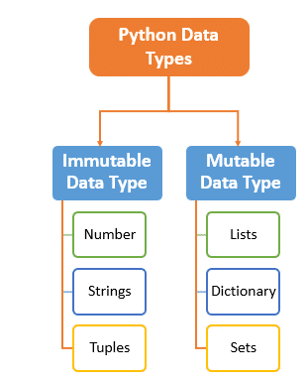
Data Types
Type represents the kind of value and determines how the value can be used.
Everything in Python is an object and every object has an identity, a type, and a value.

Slide 14
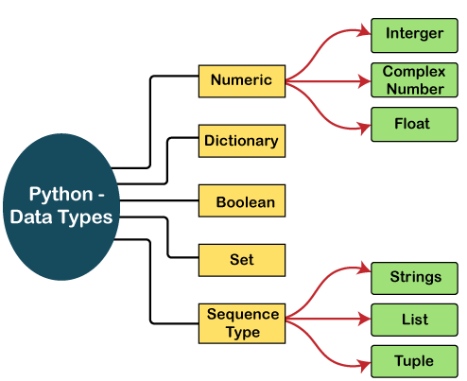
Data Types

Slide 15
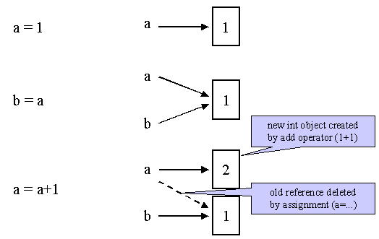
id() method
When an object is instantiated, it is assigned a unique object id.
The built-in function id() returns the identity of an object as an integer.

Slide 16
Strings
In Python, Strings are arrays of bytes representing Unicode characters.
Python does not have a character data type, a single character is simply a string with a length of 1.
Strings can be enclosed in single quotes or double quotes.
str_val=‘kmit’
str_val=“k”

Slide 17
String indexing
H | E | L | L | O
0 | 1 | 2 | 3 | 4
-5 | -4 | -3 | -2 | -1
Square brackets can be used to access elements of the string.
a = "Hello, World!” Output: e print(a[1])

Slide 18
Substrings/Slicing
In python substring is a sequence of characters within another string, In python, it is also referred to as the slicing of string.
Slicing Strings in Python:
string[start: end: step]

Slide 19
Template
Template | Description
string[start:end] | Get all characters from index start to end-1
string[:end]: | Get all characters from the beginning of the string to end-1
string[start:] | Get all characters from index start to the end of the string
string[start:end:step] | Get all characters from start to end-1 discounting every step character

Slide 20
index() and find()
The index() and find() methods finds the first occurrence of the specified value.
The index() method raises an exception if the value is not found.
The find() method returns -1 if the value is not found.
Syntax:
string.index(value, start, end)
string.find(value, start, end)

Slide 21
index() and find()
The rindex() and rfind() methods finds the last occurrence of the specified value.
If the value is not found, the rfind() method returns -1,
rindex() method will raise an exception.

Slide 22
replace()
replace() is an inbuilt function in Python programming language that returns a copy of the string where all occurrences of a substring is replaced with another substring.
Syntax:
string.replace(old, new, count)
old – old substring you want to replace.
new – new substring which would replace the old substring.
count – the number of times you want to replace the old substring with the new substring. (Optional )

Slide 23
Repetition
Repetition - Creates new strings, concatenating multiple copies of the same string
Example:
a*2 will give -HelloHello

Slide 24
Splitting, Concatenating, and Joining
The split() method breaks up a string at the specified separator and returns a list of strings.
Syntax:
str.split([separator [, maxsplit]])
separator (optional)- It is a delimiter. The string splits at the specified separator.
maxsplit (optional) - The maxsplit defines the maximum number of splits.
If maxsplit is specified, the list will have the maximum of maxsplit+1 items.
Return: list of strings.

Slide 25
Splitting, Concatenating, and Joining
Method Name | Description
rsplit | splits a string into a list, starting from the right.
splitlines() | splits a string into a list. The splitting is done at line breaks.

Slide 26
Splitting, Concatenating, and Joining
Concatenation - Adds string values
Example:
a=‘Hello’
b=‘Python’
a + b will give HelloPython
join(): function to join a list of strings. This function takes iterable as argument
Syntax:
string.join(iterable)
iterables: List, Tuple, String, Dictionary and Set.

Slide 27
methods
isalpha(): returns True if all the characters are alphabet letters (a-z).
isdigit():returns True if all characters in the string are digits.
isalnum(): Check if all the characters in the text is alphanumeric.

Slide 28
eval()
eval() dynamically evaluate expressions from a string-based or compiled-code-based input.
To evaluate a string-based expression, Python’s eval() runs the following steps:
Parse expression
Compile it to bytecode
Evaluate it as a Python expression
Return the result of the evaluation

Slide 29
str(),repr() and zfill()
Both str() and repr() methods in python are used for string representation of a string.
The zfill() method returns a copy of the string with '0' characters padded to the left.
Syntax:
str.zfill(length)
The length specifies the length of the returned string from zfill() with 0 digits filled to the left.

Slide 30
rjust()
The rjust() method will right align the string, using a specified character (space is default) as the fill character.
Syntax:
string.rjust(length, character)
length: The value of the length provided is basically used to justify the string of the given length.
fill_char: This is an optional parameter. These are the characters that needs to be padded around the string.

Slide 31
format()
This method lets us concatenate elements within a string through positional formatting.
Syntax : { } .format(value)
parameters : (value) : Can be an integer, floating point numeric constant, string, characters or even variables.
return-type : returns a formatted string with the value passed as parameter in the placeholder position.

Slide 32
format()
what if you want to specify precision in floating point number?
Syntax:
{[argument_index_or_keyword]:[width][.precision][type]}
Format codes | Description
d | for integers
f | for floating point numbers
b | for binary numbers
o | for octal numbers
x | for octal hexadecimal numbers
s | for string
e | for floating point in exponent format

Slide 33
fstrings
Also called “formatted string literals”
f-strings are string literals that have an f at the beginning and curly braces containing expressions that will be replaced with their values.
The expressions are evaluated at runtime

Slide 34
abs()
The abs() function is used to return the absolute value of a number.
Syntax:
abs(number)
number : Can be integer, a floating point number or a complex number

