Slide 1

If you are setting up your Windows computer for the very first time, you should decide what type of user account you will use. You will need some account, a username and a password which you will use each time you sign into your computer.

Slide 2
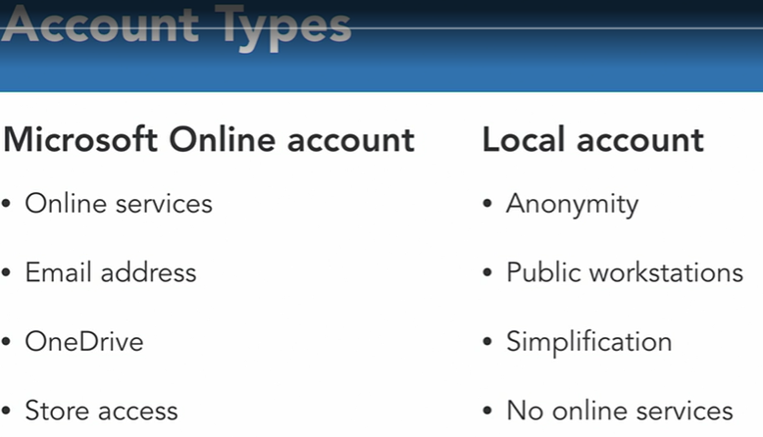
When using a windows computer, a Microsoft online account is required to make purchases in the Microsoft app store. It's also required to use some features of the bundled apps and services in windows. This is the option that Microsoft recommends for computers being used by individual people. Now, the other option is to set up a basic username and password that is used to sign into your computer, but has no connectivity or identity with Microsoft's online services. This is also known as a local account.

Slide 3
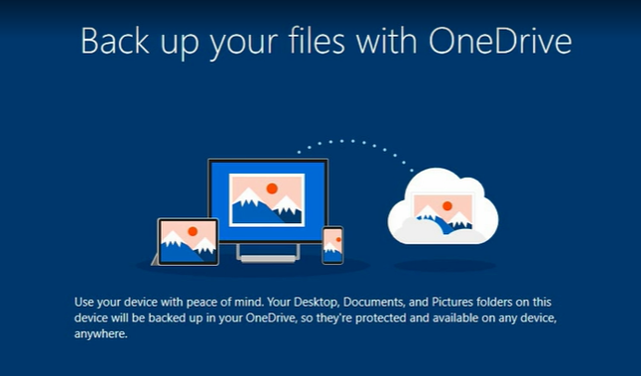
This will only be here if you sign in to your computer with a Microsoft online account. OneDrive is an online storage tool.

Slide 4
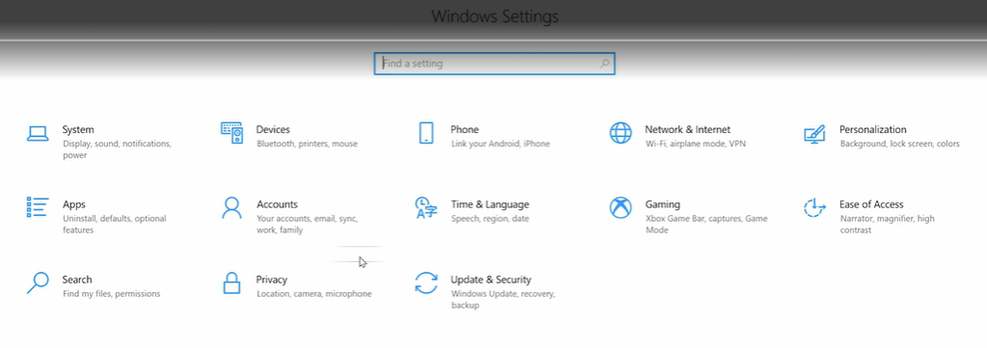
Adjust system settings
Selecting transcript lines in this section will navigate to timestamp in the video - [Instructor] Settings is a tool in Windows where you can set some global preferences for the way things work on your computer. And it's something we will revisit constantly through this course. To get the settings, We'll need to go to the start menu. So I'll click the Start button and the bottom left corner to open the menu, then I'm looking for this button with a gear on it, click on that to open settings. And there are lots of options for things that you may need to adjust on your computer, and they're organized here by these categories.

Slide 5
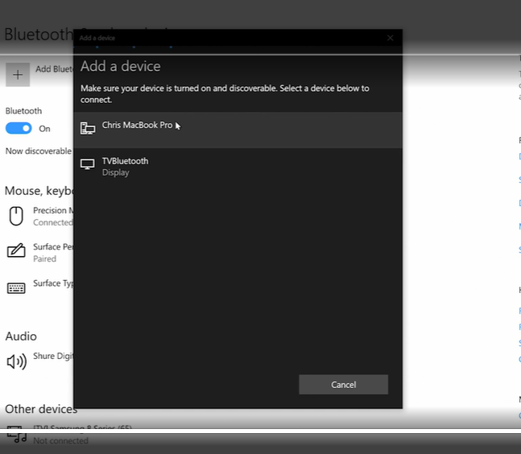
Most wireless accessories work with a system called Bluetooth. There are some devices that work differently, but for what we're doing here, you need a device that lists the Bluetooth feature on the box. And this process is called pairing. Check your device for a pairing button or a discoverable button. Usually, you turn on your device, then press or hold that button to put your device into the pairing mode.

Slide 6
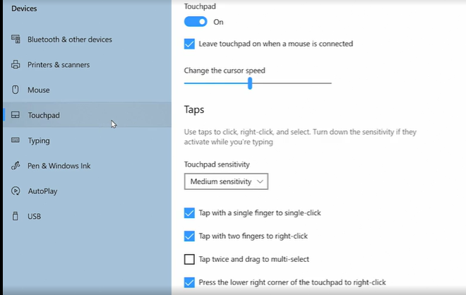
Mouse and trackpad options
Selecting transcript lines in this section will navigate to timestamp in the video - Using a modern mouse or touchpad to point and click on something is pretty standard, but most modern mice and touchpads have more functionality. First, let's see the right-click. Most mice have two buttons, one on the right, one on the left. If you have that, then clicking the button on the left is the primary click, the main action that you use to select or drag something.

Slide 7
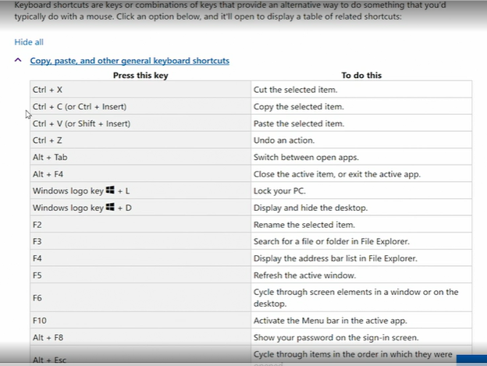
Use keyboard shortcuts
Let's talk about keyboard commands. These are actions that you can trigger using a few keys on the keyboard.

Slide 8
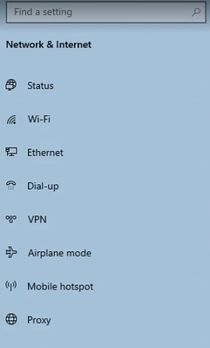
Connecting to the internet
To get to our network set up, we'll go into settings, inside of settings we'll go to the category for network and internet will work here, but you may also have a button in the task bar as a shortcut to some of these options. And I want to keep an eye on this button because it will change depending on your network setup. Now, most computers connect to a network either through ethernet, which is a cable or wifi which is a wireless connection.

Slide 9
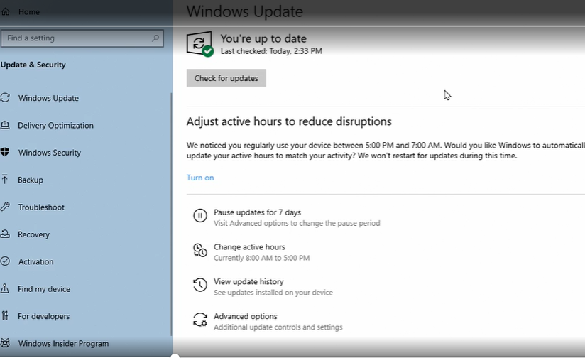
Update Windows 10
To see your update options, you'll need to go to Settings. So I'll go into the Start menu, click the gear button to go into Settings, then I'll go to the category for Update & Security. On the left side, I want to make sure the sub-category labeled Windows Update is selected. Now this may show a list of available updates that have not yet been installed, or you can click this button to check for updates now

Slide 10
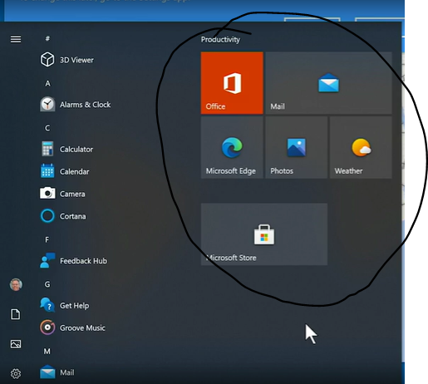
Launch applications from the Start menu or taskbar
To work with a program in Windows, you need to launch it or open it or start it up. However you want to say it. I'll show you the three most common ways to launch applications. And we'll start with the start menu. So I'll click the Start button down in the bottom left corner.
One more option, in the task bar at the bottom of the screen, you should see this cluster of buttons. You see the applications that are currently open but there are a few that will stay there all the time.

Slide 11
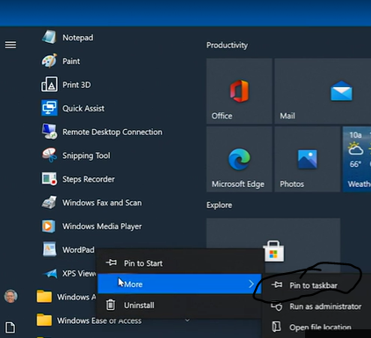
Customize the Start menu and taskbar
For example, I use an application called WordPad. I'm going to scroll through my list of all the applications but it's a little buried. I have to go to this Windows accessories folder and then I can find it there. To make it easier to access, I'm going to pin it to the task bar. So I'll right click on it, go to more and choose pin to task bar. So now I have this icon in the task bar and whenever I need that application, I can just click that to launch it.

Slide 12
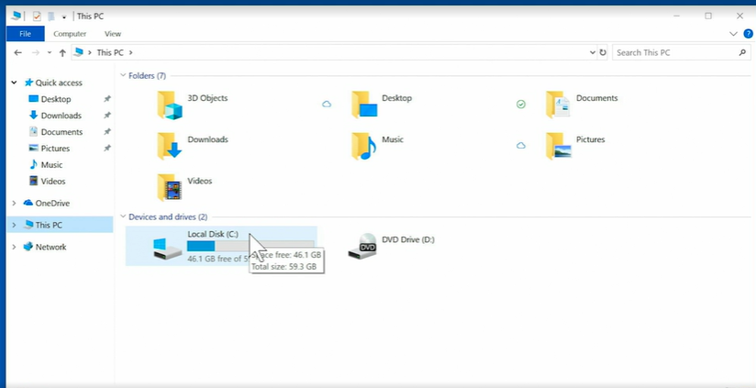
Browse through folders
Most people store documents, pictures, and other types of files on the hard drive of their computer, like a filing cabinet that you might have in your office. File Explorer is the tool that you use to browse through those files and folders.

Slide 13
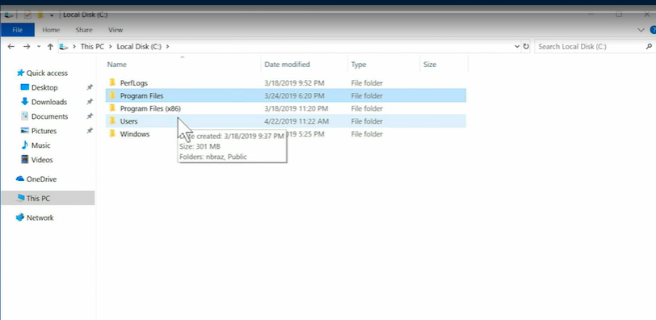
Essential folder structure, including the user folder
Before you start to store and organize your own files, it's important to understand the folder structure that already exists in Windows, so you can work within that established organization. So, I'm going to open file explorer. I'll go to this PC and I want to open up my main storage drive the C drive, so I'll double click on that.

Slide 14
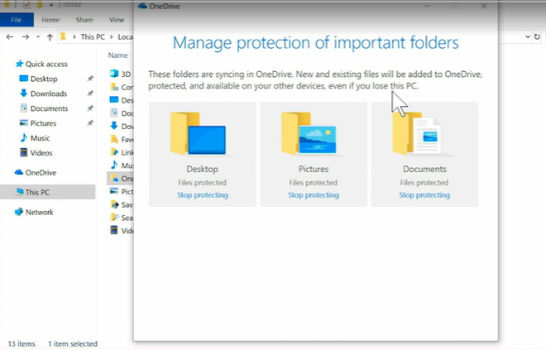
If one or more of these three folders, are set to be protected by OneDrive, then those shortcuts in the sidebar, will lead to the version of that folder, on your OneDrive. They say these folders are protected, because everything you put in those folders, is stored on your system drive and is also automatically uploaded to OneDrive, essentially creating an instant backup.

