Slide 1
Pneumonia Detection Using Chest X-rays
Team Members:- Panel Number:18
Project Advisor: Mr. Baskar A / Asst. Professor/ CSE
S.No | Reg.No | Name of the Student | Section
1 | CB.EN.U4CSE17265 | Madhav Vempaty | CSE C
2 | CB.EN.U4CSE17363 | T Jaya Bharath Reddy | CSE D
3 | CB.EN.U4CSE17617 | C Sai Teja | CSE F
4 | CB.EN.U4CSE17665 | T Srinivasa Manoj Reddy | CSE F

Slide 2
Problem Definition
To analyse and classify the given Chest X-ray image into Pneumonia or not.

Slide 3
Literature Survey
•[1] MENGJIE HU , HEZHENG LIN, ZIMENG FAN, WENJIE GAO, LU YANG , CHUN LIU , AND QING SONG Pattern Recognition and Intelligent Vision Laboratory, Beijing University of Posts and Telecommunications, Beijing 100876, China Corresponding author: Qing Song (priv@bupt.edu.cn)
•[2] Mohammad Farukh Hashmi 1,† , Satyarth Katiyar 2,†, Avinash G Keskar 3,† , Neeraj Dhanraj Bokde 4,† and Zong Woo Geem 5,*
•[3] Anunay Gupta a , Anjum b , Shreyansh Gupta c , Rahul Katarya b,∗ a Department of Electrical Engineering, Delhi Technological University, New Delhi, India

Slide 4
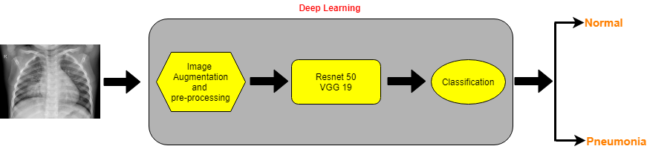
Architecture diagram
Figure: Schematic representation of Chest X-ray classification into Normal or Pneumonia

Slide 5
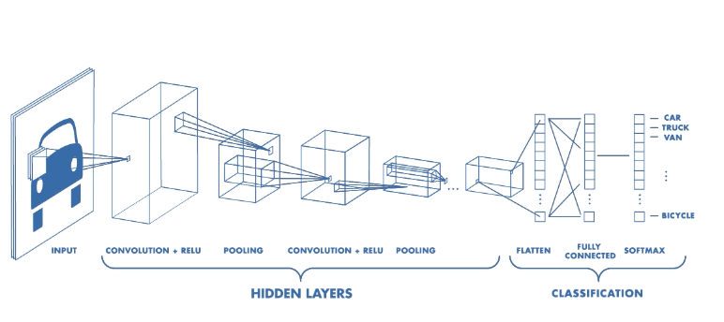
CNN Architecture

Slide 6
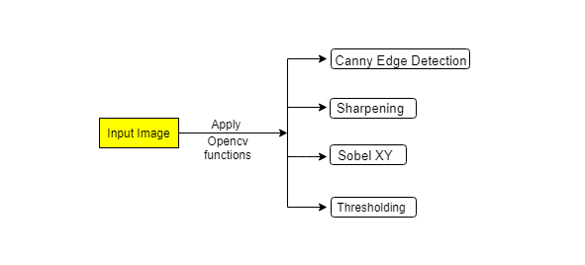
System Design
Image Processing:

Slide 7
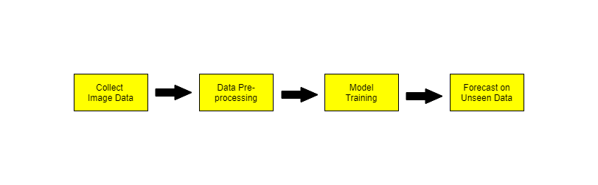
Deep Learning:-

Slide 8
Important Modules
S. NO. | MODULES
1 | Data Collection
2 | Image Processing & Data Augmentation
3 | Implement Architecture & Create data generators
4 | Train the Model by defining loss function & callbacks
5 | Test the Model on Unseen data

Slide 9
Modules Implemented in this review
S. NO. | MODULES
1 | Data Collection
2 | Image Processing & Data Augmentation
3 | Implement Architecture & Create data generators
4 | Training is under progress

Slide 10
Dataset
Link: https://www.kaggle.com/paultimothymooney/chest-xray-pneumonia
File Format: Images (.JPEG)
The dataset is organized into 3 folders (train, test, val) and contains subfolders for each image category (Pneumonia/Normal). There are 5,863 X-Ray images (JPEG) and 2 categories (Pneumonia/Normal).

Slide 11
Preprocessing

Slide 12
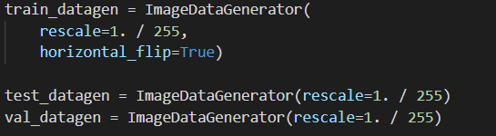
Image Data Augmentation
Rescaling:
To reduce the complexity during 3 (training, validation & testing) phases, we have divided the image with 255, this transfers all the image pixels from range [0, 255] to [0, 1].

Slide 13
Image Data Augmentation
Horizontal Flip:
We also did horizontal flipping of images during training, to make the model learn output even if the image is horizontally flipped.

Slide 14
Exploratory Data Analysis

Slide 15
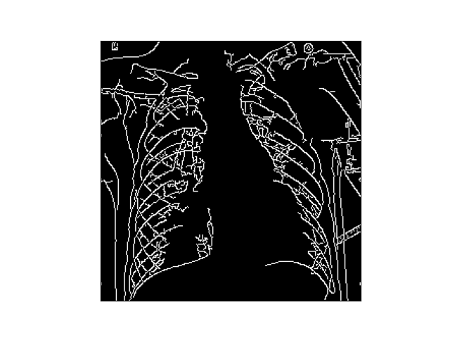
Canny Edge Detection:
Canny edge detector detects the edges in the image.

Slide 16
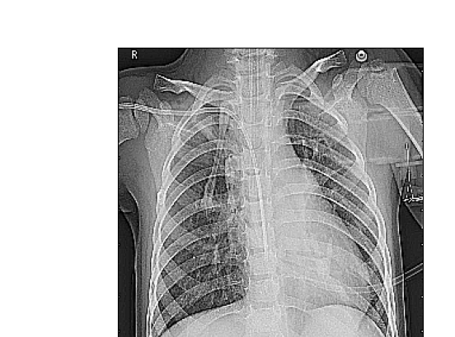
Sharpening:
This will sharpen the edges in the image.
This filter is very useful when we want to enhance the edges in an image

Slide 17
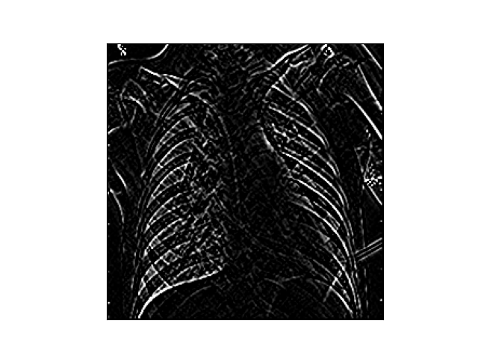
Sobel XY:
The Sobel filter is also used for edge detection.
It works by calculating the gradient of image intensity at each pixel within the image.

Slide 18
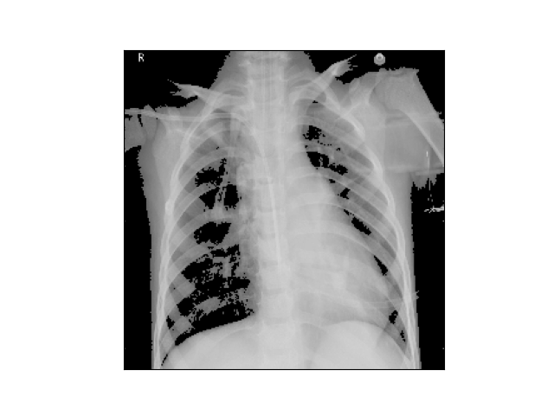
Blur using Thresholding:
Image thresholding is a simple form of image segmentation.
It is a way to create a binary image from a grayscale or full-color image.
This is typically done in order to separate "object" or foreground pixels from background pixels

Slide 19
Implementation of DL Models

Slide 20
DL models
ResNet50
ResNet-50 is a 50 layers deep CNN. You can load a pre trained network trained on more than a million images from the ImageNet database.
The pretrained network can classify images into 1000 object categories, such as Cat, Cow, Dog, Pen and many more..
As a result, the network has learned rich feature representations for a wide range of images. The network has an image input size of 224-by-224.

Slide 21
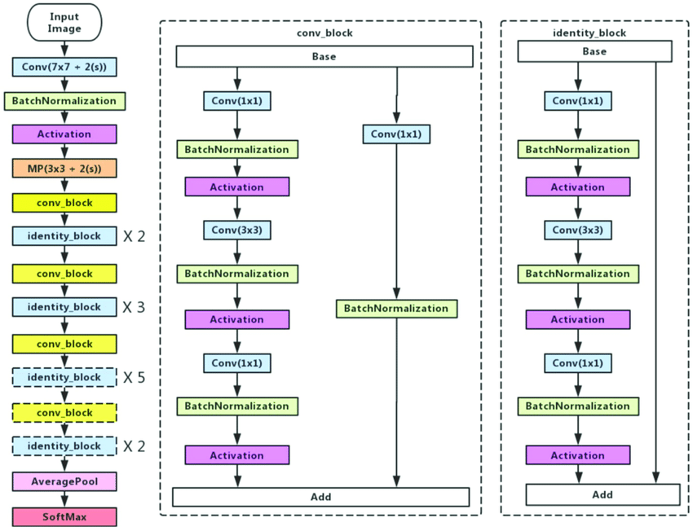
Structure of Resnet50

Slide 22
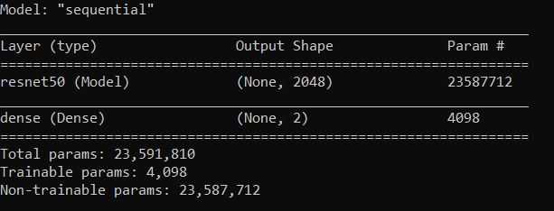
Resnet50 Model Summary:

Slide 23
Training Phase:

Slide 24
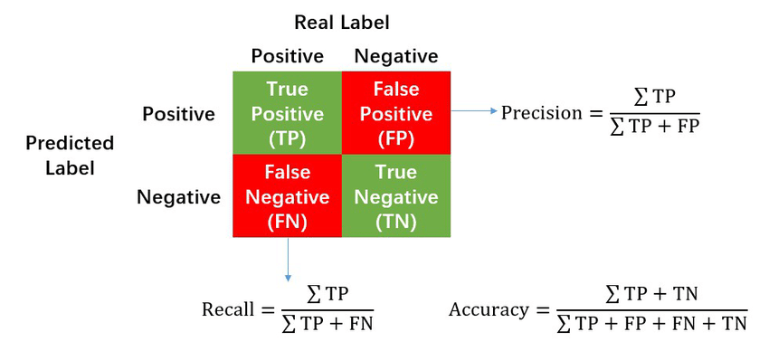
Accuracy

Slide 25
Project Plan
Month | Plan
Jan | Literature survey on past research papers
Feb (Before Review 2) | Preprocessing Exploratory Data Analysis Implementation of ML/DL Models till training phase
March (Before Review 3) | Implementation of ML/DL Models Model Evaluation Compare Results of Model
We’re currently here

Slide 26
Conclusions
We’re in process of classifying chest xray image to detect whether a person has pneumonia or not.

Slide 27
References ( in IEEE format )
•[1] MENGJIE HU , HEZHENG LIN, ZIMENG FAN, WENJIE GAO, LU YANG , CHUN LIU , AND QING SONG Pattern Recognition and Intelligent Vision Laboratory, Beijing University of Posts and Telecommunications, Beijing 100876, China Corresponding author: Qing Song (priv@bupt.edu.cn)
•[2] Mohammad Farukh Hashmi 1,† , Satyarth Katiyar 2,†, Avinash G Keskar 3,† , Neeraj Dhanraj Bokde 4,† and Zong Woo Geem 5,*
•[3] Anunay Gupta a , Anjum b , Shreyansh Gupta c , Rahul Katarya b,∗ a Department of Electrical Engineering, Delhi Technological University, New Delhi, India

Slide 28
Code References (links)
https://pablormier.github.io/2017/09/05/a-tutorial-on-differential-evolution-with-python/
https://machinelearningmastery.com/a-tour-of-machine-learning-algorithms/

Slide 29
THANK YOU

