Slide 1
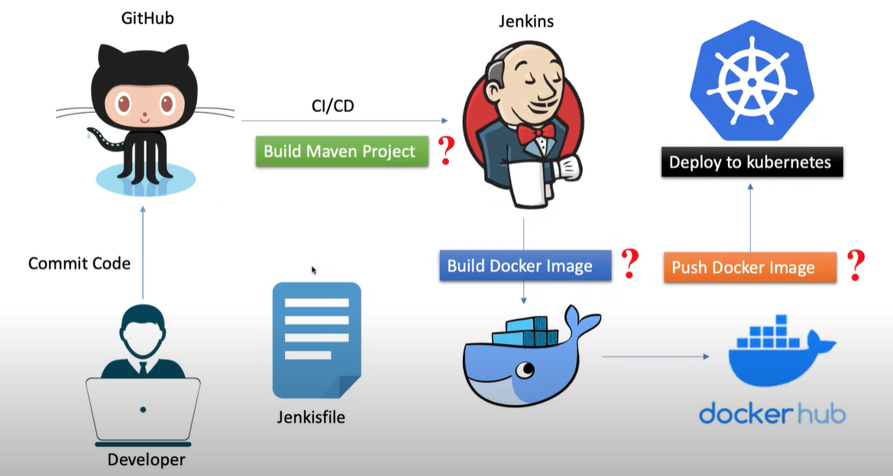
Automating ML Model Deployment with Docker, Kubernetes, and Jenkins

Slide 2
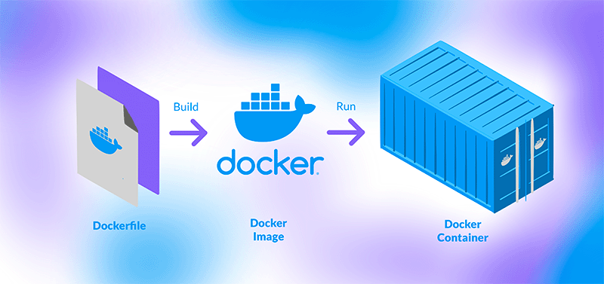

Slide 3
What is Docker?
Docker is an open-source platform that allows you to develop, ship, and run applications inside lightweight, portable containers..
Containers ensure that the application runs consistently across different environments.
Why Use Docker?
Portability: Run containers on any machine without worrying about dependencies.
Isolation: Separate application environments for better control and security.
Version Control: Easily manage application versions.

Slide 4
Basic Docker Commands
To view all the images : docker image ls
To build the image: docker build -t firstdocker .
To see the container: docker ps -a
To run the docker: docker run firstdocker
To stop the container:docker stop (container ID)
To remove the container/image: docker rm (container id/image)

Slide 5
FROM openjdk:8-jre-slim-buster
# Install Python and pip
RUN apt-get update && \
apt-get install -y python3 python3-pip && \
rm -rf /var/lib/apt/lists/*
# Install PySpark
RUN pip3 install pyspark==3.2.1
RUN pip3 install findspark
RUN pip3 install numpy
# Set the working directory
WORKDIR /app
# Copy the PySpark application code into the container
COPY forecastTflMl.py .
# Set the entrypoint
CMD ["spark-submit", "--master", "local[*]", "forecastTflMl.py"]

Slide 6

Kubernetics

Slide 7
What is Kubernetes?
Title: "What is Kubernetes?"
Bullet Points:
Kubernetes is a container orchestration platform used for automating the deployment, scaling, and management of containerized applications.
It allows you to deploy your Docker containers at scale and manage their lifecycle.
Why Use Kubernetes?
Automated container deployment and scaling.
High availability and fault tolerance.
Load balancing across multiple containers.

Slide 8
apiVersion: batch/v1
kind: Job
metadata:
name: tflkubeml
spec:
template:
spec:
initContainers:
- name: delete-models-directory
image: busybox:1.35 # Using a lightweight image to run the deletion command
command: ['sh', '-c', 'rm -rf /opt/spark-app/models/*'] # Command to delete the contents of the directory
volumeMounts:
- name: models-volume
mountPath: /opt/spark-app/models # Mount the volume at the location
containers:
- name: pysparkml
image: uttamraj9/tflkubeml:latest
volumeMounts:
- mountPath: /opt/spark-app/models # Container path where the models will be mounted
name: models-volume # Name of the volume to mount
restartPolicy: Never
volumes:
- name: models-volume
hostPath:
path: /var/lib/jenkins/workspace/TfLKubeMl/kubemlPr/ # Path on the host machine
type: Directory # Specify the type as Directory to ensure it's a directory mount
backoffLimit: 4

Slide 9
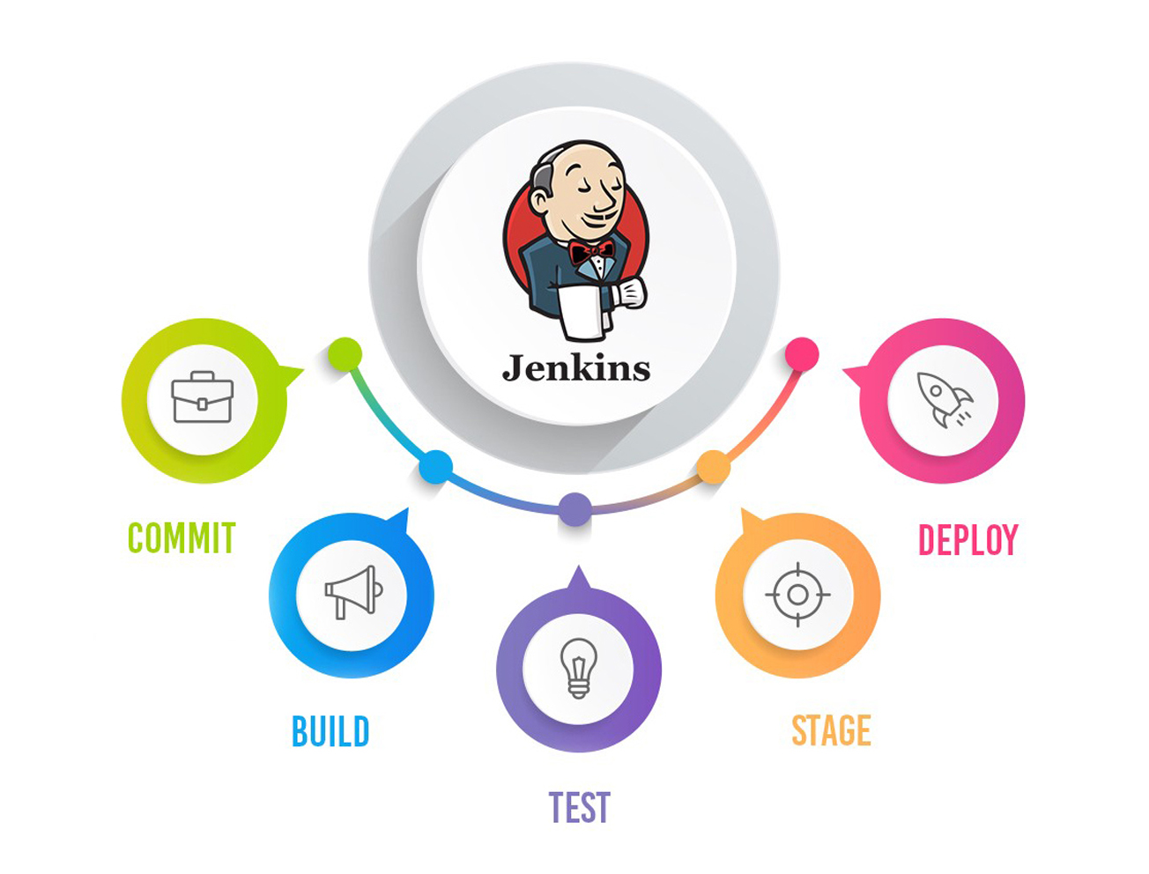

Slide 10
What is Jenkins?
Jenkins is an open-source automation server that automates tasks in the software development lifecycle.
Why Use Jenkins?
Automates the build, test, and deployment process.
Supports CI/CD pipelines for continuous integration and delivery.
Enables easy integration with Docker and Kubernetes.

Slide 11
Jenkins Pipeline for ML Model Deployment
Pipeline Stages:
Clone Repository: Retrieves the ML code from GitHub.
Build Docker Image: Uses Docker to create an image for the ML model.
Push Image to Docker Hub: Pushes the Docker image to Docker Hub.
Deploy to Kubernetes: Deploys the Docker container using Kubernetes.
This pipeline automates the entire ML model deployment process.

Slide 12


