Slide 1
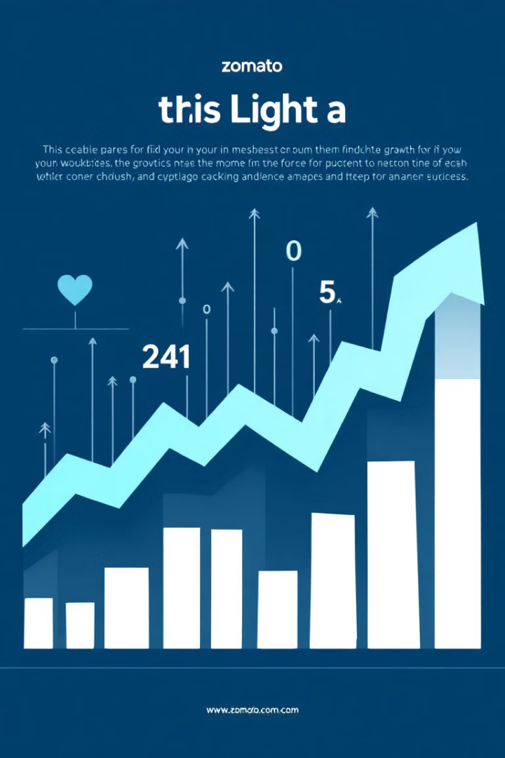

Zomato Data Analysis Project
Welcome to our Zomato data analysis project. Our team of six talented individuals has leveraged various tools to uncover valuable insights from Zomato's extensive restaurant database.
--SHERI CHANDRAKANTH REDDY
--BELE ATHARVA SUNIL
--JAYA KAVYASUNDAR
--NIRMALA DEVI
--SOUBAN ZAINUDDIN
--VIJAY LAXMAN KAMBLE
Sr

Slide 2
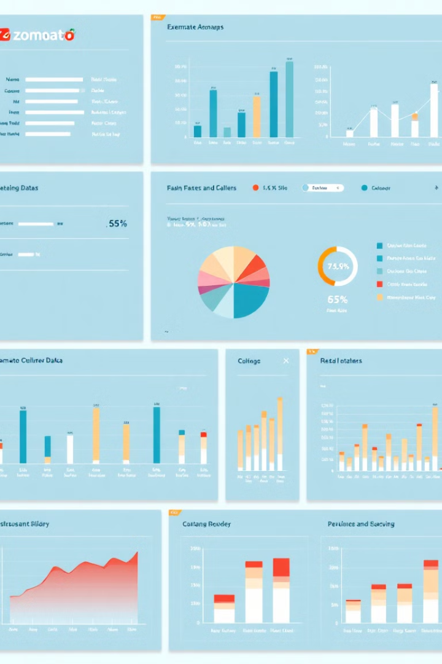
Excel Analysis: Global Restaurant Landscape
1
Restaurant Count
We analyzed 9,551 restaurants across multiple countries, with India leading in restaurant density.
2
Cuisine Insights
North Indian cuisine emerged as the most popular, reflecting regional preferences.
3
Online Delivery
26% of restaurants offer online delivery, indicating room for growth in this sector.

Slide 3
Power BI: Restaurant Deep Dive
Restaurant Metrics
City-wise Distribution
Cuisine Variety
1,022 restaurants analyzed across 15 countries and 73 cities, offering 154 cuisine types.
New Delhi leads in restaurant count, showcasing the capital's vibrant food scene.
North Indian and Chinese cuisines dominate, reflecting global culinary preferences.

Slide 4
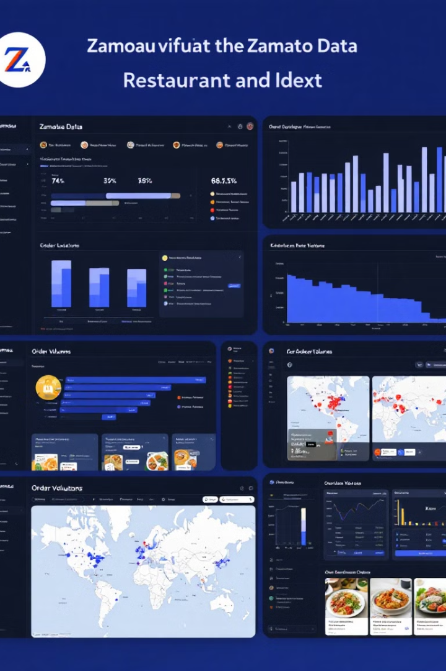

Tableau: Customer Experience Insights
1
Booking and Delivery
12% of restaurants offer booking services, while 26% provide delivery options.
2
City-wise Analysis
New Delhi, Gurgaon, and Noida emerge as restaurant hotspots in the dataset.
3
Cost Trends
Average dining costs fluctuate seasonally, providing insights for pricing strategies.

Slide 5

MySQL: Precision Data Extraction
Query Type
Example
Benefit
Rating Filter
SELECT * FROM restaurants WHERE rating > 4.5
Identify top-performing restaurants
Cuisine Analysis
SELECT cuisine, COUNT(*) FROM restaurants GROUP BY cuisine
Understand cuisine distribution
City-wise Metrics
SELECT city, AVG(rating) FROM restaurants GROUP BY city
Compare performance across cities

Slide 6




Project Insights and Future Applications
Key Findings
Identified popular cuisines, city-wise distribution trends, and customer preferences for services.
Skill Development
Mastered data preparation, interactive visualization, and advanced querying techniques across multiple platforms.
Future Applications
Our insights can guide Zomato's expansion strategies, menu optimization, and service improvements.

