Slide 1
Cognizance
Task-1
by
Jaya Krishna

Slide 2
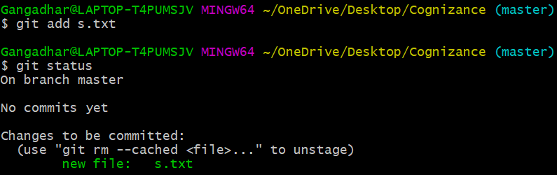
Add

Slide 3
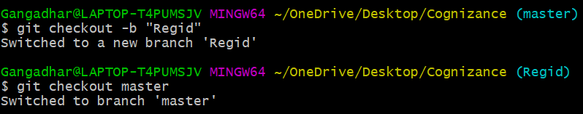
Checkout –b and checkout

Slide 4
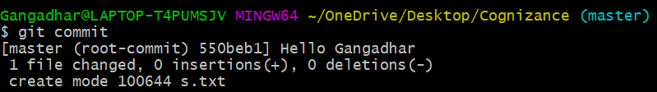
Commit

Slide 5
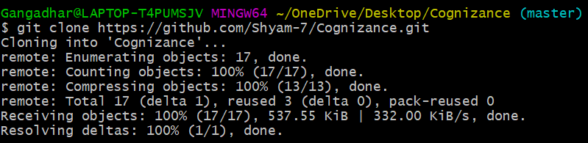
Clone

Slide 6
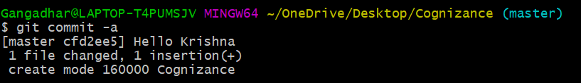
Commit -a

Slide 7
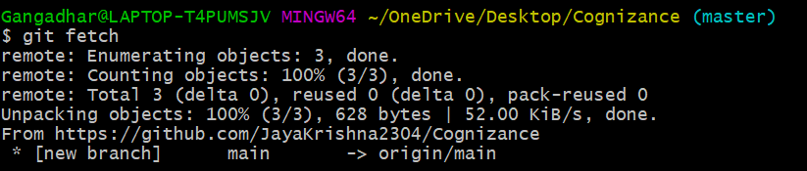
Fetch

Slide 8
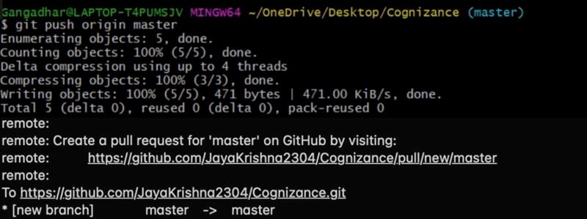
push

Slide 9
Merge

Slide 10
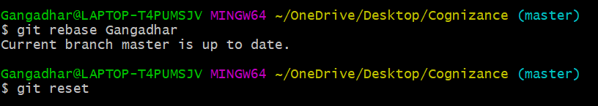
Reset and rebase

Slide 11
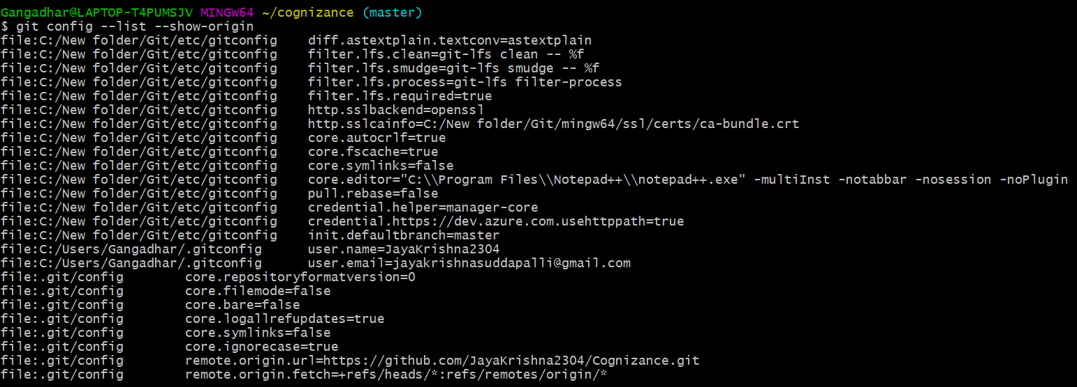
Git config –list--show-origin

