Slide 1


6th SEMESTER
DEPARTMENT
OF
COMPUTER APPLICATIONS

Slide 2



PRESENTING OUR PROJECT TO ALL
GUIDES AND HOD
PROJECT TITLE:- RAKSHA SURAKSHA
TEAM MEMBERS
PROJECT GUIDE:- JERIN SIR
HOD :- NAGA SUMA MA’AM
MD ASLAM ANSARI
SURYAKANT CHAUDARY
S JAYA KUMAR
ABHISHEK

Slide 3

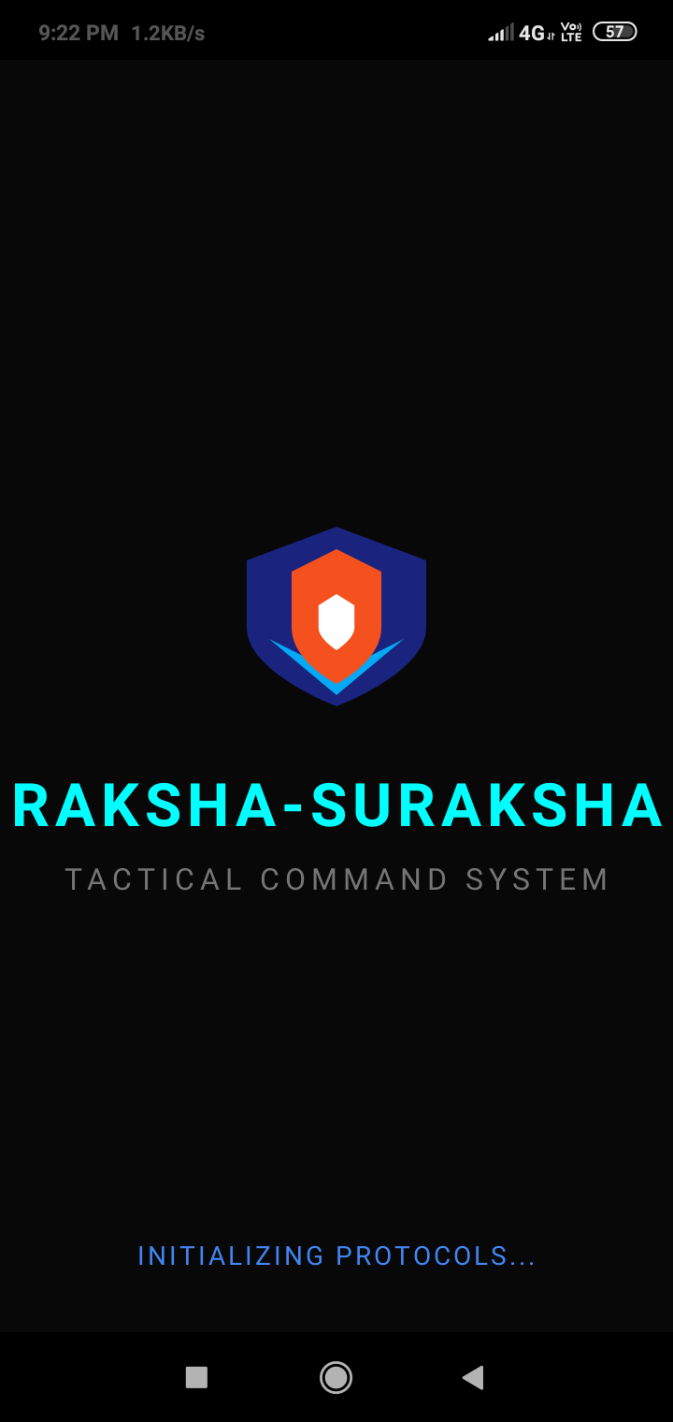
RAKSHA
SURAKSHA
Base APP SIZE :- 30 MB to 50 MB
APP INSIDE DOWNLOADABLE SIZE:- PER OFFLINE
zone map 500-700 mb
Our Website access link:-
Rakshasuraksha.github.io
Our website google search console:- Raksha Suraksha Advanced Anti-Theft Safety

Slide 4
ABSTRACT
1) Core Objective: To develop a military-grade personal safety
Android application using a 3-Tier security architecture.
​2) Methodology: The system utilizes background accessibility
services, native SmsManager APIs, and offline SQLite Vaults to bypass traditional internet constraints.
​3) Outcome: A robust mobile command center capable of
silently tracking stolen devices, overriding silent profiles for SOS
and routing off-grid tactical maps.

Slide 5

System Requirements
￼￼￼￼￼￼￼￼￼￼ ￼￼￼￼￼￼￼￼￼￼￼￼￼￼￼￼
HARDWARE
SOFTWARE
->Languages: Native Java (Backend Logic)
XML (Frontend UI), HTML5/CSS3
(Web Command Hub).
​->Background: AccessibilityService
(Fake UI Overlay), BroadcastReceivers
(Boot/SIM Detection).​
->Databases: Firebase (Real-time auth, cloud
Storage) & SQLite (On-device Offline
Evidence vault).
​->Algorithms: Continuous Background Polling
(Ghost Tracker) & Vector-based Fall
Detection and OSM Offline tiles
->Dev Environment: AndroidIDE / Android
Studio and GithubRepository
->Platform: Android Smartphone
(Android 8.0 Oreo or higher).​
->Memory (RAM/ROM): Minimum 2GB RAM. App
size is ~50MB (ROM), plus ~700MB for
the Offline Tactical Map Pack.
​
->Core Sensors: GPS Hardware
(Tracking), Accelerometer/Gravity
Sensor (Crash Detection), Camera
(Intruder Capture).
​->Connectivity: Active SIM Card
(Mandatory for offline SMS
/Telephony overrides).

Slide 6




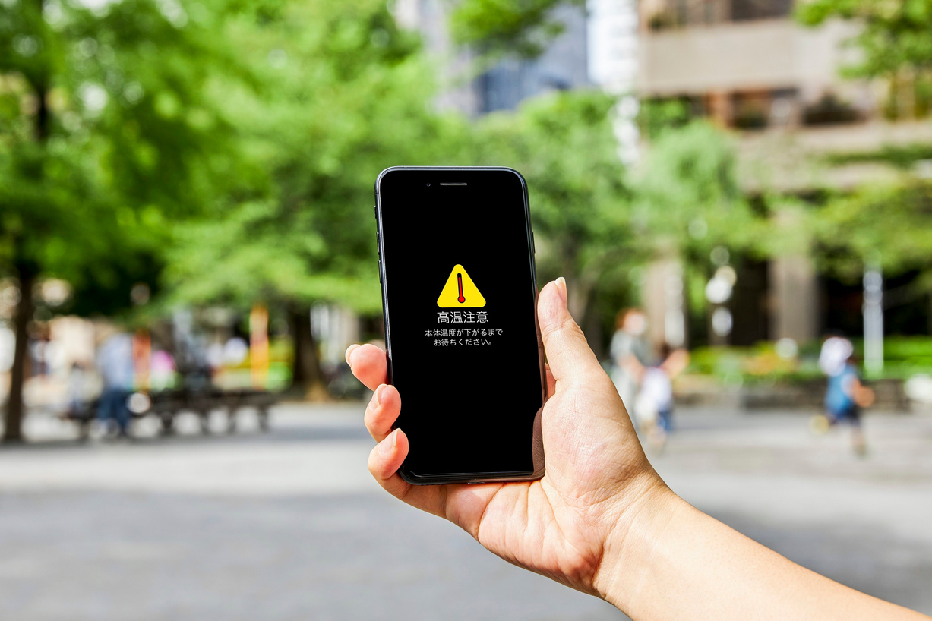
APP MODULES
SOS
TACTICAL RADAR
SMART DND OVER RIDE
ANTI-THEFT
Auto-senses gravity changes
​Instant impact detection
​Triggers automated distress message
Wrong password combo
Pocket removal alarm
​Charger disconnect siren
​Silent trigger via secret code
Offline tracking
​Direct satellite GPS pinging
​Dead-zone navigation
Multi- zone maps
Auto reply to missed calls
​Secret SMS code interception
​Forces max-volume alarm bypass

Slide 7

EXISTING Module
OUR Modules
Manual SOS Activation (Requires user to physically unlock & tap)
​Autonomous SOS Trigger (Gravity-sensor impact detection)
Basic Security (Relies only on lock-screen passwords)
Hardware Anti-Theft (Pocket removal & charger disconnect alarms)
Internet-Dependent (Tracking fails without active mobile data)
Offline Tactical Radar (Direct-satellite tracking without cell towers)
Static Communication (Only sends basic, one-time auto-replies)
Active Defence (Remote SMS override & silent trigger activation)

Slide 8

APPLICATIONS
Personal Safety & Night Commuting:- Provides instant SOS and
auto-calling for women and high-risk transit workers,
functioning even in dead zones.
​2) Vehicle Accident Response:- Acts as a digital first-responder; g
gravity sensors automatically dispatch coordinates if the user
is unconscious.
​3) Anti-Theft & Asset Recovery:- Tracks stolen devices via remote
SMS overrides, SIM-change alerts, and silent intruder logging.
​4) Off-Grid Adventure & Travel:- Gives trekkers and remote workers
a tactical offline radar for safe routing in zero-connectivity areas.

Slide 9

DATA FLOW
1) Input Layer: User manually hits SOS OR Gravity Sensor detects a crash
OR Unauthorized unlock attempt occurs.
​2) Processing Layer: The Java backend intercepts the trigger.
​Decision Branch:
​3) If Offline: System utilizes Tactical Radar logic, executes remote
SMS overrides, and triggers local Auto-Call.
​4) IfOnline: Pushes data to the Firebase Live Tracker and uploads
intruder photos to the Secure Evidence Vault.
5) Output Layer: Alerts reach designated contacts and the phone
goes into lockdown mode.

Slide 10
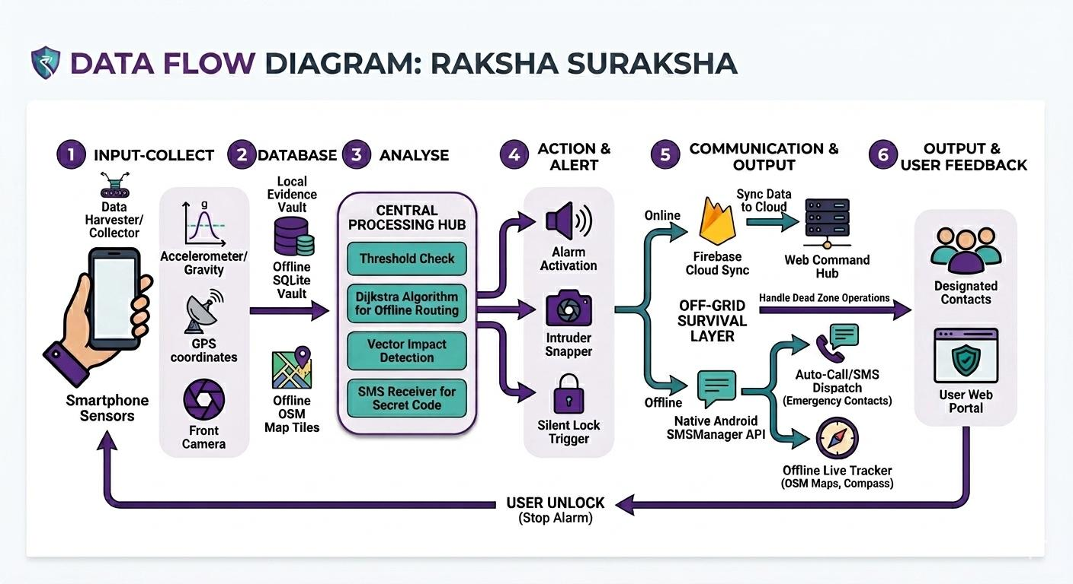

Slide 11

DRAWBACKS
​1) Sideloading & Trust Barrier: Not on Play Store; requires users to manually allow
“Unknown Sources.” ​2) Complex Uninstallation: “Device Admin” rights block thieves, but make removal
harder for actual users. ​3) Hardware Override Vulnerability: Software cannot prevent a forced physical
shutdown (15-second power hold). ​4) Third-Party Quotas: Bound by TRAI regulations (100 SMS/day limit) and Gmail
spam filters. ​5) High Resource Consumption: Continuous background GPS polling for “Ghost
Tracking” drains battery life..

Slide 12
Future Expectations
--> Direct Emergency Dispatch: Automated routing of distress calls and exact GPS
coordinates directly to local law enforcement,medical services and firefighters services .
​-->Zero-Internet Voice Assistant: A fully offline, localized voice command module to trigger SOS protocols completely hands-free.
​-->Wearable Tech Integration: Synchronizing with smartwatches to allow discreet,
one-tap SOS triggering without needing to physically touch the phone.
​-->Hardware-Level Integration: Partnering with mobile manufacturers to embed
a dedicated Bluetooth Low Energy (BLE) tracker powered by a reserve battery.
-->​Ecosystem Expansion: Developing a Swift-based version for iOS devices,
as for now it is only developed and testing are going for Android operating systems

Slide 13

CONCLUSION
​1) Active, Not Passive: Upgrades standard, manual SOS buttons into
an aggressive, autonomous defense system.
​2) Offline-First Survival: Guarantees tracking and data rescue in dead
zones using native SMS networks.
​3) Outsmarts Thieves: Deploys psychological traps (like Fake Switch-
Off) to defeat physical theft and SIM-swapping.
​4) The Ultimate Failsafe: Transforms an everyday smartphone into a
tactical, off-grid lifeline when standard apps fail.

Slide 14


