Slide 1
Analysis of “Drug Related Deaths”
Project for COMP7118: Data Mining
Group-4
Jaya Prakash Narayana Raavi, Madhan Gopal Reddy Janga, Gopi Krishna Raparla, Xiang Fu
2023-12-06

Slide 2
Introduction
Drug-related death has long been one of the serious problems that influence life quality in the United States, including fatal overdoses, medical derangements from chronic consumption, or violent death from alternation of normal behavior. In 2021, 106,699 drug overdose deaths occurred in the United States, which means the risk remained high. Drug related deaths involving psychostimulants are increasing with and without synthetic opioid involvement. As so many young people died due to improper drug use, we are really interested in how drugs impact the life of these young people. By investigating the information about the cause of death which would lead a way to help prevent such tragedies for young life.

Slide 3
Overview
Problem: Drug-related death has long been one of the serious problems that influence life quality in the United States.
Prior belief: so many young people died due to improper drug use.
Interests: in how drugs impact the life of these young people
Goal: help prevent such tragedies for young life by investigating the information about the cause of death would lead a way to.
Dataset: “Drug Related Deaths” contains 48 variables and 10654 observations from January, 2012 through December 2022.

Slide 4
Data Cleaning
The missing data from the key columns were removed, including the Date, Date Type, Age, Sex, and Race. Some necessary formats were transformed, such as the date and age. The empty cells (“”) were all replaced with NA. We added three columns to the end of the table, which represent the three main types of the drugs: opioids, psychostimulants and sedatives. There are overlaps among these three types which should be reasonable since the death could be caused by the combination usages of the drugs. I have checked the trend of overall death numbers over the years, and found they keep increasing. So, this is a good pattern for analysis.

Slide 5
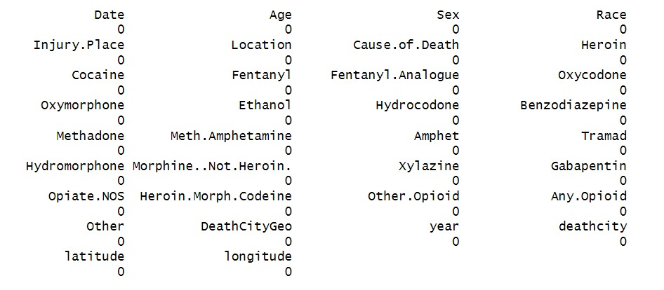
Data columns for data analysis:

Slide 6
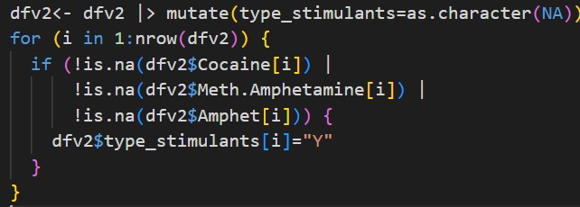
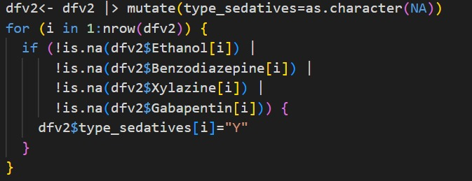
Grouping Drugs into 3 Classes:

Slide 7
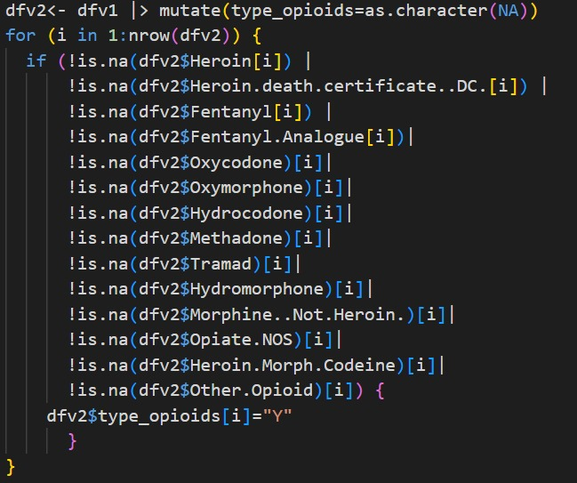

Slide 8
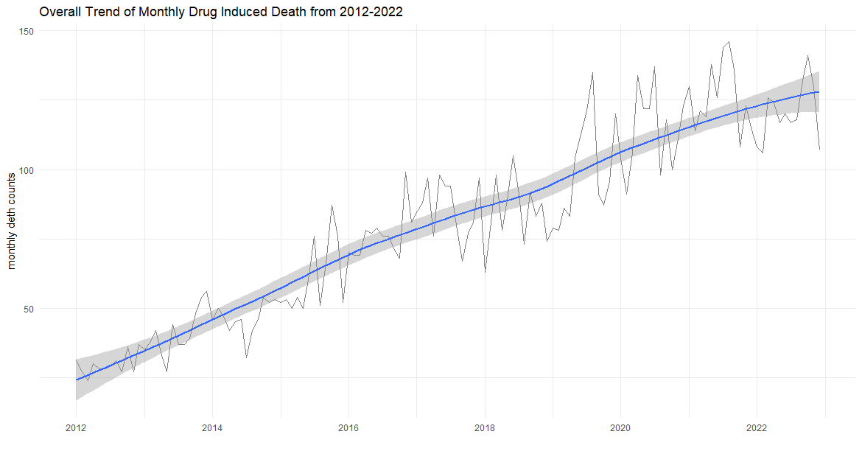
The monthly death rate keep increasing

Slide 9
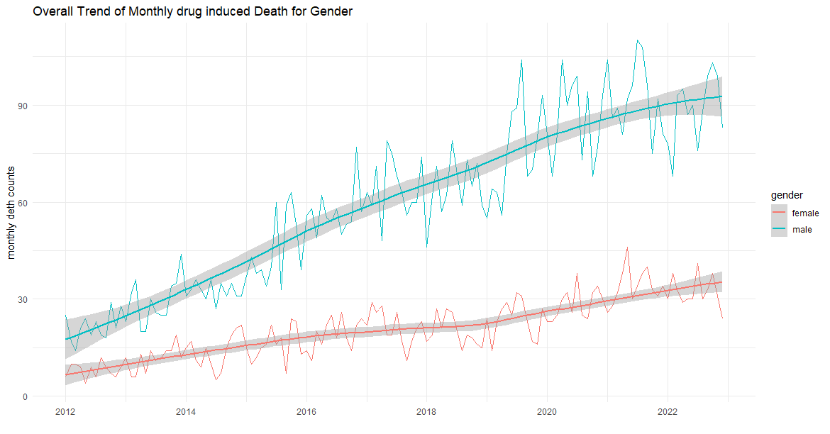
The death rate keep increasing for both genders

Slide 10
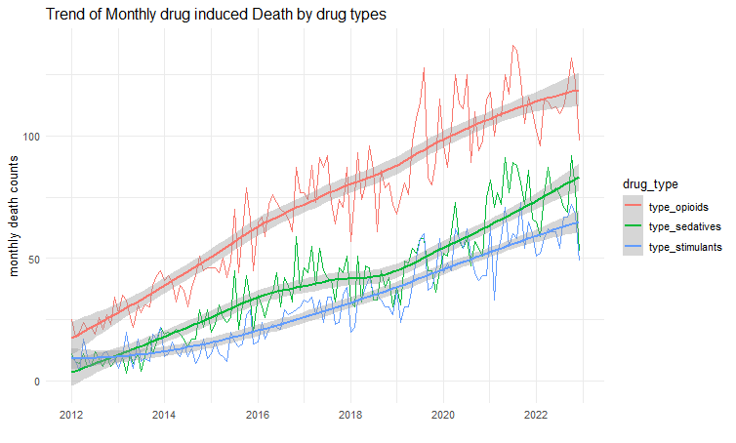
The death rate keep increasing for all types of drugs

Slide 11
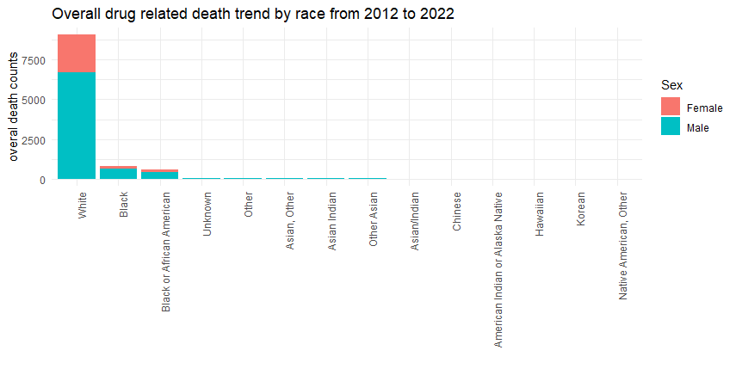
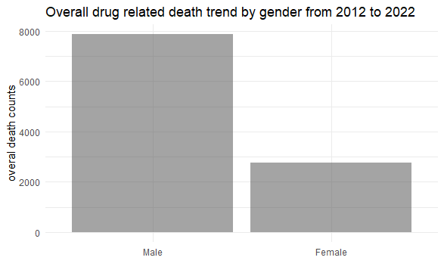
The overall death among races and genders
male | female | total
7867 | 2749 | 10616

Slide 12
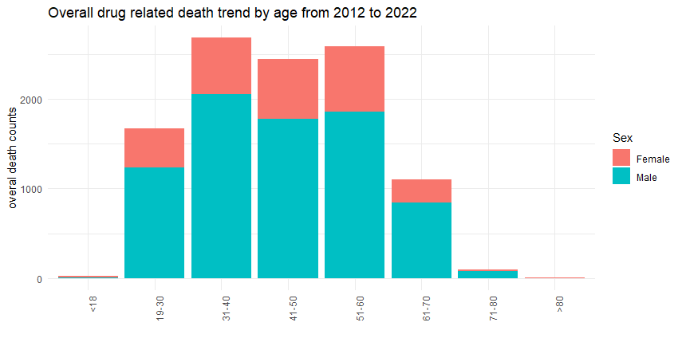
The overall death among age groups
age_group | counts
<18 | 22
19-30 | 1671
31-40 | 2683
41-50 | 2442
51-60 | 2590
61-70 | 1103
71-80 | 100
>80 | 5

Slide 13
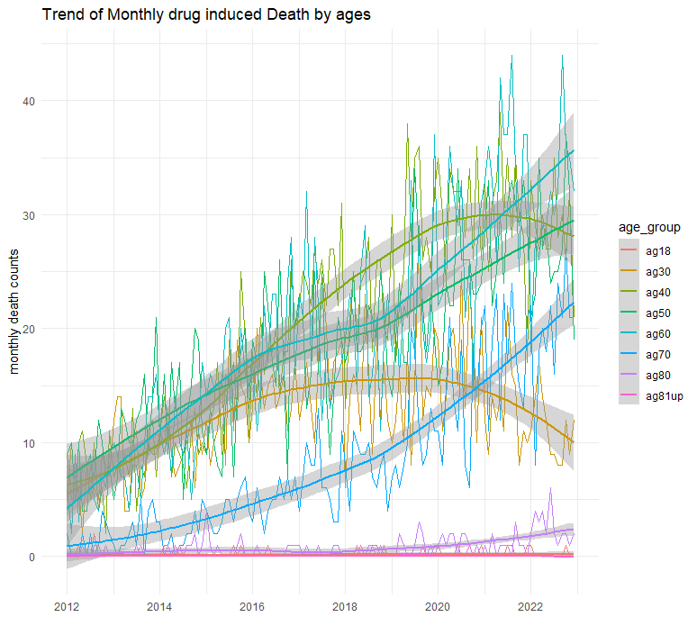

The monthly death rate among age groups
age_group | counts
<18 | 22
19-30 | 1671
31-40 | 2683
41-50 | 2442
51-60 | 2590
61-70 | 1103
71-80 | 100
>80 | 5
The overall death keep increasing.
Concave type curves among age groups of 19-30 and 31-40 show the promise!
Convex type curves indicate that senior groups tend to contribute more to the overall death rate than junior groups.

Slide 14
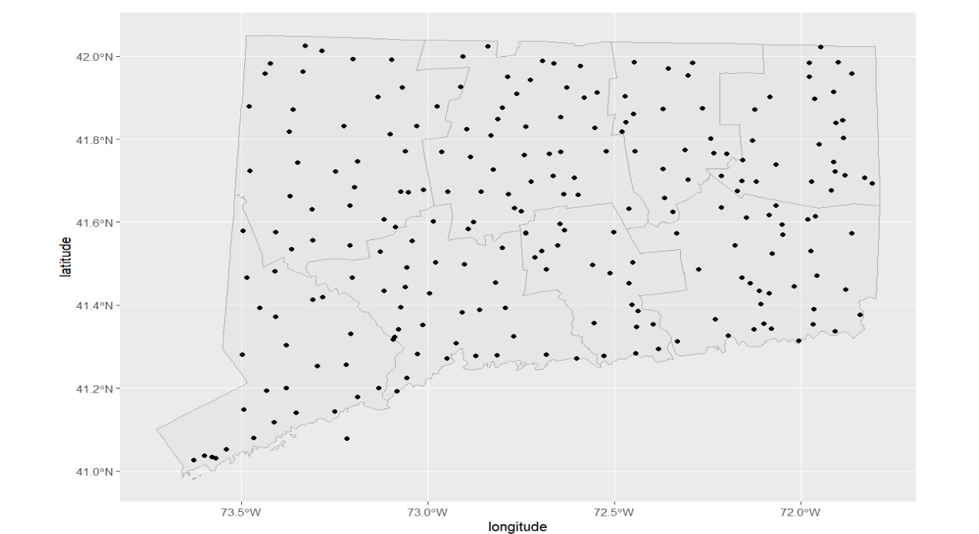
Plotting Geospatial Data:

Slide 15
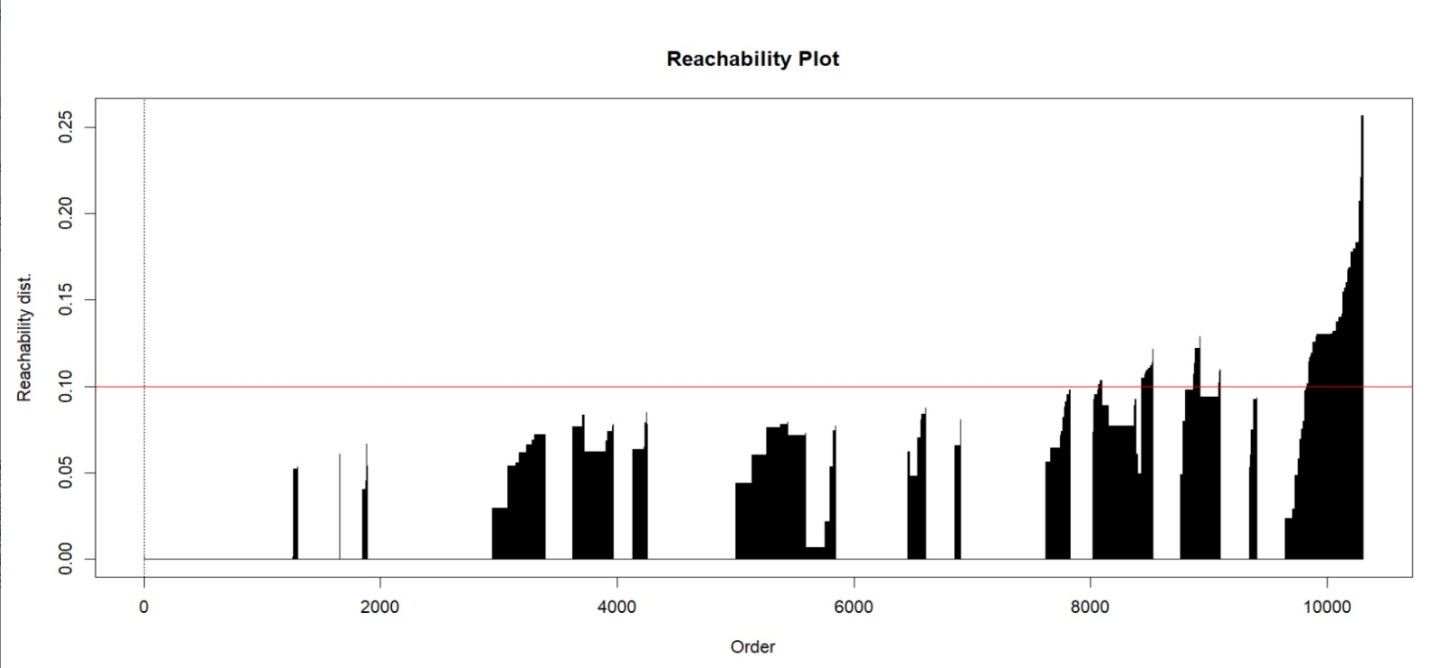

Slide 16
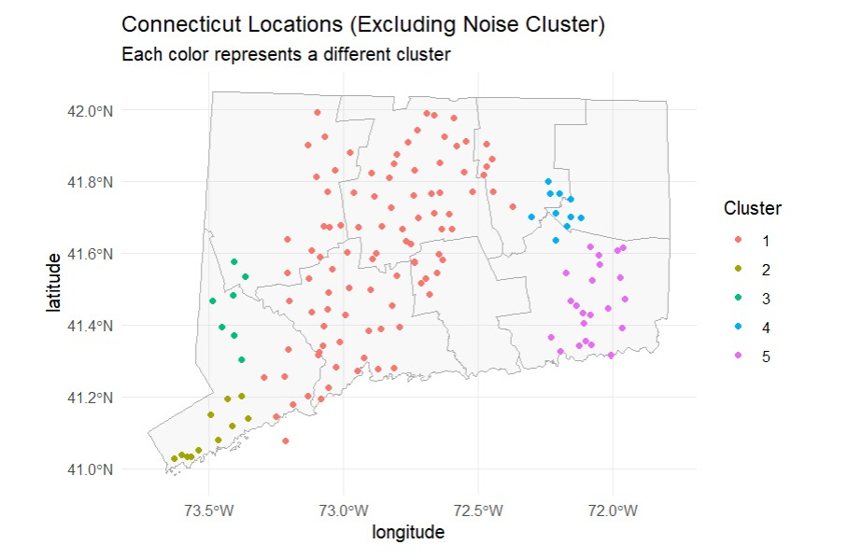
Clustering Analysis:

Slide 17

Conclusion
Continual increasing drug use issues need more attention.
Senior groups subject more death rate than young groups.
Promise and feasibility of changes that could make life better.
For further study, the correlation between drug usage and mental health may be interesting for better understanding the problem among senior groups and for quality life.
https://www.barnesandnoble.com/w/friends-lovers-and-the-big-terrible-thing-matthew-perry/1140530024

Slide 18


