Slide 1


DevOps Center of Excellence
DevOps Workshop
Configuration and Provisioning

Slide 2

DevOps Workshop
Ansible
An agentless tool
Agenda
1980
1990
2000
2010
Legacy Models
What is configuration Management
Ansible and why Ansible ?
Ansible installation and configuration
Ansible Folder structure
Ad-hoc commands
Ansible Playbooks
Ansible Roles and the need of it
VM and templates
Ansible
Manual
Manual

Slide 3




DevOps Workshop
Legacy Models- C&P
In the beginning…………………………………………………..
Developers wrote code
SysAdmins deployed code
Until one day , I know , I’ll write code to tell the computer how to set up itself
Until one day , I needed server to manage and deploy my servers through code

Slide 4




DevOps Workshop
The Rise of Ansible!!!
Scale up when you need to
Servers
The “Ansible”
SSH
Dependencies
Python
Jinja2
PyYAML
Paramiko
Python

Slide 5
The Rise of Ansible!!!(Contd..)
Configuration management tool like Puppet & Chef
Agentless configuration management tool
Relies on SSH connection
Ansible uses Python whereas Puppet/Chef uses Ruby
It uses the push mechanism whereas Puppet/Chef uses pull mechanism
Playbooks are written in YAML whereas Puppet/Chef uses Ruby

Slide 6
Ansible installation and configuration
Installation
Configuration
Apt-get install ansible
Before that install dependencies
Apt-get install jinja2
Apt-get install PyYAML
Apt-get install paramiko
Apt-get update
Apt-get install software-properties-common
Two Machines required
Cd .ssh & ssh-keygen –t rsa
ssh-copy-id -i username@destination public ip
/etc/hosts ➔ make an entry for host A & B
Scp /etc/hosts root@ipaddress:/etc/
/etc/Ansible/hosts ➔ Make an entry for the group of servers
Ansible --version

Slide 7
Ansible Directory structure
etc/Ansible/
The main configuration folder which surrounds all ansible configuration
hosts
The file holds information about the hosts/and host group you will configure
ansible.cfg
The main configuration file for ansible
roles
It allows you to create folders for each server role.. Web Server, App Server, DB Server. Etc..

Slide 8
~/ansible_hosts
Ansible Hosts- /etc/Ansible/hosts
[local]
127.0.0.1
[web-group]
www.mindtree.com
www.devops.com
[db-group]
10.0.1.123
Group Name

Slide 9
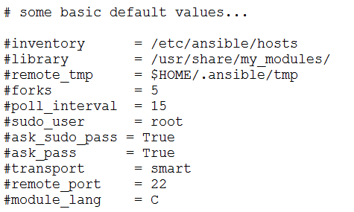

~/ansible_hosts
Ansible.cfg- /etc/Ansible/ansible.cfg

Slide 10
~/ansible_hosts
Ansible Ad-Hoc Commands
$ ansible all -m ping $ ansible web-group -m ping $ ansible all -a "/bin/echo hi“
$ ansible all –m apt –a “name=nginx state=installed”
$ ansible all –m service –a “name=nginx state=restarted”
$ ansible servername –m file –a ‘path=/tmp/hello state=directory mode=0700 owner=root’
$ansible servername –m copy –a ‘src=/home/Ubuntu/test dest=/tmp’
$ ansible-doc –l
$ ansible-doc –help
$ ansible-doc module name

Slide 11

Play Books
name: install and start nginx hosts: Server group user: root Vars: http_port:80 tasks:
Playbook is a YAML file
Declaratively define your config..
Can contain many “Plays” targeting different groups
Playbooks are divided into three sections { Target, Variable and task}
Run:
Ansible-playbook test.yml
name: install nginx apt: pkg=nginx state=installed update_cache=true notify: - start nginx handlers:
- name: start nginx
service: name=nginx state=started

Slide 12
etc/Ansible/Roles
Ansible Roles Directory Structure
Defaults
It stores the components of a role such as default variables and data
Files
It stores the static files which will be copied to the remote machines later on
Handlers
Create Role
Ansible-galaxy init ‘Role name’--offline
Tasks which will trigger an action based on the changes
meta
Information about the role such as author information
tasks
The actual actions to be done; Code would be saved here which will perform the actions
templates
Dynamic files would be saved here. Templates files in ansible written in Jinga 2 template language
vars
Same as defaults but the highest priority would be given to VARS and its difficult to overwrite

Slide 13
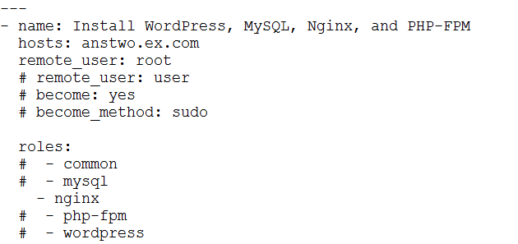
Roles
name: install and start nginx hosts: Server group user: root Vars: http_port:80 tasks:
Define the code in main.yml under tasks folder and handlers
Likewise create multiple roles and define the roles in site.yml
Roles are nothing but combining the playbooks
Run:
Ansible-playbook site.yml
--syntax-check
name: install nginx apt: pkg=nginx state=installed update_cache=true notify: - start nginx handlers:
- name: start nginx
service: name=nginx state=started

Slide 14

Thank You
DevOps – Center of Excellence
Presented by : Dinesh Sekar
Presented by : Tamil Arasu
India | USA | UK | Germany | Sweden | Belgium | France | Switzerland | UAE | Singapore | Australia | Japan | China

