Slide 1
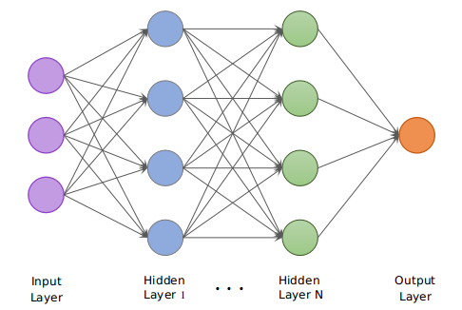
Classification of Natural Disasters Using Multi-layered Deep Convolutional Neural Network

Slide 2
Modules
Data Augmentation and pre-processing
Convolution
Neural Network
Performance evaluation

Slide 3
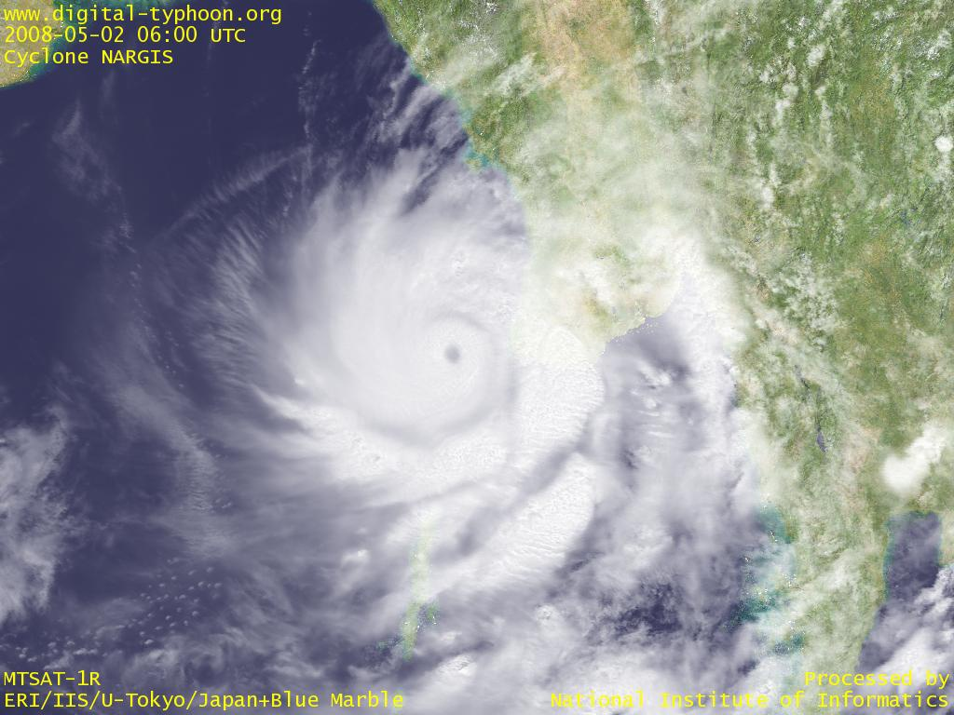
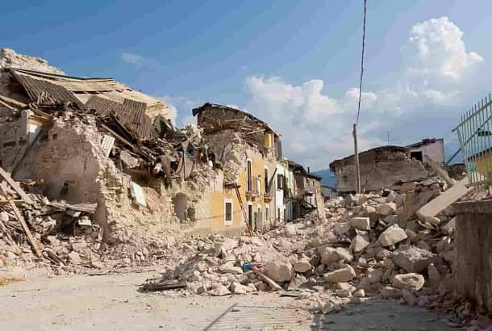
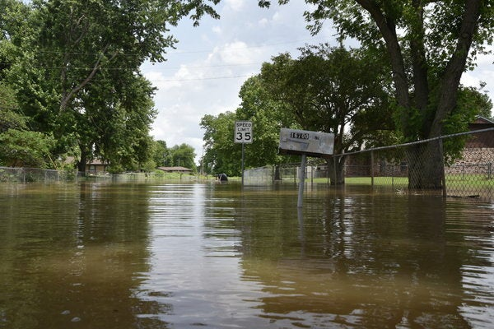
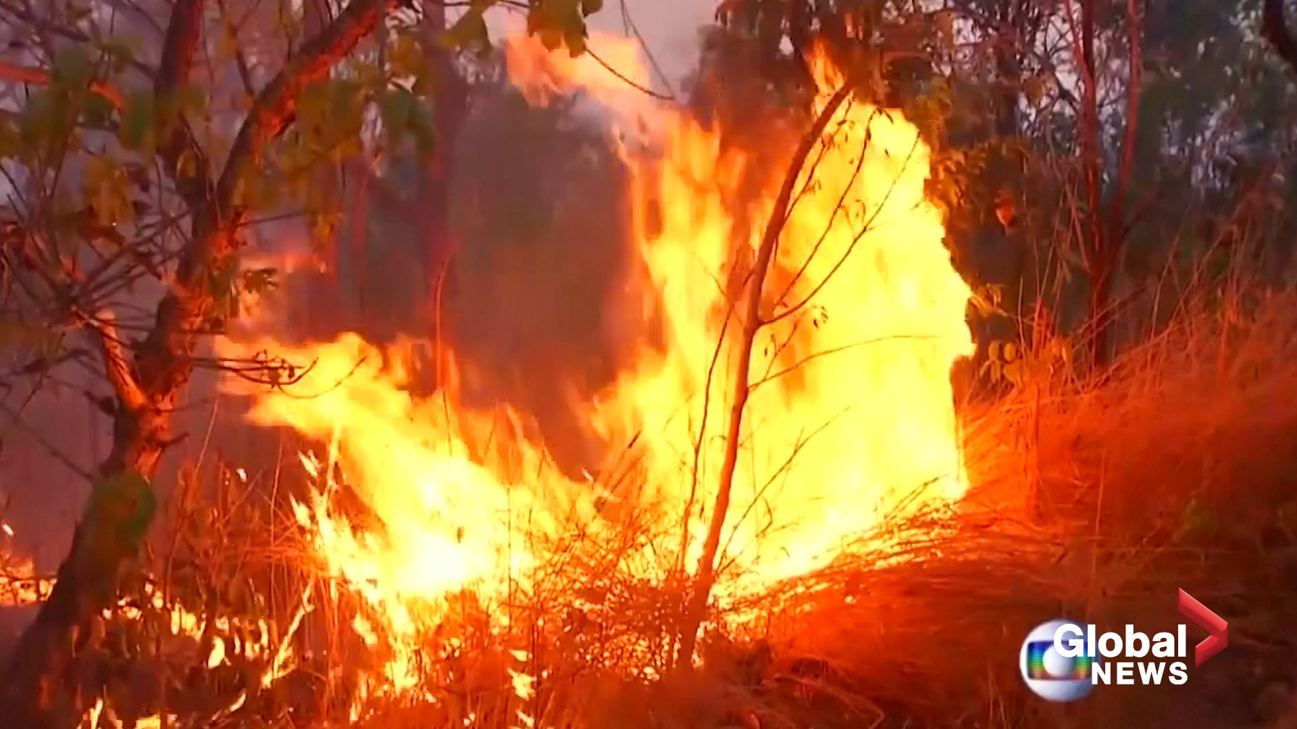
Dataset
The dataset consists of images belonging to four classes:
Cyclone
Earthquake
Flood
Wildfire
The entire dataset contains 3600 images - 3200 train and 400 for test.
Cyclone
Earthquake
Flood
Wildfire

Slide 4
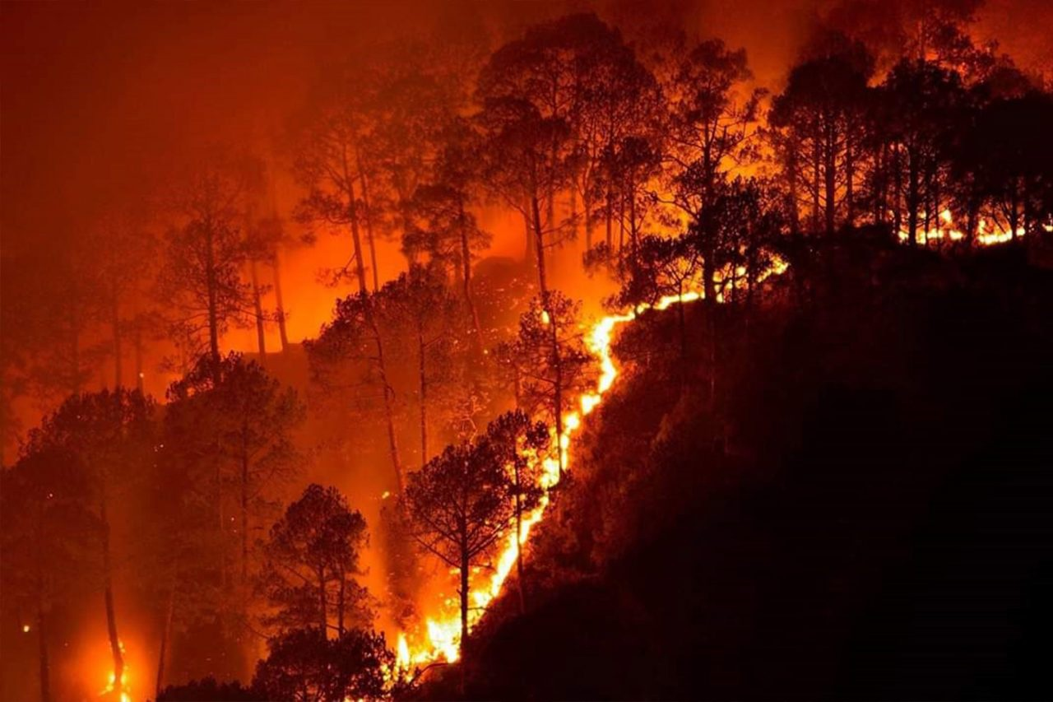
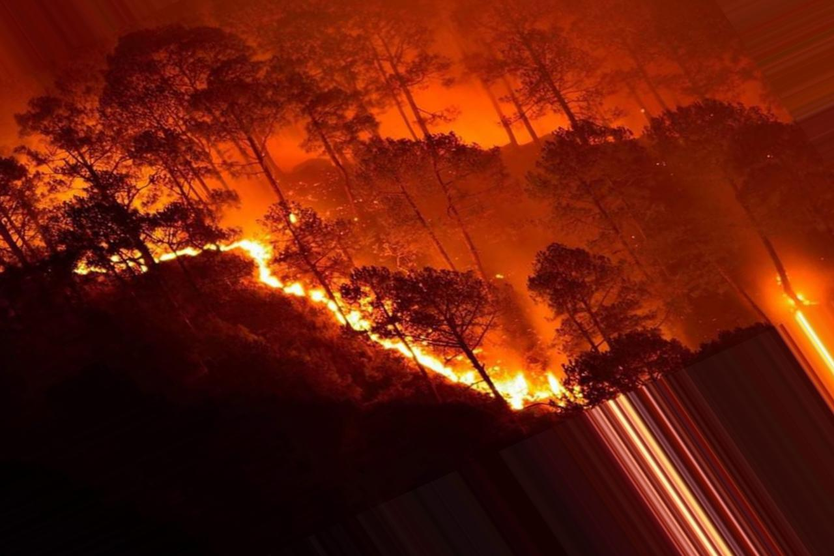
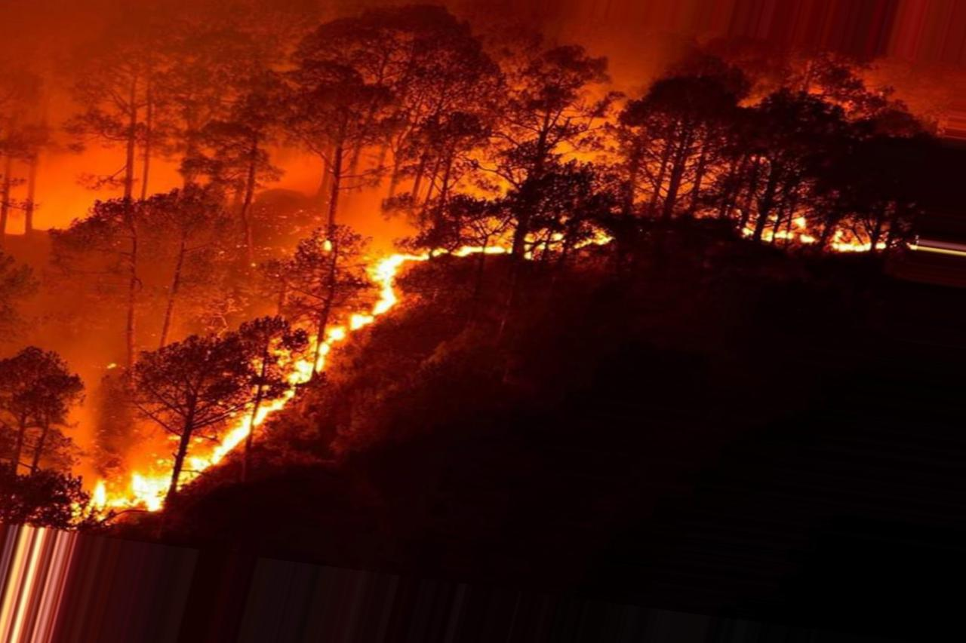
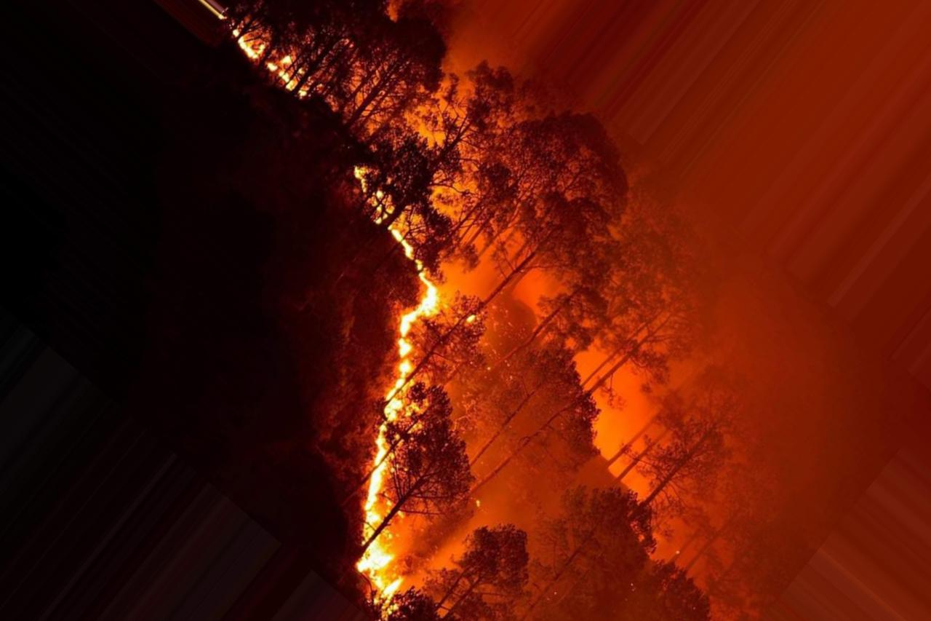
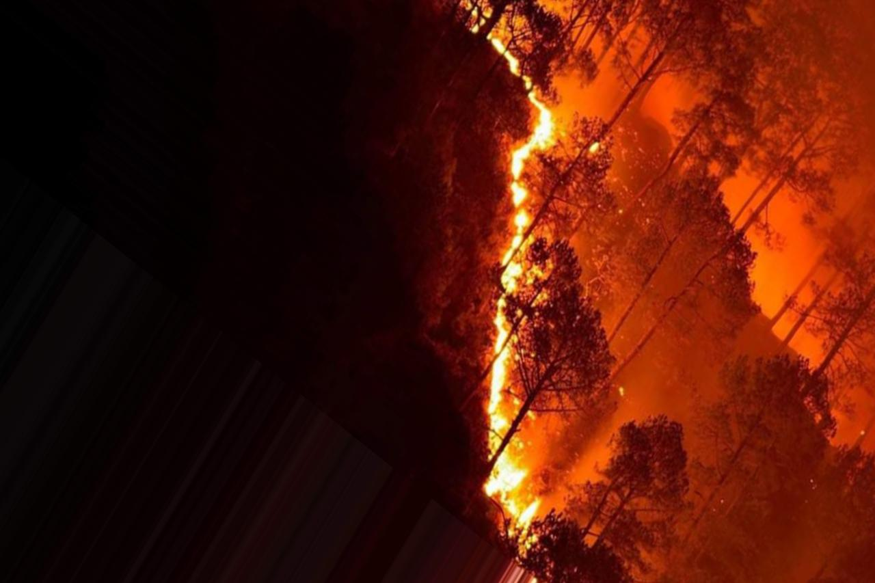
Data Augmentation
For the model to work better, we need to have a lot of training examples.
In many cases it can be impractical to get unique images in a large number due to various reasons.
The fewer examples are augmented to a number of transformations so that the model can receive different images.
Data augmentation also helps to keep the model generalised and avoid overfitting problems.
There are several ways to generate new data: by rotation by some angle, flipping horizontally or vertically, etc.
Notes:
https://blog.keras.io/building-powerful-image-classification-models-using-very-little-data.html

Slide 5
For data augmentation, we used ImageDataGenerator class in Keras: keras.preprocessing.image.ImageDataGenerator
We first need to configure the transformations to be randomly done on the image.
The we use the flow function to specify the location to save the augmented image and label prefix.
Once the two steps are done, we can convert batches of images and obtain slightly modified images none of which are identical.
Applying data augmentation we generated a total of 10000 images as the final dataset:
The organization of the dataset is:
Data
train
test
Cyclone (2400 images)
Cyclone (100 images)
Flood (2400 images)
Flood (100 images)
Earthquake (2400 images)
Earthquake (100 images)
Wildfire (2400 images)
Wildfire (100 images)

Slide 6
Data Pre-processing
The next step is to bring each image to a uniform size.
This makes it easier for the model to identify features and to perform computations.
All the images are set to 224*224*3 (Height * Width*color channels). (3 for RGB)
Also, the value of each pixel which ranges from 0 - 255 is normalized to range from 0 - 1 by dividing each value by 255.
Normalization makes probability calculation efficient and the values previous scattered now tend to remain in a small range.
20% of the training data is used to perform validation and the adjustment of weights of convolution neurons.
This completes the data pre-processing part.

Slide 7
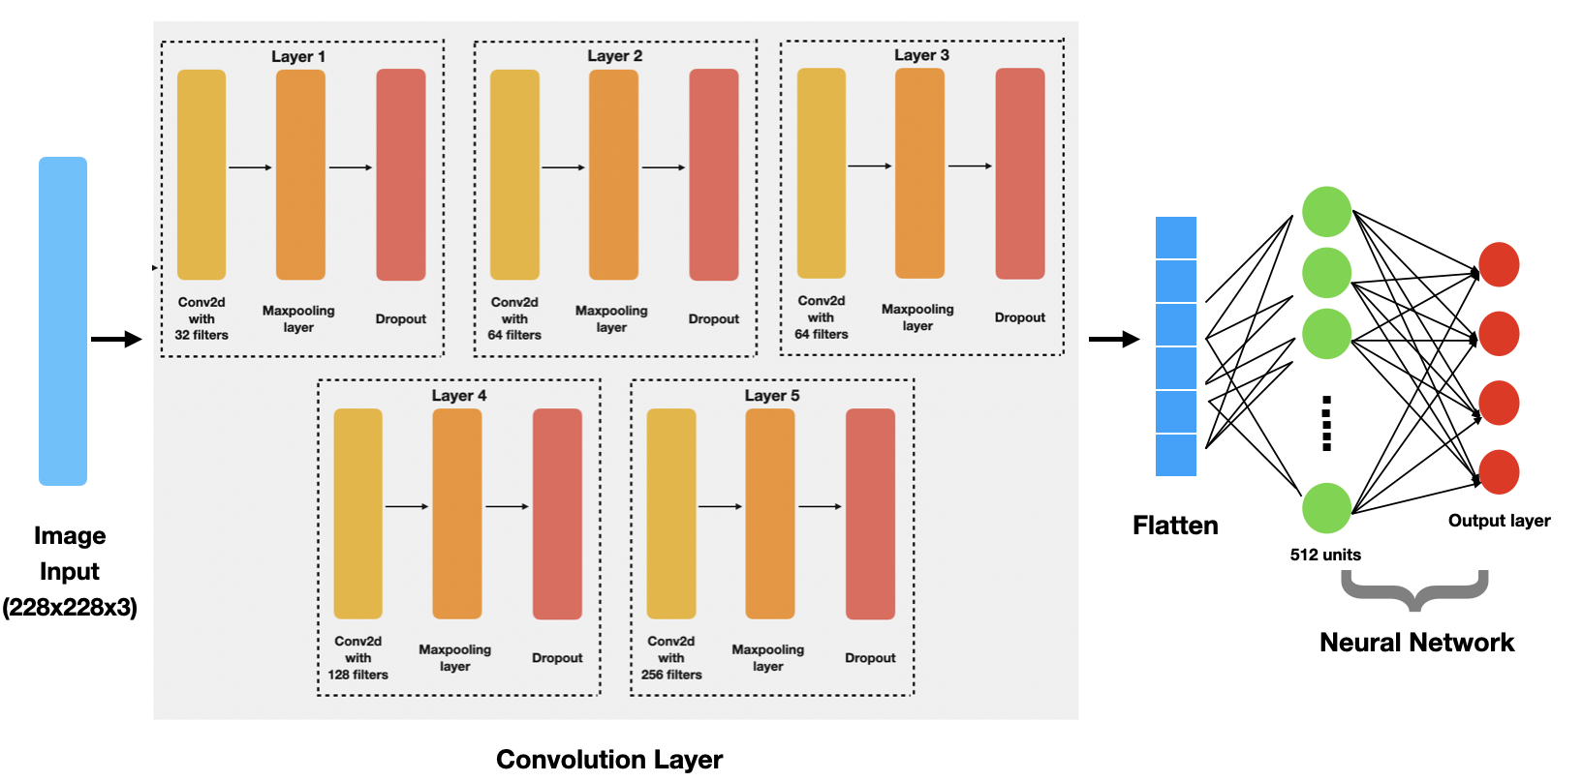
Architecture Diagram

Slide 8
Convolution Layer
The prepared data is given to the convolution layer.
Each layer consists of 3 parts
Convolution2D
Max-pooling layer
Dropout
The model has 5 such layers before providing the output to the Neural network layer.
These layers help in extracting the features of the images.
Relu Activation function was used at each neuron.
After passing through these 5 layers the vectors are flattened before providing to neural network.

Slide 9

ReLU Activation Function
An activation function maps the nodes inputs to corresponding output.
It performs transformations on the data to the data and the sum ranges between some upper and lower limits. Generally between 0 and 1.
ReLu transforms the input into either 0 or the input itself.
Formula: ReLU

Slide 10
Convolution2D is used to identify the features and help to reduce the dimensionality of the vector.
The initial dimensions of the image 224*224 and in 3 channels takes more time to extract features.
Convolution is a technique which retains the features of the image even after reducing its dimensions.
This saves a lot of computation effort for further layers.
Fig: Convolution
Maxpooling layer further extracts the dominant features and can reduce the dimensionality even more.
It avoids the minimal features and makes the model to focus on the most obvious features.

Slide 11
Overfitting is a problem that occurs when the model fits with training data and fails to work with data outside the training model.
This occurs when the neurons fit completely with the training data. All the neurons are completely trained to be able to predict the data in the training set.
To avoid the overfitting problem we ignore some nodes with probability p. This is called dropout.
Dropping out some neurons keep the model more generalized and robust.
Though this reduces the accuracy over training data to some extent, it improves the performance over the test set.

Slide 12
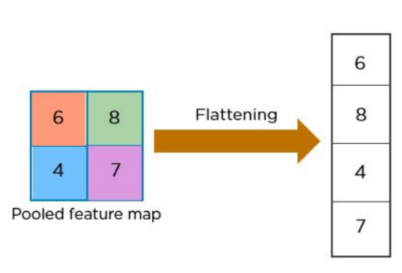
Neural Network
Once, the convolution is done, the next step is to provide the extracted features to the neural network.
Before doing so, we need to convert the output vector of the convolution layer into a single dimension.
The neural network needs the inputs in a single dimension to the hidden layers.
The hidden layer consists of 512 units (neurons) and is fully connected.
This means that each input is connected each neuron in the hidden layer.
The neural network trains itself to efficiently predict the class of the image.

Slide 13
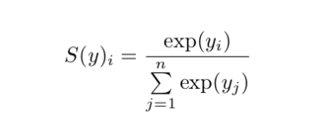
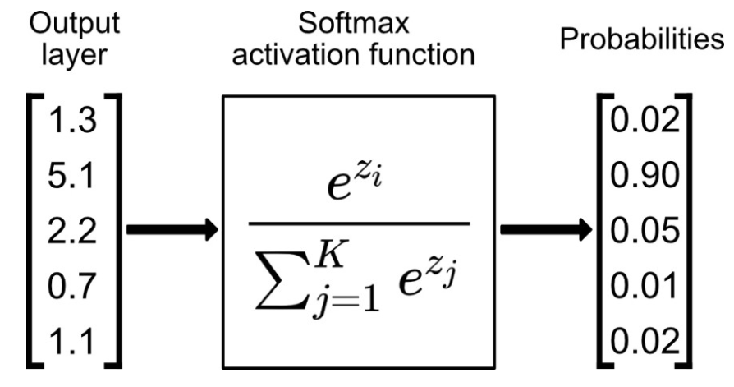
Softmax Activation Function
Softmax scales the output into probabilities. It is the last layer of the news network.
The formula for softmax function is:
Since the problem is about multi-class, we used softmax activation function.
The probability of each individual class when summed gives 1.
The class with the maximum probability is given as the output class prediction.

Slide 14
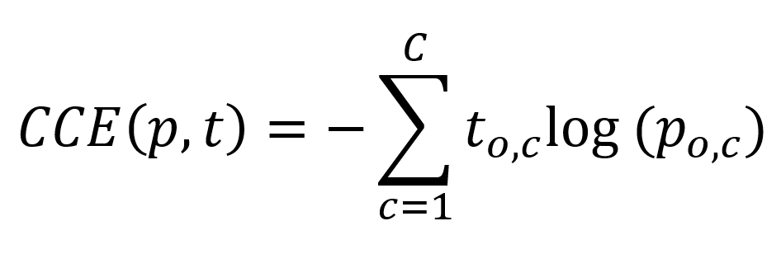
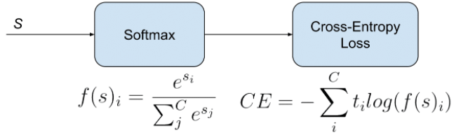
The entire architecture is trained for multiple epochs.
At the end of each epoch the accuracy of the model at for training data and the accuracy and loss for validation data.
The loss function used for the model is categorical cross entropy.
It measures the difference between the probabilities of the predicted and the probabilities of actual class.
It is an improvement over cross entropy which rewards with low less even for huge mistakes.
It improves the cross entropy by involving softmax activation along with cross entropy.

Slide 15
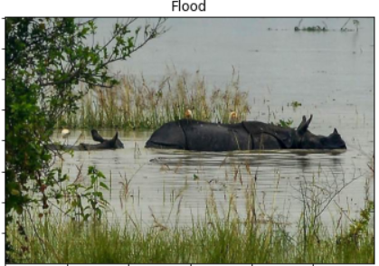
Performance Evaluation
The best model is checked after each epoch and if the present epoch gives better results then the best model is changes.
The metric used for selecting the best model is ‘validation-loss’. The model with minimal validation loss is treated as the best model.
After all the epochs, the best model is loaded and the predictions are done on the test set.
Initially an image from test set is given to perform the prediction and the result is shown as label to the output.
Fig:Prediction on test data

Slide 16
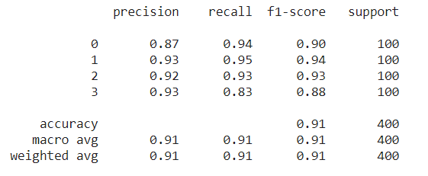
Metrics
The model was given the entire test data to perform predictions and the metrics of the predictions are as shown

Slide 17
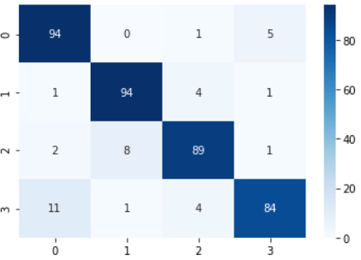
The confusion matrix showing the results of the predictions of the data on the 400 images is:
In the matrix, the x-axis and y-axis contains the labels corresponding to each class as follows:
0 - Cyclone
1 - Earthquake
2 - Flood
3 - Wildfire
The numbers along the diagonal of the confusion matrix give the number of correct predictions.
The other elements in the matrix correspond to wrongly predicted outcomes.
Fig:Confusion matrix

