Slide 1



KONGU ENGINEERING COLLEGE
PERUNDURAI ERODE-638060
COMPUTER SCIENCE & ENGINEERING
PROJECT TITLE: A Resource Efficient Transfer Learning Framework For Real Time Driver Distraction detection
TEAM : B20
HARI KIRUTHIK G R (23CSR071
JAYARAJ M (23CSR090)
KIRUTHICK B (23CSR112)
Mentor
R.S. Shudapreyaa
Assistant Professor CSE

Slide 2

Problem statement
Driver distraction is a leading cause of road accidents, however existing AI-based driver monitoring systems requires high-end GPUs, making them unsuitable for real-time distraction detection in a resource constrained environment due to the limited memory and processing power available.

Slide 3

Objectives
Design and deploy a TinyML-based driver distraction detection system on the resource constrained system using TensorFlow Lite Micro with reduced input sizes and Optimize memory consumption and inference latency to achieve real-time edge inference without high-end GPUs.

Slide 4
Literature Survey
Journal | Title | Year | Method / Model | Dataset / Hardware | Accuracy | Latency
Springer | Tiny deep learning models for real-time and efficient embedded driver state detection | 2026 | Efficient-Tiny, MCUNet, Micro-MobileNet, SqueezeNetv11 | StateFarm / no external hardware | 95.81% | 28 ms
Springer | USH: an efficient real-time distracted driving detection model | 2025 | USH (lightweight hybrid CNN + Single-Head Self-Attention) | StateFarm / NVIDIA RTX3060Ti 16 GB RAM | 96.5% | 4.7 ms
Springer | FAN-YOLO: Real-time driver behavior detection based on full-layer aggregation network of YOLO | 2025 | FAN-YOLO | State Farm v2, YawDD v2 / NVIDIA 4090, 80 GB memory | AP50: 86.8% / 97.5% | 1.9 ms
IEEE Access | Research on Transfer Learning-Based Framework for Real-Time Driver Distraction Detection on Edge Devices | 2026 | VGG16 Transfer Learning | State Farm; Docker/ Intel i7, Nvidia 1060 16 GB ram | 95.54% validation accuracy | >150 ms
Nature | Integrated Deep Learning Framework for Driver Distraction Detection and Real-Time Road Object Recognition in ADAS | 2025 | CNN + YOLO + TensorRT INT8 Optimization | State Farm + KITTI + MS COCO, NVIDIA Jetson Xavier NX | 0.915 | 39 ms
Elsevier | An Efficient Temporal Attention Framework for Real-Time Detection of Unsafe Driver Behaviors | 2025 | ATFE (Attention-Guided Temporal Feature Extraction) | Benchmark driver behavior datasets | 0.985 | 12.8 ms
ASCE library | Real-Time Distracted Driving Detection Based on GM-YOLOv8 on Embedded Systems | 2025 | GM-YOLOv8 | Driver distraction dataset/ NVIDIA Jetson AGX Orin | 0.978 | 33 ms
IEICE Transactions on Information and Systems | YOLOv10n-BC: A Novel Real-Time Object Detection Model for Driver Distracted Driving Detection | 2025 | YOLOv10n + BiFPN + CASSA Attention | CBTDDD Dataset/ NVIDIA RTX 4090 | mAP@0.5 improved by 2% | 115.3 FPS
Elsevier | A Lightweight Model for Distracted Driver Detection Based on Neural Architecture Search and Coordinate Attention | 2025 | CCNET (Neural Architecture Search + Coordinate Attention) | State Farm, AUC Distracted Driver/ NVIDIA Jetson Nano B01 | 0.9552 | 54 FPS
IEEE Access | Deep Learning-Based Real-Time Driver Cognitive Distraction Detection | 2025 | Temporal Deep Learning Network (CNN + Temporal Modeling) | Driver cognitive distraction datasets/ NVIDIA RTX 3090 | 0.974 | 22 ms

Slide 5
Research Gap
Limited deployment on resource-constrained edge devices, most studies target GPUs or high-performance embedded platforms.
Knowledge distillation, quantization, and TensorFlowLite Micro are rarely integrated into a unified TinyML pipeline.
Existing work emphasizes accuracy/FPS but provides limited analysis of runtime memory, tensor arena, and memory–accuracy trade-offs.
Few studies compare different input resolutions and optimized models to identify the most efficient configuration for real-time edge inferences.

Slide 6
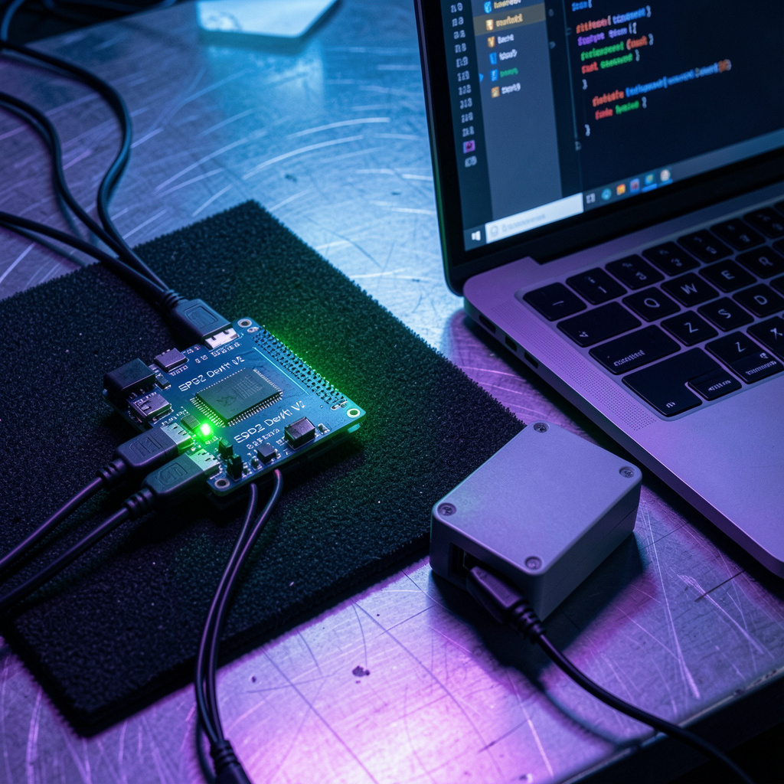
Proposed Solution
Proposes a teacher–student knowledge distillation framework for compact TinyML models Runs entirely on the ESP32 microcontroller without cloud support.
Combine lightweight CNNs, INT8 quantization, and TensorFlow Lite Micro for efficient embedded inference.
Reducing the model size allocating minimum required tensor arena, and runtime memory in the chip’s SRAM
Real-time deployment on resource-constrained microcontroller-based edge devices without high-end GPUs

Slide 7
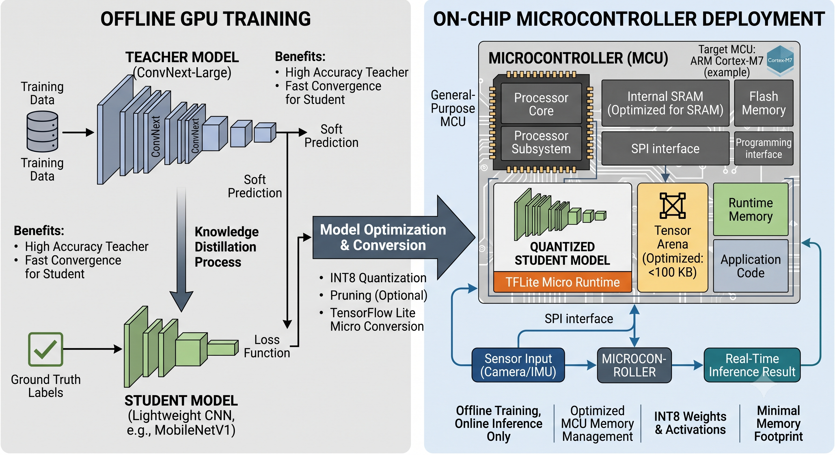
Workflow

Slide 8
Knowledge Distillation Architecture: Teacher to TinyML Student
Objective: compress high-capacity driver-distraction teachers into a microcontroller-ready INT8 student
Teacher Model
Distillation Algorithm
Student Model Changes
High-capacity teacher
TFLite teacher candidates
MobileNetV3 Small / EfficientNetB0
ResNet50 / ConvNeXt
Depth wise-separable CNN
response-based knowledge distillation
KL divergence
with temperature
Tiny depthwise-separable CNN
Input: 96 x 96 x 3 RGB
Width multiplier: 10
Output: 10 logits
Teacher input
224 x 224 x 3 RGB
ImageNet-style preprocessing
Combined distillation loss
Loss = alpha * CE(hard labels)
+ (1 - alpha) * KL(teacher || student) * T^2
Layer changes for MCU deployment
Conv2D(10, 3x3) + MaxPool
[DepthwiseConv2D + 1x1 Conv + MaxPool] x3
DepthwiseConv2D + 1x1 Conv(50)
GlobalAveragePooling + Dropout(0.2) + Dense(10)
Soft labels
Teacher outputs 10-class probability vector
Stored as cached .npy files
Caching strategy
Teacher probabilities cached once
then reused every student epoch
Deployment conversion
Full INT8 TFLite conversion
Representative dataset: first 400 train images
Hyperparameter | Value Used | Why it was used
Temperature T | 4.0 | Softens teacher probabilities so class similarity knowledge is transferred
Alpha | 0.45 | Balances true label CE with teacher KL loss
Batch size | 32 | Stable training on laptop while keeping memory manageable
Epochs | 60 | Allows student to converge; early stopping prevents overtraining
Learning rate | 1e-3 Adam | Fast training for small CNN student
Validation split | 20% driver-wise | Avoids same-driver leakage between train and validation
Distillation type used: Response-based knowledge distillation from teacher soft probabilities + supervised hard-label learning, followed by INT8 quantization for ESP32/RP2040 deployment.

Slide 9

flow
Modules
Driver Image
↓
Image stored in Flash
↓
Model boot on Flash
↓
allocating Tensor Arena
ESP32 Inference
↓
Safe Driving / Distracted
↓
LED Indication
Transfer Learning
TensorFlow Lite Micro
INT8 Quantization
Tensor Arena Optimization
PlatformIO
Wokwi Simulation
ESP32 Deployment
Insufficient SRAM
↓
Allocate PSRAM

Slide 10
Dataset Description
Dataset Used: State Farm Driver Distraction Dataset
Classes:
Safe Driving
Texting Right
Texting Left
Talking Phone Right
Talking Phone Left
Operating Radio
Drinking
Reaching Behind
Hair and Makeup
Talking to Passenger
Image Details:
Original Image Size: 224 × 224 × 3 (RGB)
Optimized Models:
  96 × 96 × 1 (Grayscale)
  64 × 64 × 1 (Grayscale)
Preprocessing:
Resize images
Convert RGB to Grayscale
Normalize
INT8 Quantization
Total images:
97,150
Training set :
22,424
Testing set:
74,726

Slide 11
Planned Implementation
  Developed an efficient TinyML-based driver distraction detection framework suitable for resource-constrained microcontroller platforms.
  Integrated transfer learning, teacher–student knowledge distillation, INT8 quantization, and TensorFlow Lite Micro to optimize model size, memory usage, and inference speed.
  Evaluated multiple input resolutions and benchmarked accuracy, latency, runtime memory, and model size to identify the best trade-off for edge deployment.
  Demonstrated that reliable real-time driver distraction detection can be achieved on low-cost embedded hardware, providing a practical solution for intelligent transportation and edge AI applications

Slide 12
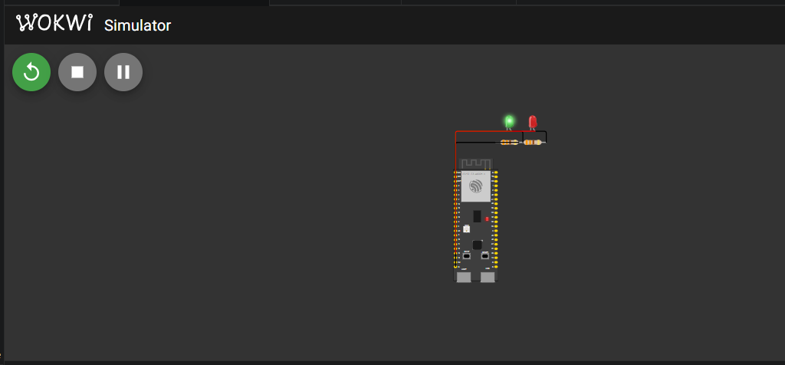
Immediate Results
Base Used | Input Size | Model Size | Tensor Arena | Teacher model size | Wokwi Latency | Est. Real ESP32 Latency | Accuracy / Result Summary
ResNet50 | 96x96x3 INT8 | 23 KB | 204,800 bytes | 0.18 MB | 48,390-48,391 ms | ~2,419.5-419.6 ms | Confidence: 0.595107 Accuracy: 0.85410
EfficientNetB0 | 96x96x3 INT8 | 23 KB | 204,800 bytes | 3.09 MB | 18,391 ms | ~1,172.6 Ms | Confidence: 0.851242 Accuracy: 0.80974
MobileNetV3 | 96x96x3 INT8 | 23 KB | 204,800 bytes | 8.07 MB | 28,391-8,392 ms | ~819.6 Ms | Confidence: 0.968652 Accuracy: 0.86008
ConvNeXt | 96x96x3 INT8 | 23 KB | 204,800 bytes | 23.93 MB | 48,392 ms | ~4,217.6 Ms | Confidence: 0.295631 Accuracy: 0.75106

Slide 13
Base used for student | Hardware | Latency | FPS | RAM usage | Model / Arena
ResNet50 | ESP32-S3 Wokwi | ~2,419.6 ms est. real | 0.41 | 24,880 B static + 204,800 B arena ~70% effective SRAM | 22,728 B 204,800 B
ResNet50 | M5Stack CoreS3 | ~2,419.6 ms est. real | 0.41 | Same ESP32-S3 class 204,800 B arena PSRAM available | 22,728 B 204,800 B
ResNet50 | Raspberry Pi Pico RP2040 | ~43.4 ms est. real | 23.04 | 251,568 / 270,336 B 93.1% RAM used | 22,728 B 204,800 B
EfficientNetB0 | ESP32-S3 Wokwi | ~2,419.6 ms est. real | 0.41 | 24,880 B static + 204,800 B arena ~70% effective SRAM | 22,728 B 204,800 B
EfficientNetB0 | M5Stack CoreS3 | ~2,419.6 ms est. real | 0.41 | Same ESP32-S3 class 204,800 B arena PSRAM available | 22,728 B 204,800 B
EfficientNetB0 | Raspberry Pi Pico RP2040 | ~43.4 ms est. real | 23.04 | 251,568 / 270,336 B 93.1% RAM used | 22,728 B 204,800 B
MobileNetV3 | ESP32-S3 Wokwi | ~2,419.6 ms est. real | 0.41 | 24,880 B static + 204,800 B arena ~70% effective SRAM | 22,728 B 204,800 B
MobileNetV3 | M5Stack CoreS3 | ~2,419.6 ms est. real | 0.41 | Same ESP32-S3 class 204,800 B arena PSRAM available | 22,728 B 204,800 B
MobileNetV3 | Raspberry Pi Pico RP2040 | ~43.4 ms est. real | 23.04 | 251,568 / 270,336 B 93.1% RAM used | 22,728 B 204,800 B
ConvNeXt | ESP32-S3 Wokwi | ~2,419.6 ms est. real | 0.41 | 24,880 B static + 204,800 B arena ~70% effective SRAM | 22,728 B 204,800 B
ConvNeXt | M5Stack CoreS3 | ~2,419.6 ms est. real | 0.41 | Same ESP32-S3 class 204,800 B arena PSRAM available | 22,728 B 204,800 B
ConvNeXt | Raspberry Pi Pico RP2040 | ~43.4 ms est. real | 23.04 | 251,568 / 270,336 B 93.1% RAM used | 22,728 B 204,800 B

Slide 14
Thank You !!

