Slide 1

Machine learning with python
Cryptocurrency price prediction
By
Ponapati JayaSaiReddy
21785A0521
III CSE-B

Slide 2

TEACHNOOK :-
.

Slide 3
IT WAS FOUNDED BY KAJAL-DAVE,LOCATED IN BENAGLORE.
THE COMPANY LOGO IT SHOWS STARTING OF YOUR CAREER .
THE COMPANY OFFERS TO THE STUDENTS INTERNSHIPS LIKE :
MACHINE LEARNING WITH PYTHON
DATA SCIENCE
ARIFICIAL INTELLIGENCE
CYBER SECURITY
WEB DEVELOPMENT
APP DEVELOPMENT
WEB DEVELOPMENT Etc……

Slide 4
CONTENTS :
PYTHON AND ITS USES
LISTS
TUPLES
SETS
DICTIONARY
MACHINE LEARNNG
APPLICATIONS
MAJOR PROJECT
CONCLUSION
REFERENCES

Slide 5
What is Python?
Python is a popular programming language.
It was created by Guido van Rossum, and released in 1991.
Python can be used on a server to create web applications.

Slide 6
It is used for:
Web development (server-side).
Software development.
Mathematics.
System scripting.

Slide 7
List Items :
List items are ordered, changeable, and allow duplicate values.
List items are indexed, the first item has index [0], the second item has index [1] etc.
example:
thislist = ["apple", "banana", "cherry"]
Tuple:-
Tuples are used to store multiple items in a single variable.
A tuple is a collection which is ordered and unchangeable.
mytuple = ("apple", "banana", "cherry")

Slide 8
Sets:-
Sets are used to store multiple items in a single variable.
A set is a collection which is unordered, unchangeable*, and unindexed.
myset = {"apple", "banana", "cherry"}
Dictionary:-
Dictionaries are used to store data values in key:value pairs.
A dictionary is a collection which is ordered*, changeable and do not allow duplicates.
thisdict = { "brand": "Ford", "model": "Mustang", "year": 1964 }

Slide 9
What is machine learning?
Machine learning is a branch of artificial intelligence (AI) and computer science
It focuses on the use of data and algorithms
To imitate the way that humans learn, gradually improving its accuracy.

Slide 10
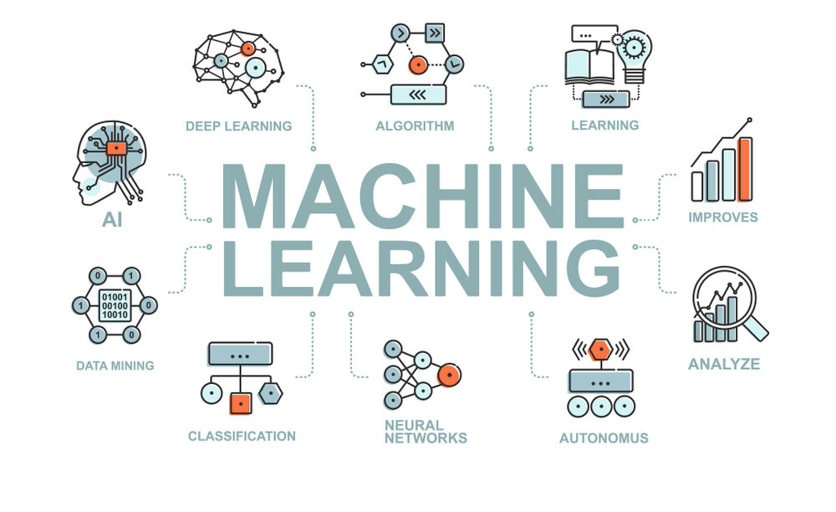
MACHINE LEARNING :-

Slide 11
APPLICATIONS OF MACHINE LEARNING:-
Machine learning is used in internet search engines.
Email filters to sort out spam.
Websites to make personalised recommendations
Banking software to detect unusual transactions
Lots of apps on our phones such as voice recognition.

Slide 12
Bitcoin Price Prediction and Analysis Using Machine Learning Models:-
It is a digital medium of exchange that is encrypted and decentralized
Cryptocurrencies are a digital way of money
Some of the cryptocurrencies are :-
Bitcoin
Ethereum
Shiba inu
BNB etc….

Slide 13
Related Works:-
Researches on the prediction of cryptocurrencies using machine learning.
Bitcoin (BTC) price prediction using different techniques.
LSTM and GRU which are the latest and efficient techniques for the forecasting of bitcoin price.
The process of prediction starting from collecting data .

Slide 14
Data and Data Set Preparation Method :-
Data set preparation is a crucial step in machine learning.
Data preparation is the process of collecting, combining, organizing, and structuring
Data then it can be considered as data visualization, analytics, and data mining
with machine learning applications.
The dataset used for this research consists of
daily price value.

Slide 15
LSTM(LONG SHORT TERM MEMORY):-
It is used for time-series data processing, prediction, and classification.
LSTM has feedback connections, unlike conventional feed-forward neural networks.
It can handle not only single data points (like photos) but also complete data streams (such as speech or video).

Slide 16
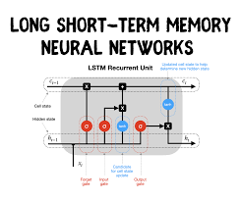
LSTM(LONG SHORT TERM MEMORY):-

Slide 17
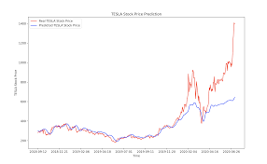

Slide 18
GRU(GATED RECURRENT UNIT):-
The GRU is the newer generation of recurrent neural networks and is pretty similar to an LSTM
It has also only two gates, a reset gate and update gate
Reset Gate: The reset gate is another gate that is used to decide how much past information to forget.
Update Gate: The update gate acts similar to the forget and input gate of an LSTM.
It decides what information to throw away and what new information to be added.

Slide 19
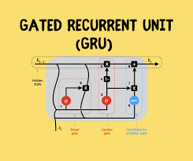

Slide 20
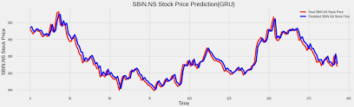

Slide 21
SOURCE CODE:-
import pandas as pd
import yfinance as yf
import datetime
from datetime import date, timedelta
today = date.today()
d1 = today.strftime("%Y-%m-%d")
end_date = d1
d2 = date.today() - timedelta(days=730)
d2 = d2.strftime("%Y-%m-%d")
start_date = d2
data = yf.download('BTC-USD',
start=start_date,
end=end_date,
progress=False)
data["Date"] = data.index
data = data[["Date", "Open", "High", "Low", "Close", "Adj Close", "Volume"]]
data.reset_index(drop=True, inplace=True)
print(data.head())

Slide 22
Results and Discussion :-
The proposed model of LSTM and GRU price prediction of cryptocurrencies was trained,
and the predictions were carried out for popular cryptocurrency.
GRU model is more effificient than that of LSTM models

Slide 23
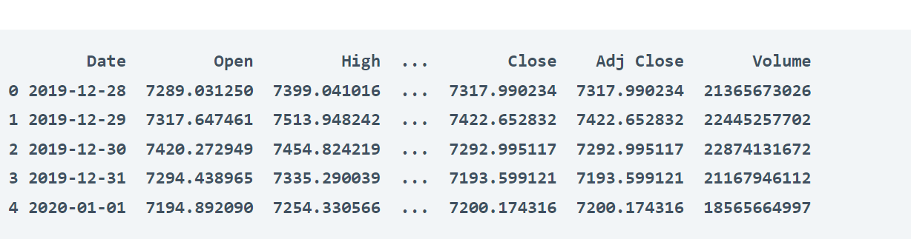
OUTPUT:-

Slide 24
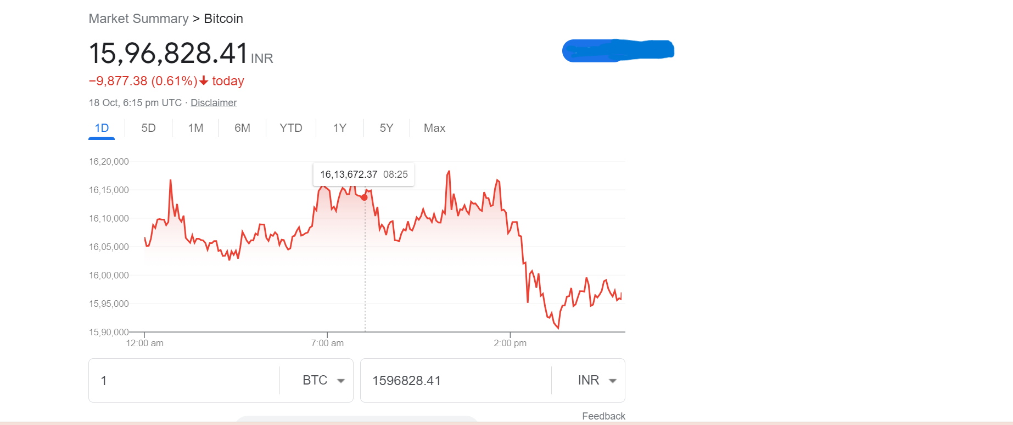
OUTPUT:-

Slide 25
Conclusion:-
Finally I conclude that , cryptocurrencies are the most popular decentralized way of virtual currency which has a great
role in the free market economy and avoids the intermediary of another third party between customers.
Successfully that I completed the machine learnig with python Internship regarding .
-- Ponapati jayasaireddy

Slide 26
References :-
Nakamoto S et al. (2008) Bitcoin: a peer-to-peer electronic cash system, 2008. Working Paper from www.bitcoin.org
Goodfellow I, Bengio Y, Courville A (2016) Deep learning. MIT press

Slide 27


Slide 28


