Slide 1
What is Elasticsearch?
Elasticsearch offers you to store, search, and analyze large amounts of structured and unstructured data. It primarily works on the concept of indexing. Since it also capable of storing large amounts of structured and unstructured data, it is considered a NoSQL database.

Slide 2
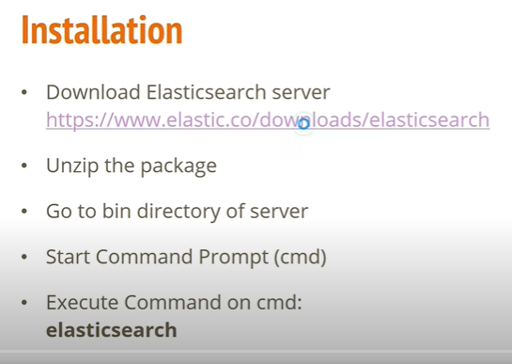

Slide 3
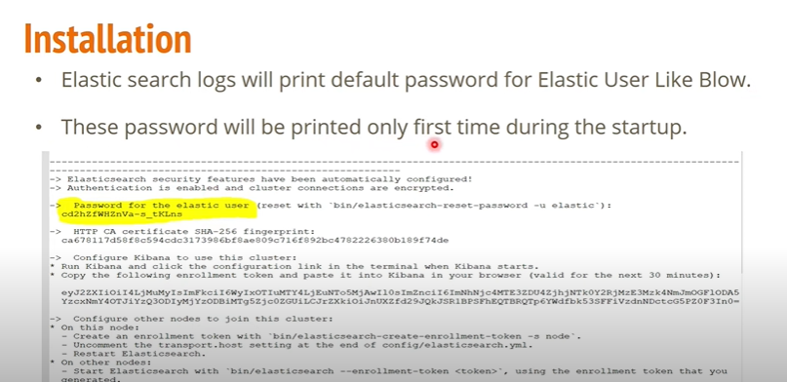

Slide 4


