Slide 1
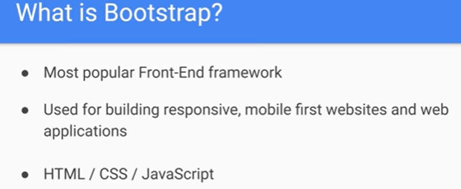
Bootstrap

Slide 2
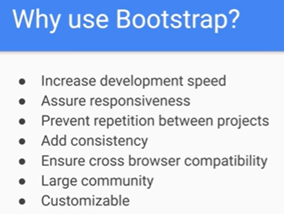

Slide 3
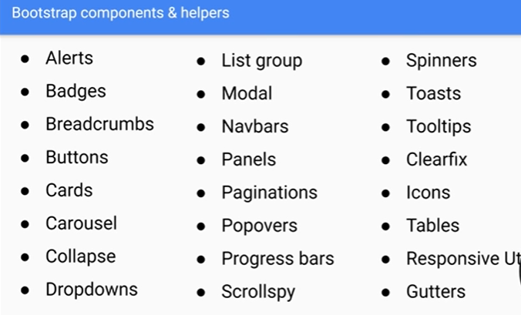

Slide 4
https://www.w3schools.com/bootstrap/bootstrap_ver.asp
Can have bootstrap with ur project via
Download src file
Cdn
Npm

