Slide 1
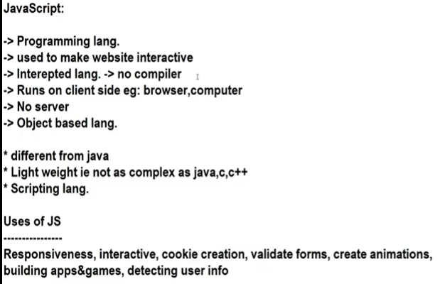
javascript

Slide 2
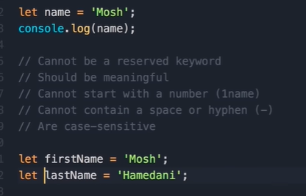

variables

Slide 3
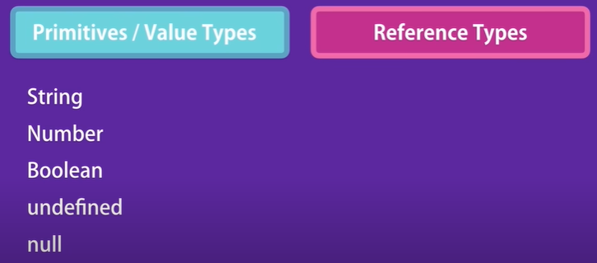
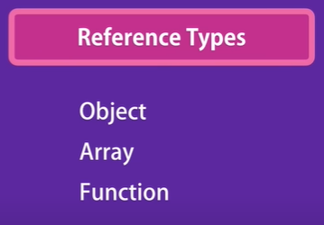

Slide 4
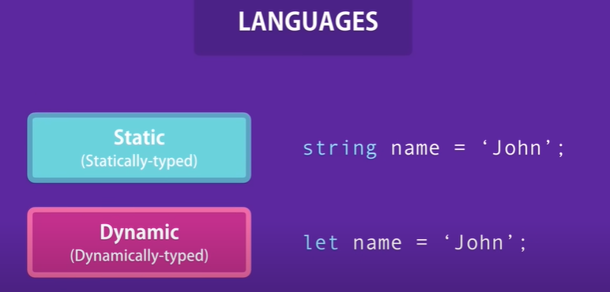

Slide 5

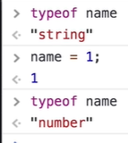
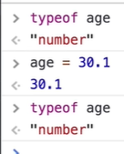
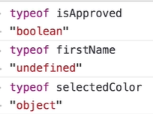

Slide 6
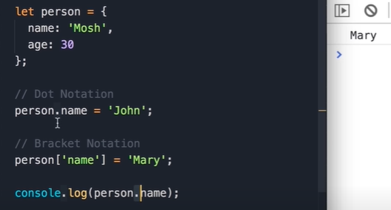

object

Slide 7


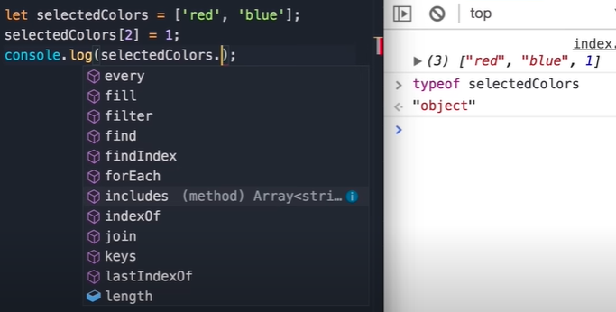
list

Slide 8



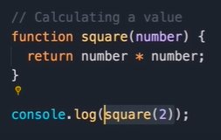
function

Slide 9

Adding element to html append- appendchild-

Slide 10


Textcontent –text that are visibile on screen innertext-represents text present in html code

Slide 11


innerHTML-recognize html tag

Slide 12
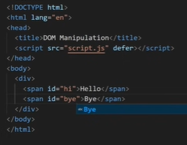


Slide 13




getAttribute- setAttribute- removeAttribute-

Slide 14




Slide 15


Add new class remove class

Slide 16

Toggle –false—removes class Toggle-True—adds class

Slide 17


