Slide 1
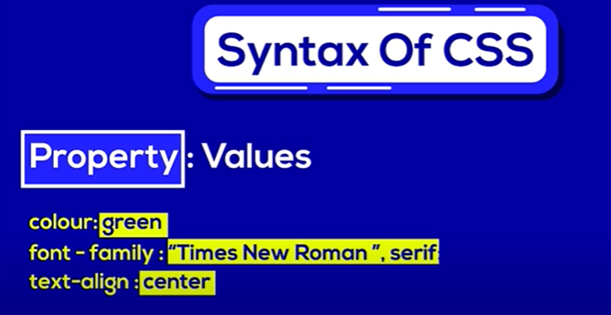
Css CSS stands for Cascading Style Sheets CSS describes how HTML elements are to be displayed on screen, paper, or in other media https://laracasts.com/series/css-grids-simplified

Slide 2
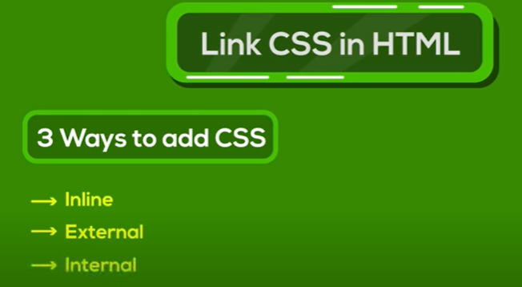

Slide 3



Slide 4
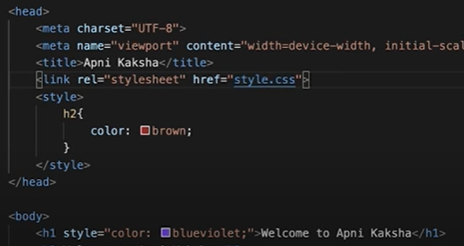

Slide 5
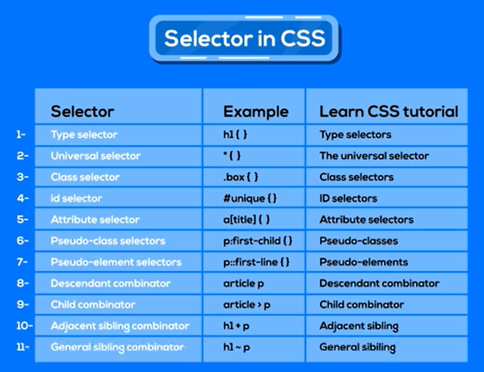

Slide 6
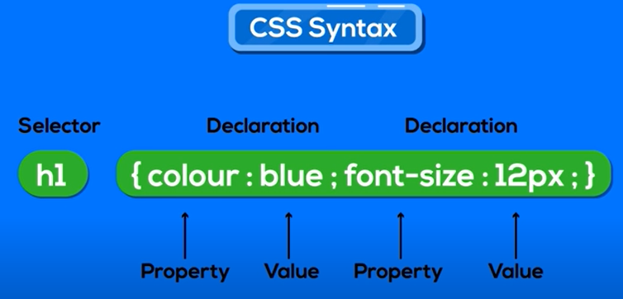

Slide 7


Slide 8
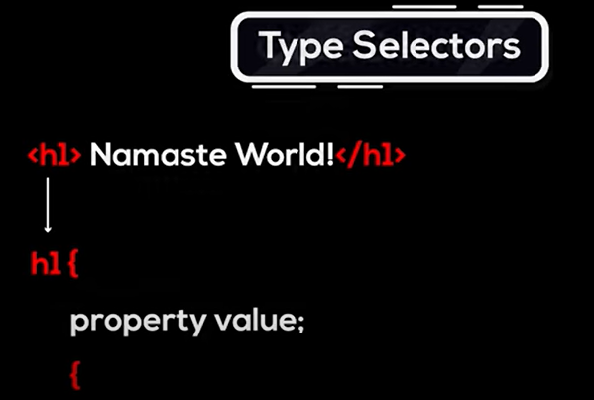
https://www.w3schools.com/cssref/trysel.php?selector=id

Slide 9
https://laracasts.com/series/css-grids-simplified

Slide 10
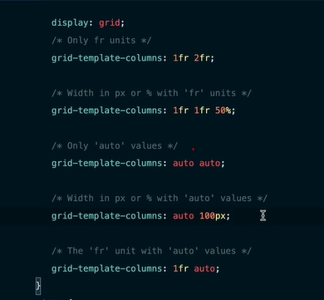
If u need equal width column column proportional to each other
If u need any specific columns to occupy 50% of space
If u need columns to occupy space according to its content
If u need one columns to have fixed width and other to have space as much its content needed
When parent width is more than combined width of columns content and if u don’t want extra space to be distributed equaly then add fr units to column that need max space and auto for other

Slide 11
loading api
Loading.io website

Slide 12
Emogi api
https://emoji-api.com/

