Slide 1

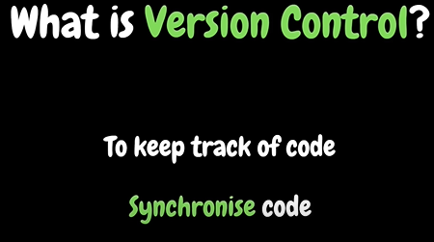
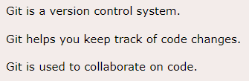
Git

Slide 2
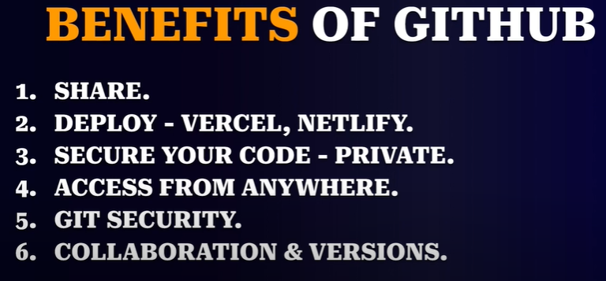

Slide 3
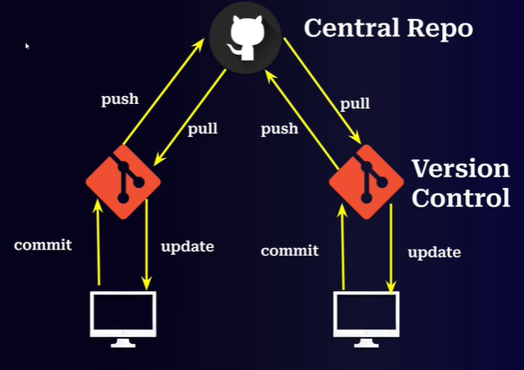

Slide 4
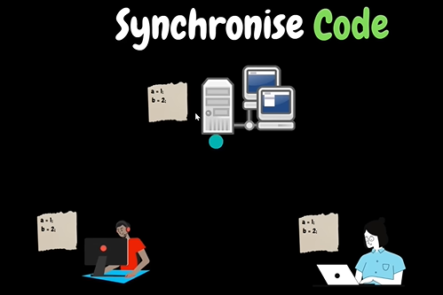
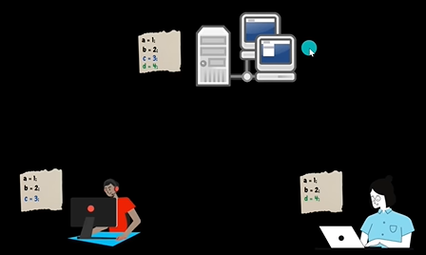
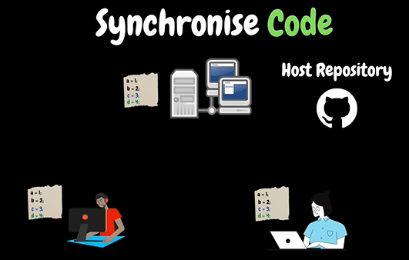

Slide 5
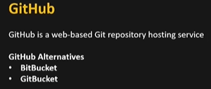
Types of git hosting services

Slide 6
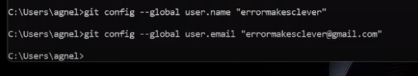
Link github user name and email to git in terminal

Slide 7
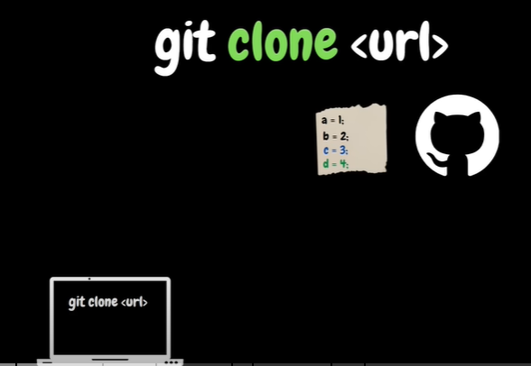
Git clone
Clones code to local system

Slide 8
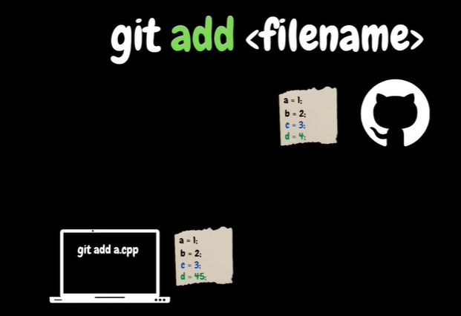
Git add
Git add . ➔add all untracked files

Slide 9
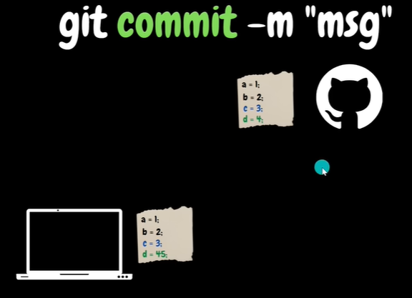
Git commit -saves changes only in local

Slide 10
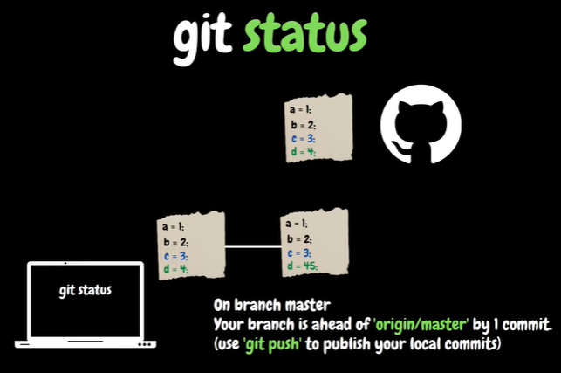
Git status

Slide 11
1st time push

Slide 12
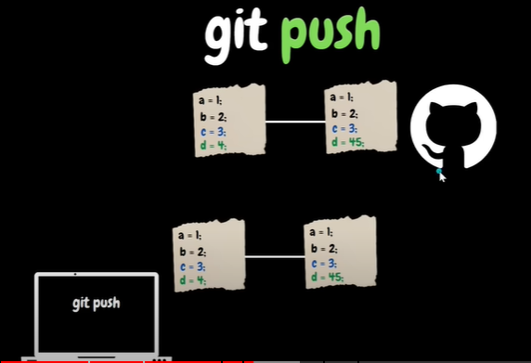
Git push -to save changes to github
Files from local is saved to github

Slide 13
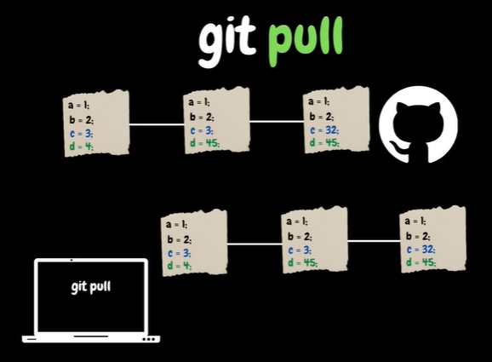
Git pull -combination of fetch and merge
Fetch files from github and merge it to local

Slide 14
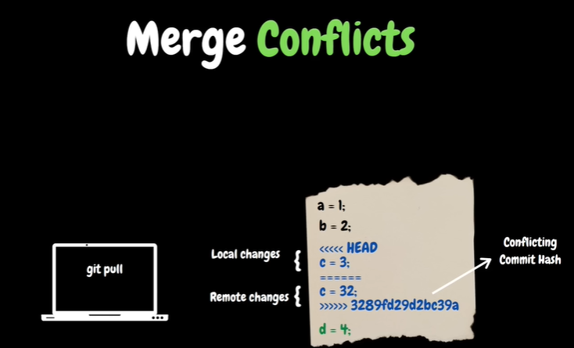

Slide 15
Shorthand for commit all files
Git commit -am “commit msg”
-am➔all files

Slide 16
connect to new repo
Initialize empty repo

Slide 17
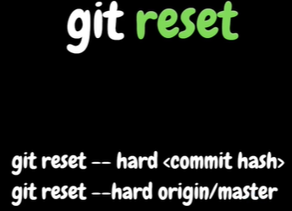

Slide 18

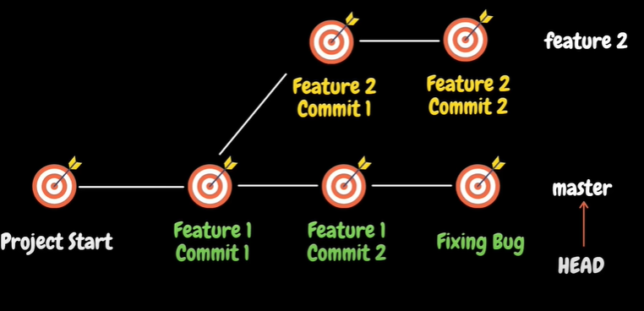
Without branch
-am➔all files
With branching

Slide 19
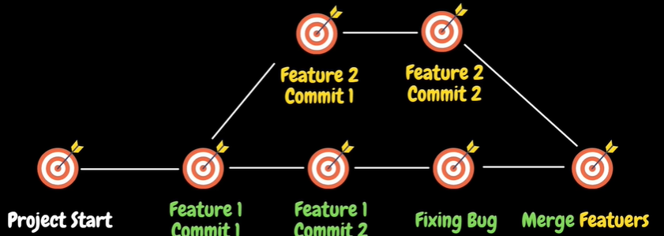

Slide 20
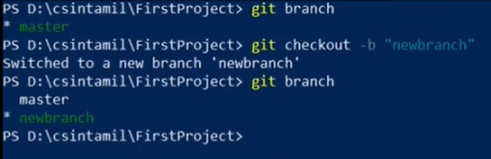
Git branch -lists all branches Checkout -used to change branch

Slide 21
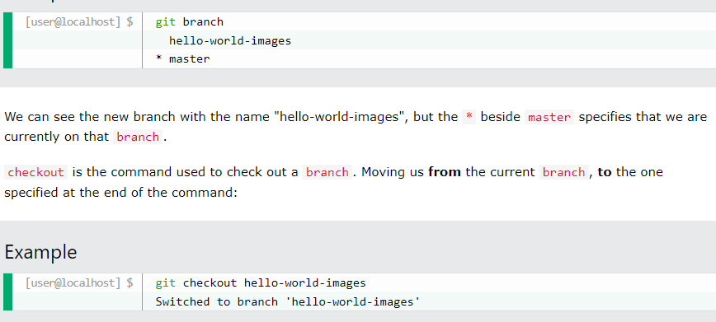
-b ➔creates new branch if doesn’t exists

Slide 22
