Slide 1
PREDICTING THE SALES PRICE BASED
ON BOSTON HOUSING DATA
By
Jayachander R Kandakatla

Slide 2

1. INTRODUCTION
Buying a new house has become very important thing in ones life.
On the other side investing in Housing has also become a lucky draw sometimes, good investments turn out to be bad investments
By applying machine learning tools and techniques predicting the housing prices may solve the problems mentioned above to some extent.
This study will benefit many household and real estate brokers and businessmen

Slide 3

2. DATA ACQUISITION AND ANALYSIS
Data Sources
Kaggle
Wikipedia

Slide 4
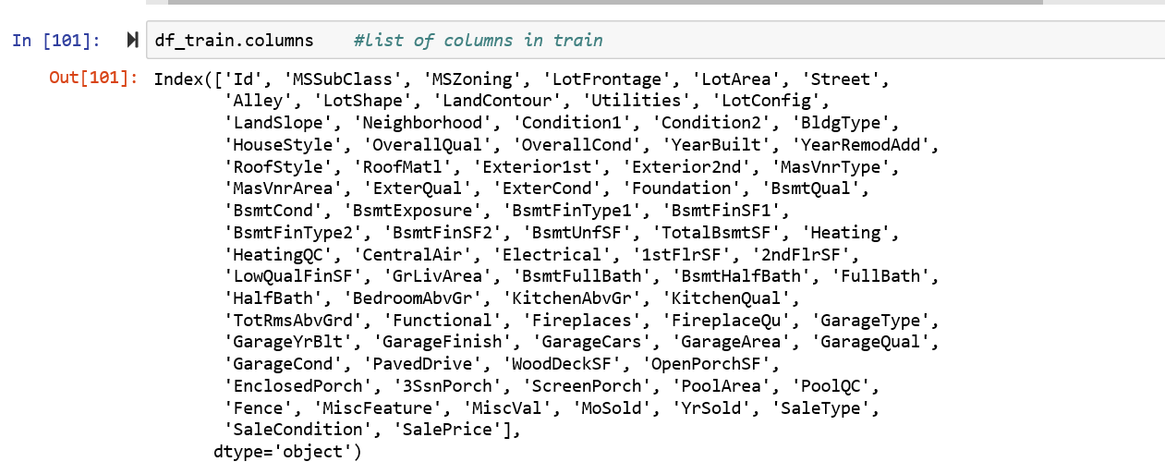
Description of Data
Below are the 81 features describing the each house corelated with Sales price

Slide 5
3. METHODOLOGY
3.1 Reading of Data
I have also found missing values for Alley, Lot Frontage, Fireplace Quality and few other features.
I have dropped few and used feature scaling techniques to assume.
The Data has 81 features and 1460 observations in train data and 1459 Observation in test data.
There are missing values in 19 features and we can drop a few which has more than 50% of the null values in total observations and remaining can be deal with feature scaling and replacing null values with Mean or mode depends on other feature effects on null values.

Slide 6
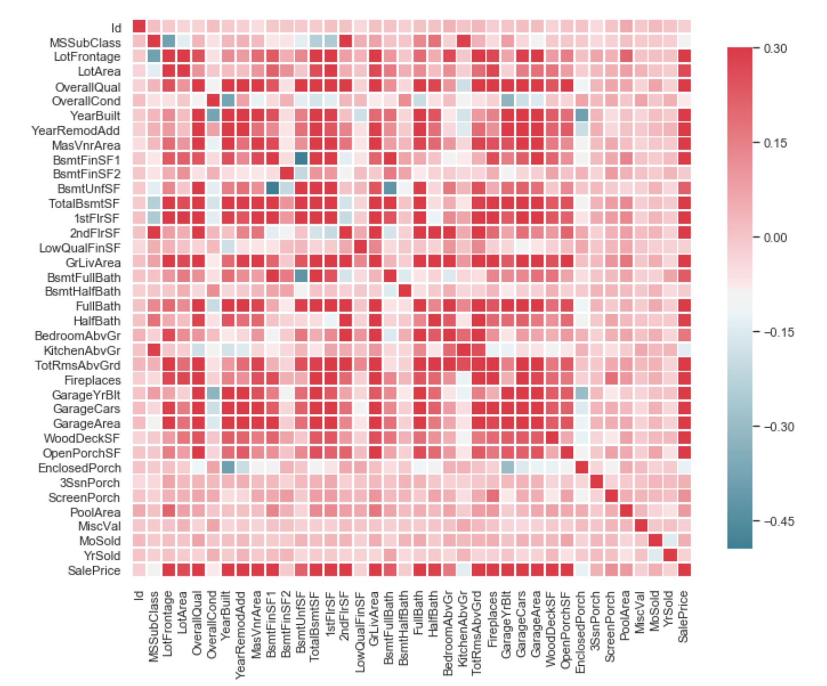
3.2 Correlation and Feature Scaling
The correlation graph shows that “Overall Quality” and “Above grade (ground) living area square feet” has highest impact on sales price.
“Total Bsmt Sf” and “1stFlr Sf” has next level impact on Sales price.

Slide 7
3.3 Data Cleaning (Null Values)
Lot Area and Lot Frontage many have Null Values, so we are filling null values with mode of the respective Neighborhood feature.
I have used similar way to fill null values for “Fireplace Qu”.
I have used where function and np.median to fill the null values in Lot Frontage.
I have done the similar cleaning with MasVnrType","MasVnrArea" with respect to “Foundation”.
We cannot simply replace the null value with Mode or median as new data coming in mode and mean values changes so, I have changed value counts to to-list and there I have taken the first values as they are in decreasing order. I have repeated the dame thing with “Bsmt Cond”, “Bsmt Exposure”, “BsmtFinType1”, “BsmtFinType2”, “Electrical”.
Here is a tricky part, “GarageType", "GarageFinish", "GarageQual", "GarageCond", “Garage YrBlt”. All have similar null values.
. Yes, without Garage Year built, there won’t be any other ways to know details of other Garage features.
Best thing is to drop all these but as the observations are less in number I keep them as unknown.
I have dropped the following featues "PoolQC", "Fence", "MiscFeature", "Alley" as they have more than 60% of the observations are null values.

Slide 8
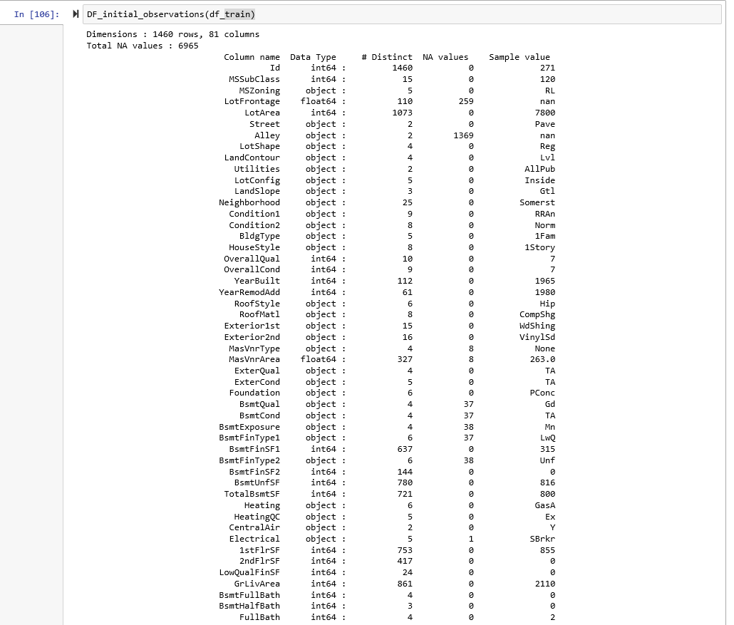
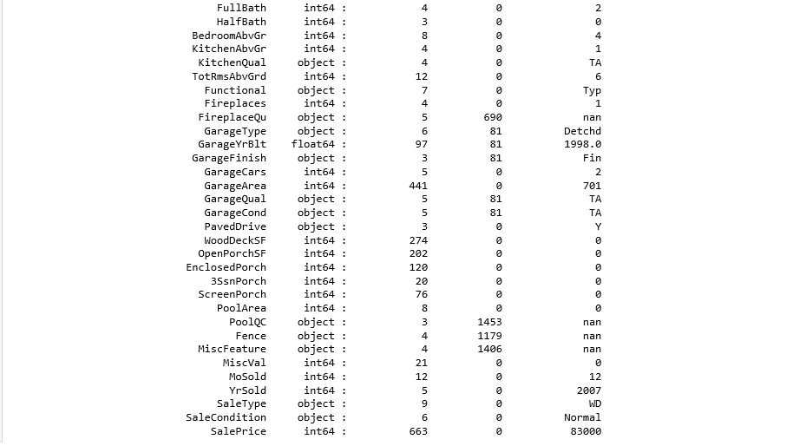

Slide 9
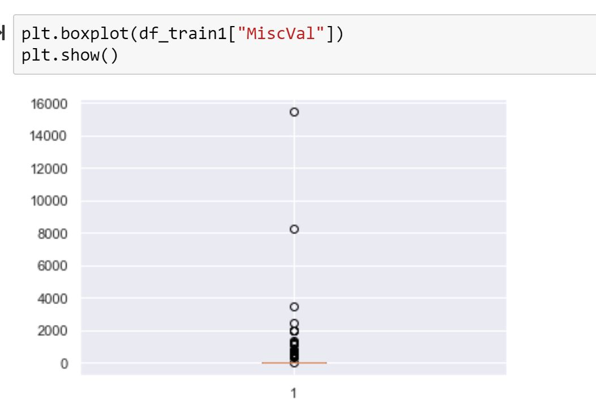
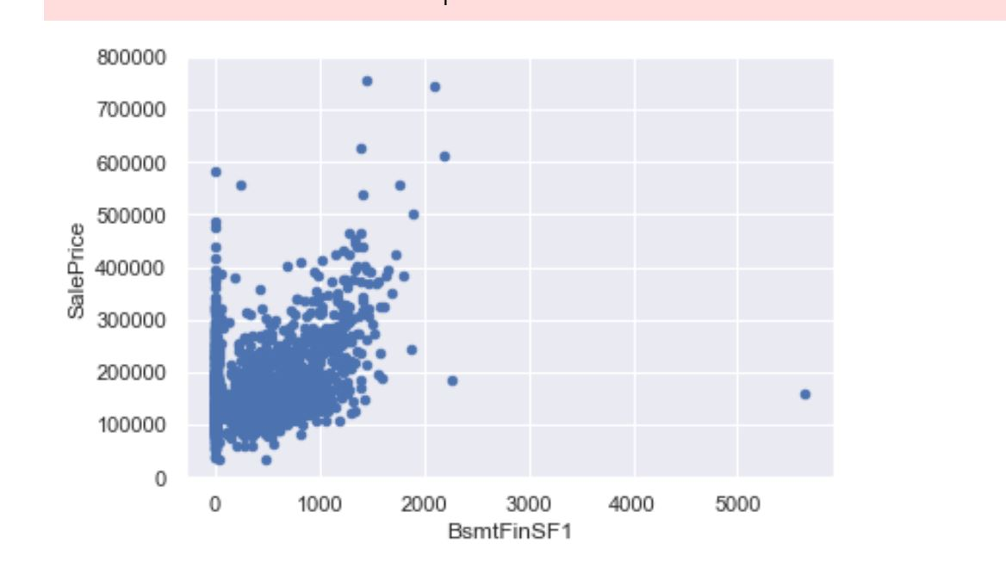
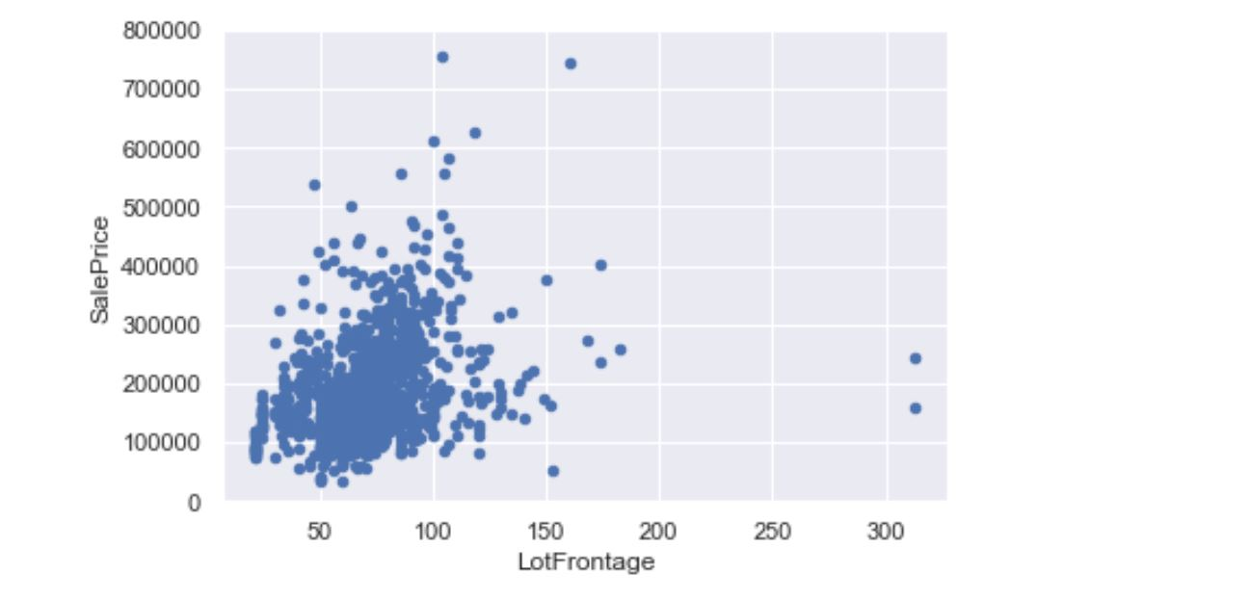
3.4 Clearing Outliers- Train Data
Outliers play an important role in increasing the variance and confuse the model which leads to predicts go wrong on unseen data which is overfitting
We need to clear outliers first.
By using Box plot I have observed that “3SsnPorch”, “LotFrontage”, “3SsnPorch”, 'MasVnrArea', 'BsmtFinSF1', 'BsmtFinSF2', 'ScreenPorch', has outliers which can be removed.

Slide 10
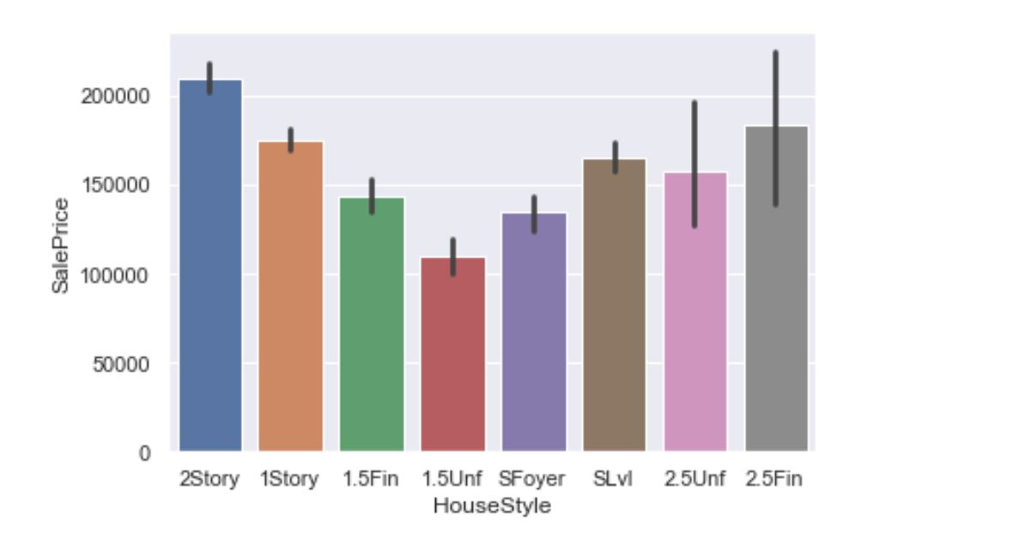
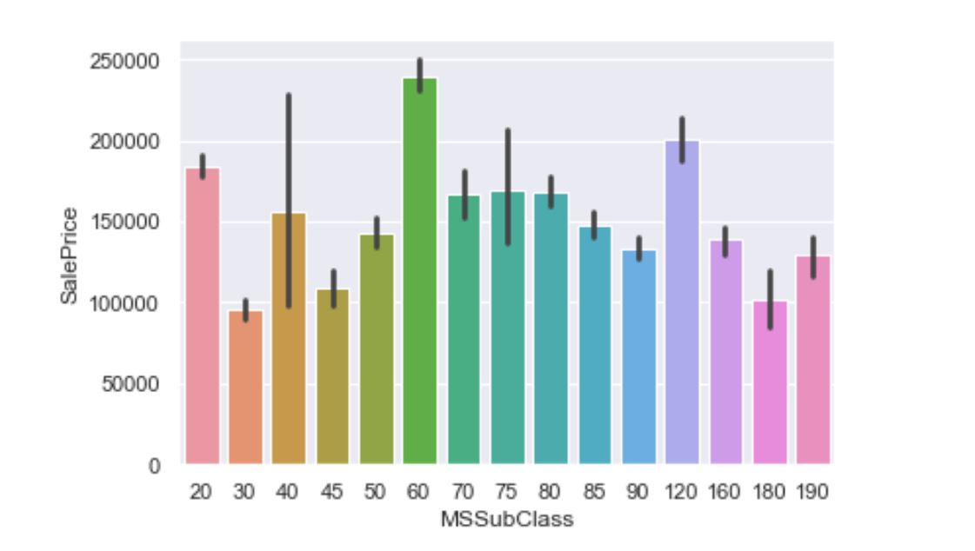
4. Visualization
From Visualization I have following Conclusions:
People are preferring 2 floor houses and has highest sale price observed ranges to 200000 followed by 2.5 floors with finished which is less than 20000.
Building Class with 60 has highest sale price ranges to almost 250000+ and other classes has not even made it to 200k club except class 120.

Slide 11
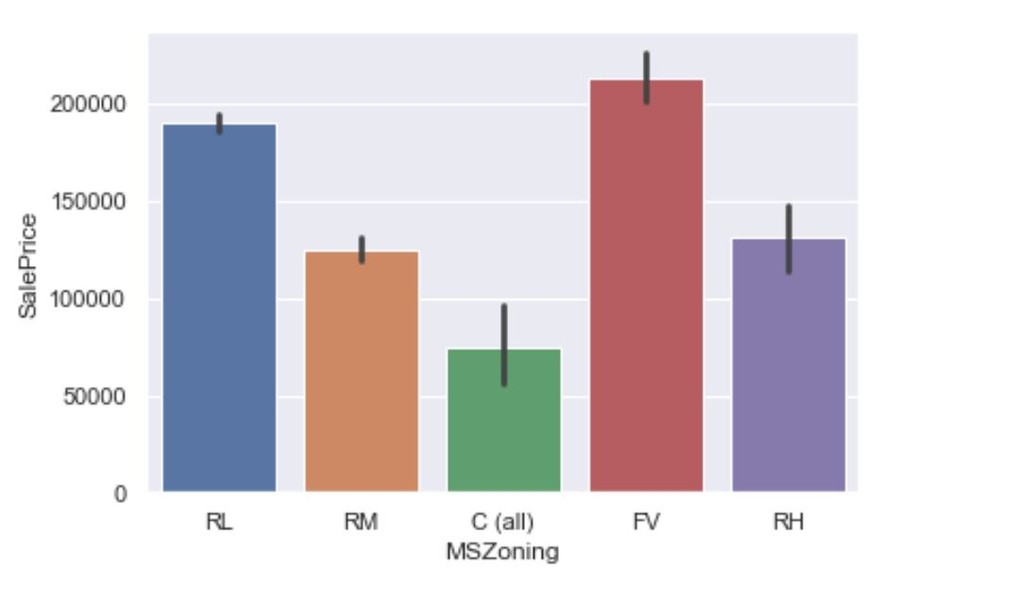
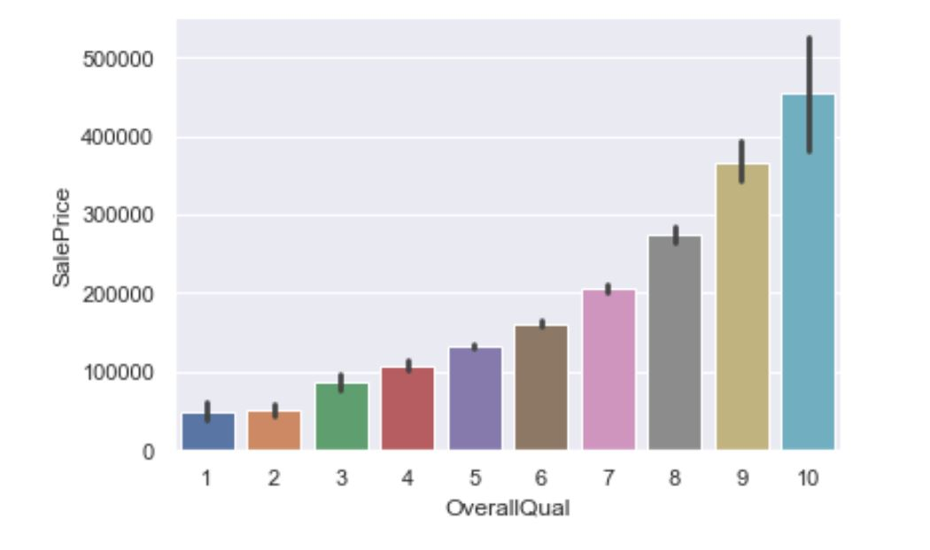
People are ready to pay highest price almost 200k+ in Village Residential Zoning.
As we discussed earlier sale price also increase with Overall Quality in a Ordered way. With 10 being Very Excellent and has highest sale price of 400k+ and others quality not even made it to 400k club.

Slide 12
5. Converting Datatypes
Datatypes of each observation must be changed to Continuous variables in order to feed to data.
It all depends of Nominal or Ordinal Data.
In summary, nominal variables are used to “name,” or label a series of values.
Ordinal scales provide good information about the order of choices.
We can use map function to map Ordinal Values and Nominal can be converted by creating Dummies.
We use these techniques to create dummies for "LotConfig", "Neighborhood", "Condition1" , "Condition2", "RoofMatl", "Exterior1st", "Exterior2nd", "Heating", "Electrical","RoofStyle" , "MasVnrType", "Foundation", "GarageType", "SaleType" , "SaleCondition”, I used map function for other Categorical features.

Slide 13
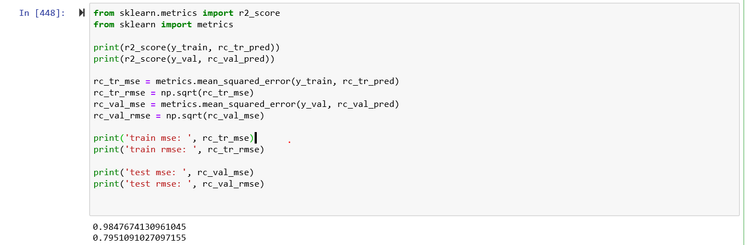
6. RESULTS:
After scaling the data I have applied Random Forest Regressor as this is Regression Dataset on train data by splitting the data in to train and validation.
Model accuracy is 97% on training data and almost 90% in validation data.
This is also a good prediction in terms of model consideration.
We can assume that out test results also 90% correctly predicted.

Slide 14
8. CONCLUSION:
With enough data feeding to the model the random forest regressor predicted outcomes are very good results and we can predict the house prices with more and more data and more and in other cities.
Although the predictions differ with cities and states and same with prices.
But the process of predicting the model with enough Data is a good thing.
Although We cannot depend 100% on the model prediction because the accuracy is not 100% we can consider the predictions for any future decisions.

Slide 15
Thank You !

