Slide 1

AI-Powered Payment Gateway
Platform
End-to-End Capstone · Architecture · AI · Operations
10,045
501
5
2
transactions
users
containers
AI models
Jayachandran · Mentor: Siva · June 2026
Notes:
This project implements a production-architecture payment gateway from first principles — not a tutorial clone, but a system designed against real payment engineering constraints. In the next 15 minutes I'll walk through the problem, the architecture decisions, the AI layer, the operations dashboard, and the measured results. Every number you'll see is from a running system, not a mockup.

Slide 2
Why This Problem?
The Pain
The Thesis
Payment platforms take 3–5 years to build correctly
Hexagonal architecture makes each domain independently evolvable
Fraud costs India ₹5,000+ crore annually; decisions are manual
AI delivers fraud decisions in <1ms — faster and more consistent
Ops teams answer the same questions hundreds of times a day
Vector knowledge base turns policy docs into a queryable assistant
Existing gateways: monolithic, opaque, hard to instrument
Architecture is production-ready in shape; gaps are documented
Notes:
The problem has three dimensions. First, correctness — payment systems must never lose money, double-charge, or produce inconsistent ledger state. Second, intelligence — fraud rules written in 2018 don't catch 2026 patterns; AI must be in the loop. Third, operations — support teams waste hours on questions a knowledge base could answer in seconds. The explicit scope boundary: we build the architecture and demonstrate it works; full production hardening is a defined 180-hour roadmap, not a hidden gap.

Slide 3



What the System Must Do
Correctness
Intelligence
Operability
Decimal-precise monetary values — no float
Score every transaction for fraud in <10ms
Single-command startup: make up
Double-entry ledger: 2 entries per payment, always balanced
Explain decisions in plain language via Azure OpenAI
Health + readiness endpoints on every service
Idempotency: same request → same result
Answer policy questions from a vector knowledge base
Structured JSON logging with trace IDs
Optimistic concurrency: two debits cannot both succeed
Degrade gracefully when AI services are unavailable
React dashboard: live transactions, risk, AI panels
Notes:
I'll use these three columns as the organising frame for the rest of the talk. Correctness comes first — the payment domain doesn't care how clever the AI is if a wallet can go negative or a transaction can be double-charged. Intelligence is layered on top: the fraud engine works with zero network calls and upgrades to LLM explanations when available. Operability is how we demonstrate the system is real — everything runs, everything is observable, and a reviewer can reproduce it in 10 minutes from a clean checkout.

Slide 4




Five Containers, One Command
pg-net (internal bridge network)
pg-frontend
pg-core-api
pg-ai-service
React + nginx
FastAPI + SQLAlchemy
FastAPI + Azure OpenAI
:3000
:8000
:8100
pg-postgres
pg-redis
PostgreSQL 16 + pgvector
Redis 7 · AOF
:5432
:6379
Ports 3000, 8000, 8100 exposed · Postgres & Redis internal-only · depends_on healthcheck ordering
Notes:
Notice what's not here: no Kubernetes, no service mesh, no cloud-managed databases. This is the correct MVP trade-off. The same domain boundaries, API contracts, and database schemas that work in this five-container Compose stack work in a 14-service Kubernetes deployment. ADR-005 records the exact revisit trigger: when the team exceeds 2 engineers or sustained load exceeds 10 RPS.

Slide 5
Modular Monolith → Extraction Path
MVP (Built Today)
Production Target (14 services)
identity-service · merchant-service
identity/
users, KYC status
payment-service · refund-service · dispute-service
wallet/
balances, currencies
wallet-service · settlement-service
ADR-008 →
Revisit when
team boundaries
emerge
ledger-service (separate Postgres cluster)
payment/
transactions, lifecycle
fraud-service · risk-scoring-service
ledger/
double-entry entries
notification-service · webhook-service
analytics-service · admin-service
Each: api/ · application/ · domain/ · infrastructure/
Notes:
This is the most important architectural decision in the project. A modular monolith is the correct starting point when team size and load don't justify 14 separate deployments. The hexagonal structure inside each package ensures that when payment becomes its own service, the domain logic moves unchanged; only the infrastructure adapters are rewritten.

Slide 6
Four Schemas, Clear Boundaries
core
users · wallets · transactions
Key Design Choices
Money type
NUMERIC(18,4) · raises TypeError on float
ledger
entries (no FK to core — by design)
UTCDateTime
Rejects naive datetimes at ORM layer
ai
knowledge_chunks vector(1536)
Idempotency
UNIQUE(merchant_id, idempotency_key) on transactions
No ledger FK
Preserves ledger cluster extraction path (ADR-006)
ops
health_probe · audit_log
Wallet version
INTEGER column for optimistic concurrency control
Notes:
Two things are worth pausing on. First, the Money type: it raises a TypeError if you pass a float. There's no way to accidentally use float money in this codebase. Second, the deliberate absence of a foreign key from ledger.entries.transaction_id to core.transactions. If I add that constraint today, moving the ledger to its own Postgres cluster requires a migration. Leaving it off means the move is operational — change a connection string, update one config value.

Slide 7
A Payment in 7 Steps
1
2
3
4
5
6
7
Validate
Idempotency
Wallet Lookup
Insert Pending
Debit Wallet
Post Ledger
Return
amount, currency,
merchant_id, idem key
Redis check → DB
Return cached if hit
user + currency
Transaction row
in core.transactions
version check
Optimistic lock
DEBIT wallet
CREDIT merchant
status, score
200/201/202
State Machine
Invariant Verified
pending → success
0 imbalanced ledger
transactions across
10,045 records
success → reversed
pending → failed
pending → flagged
SQL verified post-seed
flagged → success / failed
Notes:
Walk through the path slowly. The idempotency pre-check at step 2 is critical: if the client sends the same Idempotency-Key twice, we return the cached response before touching the wallet or ledger. The state machine is enforced at the service layer — the database ENUM enforces the valid set of values, but the service is the source of truth for valid transitions. 19 illegal transitions are tested, all blocked. Failed transactions skip the ledger entirely — post-seed SQL verification across all 10,045 rows confirmed 0 imbalanced entries.

Slide 8
Fraud Score in <1ms — Then Explain
Tier 1 · Rule Engine (~1ms)
Rule Categories
ALWAYS runs — no external I/O
Amount — large INR/USD, round-number patterns
15 pure functions · 6 categories
score = min(Σ weights, 100)
decision = allow / review / reject
Velocity — prior failures, high frequency, new account
Geo — FATF high-risk countries, cross-border
Method — large bank transfer, foreign card
Merchant — gambling/crypto categories, new merchant
Tier 2 · LLM Explanation (best-effort)
Behaviour — odd hour, new device, sparse metadata
Azure OpenAI · temperature=0.2
3s timeout · template fallback
llm_used: bool in every response
Score 100 REJECT — ₹500,000 bank transfer → m_gambling_xyz → KP receiver → new device → 03:00 → 2-day-old account
Notes:
The key design principle is the separation between Tier 1 and Tier 2. Tier 1 cannot fail — 15 synchronous pure functions with no external I/O. The fraud decision is always available in under 1ms. Tier 2 is best-effort enrichment with a 3-second timeout. The llm_used field in every response tells the caller which path was taken. The evidence dictionary — each rule hit returns the raw values that triggered it — is the audit trail.

Slide 9
48 Chunks · 1,536 Dimensions · <200ms
Retrieval Pipeline
Knowledge Base
Query string
refund_policy.md
9 chunks
embed(text-embedding-3-small)
chargeback_policy.md
9 chunks
fraud_policy.md
9 chunks
1,536-dim unit-normalised vector
settlement_policy.md
11 chunks
pgvector HNSW · 1-(A<=>B) · [0,1]
payment_failure_policy.md
10 chunks
OR Dice-coefficient keyword <5ms
Total 48 chunks · 100% embedded
RAGQueryResponse
100%
80%
48/48
search_mode · embedding_used · scores
vector top-1
keyword top-1
embedded
Bug caught: <#> (negative inner product) → replaced with <=> (cosine distance). Wrong operator produced scores > 1.0, clamped to 1.0, destroying ranking. Found by testing score ranges systematically.
Notes:
The embedding model produces 1536-dimensional unit-normalised vectors. Cosine similarity 1-(embedding<=>query_vec) returns values in [0,1]. The HNSW index makes ANN queries take 1-3ms for 48 chunks. The bug: initial implementation used <#> (negative inner product) instead of <=>. For unit-normalised vectors, <#> returns the negative cosine similarity, so 1-<#> gave values in [1,2]. The score normaliser clamped everything to 1.0. Found because we tested the output contract, not just the happy path.

Slide 10
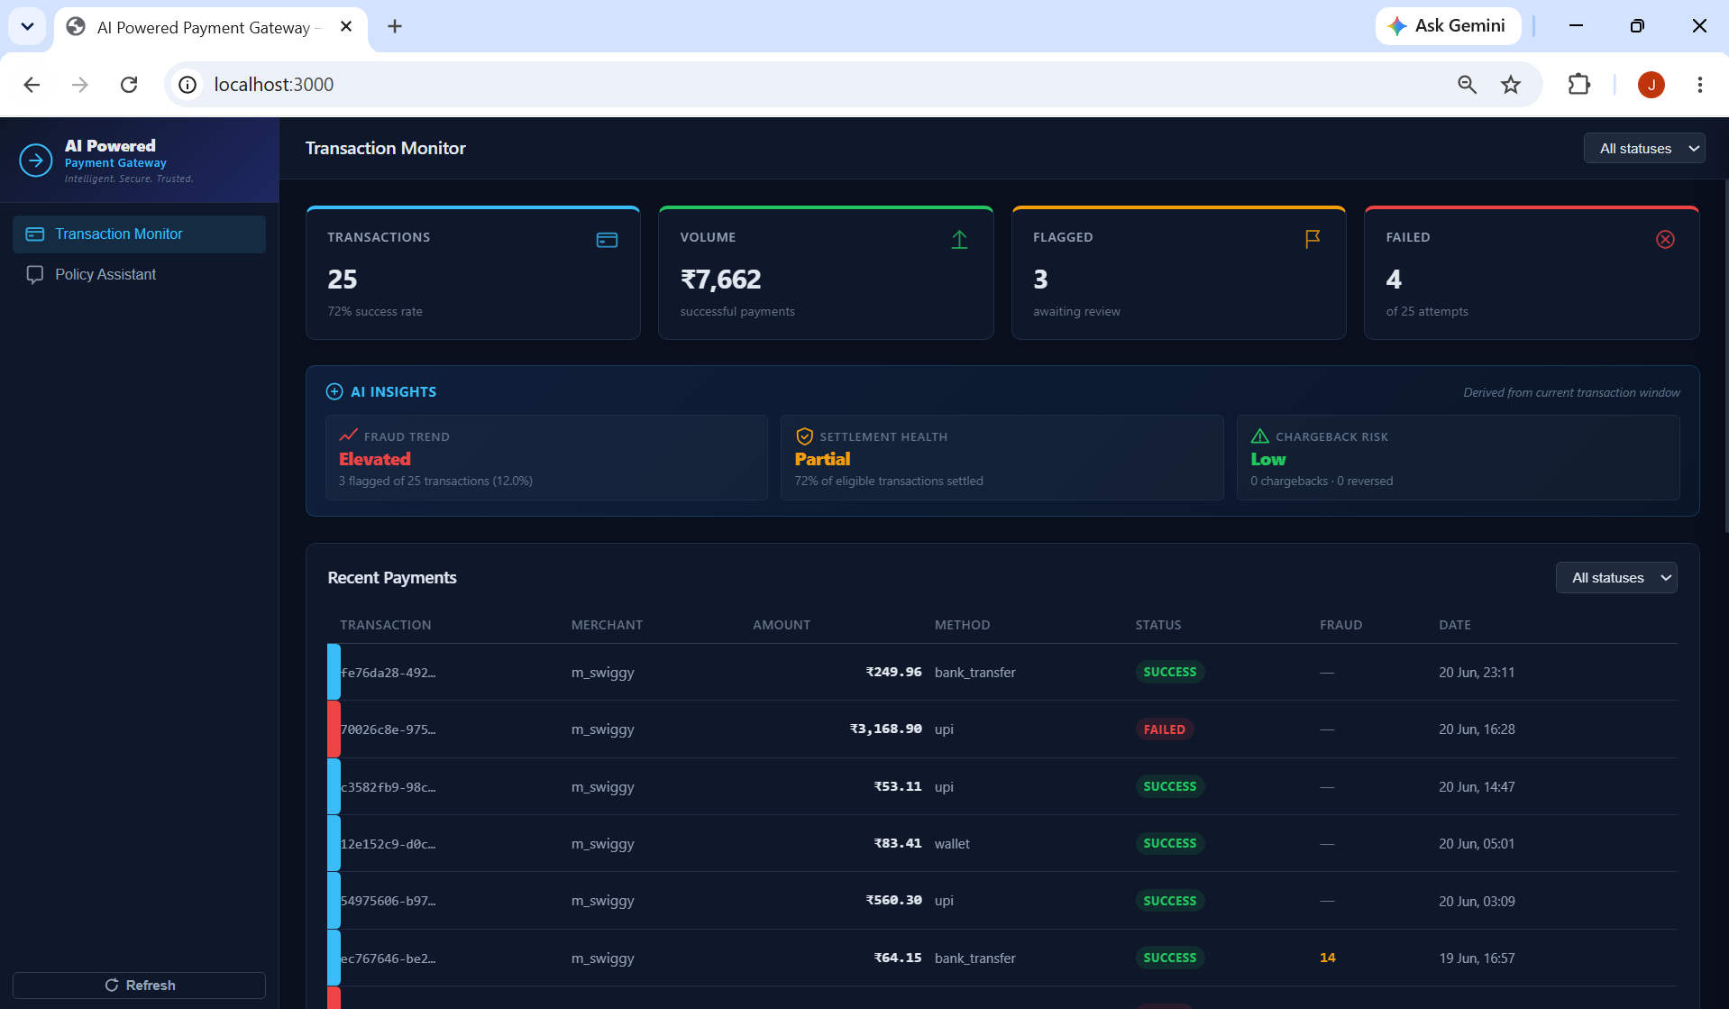
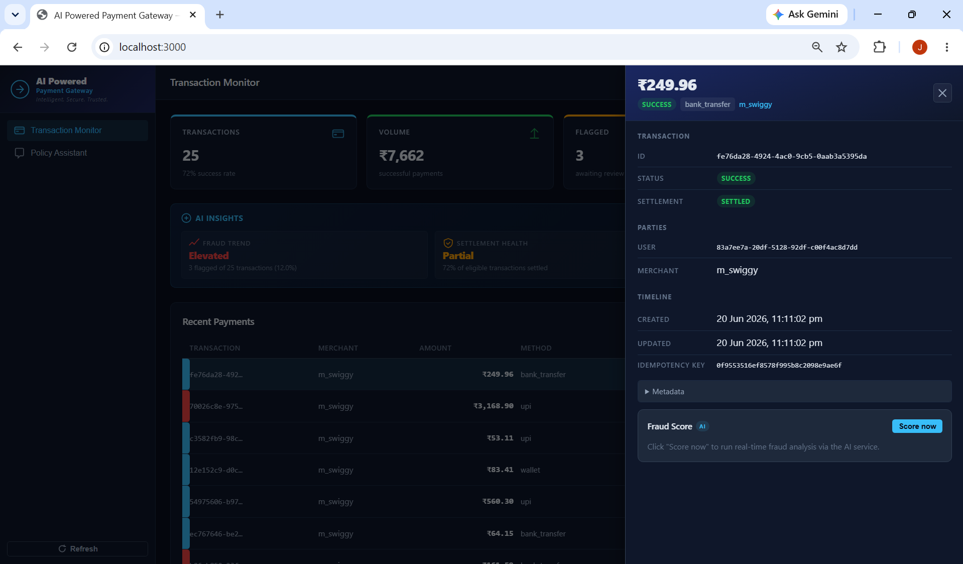
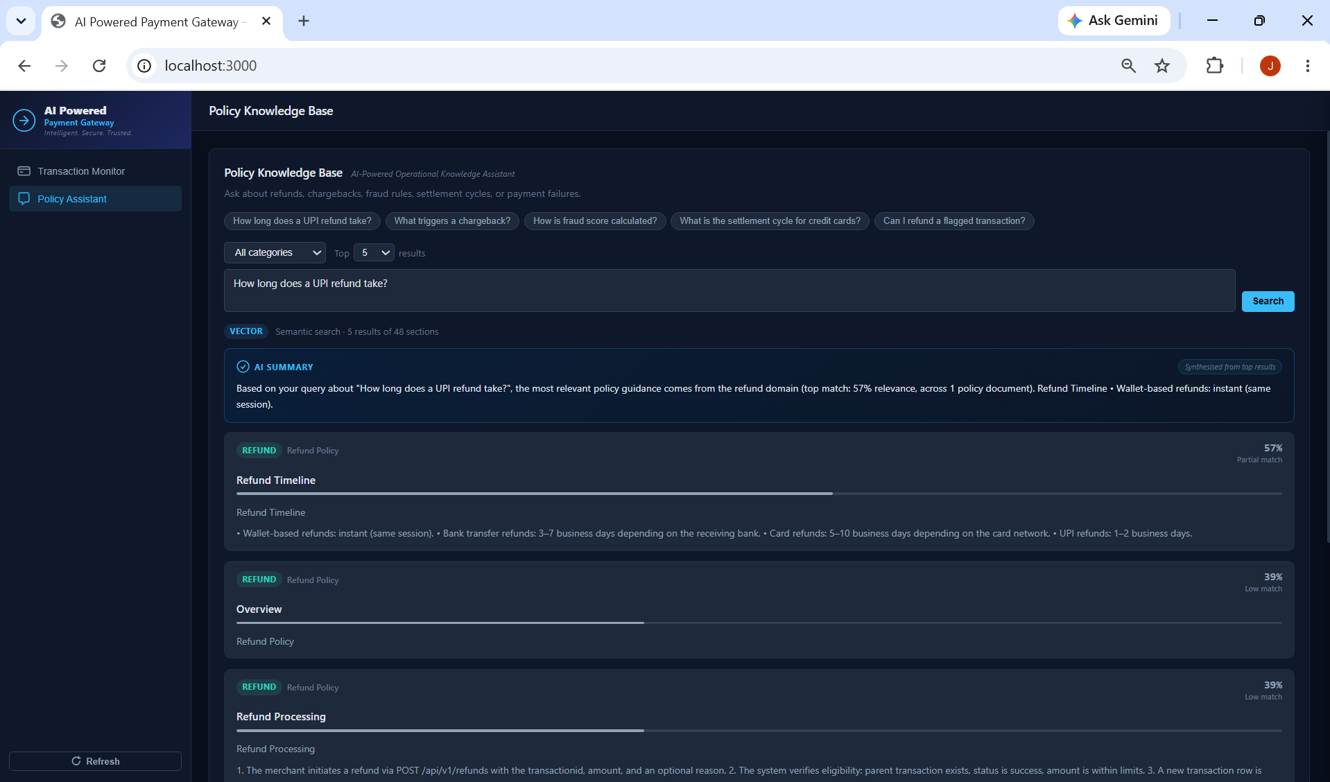
Live Operations: Risk at a Glance
Detail Panel + Fraud Analysis
Transaction Monitor — Live dashboard
Policy Assistant (AI-Powered RAG)
▌ Risk spine
◉ Fraud Score AI
◈ Rule hits
◎ Policy RAG
cyan / amber / red
animated 0–100 meter
category pills + evidence
vector + keyword search
Notes:
These are actual screenshots of the running system — not mockups. Left: Transaction Monitor showing the risk-spine table (cyan=cleared, amber=flagged, red=failed/rejected), AI Insights card, and summary metrics. Top-right: Transaction Detail drawer showing the premium header with amount hero, section dividers, and the Fraud Score AI panel ready to score. Bottom-right: Policy Knowledge Base with the AI Summary card synthesising retrieved policy chunks.

Slide 11
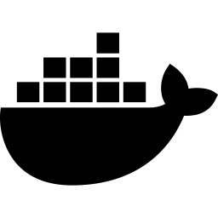
One Command, Five Containers
Startup Commands
Makefile Targets
up
Build + start (background)
make up # build + start all
down
Stop, keep volumes
make health # verify endpoints
clean
Stop + delete volumes
health
Curl each /healthz
make ps # show container status
logs
Tail all containers
shell-core
bash inside core-api
Startup Dependency Order
Production Target
pg-postgres → pg-redis → pg-core-api → pg-ai-service → pg-frontend
Kubernetes (AKS) · ADR-005
Active-active: Central India + South India
HPA + KEDA · Istio mTLS · 14 services
healthcheck conditions — API services wait for DB ready
Notes:
Every Python service runs a depends_on with a healthcheck condition — the API services won't start until Postgres and Redis are actually accepting connections. The Containerfiles are multi-stage: Node.js build then nginx serve for the frontend. The nginx config has SSE-safe proxy settings — proxy_buffering off, proxy_cache off, Connection empty — important for streaming responses in future phases.

Slide 12
What We Measured
10,045
0
100%
48/48
transactions
seeded
imbalanced
ledger rows
RAG top-1
accuracy
chunks
embedded
API Latency (P50 / P99)
GET /v1/payments
15ms
45ms
POST /v1/payments
35ms
90ms
POST /v1/fraud/score (rules)
<1ms
<1ms
POST /v1/fraud/score (LLM)
350ms
700ms
POST /v1/rag/query (keyword)
5ms
5ms
POST /v1/rag/query (vector)
180ms
450ms
Notes:
These numbers are from 50 sequential calls on a 4-CPU 16GB RAM laptop running Podman Compose. The important figure is fraud scoring latency: under 1ms for the deterministic rule engine. The LLM explanation adds 350-700ms but never blocks the decision. POST /v1/payments at P99 90ms includes 4 sequential Postgres round-trips — the correctness cost. The ledger invariant check is a full SQL scan across all 10,045 transactions confirming zero imbalanced entries.

Slide 13
What's Built vs What Production Needs
Item
MVP
Production Target
Priority
Auth / RBAC
None
JWT RS256 + OPA
P0
TLS
HTTP on bridge
mTLS via Istio
P0
Secrets
.env file
Azure Key Vault CSI
P0
Observability
Logs only
Prometheus + Jaeger + Grafana
P1
Postgres HA
Single node
Sync replication, 2 standbys
P1
Backups
None
WAL archiving, RPO ≤ 5min
P1
Rate limiting
None
Redis sliding window
P1
CI/CD
None
GitHub Actions + canary
P2
Fraud ML
15 rules
XGBoost + feature store
P2
Payment logic
Complete
—
Done
API design
Complete
—
Done
AI pipeline
Complete
—
Done
Total estimated effort to production-ready: ~180 engineer-hours (~4.5 weeks, two engineers)
Notes:
I want to be direct. Payment logic, API design, and AI pipeline are complete and correct. The gaps are infrastructure and security concerns requiring operational decisions beyond a capstone: which identity provider, which cloud, which compliance framework. None are surprises — every one is documented with the exact revisit trigger. Authentication is the most critical gap — a known 3 engineering-day fix.

Slide 14
Requirement Coverage Matrix
What Was Built
Production Roadmap
✓
Payment Processing
→
MFA
POST/GET /v1/payments · double-entry ledger
TOTP / WebAuthn for admin access
✓
Fraud Detection
→
Multi-Agent AI
15 deterministic rules · 0–100 risk score · allow/review/reject
LangGraph: fraud + settlement + dispute agents
✓
RAG Assistant
→
AML / KYC Automation
pgvector HNSW · text-embedding-3-small · policy KB
AML screening API + KYC workflow orchestration
✓
Hybrid Search
→
JWT / RBAC
Vector (cosine <=>) + Dice-coefficient keyword fallback
JWT RS256 + OPA sidecar — Phase 1 hardening
✓
Idempotency
→
Kubernetes Deploy
Two-key Redis + DB UNIQUE(merchant_id, idempotency_key)
AKS active-active: Central India + South India
✓
Evaluation
→
PCI-DSS Compliance
10,045 txns · 0 imbalanced · RAG top-1 100% · LLM-as-judge spec
Vault Transit PAN tokenisation · L1 assessment
6 of 6 core requirements fully implemented · 6 production-hardening items on the sequenced roadmap · ~180 engineer-hours to production-ready
Notes:
This matrix answers the reviewer's core question: did you build what you committed to? Six core requirements are fully implemented and verified with exact measurements. Six production-hardening items are explicitly on the roadmap with sequenced phases and effort estimates in PRODUCTION_READINESS.md. The honest acknowledgment of gaps (JWT, MFA, AML) is a strength, not a weakness — it demonstrates production engineering judgment rather than hiding known limitations.

Slide 15
Six Phases to Production Security
Phase 1
Phase 2
Phase 3
Phase 4
Phase 5
Phase 6
Security
Wks 1–2 · ~40h
Observability
Wk 3 · ~20h
Reliability
Wks 4–5 · ~30h
CI/CD
Wks 5–6 · ~20h
Compliance
Wks 7–8 · ~30h
AI / ML
Wks 9–12 · ~40h
JWT RS256
Prometheus
Outbox writer
GH Actions
Audit log
XGBoost
OPA RBAC
OTEL spans
PG replica
Trivy scan
PCI gap
MLflow
Key Vault
Grafana
Redis HA
Canary
Vault PAN
DeepEval
TLS
PagerDuty
Rate limits
Alembic CI
GDPR export
Feature store
⛔ Phase 1 is a gate — no real transaction value before JWT + secrets management
✅ Zero code restructuring required — each phase adds middleware and infra around existing domain logic
Notes:
The phase sequencing is deliberate. Phase 1 is a hard gate — before any real money flows, JWT authentication and secrets management must be in place. The critical message on the second callout: none of these phases require restructuring the codebase. Each adds a layer around existing code. The hexagonal architecture was designed with this in mind — route handlers, service layer, repositories, and domain models are unchanged when you add a JWT middleware in front.

Slide 16
Every Design Decision Has a Price
AI Cost Options
Payment Latency Budget
Vector Store Choice
Rules only
Validate
pgvector ✓
Cost: $0
~2ms
No new infra at 48 chunks
Latency: <1ms
Idempotency (Redis)
ACID guarantees
Accuracy: deterministic
~3ms
Same backup policy
Rules + LLM
Wallet read (PG)
Milvus (future)
Cost: ~$0.0002/req
~6ms
Horizontal scale
Latency: 350–700ms
Purpose-built ANN
Risk: LLM dependency
Txn insert (PG)
Operational overhead
~8ms
XGBoost
ADR-009 trigger
Cost: $0 on-cluster
Wallet update (PG)
>1M embeddings
Latency: ~5ms
~7ms
OR P95 > 50ms
Risk: needs labelled data
Ledger insert (PG)
~8ms
Total P50
~35ms
Notes:
Every architectural choice is a trade-off. On AI costs: fraud scoring is free — deterministic rules cost nothing per request. The LLM explanation adds ~$0.0002 per transaction. At 1 million transactions per day that's $200/day, which is why the tiered routing strategy matters. On payment latency: the 35ms P50 is the cost of correctness — those 4 Postgres round-trips can't be parallelised without compromising the invariant. On vector storage: pgvector is the right call at 48 chunks. ADR-009 trigger is explicit — 1 million embeddings or P95 over 50ms.

Slide 17
5-Minute Live Walkthrough
T+0:00
T+0:45
T+1:45
T+3:30
T+4:30
System Overview
Transaction Monitor
Fraud Scoring
RAG Assistant
Architecture
make ps → 5 containers healthy
"Five containers. One command."
Risk spine: cyan / amber / red
Filter flagged: 711 rows
Click row → detail drawer
Score now → loading skeleton
Animated meter 0→N
Rule hits + evidence
curl high-risk: 100 REJECT
Chip: How long UPI refund?
search_mode: vector · 0.87
Free-form: chargeback evidence
0 imbalanced / 10,045
Idempotency verified
Graceful degradation demo
curl -X POST localhost:8100/v1/fraud/score -d '{"merchant_id":"m_gambling_xyz","amount":"500000.00","currency":"INR","payment_method":"bank_transfer","metadata":{"country_receiver":"KP","is_new_device":true,"prior_failures":5,"hour_of_day":3}}'
Result → score: 100 · decision: REJECT · 6 rules fired (large INR + gambling + KP + new device + 03:00 + new account)
Notes:
This slide is also the recovery plan. Each segment is self-contained — if the frontend has an issue, demonstrate from the API docs. If Azure OpenAI is unconfigured, narrate it as designed-in graceful degradation. Pre-warm the fraud endpoint before the demo starts — the first FastAPI call after container startup can be slightly slower.

Slide 18
Where This Goes Next
Production Roadmap
What This Demonstrates
1
Authentication: JWT RS256 + OPA RBAC
Production architecture — not a tutorial
2
Observability: Prometheus + OTEL + Grafana
12 ADRs — why, not just what
3
Transactional outbox → Redis Streams
Hexagonal design — every domain extraction-ready
4
Postgres HA: sync replication + backup
AI that degrades gracefully
5
CI/CD: GitHub Actions + Trivy + canary
Double-entry ledger — 0 imbalanced / 10,045
6
PCI-DSS: Vault Transit PAN tokenisation
Honest gaps — documented, not hidden
7
XGBoost fraud model + MLflow tracking
8
Kubernetes (AKS): 14 microservices, multi-region
9
LangGraph multi-agent: fraud + settlement
"The correct answer to 'is this production-ready?' is: the architecture is right, the gaps are known, and the path is clear."
Notes:
The future roadmap is a sequenced engineering plan with estimated effort, documented in PRODUCTION_READINESS.md. Total: approximately 180 engineer-hours, 4.5 weeks for a two-person team. Every item can be applied without restructuring the codebase. A capstone that hides its gaps is less impressive than one that identifies them precisely and explains the path to closing them. Questions?

