Slide 1
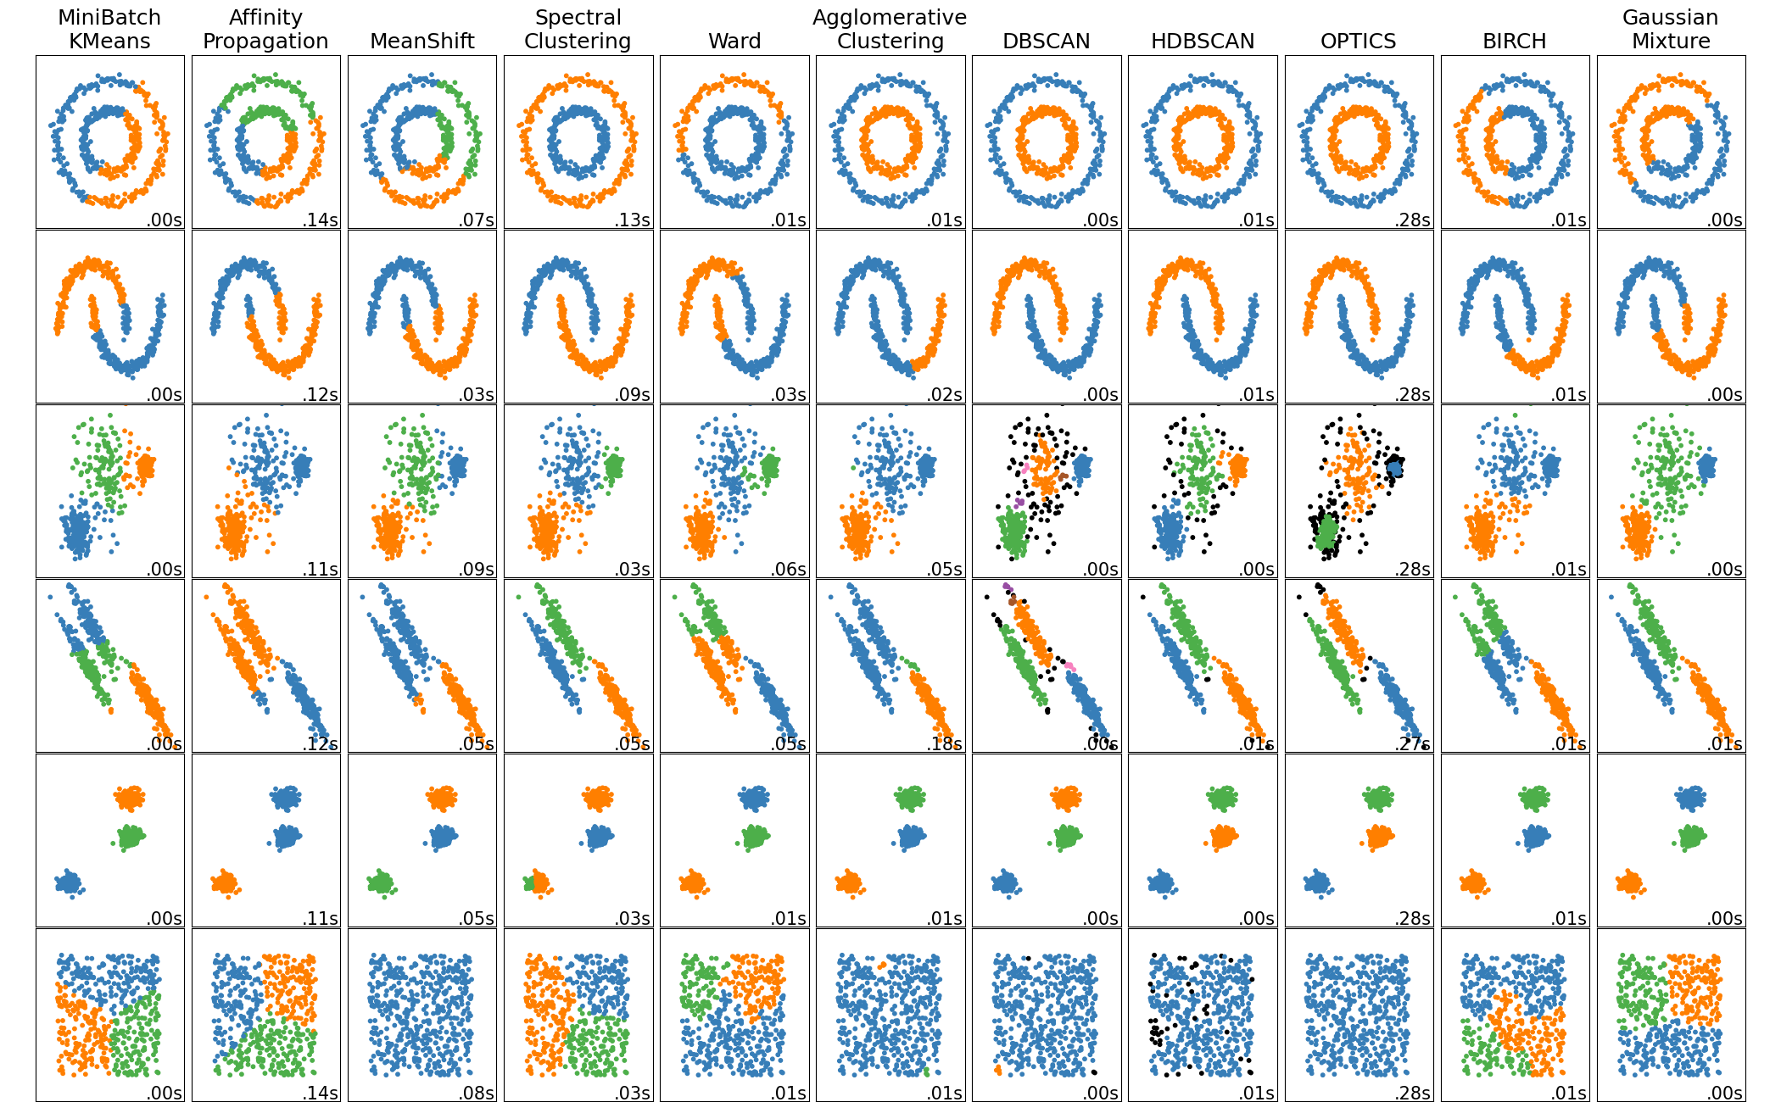
A
A Presentation On Machine Learning Clustering Algorithms
A
- SM Jayachandran

Slide 2

Agenda
What is Clustering ?
About Affinity Propagation
About Mean Shift
About Spectral clustering
About DBSCAN
About HDBSCAN
About OPTICS
About BIRCH

Slide 3
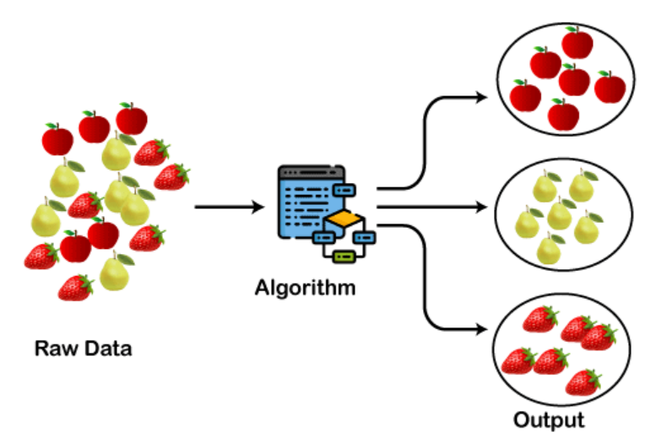
-> What is Clustering ?
Clustering is a process of creating a distinct logical groups for target marketing from the training dataset.
In a nutshell, a way of grouping the data points into different clusters, consisting of similar data points. The objects with the possible similarities remain in a group that has less or no similarities with another group

Slide 4
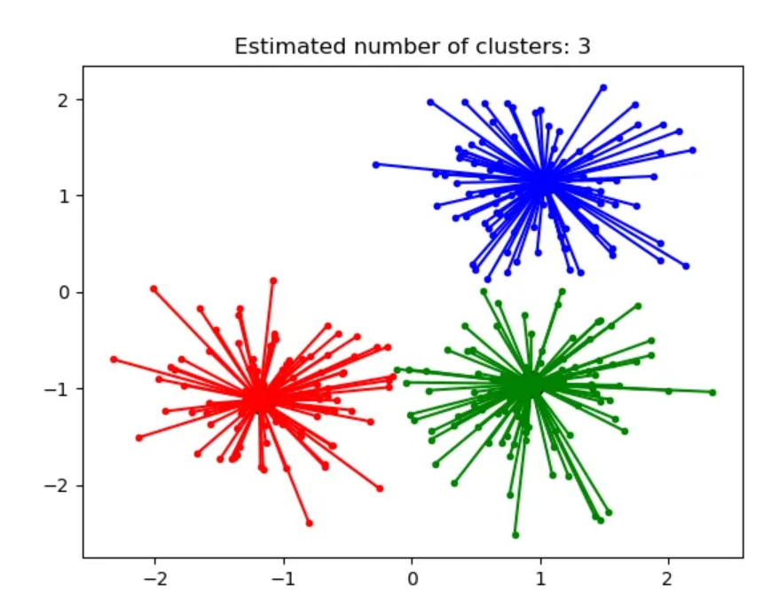
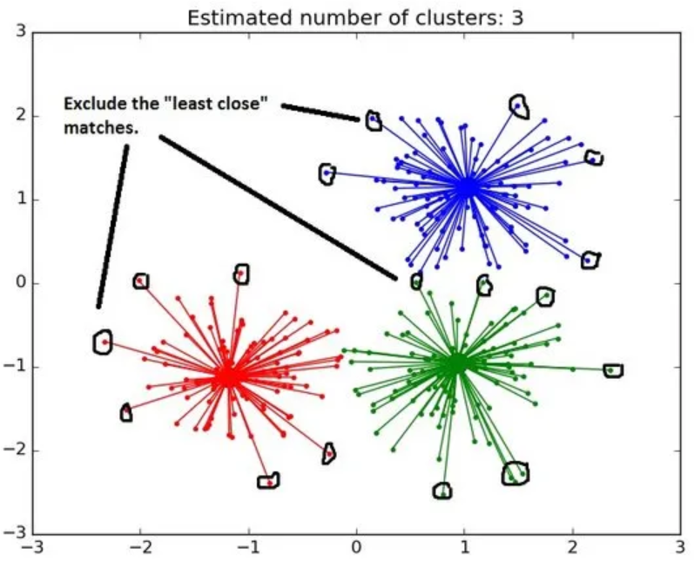
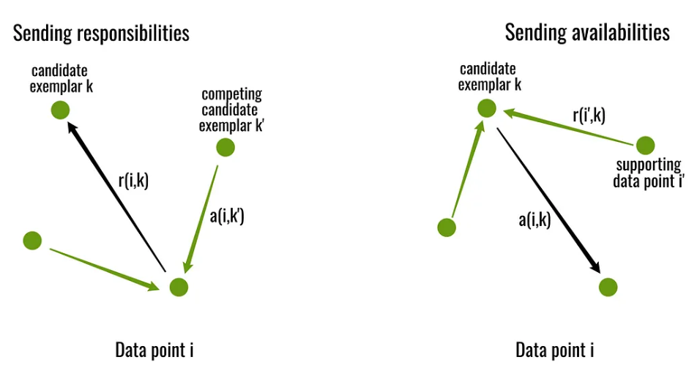
About Affinity Propagation
Affinity Propagation is a clustering algorithm which send messages between data points until convergence formed.
The two important parameters are the preference, which controls how many exemplars (or prototypes) are used.

Slide 5
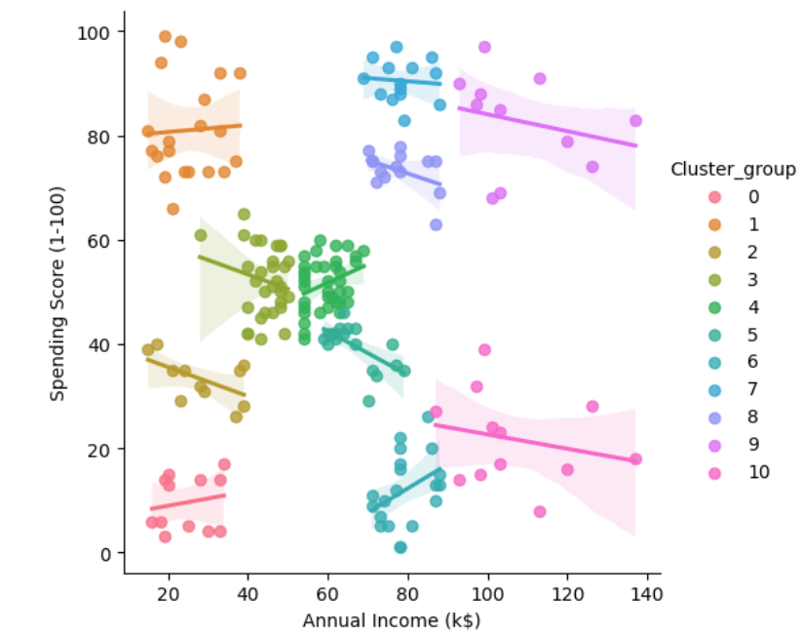
About Affinity Propagation - Continued
A dataset is described using a small number of exemplars, ‘exemplars’ are members of the input set that are representative of clusters.
The messages sent between pairs represent the suitability for one sample to be the exemplar of the other, which is updated in response to the values from other pairs. This updating happens iteratively until convergence, at that point the final exemplars are chosen, and hence we obtain the final clustering.

Slide 6
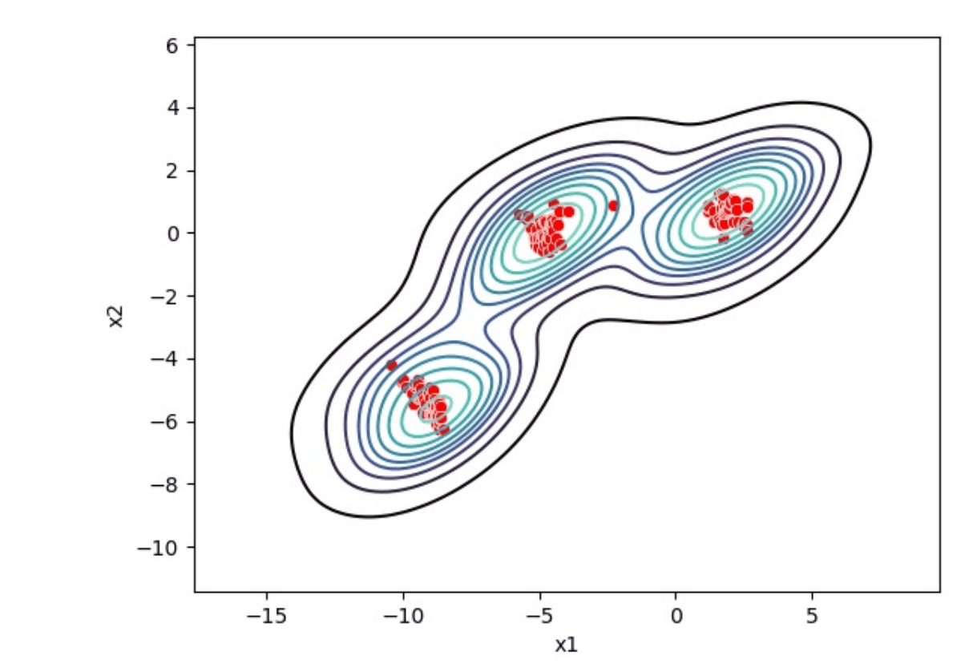
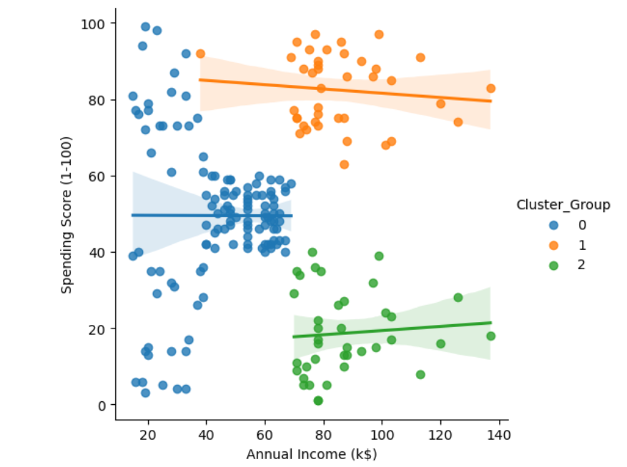
About Mean Shift
MeanShift clustering aims to discover blobs in a smooth density of samples.
It is a centroid based algorithm, which works by updating candidates for centroids to be the mean of the points within a given region.
These candidates are then filtered in a post-processing stage to eliminate near-duplicates to form the final set of centroids.

Slide 7
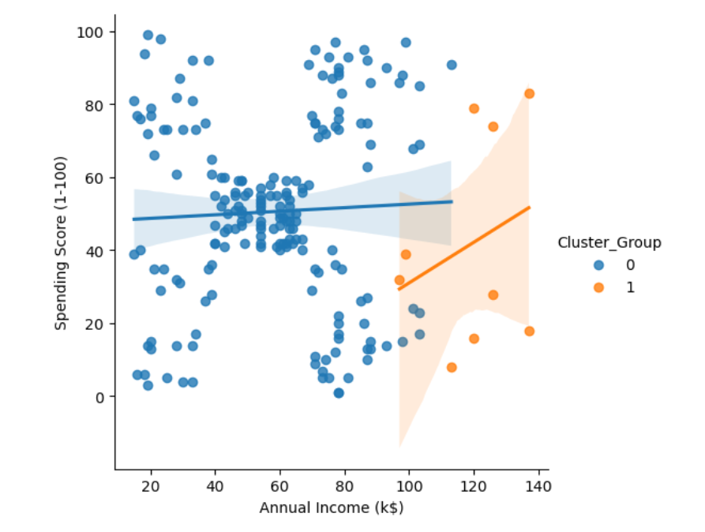
About Spectral clustering
Spectral clustering is a technique with roots in graph theory,
It is used to identify communities of nodes in a graph based on the edges connecting them.
The method is flexible and allows us to cluster non graph data as well.
The clusters do not follow a fixed shape. Points that are far away but connected belong to the same cluster and the points which are less distant from each other could belong to different clusters if they are not connected.
This implies that the algorithm could be effective for data of different shapes and sizes.

Slide 8
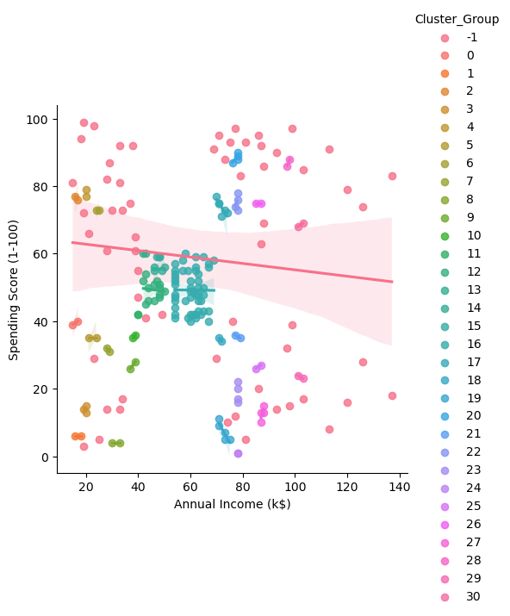
About DBSCAN clustering
DBSCAN stands for Density-Based Spatial Clustering of Applications with Noise.
DBSCAN is a density-based clustering algorithm that works on the assumption that clusters are dense regions in space separated by regions of lower density.

