Slide 1
EBAY SHOPPING WEBSITE
Under the guidance of
Mrs .Vaishali Sonanis mam

Slide 2
Introduction
eBay is a global online marketplace that connects buyers and sellers worldwide, offering a platform to trade new and pre-owned goods.
It enables individuals and businesses to list products for auction or fixed-price sale, creating a diverse e-commerce ecosystem.
With millions of listings across categories, eBay provides a convenient way to shop, sell, and discover unique items.

Slide 3
Overview
In this eBay automation testing project, I validated critical e-commerce functionalities that directly impact user experience and business operations if defective.
Developed and executed automated test scripts using Selenium WebDriver (Java) and TestNG to ensure reliability across key workflows like login, search, cart, and checkout.
Implemented the Page Object Model (POM) design pattern to enhance code maintainability, reduce duplication, and improve test scalability.
Focused on real-world scenarios including dynamic UI elements, cross-browser compatibility.

Slide 4
Modules
MODULE 1: SIGN-IN PAGE
Objective: Verified the Functionality of ebay's sign in system
Validated username (email) and password fields.
Checked error handling for invalid credentials.
Confirmed successful redirection post-login.
MODULE 2: MULTIPLE SEARCHES
Objective: Ensured the search feature returns accurate results. Tests Performed:
Tested with varied search terms (e.g., "watch," "phone," "laptop").
Verified auto-suggestions and result relevance.
Cleared search history between queries.

Slide 5
MODULE 3: ADD TO CART
Objective: Validated the cart workflow for a seamless shopping experience. Tests Performed:
Searched for a specific item ("VIVO S1 Pro Mobile").
Added the item to cart and verified cart updates.
Returned to the homepage post-addition.
MODULE 4: REMOVE FROM CART
Objective: Ensured users can easily modify their cart. Tests Performed:
Navigated to the cart and removed the added item.
Confirmed cart updates and return to homepage.

Slide 6
MODULE 5: UPDATE USERNAME (ACCOUNT SETTINGS)
Objective: Validate the functionality to modify the user's display name. Tests Performed:
Navigated to account settings and edited the username.
Verified field clearance, new input acceptance, and save confirmation.
Re-authenticated post-update to ensure security.
MODULE 6: UPDATE ADDRESS (ACCOUNT SETTINGS)
Objective: Verify address modification in user profile. Tests Performed:
Edited address fields (street, city, state, postal code).
Confirmed submission .

Slide 7
MODULE 7: SHOP BY CATEGORY (NAVIGATION)
Objective: Test category-based product browsing. Tests Performed:
Accessed "Electronics" category via hover menu.
Verified redirection to category page and subcategory selection.
MODULE 8: SHOP BY ALL CATEGORIES (DROPDOWN)
Objective: Validate the "All Categories" dropdown filter. Tests Performed:
Selected "Collectibles" from the dropdown and triggered search.
Confirmed results match the chosen category.

Slide 8
MODULE 9: FOOTER LINK VALIDATION
Objective: Test footer navigation links. Tests Performed:
Clicked "Facebook icon" footer link and verified page load.
Validated return to homepage post-navigation.
MODULE 10: LOGOUT FUNCTIONALITY
Objective: Ensure secure session termination. Tests Performed:
Logged out via account hover menu.
Verified redirection to sign-in page and session clearance.

Slide 9
DEFECTS:
While running a testcase at certain point some fields are not working as it is expected which is nothing but a defect, so I have created a Defect report on those defects.

Slide 10
Defect identifier :- D_001
Defect summary :-Responsiveness in mobiles in not functioning properly Ø Test Id :- TC_040
Ø Test case name :-TC_responsiveness in mobile Ø Module name :-Responsiveness
Ø Reproducible :- checking responsiveness in mobile
Ø Severity :- Medium
Ø Priority :- Medium
Ø Raised by :- Team LEad
Ø Assigned to :- developer Team lead
Ø Date of assignment :-18/08/2024
Ø Status :- pending
Ø Fixed by :- developer
Ø Date of fixing :-

Slide 11
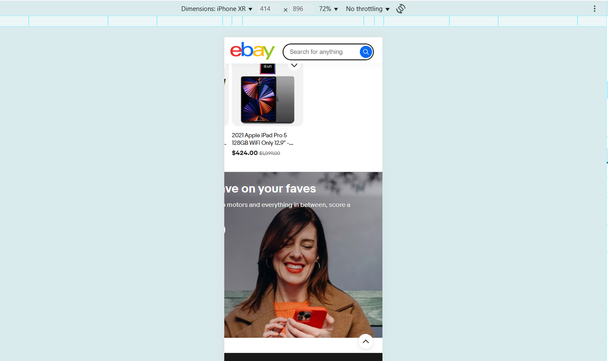

Slide 12
Defect identifier :- D_002
Ø Defect summary :- Ship to button is highlighted in one page
Ø Test Id :- TC_041 Ø Test case name :- TC_ship_to
Ø Module name :- Ship to button
Ø Reproducible :- click on motors in homepage check the design of ship to click on daily deals in homepage check the design odf ship to
Ø Severity :- MEDIUM
Ø Priority :- MEDIUM
Ø Raised by :- Team lead
Ø Assigned to :- developer Team lead
Ø Date of assignment :-18/08/2025
Ø Status :- pending
Ø Fixed by :- developer
Ø Date of fixing :-

Slide 13
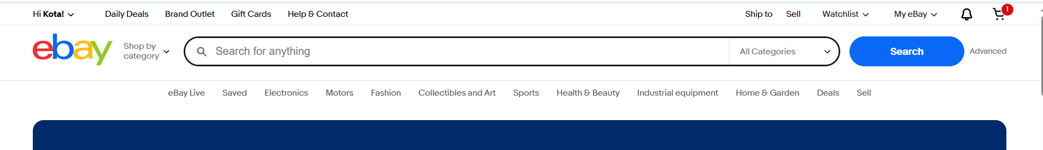
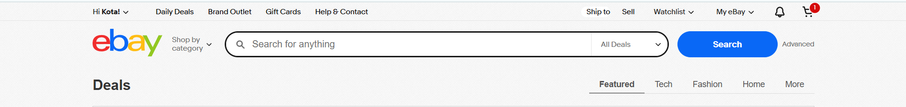

Slide 14
CHALLENGES:
Difficulties with multi-tab navigation during cart operations
Hover menus and dynamic elements
Tests failing randomly due to slow page loads.
CAPTCHA/verification interrupting automation flow.

Slide 15
EXPERIENCE:
Automated critical user flows including login, product search, cart management, and checkout processes.
Worked with real-world scenarios like profile updates and address modifications.
Gained experience in testing both frontend UI elements and backend functionality.
Implemented solutions for multi-tab navigation and complex user interactions.
Learned to handle test failures.

Slide 16


