Slide 1

Exploring the Value of Android Smartphones: Love, Challenges, and Future Enhancements

Slide 2



In today's world, play a crucial role in our daily lives. They offer a wide range of features and functionalities. This presentation will explore the
, , and of Android smartphones, highlighting their signiﬁcance in modern technology.

Slide 3






The Love for Android Smartphones
Many users are drawn to
due to their
and . They provide a platform for creativity and personal
expression, allowing users to tailor their devices to meet their unique needs and
preferences. This love fosters brand loyalty and community.

Slide 4




Diverse Ecosystem of Apps
One of the greatest strengths of
is their vast
. With millions of applications available on the Google Play Store, users
can ﬁnd tools for productivity, entertainment, and social networking,
enhancing their smartphone experience signiﬁcantly.

Slide 5





Challenges Faced by Users
Despite their advantages,
face several challenges,
including
and
. Different manufacturers
and versions can lead to inconsistent user experiences and potential risks, making it essential for users to stay informed about updates and best practices.

Slide 6



Importance of Security Features
As smartphones become central to our lives, are paramount.
Android manufacturers are continually enhancing security measures, such as
and ,
to protect user data. Understanding these features is crucial for safe smartphone usage.

Slide 7





The (UX) and of Android smartphones vary widely among manufacturers. While some prioritize , others focus on
. This diversity can impact user satisfaction and adoption rates across different demographics.

Slide 8
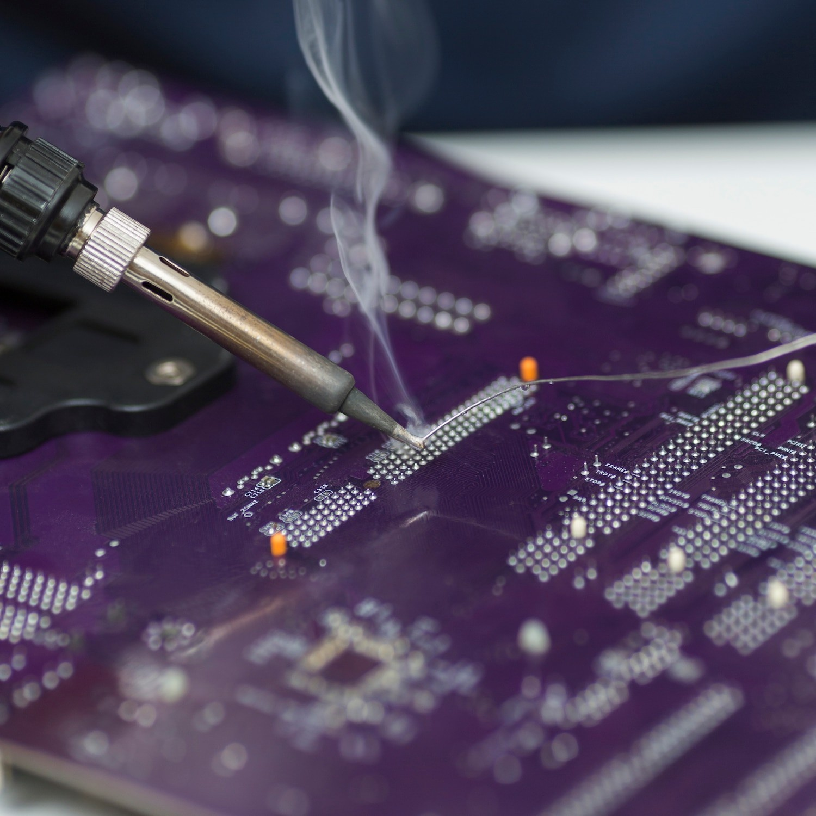





The Role of Hardware
The of Android smartphones signiﬁcantly inﬂuences their performance. Innovations in ,
, and are essential for meeting user demands. As technology advances, users expect faster, more powerful devices that can handle multitasking with ease.

Slide 9



Future Trends in Android Technology
Looking ahead, we can anticipate exciting in Android technology, such as
,
, and
. These advancements
promise to revolutionize how we interact with smartphones, making them even more integral to our daily lives.

Slide 10


Impact of Android on Society
Android smartphones have a profound
, inﬂuencing communication, education, and business. They empower individuals with access to information and resources, bridging gaps in technology and fostering a more connected world.

Slide 11

Community and Developer Engagement
The thrives on
collaboration and innovation. Developers play a vital role in enhancing the platform through and
creating apps that cater to diverse user needs. This engagement fosters a rich ecosystem of creativity and support.

Slide 12




Conclusion: The Future of Android
In conclusion, offer
immense value, despite facing certain challenges. By focusing on ,
, and
,
the future of Android technology looks promising. Continuous enhancements will ensure that Android remains a leader in the smartphone market.

Slide 13
Thanks…!

