Slide 1

CareNest
Cloud-Native Healthcare Platform on Azure
Infrastructure as Code with Terraform
Azure · AKS · Terraform · Switzerland North

Slide 2
PLATFORM OVERVIEW
What Is CareNest — and What Problem Do We Solve?
The Platform
Problem vs. Solution
CareNest is a cloud-native healthcare management platform connecting patients and doctors in one secure digital system. Patients describe symptoms, book appointments, and receive digital prescriptions. Doctors manage schedules and create structured prescriptions. Built on microservices architecture running on Azure AKS in Switzerland North.
Problem
CareNest Solution
Unclear which specialist to visit
AI symptom analysis guides to the right doctor
Phone-based appointment booking
Digital self-service booking
Unreadable handwritten prescriptions
AI plain-language prescription summary
Generic notifications nobody reads
Personalized AI smart notifications
Unstructured doctor free-text notes
Azure AI Language extracts diagnosis and medications automatically

Slide 3
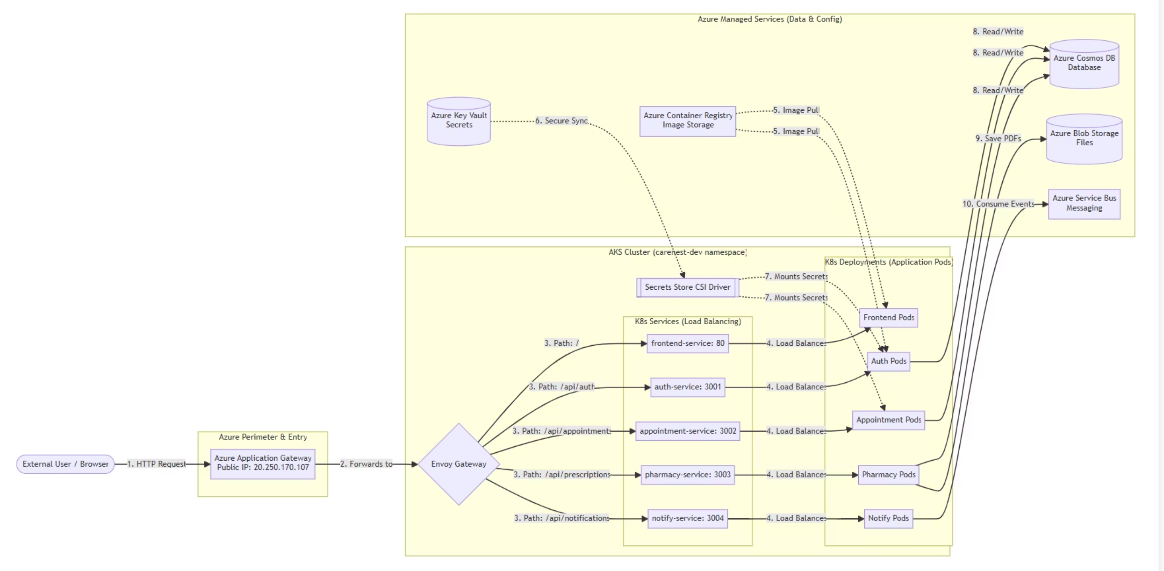
Application Architecture

Slide 4
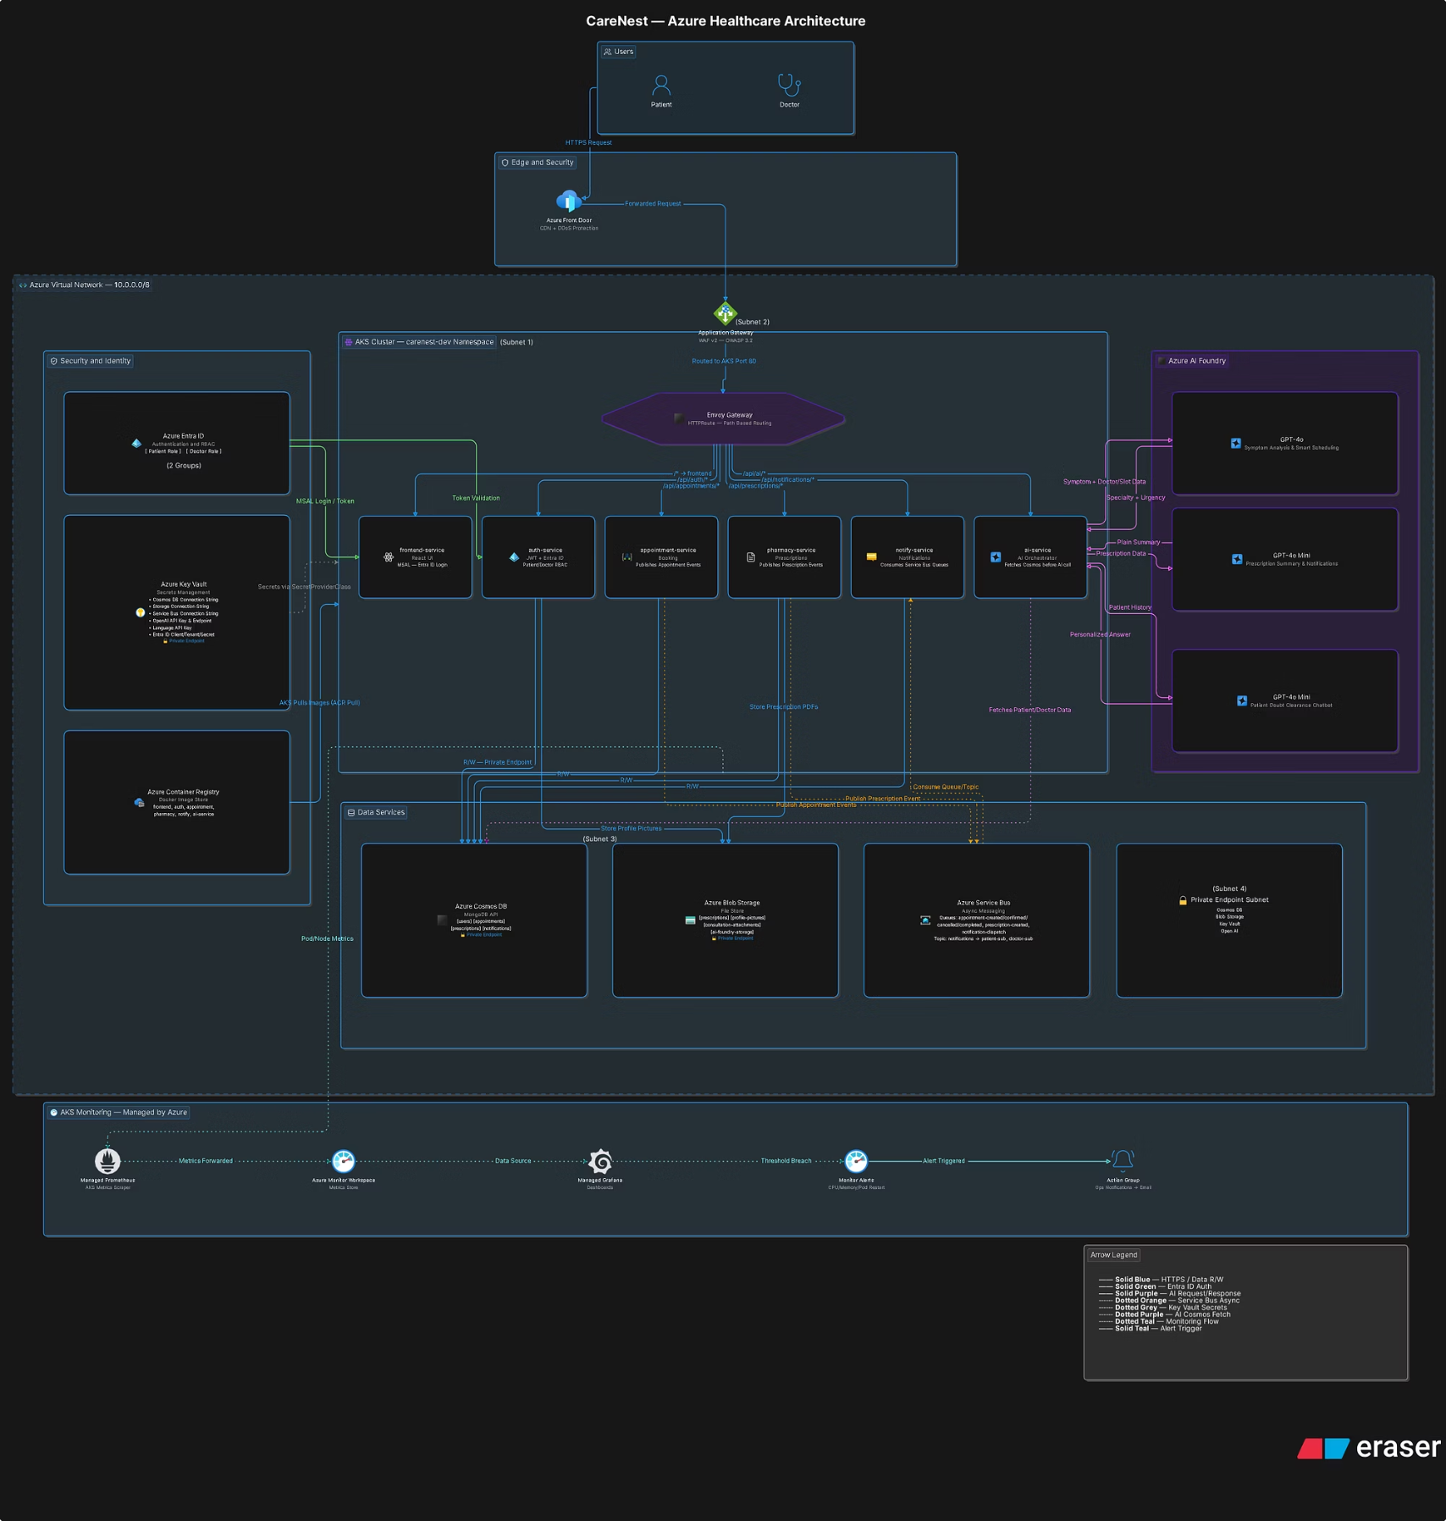
ARCHITECTURE
Overall Azure Architecture

Slide 5
INFRASTRUCTURE AS CODE
Terraform Module-Wise Structure
Instead of one monolithic file, infrastructure is split into 13 focused modules — each handling one concern. Every module contains exactly three files: main.tf (what to create), variables.tf (inputs needed), and outputs.tf (values exposed to other modules). Root orchestrator files: main.tf, variables.tf, outputs.tf, terraform.tfvars, versions.tf, and backend.tf.
1. Resource Group
2. Networking
3. ACR
Container for all resources
VNet and all subnets
Private container registry
4. Entra ID
5. Key Vault
6. Monitoring
App registration and user roles
Central secret storage
Log Analytics and alerts
7. AKS
8. Cosmos DB
9. Blob Storage
Core Kubernetes cluster
MongoDB database
File storage
10. App Gateway
11. Front Door
12. Service Bus
WAF and load balancing
Global CDN
Async messaging
13. AI Foundry
AI models

Slide 6
DEPLOYMENT ORDER
Module Deployment Order and Dependencies
Modules must deploy in a specific order because each depends on outputs from previous modules. Terraform resolves this automatically through explicit dependency declarations.
01
02
Resource Group
Networking
Deploys first — every Azure resource needs a resource group to exist inside.
Deploys second — AKS, Application Gateway, Cosmos DB, and Key Vault all need subnet IDs created here.
03
04
ACR
Entra ID
Deploys third — AKS needs the ACR resource ID for image pull role assignment.
Deploys fourth — Key Vault needs the client ID and secret from Entra ID to store as secrets.
05
06
Key Vault
Monitoring
Deploys fifth — AKS, Cosmos DB, Service Bus, Blob Storage, and AI Foundry all need the Key Vault ID.
Deploys sixth — critically before AKS, which requires the Log Analytics Workspace ID at cluster creation.
07
08
AKS
Final Phase
Deploys seventh once all prerequisites are ready.
Cosmos DB, Blob Storage, App Gateway, Front Door, Service Bus, and AI Foundry deploy last. Front Door needs App Gateway's FQDN as origin.

Slide 7
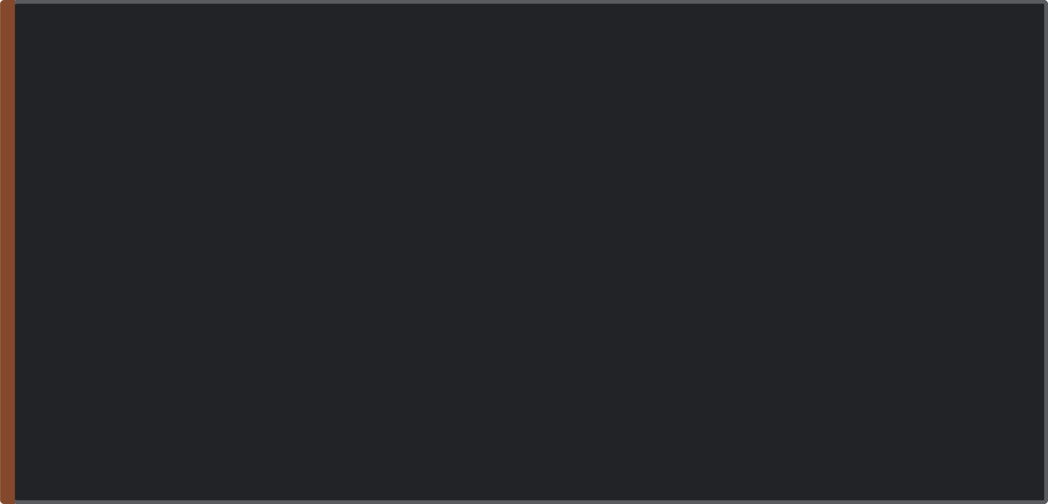

MODULE DEEP DIVE
Key Modules Deep Dive
Key Vault
Networking
All platform secrets stored here — Cosmos DB connection string, Service Bus connection string, OpenAI API key, Entra ID credentials, JWT secret, and storage connection string. Uses RBAC authorization with a private endpoint (no public internet access). AKS reads secrets via kubelet managed identity with Key Vault Secrets User role. Secrets rotate every 2 minutes inside pods without restart.
Single VNet (10.0.0.0/8) with four subnets: AKS (10.240.0.0/16, large for Azure CNI pod IPs), App Gateway (10.2.0.0/24, dedicated by Azure rules), Database (10.3.0.0/24, isolates DB traffic), Private Endpoints (10.4.0.0/24, where Key Vault, Cosmos DB, OpenAI, and Storage land). Each subnet has a Network Security Group.
ACR
Monitoring
Azure Container Registry replaces Docker Hub — private, inside Azure network, no rate limits. AKS connects via managed identity: zero username/password stored. The kubelet identity receives the AcrPull role through a Terraform role assignment.
Must deploy before AKS (cluster needs Log Analytics Workspace ID at creation). Creates Log Analytics Workspace, Container Insights, Application Insights, Action Group for email alerts, and two metric alerts triggering when AKS node CPU or memory crosses 80%.

Slide 8

COMPUTE LAYER
AKS Cluster in Detail
The jd-carenest-aks cluster runs in Switzerland North on Kubernetes 1.35.5 with Standard SKU tier (SLA-backed). Two-tier node pool design ensures system stability and cost-efficient scaling.
System Node Pool
Application Node Pool
Standard_D2s_v3 VMs, fixed 2 nodes. Runs only critical system pods (CoreDNS, kube-proxy, Azure Policy). Isolated from application workloads — never starved by user traffic.
Standard_D4s_v3 VMs with cluster autoscaler: min 2, max 10 nodes. All CareNest microservices run here. Scales automatically with traffic demand.
Horizontal Pod Autoscaler
Cluster Autoscaler
Watches pod CPU and memory, scaling pods between min/max when CPU crosses 70%. Works inside the cluster at the pod level.
Adds VM nodes when HPA needs more capacity and existing nodes are full. Removes idle nodes when traffic drops — automatic cost optimization.
Key Addons
OMS Agent (logs to Log Analytics) · Azure Policy (governance) · Key Vault Secrets Provider (auto-rotation every 2 min) · Azure CNI (real VNet IPs per pod) · Calico NetworkPolicy (pod-to-pod isolation) · Entra ID RBAC (kubectl via Azure roles) · Automatic patch upgrades every Sunday 2AM–6AM

Slide 9
DATA & MESSAGING
Data Layer and Async Messaging
Cosmos DB
Service Bus — Async Decoupling
Account jd-carenest-cosmos uses MongoDB API v4.2 (Mongoose-compatible). Database carenest has four collections: users (shard key _id), appointments (shard key patientId), prescriptions (shard key appointmentId), notifications (shard key userId). Private endpoint; connection string in Key Vault.
Without Service Bus, if notify service is down, booking fails entirely. With Service Bus, appointment service saves to Cosmos DB, publishes to appointment-created queue, and returns success immediately. Notify service reads independently when ready.
Six Queues
Blob Storage
appointment-created
appointment-confirmed
appointment-cancelled
appointment-completed
prescription-created
notification-dispatch
Four containers: prescriptions (PDFs), profile-pictures (patient/doctor photos), consultation-attachments (medical documents), ai-foundry-storage (AI Foundry Hub backend). Versioning enabled; private endpoint created.
Topic + Subscriptions
A notifications topic with patient-sub and doctor-sub subscriptions delivers the same message to both parties simultaneously.

Slide 10

AI & SECURITY
AI Foundry and Security Design
Azure AI Foundry
Security at Every Layer
Azure OpenAI deploys in Sweden Central (unavailable in Switzerland North); AI Foundry Hub and Language Service stay in Switzerland North.
Network Edge: Front Door DDoS protection; App Gateway WAF v2 blocks SQL injection and XSS (OWASP 3.2, prevention mode)
Identity: All service-to-service auth uses Azure Managed Identities — zero passwords. Entra ID handles user auth with Patient and Doctor app roles
Secrets: All 10 secrets in Key Vault with private endpoint and RBAC authorization
Network Isolation: Key Vault, Cosmos DB, OpenAI, and Blob Storage have private endpoints — unreachable from the public internet
Pod Network: Calico NetworkPolicy enforces default-deny with explicit allow rules only between authorized services
GPT-4o — Symptom Analysis
Reads available doctors and appointment slots from Cosmos DB, returns the most relevant specialty and urgency level.
GPT-4o Mini — Prescription Summary
Converts clinical shorthand into plain language patients can understand.
GPT-4o Mini — Patient Chatbot
Fetches the patient's own appointment history and doctor notes for personalized answers.

Slide 11
Terraform Workflow and Project Summary
Terraform Deployment Workflow
01
02
03
Remote State Storage
terraform init
terraform validate
Create Azure Blob Storage for Terraform state — enables team collaboration and protects against data loss.
Downloads provider plugins and configures the backend.
Checks syntax across all 13 modules.
04
05
06
terraform plan
terraform apply
Get AKS Credentials
Shows all 60+ resources to be created — zero changes made.
Creates all resources in correct dependency order (~20 minutes).
az aks get-credentials and verify with kubectl get nodes.
07
Deploy Application
kubectl apply for all Kubernetes manifests.
What Was Built
Category
Details
Terraform Modules
13 modules · 60+ Azure resources
Infrastructure
Terraform, Azure, AKS Kubernetes 1.35.5, Envoy Gateway
Data & Messaging
Cosmos DB MongoDB API, Service Bus (6 queues + 1 topic), Blob Storage
AI Services
GPT-4o, GPT-4o Mini, Azure AI Language
Security
Entra ID, Key Vault, App Gateway WAF v2, Calico NetworkPolicy
CDN & Registry
Azure Front Door, Azure Container Registry
Monitoring
Log Analytics, Container Insights, Application Insights
CareNest demonstrates how Terraform's module-wise structure brings order, repeatability, and security to complex cloud-native healthcare infrastructure on Azure.

