Slide 1
Ecommerce store
By:
S.Jayadritha-21MIC7114
C.Rishik-21MIC7045

Slide 2

Ecommerce Store
This project aims to develop a comprehensive, production-level online store with an integrated admin panel, leveraging modern web technologies to ensure a robust, scalable, and user-friendly application. The client-side application will be built using Flutter, a versatile UI toolkit from Google, while the server-side API will be implemented using Node.js, a powerful JavaScript runtime. The database will be powered by MongoDB, a flexible and scalable NoSQL database, to handle the dynamic nature of e-commerce data.

Slide 3
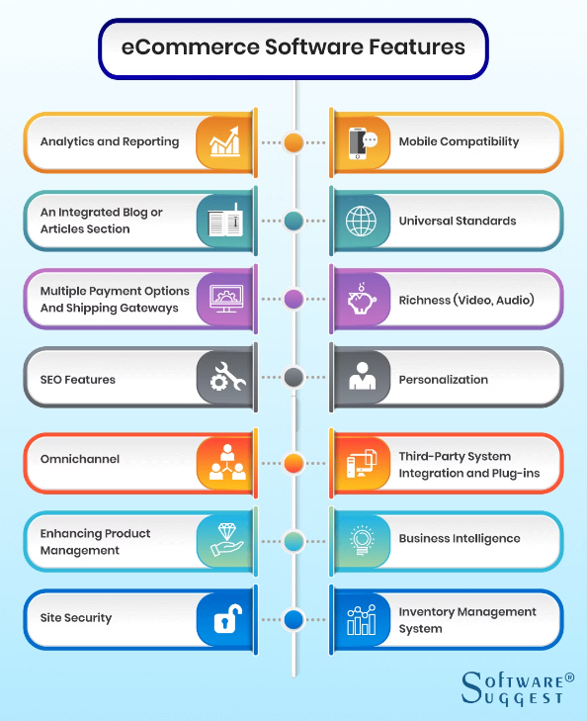
Software Requirements
Operating System
Server: Windows XP or later
Database
Mongo DB and Mongo DB Atlas
Client
Microsoft Internet Explorer, Node.js, Express.js, Mongoose ODM for MongoDB

Slide 4

Hardware Requirements
1
Processor
Flutter SDK
2
RAM
512 MB Ram
3
Hard Disk
PC with 20GB

Slide 5
Functional Components
User Authentication
Product Catalog
User registration and login, password reset and recovery, profile management.
Browse and search products, view product details, add to Wishlist.
Shopping Cart
Order Management
Add or remove items, update quantities, apply discounts, proceed to checkout.
View order history, track status, cancel or return orders.

Slide 6




Server-Side API
Authentication
Product Management
Order Processing
Analytics
Secure user authentication and role-based access control.
CRUD operations for products, manage categories and tags, handle product images.
Handle order creation, updates, and cancellations, integrate payment processing.
Generate sales reports and analytics, track user activity and engagement.

Slide 7



Scalability and Performance
Robust Infrastructure
Efficient Data Management
Responsive UI
The Flutter-based client application will provide a seamless and responsive user experience.
The system will be designed to handle high traffic volumes and ensure data integrity.
MongoDB's flexibility and scalability will enable efficient handling of e-commerce data.

Slide 8
Improved Customer Experience
Streamlined
Operations
Increased
Revenue
Intuitive and user-friendly interface, personalized recommendations, and efficient order management.
Automated inventory management, real-time analytics, and centralized admin controls.
Expanded customer reach, targeted marketing campaigns, and optimized sales strategies.

