Slide 1
GBLSTSVM Groundwork Before the Fuzzy Study
Baseline reproduction, ball generation, ten ball-weighting ideas and the M0–M3 classifier-guided models
Work done August to September 2026 · Jayagna
Notes:
This deck is the record of what I did before the fuzzy-membership study. It covers four things: reproducing the GBLSTSVM baseline in Python and MATLAB, comparing two ways of building granular balls, a series of ideas for weighting balls inside the twin SVM, and finally the M0 to M3 models, where the classifier itself guides how balls are split. Most ideas did not beat a simple class-weighted baseline, and the reasons why shaped how the fuzzy study was set up.

Slide 2
Six steps from August to September
OVERVIEW
1
2
3
4
5
6
Aug
Aug
Sessions 1–2
Session 3, 22 Aug
Sessions 4–7, to 7 Sep
28–29 Sep
Reproduce the baseline
Ball generation
Class and reliability weights
Neighbourhood weights
Granulation and compression
M0–M3 models
Python and MATLAB versions of GBLSTSVM give the same balls and planes.
K-means splitting compared with the ADPGBG builder on two moons.
CW, R, CR, BMRU and overlap weights on three imbalanced datasets.
CBCM/CA, IPA, Topo and SA-Topo, built on a k-NN graph of balls.
Split rules, entropy order and ball budgets on 17 datasets × 10 seeds.
Classifier-guided splitting (M1) and reliability weights (M2).
Only class weighting helped reliably; Session 7 traced the other gains to data compression, not ball structure.
Notes:
Here is the order things happened. First I reproduced the published GBLSTSVM so I had a baseline I trusted. Then I looked at how the balls are built. Then, in seven working sessions, I tried to make some balls count more than others, first with class and reliability weights, then with weights based on each ball's neighbours, and then by changing how the balls are split. The last step, at the end of September, was M0 to M3, where the classifier's own planes decide which balls to split. The one-line summary is on the bottom: only class weighting gave a consistent gain, and the final session showed that the remaining gains came from compressing the data, which a random stratified sample does just as well.

Slide 3
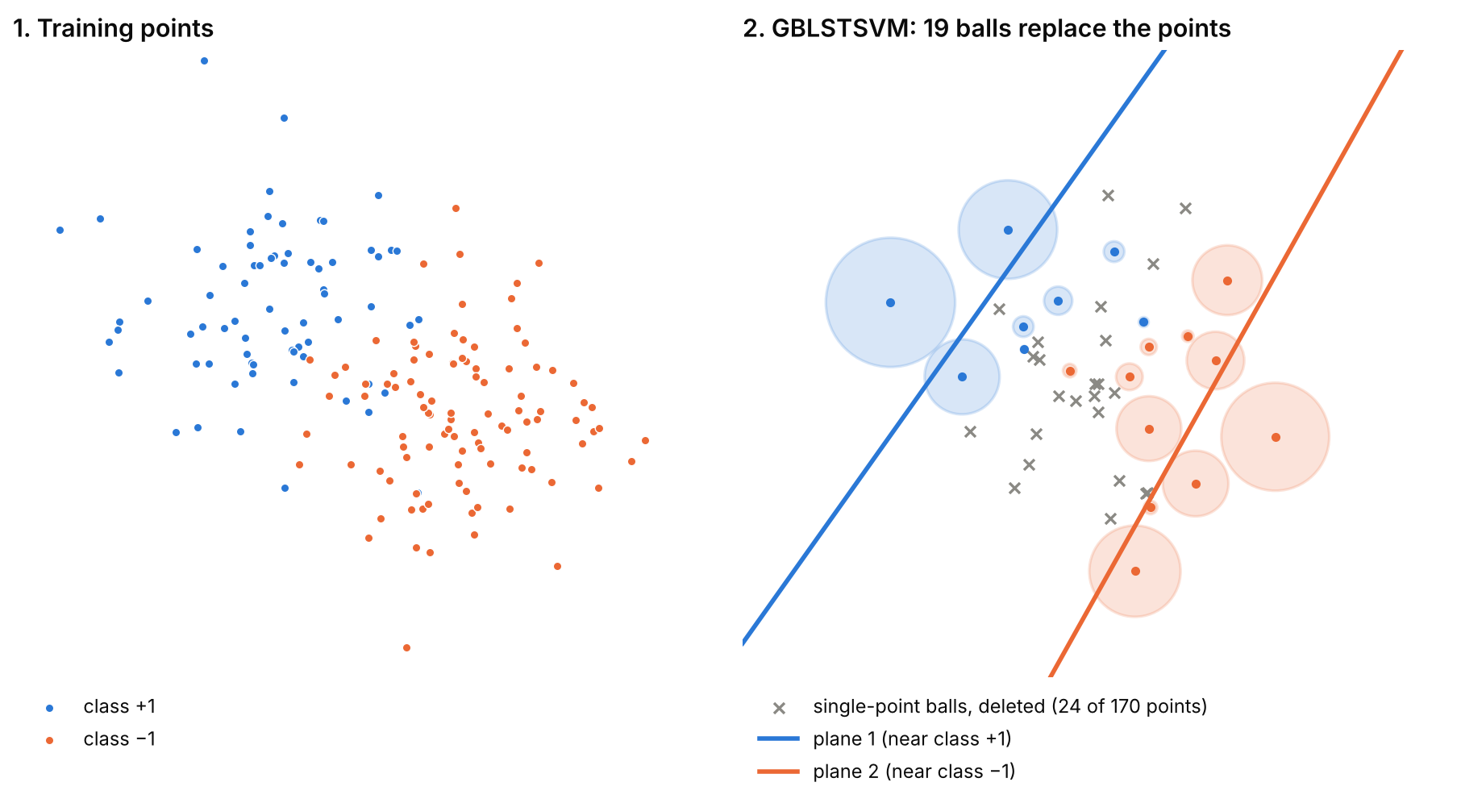
GBLSTSVM trains two planes on ball centres
BACKGROUND
Twin SVM: two non-parallel planes, each close to one class and far from the other [1].
Least squares: equalities replace inequalities, so each plane is one linear solve [2].
Granular ball: centre, radius (mean distance), majority label and purity of a group of points [3].
GBLSTSVM: trains on ball centres and radii instead of points; balls with one point are deleted [4].
Every model in this deck changes either how the balls are built or how much each ball counts.
Notes:
A quick reminder of the model. A twin SVM fits two planes: plane 1 hugs the positive class and stays away from the negative class, and plane 2 does the opposite. A new point goes to the class whose plane is closer. The least squares version turns each plane into a single linear system, so training is fast. Granular balls compress the data: points are grouped into balls by repeated 2-means splitting until each ball is pure enough, and each ball is summarised by its centre, radius and majority label. GBLSTSVM fits the two planes to the ball centres instead of the points, and drops balls with only one point. In the picture, 170 points become 19 balls, and the crosses are the single-point balls that get deleted.

Slide 4
Each plane is one linear solve
BACKGROUND
Plane 1 (near class +1)
min ½‖A w₁ + e₁ b₁‖² + (c₁/2)‖ξ‖²
s.t. −(B w₁ + e₂ b₁) + ξ = e₂ + R₋
u₁ = −(G^{T}G + (1/c₁) H^{T}H + εI)⁻¹ G^{T}(e₂ + R₋)
Plane 2 (near class −1)
u₂ = (H^{T}H + (1/c₂) G^{T}G + εI)⁻¹ H^{T}(e₁ + R₊)
Decision rule
predict +1 if |x^{T}w₂ + b₂| > |x^{T}w₁ + b₁|
H = [A e], G = [B e]; A, B hold the ball centres of each class and R₊, R₋ their radii.
gen_ball_new.py · _fit_provisional_gblstsvm
A = np.asarray([b.center for b in pos])
B = np.asarray([b.center for b in neg])
H = np.column_stack((A, e1))
G = np.column_stack((B, e2))
lhs1 = G.T @ G + (1.0 / c1) * (H.T @ H) + reg_term * identity
rhs1 = np.concatenate((B.T @ (e2 + R_neg), [np.sum(e2 + R_neg)]))
lhs2 = H.T @ H + (1.0 / c2) * (G.T @ G) + reg_term * identity
rhs2 = np.concatenate((A.T @ (e1 + R_pos), [np.sum(e1 + R_pos)]))
hyper1 = -np.linalg.solve(lhs1, rhs1)
hyper2 = np.linalg.solve(lhs2, rhs2)
The radius enters the right-hand side, so larger balls push the opposite plane further away.
Notes:
These are the two closed-form solutions. A and B hold the ball centres of the two classes, and R holds their radii. For plane 1, the negative balls must sit at least one unit plus their radius away, which is why e plus R appears on the right. The code on the right is from my M0 to M3 generator and is the same system: build H and G by adding a column of ones, form the left-hand matrix, and solve. Using solve instead of an explicit inverse is one of the engineering choices from the reproduction. Every later weighting model changes this system by putting a weight on each ball's row.

Slide 5
Python and MATLAB versions match the original code
BASELINE REPRODUCTION
18 / 18
100%
94.74%
balls identical to the original script on the same seed
agreement on the benchmark linear systems
breast-cancer accuracy, trained and tested in under 0.037 s (MATLAB)
Python suite (GBLSTSVM-Ex)
MATLAB suite
scikit-learn style fit / predict / decision_function in src/gblstsvm.py
original GBLSTSVM.py kept frozen as the reference
one module per extension: class weights, reliability, overlap and others
tests for matrix equality, ball counts and tolerances
backslash solve (M \ RHS) instead of an explicit inverse
GranularBall class with 5 k-means replicates per split
self-contained: LSTWGBSVM.m, gen_balls.m, GBLSTSVM_demo.m
2-D visual suite used for the two-moons study
With a trusted baseline, every later model could be compared against the same code.
Notes:
Before changing anything, I rebuilt GBLSTSVM twice. The Python version follows the scikit-learn interface so it can be run in batch experiments, and the original script is kept untouched as a reference. On the same seed it produced exactly the same 18 balls and the same planes. The MATLAB version is used for checking the linear algebra and for 2-D pictures; it trains and tests breast cancer in under four hundredths of a second. This matters because every comparison later in the deck uses this same code with one thing changed.

Slide 6
Four places where the paper and the code differ
BASELINE REPRODUCTION
Aspect | Paper | Original code | What we kept
Regularisation | one penalty for all plane parameters | separate c1 and c2 on H'H and G'G | separate c1, c2: handles imbalance between the two planes
Radius column | features are the ball centres (d columns) | radius briefly grouped with the features | store [centre (d), radius, label] separately
Solving | written as an explicit inverse | np.linalg.inv (Python), backslash (MATLAB) | linear solve, never an explicit inverse
2-means splits | no replicate count given | one k-means run can stall in a bad split | 5 replicates and a safe fallback
These choices are small, but writing them down makes later comparisons reproducible.
Notes:
Reproducing a paper always turns up gaps between the equations and the code. I found four. The code uses two penalty constants, one per plane, which we kept because it helps with class imbalance. The radius was at one point mixed into the feature columns, which we separated. The code inverts a matrix; we solve the system instead, which is more stable. And a single k-means run can get stuck, so we use five replicates. None of these change the idea of the model, but they change numbers, so they are documented.

Slide 7
Two ways to build balls: k-means splitting and ADPGBG
BALL GENERATION
1
K-means splitting (original)
2
ADPGBG [5]
Start with one ball holding all points.
While a ball's purity is below the threshold, split it with 2-means and repeat.
The split line ignores the class boundary, so on curved data balls can straddle it.
The purity threshold (0.80 to 1.0) must be tuned for each dataset.
Grow each ball from a centre until it reaches the nearest point of the other class: hd1st(c) = min_{l(x) ≠ l(c)} d(c, x).
Members: T = {x : d(x, c) < hd1st(c)}, then centre = mean(T) and radius = mean distance.
No purity threshold to tune.
A second distance, hd2nd, flags single isolated points as noise.
ADPGBG builds balls from the class boundary inward instead of cutting blindly.
Notes:
The original builder starts from one big ball and keeps cutting impure balls in two with 2-means. The cut does not know where the class boundary is, so on curved data a ball can end up spanning both classes, and the purity threshold has to be tuned per dataset. ADPGBG, from Liao and co-authors, works the other way round: it grows each ball from a centre until it touches the nearest point of the other class, so a ball can never cross the boundary. There is no threshold to tune, and points that sit alone among the other class are flagged as noise.

Slide 8
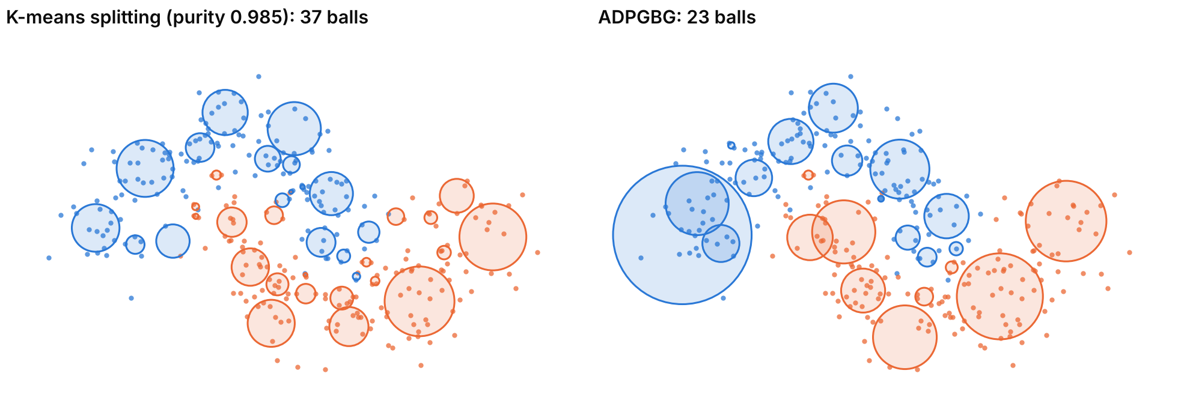
Two moons: fewer balls with ADPGBG, but no overlap either way
BALL GENERATION
 | MATLAB (Aug, old deck) | Python (Oct) | Python (Oct)
Noise | 0.08 | 0.08 | 0.20
K-means balls | 75 | 9 | 37
ADPGBG balls | 7 | 9 | 23
Overlapping pairs, k-means | 278 | 0 | 0
Overlapping pairs, ADPGBG | 0 | 0 | 0
Python re-run, October: two moons, n = 300, noise 0.20, seed 42; k-means at purity 0.985 with balls of under 2 points removed.
Open question: the MATLAB run reported 278 overlapping pairs (10% of 75 × 74 / 2). The Python re-run gives none at either noise level. The MATLAB run probably counted balls before small ones were removed or used a different radius (inferred, not checked). Later, round 5 of the fuzzy study found no accuracy gain from ADPGBG.
ADPGBG gives fewer balls; the 278-conflict claim did not reproduce and must be re-checked before use.
Notes:
This is the two-moons experiment. The old deck showed a MATLAB run where k-means made 75 balls with 278 overlapping pairs and ADPGBG made 7 balls with none. When I re-ran it in Python with the same generator code that the rest of the work uses, k-means made 37 balls and ADPGBG 23 at noise 0.2, and neither had overlapping balls of different classes. At the old noise level of 0.08 both made 9 balls. So the clean part of the story holds: ADPGBG uses fewer balls. The dramatic overlap number does not reproduce, and I think the MATLAB count included tiny balls or a larger radius definition, but I have not confirmed which. In the fuzzy study, round 5, ADPGBG did not improve accuracy either.

Slide 9
How the weighting models were tested
BALL WEIGHTING MODELS
diabetes
ecoli2
vehicle0
Where a ball weight w enters (plane 1)
768 points
imbalance 1.87
336 points
imbalance 5.46
846 points
imbalance 3.25
(G^{T} W G + (1/c₁) H^{T}H + εI) u₁ = −G^{T} W (e₂ + R₋)
W = diag(w) over the opposite-class balls
KEEL imbalanced datasets [14]; stratified 70/15/15 split, seed 42, no scaling.
c1 = 100, c2 = 0.01, purity 0.95, balls of under 2 points removed.
Phase 8 added a validation grid and seeds {0, 1, 2, 3, 4, 42}; later screens used 17 datasets × 3 seeds.
Control: every new weight is compared with CW (class weights), not only with plain GBLSTSVM.
src/cw_gblstsvm.py · solve_cw_gblstsvm_systems
gram_hp1 = _weighted_gram(mat_G, w_opp_hp1) + (
1.0 / c1) * _weighted_gram(mat_H, w_own_hp1)
inv_p_1 = np.linalg.inv(gram_hp1 + eye)
e2_R_neg = mat_e2 + R_neg
rhs_1_top = _weighted_matvec(B, w_opp_hp1, e2_R_neg)
rhs_1_bottom = _weighted_matvec(
mat_e2, w_opp_hp1, mat_e2 + R_neg)
rhs_1 = np.concatenate([rhs_1_top, rhs_1_bottom])
hyper_p_1 = -1.0 * inv_p_1 @ rhs_1.reshape(-1, 1)
A new weight had to beat class weighting, so any gain had to come from the ball itself.
Notes:
All weighting models were tested the same way. Three imbalanced datasets from KEEL, a fixed split into training, validation and test, and fixed settings. Every model plugs a weight per ball into the same weighted least squares system shown on the right: the weight multiplies that ball's row, so a ball with weight 2 counts like two copies. The important design choice was the control. Weighting by class alone already helps imbalanced data, so a new ball weight only counts as useful if it beats the class-weighted model, CW, not just plain GBLSTSVM.

Slide 10
CW, R and CR: does ball reliability add anything?
BALL WEIGHTING MODELS
CW: class weight
R: ball reliability
CR: both
κ_{c} = n / (2 n_{c})
w_{i} = κ for the ball's class
a_{i} = ε + (1 − ε) p_{i}^{γ} exp(−λ r̃_{i} (1 − p_{i}))
p = purity, r̃ = r / median(r)
w_{i} = κ · a_{i}
is CR better than CW?
Macro F1 difference | diabetes | ecoli2 | vehicle0
CW − GBLSTSVM, tuned test | +0.003 | −0.025 | +0.011
CW − GBLSTSVM, 6-seed mean | −0.029 | −0.008 | −0.017
R − GBLSTSVM, tuned test | −0.008 | 0.000 | −0.012
CR − CW, tuned test | −0.007 | 0.000 | 0.000
Mean reliability | 0.998 | 0.995 | 0.999
src/reliability.py · ball_reliability_score
elif variant == "full":
core = (p**gamma) * float(
np.exp(-lambda_r * r_tilde * (1.0 - p)))
...
return epsilon + (1.0 - epsilon) * core
At purity 0.95 every ball is nearly pure, so reliability is about 1 and CR equals CW.
Notes:
The first falsifiable question was: does a ball's reliability, meaning how pure and compact it is, add anything beyond class weighting? CW weights each ball by the inverse of its class frequency. R trusts pure, small balls more. CR multiplies the two. The table shows the result. CW helps a little on diabetes and vehicle0 on the tuned split but is negative on average over seeds. R and CR change almost nothing. The last row explains why: with a purity threshold of 0.95, every ball is almost pure, so the reliability is 0.995 or more for every ball and multiplying by it does nothing. On vehicle0 the CR and CW planes differ slightly, but not a single test prediction changed.

Slide 11
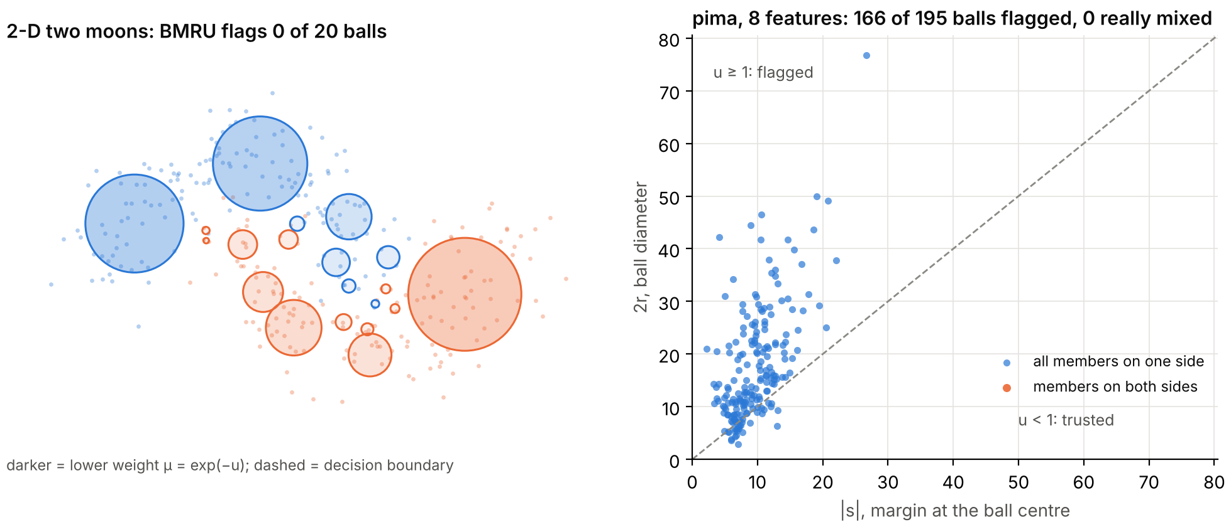
BMRU: trust balls that sit far from the decision boundary
BALL WEIGHTING MODELS
Ball-margin reliability update
s_{i} = |f₂(c_{i})| − |f₁(c_{i})| (margin at the centre)
u_{i} = 2 r_{i} / (|s_{i}| + ε), μ_{i} = exp(−α u_{i})
fit → weight → refit, for 3 to 5 rounds
src/bmru.py
if r == 0.0:
return 0.0
return (2.0 * r) / (abs(float(margin)) + epsilon)
...
u = bmru_uncertainty(radius, margin, epsilon=epsilon)
mu = float(np.exp(-alpha * u))
98.7%
98.2%
0.40 → 0.00
diabetes balls flagged; 0% really cross the boundary
vehicle0 balls flagged; 5.4% cross the boundary
vehicle0 minority recall, CW + BMRU vs CW
With 8 or more features every ball is wider than its margin, so BMRU down-weights almost all of them.
Notes:
BMRU asks: is this ball wider than its distance to the decision boundary? If the diameter is large compared with the margin at the centre, the ball probably straddles the boundary, so it gets a lower weight, and the planes are refitted a few times. In two dimensions, on the left of the picture, this looks sensible: none of the 20 balls is flagged. But on real data with 8 or more features, radii grow with the number of features. On pima, on the right, 166 of 195 balls are flagged even though none actually has members on both sides of the boundary. The original runs found the same: 98 percent of balls flagged against 0 to 5 percent really straddling. On vehicle0 it wiped out minority recall. So BMRU was dropped as a failed hypothesis.

Slide 12
Overlap weight: boost minority balls that touch the other class
BALL WEIGHTING MODELS
src/overlap.py
denom = ri + rj + epsilon
return float(max(0.0, (ri + rj - d) / denom))
...
if ball.label == minority_label:
mu[i] = 1.0 + alpha * O[i]
else:
mu[i] = 1.0 - alpha * O[i]
d_{ij}
r_{i}
r_{j}
O_{ij} = max(0, (r_{i} + r_{j} − d_{ij}) / (r_{i} + r_{j} + ε))
O_{i} = mean of the 3 largest O_{ij}
minority μ_{i} = 1 + αO_{i}, majority μ_{i} = 1 − αO_{i}
CW + overlap − CW = 0
on every metric for all three datasets; correlation of the weights with CW ≈ 0.998.
Pure balls rarely overlap, so the overlap weight was zero for most balls and changed nothing.
Notes:
The overlap idea was: where a minority ball overlaps a majority ball, the boundary is contested, so give that minority ball more weight and the majority ball less. Overlap between two balls is how much the sum of the radii exceeds the distance between the centres, scaled to between 0 and 1. The chart shows the problem: with pure balls, most balls touch nothing. On ecoli2 every overlap score was exactly zero, and on diabetes 93 percent were. Even on vehicle0, the largest overlap was only 0.13. So the weights were almost identical to plain class weights and no metric moved. This was also dropped.

Slide 13
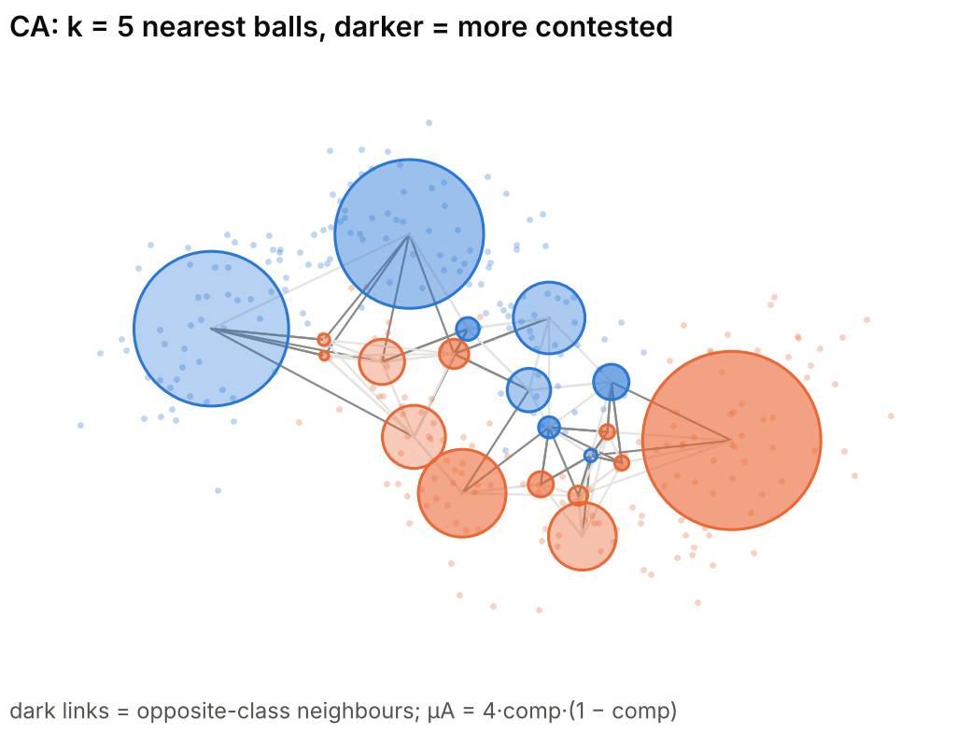
CBCM: give weight to contested balls
BALL WEIGHTING MODELS
Competition among the k nearest balls
k = max(5, ⌈0.05 N⌉), g_{ij} = exp(−d_{ij}² / 2σ_{i}²), σ_{i} = median distance
comp_{i} = Σ_{opposite} g_{ij} / Σ_{j} g_{ij}
μA_{i} = 4 comp_{i} (1 − comp_{i}) (largest at comp = ½)
CA: w = κ · μA CC: w = κ · μA · μB (μB = density support)
src/cbcm.py · compute_competition_membership
dists = np.linalg.norm(centers[i] - centers[idx], axis=1)
sigma_i = _adaptive_bandwidth(dists, sigma_eps=sigma_eps)
weights = _gaussian_weights(dists, sigma_i)
opp = labels[idx] != labels[i]
comp_a[i] = float(np.sum(weights[opp]) / w_sum)
...
mu_a = 4.0 * comp_a * (1.0 - comp_a)
CA gives the most weight to balls whose neighbours are half from the other class.
Notes:
CBCM looks at each ball's neighbourhood instead of its own shape. For each ball, take its k nearest balls and work out, with Gaussian weights so closer balls count more, what fraction belong to the other class. That is the competition. A ball surrounded by its own class has competition 0; a ball whose neighbours are half the other class has competition one half. The membership 4 c times 1 minus c turns that into a weight that peaks at one half, so contested boundary balls get the most weight. CA uses only this part; CC also multiplies in a density term. In the picture the dark links go to neighbours of the other class, and the darker balls are the contested ones in the middle.

Slide 14
CA: one clean gain on vehicle0, unstable elsewhere
BALL WEIGHTING MODELS
Check | CW | CA
vehicle0, 5-fold CV, G-mean | 0.710 | 0.720 ± 0.085
CC vs CW on that CV (Wilcoxon p) | — | p = 1.0
17 datasets × 3 seeds, mean macro F1 | 0.550 | 0.537
Datasets where CA beats CW | — | 7 of 17
bcw_original, macro F1 | 0.849 | 0.397
ecoli2 noise check | — | failed: noise rewarded
Mean over 17 datasets computed from topo_broad_screening_aggregate.csv
CA's gain on vehicle0 shrank under cross-validation and reversed on other data; it stayed only as a reference.
Notes:
On the vehicle0 test split CA looked good: G-mean up from 0.61 to 0.68 and macro F1 up by five points. That is the bar chart. The table is what happened when I checked it properly. Under 5-fold cross-validation on the same dataset the gap shrank to one point, and the CC variant was no different from CW at all. Across 17 datasets CA was on average slightly worse than CW, better on only 7 of them, and on one dataset it collapsed. On ecoli2 a sanity check with injected noise showed CA rewarding the noisy balls, because noisy balls also look contested. So CA was marked promising but unstable and kept only as the reference for the next ideas.

Slide 15
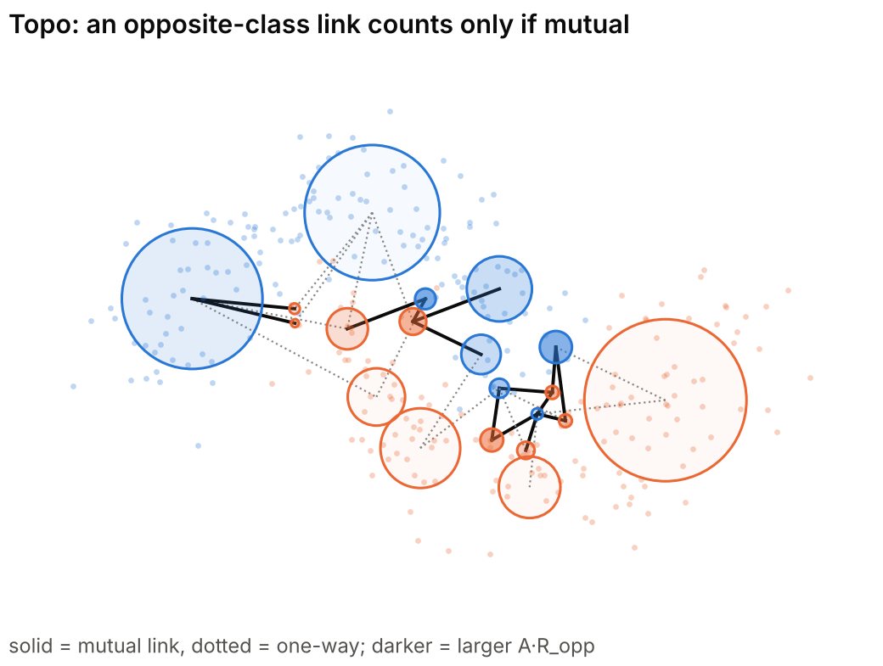
IPA and Topo: two fixes for CA's noise problem
BALL WEIGHTING MODELS
IPA: penalise isolated balls
A = 2 min(c, 1 − c); ρ_{i} = q_{i} / median_{y}(q), q = distance to nearest same-class ball
μ_{i} = A / (1 + λ max(0, ρ_{i} − 1))
Topo and SupportAware-Topo: count only mutual links
Topo: μ_{i} = A · R_{opp}, R_{opp} = n_{recip} / (n_{opp} + ε)
SA-Topo: c = n_{opp} / (n_{opp} + 1), R^{S} = c R_{opp} + (1 − c)
vs CA | Result
IPA | vehicle0 G-mean −0.020, ecoli2 +0.011, diabetes 0
Topo, 51 runs | macro F1 wins/ties/losses 16 / 15 / 20, mean −0.001
SA-Topo, 51 runs | 15 / 20 / 16, mean +0.003; erased Topo's best win
Neither IPA nor Topo beat CA consistently, so the neighbourhood family was closed.
Notes:
Two follow-ups tried to stop CA from rewarding noise. IPA says a contested ball that is also far from any ball of its own class is probably noise, so its weight is divided by how isolated it is. Topo says a contested link only counts if it is mutual: ball i lists ball j among its nearest neighbours and j lists i back. In the picture the solid links are mutual and the dotted ones are one-way. SupportAware-Topo softens Topo when a ball has very few opposite-class neighbours. The table shows the results against CA. IPA helped on ecoli2 but hurt on vehicle0. Over 51 runs, Topo and SA-Topo won about as often as they lost. So this whole family of neighbourhood weights was closed.

Slide 16
Ten weighting ideas, one survivor
BALL WEIGHTING MODELS
Model | What gets more weight | Best evidence | Verdict
CW | balls of the smaller class | vehicle0 minority recall 0.33 → 0.40 | kept as control
R | pure, compact balls | reliability ≈ 1, no change | rejected
CR | class × reliability | CR − CW ≤ 0 on every dataset | rejected
BMRU | balls far from the margin | 98% of balls flagged | rejected
Overlap (OBRU) | overlapping minority balls | overlap 0 for 61–100% of balls | rejected
CBCM: CA, CC | contested balls | vehicle0 only; 7 of 17 datasets | reference only
IPA | contested, not isolated | mixed vs CA | rejected
Topo, SA-Topo | contested with mutual links | 16 / 15 / 20 vs CA | not promoted
Only class weighting survived, which is why the fuzzy study compared every membership against a fair baseline.
Notes:
This table puts the weighting ideas side by side. Counting the variants, that is about ten ideas. The pattern is clear: anything that depends on purity or overlap does nothing because the balls are almost pure, and anything that depends on the margin or the neighbourhood is unstable from dataset to dataset. Only class weighting gave a gain, and that gain was small. This is the main reason the fuzzy study later insisted on cross-validation, many datasets and a fair baseline before believing any improvement.

Slide 17
Changing how balls are split did not help either
GRANULATION AND COMPRESSION
Variant | Idea | Result | Verdict
Split-utility gate | refuse 2-means splits that peel off a few minority points | minority survival 0.58 → 0.99, but macro F1 −0.014 | rejected
Online entropy order | always split the most mixed ball first | F1 0.613 vs 0.597, but 52% of runs collapse | rejected
Ball budget | stop at a ball count, not a purity | best budget F1 0.514 vs 0.597 at purity 0.90 | rejected
Ranked compression | keep the K most useful balls | all ranking rules gave identical scores (likely a bug) | unclear
Validation-chosen K | pick K on the validation split | +0.039 F1 (p = 0.002), but the control was not matched | overruled
17 datasets × 10 seeds; purity-0.90 builder as reference
Session 4 found that deleting small balls loses 42% of minority points, a problem the fuzzy study came back to.
Notes:
Sessions 4 to 6 tried to change the ball builder itself. A diagnostic in Session 4 showed that 2-means often splits off a few minority points into a tiny ball, which is then deleted, so only 58 percent of minority points survive. The split-utility gate blocked those splits and kept 99 percent of minority points, but accuracy still went down. Splitting the most mixed ball first, or stopping at a fixed number of balls, were both worse than the plain builder at purity 0.90. A ranking experiment gave identical numbers for every ranking rule, which points to a bug rather than a finding. And a validation-chosen ball count looked significant until we noticed its control was not matched. The deletion problem at the bottom is exactly what the fuzzy study later measured properly.

Slide 18
Session 7: balls help only by compressing the data
GRANULATION AND COMPRESSION
Same points: every arm starts from the same sample indices (hash-checked).
Balls vs single points: +0.13 to +0.14 macro F1, Wilcoxon p < 10⁻⁵⁷.
Balls vs a stratified sample of the same size: 0.6179 each.
Verdict (CASE B): no advantage from ball structure beyond sample-level compression and class weights.
A stratified sample of the same size did exactly as well as the balls.
Notes:
The last session was a careful ablation. Every method started from exactly the same subset of training points, checked by hash. Turning those points into balls, at any purity from 0.80 to 0.98, beat using the points one by one by about 13 to 14 points of macro F1, which looks like a big win for balls. But a plain stratified sample with the same number of points, the yellow bar, scored exactly the same as balls at purity 0.90. So the gain comes from compressing and rebalancing the data, not from anything special about balls. The recommendation in early September was to stop inventing new ball heuristics. M0 to M3, next, tested one last idea: letting the classifier guide the splitting. After that the project moved to fuzzy membership and to asking which points the balls throw away.

Slide 19
Why let the classifier guide ball splitting
M0–M3 CLASSIFIER-GUIDED BALLS
Original pipeline (M0)
What it cannot see
1
All training points start in one ball
Classifier-blind
Two balls of equal purity get the same treatment, even if one sits on the decision boundary.
2
Compute centre, radius, label, purity
Pure boundary balls are ignored
A first score multiplied entropy by the boundary signal, so a pure ball always scored 0.
3
If purity < threshold, split with 2-means
4
Repeat for impure children
Weights were never used
Reliability values were computed and stored, but the solver still saw only centre, radius and label.
5
Delete very small balls
Thresholds do not transfer
A fixed score threshold such as 0.05 is too strict on one dataset and too loose on another.
6
Pass [centre, radius, label] to GBLSTSVM
Purity alone cannot tell an easy interior ball from a ball on the decision boundary.
Notes:
After the weighting experiments, the last idea was to change where balls are split. The original pipeline, on the left, only looks at purity. It cannot tell whether a ball is deep inside its class, where splitting is wasted, or right on the boundary, where finer balls could move the planes. My first attempt had a flaw: it multiplied entropy by the boundary signal, so a pure ball on the boundary scored zero and was never refined. Also, the reliability weights from earlier were computed but never actually entered the solver. The M0 to M3 design fixes these.

Slide 20
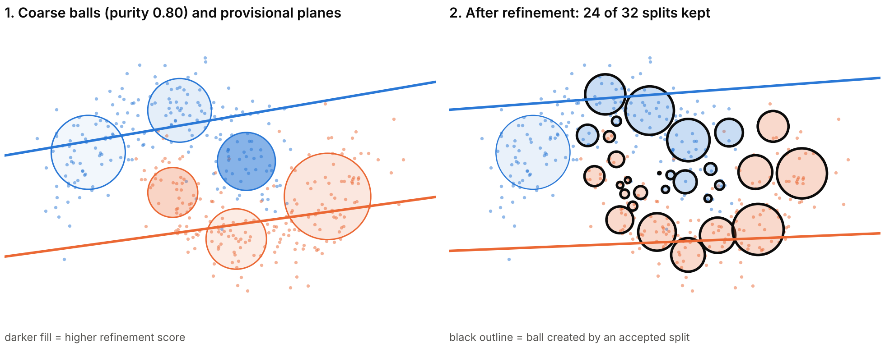
M1: split the balls the current planes are unsure about
M0–M3 CLASSIFIER-GUIDED BALLS
Plane ambiguity
d_{k} = |w_{k}^{T}c_{j} + b_{k}| / ‖w_{k}‖
A_{j} = 1 − |d₁ − d₂| / (d₁ + d₂)
Boundary signal
B_{j} = (1 − ρ) A_{j} + ρ O_{j}
Refinement score (29 Sep)
S_{j} = Z_{j} [(1 − μ) H_{j}^{α} + μ B_{j}^{β}]
Z_{j} = log(1 + n_{j}) / log(1 + n_{max})
Split acceptance
gain = S_{parent} − Σ (n_{c} / n_{p}) S_{c} − λ
Two moons, n = 400, noise 0.25. 6 coarse balls become 30 after 7 rounds; 24 of 32 proposed splits were kept.
Coarse balls
›
Fit planes
›
Score balls
›
Try a 2-means split
›
Keep if gain > min
M1 spends extra balls only where the current planes cannot tell the classes apart.
Notes:
M1 is margin-guided generation. Start from coarse balls, fit provisional planes, and score each ball by how unsure the planes are about it: if a ball centre is about equally far from both planes, its ambiguity is close to 1. That is mixed with an overlap term into a boundary signal, and with label entropy and a size factor into a refinement score. High-scoring balls are split with 2-means, but the split is only kept if the children's score drops by more than a small complexity penalty. Then the planes are refitted and the loop repeats. In the picture, darker balls on the left have higher scores, and the black-outlined balls on the right came from accepted splits. Most new balls sit in the middle where the moons meet.

Slide 21
M1 in code: score each ball, keep a split only if it pays
M0–M3 CLASSIFIER-GUIDED BALLS
gen_ball_new.py · _hyperplane_ambiguity
gen_ball_new.py · _update_dynamic_metrics
d1 = abs(np.dot(c, w1) + b1) / (np.linalg.norm(w1) + _EPS)
d2 = abs(np.dot(c, w2) + b2) / (np.linalg.norm(w2) + _EPS)
gap = abs(d1 - d2)
ambiguity = 1.0 - gap / (d1 + d2 + _EPS)
return float(np.clip(ambiguity, 0.0, 1.0))
boundary_signal = ((1.0 - overlap_mix) * ball.ambiguity
+ overlap_mix * ball.overlap)
ball.refinement_score = float(
(ball.entropy ** entropy_power)
* (boundary_signal ** boundary_power)
* ball.size_factor)
gen_ball_new.py · refine_balls_margin_guided
Note on the score: the code in the zip still multiplies entropy by the boundary signal, so a pure boundary ball scores 0. The 29 Sep report switched to the additive form S = Z[(1 − μ)H^{α} + μB^{β}] and added a pure-margin path; that version is not in the zip.
gain = (parent.refinement_score
- weighted_child_score - complexity_penalty)
if gain > min_gain:
gb.granular_balls[parent_index] = children[0]
gb.granular_balls.append(children[1])
The split rule is greedy and cheap: one 2-means call and one score per candidate ball.
Notes:
Here is the code behind M1. Top left is the ambiguity: the distances from the ball centre to both planes, normalised, and one minus their relative gap. Top right combines ambiguity and overlap into the boundary signal and the refinement score. Bottom left is the acceptance rule: a split replaces the parent with its two children only if the gain beats the minimum. One honest caveat on the right: the code I have still uses the multiplicative score, which gives pure balls a score of zero. The 29 September report describes the fixed additive score, so the two should be brought in line before anything is reported.

Slide 22
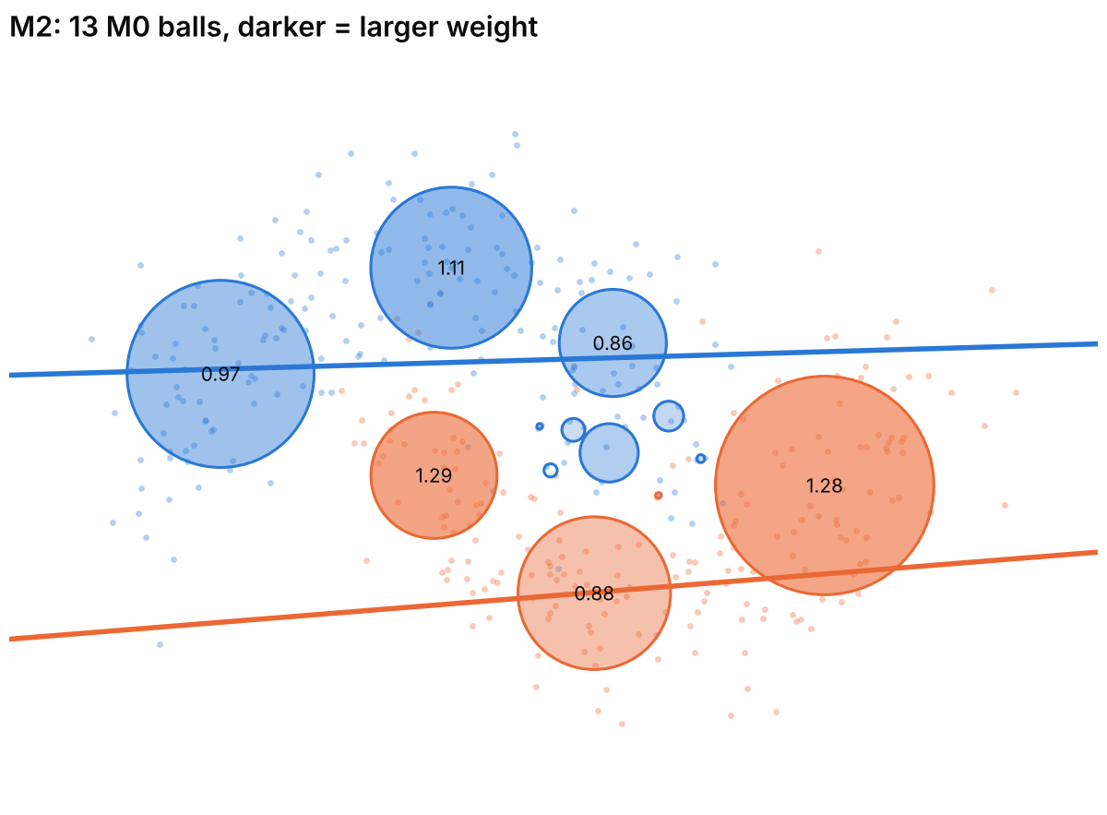
M2: weight each ball by how sure we are of its label
M0–M3 CLASSIFIER-GUIDED BALLS
θ_{j} | data ~ Beta(k_{j} + 1, n_{j} − k_{j} + 1), reliability_{j} = 2.5% quantile
w_{j} = reliability_{j} (1 + η B_{j})
w̃_{j} = w_{j}^{p} / mean_{class}(w^{p})
k = points agreeing with the label, n = ball size, B = boundary signal, η = boost. Weights go into the same weighted solve as CW.
experiments/run_m0_m3.py · fit_model
weights_pos = class_mean_normalize(weights_pos)
weights_neg = class_mean_normalize(weights_neg)
w1, b1, w2, b2 = solve_cw_gblstsvm_systems(
A, R_pos, B, R_neg, args.c1, args.c2,
weights_pos, weights_neg,
weight_placement=args.weight_placement)
M2 keeps the M0 balls and changes only how much each one counts in the solve.
Notes:
M2 leaves the balls alone and changes their weights. The reliability of a ball is a cautious estimate of its purity: the lower end of a 95 percent interval from a Beta distribution, so a ball of 2 points that agree gets a much lower value than a ball of 50 points that agree. That is multiplied by one plus a boost times the boundary signal, so informative boundary balls count a bit more, and the weights are rescaled to mean 1 within each class so they do not silently change c1 and c2. In the picture, 13 balls are shaded by weight, which ranges from 0.12 to 1.29 here; the numbers are written on the larger balls. The tiny balls get small weights because their purity interval is wide.

Slide 23
A 2 × 2 design separates the two ideas
M0–M3 CLASSIFIER-GUIDED BALLS
Model | Ball generation | Weighting | Tests
M0 | purity splitting | none | baseline
M1 | margin-guided refinement | none | does better splitting help?
M2 | purity splitting | reliability weights | do weights help?
M3 | margin-guided refinement | reliability weights | both together
Diagnostics recorded per run
number of balls
attempted and accepted splits
mean and max plane ambiguity
spread of refinement scores
weight spread, within each class
share of test predictions that change between two models
Leakage-safe tuning
Test split held out once. Three CV stages on the training part: base (purity, c1, c2, deletion), margin (thresholds, mixes, powers, penalty, rounds) and weight (boost, power, placement). Scaling fitted on each training fold only.
The diagnostics show whether a mechanism actually changed the balls, the weights or the predictions.
Notes:
M0 to M3 is a two by two design: better splitting on or off, weights on or off. That way a gain in M3 can be traced to one of the two ideas. Tuning is done only by cross-validation on the training part, in three stages, and the test split is touched once at the end. The diagnostics on the right were added because of the earlier sessions: several models there turned out to change nothing at all, and accuracy alone does not reveal that. Counting accepted splits and the share of predictions that changed tells us immediately whether a mechanism is active.

Slide 24
Breast cancer: M1 lifted accuracy, weights added nothing
M0–M3 CLASSIFIER-GUIDED BALLS
Pair | Predictions changed
M0 vs M1 | 14.04%
M0 vs M2 | 0.88%
M1 vs M3 | 0.00%
M2 vs M3 | 13.16%
Balls: M0 and M2 12, M1 and M3 3 (one accepted split).
Caveats
One dataset and one split, so not a general claim. In the untuned runs saved in the zip (scikit-learn breast cancer, purity 0.95), M1 accepted no splits and M2 lowered test macro F1 from 0.697 to 0.638.
M1 raised accuracy from 87.7% to 94.7% on one split; M2 moved under 1% of predictions.
Notes:
These are the tuned results from the 29 September report. Margin-guided generation, M1, raised accuracy from 87.7 to 94.7 percent, and balanced accuracy and macro F1 rose by the same amount. It changed 14 percent of predictions, so the mechanism really did something. Interestingly the tuned M1 ended up with only 3 balls. Weighting, M2, changed less than one percent of predictions, and M3 made exactly the same predictions as M1. The caveat matters: this is one dataset and one split, and the untuned runs saved with the code show the opposite pattern. The plan at that point was to test the fixed benchmark collection before claiming anything, which is where the fuzzy study picked up.

Slide 25
Related work that limits what we can claim
WRAP-UP
GBLSTSVM [4]
the baseline: LSTSVM trained on ball centres and radii
Granularity tuning [9]
adaptive radius and heterogeneous overlap
ADPGBG [5]
better ball generation is an established direction
GB fuzzy TSVM [10]
fuzzy weights on balls in a twin SVM: closest to a fuzzy extension
GBG++ [6]
fast, stable generation without k-means
GB intuitionistic fuzzy TSVM [11]
intuitionistic fuzzy ball weights for imbalance and noise
Shadowed balls [7]
entropy and three-way decisions on balls: entropy alone is not new
Boundary-driven balls [12]
balls generated from the class boundary
Local-density balls [8]
density-chosen centres
Entropy, overlap, radius tuning and fuzzy ball weights are all published, so a new claim must be narrower.
Notes:
These nine papers came up while positioning the work. Several of them already cover what we tried: entropy on balls, boundary-aware generation, overlap and radius tuning, and two papers that already put fuzzy or intuitionistic fuzzy weights on granular balls in a twin SVM. That means a paper cannot claim fuzzy ball weights as new in themselves. It has to say something narrower and testable, which is how the fuzzy study ended up as an analysis of where balls help and where they hurt.

Slide 26
What this phase taught us, and where the fuzzy study picked up
WRAP-UP
1
2
3
4
Beat a fair baseline
Pure balls make weights flat
Deletion costs the minority
One split misleads
Class weighting alone explained most gains.
Reliability ≈ 1 and overlap = 0 for most balls.
Only 58% of minority points survive small-ball deletion.
CA, validation K and M1 looked good on one split.
In the fuzzy study: every membership is compared with GBLSTSVM and plain LSTSVM under the same tuning.
In the fuzzy study: over 99% of k-means balls turned out to be pure, so ball-level scores collapse.
In the fuzzy study: keeping single-point balls lifts GBLSTSVM by 3.2 points (Holm p = 0.002).
In the fuzzy study: cross-validation, 21 datasets, 10 splits and Holm-corrected tests.
These lessons set up the fuzzy study: fair tuning, many datasets, and a close look at what the balls discard.
Notes:
To close, four lessons from this phase and how each one shaped the fuzzy study. First, always compare with a fair baseline; here that was class weighting, and later it was plain LSTSVM under the same cross-validation. Second, when balls are pure, any weight built from purity or overlap is flat; the fuzzy study later showed that over 99 percent of k-means balls are pure. Third, deleting small balls throws away minority and boundary points; the fuzzy study measured this and found that simply keeping single-point balls lifts GBLSTSVM by about three points. Fourth, single splits mislead, so everything since then uses cross-validation over 21 datasets and corrected significance tests.

Slide 27
References
WRAP-UP
[1] Jayadeva, R. Khemchandani, S. Chandra. Twin support vector machines for pattern classification. IEEE Trans. Pattern Analysis and Machine Intelligence 29(5):905–910, 2007.
[2] M. A. Kumar, M. Gopal. Least squares twin support vector machines for pattern classification. Expert Systems with Applications 36(4):7535–7543, 2009.
[3] S. Xia, Y. Liu, X. Ding, G. Wang, H. Yu, Y. Luo. Granular ball computing classifiers for efficient, scalable and robust learning. Information Sciences 483:136–152, 2019.
[4] M. Tanveer, R. K. Sharma, A. Quadir, M. Sajid. Enhancing robustness and efficiency of least square twin SVM via granular computing. Pattern Recognition 170, 112021, 2026. (GBLSTSVM)
[5] W. Liao, Q. Zhang, Q. Xie, M. Gao, P. Jin. A new adaptive and effective granular ball generation method for classification. Int. J. Machine Learning and Cybernetics 16:3501–3520, 2025. (ADPGBG)
[6] Q. Xie et al. GBG++: a fast and stable granular ball generation method for classification. IEEE Trans. Emerging Topics in Computational Intelligence, 2024.
[7] J. Yang et al. A robust three-way classifier with shadowed granular balls based on justifiable granularity. IEEE Trans. Neural Networks and Learning Systems 36(9):16534–16548, 2025.
[8] F. Liu et al. A granular-ball generation method based on local density for classification. Information Sciences 717, 122295, 2025.
[9] J. Pan et al. A framework of granular-ball generation for classification via granularity tuning. Applied Intelligence 55, article 63, 2025.
[10] G. Lang, L. Zhao, D. Miao, W. Ding. Granular-ball computing-based fuzzy twin support vector machine for pattern classification. IEEE Trans. Fuzzy Systems 33(7):2148–2160, 2025.
[11] X. Liu, G. Xie, J. Xie. A granular-ball intuitionistic fuzzy twin support vector machine with RVFL-based feature enhancement for imbalance learning. Int. J. Data Science and Analytics 22(1), 2026.
[12] S. Wang, J. Zhan, S. Xia, W. Ding. Boundary-driven granular ball generation and classification via three-way decision. Information Sciences 755, 123780.
[13] C.-F. Lin, S.-D. Wang. Fuzzy support vector machines. IEEE Trans. Neural Networks 13(2):464–471, 2002.
[14] J. Alcalá-Fdez et al. KEEL data-mining software tool: data set repository, integration of algorithms and experimental analysis framework. J. Multiple-Valued Logic and Soft Computing 17(2–3):255–287, 2011.
[15] J. Demšar. Statistical comparisons of classifiers over multiple data sets. J. Machine Learning Research 7:1–30, 2006.
[16] GBLSTSVM-Ex research suite (Python, Sessions 1–7, Aug–Sep 2026) and GBLSTSVM MATLAB suite: CW, R, CR, BMRU, OBRU, CBCM, IPA and Topo weights; M0–M3 code (gen_ball_new.py, run_m0_m3.py). Unpublished SOP research code.
Notes:
References for the papers and code mentioned in this deck. The last entry is my own research code, which holds every model shown here.

