Slide 1



Sustainable Supply Chain Performance using Dashboard

Slide 2

Learning Objectives
1. Data Preparation & Transformation
Import and clean supply chain data from CSV files.
Understand data types (text, whole numbers, decimals) and apply
necessary transformations.
Create calculated columns and measures for key performance metrics
(e.g., revenue, defect rates).
2. Data Modeling
Establish relationships between different data attributes (e.g., linking
SKU with sales and stock levels).
Use Power BI's Data Model to connect tables and improve analysis
efficiency.
3. Exploratory Data Analysis (EDA)
Use visualizations to identify trends in product sales, revenue, and
manufacturing performance.
Analyze stock levels, lead times, and production volumes to assess
supply chain efficiency.
GOAL
Source :
www.freepik.com/

Slide 3
4. Performance Metrics & KPI Development
Calculate Key Performance Indicators (KPIs) such as Revenue per SKU, Defect Rate, and Lead Time Variability.
Create DAX measures to analyze profit margins, transportation costs, and manufacturing lead times.
5. Visualization & Reporting
Build interactive Power BI dashboards to track supply chain performance.
Use slicers and filters to drill down into product categories, locations, and transportation methods.
Create heatmaps, bar charts, and trend lines for insights into supply chain bottlenecks.
6. Supply Chain Optimization Insights
Identify cost-effective transportation modes and routes using Power BI.
Compare defect rates across different manufacturing sites and suppliers.
Forecast demand using historical sales and production trends.
7. Decision Support & Business Intelligence
Develop real-time dashboards for stakeholders to monitor key metrics.
Implement conditional formatting and alerts for low stock levels or high defect rates.
Use Power BI's AI insights to predict potential supply chain disruptions.

Slide 4
Tools and Technology used
Power BI Embedded:
If you are building a custom application or a console, we may consider using Power BI Embedded to integrate Power BI reports and dashboards directly into your application.
OTHER TECHNOLOGY:-
1. Data Extraction from Datasets:
Use Amazon Marketplace APIs or data export tools to extract relevant data.
Extracted data may include sales data, customer reviews, inventory levels, and other key metrics.
2. Data Transformation and Cleaning:
Power BI can connect to various data sources, and you may need to transform and clean the data to make it suitable for analysis..
3. Data Visualization:
Create dashboards and reports to visualize the extracted and transformed data. Power BI offers a variety of visualization options such as charts, tables, maps, and more.
4. Automation and Scheduled Refresh:
Schedule data refresh in Power BI Service to keep your reports up-to-date. This is crucial for ensuring that the latest Amazon Marketplace data is reflected in your reports.
5. Security:
Implement security measures to ensure that only authorized users have access to the sensitive data.

Slide 5
Methodology
1. Data Understanding & Preparation
Load the dataset into Power BI and explore its structure.
Check for missing values, duplicates, and inconsistencies.
Convert data types where necessary (e.g., dates, numerical values).
Use Power Query to clean and preprocess the data.
2. Define Key Sustainability Metrics
To measure sustainability in the supply chain, define key KPIs (Key Performance Indicators):
Environmental Impact:
Transportation mode efficiency (Air, Road, Rail impact on costs & emissions).
Manufacturing lead time vs. defect rates (to assess waste and efficiency).
Economic Impact:
Cost analysis: Production costs vs. Revenue Generated.
Stock levels and demand forecasting to reduce excess inventory.
Social Impact:
Customer demographics and order fulfillment rate.
Inspection results and defect rates affecting consumer safety.

Slide 6
3. Exploratory Data Analysis (EDA)
Identify patterns in product demand across locations and customer demographics.
Analyze stock levels vs. lead times to spot inefficiencies in inventory management.
Compare revenue generated across different product categories.
Detect patterns in defect rates and inspection results to improve quality control.
4. Data Modeling & Calculations
Use DAX (Data Analysis Expressions) to create new metrics:
Profit Margin % = (Revenue - Costs) / Revenue
Defect Rate % = (Defective Products / Total Products) * 100
On-time Delivery Rate = (Orders Delivered on Time / Total Orders) * 100
Stock Turnover Ratio = (Products Sold / Stock Levels)
5. Visualization & Dashboarding
Trend Analysis:
Line charts to track changes in lead times, stock levels, and revenue.
Geospatial Analysis:
Use Power BI Maps to analyze regional performance in logistics.
Correlation Analysis:
Compare transportation modes vs. costs vs. defect rates.
Interactive Reports:
Use slicers for different categories (e.g., product type, location, transportation mode).

Slide 7
Problem Statement:
Optimizing Sustainable Supply Chain Performance: Identifying Key Factors Affecting Cost, Lead Time, and Product Quality for Enhanced Efficiency and Sustainability
Expected Insights from Analysis
Which transportation modes contribute the most to cost and emissions?
Which products have the highest defect rates, and how does that impact revenue?
Which locations experience the highest lead times and inventory shortages?
How do customer demographics influence sales and sustainability trends?

Slide 8
Solution:
1. Analyze Supply Chain Efficiency
Evaluate transportation modes, lead times, and stock levels to identify
bottlenecks.
Compare cost vs. revenue across different SKUs and locations.
2. Enhance Product Quality & Reduce Defects
Identify patterns in inspection failures and defect rates to improve
manufacturing.
Optimize manufacturing lead times to reduce waste and inefficiencies.
3. Improve Sustainable Logistics
Assess eco-friendly transportation alternatives to minimize costs and
emissions.
Use demand forecasting to optimize stock levels and prevent
overproduction.

Slide 9
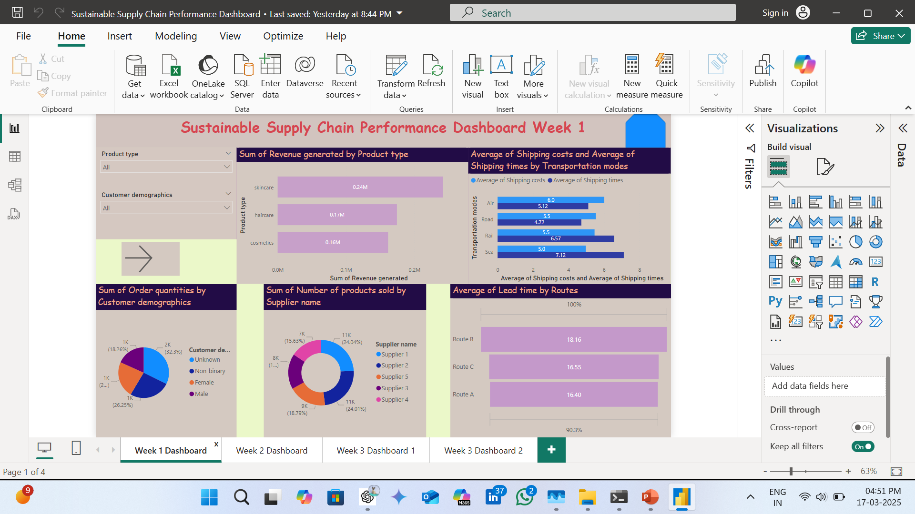
Screenshot of Output:

Slide 10
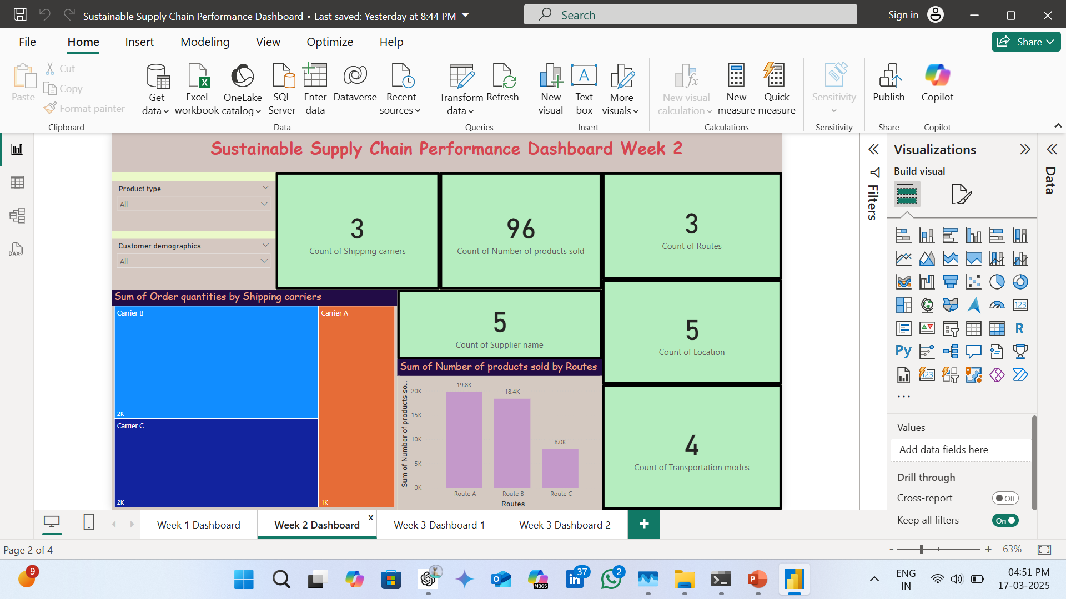

Slide 11
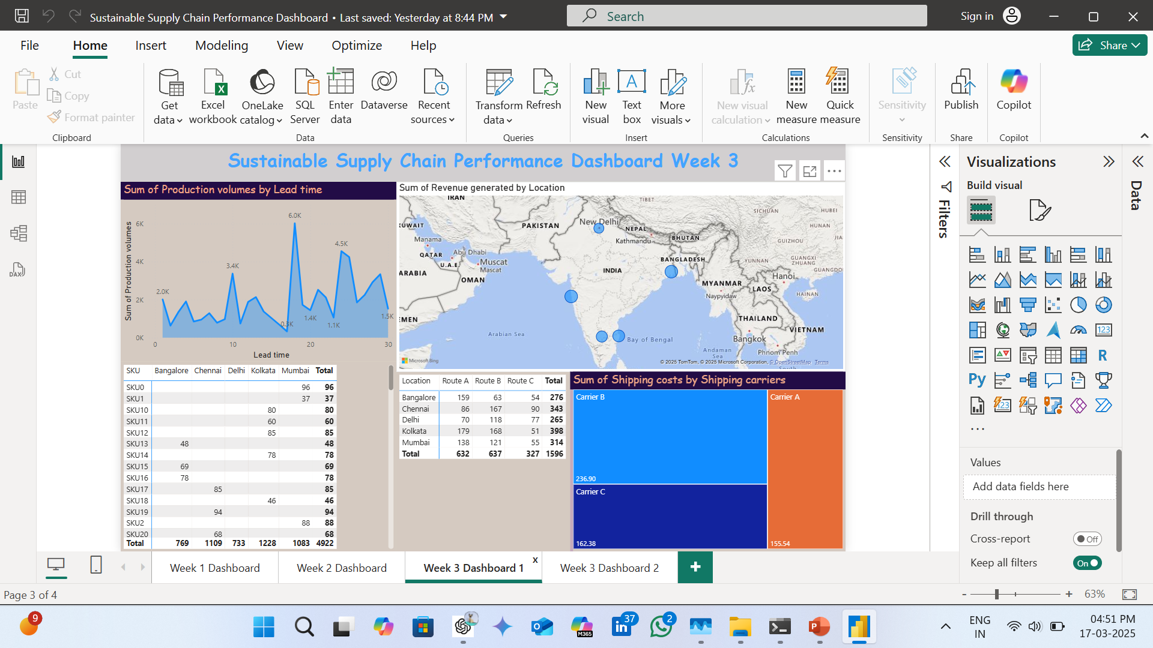

Slide 12
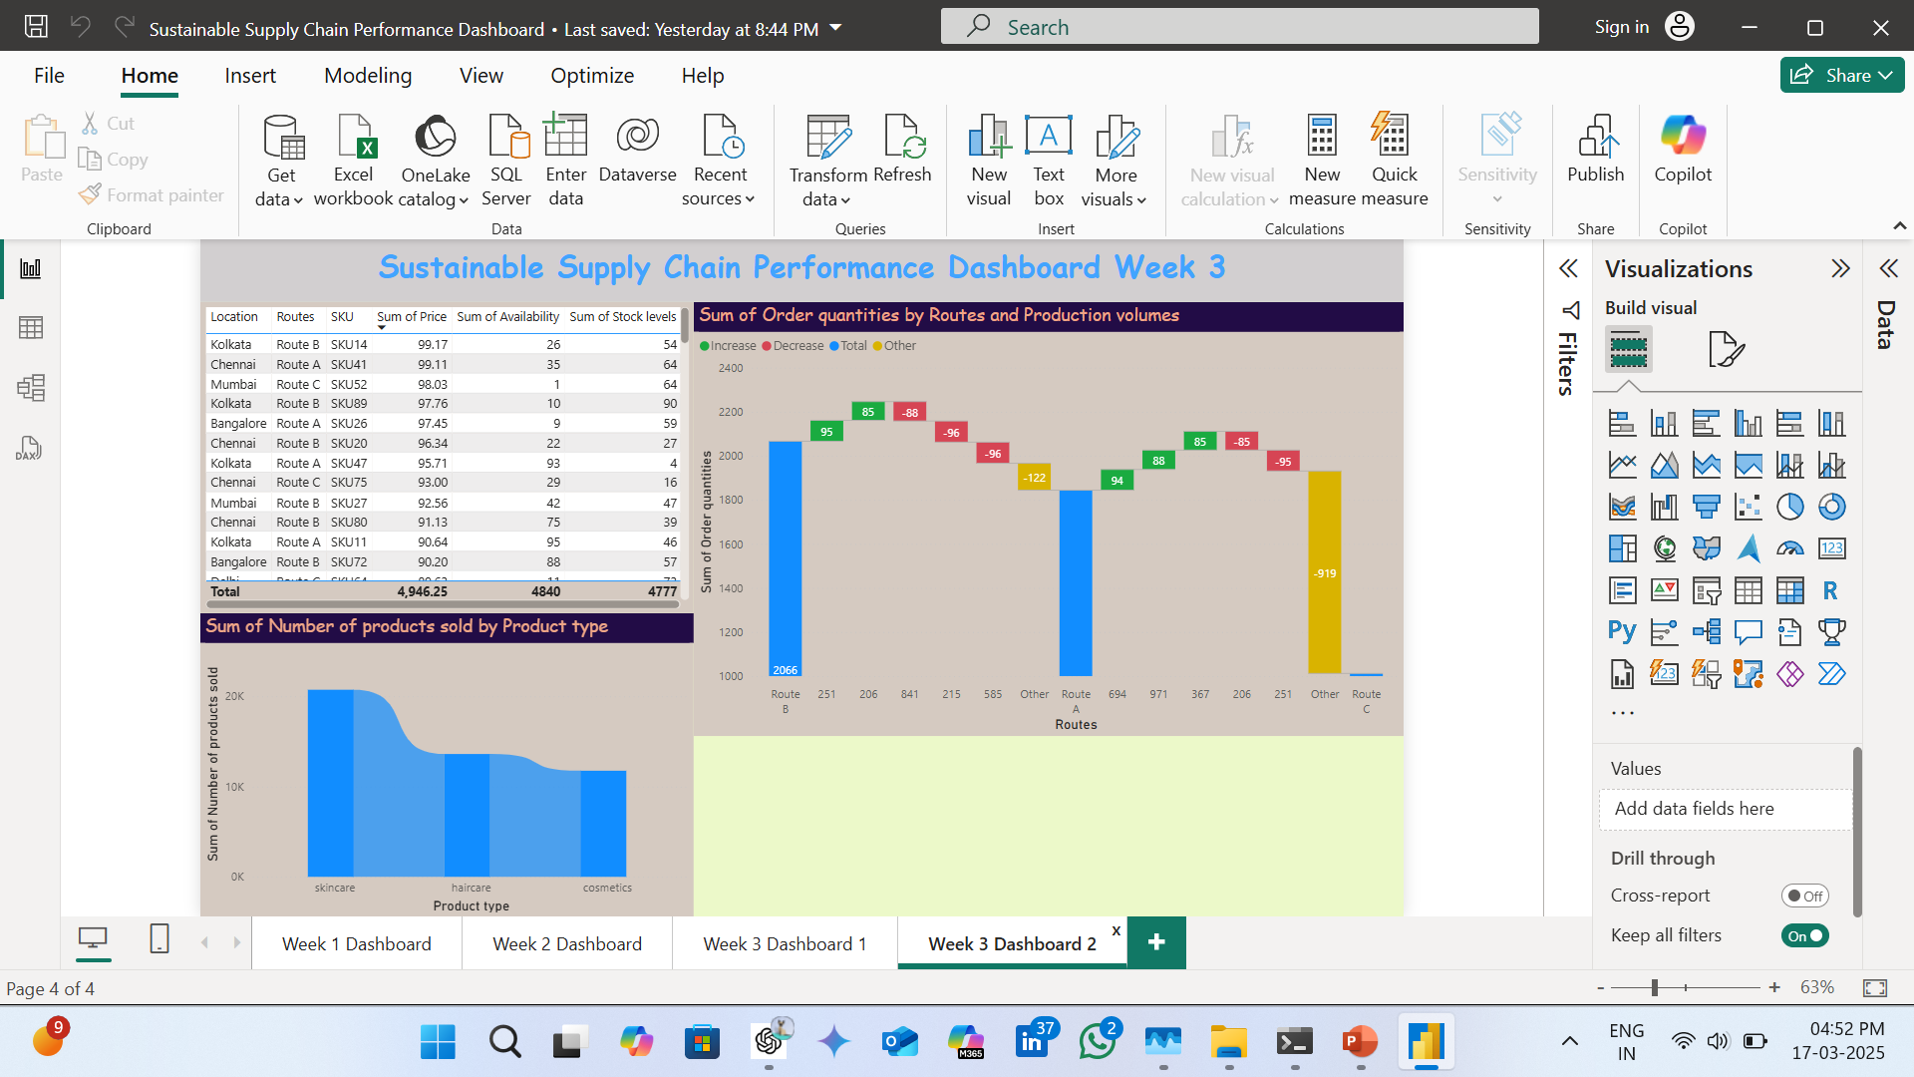

Slide 13
Conclusion:
The analysis of the Sustainable Supply Chain Performance dataset provided key insights into optimizing logistics, reducing costs, and improving product quality. By evaluating transportation modes, lead times, defect rates, and stock levels, we identified crucial areas for efficiency enhancement.
Key Findings:
✅ Optimized Transportation & Logistics – Identifying cost-effective and eco-friendly routes reduces overall supply chain costs and environmental impact. ✅ Improved Product Quality – Addressing high defect rates and failed inspections enhances customer satisfaction and reduces waste. ✅ Efficient Inventory Management – Balancing stock levels with demand forecasting prevents overstocking and shortages. ✅ Enhanced Lead Time Performance – Reducing lead time variations improves overall supply chain agility.
Final Recommendations:
Implement data-driven decision-making using Power BI dashboards for real-time tracking.
Adopt sustainable logistics strategies by choosing optimal transportation methods.
Enhance manufacturing efficiency by reducing lead times and defect rates.
Use predictive analytics for demand forecasting and risk management.

