Slide 1
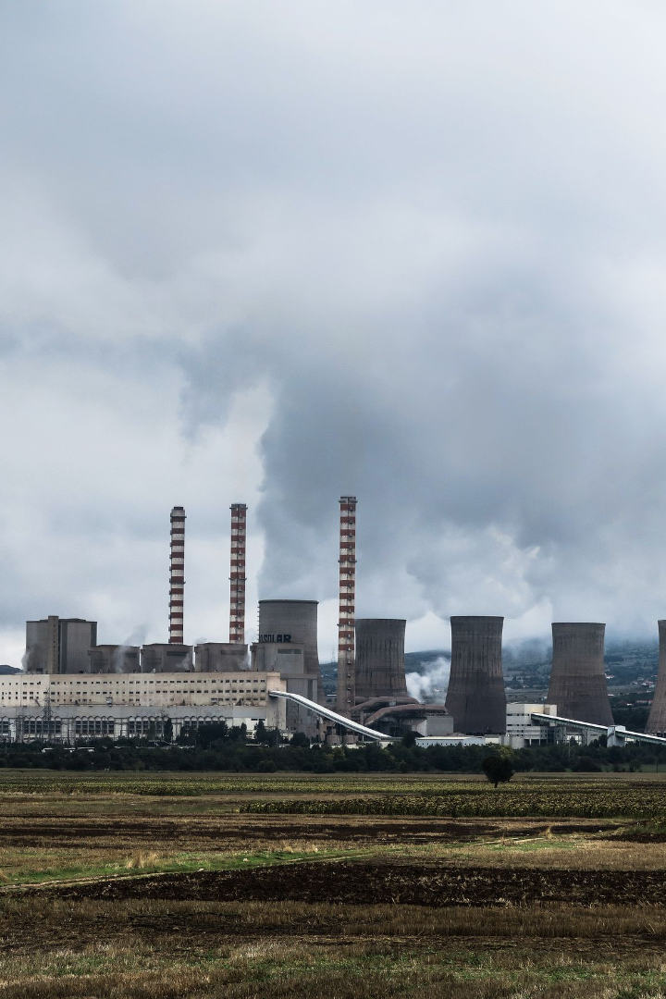
Air Quality Analysis and Prediction in Tamilnadu
Phase 2 Submission Document
TEAM MEMBER
JAYAKRISHNA S.R
REG NO:961721106306

Slide 2
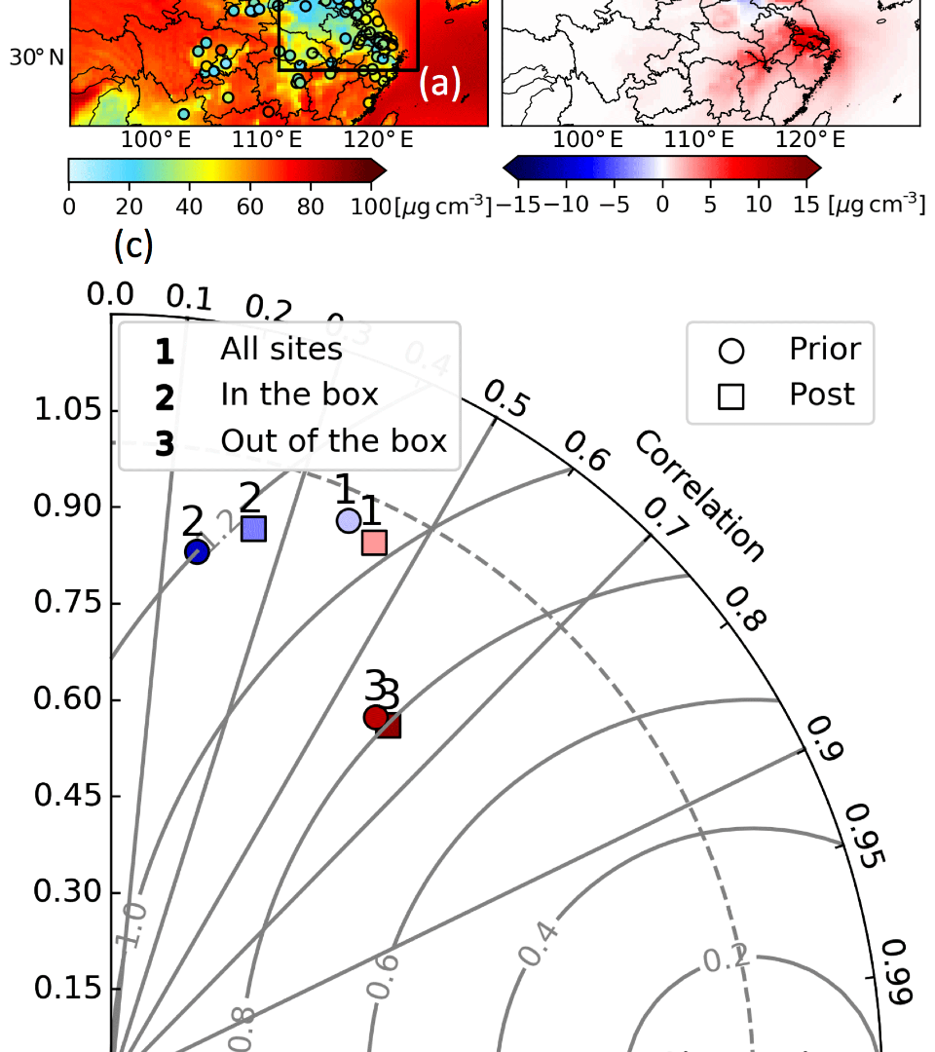
Importance of Air Quality Analysis and Prediction
1
Health Risks
2
Environmental Impact
Poor air quality can lead to severe health risks and diseases, including lung problems, heart disease, and other respiratory illnesses.
High levels of air pollution lead to global warming and climate change, impacting the health of the planet and affecting future generations.
3
Economic Costs
Studies show that air pollution carries a significant economic burden, including medical costs, lost productivity, and property damages.

Slide 3
Data Collection
1
Gathering Relevant Data
We gather relevant data on air quality in Tamilnadu by monitoring and measuring air quality parameters such as PM10, PM2.5, SO2, and NOx.
Sources of Data Collection
2
We utilize data collected by dedicated air quality monitoring stations across Tamilnadu as well as satellite-based remote sensing.
3
Challenges in Data Collection
We face challenges in maintaining the monitoring stations, ensuring data accuracy, and filling gaps in the data set.

Slide 4
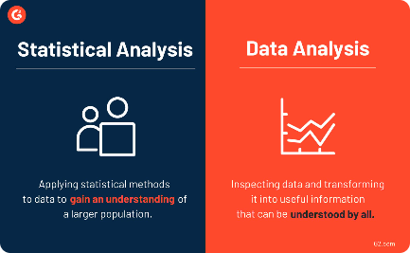

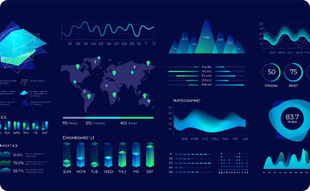
Data Analysis
Advanced Statistical Analysis
Machine Learning Techniques
Data Visualization
We use data visualization tools to create compelling and visually appealing graphs, charts, and maps.
We use sophisticated statistical models to identify patterns and trends in air quality data in Tamilnadu.
We leverage machine learning algorithms for data mining, feature extraction, and predictive modeling.

Slide 5
Prediction Model
Developing a Prediction Model for Air Quality
Factors Considered in the Model
Testing and Validating the Model
We develop a data-driven prediction model that uses historical trends, meteorological factors, and other variables to forecast air quality in Tamilnadu.
The model takes into account various parameters such as wind direction, temperature, relative humidity, rainfall, and traffic flow.
We rigorously test and validate the model using statistical metrics, cross-validation, and model comparison techniques.

Slide 6
Results and Findings
1
Presenting the results of the analysis and prediction
We present the findings of the analysis and prediction model using data visualizations and other impactful graphics.
2
Key Findings and Insights
Our findings show that PM2.5 and PM10 are the most consistent pollutants in the air of Tamilnadu, exceeding safe limits, and we provide insights into the sources of these pollutants.

Slide 7
Conclusion
Recap of the Steps Discussed
Importance of Air Quality Analysis and Prediction
Future Directions and Potential Applications
We discussed the crucial steps involved in Air Quality Analysis and Prediction in Tamilnadu, starting from data collection to the presentation of findings.
We learned that air pollution has severe health risks, environmental impacts, and economic costs and needs to be addressed.
We highlighted that Air Quality Analysis and Prediction has a significant potential impact in preventing and mitigating pollution and ensuring sustainable development in Tamilnadu.

