Slide 1
ZUCI HACKFEST '26 · AGENTIC PRESCRIPTIVE ANALYTICS
From Prediction to Governed Action
Zuci Agent Services — Agentic Prescriptive Analytics Hackfest Showcase
Prediction tells us what is likely to happen. This deck shows what should happen next.
Notes:
Opening: this is a real, running application -- everything shown is live, not slides.

Slide 2
“
Prediction tells us what is likely to happen.
Our solution focuses on what should happen next.
The core message of this showcase

Slide 3
1
Current Business Problem
Manual claim intake is slow, inconsistent, and stops at “here's a number.”
1
Manual retyping
2
No text layer
A reviewer retypes up to 15 fields per claim document by hand.
Faxed/scanned documents often need ad hoc OCR or manual reading.
3
Skipped cross-checks
4
Inconsistent policy
Verifying a value against the source is tedious and skipped under time pressure.
“Is this even a valid claim?” is a subjective, reviewer-dependent judgment call.

Slide 4
2
What Existing Solutions Do
Each capability below is real and works well — none alone closes the loop.
Descriptive analytics
Live counts, status distribution, confidence buckets
Diagnostic analytics
Per-field confidence, source citation, conflict flags
Predictive analytics
Relevance score + AI extraction confidence, per document
Rule-based decisions
Three configured thresholds route every claim identically
Workflow automation
Async upload → extraction → routing pipeline
Generative AI
Gemini drafts field values, chat answers, assessments
Agentic AI
Four bounded, code-governed AI touch points

Slide 5
3
What Gap Remains
Prediction ≠ Decision
A confidence score is not a decision — someone still has to decide, consistently, auditably.
PRESENT TODAY
THE HONEST GAP
✓ Context (extracted claim fields)
Optimization — comparing alternative actions
✓ Rules / Policy (3 thresholds)
✓ Explainability (source citations)
Learning — feeding outcomes back into policy
✓ Human approval
Everything else needed to turn a signal into a governed action already exists.
✓ Governance / audit
✓ Outcome measurement (KPI)

Slide 6
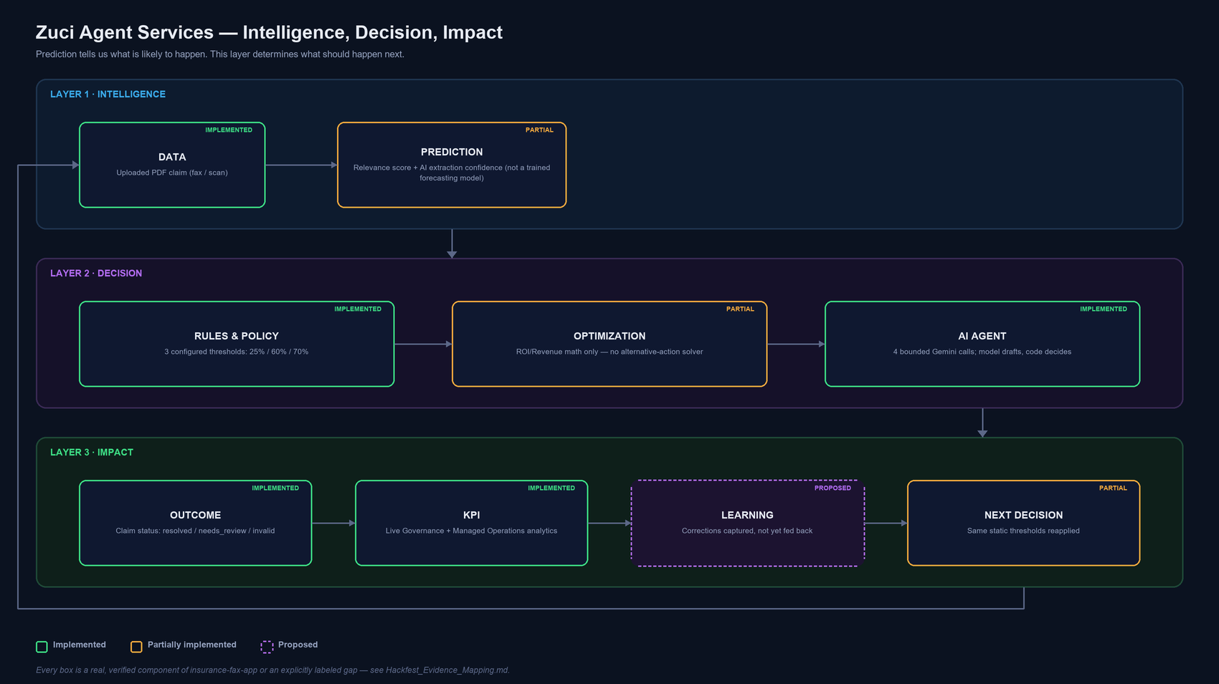
4
Our Solution — Agentic Prescriptive Analytics
The innovation is connecting signal, policy, and AI into a governed decision loop.

Slide 7
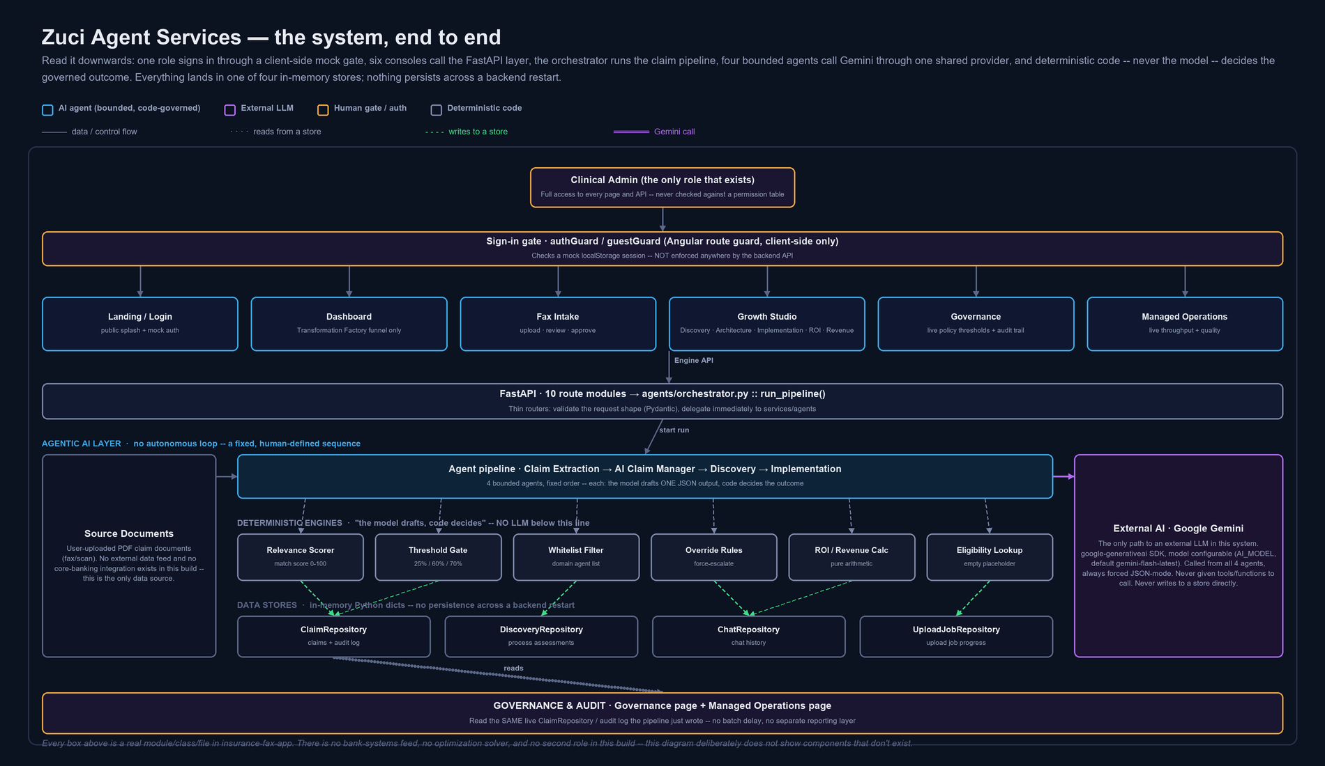
5
End-to-End Architecture
Verified stack — nothing assumed.
Real stack: Angular 17.3 · FastAPI (Python) · Google Gemini · in-memory repositories (no database). Not present: Node.js, PostgreSQL, Azure OpenAI, OpenAI, Redis, any ML/optimization framework.

Slide 8
6
Data → Prediction → Rules → Optimization → AI Agent → Outcome
DATA
PREDICTION
RULES & POLICY
OPTIMIZATION
AI AGENT
OUTCOME
PDF upload, orchestrator pipeline
Relevance score + extraction confidence
3 configured thresholds, domain whitelist
ROI/Revenue math only — no solver
4 bounded Gemini-backed agents
Claim status transition, decision endpoint
→
→
→
→
→
IMPLEMENTED
PARTIAL
IMPLEMENTED
PARTIAL
IMPLEMENTED
IMPLEMENTED
Key message: “AI provides contextual reasoning; deterministic controls provide governance.” — proven four separate times in this codebase.

Slide 9
7
KPI → Learning → Next Decision
Real fields computed by analytics_service.py — not illustrative numbers.
Total / Pending / Resolved / Invalid claims
Volume and backlog at a glance
LEARNING
Total / Approved / Pending / Rejected value (INR)
Financial exposure by state
[PROPOSED] — corrections update only the current record, not thresholds or the model.
Status distribution (%)
Real, not hardcoded, percentage split
High / Medium / Low confidence fields
Extraction reliability
NEXT DECISION
Source-mapping success rate
% of fields with a verifiable citation
[PARTIAL] — same static thresholds re-applied to the next uploaded claim.
Attention-required queue (HIGH/MED/LOW)
Prioritized real work backlog

Slide 10
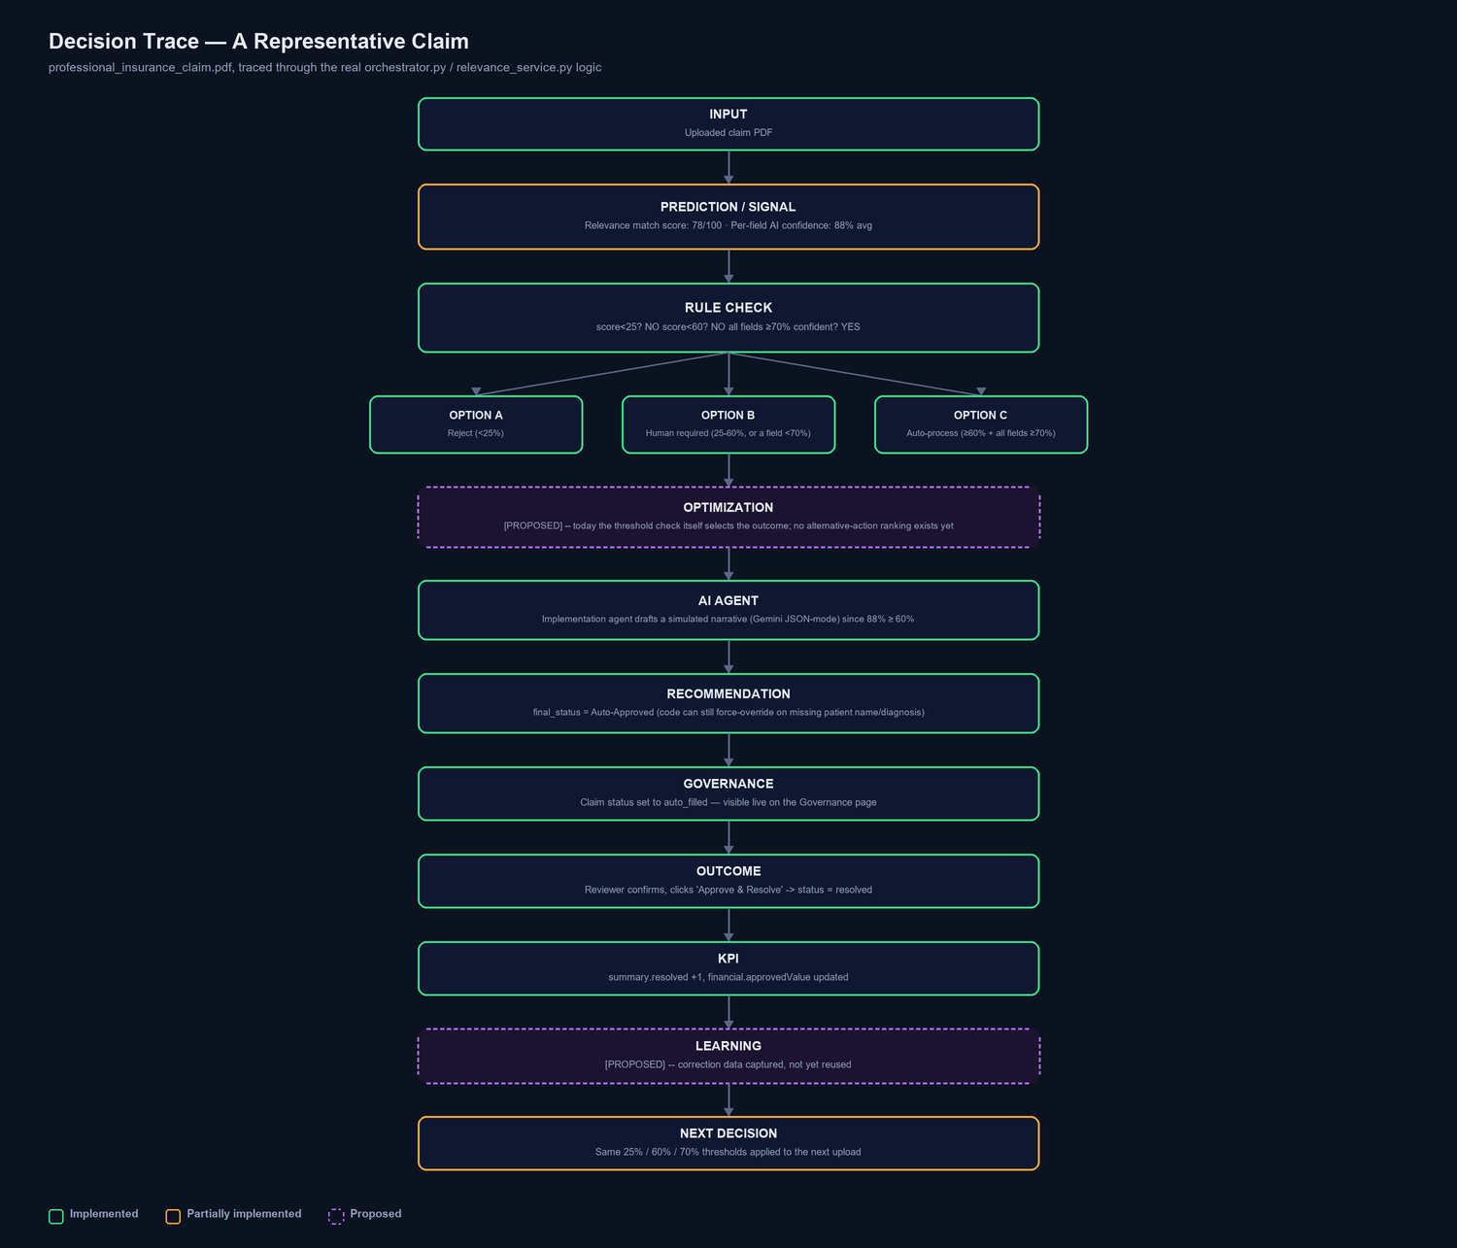
8
Decision Trace — A Representative Scenario
A document with a 78/100 relevance score and 88% average field confidence clears both the invalid (25%) and review (60%) thresholds — it auto-processes.
The Implementation agent's AI call still runs (confidence ≥ 60%) to draft a simulated narrative — and code-level overrides remain active regardless.

Slide 11
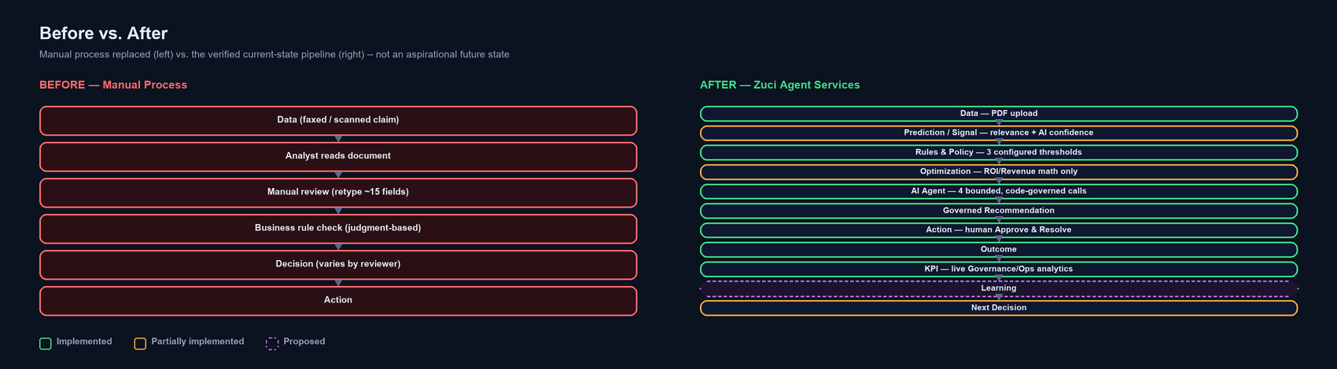
9
Before vs. After
Not hypothetical — every box on the right is a verified, working stage today.

Slide 12
10
Governance and Responsible AI
How this application prevents an AI model from making an uncontrolled decision.
AI Agent
→
Recommendation
(drafted, not trusted)
→
Rules / Policy
Validation
→
Approval /
Controlled Action
→
Audit Trail
HONEST SECURITY GAPS (stated plainly, not hidden)
✗ No backend authentication — every API endpoint is fully open
✗ No RBAC — one mock role, never checked against a permission table
✗ CORS wide open (allow_origins=["*"]) — a development convenience
✗ No tamper-evident audit log — a plain in-memory list

Slide 13
11
Business Value + Innovation
1
Faster, consistent decisions
One policy, applied identically, every time — not a judgment call that varies by reviewer.
2
From signal to action
A confidence score doesn't just sit on a dashboard; it drives a real routing decision, in code.
3
Explainable by construction
Every value cites its source page; every routing decision names its threshold.
4
Repeatable governance pattern
“Model drafts, code decides” proven four times, not once — evidence it generalizes.
5
Augments, doesn't replace
Designed to sit on top of existing predictive signals rather than requiring a rebuilt model.

Slide 14
12
Implemented vs. Proposed — Final Capability Matrix
IMPLEMENTED (10)
PARTIALLY IMPLEMENTED (2)
PROPOSED (5)
• PDF upload + async pipeline
• Eligibility lookup (empty backing table)
• True optimization (alternative-action comparison)
• OCR fallback
• ROI / Revenue (arithmetic, not optimization)
• Feedback / learning loop
• AI extraction + rule-based fallback
• Multi-role RBAC
• Source verification / conflict detection
• Backend authentication
• Policy-threshold routing
• Trained prediction model
• Human approval gate
• Grounded AI chat
• Agent whitelist enforcement
• Confidence-based overrides
• Live KPI / audit trail

Slide 15
13
10-Minute Demo Journey
0:00–1:00
Business Problem
Prediction tells us what is likely; we show what should happen next
1:00–2:00
Existing Solution
We augment, not replace
2:00–3:00
The Gap
Prediction ≠ Decision
3:00–4:00
Our Solution
Connecting signal, policy, and AI into a governed loop
4:00–6:00
Live Demo
Every value is source-verified
6:00–7:30
Rules + Optimization + AI Agent
AI reasons; deterministic controls govern
7:30–9:15
Governance + Outcome + KPI
No batch delay — no batch layer exists
9:15–10:00
Learning + Next Decision
From isolated predictions to continuous decision intelligence

Slide 16
“
“We are not pitching a new prediction model.”
We are showing the governed decision layer that sits on top of one — proven four separate times in a single working application.
From Prediction to Governed Action · Zuci Agent Services

