Slide 1
Advantages of ASP.NET
Uses the common type system.
Object oriented
Separate design and code behind window.
Use of HTMLControls , Server side controls and Validation controls.
Creating User Controls.
Creating Custom controls.
Viewstate management.
Server side event handling.
Compiled code.
Sessions can be managed InProcess , StateServer or SQL Server.
Using web.config file to set SessionState, Autentication, Authorization,Tracing etc.
Optimizing performance of ASP.NET page and Controls by caching.
Using ListBound controls to display and format database related data.
Securing ASP.NET pages using Windows , Forms and Passport Authentication.

Slide 2
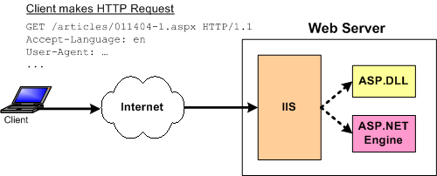
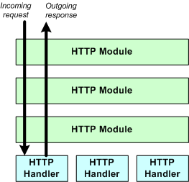
Processing Of ASP.NET Pages
ASP.NET Engine

Slide 3
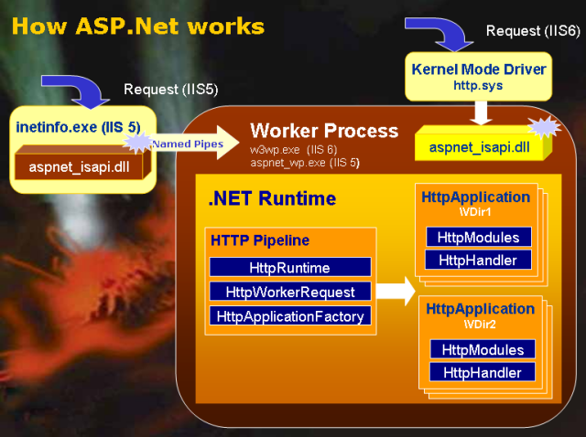

Slide 4
HTTP Module
<httpModules>
<add name="OutputCache" type="System.Web.Caching.OutputCacheModule" />
<add name="Session" type="System.Web.SessionState.SessionStateModule" />
<add name="WindowsAuthentication" type="System.Web.Security.WindowsAuthenticationModule" />
<add name="FormsAuthentication" type="System.Web.Security.FormsAuthenticationModule" />
<add name="PassportAuthentication" type="System.Web.Security.PassportAuthenticationModule" />
<add name="UrlAuthorization" type="System.Web.Security.UrlAuthorizationModule" />
<add name="FileAuthorization" type="System.Web.Security.FileAuthorizationModule" />
<add name="ErrorHandlerModule" type="System.Web.Mobile.ErrorHandlerModule,
System.Web.Mobile, Version=1.0.5000.0,
Culture=neutral, PublicKeyToken=b03f5f7f11d50a3a" />
</httpModules>

Slide 5
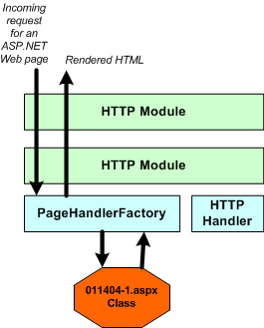
PageHandlerFactory Class

Slide 6
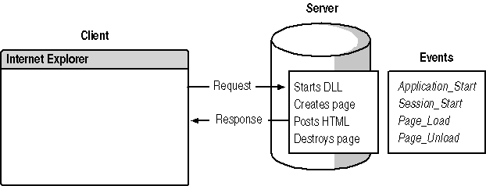
Events in the Life Cycle of a WebApplication

Slide 7
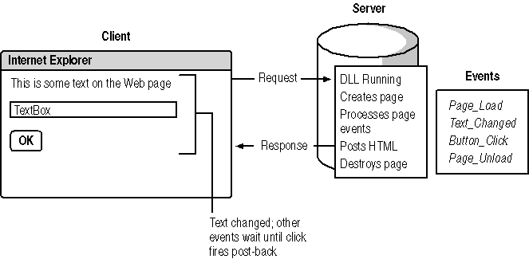
After a PostBack

Slide 8
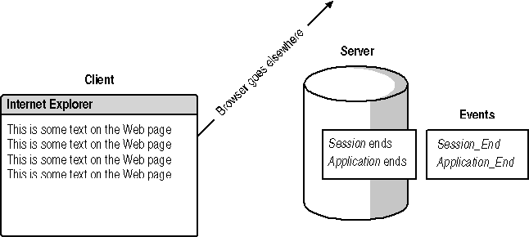
End of a Session
User stops using web application for default 20 minutes user’s session timeouts.
If there are no sessions for other user’s Application ends.

Slide 9
Sequence of events for first access of page and post back
Here is a simplified sequence of events when a page is first accessed:
Page and its controls are created, based on ASPX file.
Page_Load event fires.
Page and control properties are saved to a hidden field.
Page and controls are turned into HTML.
Everything is thrown away.

Slide 10
Now, when a user clicks on a button or similar control, it goes back to the server and does a similar sequence. This is called the post-back sequence:
Page and its controls are created based on ASPX file.
Page and control properties are recovered from hidden field.
Page controls are updated based on user input.
Page_Load event fires.
Change notification events fire.
Page and control properties are saved to a hidden field.
Page and controls are turned into HTML.
Everything is thrown away again.

Slide 11
Control Execution LifeCycle
Phase | Method or event
Initilize | Init event (OnInit method)
Load View State | LoadViewState method
Process Postback Data | LoadPostData method
Load | Load event (OnLoad Method)
Send Postback Change Notification | RaisePostDataChangedEvent
Handle Postback Events | RaisePostBackEvent
Prerender | PreRender event (OnPreRender method)
Save State | SaveViewState method
Render | Render method
Dispose | Dispose method
Unload | UnLoad event (OnUnLoad method)

Slide 12
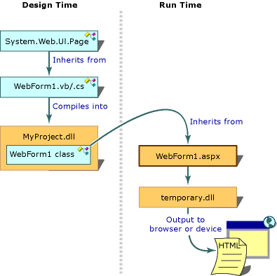

Slide 13
Namespaces in Web Application.
System.Web
  HttpApplication
    HttpRequest
    HttpResponse
    HttpServerUtility
    SessionState
System.Web.Services
System.Web.UI
System.Web.UI.WebControls
System.Web.UI.HTMLControls
System.Web.Caching
System.Web.Mail
System.Web.Security
Notes:
System.Web.UI → used by Page and control object, Web forms are based on Page class
System.Web.UI.WebControls → All web server control

Slide 14
The Page Object
Page
  Cache
  Controls
  Request
  Response
  Server
  Session
  Trace

Slide 15
Request and Response Model
HTTP Request
HTTP Response
Message Line
Status Code
Reason Phrase
Request Headers
Response Headers
Message Body
Response Body

Slide 16
Common HTTP status Codes
Status Code | Reason Phrase
200 | OK
204 | NoContent
301 | Moved,Moved Permanently
302 | Found,Redirect
400 | BadRequest
401 | Unathorized
403 | Forbidden
404 | NotFound
408 | RequestTimeOut
500 | InternalServerError
503 | ServiceUnavailable
505 | HttpVersionNotSupported

Slide 17
Choosing ASP or HTML Server controls.
Feature | Server Controls | HTML Controls
Server Events | Control-specific event are triggered. | Page level events on server.
State Management | Data maintained in the control across requests. | Not maintained : has to be restored Page level scripts.
Adaptation | Detects browser and adapts display. | No automatic adaptation
Properties | .NET provides many server side properties | HTML attributes only.

Slide 18
Types of State Management
Server-Side State Management | Client-Side State Management
Application state Information is available to all users of a Web application | Cookies Text file stores information to maintain state
Session state Information is available only to a user of a specific session | The ViewState property Retains values between multiple requests for the same page
Database In some cases, use database support to maintain state on your Web site | Query strings Information appended to the end of a URL

Slide 19








Server-Side State Management
Application state is a global storage mechanism accessible from all pages in the Web application
Session state is limited to the current browser session
  Values are preserved through the use of application and session variables
  Scalability
ASP.NET session is identified by the SessionID string
Web Server
Client Computer
Application and Session variables
SessionID

Slide 20

Client-Side State Management
Uses cookies to maintain state
  Persistent cookies
  Temporary/ Non-persistent cookies
Less reliable than server-side state management options
  User can delete cookies
Less secure than server-side state management options
Limited amount of information
  Client-side restrictions on file sizes
Web Server
Client Computer
Cookies

Slide 21
Initializing Application and Session Variables
Variables are initialized in Global.asax
  The Application object shares information among all users of a Web application
void Application_Start( Object sender,EventArgs e)
{
Application["NumberofVisitors“] = 0;
}
The Session object stores information for a particular user session
Session["BackColor“] = "blue“;
Application.Lock();
Application["NumberOfVisitors“] += 1;
Application.UnLock() ;

Slide 22
Read session and application variables
strBgColor = Session["BackColor“];
lblNbVisitor.Text = Application["NumberOfVisitors“];

Slide 23
Application and Session Variable Duration
Session variables have a set duration after last access
  Default is 20 minutes
Session duration can be changed in Web.config:
Application variables persist until the Application_End event is fired
<configuration>
<system.web>
<sessionState timeout="10" />
</system.web>
</configuration>

Slide 24

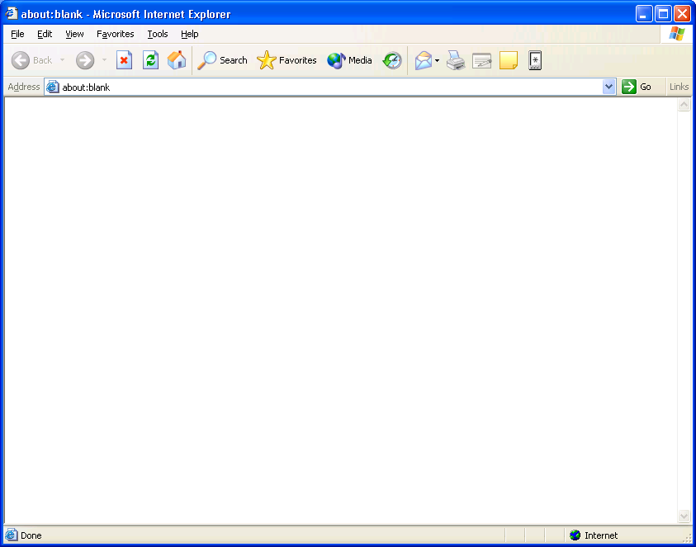
Scalable Storage of Application and Session Variables
By default, the session state is managed in process
Disadvantage of in process storage:
  Not Scalable
ASP.NET provides out of process storage of session state
  State can be stored in a SQL Server database or a state server
Advantages of out of process storage:
  Scalable
State server
Web farm
Session and Application variables
-Or-
SQL
Client
Session and Application variables

Slide 25
Using Cookieless Sessions
Each active session is identified and tracked using session IDs
Session IDs are communicated across client-server requests using an HTTP cookie or included in the URL
Cookieless sessions
  Session ID information is encoded into URLs
  Cannot use absolute URLs
  Most browsers limit the URL size to 255 characters, which limits use of cookieless Session IDs
<sessionState cookieless="true" />
http://server/(h44a1e55c0breu552yrecobl)/page.aspx

Slide 26
What Is the Cache Object?
An object used to store information
  One Cache object per Web Application
  An alternative to application variables
  Not used to store information in session variables
Uses key-value pairs to store and retrieve items
Cache["myKey“] = myValue;

Slide 27
How to Use the Cache Object
Writing to the Cache object:
'Implicit method
Cache["myKey“] = myValue;
'Explicit method
Cache.Insert("myKey", myValue, Dependency, AbsoluteExpiration, _
SlidingExpiration, CacheItemPriority, CacheItemRemovedCallBack);
Retrieving values from the Cache object:
myValue = Cache["myKey"];

Slide 28
Removing Items from the Cache Object
AbsoluteExpiration time
SlidingExpiration time
Dependent on a changed value
Cache item priority
DateTime.Now.AddMinutes(5)
TimeSpan.FromSeconds(20)
AddCacheItemDependency("Variable.Value")
CacheItemPriority.High

Slide 29
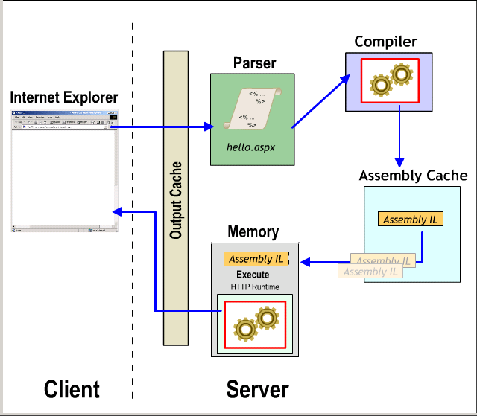
Output Caching

Slide 30
Output Cache Types
Page caching
Page fragment caching as a user control

Slide 31
How to Use Page Output Caches
Cache content is generated from dynamic pages
Entire Web page is available in cache
Set cache duration in seconds
Set the VaryByParam property to control the number of page variations in the cache
<%@ OutputCache Duration="900"
VaryByParam="none" %>

Slide 32
How to Use Fragment Caching
Convert the page fragment into a user control
Set the Duration and varyByParam properties
<%@ OutputCache Duration="120" VaryByParam="none" %>

Slide 33
Understanding Configuration Inheritance
Application-level Web.config file inherits settings from Machine.config file
Settings in Web.config file that conflict override inherited settings
Individual directories may have Web.config files that inherit from—and can override—application-level settings
CONFIG
Machine.config
VirtualDir
Web.config
SubDir
Web.config

Slide 34
Storing and Retrieving Data in Web.config
Storing application settings in a Web.config file
Retrieving application settings from a Web.config file
<configuration>
<appSettings>
<add key="pubs" value="server=localhost;
integrated security=true; database=pubs"/>
</appSettings>
</configuration>
Dim strPubs As String = _
ConfigurationSettings.AppSettings("pubs")

Slide 35
What is ADO.NET?
ADO.NET provides a set of classes for working with data. ADO.NET provides:
An evolutionary, more flexible successor to ADO
A system designed for disconnected environments
A programming model with advanced XML support
A set of classes, interfaces, structures, and enumerations that manage data access from within
the .NET Framework

Slide 36
Using Namespaces
Use the Imports or using statement to import namespaces
Namespaces used with ADO.NET include:
  System.Data
  System.Data.SqlClient
  System.Data.OleDb
using System.Data;
using System.Data.SqlClient;

Slide 37
The ADO.NET Object Model
DataSet
DataTable
DataTable
SqlDataAdapter
OleDbDataAdapter
SQL Server .NET
Data Provider
OLE DB .NET
Data Provider
OleDbConnection
SqlConnection
SQL Server 7.0
(and later)
OLEDB sources
(SQL Server 6.5)

Slide 38
What is a Dataset?
DataSet
DataTable
DataTable
DataTable
SqlDataAdapter
Web server memory
SqlConnection
Physical storage
OleDbDataAdapter
OleDbConnection
SQL Server 2000
OleDb Database

Slide 39


Accessing Data with ADO.NET
1
Database
Client makes request
Create the SqlConnection and SqlDataAdapter objects
2
Fill the DataSet from the DataAdapter and close the connection
SqlConnection
3
Web server
Return the DataSet to the Client
4
SqlDataAdapter
Client manipulates the data
5
Update the DataSet
6
Use the SqlDataAdapter to open the SqlConnection, update the database, and close the connection
7
DataSet
List-Bound
Control
Client

Slide 40
The DataAdapter Object Model
DataSet
DataAdapter
SelectCommand
UpdateCommand
InsertCommand
DeleteCommand
DataReader
Command
Command
Command
Command
Connection
sp_SELECT
sp_UPDATE
sp_INSERT
sp_DELETE
Database

Slide 41
What are List-Bound Controls?
Controls that connect to a data source and display the data
List-bound controls include the following:
  DropDownList
  ListBox
  CheckBoxList
  RadioButtonList
  DataGrid
  DataList
  Repeater

Slide 42
Displaying DataSet Data in List-Bound Controls
Set the properties
Fill the DataSet, then call the DataBind method
Property
Description
DataSource
The DataSet containing the data
DataMember
The DataTable in the DataSet
DataTextField
The field in the DataTable that is displayed
DataValueField
The field in the DataTable that becomes the
value of the selected item in the list
DataAdapter1.Fill(ds);
lstEmployees.DataBind();

Slide 43
DataBind
Control.DataBind()
Binds a data source to the invoked server control
Use this method to bind data from a source to a server control. This method is commonly used after retrieving a data set through a database query.
<%# DataBinder.Eval(Container.DataItem, "Price", "{0:c}") %>
Without DataBinder.Eval
<%# String.Format("{0:c}", ((DataRowView)Container.DataItem)["IntegerValue"]) %>
With
<%# DataBinder.Eval(Container.DataItem, "IntegerValue", "{0:c}") %>
DataBinder.Eval is particularly useful when data-binding controls within a templated list, since often both the data row and the data field must be cast.

Slide 44
<html>
<head>
<script language="C#" runat="server">
void SubmitBtn_Click(Object sender, EventArgs e) {
// Rather than explictly pull out the variable from the StateList
// and then manipulate a label control, just call Page.DataBind.
// This will evaluate any <%# %> expressions within the page.
Page.DataBind();
}
</script>
</head>
<body>

Slide 45
<h3><font face="Verdana">Data binding to a property of another server control</font></h3>
<form runat="server">
<asp:DropDownList id="StateList" runat="server">
<asp:ListItem>CA</asp:ListItem>
<asp:ListItem>IN</asp:ListItem>
<asp:ListItem>KS</asp:ListItem>
<asp:ListItem>MD</asp:ListItem>
<asp:ListItem>MI</asp:ListItem>
<asp:ListItem>OR</asp:ListItem>
<asp:ListItem>TN</asp:ListItem>
<asp:ListItem>UT</asp:ListItem>
</asp:DropDownList>
<asp:button Text="Submit" OnClick="SubmitBtn_Click" runat="server"/>
<p>
Selected State: <asp:label text='<%# StateList.SelectedItem.Text %>' runat="server"/>
</form></body></html>

Slide 46
Using DataSets vs. DataReaders
DataSet
DataReader
Read/write access to data
Read-only
Includes multiple tables from different databases
Based on one SQL statement from one database
Disconnected
Connected
Bind to multiple controls
Bind to one control only
Forward and backward scanning of data
Forward-only
Slower access
Faster access
Supported by Visual Studio .NET tools
Manually coded

Slide 47
Creating the Connection
Using SqlConnection
Setting connection string parameters
  Connection timeout
  Data source
  Initial catalog
  Integrated security
Dim strConn As String = "data source=localhost; " & _
"initial catalog=northwind; integrated security=true"
Dim conn As New SqlConnection(strConn)
  Password
  Persist security info
  Provider
  User ID

Slide 48
Creating a DataSet
Create and populate a DataSet with DataTables
  Fill method executes the SelectCommand
Access a DataTable
Dim ds As New DataSet();
da.Fill(ds, "Authors");
ds.Tables["Authors“].Rows.Count
DataRow r;
String str;
For Each r in _
ds.Tables["Authors“].Rows
{
str += r[2];
str += r["au_lname“];
}

Slide 49
Using a DataView
A DataView can be customized to present a subset of data from a DataTable
The DefaultView property returns the default DataView of the table
Setting up a different view of a DataSet
DataView dv = ds.Tables["Authors“].DefaultView;
DataView dv = New DataView (ds.Tables["Authors“]);
dv.RowFilter = "state = 'CA'“;

Slide 50
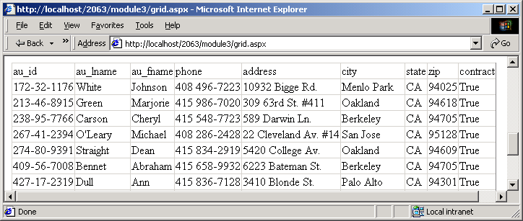
Binding a DataSet to a List-Bound Control
Create the control
Bind to a DataSet or a DataView
<asp:DataGrid id="dg" runat="server" />
dg.DataSource = ds;
dg.DataMember = "Authors";
dg.DataBind();

Slide 51
Storing Multiple Tables
Add the first table
Add the subsequent table(s)
daCustomers = New SqlDataAdapter _
("select * from Customers", conn1);
daCustomers.Fill(ds, "Customers");
Customers
conn1
conn2
DataSet
Orders

Slide 52
Creating Relationships
DataColumn parentCol = _
ds.Tables["Customers“].Columns["CustomerID“];
Identify parent column
Identify child column
Create DataRelation
DataColumn childCol = _
ds.Tables["Orders“].Columns["CustomerID“];
parentCol
Customers table
DataRelation
DataRelation dr = New _
DataRelation("name", parentCol, _
childCol);
ds.DataRelations.Add(dr);
childCol
DataSet
Orders table

Slide 53
Programmatically Navigating Between Tables Using Relationships
ds.Tables[index].Rows[index].GetChildRows("relation")
ds.Tables[index].Rows[index].GetParentRow("relation")
Customers
Orders
GetChildRows
GetParentRow
DataSet

Slide 54
What is a DataReader?
Forward-only, read-only
Fast access to data
Connected to a data source
Manage the connection yourself
Manage the data yourself, or bind it to a list-bound control
Uses fewer server resources

Slide 55
Creating a DataReader
To use a DataReader:
  Create and open the database connection
  Create a Command object
  Create a DataReader from the Command object
  Call the ExecuteReader method
  Use the DataReader object
  Close the DataReader object
  Close the Connection object
Use Try…Catch…Finally error handling
1
2
3
4
5
6
7

Slide 56
Reading Data from a DataReader
Call Read for each record
  Returns false when there are no more records
Access fields
  Parameter is the ordinal position or name of the field
  Get functions give best performance
Close the DataReader
Close the connection
Do While (myReader.Read())
{
str += myReader[1];
str += myReader["field“] ;
str == myReader.GetDateTime(2);
}

Slide 57



Why Use XML with Datasets?
XML is the universal format for exchanging data on the Internet
Datasets serialize data as XML
XML provides a convenient format for transferring the contents of a dataset to and from remote clients
XML objects synchronize and transform data
Firewall
Human Readable
Web Server
XML File
Or Stream
Browser Readable
DataSet
Mainframe Readable

Slide 58
Overview of XML and Datasets
WriteXML
XML File
XML File
DataAdapter
Doc.Save
DataSet
Object
XmlDataDocument
Object
Database
XslTransform
Object
ReadXML
XML File
XML or
HTML File
XSLT File

Slide 59
The XML-Based Methods of the DataSet Object
Use ReadXml to load data from a file or stream
Use WriteXml to write XML data to a file or stream
Use GetXml to write data to a string variable
DataSet ds;
ds = new DataSet();
ds.ReadXml(Server.MapPath("filename.xml"))
String strXmlDS ;
strXmlDS = ds.GetXml();

Slide 60
Creating Nested XML Data
By default, the output of DataTables is sequential
To make XML nested, make the DataRelation nested
Sequential Nested
DataRelation dr = New _
DataRelation ("name", parentCol, childCol);
dr.Nested = True;
ds.Relations.Add(dr);
<Publisher name="pub1" >
<Title name="title1" />
<Title name="title3" />
</Publisher>
<Publisher name="pub2" >
<Title name="title2" />
</Publisher>
<Title name="title1" />
<Title name="title2" />
<Title name="title3" />
<Publisher name="pub1" />
<Publisher name="pub2" />

Slide 61
Reading Xml into Dataset
DataSet myDS = New DataSet;
myDS.ReadXml("input.xml", XmlReadMode.ReadSchema);
DataSet myDS = New DataSet;
DataTable myTable = New DataTable("table1");
myTable.Columns.Add("col1", Type.GetType("System.String"));
myDS.Tables.Add(myTable);
String xmlData = "<XmlDS><table1><col1>Value1</col1></table1><table1><col1>Value2</col1></table1></XmlDS>“;
System.IO.StringReader xmlSR = New System.IO.StringReader(xmlData);
myDS.ReadXml(xmlSR, XmlReadMode.IgnoreSchema);

Slide 62
Writing XML Schema
System.IO.StreamWriter xmlSW = New System.IO.StreamWriter("Customers.xsd");
custDS.WriteXmlSchema(xmlSW);
xmlSW.Close();
To obtain the schema of a DataSet and write it as an XML Schema string, use the GetXmlSchema method as shown in the following example.
String xsdDS = custDS.GetXmlSchema();

Slide 63
Synchronizing Xml with Dataset
DataSet myDataSet = New DataSet();
' Add code here to populate the DataSet with schema, but not data.
XmlDataDocument xmlDoc = New XmlDataDocument(myDataSet);
xmlDoc.Load("XMLDocument.xml");

Slide 64
Securing ASP.Net Pages

Slide 65
Authentication vs. Authorization
Authentication
  Accepts credentials from a user
  Validates the credentials
Authorization
  Given the authentication credentials supplied, determines the right to access a resource
  Can be assigned by user name or by role

Slide 66
What Are ASP.NET Authentication Methods?
Windows-based authentication
  Relies on the Windows operating system and IIS
  User requests a secure Web page and the request goes through IIS
  After credentials are verified by IIS, the secure Web page is returned
Forms-based authentication
  Unauthenticated requests are redirected to an HTML form
  User provides credentials and submits the HTML form
  After credentials are verified, an authentication cookie is issued
Microsoft Passport authentication
  Centralized authentication service that offers a single logon option
  Microsoft Passport is an XML Web service

Slide 67
Comparing the ASP.NET Authentication Methods
Method | Advantages | Disadvantages
Windows-based Authentication | Uses existing Windows infrastructure Controls access to sensitive information | Not appropriate for most Internet applications
Forms-based Authentication | Good for Internet applications Supports all client types | Based on cookies
Microsoft Passport Authentication | Single sign in for many Internet sites No need to maintain a database to store user information Allows developers to customize the appearance of the registration page | Based on cookies Fees involved

Slide 68
What Are the IIS Authentication Mechanisms?
Mechanisms | Security Level | Description
Anonymous | None | No authentication occurs
Basic | Low (Medium with SSL) | Client sends username and password as clear text Can be encrypted by using SSL Part of the HTTP specification and supported by most browsers
Digest | Medium | Sends information as encoded hash Requires Internet Explorer 5 or later Requires Active Directory
Integrated Windows | High | Uses either NTLM or Kerberos Generally good for intranets, not Internet Does not work through most firewalls

Slide 69
How to Enable Windows-Based Authentication
Configure IIS to use one or more of the following authentication mechanisms:
  Basic
  Digest
  Integrated Windows security
Set Windows-based authentication in Web.config
1
2
<system.web>
<authentication mode="Windows" />
</system.web>

Slide 70
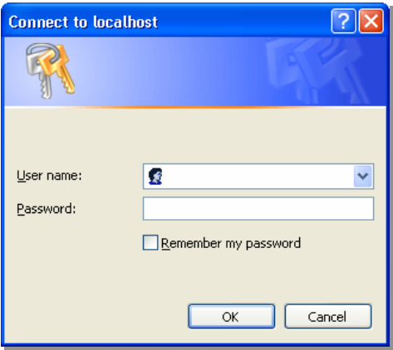
How to Enable Windows-Based Authentication (continued)
3
Set up authorization in Web.config
When users access the
Web Form, IIS requests
logon information
<location path="ShoppingCart.aspx">
<system.web>
<authorization>
<deny users="?"/>
</authorization>
</system.web>
</location>
4

Slide 71
Reading User Information
After authentication, the Web server can read the user identity
lblAuthUser.Text = User.Identity.Name;
lblAuthType.Text = User.Identity.AuthenticationType;
lblIsAuth.Text = User.Identity.IsAuthenticated;

Slide 72
Overview of Forms-Based Authentication
1
IIS
2
ASP.NET Forms Authentication
✗
Not
Authenticated
Authenticated
Client requests page
6
Username
Access Denied
Someone
4
Authorized
✗
Password
Logon Page
(Users enter
their credentials)
***********
Not
Authenticated
Submit
3
Authenticated
Authentication Cookie
Authorized
7
Requested
Secure Page
5

Slide 73
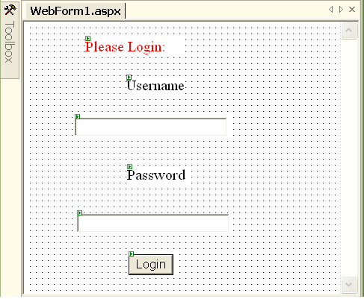
How to Enable Forms-Based Authentication
Configure IIS to use Anonymous authentication
Set Forms-based authentication in Web.config
Set up authorization
Build a Logon Web Form
1
2
<authentication mode="Forms" >
<forms name=".namesuffix"
loginUrl="login.aspx" />
</authentication>
3
4

Slide 74
Creating a Logon Page
Reference System.Web.Security
Logon page verifies and checks the credentials of a user
Reading user credentials from a cookie
  User.Identity.Name returns the value saved by FormsAuthentication.RedirectFromLoginPage
void cmdLogin_Click(Object s , eventArgs e)
{
If (login(txtEmail.Text, txtPassword.Text))
{
FormsAuthentication.RedirectFromLoginPage(txtEmail.Text, False);
}
}

Slide 75

How Microsoft Passport Works
1
The client requests a page from the host
Website.msft
2
The site redirects the client to Passport.com
3
The client is redirected and logs on to Passport.com
4
Passport returns a cookie with the ticket information
5
The client accesses the host, this time with ticket information
Client
6
The host returns a Web Form and possibly a new cookie that it can read and write
Passport.com

Slide 76
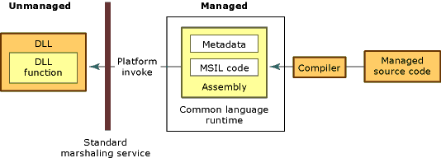
Platform Invoke
When platform invoke calls an unmanaged function, it performs the following sequence of actions:
Locates the DLL containing the function.
Loads the DLL into memory.
Transfers control to the unmanaged function

Slide 77
Using DLLImports
using system.runtime.interopservices;
using microsoft.visualbasic
public class useApi
{
[Dllimport("kernel32.dll",entrypoint="MoveFileW",Charset=charset.unicode,exactspelling=true)]
public static bool MoveFile(src as string,dst as string)
{
}
[DllImport("msvcrt.dll", CallingConvention=CallingConvention.stdcall)]
static int printf ( _
String format , Integer i , Double d ) End Function
{
}
}

Slide 78
Public class myClass
{
public static void Main()
{
useApi.MoveFile("c:\lce.txt","d:\a.txt")
useApi.printf(ControlChars.CrLf + "Print params: %i %f", 99,99.99)
}
}

Slide 79


How to Call COM Components from .NET
The CLR enables managed code to call COM objects through a proxy called the Runtime Callable Wrapper (RCW)
The RCW is a managed object and subject to garbage collection
COM Object A
RCW
.NET Client
COM Object B
RCW
.NET Client
Unmanaged
Managed

Slide 80


Role of the RCW
Maintains object lifetime
Marshals method calls between managed and unmanaged code
Consumes selected COM interfaces without exposing them to the .NET client
IUnknown
INew
COM
Object
RCW
.NET
Client
IDispatch
INew
Unmanaged
Managed

Slide 81


How to Generate Interop Assemblies
A
B
COM object
Interop
Assembly
A
Tlbimp.exe
B
C
D
C
D
COM object
Unmanaged
Managed

Slide 82
COM + Services

Slide 83
Component-Based Applications with COM and .NET
Benefits of using COM
  Cross-platform interoperability
  Location transparency
  Code reusability
  Version control
  Language neutrality
Benefits of using .NET
  Cross-platform deployment
  Type safety
  Better version control

Slide 84
COM+ Services
Transactions
Compensating Resource Managers
Resource management
  JIT
  Object pooling
Synchronization
Security
Loosely coupled events
Queued Components

Slide 85
COM+ and .NET Terminology
Configured Components
Unmanaged
Visual C++ 6
Components
Other COM
Components
Visual Basic 6
Components
Managed
Serviced
Components

Slide 86
COM+ Applications
A COM+ application is
  A grouping of configured classes
  A security boundary
  A unit of deployment
Two types of applications: server and library
Client Process
Dllhost.exe Process
Library Application
Server Application
Class A
Class B

Slide 87
Applications, Assemblies, and Classes
An application contains one or more classes from one or more assemblies
Application 1
Application 2
Assembly1.dll
Assembly2.dll
Class A
Class B
Class C
Class D
Class E

Slide 88
COM+ Catalog
All configuration data is kept in a database
You use the catalog to determine run-time requirements when an object is activated
The catalog can be accessed by the Component Services tool or administrative API
Catalog
Application
Type = Server
Name = MyApp
Component
Name = MyClass
Application MyApp
Class MyClass

Slide 89
Context and Interception
Computer
COM+ Application Process
Context A
Context B
Object A
objX=
Interception
Object X
Proxy
objX = new X ()
.NET Enterprise Services
CoCreateInstance
CreateInstance
COM+
Catalog
COM+ Services

Slide 90
Context
Context is a set of run-time requirements for a class
The COM+ catalog stores run-time requirements as attributes, which are checked during activation
Context properties flow with the method call, depending on configuration attributes
Process
Application
Context A
Context B
Attributes:
Transaction=Required
Synchronization=Supported
Attributes:
Transaction=Required
Synchronization=Requires New
Object A
Object B
Properties:
TransactionID=1234
ActivityID=5678
Properties:
TransactionID=1234
ActivityID=9012

Slide 91
How to Use Attributes to Configure Assemblies for .NET Enterprise Services
Reference the System.EnterpriseServices namespace
Set attributes
  ApplicationName sets the name of application
  ApplicationActivation determines whether it is a library or server activation
[assembly: ApplicationName(“MyApplication”)]
[assembly: ApplicationActivation(
ActivationOption.Server)]
Notes:
BeginC#1
[assembly: ApplicationName(“MyApplication”)]
[assembly: ApplicationActivation(
ActivationOption.Server)]
EndC#1
BeginVB1
<Assembly: ApplicationName(“MyApplication”)>
<Assembly: ApplicationActivation( _
ActivationOption.Server)>
EndVB1

Slide 92
How to Create a Serviced Component
Inherit from the ServicedComponent class
  Ensures appropriate activation and interception occur when accessing other classes
  Provides base methods that you can override when using .NET Enterprise Services
using System.EnterpriseServices;
public class MyCSClass : ServicedComponent
{
public System.GUID Method1()
{
}
}
Notes:
BeginC#1
using System.EnterpriseServices
public class MyCSharpClass : ServicedComponent
{
public System.Guid Method1(){…}
}
EndC#1
BeginVB1
Imports System.EnterpriseServices
Public class MyVBClass
Inherits ServicedComponent
Public Sub Method1() as System.Guid
…
End Sub
End Class
EndVB1

Slide 93
Why Is JIT Activation Needed?
Stateful vs. stateless programming model
  Traditional client/server applications are stateful, keeping acquired resources across multiple method calls
  Scalable solutions are stateless, acquiring resources when the server is called and releasing resources when the call returns
JIT activation preserves both models
JIT activation is required for classes requiring transactions or synchronization

Slide 94
How to Implement JIT Activation
JustInTimeActivation attribute enables JIT Activation
Override the Activate and Deactivate methods
[JustInTimeActivation(true)]
public class MyCSharpClass: ServicedComponent
{
Public void Method1()
{
}
protected override void Activate()
{
}
protected override void Deactivate()
{
}
}
Notes:
BeginC#1
[JustInTimeActivation(true)]
public class MyCSharpClass : ServicedComponent, IMyClass {
void IMyClass.Method1(){}
protected override void Activate()
{// Initialize object}
protected override void Deactivate()
{// Release resources
} }
EndC#1
BeginVB1
<JustInTimeActivation(True)> _
Public Class MyVBClass
Inherits ServicedComponent
Implements IMyClass
Public Sub Method1()
End Sub
Protected Overrides Sub Activate()
End Sub
Protected Overrides Sub Deactivate()
End Sub
End Class
EndVB1

Slide 95
The Done Bit
The done bit is checked when a method call returns
  If True, Deactivate is called, and the object is no longer referenced by the interception layer
  If False, Deactivate is not called, and the object reference remains alive until the next method call
Use the DeactivateOnReturn property to set it
Use the AutoComplete attribute to automatically set it
void IMyClass.Method1()
{
‘Do Work
ContextUtil.DeactivateOnReturn = true;
}
[AutoComplete(true)]
Notes:
BeginC#1
void IMyClass.Method1()
{//Do Work
ContextUtil.DeactivateOnReturn = true;}
EndC#1
BeginVB1
Public Sub Method1()
‘Do Work
ContextUtil.DeactivateOnReturn = True
End Sub
EndVB1
BeginC#2
[AutoComplete(true)]
EndC#2
BeginVB2
<AutoComplete(True)>
EndVB2

Slide 96
Activation and Deactivation
Activation and constructors
Traditional COM component deactivation
  Deactivate is called
  Release is called, causing count to go to zero
  The COM component deletes itself
.NET Framework object deactivation
  Deactivate is called
  The object reference is dropped, making it available for garbage collection
Dispose and Finalize are unnecessary, because resources should be released in Deactivate

Slide 97
Synchronization Settings and Activities
Disabled
Not Supported
Supported
Required
Requires New

Slide 98
How to Configure Synchronization for COM+ Applications
Synchronization
  Enabled by setting the Synchronization attribute
  Controls when threads execute methods of an object rather than which threads
  Provides synchronization without thread affinity
<JustInTimeActivation(true)
,Synchronization(
SynchronizationOption.Required)>
public class MyVBClass
inherits ServicedComponent
End class
Notes:
BeginC#1
[JustInTimeActivation(true)]
[Synchronization(
SynchronizationOption.Required)]
public class MyCSharpClass : ServicedComponent
{…}
EndC#1
BeginVB1
<JustInTimeActivation(True), _
Synchronization(SynchronizationOption.Required)> _
Public Class MyVBClass
Inherits ServicedComponent
…
End Class
EndVB1

Slide 99
Activities
Activity = synchronization domain
  Can cross context, AppDomain, and process boundaries
Only one logical thread can execute in an activity at
a time
Activity boundary
Process
Process
AppDomain
AppDomain
Logical
thread
Context
Context
AppDomain
Context
Context
Context

Slide 100
Transactions
A transaction is a set of separate but interdependent changes that are made to some persistent data and that must be performed
Together as an atomic operation
ACID properties
Atomicity
Consistency
isolation
Durability

Slide 101
What Are Resource Managers?
Store data in permanent storage
Support local and distributed transactions
Examples
SQL Server6.5, SQL server 7, and SQL Server 2000
Other relational databases
Messages Queuing
Transacted mail stores

Slide 102
Local Transactions
Multiple select, update, and delete operations are composed into a single atomic operation
Local transactions can be created by using:
Transact-SQL
ADO.NET or OLE DB

Slide 103
Distributed transactions and the DTC
Microsoft Distributed Transaction coordinator (DTC)
Manages connections to multiple databases
Manages connections from multiple database clients
coordinates work into a single transaction
Database
connection
#1
Database
connection
#2

Slide 104
How to use the Transaction Attribute
Transaction attribute
Transaction Option enumeration
Not Supported- Never runs in a transaction
Supported- Joins existing transaction
Required- Joins existing transaction or creates new one
Requires New –Always creates new transaction
Disabled- Transaction attribute is ignored by COM+
<Transaction (TransactionOption.Required)> _
Class MyTxClass
inherits ServicedComponent
End class

Slide 105
Transaction Streams
Transaction propagated to each new context
Transaction ID (unit-of-work ID) and transaction object
can be accessed through the object context
Database connections are automatically enlisted
Transaction Stream
Root =
Required or
Required New
Sub1 & Sub 2=
Required or
Sub1
Root
Sub2

Slide 106
Affecting Transaction Outcome
Com+checks three bit flags to control transaction outcome and component life time
Per object context – Consistent flag and done flag
Per transaction – Abort flag
Root
Client
Sub1
Root
Sub2

Slide 107
ASP.NET Application State
The HttpApplicationState class
  Implements application state
  Cannot be shared with other applications or processes
Serviced components
  Must be configured in a COM+ library application
  Can share state with ASP.NET pages

Slide 108
How to Store ASP.NET Application Values
Use Add or Insert method or specify an index key to store a value
Use Lock and Unlock methods to synchronize access
Dataset ds = new Dataset();
Fill dataset
HttpApplicationState hs =
HttpContext.Current.Application;
hs.Lock();
//Add value by index
Hs["Finance“]=ds;
or
//Add value by using the Add method
hs.Add("Finance",fd);
hs.UnLock();
Notes:
BeginC#1
FinData fd = new FinData(“example”);
HttpApplicationState hs =
HttpContext.Current.Application;
hs.Lock();
//Add value by index
hs["Finance"]=fd;
//Add value by using the Add method
hs.Add("Finance",fd);
hs.UnLock();
EndC#1
BeginVB1
Dim fd As New FinData("example")
Dim hs As HttpApplicationState = _
HttpContext.Current.Application
hs.Lock()
'Add value by index
hs("Finance") = fd
'Add value by using the Add method
hs.Add("Finance", fd)
hs.UnLock()
EndVB1
BeginC#2
---
EndC#2
BeginVB2
---
EndVB2

Slide 109
How to Retrieve and Remove ASP.NET Application Values
Use the Get method or specify an index key to retrieve a value
Use the Remove, RemoveAt, or RemoveAll methods of the HttpApplicationState class to remove values
HttpApplicationState ds = HttpContext.Current.Application;
//Retrieve value by index
ds = (Dataset) hs(“Finance”);
//Retrieve value by Get method
ds = hs.Get(“Finance”);
Notes:
BeginC#1
HttpApplicationState hs = HttpContext.Current.Application;
FinData fd;
//Retrieve value by index
fd = (FinData) hs[“Finance”];
//Retrieve value by Get method
fd = (FinData) hs.Get(“Finance”);
EndC#1
BeginVB1
Dim hs As HttpApplicationState = _
HttpContext.Current.Application
Dim fd As FinData
'Retrieve value by index
fd = CType(hs("Finance"), FinData)
'Retrieve value by Get method
fd = CType(hs.Get("Finance"), FinData)
EndVB1
BeginC#2
---
EndC#2
BeginVB2
---
EndVB2

Slide 110
How to Use Cache Features
Lifetime, dependencies, priority, and removal notification
public void OnRemoval (string key, object value, CachItemRemovedReason reason)
…
Cache c = HttpContext.Current.Cache;
CacheDependency cd = new CacheDependency(
Server.MapPath(“Finance.xml”);
CacheItemRemovedCallback d = new
CacheItemRemovedCallback(OnRemoval);
c.Insert("Finance",fd,cd,
Cache.NoAbsoluteExpiration,
Cache.NoSlidingExpiration,
CacheItemPriority.Normal,d);
Notes:
BeginC#1
public void OnRemoval (string key, object value, CachItemRemovedReason reason)
…
Cache c = HttpContext.Current.Cache;
CacheDependency cd = new CacheDependency(
Server.MapPath(“Finance.xml”);
CacheItemRemovedCallback d = new
CacheItemRemovedCallback(OnRemoval);
c.Insert("Finance",fd,cd,
Cache.NoAbsoluteExpiration,
Cache.NoSlidingExpiration,
CacheItemPriority.Normal,d);
EndC#1
BeginVB1
public Sub OnRemoval (key as string, value as object, reason as CachItemRemovedReason)
…
Dim fd As New FinData("example")
Dim c As Cache = HttpContext.Current.Cache
Dim cd As New CacheDependency( _
Server.MapPath("Finance.xml"))
Dim d As New CacheItemRemovedCallback( _
AddressOf (OnRemoval))
c.Insert("Finance",fd,cd, _
Cache.NoAbsoluteExpiration, _
Cache.NoSlidingExpiration, _
CacheItemPriority.Normal,d)
EndVB1
BeginC#2
---
EndC#2
BeginVB2
---
EndVB2

Slide 111
How to Store ASP.NET Session Values
Use the Add method or specify an index key to store a value
// Storing a property by index
HttpSessionState s =
HttpContext.Current.Session;
S["Product“]=productobj;
// Storing a property by Add method
s.Add(“Product”,productobj);
Notes:
BeginC#1
// Storing a property by index
HttpSessionState s =
HttpContext.Current.Session;
s["Product"]=productobj;
// Storing a property by Add method
s.Add(“Product”,productobj);
EndC#1
BeginVB1
' Storing a property by index
dim s as HttpSessionState = _
HttpContext.Current.Session
s("Product") = productobj
' Storing a property by Add method
s.Add("Product", productobj)
EndVB1
BeginC#2
---
EndC#2
BeginVB2
---
EndVB2

Slide 112

The Need for
XML Web Services

Slide 113
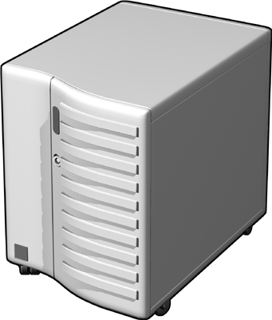

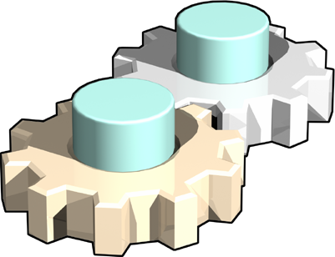
Problems with Traditional Distributed Applications
Design Considerations for Distributed Applications
RPC-Based Architectures
Message-Based Architectures
Web Standards

Slide 114
Design Considerations for Distributed Applications
Data types that are not compatible across different systems
Server failures or loss of server response
Client failures
Retrying a call
Security
Synchronizing clocks between multiple computers

Slide 115
RPC-Based Architectures
What is an RPC?
  RPCs are calls made to procedures or functions that reside on a remote system
Synchronous function calls
Problems with RPC-based architectures
  Building redundancy
  Aggregate availability
  Load balancing and failover
  Prioritization
  Load spikes

Slide 116
Message-Based Architectures
Asynchronous messaging
Problems with message-based architectures
  Message payload processing
  Interoperability
  Workflows and message sequencing

Slide 117


Introducing Web Services
What are Web services?
  URL-addressable set of functionality exposed over a network
Based on Internet technologies
Building blocks
The future of distributed
applications

Slide 118
Common Web Service Scenarios
ASP/Hosted applications
Application integration
Subscribers
Application Service
Provider
Application Hosting Provider/Infrastructure Service Provider
Application
User Interface
Metering
Web Service
Support

Slide 119
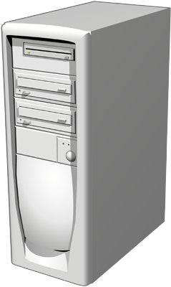




Overview of Web Service Architectures
UDDI (Web Service Broker)
Publish
Find
Internet
Bind
Web Service Provider
Web Service Consumer

Slide 120

Web Services As an Implementation of a Service-Oriented Architecture
UDDI
SOAP
SOAP
IIS
SOAP
Web Service
Any Client

Slide 121
The Web Services Programming Model
Web protocols
Stateless
Loosely coupled
Universal data format

Slide 122
Structures of HTTP Requests and Responses
Requests
Responses
Example
POST /TheStockExchange/Trading/GetStockPrice.asp HTTP/1.1
Host: localhost
Content-Type: application/x-www-form-urlencoded
Content-Length: 11
Symbol=MSFT
Example
HTTP/1.1 200 OK
Content-Type: text/xml; charset=utf-8
Content-Length: 75
<?xml version="1.0" encoding="utf-8"?>
<stock symbol="MSFT" Price="71.50" />

Slide 123
Structure of SOAP Messages
<?xml version="1.0" encoding="utf-8"?>
<soap:Envelope xmlns:xsi=…>
<soap:Header>
<WoodgroveAuthInfo xmlns="http://tempuri.org/">
<Username>string</Username>
<Password>string</Password>
</WoodgroveAuthInfo>
</soap:Header>
<soap:Body>
<GetAccount xmlns="http://tempuri.org/">
<acctID>int</acctID>
</GetAccount>
</soap:Body>
</soap:Envelope>
SOAP Envelope
SOAP Header
SOAP Body
SOAP Fault
<soap:Envelope xmlns:soap="http://schemas.xmlsoap.org/soap/envelope/”>
<soap:Body>
<soap:Fault>
<faultcode>123XYZ</faultcode>
<faultstring>Server Error</faultstring>
<detail>
<bank:faultdetails xmlns:bank="urn:OnlineBank">
<message>Your account is overdrawn</message>
<errorcode>1234</errorcode>
</bank:faultdetails>
</detail>
</soap:Fault>
</soap:Body>
</soap:Envelope>

Slide 124

WSDL Documents
What is WSDL?
Structure of a WSDL document
  The types element
  The message element
  The portType element
Web Service
Web Service Consumer
  The binding element
  The service element

Slide 125
Generating Proxies Using Wsdl.exe
Syntax for invoking Wsdl.exe
wsdl [options] {URL | Path}
Example
wsdl  http://www.woodgrovebank.com/services/bank.asmx?wsdl
Example
wsdl /l:VB /protocol:HttpGet /out:Bank.vb 
http://www.woodgrovebank.com/services/bank.asmx?wsdl

Slide 126
Examining the Parts of a Web Service Project
References
  System namespace
  System.Data namespace
  System.Web namespace
  System.Web.Services namespace
  System.XML namespace
The .asmx file
  Service Help page
  Service Method Help page
  Service Description page

Slide 127
Exposing Web Service Methods
Applying the WebMethod attribute
Configuring the WebMethod attribute properties
  BufferResponse
  CacheDuration
  Description
  EnableSession
  MessageName
  TransactionOption

Slide 128
Using Web method attributes
Public Class Service1 : System.Web.Services.WebService
[System.Web.Services.WebMethod(BufferResponse=False)]
Public DataSet GetBigData()
{
'implementation code
}
}
When set to true, the default setting, ASP.NET buffers the entire response before sending it down to the client.
When set to false, ASP.NET buffers the response in chunks of 16KB

Slide 129
Public Class Service1 : System.Web.Services.WebService
{
[System.Web.Services.WebMethod(CacheDuration=60)]
Public Double ConvertTemperature(Double dFahrenheit )
{
ConvertTemperature = ((dFahrenheit - 32) * 5) / 9;
}
}

Slide 130
Public Class Service1 : System.Web.Services.WebService
[System.Web.Services.WebMethod(Description="This method converts a temperature in degrees Fahrenheit to a temperature in degrees Celsius.“)]
Public Double ConvertTemperature(Double dFahrenheit )
{
ConvertTemperature = ((dFahrenheit - 32) * 5) / 9;
}
}

Slide 131
Public Class Service1: System.Web.Services.WebService
{
[System.Web.Services.WebMethod(EnableSession=True)]
Public Double ConvertTemperature(Double dFahrenheit )
{
Session["Conversions“] = Session["Conversions“] + 1
return ((dFahrenheit - 32) * 5) / 9;
}
[System.Web.Services.WebMethod(EnableSession=True)]
Public Integer GetNumberOfConversions()
{
GetNumberOfConversions = Session["Conversions“];
}
}
Once enabled, the XML Web service can access the session state collection directly from HttpContext.Current.Session or with the WebService.Session

Slide 132
Public Class Service1: System.Web.Services.WebService
{
[System.Web.Services.WebMethod(MessageName:="AddDoubles")]
Public Double Add(Double dValueOne , _
Double dValueTwo)
{
return dValueOne + dValueTwo;
}
[System.Web.Services.WebMethod(MessageName:="AddIntegers")]
Public Integer Add(Integer iValueOne , _
Integer iValueTwo)
{
Return iValueOne + iValueTwo;
}
}

Slide 133
Public Class Service1 : System.Web.Services.WebService
{
[System.Web.Services.WebMethod( _
TransactionOption=TransactionOption.RequiresNew)]
Public String DoSomethingTransactional()
{
'The transaction was successful...
ContextUtil.SetComplete();
return ContextUtil.TransactionId.ToString();
}
}

Slide 134



Types of Authentication
IIS authentication
ASP.NET authentication
Forms authentication
Passport authentication
Custom SOAP header authentication

Slide 135
Built-In Authentication
Basic and Digest Authentication
Integrated Windows Authentication
Using IIS Authentication on a Web Server

Slide 136
Basic and Digest Authentication
Basic authentication
  IIS prompts for a valid Windows user name/password
  Credentials sent via clear-text – not secure!
  Basic authentication with SSL hides password
Digest authentication
  Credentials hashed
  Supported by HTTP 1.1 clients only

Slide 137
Integrated Windows Authentication
Characteristics
  Previously called NTLM or Windows NT Challenge/Response authentication
  Secure form of authentication because the user name and password are not sent across the network
Limitations
  Not all Web service clients support this authentication method
  Integrated Windows authentication does not work over HTTP proxy connections
  Additional TCP ports have to be opened in the firewall

Slide 138
Using a SOAP Header in a Web Service
To define a SOAP header for a Web service and use that header in the Web service method:
Derive a class from SoapHeader
1
Add a public field of the SoapHeader-derived type
2
Apply the SoapHeader attribute
3

Slide 139
Creating Soap Headers
Public Class AuthHeade : SoapHeader
{
Public String un ;
Public String pwd;
}
Public Class first : System.Web.Services.WebService
{
Public AuthHeader hed;
}

Slide 140
[WebMethod(), SoapHeader("hed")]
Public Long addSoapAuth(Integer no1 , Integer no2)
{
try
{
Return no1 + no2;
}
Catch (Exception ex)
{
throw new Exception(ex.Message)
}
}

Slide 141
Client to consume the Header
To process SOAP headers within an XML Web service client
Create a new instance of the class representing the SOAP header.
AutHeader header = New AutHeader() ;
Populate the values for the SOAP header.
header.un = “xml”;
header.pwd = “web”;
Create a new instance of the proxy class.
MyWebService proxy = New MyWebService() ;
Assign the SOAP header object to the member variable of the proxy class representing the SOAP header.
proxy.MyHeaderValue = header;
Call the method on the proxy class that communicates with the XML Web service method. The SOAP header portion of the SOAP request sent to the XML Web service will include the contents of the data stored in the SOAP header object.
String results = proxy.MyWebMethod() ;

Slide 142
Authorization Using Role-Based Security
Identities
Principals
Using WindowsIdentity and WindowsPrincipal Objects
Using GenericIdentity and GenericPrincipal Objects

Slide 143



Identities
GenericIdentity
WindowsIdentity

Slide 144
Using WindowsIdentity and WindowsPrincipal Objects
Using the Name property of the Identity object to control access to code based on Windows account
Using the IsInRole method to control access to code
Example
If (User.Identity.Name == "CONTOSO\Fred“)
' Permit access to some code.
Example
If (User.IsInRole("CONTOSO\Administrators"))
' Permit access to some code.
Notes:
BeginC#1
if (User.Identity.Name == "CONTOSO\\Fred")
// Permit access to some code.
EndC#1
BeginC#2
if (User.IsInRole("CONTOSO\\Administrators"))
// Permit access to some code.
EndC#2
BeginVB1
If User.Identity.Name = "CONTOSO\Fred" Then
' Permit access to some code.
EndVB1
BeginVB2
If User.IsInRole("CONTOSO\Administrators") Then
' Permit access to some code.
EndVB2

Slide 145
Using GenericIdentity and GenericPrincipal Objects
Creating and initializing a GenericIdentity object
Creating and initializing a GenericPrincipal object
Saving the current principal
Example
GenericIdentity MyIdentity =New GenericIdentity("User1") ;
Example
String[] MyStringArray = {"Manager", "Teller"};
GenericPrincipal MyPrincipal =
New GenericPrincipal(MyIdentity, MyStringArray);
Example
GenericPrincipal save = Thread.CurrentPrincipal ;
Notes:
BeginC#1
GenericIdentity MyIdentity =
new GenericIdentity("User1");
EndC#1
BeginC#2
String[] MyStringArray = {"Manager", "Teller"};
GenericPrincipal MyPrincipal =
new GenericPrincipal(MyIdentity, MyStringArray);
EndC#2
BeginC#3
GenericPrincipal save = Thread.CurrentPrincipal;
EndC#3
BeginVB1
Dim MyIdentity As GenericIdentity MyIdentity =
New GenericIdentity("User1")
EndVB1
BeginVB2
Dim MyStringArray As String() = {"Manager", "Teller"}
Dim MyPrincipal As
New GenericPrincipal(MyIdentity, MyStringArray)
EndVB2
BeginVB3
Dim save As GenericPrincipal = Thread.CurrentPrincipal
EndVB3

