Slide 1

Department of Electronics & Instrumentation Engineering

Slide 2
Title: Automatic attendance using face recognition
Broader Area of Project: Automation In-house/Industrial: In-house EIE: B.E Final Year - Project Presentation
Member :
KAVIYA K - 16BEI034
SUBAHANUMANH C - 16BEI036
DINESH - 16BEI201
Project Guide:
UMESH M V
Professor,
Dept. of Electronics and Instrumentation Engineering
Notes:
<number>
<number>

Slide 3
Problem Statement
Manual method will take a lot of time consuming and difficult to maintain

Slide 4
Problem Statement
Manual error
Difficult to maintain
Proxy

Slide 5
Solution
Automated the attendance system
Advantages:
Completely automated
Reduce manual error
Time efficient

Slide 6
Impact and Outcome
A Virtual platform for students and Industries which enables remote access. (Class room learning)
Completely automated and remotely accessible virtual test bench for control valve characteristics measurement.

Slide 7
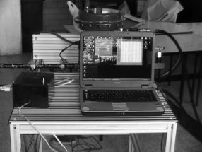
Literature Survey
[1]. Test Bench for Process Control Valves
Fourth Congress of Electronics, Robotics and Automotive Mechanics (2007)
The valve coefficient was measured using the relation,
Cv = Q* sqrt ( Sg/ Δ p )
The electronics instrumentation involves
the PIC microcontroller, Signal
amplifiers and LCD display.

Slide 8
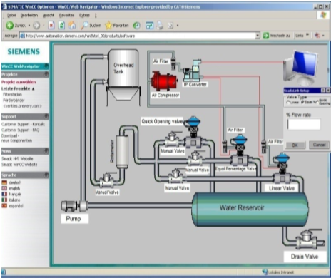
Literature Survey
[2]. Supervision of Control Valve Characteristics Using PLC and Creation of HMI by SCADA
Controlling the ON / OFF states of control valves
The electronics instrumentation involves the
PLC Siemens SIMANTIC S7-300, and HMI
Using SCADA.

Slide 9
Abstract
The automatic attendance management will replace the manual method,which takes a lot of time consuming and difficult to maintain.There are many biometric processes,in that face recognition is the best method.
Face biometrics,useful for a person’s authentication is simple and non intrusive method that recognizes face in complex multidimensional visual model and develops a computational model for it.

Slide 10
Implementation

Slide 11
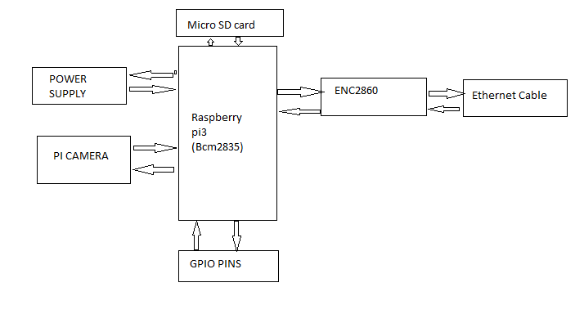
BLOCK DIAGRAM

Slide 12
Overall Block Diagram

Slide 13
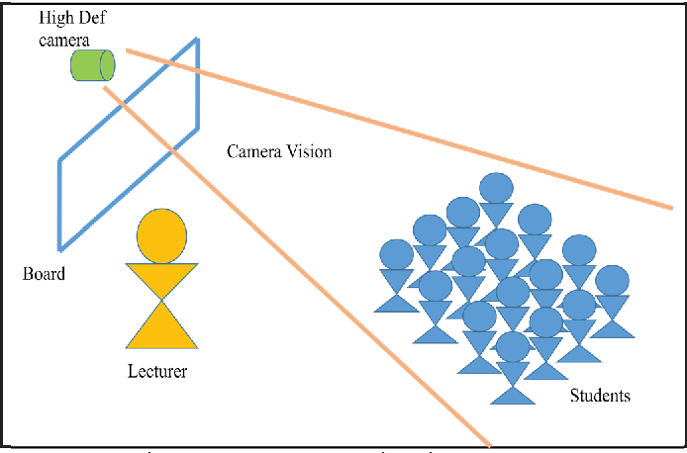
Isometric View

Slide 14
Instrumentation Design Specifications
Pi camera version 2
Weight - 3 gram
Still resolution – 8 Megapixels
Video modes – 1080p30,720p60,640*480p60/90

Slide 15
Instrumentation Design Specifications
Raspberry Pi 3 Model B :
Single-board computer with wireless LAN and Bluetooth connectivity
MicroSD:
Storage - 8GB
Pump

Slide 16
Electronic Design
Raspberry pi
SD card
Input Range | 0 - 5 V
Output Range | 4 – 20 mA
Pins | 13 digital pins
Storage | 8GB

Slide 17
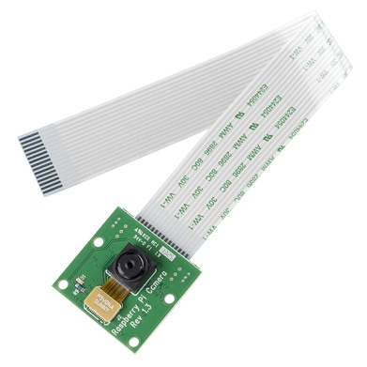
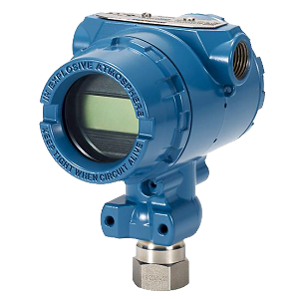


Tools Used
Hardware Tools:
Software Tools:
Pi camera version 3
DPT

Slide 18
Bill Of Materials
Picamera v2 - Price - $24.80
Raspberry Pi 3 Model B with 16 GB SD Card (NOOBS pre-loaded) and Ethernet Cable Combo | Robocraze – price - ₹3,500

Slide 19
Thank You

