Slide 1
Date | 18 October 2023
Team id | NM2023TMID5559
Team Name | .Proj_227254_Team_2
Project Name | Chatbot deployment with IBM cloud Watson Assistant
Phase | Four (4)
Name | Jayalakshmi .S
Set Up Facebook Messenger Integration
Create a Facebook App:
Go to the Facebook Developers website and create a new app.
Set up the Messenger product for your app and get your Page Access Token.
Integrate the API:
Use the Facebook Messenger API to send and receive messages.
Implement a webhook to receive messages from users and respond accordingly.
Handle Messages:
Extract user messages and send them to the chatbot for processing.
Receive responses from the chatbot and send them back to the user via the Messenger API.

Slide 2
Set Up Slack Integration
Create a Slack App:
Go to the Slack API website and create a new app.
Configure the app's permissions and scopes.
Integrate the API:
Use the Slack API to send and receive messages.
Implement event subscriptions to receive messages from users.
Handle Messages:
Extract user messages and send them to the chatbot for processing.
Receive responses from the chatbot and send them back to the user via the Slack API.
Refine Chatbot Responses
Natural Language Processing (NLP):
Utilize NLP techniques to understand user intent and context.
Implement entity recognition to extract relevant information from user messages.
Knowledge Base:
Ensure the chatbot has access to an up-to-date knowledge base.
Use the knowledge base to provide accurate and informative responses to user queries.
Response Generation:
Use advanced text generation techniques to generate natural-sounding responses.
Implement variations in responses to avoid sounding repetitive.

Slide 3
4.Error Handling:
Implement error handling mechanisms to gracefully handle user queries that the chatbot cannot understand or process.
Provide helpful error messages and suggest alternative queries to
users
Testing and Iteration
Testing:
Test the chatbot extensively on both Facebook Messenger and Slack platforms.
Identify and fix any issues related to message handling, response generation, or integration.
User Feedback:
Collect user feedback to identify areas for improvement.
Analyze user interactions and identify common queries or problems to refine the chatbot's responses.
Continuous Improvement:
Iterate on the chatbot's responses based on user feedback and usage patterns.
Regularly update the knowledge base to keep the information current and accurate.

Slide 4
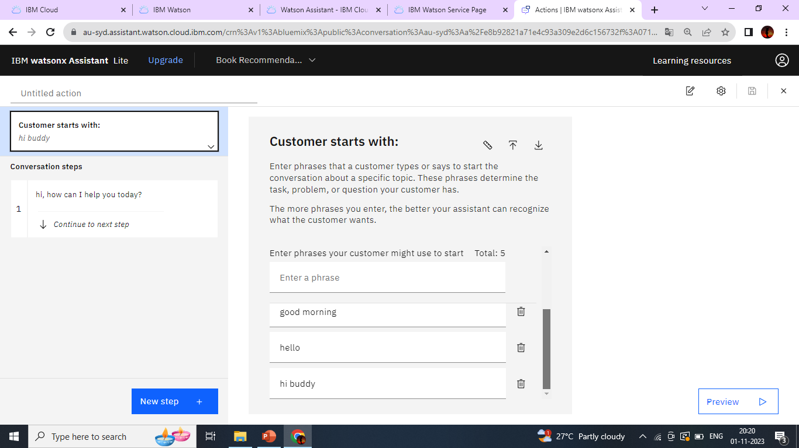
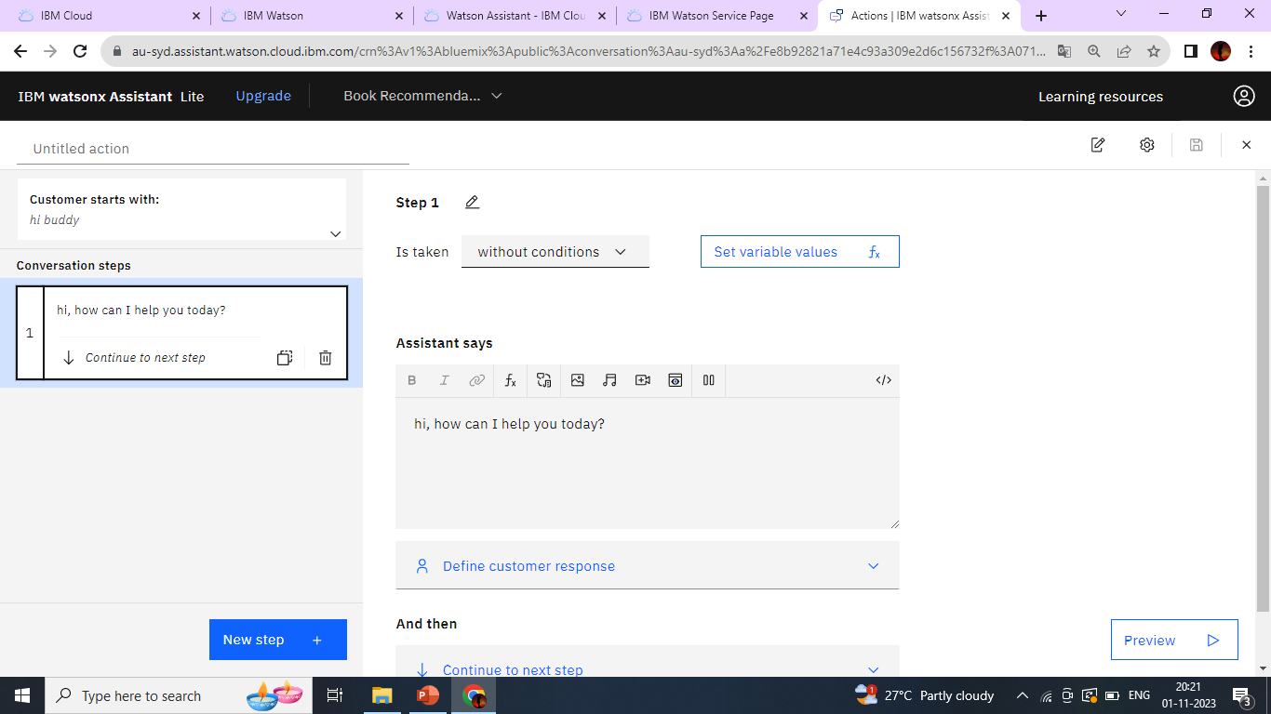

Slide 5
