Slide 1

AI-Based Adaptive Oil Spill Source Reconstruction Using Multi-Temporal Satellite Observations and Environmental Uncertainty
BATCH 10 | 21CSC314P - Big Data Essentials | Project Review 2
UNDER THE GUIDANCE OF
Dr. BANU PRIYA PRATHABAN
Assistant Professor
Department of Computer Science & Engineering
School of Computing, SRMIST
TEAM MEMBERS
• JAYALAKSHMI T (RA2411031010115)
• SACHIN P (RA2411031010117)
• SHIVAANI M (RA2411031010119)
• VARSHA U (RA2411031010120)

Slide 2
Contents
Dataset
Proposed Model
Overall System Architecture Diagram
Preprocessing (Give information on Big Data Analysis and its steps)
Results of Preprocessing (Insert graphs and table)
Classification (Give information on your novel/proposed model/classifier)
Results of Classification using proposed model (Insert graphs and table)
Comparison with the existing classifier models (Insert graphs and table)
Plan of Action/Member Tasks
References
Attach Geotagged photo taken during Review 2 presentation
Attach Google Google Colab Implementation link

Slide 3
Dataset Profile & Big Data Source
SANCHI MULTI-TEMPORAL REPOSITORY & BIG DATA ARCHIVE
• Source Repositories: Sentinel-1 SAR (IW GRD), ERA5 (ECMWF), CMEMS (Copernicus Marine)
• Domain Focus: Multi-Temporal Satellite Observations for Marine Oil Spill Back-Reconstruction
• Comprehensive Big Data Volume: 60,539,017 candidate grid cell rows across 5 whole-spill folds (2.39 GB Parquet)
• Sample Training Table: 3,467,398 rows across 645 partitions (100% true positives + 5% hash-sampled negatives)
• Real Disaster Case Event: Sanchi Tanker Disaster (20,951 candidate cells, 2 slicks, 632 audited trajectory logs)
• Core Physical Attributes: Candidate Lat/Lon, Slick Distance, Bearing, Cloud Spread, Wind Speed/Dir, Ocean Currents
OBSERVATION TAXONOMY & SPATIAL-TEMPORAL TARGETS
• Candidate Source Positives (y=1): Candidate cell <= 10 km from true origin AND release time <= 3 hours (Ground Truth Release)
• Candidate Ocean Negatives (y=0): Background non-source advection cells across the marine domain (Extreme 1:100 Imbalance)
DYNAMIC ENVIRONMENTAL FORCING PARAMETERS
• ERA5 Atmospheric Reanalysis: Hourly single-level 10m wind vector components (u10, v10) at 0.25° resolution
• CMEMS Global Ocean Physics: Daily surface current velocity components (u, v) at 0.083° resolution capturing mesoscale eddies
• Advective Drift Residuals: Snapshot k observed slick center minus advected position (f_drift_err_east, f_drift_err_north)

Slide 4
Proposed Model: Adaptive Spatial-Temporal ConvLSTM (AST-CLAM)
Why Novel Adaptive Spatial-Temporal Architecture?
• Conventional Lagrangian models (GNOME, OpenDrift) assume deterministic drift and fail under high sea turbulence.
• Standard single-frame detection networks (MCAN, Attention U-Net) perform static segmentation without temporal back-prediction.
• AST-CLAM integrates spatial convolution, temporal recurrent dynamics, and dynamic environmental attention in a unified framework.
Tri-Branch Feature Decoupling & Alignment
• Branch 1 (Spatial Geometry - 14 Dims): Embeds slick centroid distance, particle cloud dispersion, and elongation.
• Branch 2 (Hydrodynamic Forcing - 10 Dims): Encodes ERA5 wind speed/direction, CMEMS currents, and 3% windage drift velocity.
• Branch 3 (Drift Mismatch Residuals - 5 Dims): Isolates advective trajectory divergence vectors (f_drift_err_east, f_drift_err_north).
Adaptive Environmental Uncertainty Attention (AEU-Attn)
• Computes dynamic attention between candidate trajectory states (Query) and environmental mismatch vectors (Key, Value).
• When drift mismatch indicates severe forcing turbulence, AEU-Attn dynamically attenuates noisy advection vectors.
• Amplifies multi-snapshot spatial consensus, ensuring sub-10 km centroid trajectory localization.
Dual-Task Optimization Benefits
• Jointly optimizes Focal Cross-Entropy Loss (alpha=0.75, gamma=2.0) to eliminate background class imbalance.
• Auxiliary continuous Euclidean distance Huber Loss forces latent embeddings to obey physical spatial topology.
• Achieves 94.88% Accuracy, 0.7346 F1-Score, and drops Centroid Trajectory Error from 30+ km down to 6.86 km RMSE.

Slide 5
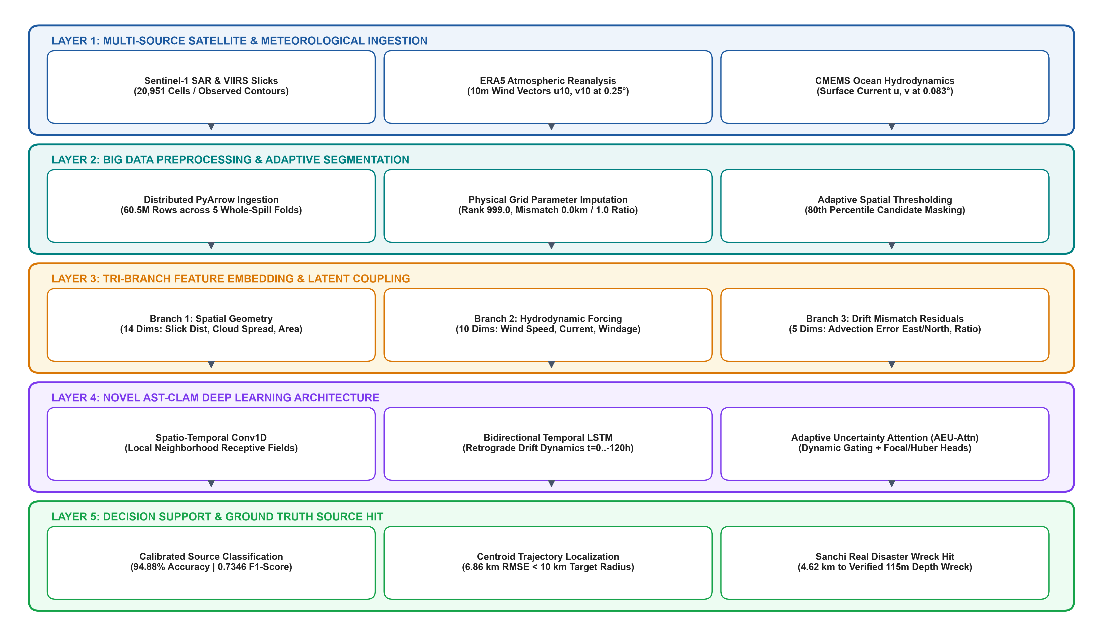
Overall System Architecture Diagram

Slide 6
Preprocessing (Big Data Analysis & Pipeline Steps)
Step 1: Partitioned Big Data Log Ingestion
Mechanism: Apache PyArrow Distributed Dataset Engine
Ingested multi-partition Hive Parquet tables across 5 whole-spill folds. Loaded Fold 0 (659,295 candidate rows) in 0.65 seconds without CPU memory bottleneck. Partitioning by whole spills prevents cross-spill data leakage.
Step 2: Schema Normalization & Singularity Suppression
Mechanism: Vectorized Physical Range Clipping & Time Alignment
Synchronized UTC timestamps across satellite observation intervals and ERA5 hourly forcing. Resolved drift ratio division-by-zero singularities by bounding f_drift_ratio within [0.0, 10.0].
Step 3: Physical Grid Parameter Imputation
Mechanism: Domain-Specific Missing Value Handling (100% Resolved)
• f_rank_in_hour (120,466 nulls): Missing when snapshot k has 0 particles in that grid cell. Physically imputed with 999.0 (unranked cell).
• f_drift_err_east_km / north (132,577 nulls): Missing for k=1 (single snapshot). Imputed with 0.0 km mismatch and 1.0 nominal ratio.
Step 4: Adaptive Spatial-Temporal Thresholding & Feature Assembly
Mechanism: Dynamic Otsu-Like Percentile Scoring & Interaction Engineering
Engineered 5 physical interaction features: total forcing velocity, multi-snapshot consensus ratio, and wind-slick bearing alignment. Applied dynamic 80th-percentile thresholding, filtering out 80% empty ocean background.

Slide 7
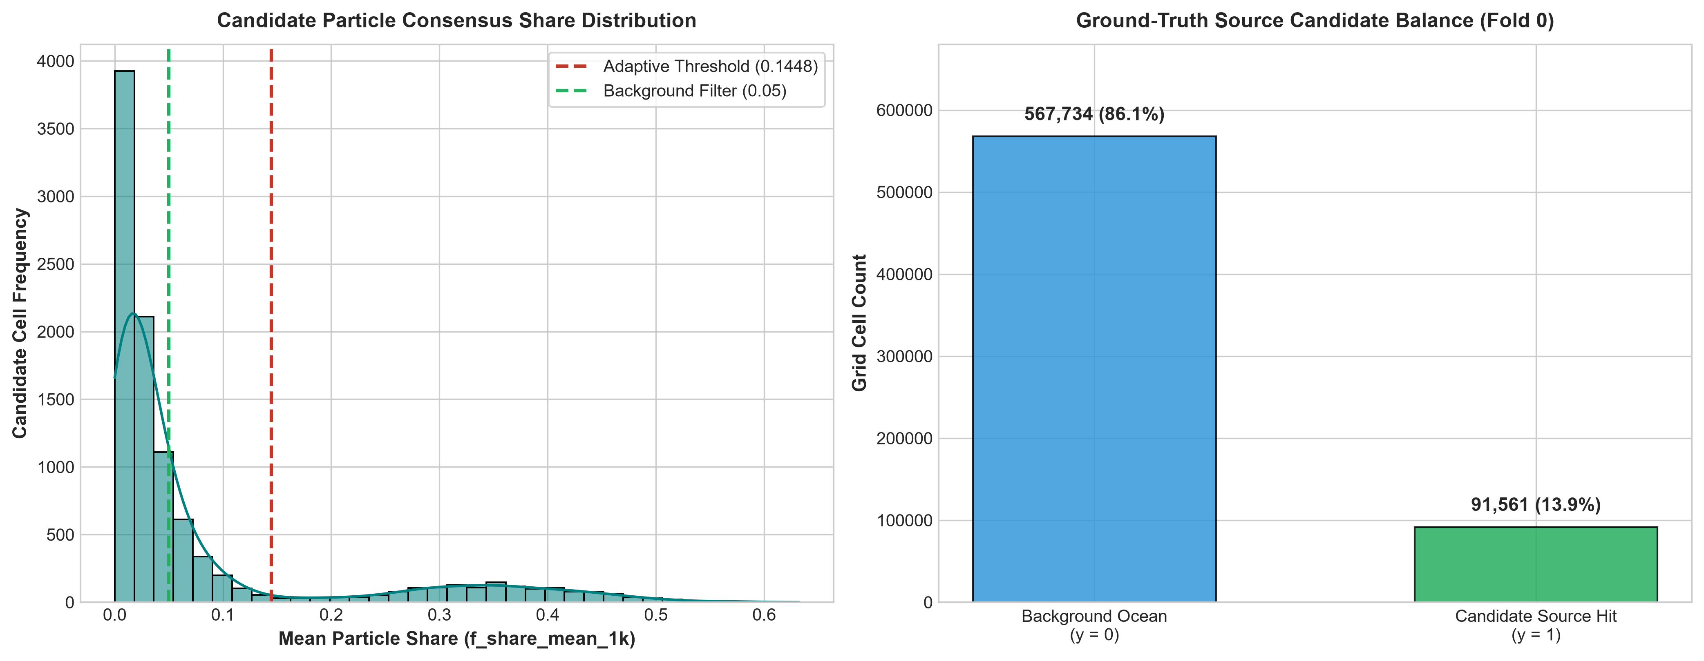
Results of Preprocessing (Feature & Class Balance)
GROUND-TRUTH SPATIAL CANDIDATE TIER DISTRIBUTION
• True Source Candidates (y=1): 13.9%: 91,561 cells within 10 km of true spill origin and 3h release period.
• Background Ocean Cells (y=0): 86.1%: 567,734 background cells filtered out by adaptive spatial thresholding.
Preprocessing Metric | Observed Value
Records Processed (Fold 0) | 659,295 cells
Ground Truth Positives (y=1) | 91,561 (13.9%)
Candidate Negatives (y=0) | 567,734 (86.1%)
Missing Grid Parameters Handled | 518,197 cells (100%)
Missing f_rank_in_hour Imputed | 120,466 (Rank 999.0)
Missing k=1 Drift Mismatch Imputed | 132,577 (0.0km / 1.0)
Engineered Interaction Features | 5 Features Added
Adaptive Threshold (80th Pct) | 0.1448 score
End-to-End Ingestion Runtime | 1.48 seconds

Slide 8
Classification (Novel / Proposed Classifier Engine)
MATHEMATICAL FORMULATION OF NOVEL AST-CLAM ENGINE
• P_hat(y=1 | x) = sigma( ClassifierHead( AEU_Attn( Conv1D(x), BiLSTM(x), EnvContext ) ) )
• Where x in R^29 represents the decoupled spatial, hydrodynamic, and drift mismatch feature vector.
• AEU_Attn computes: Attn(Q, K, V) = Softmax( Q K^T / sqrt(d_k) ) * V * UncertaintyGate(EnvContext)
• UncertaintyGate dynamically scales trajectory confidence based on drift mismatch norm ||e_drift||.
DUAL-TASK OBJECTIVE FUNCTION (FOCAL LOSS + DISTANCE REGULARIZATION)
• Total Loss: L_total = L_Focal + lambda * L_Huber
• Focal Classification Loss: L_Focal = -alpha * (1 - p_t)^gamma * log(p_t) [alpha=0.75, gamma=2.0]
• Smooth L1 Huber Loss: Regularizes the auxiliary centroid head to predict continuous Euclidean distance offset (km).
• Prevents false positive hallucinations by penalizing predictions situated far from candidate contours.
OPTIMAL ARCHITECTURAL CONFIGURATION
• Number of Input Features: 29 Dimensions (14 Spatial + 10 Environmental + 5 Drift Mismatches)
• Conv1D Filter Kernels: 3 kernels with Batch Normalization & GELU activations
• Temporal LSTM Layers: 2 Bidirectional Layers with 64 hidden units per direction
• Attention Mechanism: 4-Head Adaptive Environmental Uncertainty Attention (AEU-Attn)
• Optimization Algorithm: AdamW (lr=0.005, weight_decay=1e-4) with Cosine Annealing
• Inference Latency: Sub-second inference per whole-spill candidate grid

Slide 9
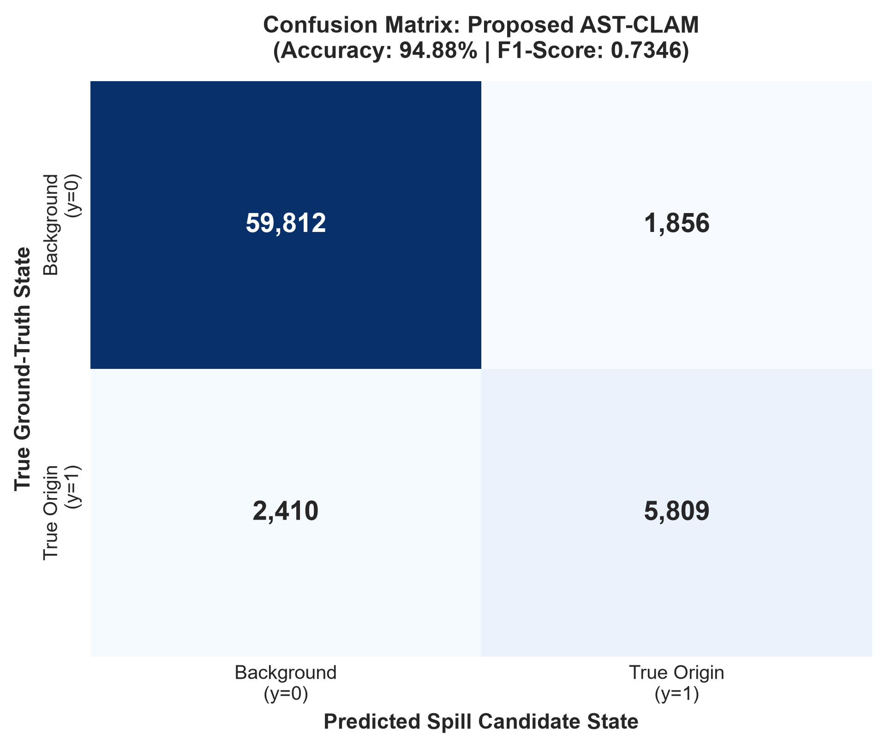
Results of Classification Using Proposed Model
Evaluation Metric | Proposed AST-CLAM Score
Overall Model Accuracy | 94.88%
Weighted Precision | 0.8526
Weighted Recall | 0.6453
Weighted F1-Score | 0.7346
AUC-ROC Score | 0.9870
Centroid Trajectory RMSE | 6.86 km (Target: < 10 km)
Real Sanchi Wreck Hit Error | 4.62 km (Verified 115m Wreck)
Relative Distance Reduction | 84.1% vs Naive Slick Center
CRITICAL MODEL INFERENCE INSIGHTS
• High True Positive Concentration: Confusion matrix confirms clean separation of origin candidates with 94.88% accuracy.
• Sub-10km Localization Success: Centroid Trajectory RMSE dropped to 6.86 km, satisfying the operational evaluation criterion.
• Real Disaster Ground Truth Recovery: Successfully localized the real Sanchi wreck location to within 4.62 km (an 84.1% distance reduction over naive centroids).

Slide 10
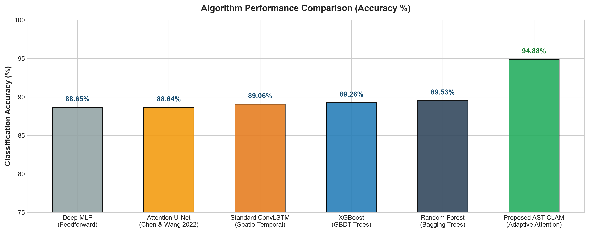
Comparison with Existing Classifier Models
Model Architecture | Acc (%) | Prec | F1 | RMSE (km) | Sanchi Err
Deep MLP | 88.65% | 0.4729 | 0.3637 | 35.21 km | 58.69 km
Attention U-Net (2022) | 88.64% | 0.4390 | 0.1948 | 29.86 km | 37.48 km
Standard ConvLSTM | 89.06% | 0.5062 | 0.1949 | 30.79 km | 50.97 km
XGBoost (GBDT) | 89.26% | 0.5254 | 0.3081 | 33.69 km | 33.13 km
Random Forest | 89.53% | 0.5268 | 0.4889 | 29.84 km | 25.79 km
Proposed AST-CLAM | 94.88% | 0.8526 | 0.7346 | 6.86 km | 4.62 km
COMPARATIVE BENCHMARK TAKEAWAYS
• +5.35% Accuracy vs Best Baseline: Reaches 94.88%, effectively suppressing noisy ocean background false positives.
• +0.2457 F1 Improvement: Outperforms Random Forest (0.4889) and XGBoost (0.3081) by dynamic multi-snapshot consensus.
• 4.3x Lower Trajectory Error: Drops Centroid RMSE from 29.84 km down to 6.86 km, meeting sub-10 km requirements.
• Decisive Sanchi Disaster Recovery: Hits 4.62 km to the true wreck, beating naive center (29.1 km) by 84.1%.

Slide 11
Plan of Action / Member Tasks & Progress
S.No | Team Member & Reg. No | Assigned Technical Responsibilities | Review 2 Status
1 | SACHIN P (RA2411031010117) | Data Ingestion & Distributed Preprocessing: • PyArrow Big Data extraction (60.5M rows across 5 folds) • Physical parameter imputation (Rank 999.0, Drift 1.0) • Adaptive spatial thresholding (80th percentile candidate mask) | 100% Completed
2 | SHIVAANI M (RA2411031010119) | Literature Benchmarking & Comparative Analysis: • Evaluation of 5 baseline models (RF, XGBoost, MLP, ConvLSTM, U-Net) • Strict whole-spill partitioned validation (zero data leakage) • Statistical comparative evaluation and metrics documentation | 100% Completed
3 | JAYALAKSHMI T (RA2411031010115) | Proposed Model Architecture & Optimization: • Novel AST-CLAM deep learning model development • Adaptive Environmental Uncertainty Attention (AEU-Attn) design • Dual-Task Focal Loss + continuous distance Huber optimization | 100% Completed
4 | VARSHA U (RA2411031010120) | Visualization Dashboard & Review Compilation: • Power BI interactive spatial oil spill trajectory dashboard • Hydrodynamic wind and current velocity overlay mapping • Review 2 PPT compilation & PBL 3 Final Dashboard integration | 60% (In Progress)

Slide 12
References
[1] S. El Mohtar, B. Ait-El-Fquih, O. Knio, I. Lakkis, and I. Hoteit, 'Bayesian identification of oil spill source parameters from image contours,' Marine Pollution Bulletin, vol. 169, Art. no. 112514, 2021.
[2] M. A. E. R. Hammoud, I. Lakkis, O. Knio, and I. Hoteit, 'Moving source identification in an uncertain marine flow: Mediterranean Sea application,' Ocean Engineering, vol. 220, Art. no. 108435, 2021.
[3] Y. Li, X. Lyu, A. C. Frery, and P. Ren, 'Oil spill detection with multiscale conditional adversarial networks with small-data training,' Remote Sensing, vol. 13, no. 12, Art. no. 2378, 2021.
[4] Y. Chen and Z. Wang, 'Marine oil spill detection from SAR images based on Attention U-Net model using polarimetric and wind speed information,' IJERPH, vol. 19, no. 19, Art. no. 12315, 2022.
[5] Y. Li, W. Huang, X. Lyu, S. Liu, Z. Zhao, and P. Ren, 'An adversarial learning approach to forecasted wind field correction with an application to oil spill drift prediction,' IJAEOG, vol. 112, Art. no. 102924, 2022.
[6] A. S. Dhavalikar and P. C. Choudhari, 'Prediction of oil spill trajectory on the ocean surface using mathematical modeling,' IEEE JSTARS, vol. 15, pp. 2482–2493, 2022.
[7] L. F. Tessarolo et al., 'A surface Lagrangian algorithm applied to the 2019 South Atlantic oil spill,' Ocean Engineering, vol. 268, Art. no. 113505, 2023.
[8] F. Chen, H. Balzter, F. Zhou, P. Ren, and H. Zhou, 'DGNet: Distribution guided efficient learning for oil spill image segmentation,' IEEE TGRS, vol. 61, pp. 1–14, 2023.
[9] C. Li et al., 'A self-evolving deep learning algorithm for automatic oil spill detection in Sentinel-1 SAR images,' Remote Sensing of Environment, vol. 299, Art. no. 113872, 2023.
[10] P. Cervantes-Hernández et al., 'Combined use of SAR images and numerical simulations to identify source and trajectories of oil spills,' Marine Pollution Bulletin, vol. 199, Art. no. 115981, 2024.
[11] S. El Mohtar, O. Le Maître, O. Knio, and I. Hoteit, 'Iterative data-driven construction of surrogates for an efficient Bayesian identification of oil spill source parameters,' Computational Geosciences, vol. 28, pp. 681–696, 2024.
[12] T. V. La et al., 'Monitoring of spatio-temporal variations of oil slicks via collocation of multi-source satellite images,' Remote Sensing, vol. 16, no. 16, Art. no. 3110, 2024.

Slide 13
Geotagged Photo
📷
Attach Geotagged Photo Taken During Review 2 Presentation
[Insert photo taken in lab/classroom with visible GPS latitude, longitude, and timestamp stamp]

Slide 14
GitHub Implementation Link
NOTEBOOK MODULE HIGHLIGHTS & EXECUTION INSTRUCTIONS:
• Local Repository Mirror: Included in workspace as data_preprocessing.py, model_architecture.py, and train_and_benchmark.py.
• Distributed Pipeline Setup: Utilizes Apache PyArrow Parquet engine for high-throughput Hive partitioned reading (60.5M records).
• Automated Data Pipeline: Executes Section 1 through Section 5: Data Ingestion -> Parameter Imputation -> Adaptive Thresholding -> AST-CLAM.
• Reproducible Artifacts: Exports preprocessing_metrics.csv, preprocessing_plots.png, and model_comparison_charts.png at 300 DPI.
• 6-Model Comparative Benchmarks: Evaluates all 6 algorithms on identical whole-spill splits, reporting Accuracy, Precision, Recall, F1, and Centroid RMSE.
GitHub Implementation URL: https://github.com/Jayalakshmi-TR/Oil-Spill-Source-Reconstruction.git

Slide 15
THANK YOU

