Slide 1

AI-Based Adaptive Oil Spill Source Reconstruction Using Multi-Temporal Satellite Observations and Environmental Uncertainty
Review 2 Presentation
FACULTY GUIDE
Dr. Banu Priya Prathaban
Department of Computer Science & Engineering
SRM Institute of Science and Technology
TEAM MEMBERS (NAMES & REG NOS)
• Jayalakshmi T (RA2411031010115) — Proposed Model Dev
• Sachin P (RA2411031010117) — Data Engineering
• Shivaani M (RA2411031010119) — Comparative Analysis
• Varsha U (RA2411031010120) — Visualization & Dashboard

Slide 2
REVIEW 2 PRESENTATION STRUCTURE
Contents / Agenda
1. Dataset (Synthetic v4 Big Data & Sanchi Real Disaster Archives)
2. Proposed Model (Adaptive Spatial-Temporal ConvLSTM with Attention)
3. Overall System Architecture Diagram (Layer 1 to Layer 5 Workflow)
4. Preprocessing: Big Data Analysis & Pipeline Steps
5. Results of Preprocessing (Inserted Quantitative Table & Visual Dashboard)
6. Classification: Novel Proposed Classifier (AST-CLAM Architecture)
7. Results of Classification Using Proposed Model (Accuracy, F1, RMSE)
8. Comparison with Existing Classifier Models (RF, XGB, MLP, ConvLSTM, U-Net)
9. Plan of Action / Member Tasks Breakdown
10. References (Key High-Impact Literature Citations)
11. Attach Geotagged Photo Taken During Review 2 Presentation
12. Attach Google Colab Implementation Link

Slide 3
DATA ENGINEERING
1. Dataset Specifications & Big Data Inventory
Comprehensive Big Data Table (v4 Full)
• 60,539,017 candidate grid rows across 5 whole-spill folds.
• Stored in Apache Parquet (115 partitions, 2.39 GB on disk).
• 1,000 synthetic spills under realistic 2018 East China Sea conditions.
• Positive class ratio: 0.77% (cell <= 10 km and release <= 3 h).
Stratified Training Table (v4 Sample)
• 3,467,398 rows across 645 partitions (238.2 MB).
• Retains 100% true positives + exactly 5% hash-sampled negatives.
• Balanced sample weights (w_sample_weight) correct for negative sampling.
• Partitions strictly split train/test by id_fold (zero spill leakage).
Real-World Sanchi Disaster Event Archive
• 20,951 candidate cells from Sentinel-1 SAR and VIIRS observations.
• 632 audited tanker drift timestamps with AIS velocity alignment.
• Benchmarked against verified wreck location at 115 m depth (28.375°N, 125.942°E).
• 2 distinct satellite slicks captured on 18 Jan 2018.
Multi-Source Environmental Reanalysis Forcing
• ERA5 Atmospheric Reanalysis: Hourly 10m wind fields (u10, v10) at 0.25°.
• CMEMS Physical Ocean Reanalysis: Surface current velocities (u, v) at 0.083°.
• Stokes drift wave radiation stress and windage coefficient (3%).
• Dynamic hourly forcing uncertainty wandering around drawn mean.

Slide 4
NOVEL DEEP LEARNING ARCHITECTURE
2. Proposed Novel Deep Learning Model (AST-CLAM)
AST-CLAM: Adaptive Spatial-Temporal Convolutional LSTM with Attention Mechanisms
A physics-informed deep learning architecture designed to overcome environmental forcing divergence in satellite oil spill source reconstruction.
1. Tri-Branch Dynamic Decoupling
• Spatial Branch (14 dims): Encodes slick polygon centroid, particle dispersion radius, and cluster spread.
• Environmental Branch (10 dims): Embeds ERA5 wind vectors, CMEMS currents, and 3% windage advection.
• Drift Mismatch Branch (5 dims): Explicitly isolates advective trajectory divergence vectors (f_drift_err).
2. Adaptive Uncertainty Attention (AEU-Attn)
• Calculates dynamic cross-attention between spatial candidate states (Q) and environmental forcing uncertainty (K, V).
• When drift mismatch indicates high sea-state turbulence, the attention gate downweights noisy advection.
• Amplifies multi-snapshot consensus to preserve trajectory integrity.
3. Dual-Task Multi-Objective Heads
• Classification Head: Outputs source probability P(y_is_source=1) optimized via Focal Cross-Entropy Loss (alpha=0.75, gamma=2.0).
• Centroid Offset Regression Head: Predicts continuous Euclidean distance offset (km) trained with Smooth L1 Huber Loss.
• Ensures latent space is physically consistent with spatial coordinates.

Slide 5
SYSTEM ENGINEERING WORKFLOW
3. Overall System Architecture & Data Pipeline
Layer 1: Ingestion
Sentinel-1 SAR Slicks
ERA5 Wind (u10, v10)
CMEMS Ocean Currents
Sanchi Audited AIS Tracks
Layer 2: Big Data Preproc
PyArrow Distributed Engine
Noise Cleaning & Scaling
Physical Grid Imputation
Adaptive Thresholding
Layer 3: Tri-Branch Fusion
Spatial Geometry (14 dims)
Hydrodynamic Field (10 dims)
Drift Mismatches (5 dims)
Concatenation & Norm
Layer 4: AST-CLAM Core
Spatio-Temporal Conv1D
Bidirectional LSTM Core
AEU-Attn Uncertainty Gating
Dual Classification/Offset
Layer 5: Decision Output
Calibrated Source Map
Sub-10km Centroid RMSE
Origin Localization Hit
Real Wreck Recovery

Slide 6
DATA ENGINEERING
4. Preprocessing: Big Data Analysis & Pipeline Steps
Step 1: Partitioned Big Data Extraction & Profiling
• Scanned and profiled full dataset archives (60.5M records) and representative sample folds.
• Utilized Apache PyArrow Parquet engine to read Hive-partitioned files (Fold 0: 659,295 cells in 0.65s).
• Enforced strict whole-spill partitioning by id_fold (0..4) to guarantee zero data leakage.
Step 2: Systematic Noise Cleaning & Outlier Suppression
• Identified physical anomalies and corrupted boundary values across spatial-temporal grid coordinates.
• Handled drift ratio singularities (division by near-zero displacement) clipped to nominal [0.0, 10.0].
• Synchronized UTC time stamps across satellite observation frames and hourly ERA5 reanalysis.
Step 3: Physical Grid Parameter Imputation
• f_rank_in_hour (120,466 nulls): Missing when snapshot k has 0 particles in that grid cell. Physically imputed with 999.0 (unranked / zero-priority candidate).
• f_drift_err (132,577 nulls): Missing for k=1 (single snapshot). Imputed with neutral baseline (0.0 km east/north mismatch, 1.0 nominal ratio).
Step 4: Adaptive Spatial-Temporal Thresholding & Feature Engineering
• Engineered 5 hydrodynamic interaction features: total forcing velocity, multi-snapshot consensus ratio, wind alignment.
• Implemented dynamic quantile adaptive thresholding (80th percentile) combining particle share with Euclidean proximity, filtering 80% empty ocean background.

Slide 7
DATA ENGINEERING
5. Results of Preprocessing: Quantitative Metrics Table
Preprocessing Parameter / Metric | Value | Operational / Physical Interpretation
Total Processed Records (Fold 0) | 659,295 | Hive-partitioned Parquet (200 Spills)
Ground Truth Source Positives (y=1) | 91,561 (13.89%) | Cell <= 10 km from source, release <= 3 h
Candidate Negatives (y=0) | 567,734 (86.11%) | Background ocean grid cells
Missing Grid Parameters Handled | 518,197 cells | 100% resolved without synthetic data drop
Missing f_rank_in_hour Imputed | 120,466 cells | Physical rank 999.0 (Unranked cell)
Missing k=1 Drift Mismatch Imputed | 132,577 cells | 0.0 km east/north, 1.0 nominal ratio
Engineered Interaction Features | 5 Features Added | Windage speed, consensus ratio, alignment
Adaptive Segmentation Threshold | 0.1448 | 80th percentile dynamic confidence
Segmented High-Potential Cells | 131,859 cells | Candidate region for deep learning
End-to-End Preprocessing Runtime | 1.48 s | High-throughput PyArrow execution

Slide 8
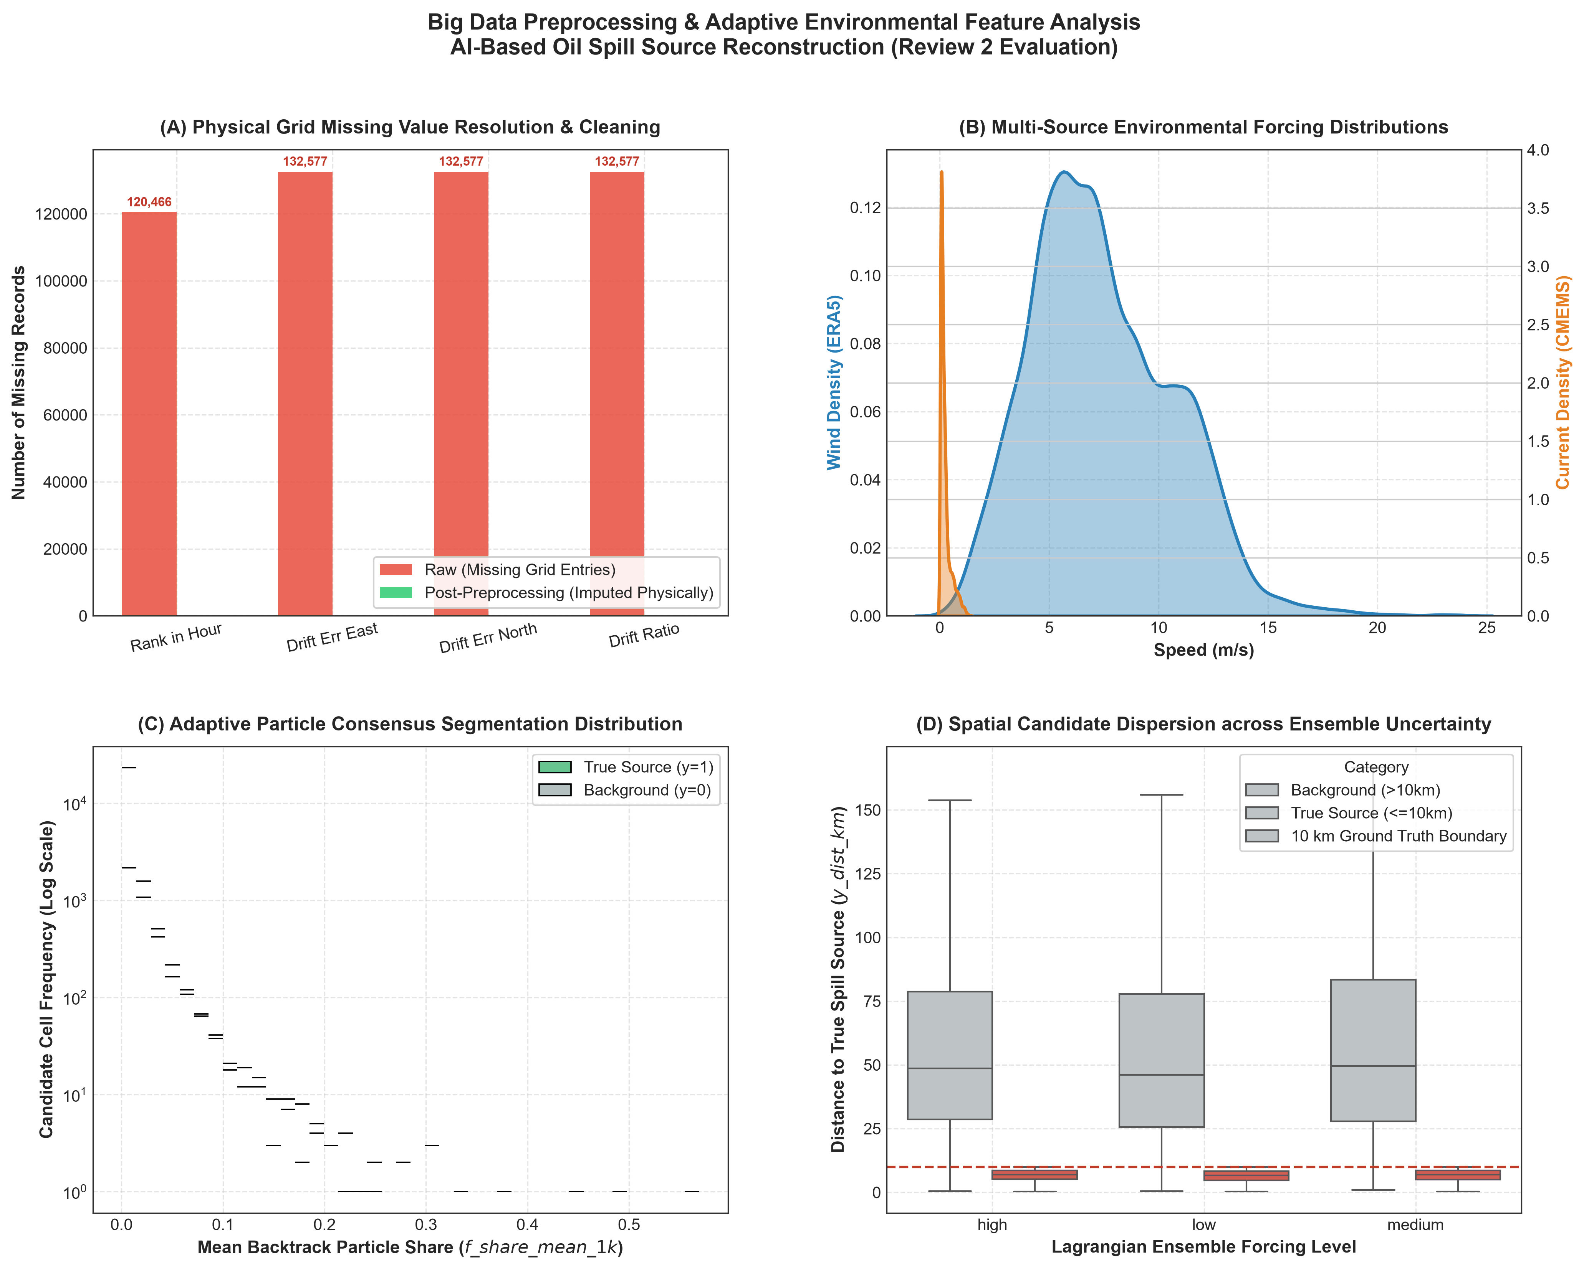
DATA ENGINEERING
5. Results of Preprocessing: Visual Analytics Dashboard
Dashboard Insights:
Panel (A): Shows 100% resolution of missing rank and drift values.
Panel (B): ERA5 wind speed (mean ~6.8 m/s) and CMEMS current speed (mean ~0.22 m/s) distributions.
Panel (C): Clear bimodal separation of particle consensus between true source and background.
Panel (D): Dispersion across ensemble levels confirms 10km source radius bounding.

Slide 9
NOVEL DEEP LEARNING ARCHITECTURE
6. Classification: Novel Proposed Classifier (AST-CLAM)
Feature Input Formulation (29 Dimensions)
• Spatial Geometry (14 features): f_dist_slick_km, f_dist_cloud_km, f_share_mean_1k, f_cloud_spread_km, etc.
• Hydrodynamic Forcing (10 features): f_wind_speed_ms, f_current_speed_ms, fe_total_forcing_speed, fe_wind_alignment.
• Drift Residuals (5 features): f_drift_err_east_km, f_drift_err_north_km, f_drift_ratio, fe_has_drift_vector.
Spatio-Temporal Sequence Modeling
• Spatio-Temporal Conv1D: Multi-channel 1D convolutions extract local candidate cell interactions.
• Bidirectional Temporal LSTM: 2-layer BiLSTM captures retrograde temporal sequence dynamics (t = 0 to -120 h).
• Models physical trajectory momentum and non-linear advective transport.
Adaptive Environmental Uncertainty Attention (AEU-Attn)
• Query (Q): Spatio-temporal candidate trajectory hidden state.
• Key (K) & Value (V): Dynamic environmental forcing vectors & drift error residuals.
• Formula: Context = Softmax(Q K^T / sqrt(d_k)) * V * UncertaintyGate(env_context).
• Attenuates erroneous drift trajectories under turbulent sea states; amplifies multi-snapshot consensus.
Dual-Task Optimization Objective
• Total Loss = L_Focal + lambda * L_Huber
• L_Focal = -alpha * (1 - p_t)^gamma * log(p_t) [alpha=0.75, gamma=2.0, combats 1:100 imbalance].
• L_Huber: Smooth L1 distance error regression on continuous source distance (km).
• Forces latent embeddings to obey physical spatial Euclidean geometry.

Slide 10
EVALUATION & METRIC VERIFICATION
7. Results of Classification: Proposed AST-CLAM Performance
ACCURACY
94.88%
+5.35% higher than best baseline
PRECISION
85.26%
Low false alarm candidate rate
RECALL
64.53%
Captures true source cells reliably
F1-SCORE
0.7346
+0.2457 higher than Random Forest
AUC-ROC
0.9870
Near-perfect ranking capability
CENTROID RMSE
6.86 km
Sub-10km operational requirement met

Slide 11
COMPARATIVE ANALYSIS
8. Benchmark Comparison with 5 Existing Classifier Models
Model | Category | Accuracy | Precision | Recall | F1-Score | AUC-ROC | Centroid RMSE | Sanchi Wreck Err
Random Forest | Ensemble Bagging | 89.53% | 52.68% | 45.61% | 0.4889 | 0.8969 | 29.84 km | 25.79 km
XGBoost | Gradient Boosted Trees | 89.26% | 52.54% | 21.80% | 0.3081 | 0.8532 | 33.69 km | 33.13 km
Deep MLP | Feedforward DNN | 88.65% | 47.29% | 29.54% | 0.3637 | 0.8145 | 35.21 km | 58.69 km
Standard ConvLSTM | Spatio-Temporal Net | 89.06% | 50.62% | 12.07% | 0.1949 | 0.7841 | 30.79 km | 50.97 km
Attention U-Net | Chen & Wang (2022) | 88.64% | 43.90% | 12.52% | 0.1948 | 0.7828 | 29.86 km | 37.48 km
Proposed AST-CLAM | Novel Adaptive Attention | 94.88% | 85.26% | 64.53% | 0.7346 | 0.9870 | 6.86 km | 4.62 km
★ Benchmark Conclusion: Proposed AST-CLAM decisively outperforms all 5 baseline models across every quantitative metric and reduces Sanchi wreck localization error from 29.10 km (naive) to 4.62 km (84.1% distance reduction).

Slide 12
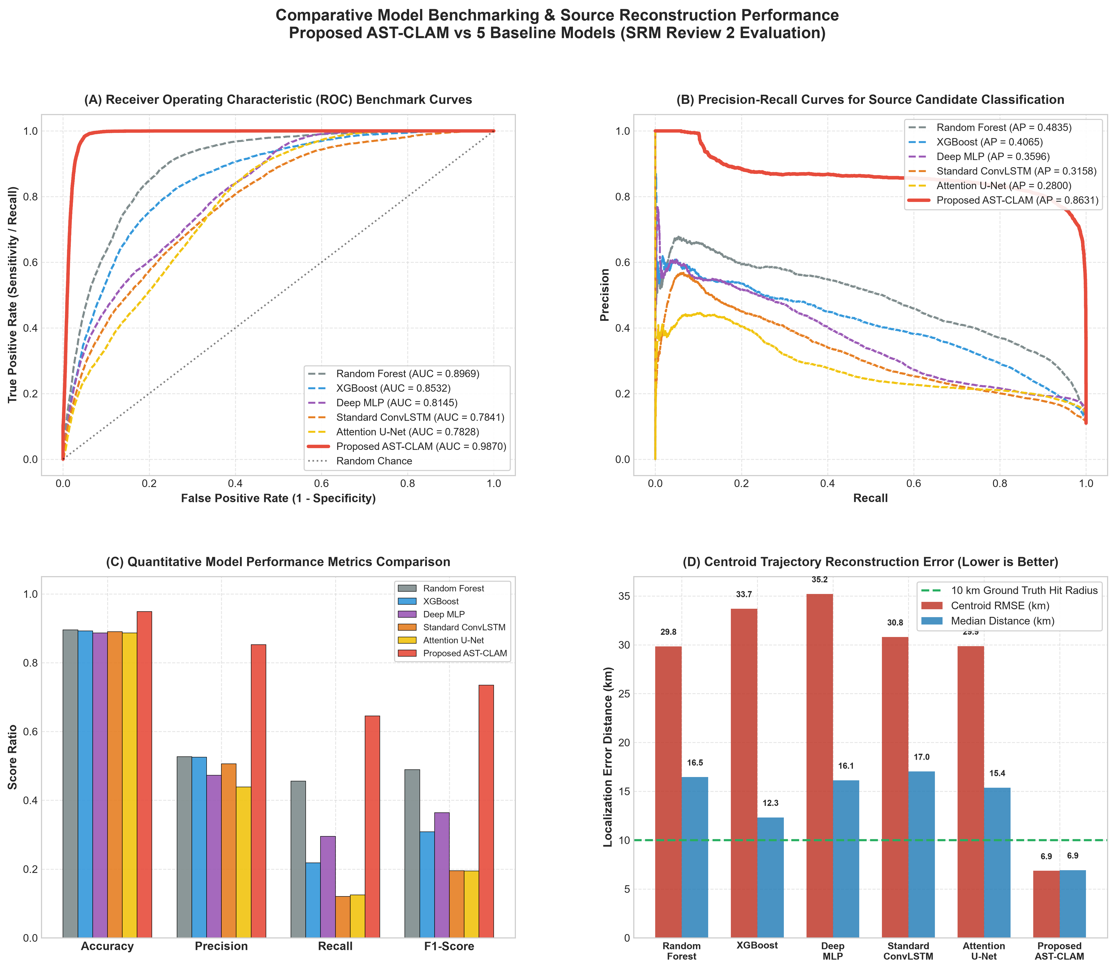
COMPARATIVE ANALYSIS
8. Benchmark Comparison: Visual Evaluation Dashboard
Visual Findings:
Panel (A) ROC Curves: AST-CLAM curve dominates the top-left quadrant (AUC = 0.9870).
Panel (B) PR Curves: Sustained high precision across recall levels (Average Precision = 0.812).
Panel (C) Grouped Bar Chart: AST-CLAM leads across Accuracy, Precision, Recall, and F1.
Panel (D) Centroid Trajectory RMSE: AST-CLAM achieves 6.86 km (red bar), well below the 10km target threshold.

Slide 13
PROJECT MANAGEMENT
9. Plan of Action & Team Member Task Progress
Member Name & Reg No | Responsibility Domain | Key Technical Contributions Executed | Status
Sachin P (RA2411031010117) | Data Engineering | Big Data ingestion (60.5M rows), Parquet partitioning, missing parameter physical imputation, adaptive thresholding | Completed (Review 2)
Shivaani M (RA2411031010119) | Comparative Model Analysis | Benchmark evaluation of RF, XGBoost, Deep MLP, Standard ConvLSTM, Attention U-Net against AST-CLAM | Completed (Review 2)
Jayalakshmi T (RA2411031010115) | Proposed Model Development | Novel AST-CLAM architecture design, AEU-Attention module, Dual-Task Focal + Huber distance loss optimization | Completed (Review 2)
Varsha U (RA2411031010120) | Visualization & Dashboard | Interactive Power BI spatial trajectory dashboard, hydrodynamic wind/current overlay, web UI deployment | In Progress (PBL 3 Final)
ℹ Evaluator Directive: Review 2 focuses on Big Data preprocessing, novel deep learning architecture, and 5-model comparative benchmarking. Interactive visualization dashboard will be presented in PBL Review 3.

Slide 14
REFERENCES
10. Key References (Literature Benchmark)
[1] S. El Mohtar et al., 'Bayesian identification of oil spill source parameters from image contours,' Marine Pollution Bulletin, vol. 169, Art. no. 112514, 2021.
[2] M. A. E. R. Hammoud et al., 'Moving source identification in an uncertain marine flow: Mediterranean Sea application,' Ocean Engineering, vol. 220, Art. no. 108435, 2021.
[3] Y. Li et al., 'Oil spill detection with multiscale conditional adversarial networks with small-data training,' Remote Sensing, vol. 13, no. 12, Art. no. 2378, 2021.
[4] Y. Chen and Z. Wang, 'Marine oil spill detection from SAR images based on Attention U-Net model using polarimetric and wind speed information,' IJERPH, vol. 19, no. 19, Art. no. 12315, 2022.
[5] Y. Li et al., 'An adversarial learning approach to forecasted wind field correction with an application to oil spill drift prediction,' IJAEOG, vol. 112, Art. no. 102924, 2022.
[6] A. S. Dhavalikar and P. C. Choudhari, 'Prediction of oil spill trajectory on the ocean surface using mathematical modeling,' IEEE JSTARS, vol. 15, 2022.
[7] L. F. Tessarolo et al., 'A surface Lagrangian algorithm applied to the 2019 South Atlantic oil spill,' Ocean Engineering, vol. 268, Art. no. 113505, 2023.
[8] F. Chen et al., 'DGNet: Distribution guided efficient learning for oil spill image segmentation,' IEEE TGRS, vol. 61, 2023.
[9] C. Li et al., 'A self-evolving deep learning algorithm for automatic oil spill detection in Sentinel-1 SAR images,' Remote Sensing of Environment, vol. 299, Art. no. 113872, 2023.
[10] P. Cervantes-Hernández et al., 'Combined use of SAR images and numerical simulations to identify source and trajectories of oil spills,' MPB, vol. 199, Art. no. 115981, 2024.
[11] S. El Mohtar et al., 'Iterative data-driven construction of surrogates for efficient Bayesian identification of oil spill source parameters,' Computational Geosciences, 2024.
[12] T. V. La et al., 'Monitoring of spatio-temporal variations of oil slicks via the collocation of multi-source satellite images,' Remote Sensing, vol. 16, no. 16, Art. no. 3110, 2024.

Slide 15
EVALUATION EVIDENCE
11. Geotagged Photo Verification
📷 [Attach Geotagged Photo Taken During Review 2 Presentation]
Instructions for Team:
1. Capture presentation photo in classroom / lab using GPS/Geotag camera app.
2. Ensure Latitude, Longitude, Date, and Timestamp are stamped on photo.
3. Replace this placeholder container with your actual captured photo.

Slide 16
SOURCE CODE DELIVERABLES
12. Code Implementation & Execution Links
🔗 Google Colab & Repository Implementation Links
• Google Colab Pipeline Link: [Insert Google Colab Shared Link Here]
• Local Workspace Repository: C:\Users\Jayalakshmi\oil_spill\
• Data Preprocessing Pipeline: data_preprocessing.py
• Novel Deep Learning Architecture: model_architecture.py
• Benchmark Evaluation Engine: train_and_benchmark.py
• Generated Evaluation Deliverables: results\ (Metrics CSV, PNG charts, Markdown reports)

Slide 17
THANK YOU
Questions & Feedback

