Slide 1
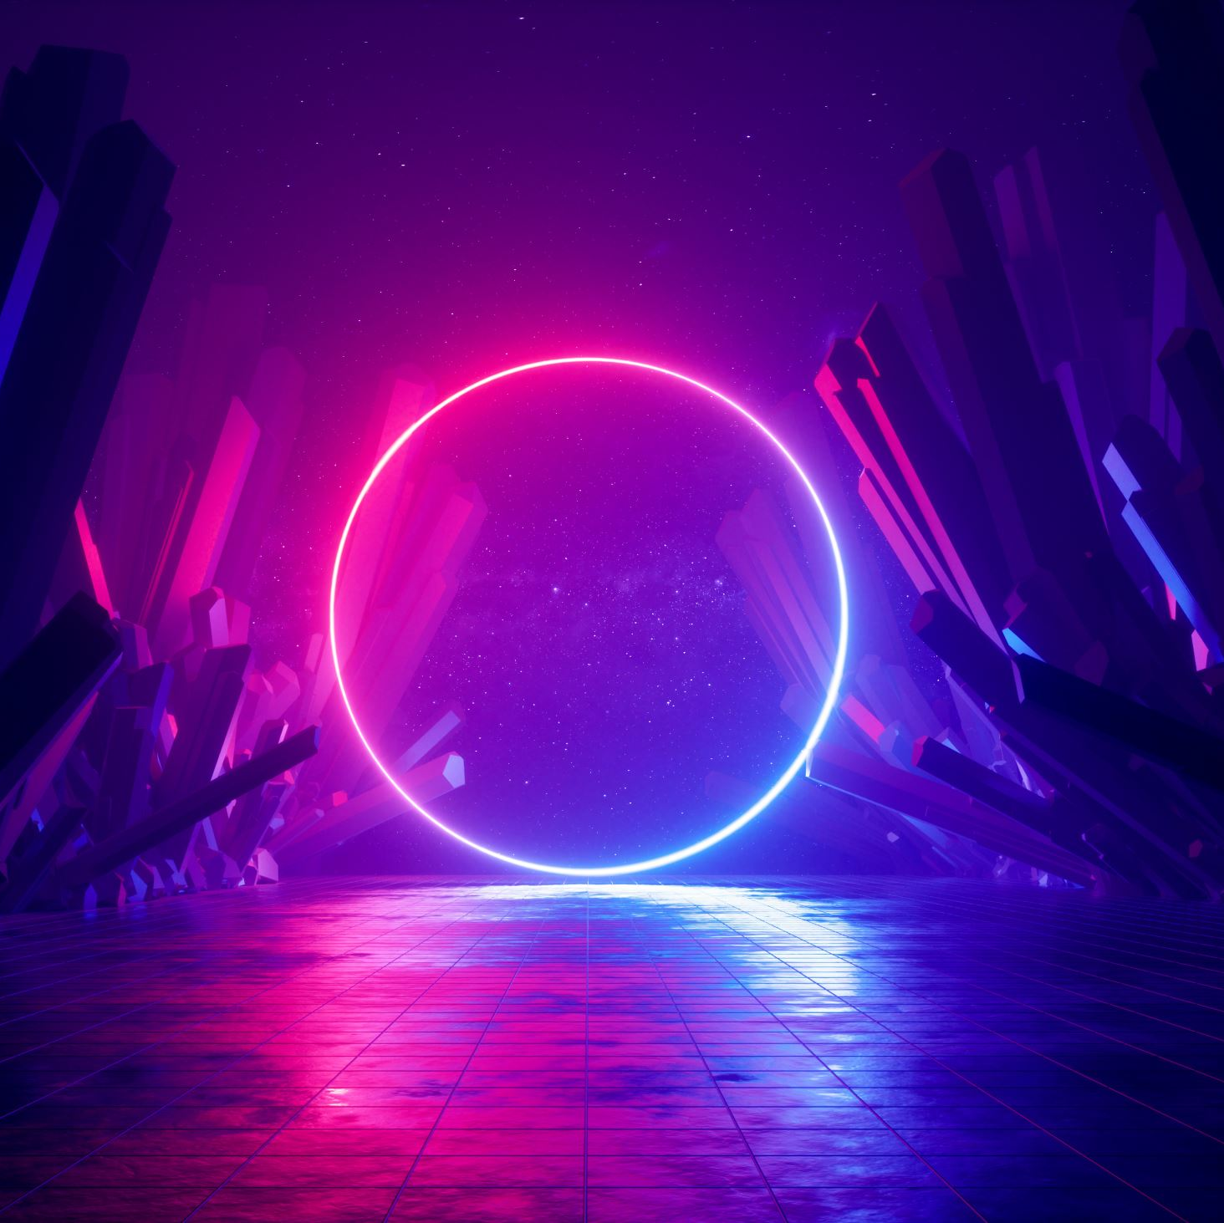
Skin Cancer Detection Application
Sprint 1 Presentation:
Planning & Stories

Slide 2

Team Workspaces:
Trello: https://trello.com/w/skincancerdetectionteam
GitHub: https://github.com/johnsmillie-portfolio/Skin-Cancer-Detection-App

Slide 3
Backlog Management
Epics:
Epic 1 I am a user who wishes to upload an image to detect skin cancer so that I receive information about my condition
Epic 2 I am a user who wishes to use their mobile device to take a photo of skin for skin cancer detection
Stories:
Story 1 As a developer, I need a sequence to preprocess images (resize, normalize), so they are formatted correctly for the ML model
Story 2 As a backend developer, I need to provide backend calls that execute the ML model, so that the frontend can make the proper calls to the backend.
Story 3 As a user, I want to upload a clear image of the affected skin area so that I can receive an instant diagnosis.
Story 4 As a user, I want to download the analysis results, so I can share them with my health team
Story 5 As a user, I want to view or download the analysis results, so I can share them with my health team

Slide 4
Release Plan: Estimated Velocity = 20
Sprint 2:
Item 1 Determine the required input size for your ML model (2)
Item 2 Identify datasets from where we can fetch the images for training the ML model (2)
Item 3 Convert images to the required color space (1)
Item 4 Implement an image augmentation pipeline to improve model generalization (3)
Item 5 Use a CNN to classify the skin cancer type (1)
Item 6 Establish a repeatable pipeline for training the ML model (3)
Item 7 Test the ML model for accuracy and reliability (3)
Item 8 Validate the ML end-to-end workflow - image upload --> analysis --> results (1)
Item 9 Backend API / Event Processor initialized and pingable (2)
Sprint 3:
Item 1 Backend API/event processor initialized and pingable
Item 2 Establish a preprocessing tool to format the user-loaded image for the ML model
Item 3 Backend responds to image event call by preprocessing the image
Item 4 Backend executes the ML model with the preprocessed image
Item 4 Responsive frontend renders with option to upload a photo
Item 5 An image can be uploaded from the frontend
Item 6 Frontend calls the backend API with the uploaded image
Sprint 4:
Item 1 Backend returns simple result after ML model execution
Item 2 Validate the end-to-end workflow (image upload → analysis → results).
Item 3 Backend content management for results information to be dynamically displayed with results
Item 4 Backend serves content to the front end along with the results
Item 5 Front end responds dynamically to content with information

Slide 5
Additional Stories
Test and optimize backend API response time to ensure real-time diagnosis feedback
Integrate a visualization tool to show model confidence in predictions
Offer a mobile version of the application with React Native development

Slide 6
Technology Stack
Frontend:
React.js / React Native
Backend
Express.js / MongoDB or PostgreSQL
ML
Image Processing
Keras
CI/CD
GitHub Actions / Docker / Vercel
TensorFlow / Python

Slide 7
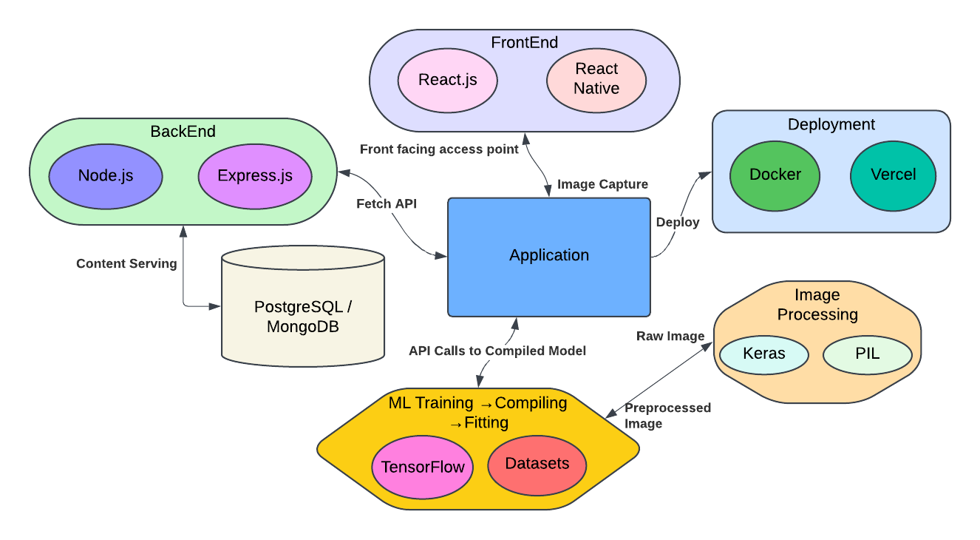
Context Diagram

Slide 8
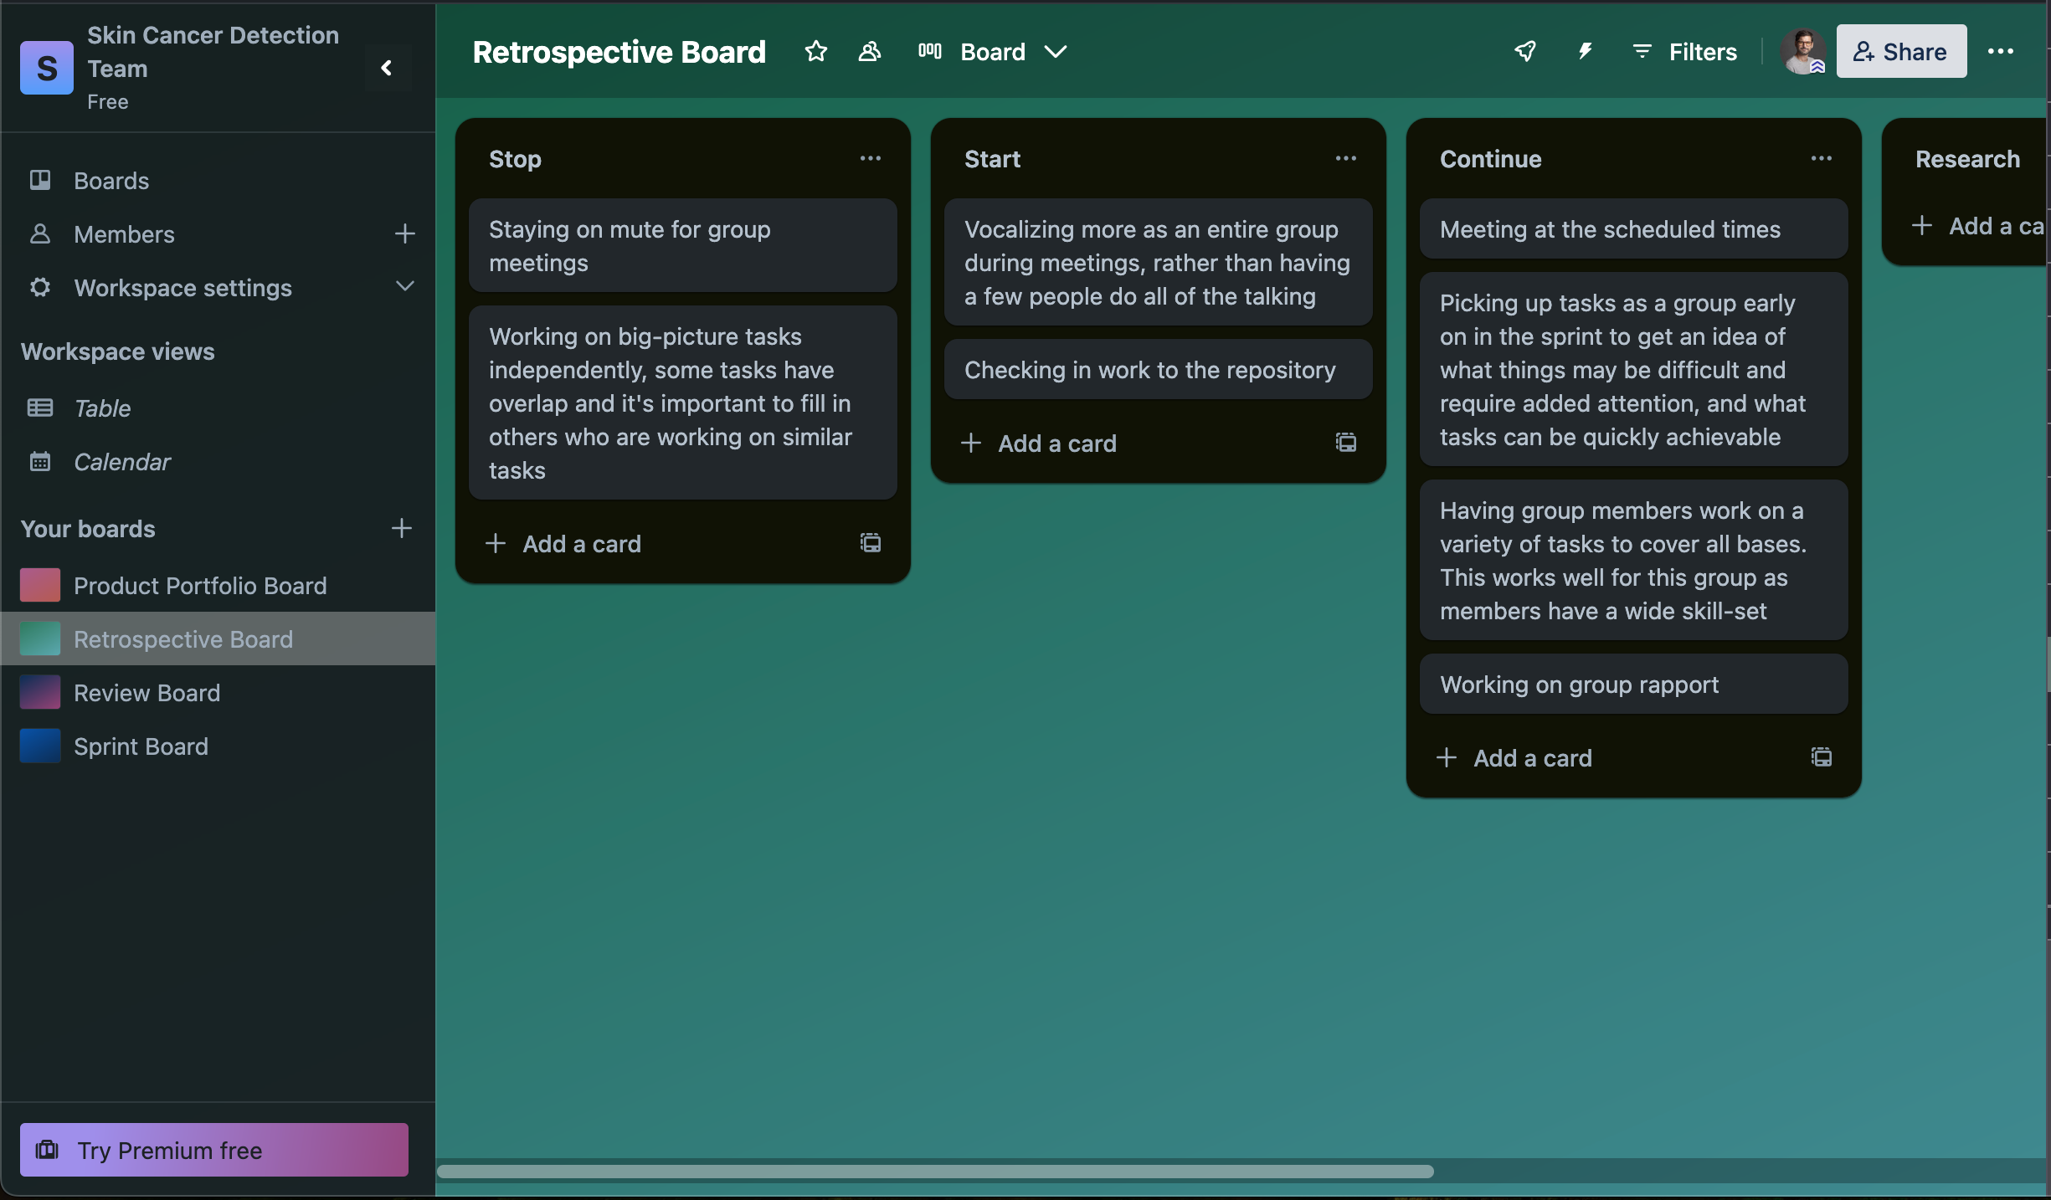
Sprint Retrospective

