Slide 1
Historical Place Guide
Jayalakshmi(176269)
03/04/2019

Slide 2
Introduction
India, being a place of diverse culture and landscapes, is a complex country to fit in your travels with one trip. It is impossible to experience all of India, or even half .so that guide has to guide for the trip and make a trip easy .

Slide 3
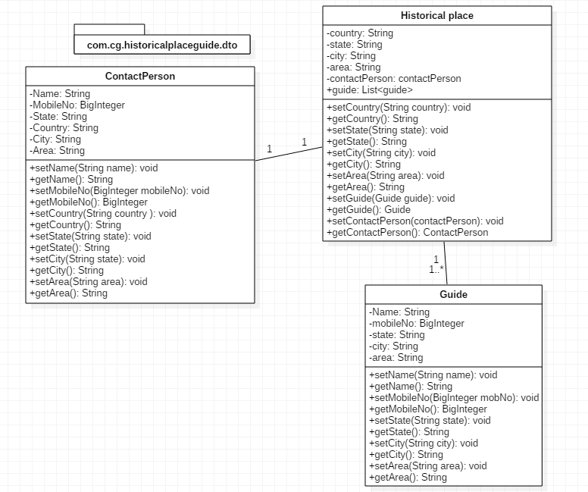
DTO

Slide 4
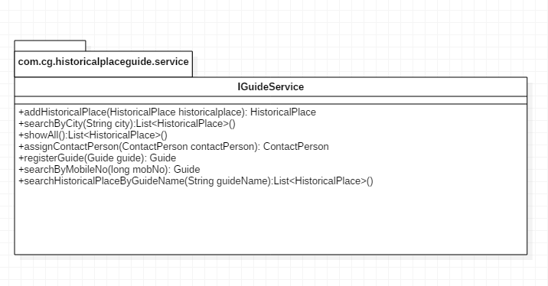
Service

Slide 5
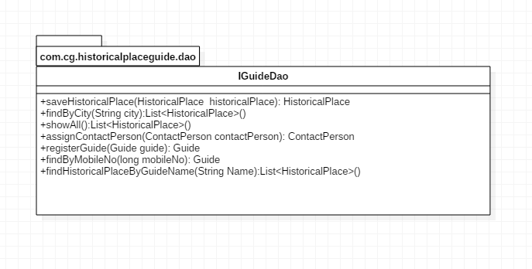
DAO

Slide 6
Thank You

