Slide 1
Breast Cancer Detection using AdaBoost Classifier
Presented by
Team 4

Slide 2
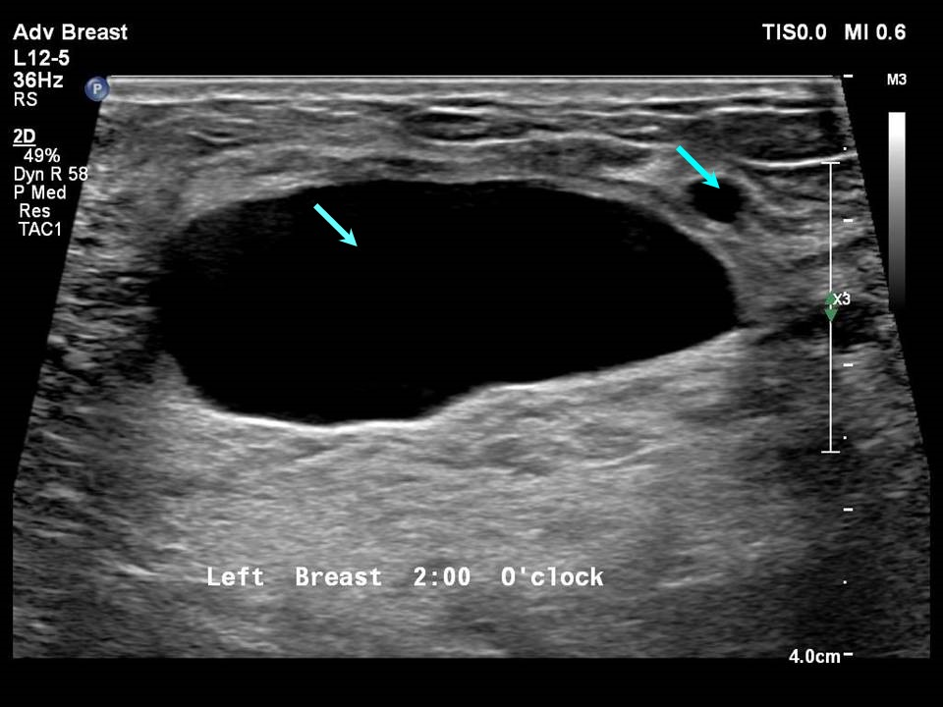
Introduction to Breast Cancer
Breast cancer is a complex and devastating disease, but advancements in machine learning are revolutionizing its diagnosis. Early detection is crucial, and cutting-edge AI models are enhancing our ability to identify malignant tumors with unprecedented accuracy.
The disease occurs when abnormal cells in the breast grow uncontrollably, forming a tumor. These tumors can be benign (non-cancerous) or malignant (cancerous). Malignant tumors have the potential to invade nearby tissues and spread (metastasize) to other parts of the body through the lymphatic system or bloodstream.

Slide 3
Malignant Vs Benign
Malignant Tumor:
Cancerous: Malignant tumors are composed of cancerous cells that grow uncontrollably and can invade surrounding tissues.
Aggressive: These tumors tend to grow rapidly and can damage nearby tissues and organs.
Metastasis: Malignant tumors have the ability to spread (metastasize) to other parts of the body through the bloodstream or lymphatic system. This spread can create secondary tumors in distant organs, making the disease more dangerous and harder to treat.
Life-threatening: Because of their invasive nature and ability to metastasize, malignant tumors pose a serious risk to health and can be life-threatening.
Treatment: Malignant tumors often require aggressive treatments such as surgery, chemotherapy, radiation therapy, or targeted therapies to stop the cancer from spreading or returning.
Benign Tumor:
Non-cancerous: Benign tumors are made of abnormal cells, but they do not have the ability to invade nearby tissues or spread to other parts of the body.
Slow-growing: These tumors generally grow more slowly than malignant ones and remain localized in one area.
No metastasis: Benign tumors do not spread to other parts of the body and usually stay confined to their original location.
Not life-threatening: Most benign tumors are not life-threatening unless they grow large enough to press on vital organs or cause other complications (like blocking the airways or affecting brain function).
Treatment: Treatment is often less aggressive and may involve surgery to remove the tumor, particularly if it causes discomfort or health issues. In some cases, benign tumors do not require treatment and can be monitored over time.

Slide 4


Machine Learning in HealthCare
Disease Prediction and Diagnosis: ML algorithms analyze patient data (e.g., imaging, genetic information) to predict diseases like cancer, diabetes, and cardiovascular conditions early.
Medical Imaging: ML models help detect patterns in medical images (X-rays, MRIs, CT scans) to identify abnormalities like tumors, fractures, or infections.
Personalized Treatment Plans: ML can create customized treatment recommendations by analyzing patient histories, genetic data, and drug responses.
Predictive Analytics: ML models predict patient outcomes, readmission risks, and future health conditions, enabling proactive care.

Slide 5


Why early detection of Breast Cancer is important?
1. Higher Survival Rates:
Breast cancer detected at an early stage (before it spreads) is easier to treat successfully.
2. Less Aggressive Treatment:
Early-stage breast cancer often requires less invasive treatments, such as smaller surgeries (e.g., lumpectomy instead of mastectomy) and lower doses of chemotherapy or radiation therapy.
3. Lower Risk of Metastasis:
Catching the cancer early means it is less likely to have spread (metastasized) to other organs, which makes it harder to treat and lowers the chances of long-term survival.
4. Reduced Healthcare Costs:
Treating early-stage breast cancer is less costly than advanced stages, as advanced cancer requires more complex and prolonged treatments.

Slide 6
AdaBoost Classifier
The AdaBoost classifier (Adaptive Boosting) is a machine learning algorithm that enhances the performance of weak learners, typically simple classifiers like decision stumps, by combining them into a strong classifier.
It works iteratively, where each weak learner is trained on the same dataset but with different weights assigned to the data points. Initially, all samples are weighted equally, but after each iteration, the weights of misclassified samples are increased, while the weights of correctly classified ones are reduced.
This forces subsequent weak learners to focus on the harder-to-classify cases. The final prediction is made by combining the outputs of all weak learners through a weighted majority vote, giving more weight to those learners that performed well on difficult cases.
AdaBoost is widely used for binary classification tasks and is known for improving the accuracy of models while reducing overfitting.

Slide 7
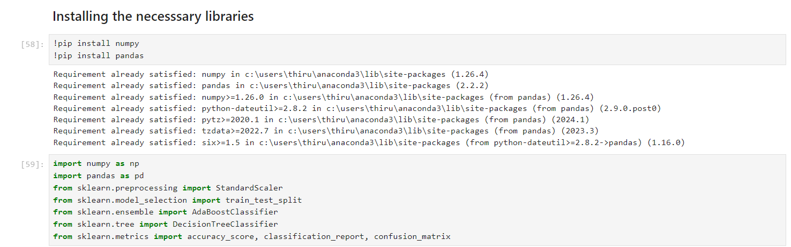
Data Collection and Preprocessing
At first installing all necessary libraries for our project

Slide 8
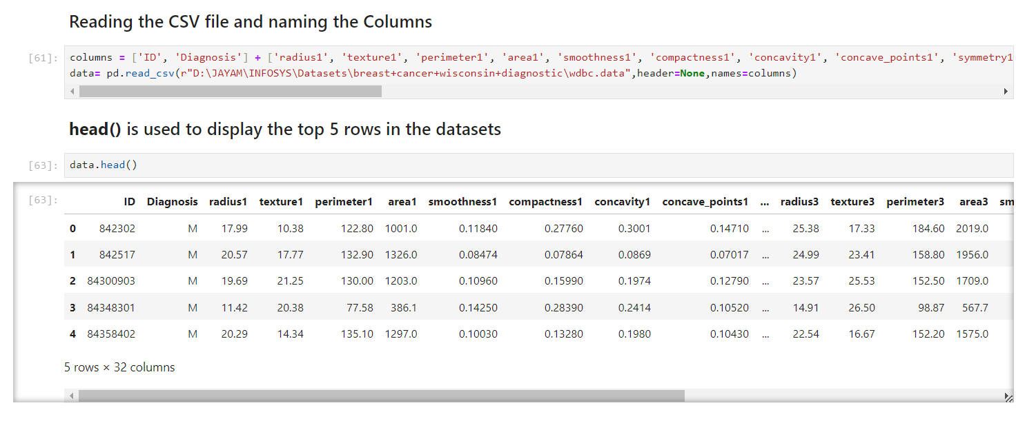
Data Collection and Preprocessing
Then, collect and preprocess breast cancer data, typically sourced from datasets like the UCI Breast Cancer Wisconsin dataset.

Slide 9
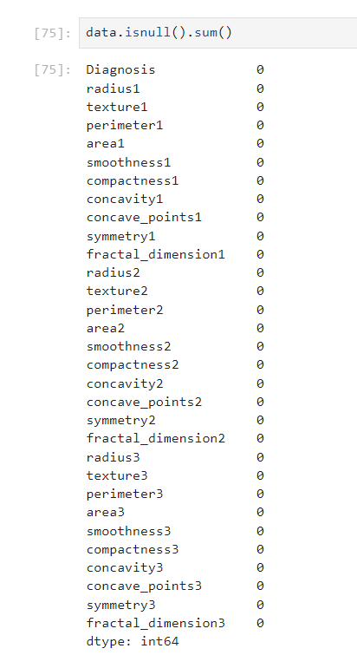


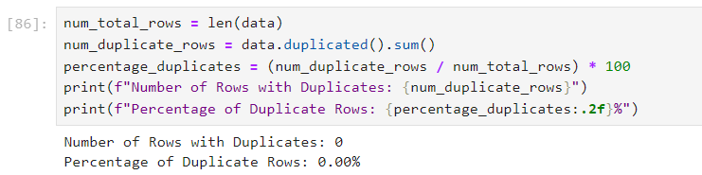
Data Collection and Preprocessing
Handle missing values
Finding the dimensions of the Dataset
Finding the duplicate values

Slide 10

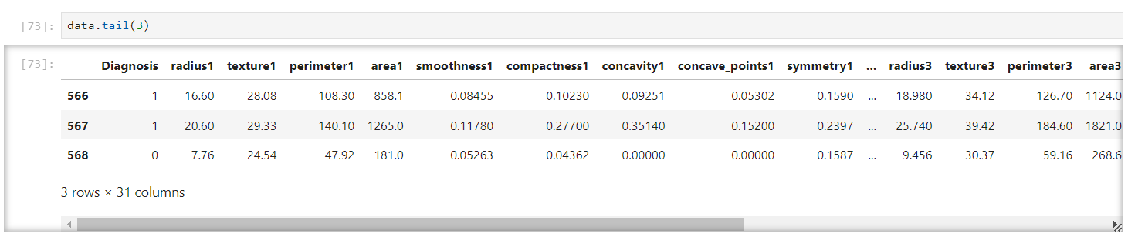
Data Collection and Preprocessing
Encode categorical labels
Categorical labels like M and B is encoded as 1 and 0 respectively

Slide 11
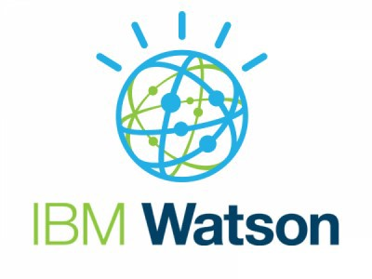

Real-World Examples
IBM Watson
IBM Watson Health uses AI and machine learning to analyze large volumes of medical data, including imaging data, pathology reports, and patient history. Its machine learning models assist doctors in making more informed decisions.
Google Health / DeepMind
Google's DeepMind has developed AI models that analyze mammograms to detect breast cancer with performance on par with or better than radiologists. The model has been tested in real-world settings to reduce both false positives and false negatives in screening programs.

