Slide 1
Breast Cancer Detection using AdaBoost Classifier
Presented by
Team 4

Slide 2
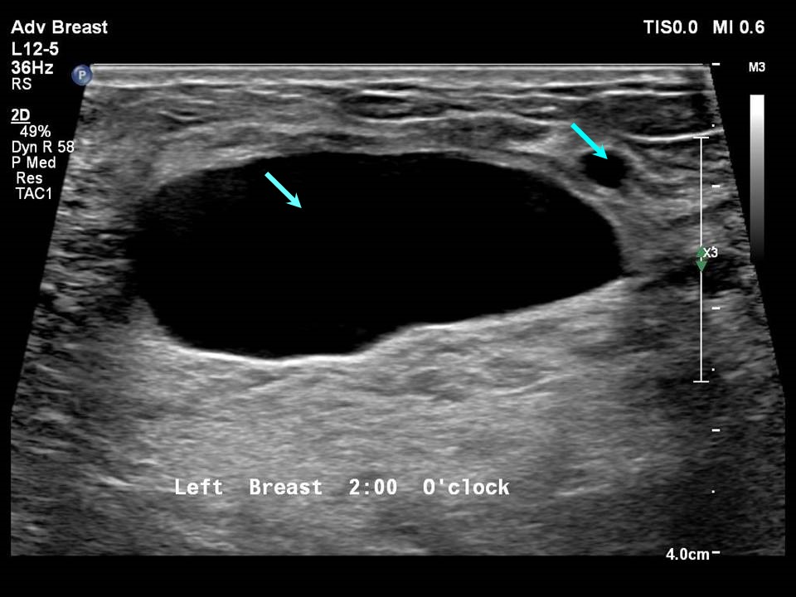

Introduction to Breast Cancer
The disease occurs when abnormal cells in the breast grow uncontrollably, forming a tumor. These tumors can be benign (non-cancerous) or malignant (cancerous).

Slide 3
Malignant Vs Benign
Malignant Tumor:
Cancerous
Aggressive
Metastasis
Life-threatening
Benign Tumor:
Non-cancerous
Slow-growing
No metastasis
Not life-threatening

Slide 4


Machine Learning in HealthCare
Disease Prediction and Diagnosis
Medical Imaging
Personalized Treatment Plans
Predictive Analytics

Slide 5


Why early detection of Breast Cancer is important?
Higher Survival Rates
Less Aggressive Treatment
Lower Risk of Metastasis
Reduced Healthcare Costs

Slide 6


Real-World Examples
IBM Watson
IBM Watson Health uses AI and machine learning to analyze large volumes of medical data, including imaging data, pathology reports, and patient history. Its machine learning models assist doctors in making more informed decisions.
Google Health / DeepMind
Google's DeepMind has developed AI models that analyze mammograms to detect breast cancer with performance on par with or better than radiologists. The model has been tested in real-world settings to reduce both false positives and false negatives in screening programs.

Slide 7
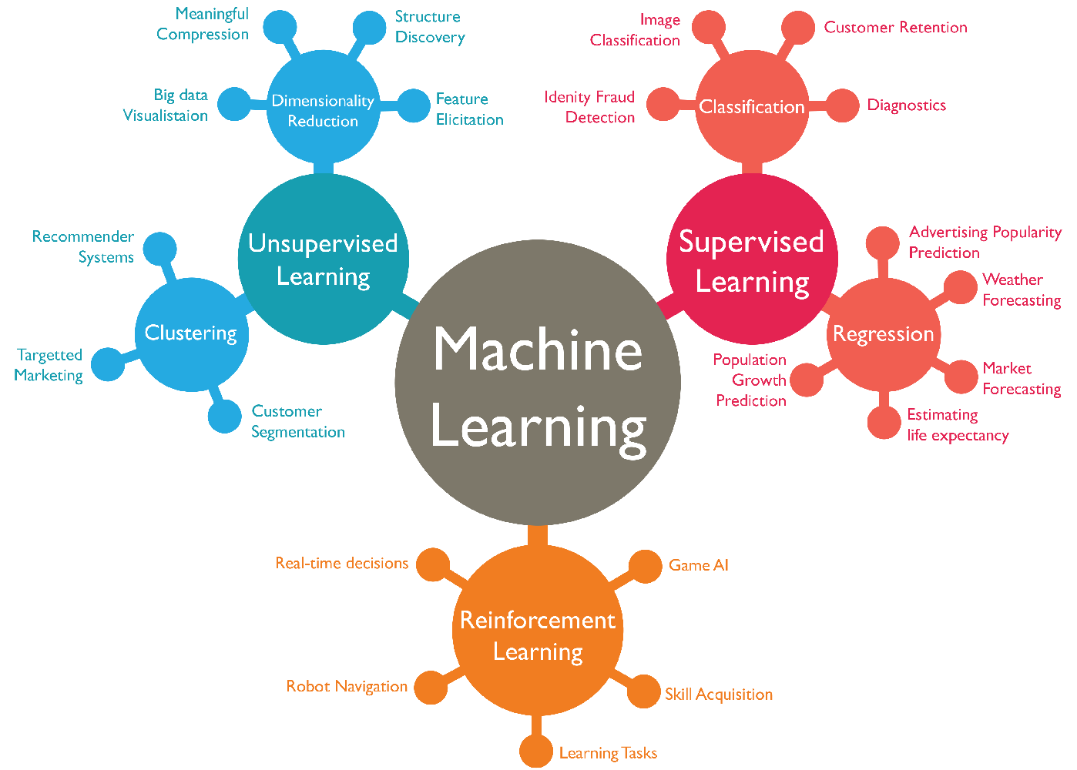
Some Algorithms used to analyze medical data
Decision Trees
Random Forest
Support Vector Machines (SVM)
K-Nearest Neighbors (KNN)
Logistic Regression

Slide 8
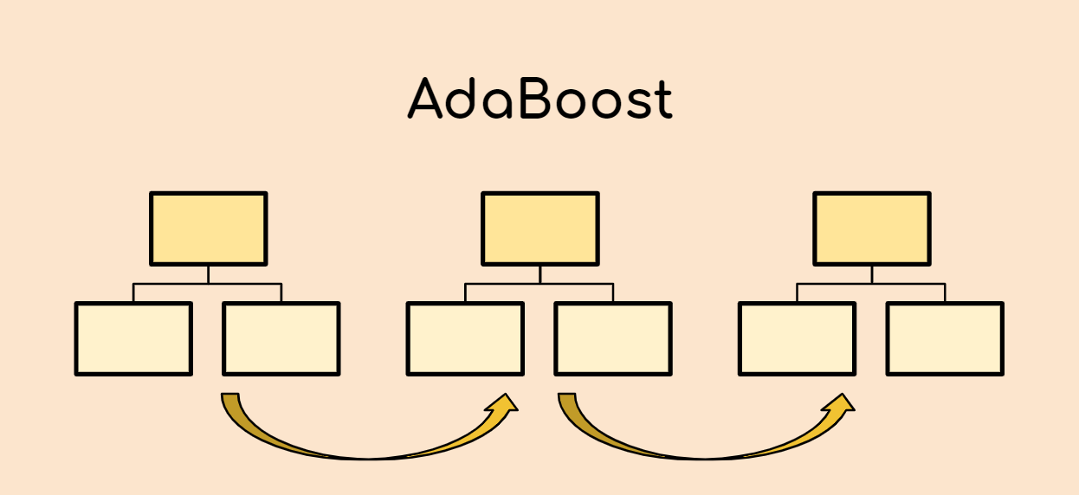
AdaBoost Classifier
The AdaBoost classifier is a machine learning method that helps improve the accuracy of predictions by combining the strengths of many weak models (often called "weak learners").
AdaBoost takes weak models and makes them work together. It boosts their performance by focusing on the mistakes made by the previous models.
In each step, AdaBoost trains a new model and gives more importance (or "weight") to the data points that were misclassified by the previous models. This way, the new model focuses more on the difficult cases.

Slide 9

Problem Statement
A project focused on detecting breast cancer using the AdaBoost classifier. To develop a machine learning model that accurately classifies breast cancer as either malignant or benign using the AdaBoost algorithm.

Slide 10

Data Collection
Collect and preprocess breast cancer data, typically sourced from the “UCI Breast Cancer Wisconsin dataset.”

Slide 11
Installing necessary libraries
Pandas
Seaborn
Matplotlib
Numpy
Sklearn

Slide 12
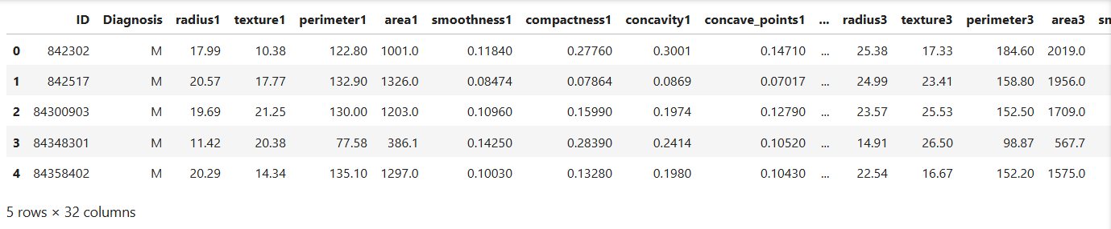


Reading the CSV file and naming the Columns
Analysis and Preprocessing of Dataset
Shape:
Number of duplicated rows:

Slide 13
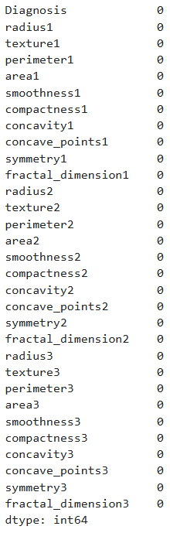
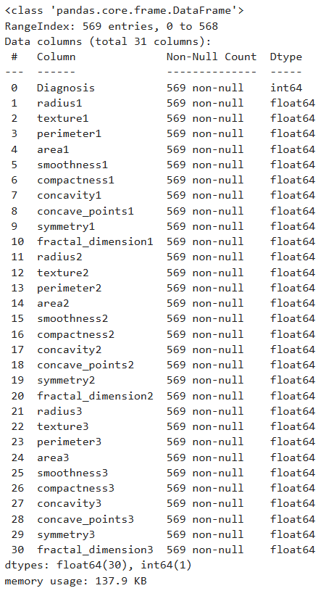
Number of NULL or missing values:
Analysis and Preprocessing of Dataset
info:
There is no missing or NULL values in our dataset

Slide 14
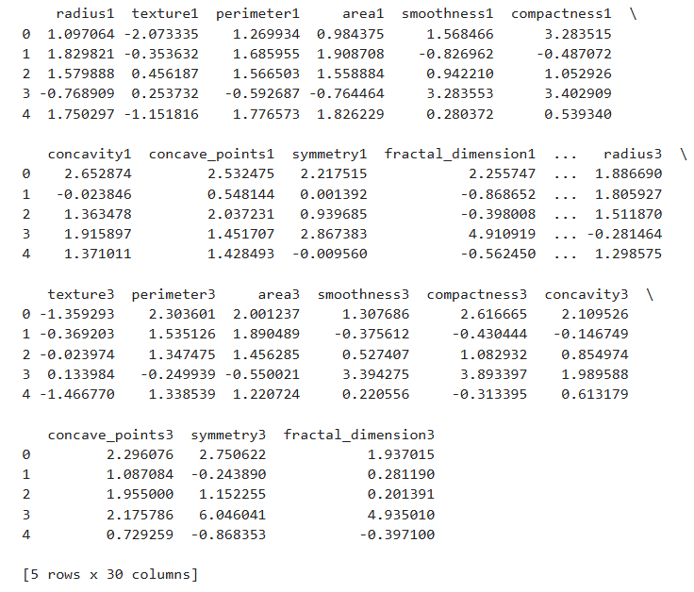
Scaling the data
By initializes a StandardScaler (from sklearn lib.) object which will standardize the features by removing the mean and scaling to unit variance.

Slide 15
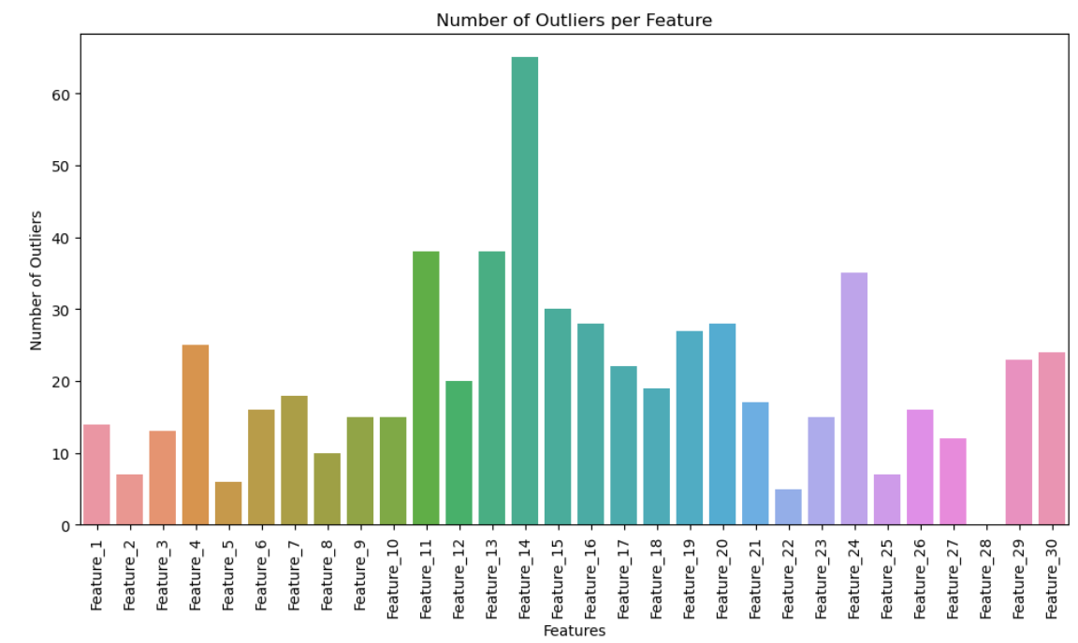
Data cleaning
Outlier Detection: Using IQR (Interquartile Range)
From our dataset we got around 171 outliers right now.
And removing the ID column which is not required for our Model

Slide 16
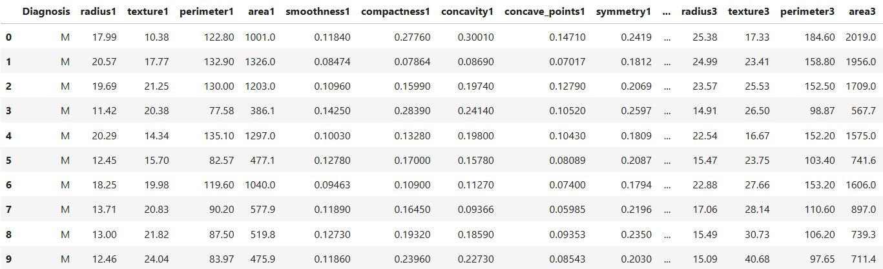
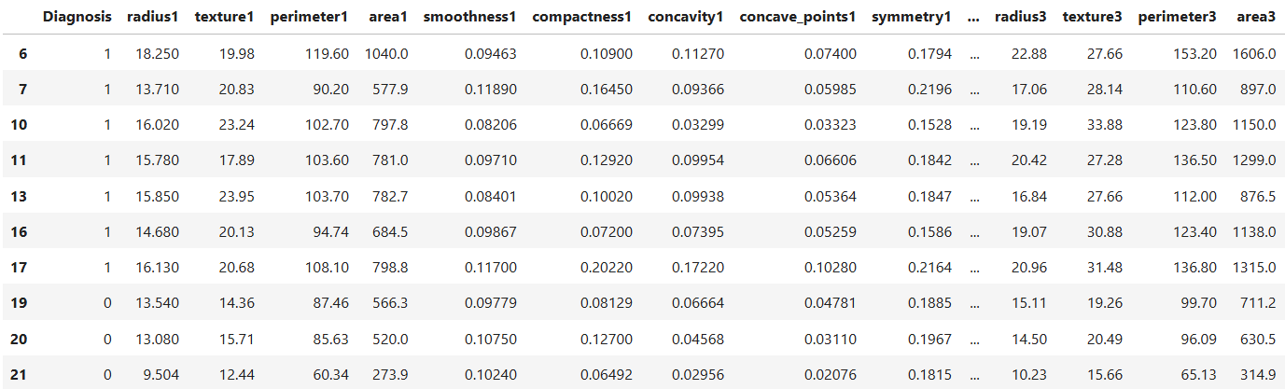
Encode categorical labels
Encoding categorical labels is important because:
Mathematical Interpretability
Model Compatibility
Improved Model Performance
Mapping
Malignant = 1
Benign = 0

Slide 17
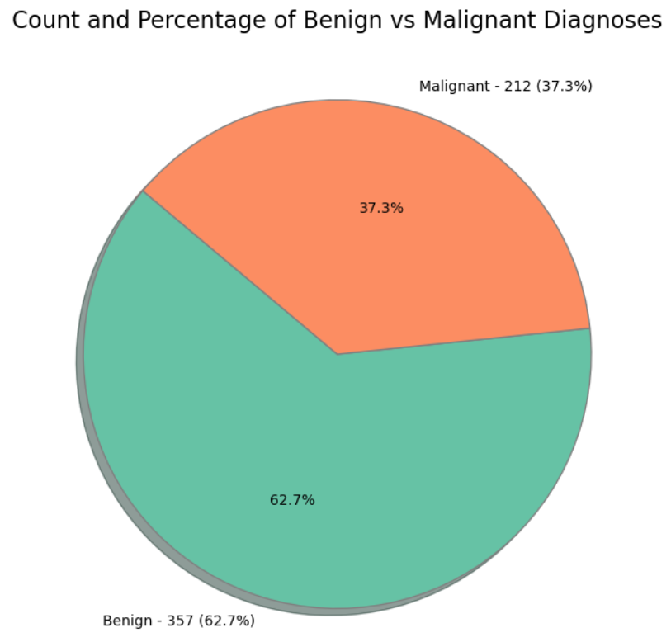
Data visualization
The given dataset is imbalanced which leads to
High False Negatives/Positives
Poor Performance on Minority Class
Misleading Evaluation Metrics
Percentage of benign cases = 62.7
Percentage of malignant cases = 37.3

Slide 18
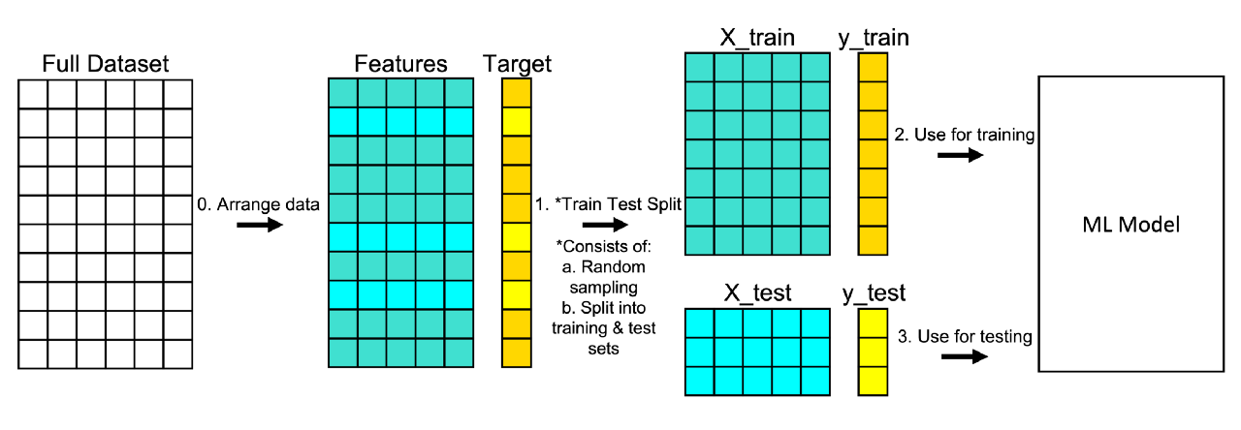

Data splitting
Before splitting Dataset
Shape of dataset:
After splitting Dataset
We have split the data with the ratio of 80:20

Slide 19
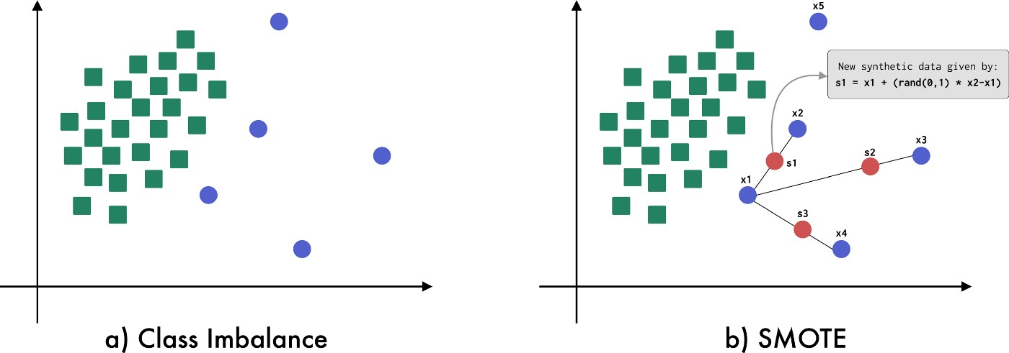
SMOTE for Imbalance Dataset
Synthetic Minority Over-sampling Technique, is a method used to handle imbalanced datasets.

Slide 20
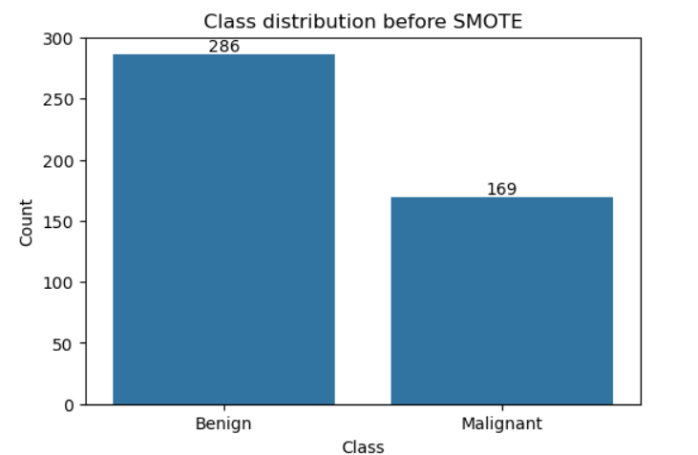
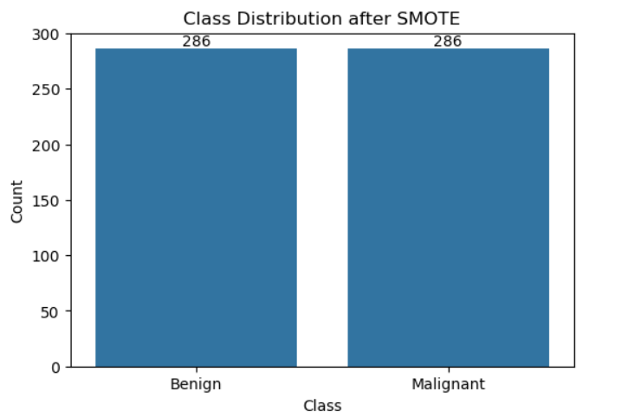
Implementing SMOTE
SMOTE is implemented in train data after splitting the Original dataset.
not @test data

Slide 21
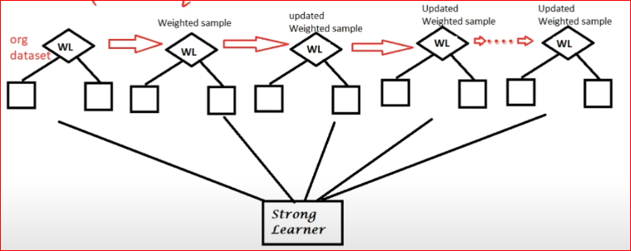
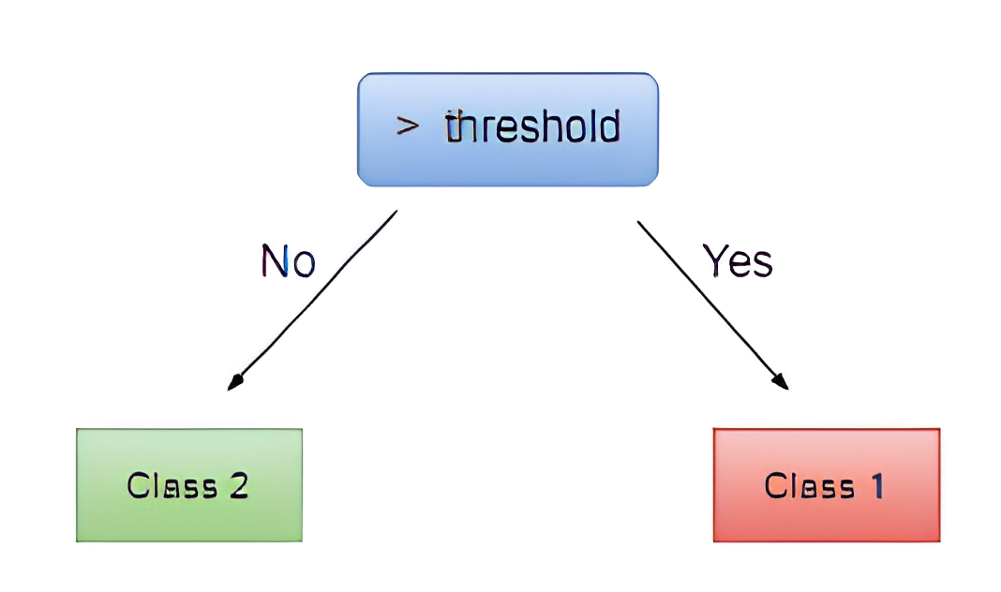
Implementation of ADABOOST Classifier
decision stump
AdaBoost (Adaptive Boosting) is a popular ensemble method that improves the performance of weak learners, typically decision trees, by combining multiple models into a single, strong model.
We use scikit-learn to implement Adaboost in our dataset

Slide 22

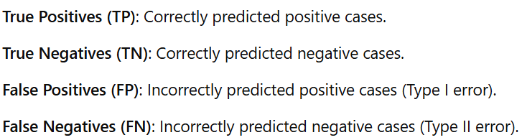
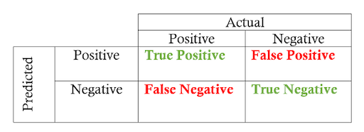
Confusion Matrix
The confusion matrix is a tool to evaluate the performance of a classification model, showing how well the model distinguishes between classes

Slide 23
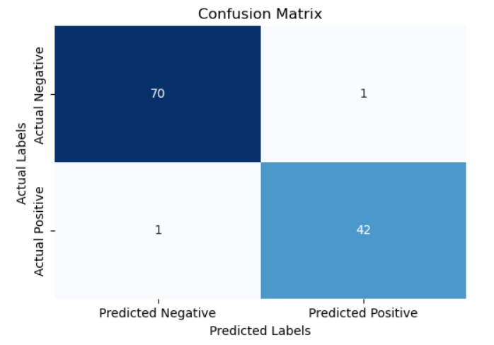
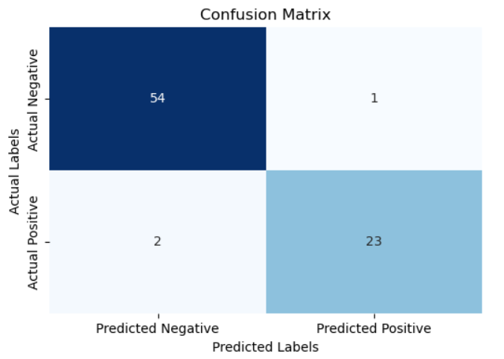
Confusion Matrix
WITH Outlier
WITHOUT Outlier
The WITH Outlier model has higher recall with fewer false negatives, making it slightly better at identifying positive cases than WITHOUT Outlier.

Slide 24

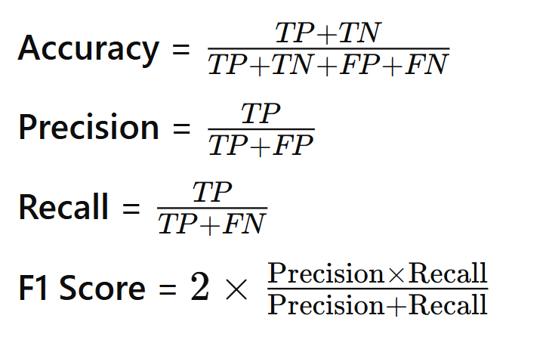
Performance Evaluation
We can evaluate the performance of our model with following values

Slide 25


Performance Evaluation
In our Dataset we have, we TRAINED the model with and without outliers
WITH Outlier
WITHOUT Outlier
In our case the Performance reduced after removing outliers

Slide 26

Presented by TEAM-4

