Slide 1

KEALVI
Live audience workspace
Mrithyunjayan M
Register No. 2403717610421033
B.E. Computer Science and Engineering
13 September 2026
Government Aided Autonomous Institution Affiliated to Anna University
Coimbatore 641014
Coimbatore Institute of Technology
01
Notes:
Source: 2403717610421033 - Mrithyunjayan M.pptx, slide 1. Institution: Government Aided Autonomous Institution Affiliated to Anna University, Coimbatore 641014.

Slide 2
Presentation overview
01
Context & objectives
Introduction, problem statement and project goals
02
Implementation
Technologies, application structure and features
03
Product walkthrough
Desktop screens and responsive mobile layouts
04
Interface study
Apple TV analysis, design lessons and conclusion
Kealvi
02
Notes:
Source: 2403717610421033 - Mrithyunjayan M.pptx, slide 2.

Slide 3
A workspace for audience participation
Kealvi brings poll creation, voting and result review into one responsive web application.
Core workflow
Create a poll, collect votes, review results and make a decision.
Audience
Teams, classrooms, communities and live sessions.
Interaction goal
Quick actions with clear feedback on desktop and mobile.
Kealvi
03
Notes:
Source: 2403717610421033 - Mrithyunjayan M.pptx, slide 3. Results refresh every 15 seconds and after voting or publishing. Source: project README.md.

Slide 4
The problem with fragmented polling
Questions, responses and results often live in different tools.
Fragmented interaction
Separate forms and chat threads add friction for organizers and participants.
Limited visibility
A scattered workflow makes active polls and response distribution harder to follow.
Weak decision support
Raw responses need context, including participation history and engagement.
Kealvi
04
Notes:
Source: 2403717610421033 - Mrithyunjayan M.pptx, slide 4.

Slide 5
Project objectives
Create and manage polls
Support live voting
Set a question, answer options, category and closing time.
Record responses and display the result distribution.
Organize poll history
Show participation insights
Search and filter All polls, My polls, Voted and Saved.
Review rankings, category summaries and recent activity.
Support mobile use
Assist poll drafting
Keep navigation and essential actions accessible.
Offer optional Gemini drafts alongside editable templates.
Kealvi
05
Notes:
Source: 2403717610421033 - Mrithyunjayan M.pptx, slide 5. Gemini requires configuration. It is not enabled in the supplied checkout.

Slide 6
Technologies and tools
Component | Role
Next.js / React | Web interface and application routes
CSS / Tailwind CSS | Responsive styling and interface layout
Supabase / PostgreSQL | Poll, option and vote persistence
Google Gemini (optional) | Assisted poll drafting when configured
Vercel | Hosting and deployment platform
GitHub | Source control and collaboration
Kealvi
06
Notes:
Source: 2403717610421033 - Mrithyunjayan M.pptx, slide 6. Technology roles follow the supplied deck. Hosting listed here does not establish a live deployment.

Slide 7
System architecture
01 Browser interface
Audience and organizers use Next.js / React pages, forms and poll views.
02 Application routes
Server handlers validate creation and voting requests, then return updated results.
03 Supabase / PostgreSQL
Persistent data stores polls, answer options and recorded votes.
04 Optional Gemini integration
A server route requests a draft when the Gemini API key is configured.
Browser storage retains display identity and saved polls. GitHub and Vercel support delivery.
Kealvi
07
Notes:
Source: 2403717610421033 - Mrithyunjayan M.pptx, slide 7. Architecture clarified against project README.md: browser-local identity and bookmarks, server Route Handlers, Supabase persistence.

Slide 8
Application capabilities
Overview and polling
Poll library
Workspace totals, editable templates, voting and poll closing.
Saved polls, voting history, search and status filters.
Leaderboard and insights
Activity feed
Contributor rankings and category-level participation.
Recent poll launches and voting actions.
Sharing and export
Responsive interface
Direct poll links and downloadable JSON results.
Desktop and mobile views with clear action feedback.
Kealvi
08
Notes:
Source: 2403717610421033 - Mrithyunjayan M.pptx, slide 8.

Slide 9
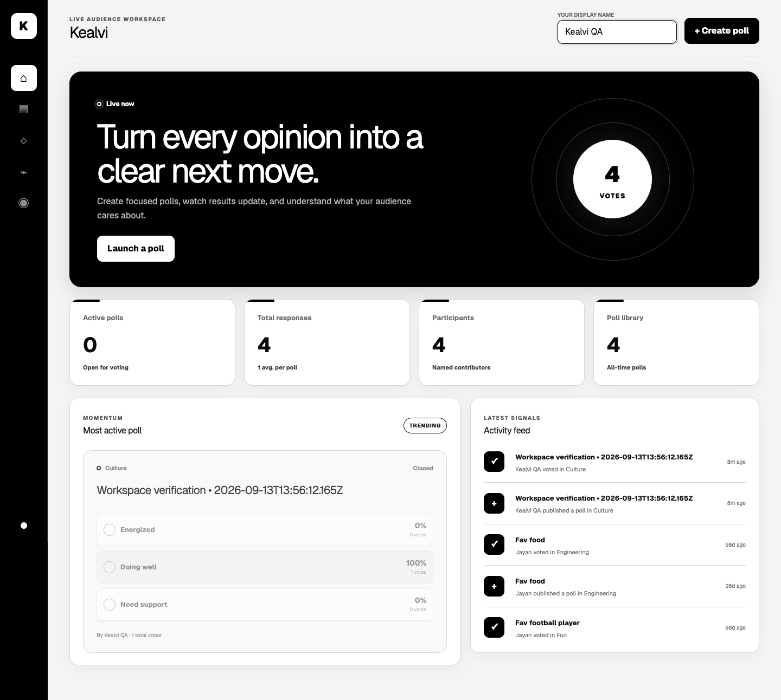
Overview dashboard
Workspace metrics provide a quick view of active polls, responses and recent activity.
Kealvi / Product walkthrough
09
Notes:
Source: 2403717610421033 - Mrithyunjayan M.pptx, slide 9. Original supplied screenshot. Values describe the captured demonstration state.

Slide 10
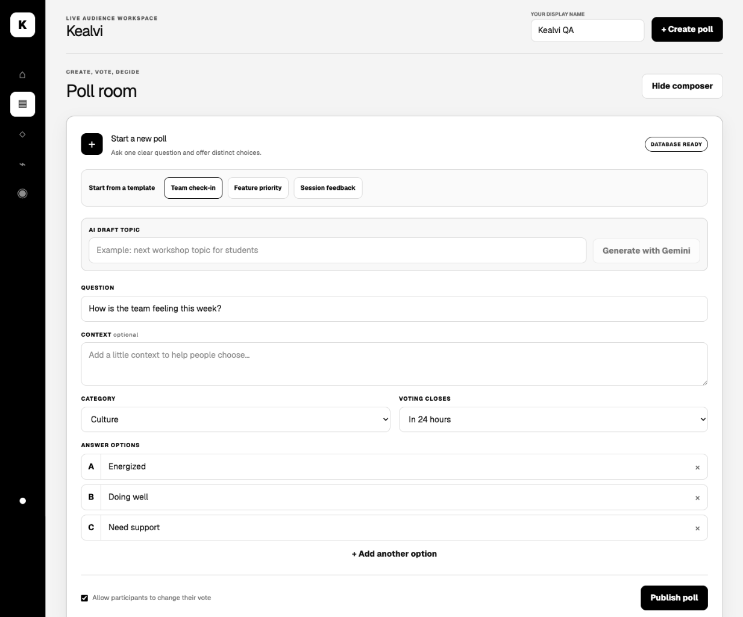
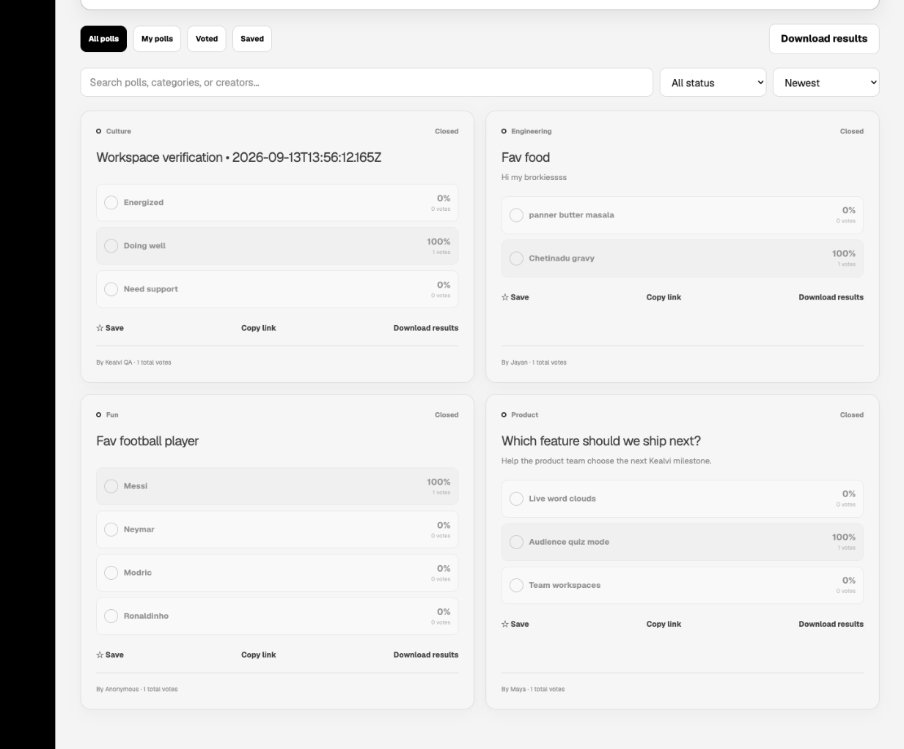
Poll creation
Templates give creators a starting point. Questions, options and closing times remain editable.
Page continues from left to right
Kealvi / Product walkthrough
10
Notes:
Source: 2403717610421033 - Mrithyunjayan M.pptx, slide 9. Original supplied screenshot. Values describe the captured demonstration state.

Slide 11
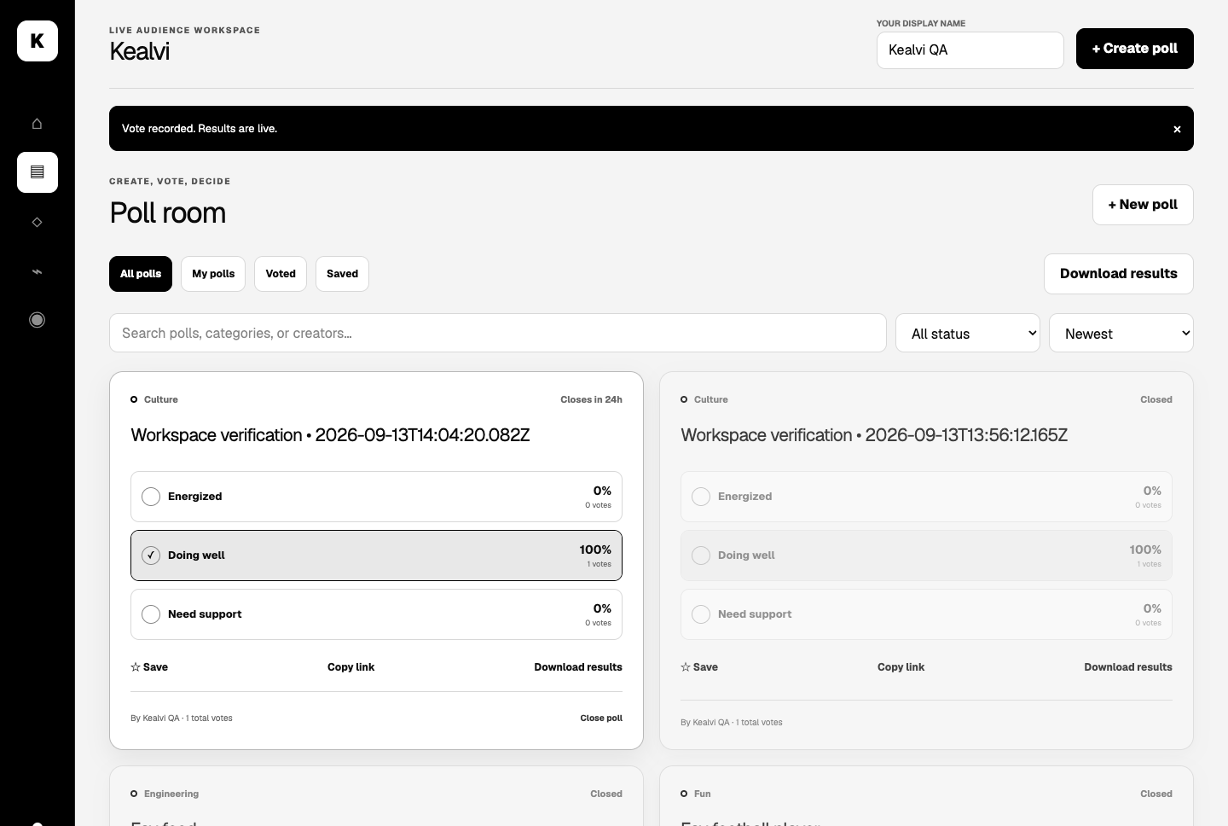
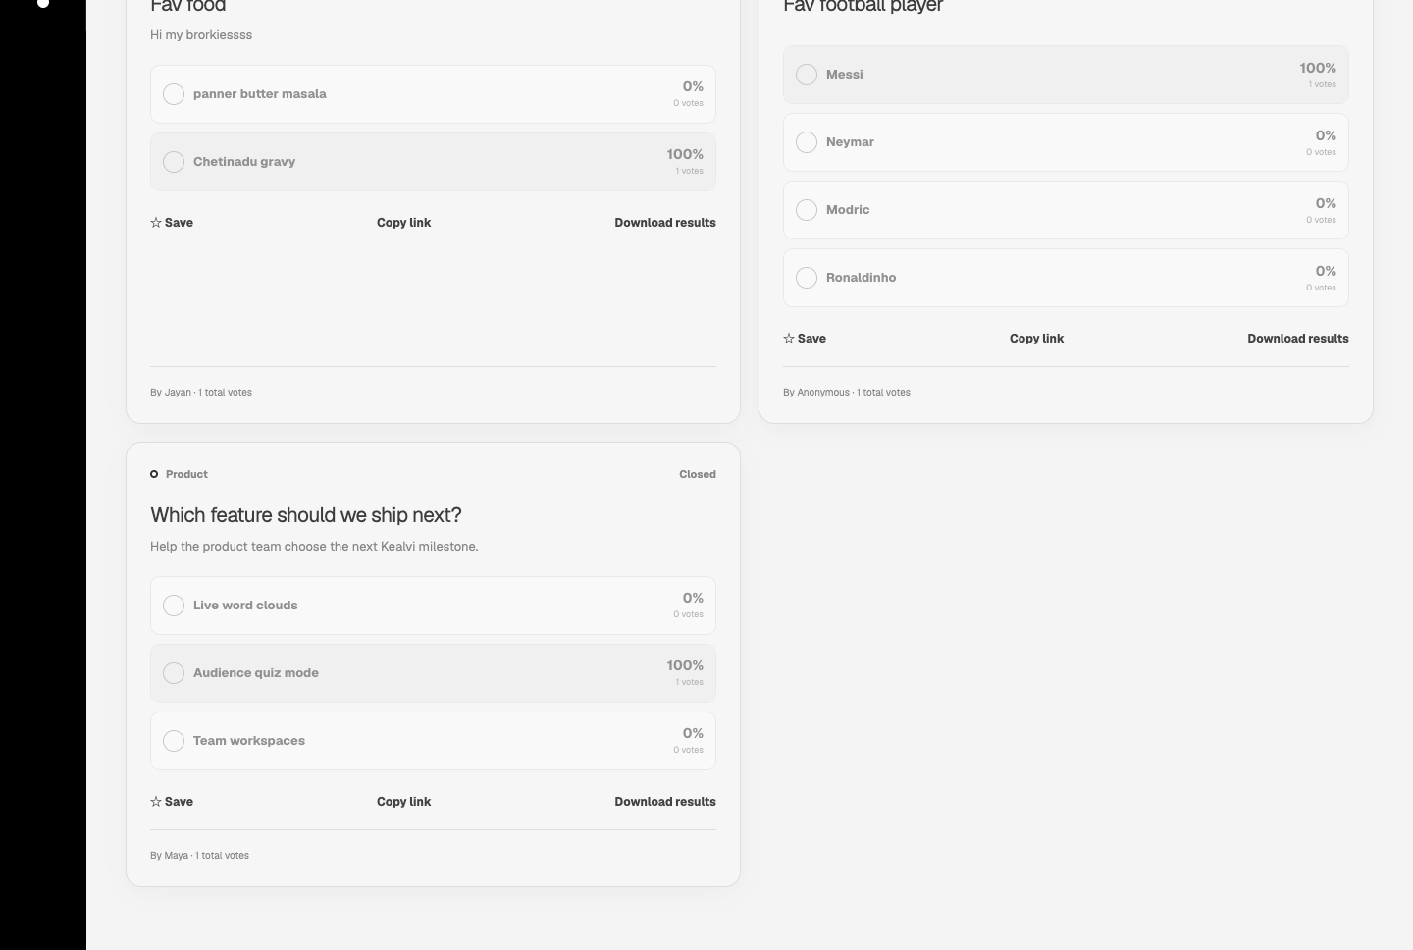
Live voting
Participants choose an answer and receive clear confirmation with updated counts and percentages.
Page continues from left to right
Kealvi / Product walkthrough
11
Notes:
Source: 2403717610421033 - Mrithyunjayan M.pptx, slide 10. Original supplied screenshot. Values describe the captured demonstration state.

Slide 12
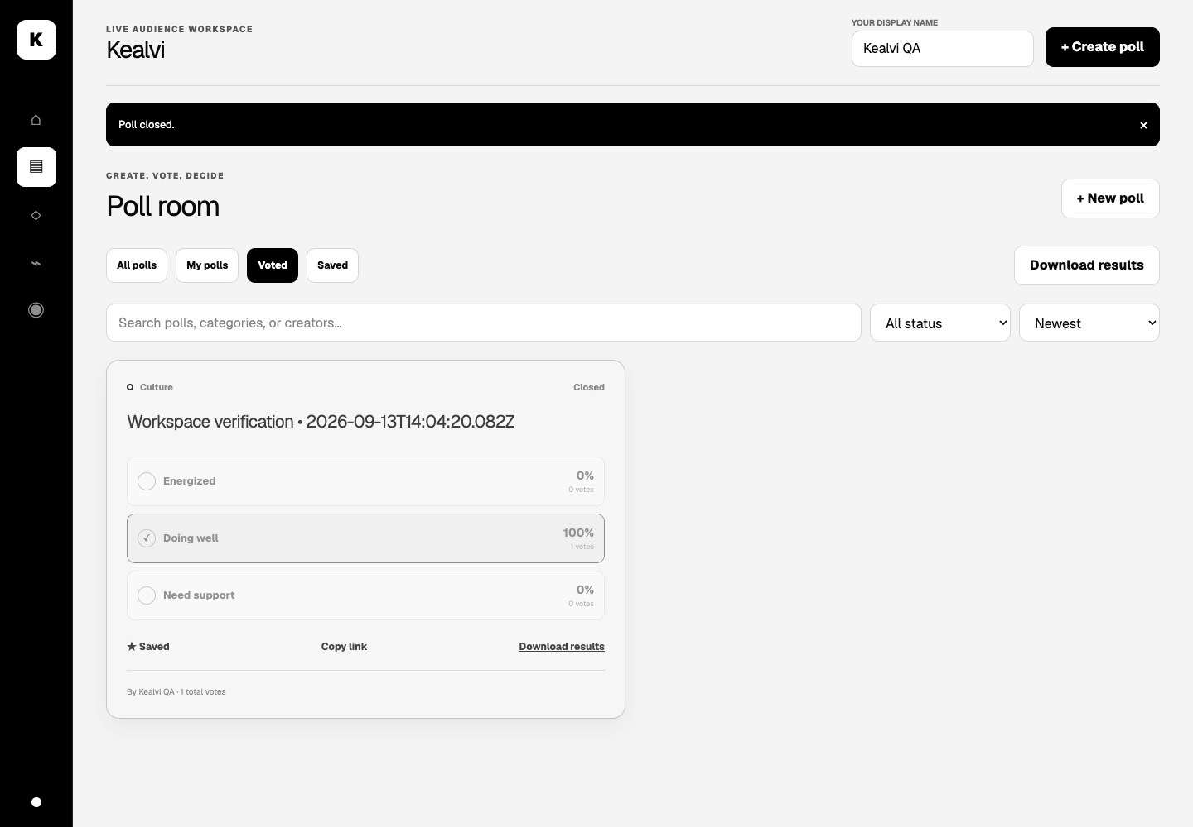
Closed poll results
Closing a poll disables voting while keeping the final result distribution available.
Kealvi / Product walkthrough
12
Notes:
Source: 2403717610421033 - Mrithyunjayan M.pptx, slide 10. Original supplied screenshot. Values describe the captured demonstration state.

Slide 13
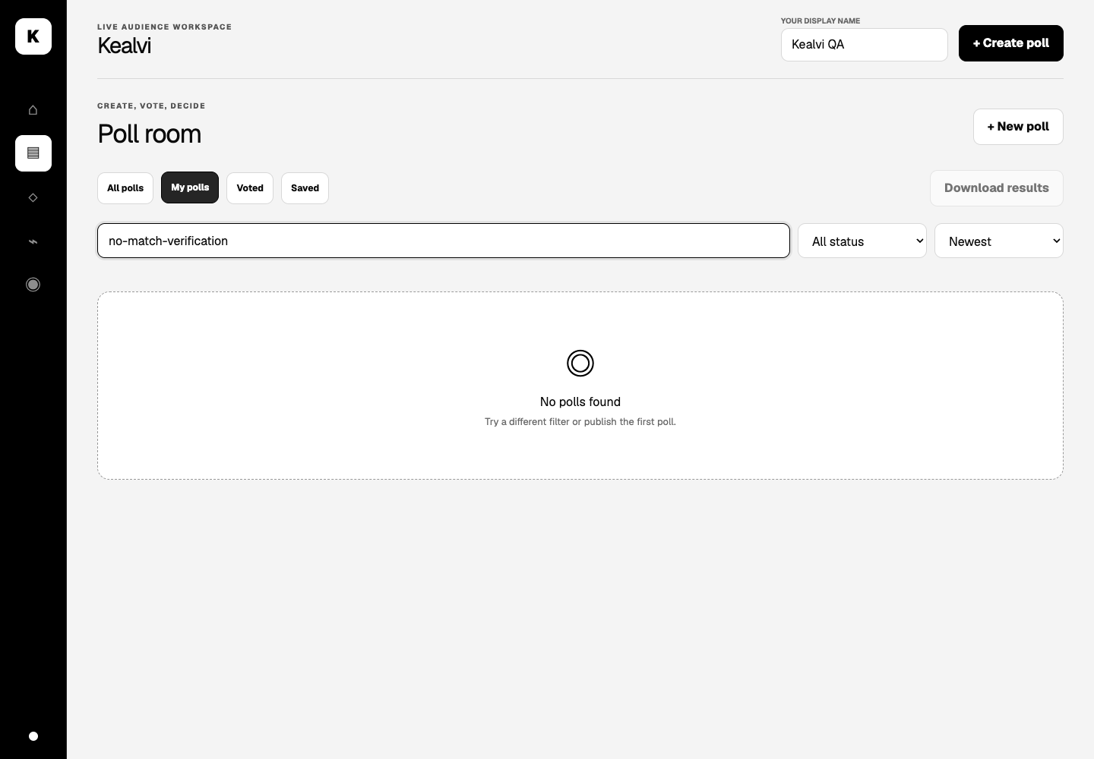
Search and empty states
When no poll matches, the interface explains the empty state and suggests a next step.
Kealvi / Product walkthrough
13
Notes:
Source: 2403717610421033 - Mrithyunjayan M.pptx, slide 10. Original supplied screenshot. Values describe the captured demonstration state.

Slide 14
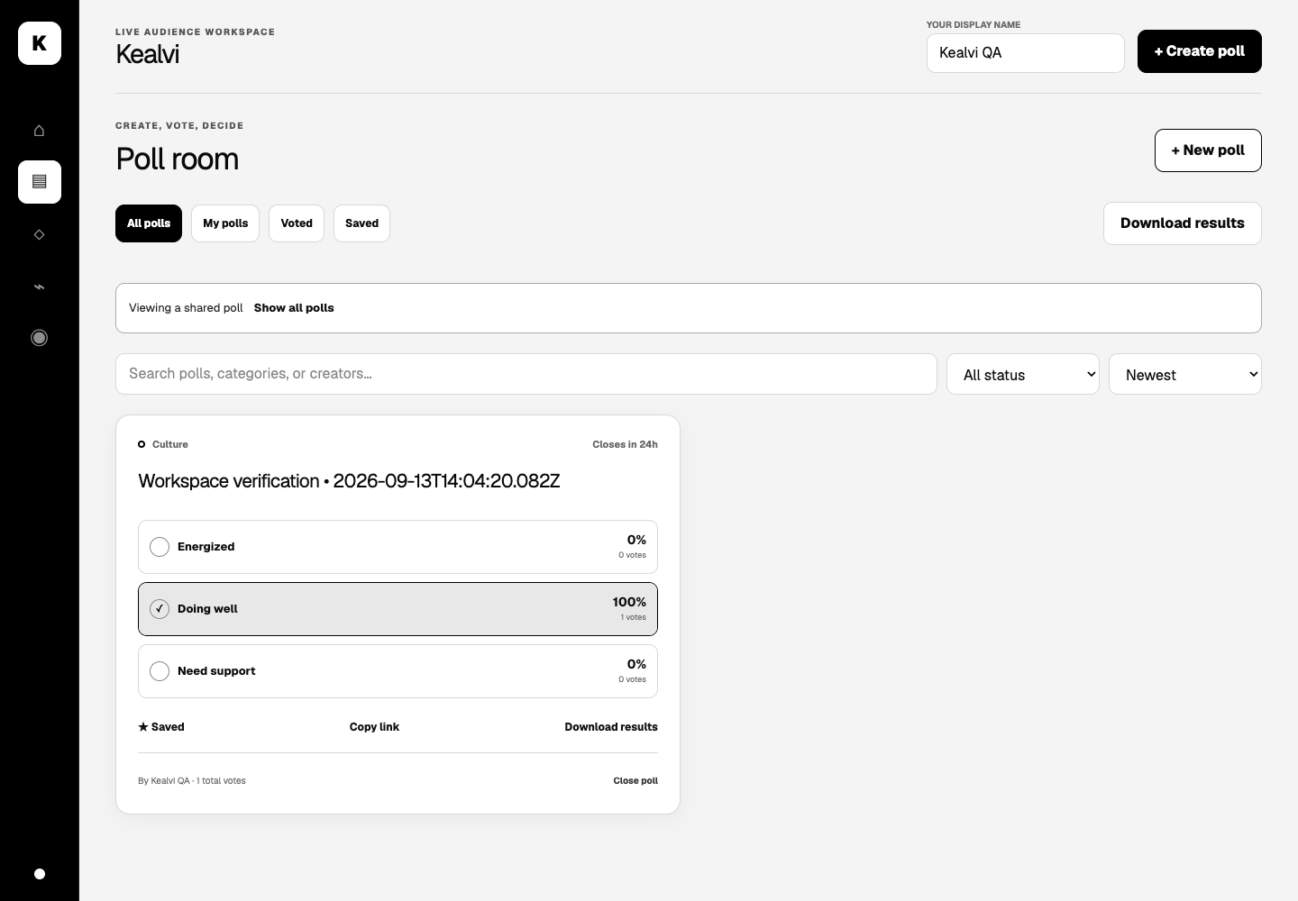
Shared poll view
A direct link focuses the workspace on one poll. Users can return to the full library.
Kealvi / Product walkthrough
14
Notes:
Source: 2403717610421033 - Mrithyunjayan M.pptx, slide 11. Original supplied screenshot. Values describe the captured demonstration state.

Slide 15
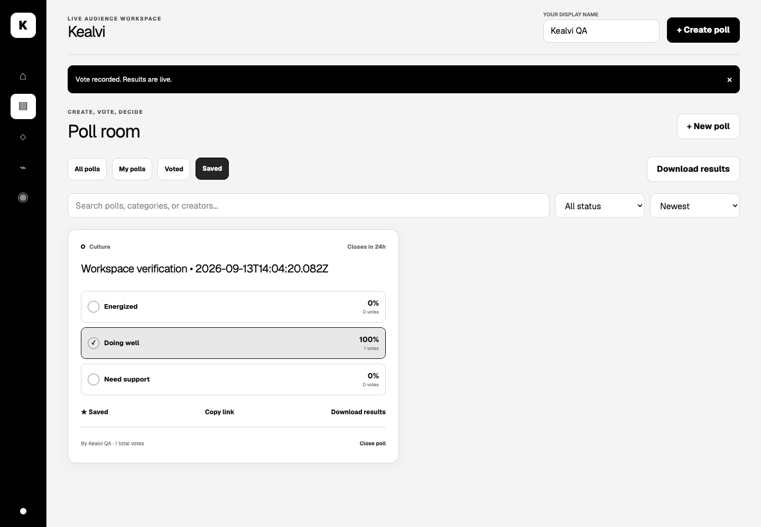
Saved polls
Bookmarks keep useful polls within reach and persist across reloads in the same browser.
Kealvi / Product walkthrough
15
Notes:
Source: 2403717610421033 - Mrithyunjayan M.pptx, slide 11. Original supplied screenshot. Values describe the captured demonstration state.

Slide 16
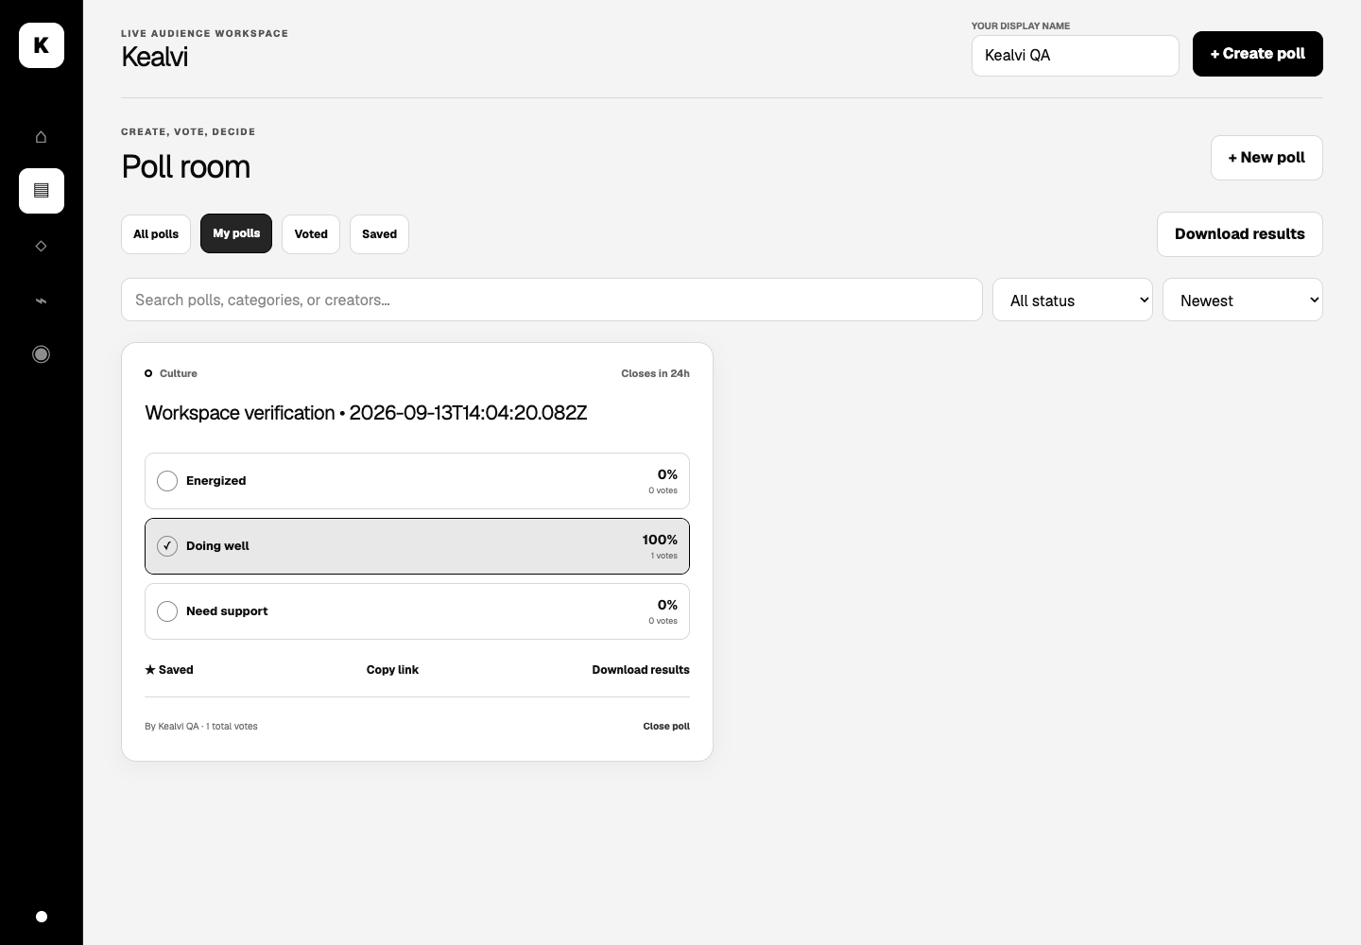
My polls
Creators can revisit polls made in their browser and manage their closing state.
Kealvi / Product walkthrough
16
Notes:
Source: 2403717610421033 - Mrithyunjayan M.pptx, slide 11. Original supplied screenshot. Values describe the captured demonstration state.

Slide 17
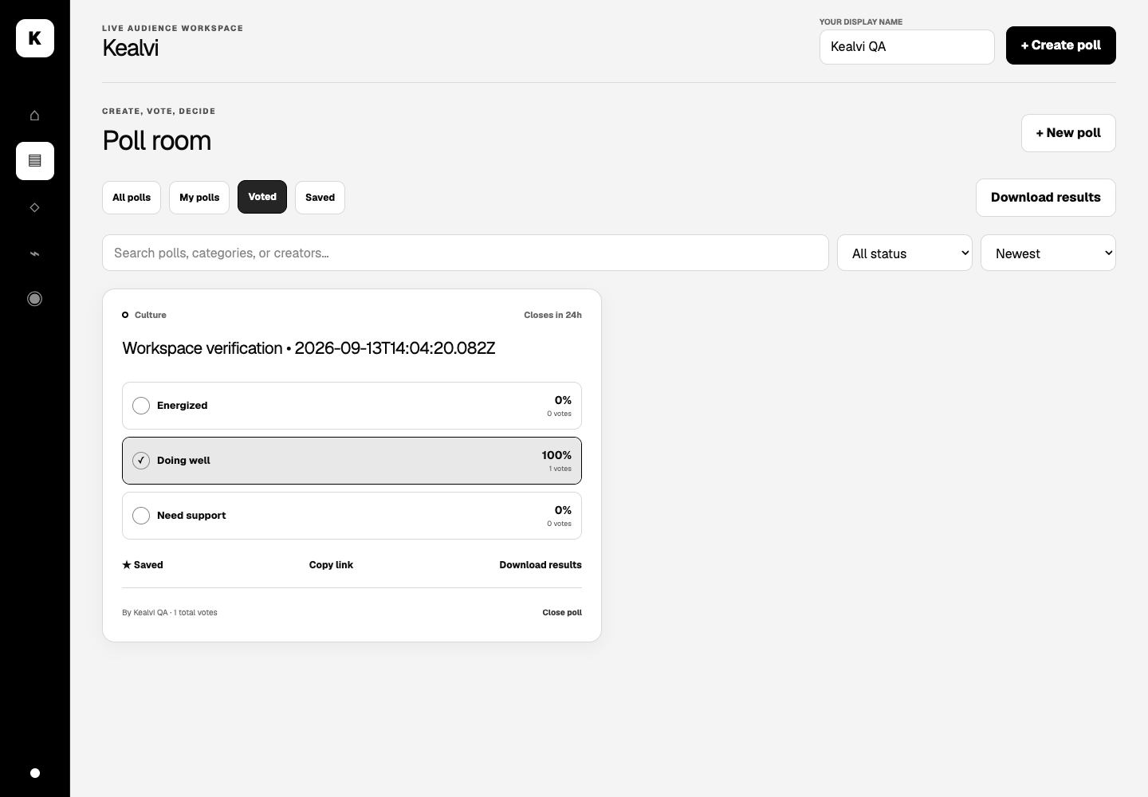
Voting history
The Voted collection provides a convenient way to revisit participated polls and their results.
Kealvi / Product walkthrough
17
Notes:
Source: 2403717610421033 - Mrithyunjayan M.pptx, slide 11. Original supplied screenshot. Values describe the captured demonstration state.

Slide 18
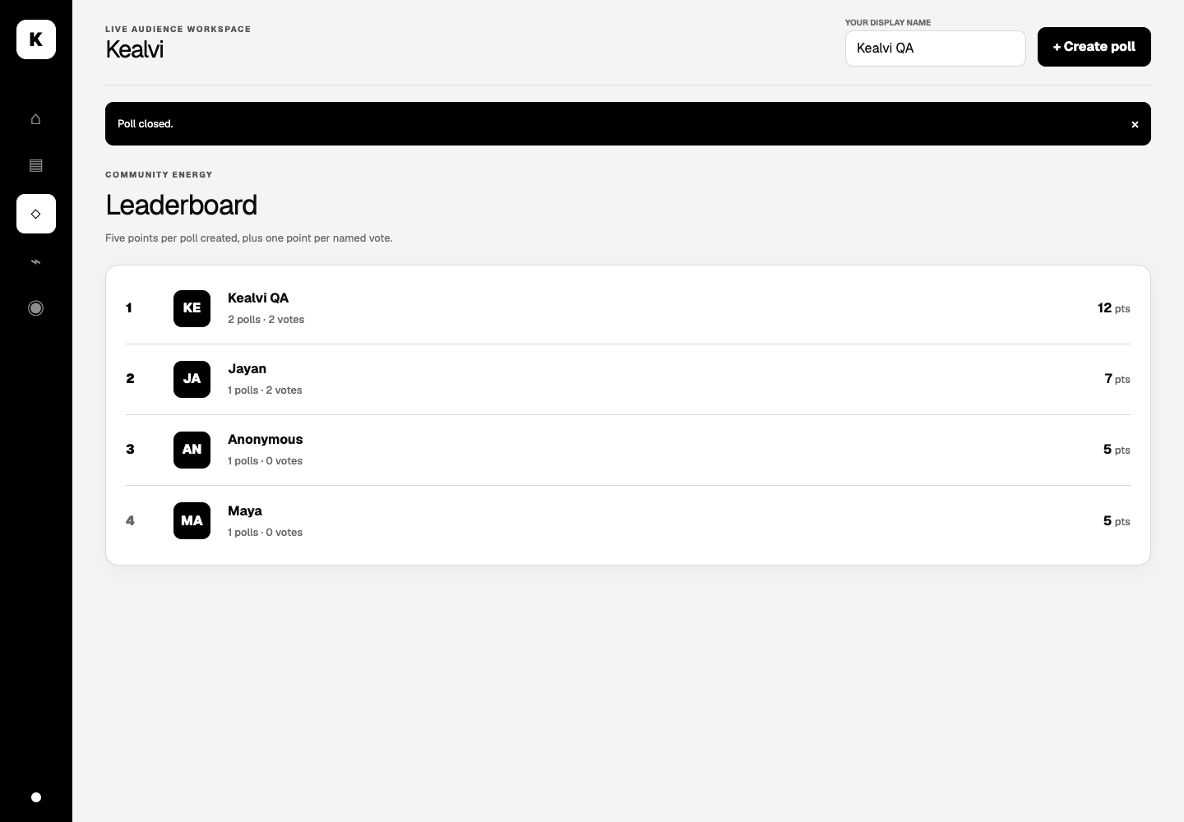
Contributor leaderboard
The leaderboard brings poll creation and named voting activity into one contributor view.
Kealvi / Product walkthrough
18
Notes:
Source: 2403717610421033 - Mrithyunjayan M.pptx, slide 12. Original supplied screenshot. Values describe the captured demonstration state.

Slide 19
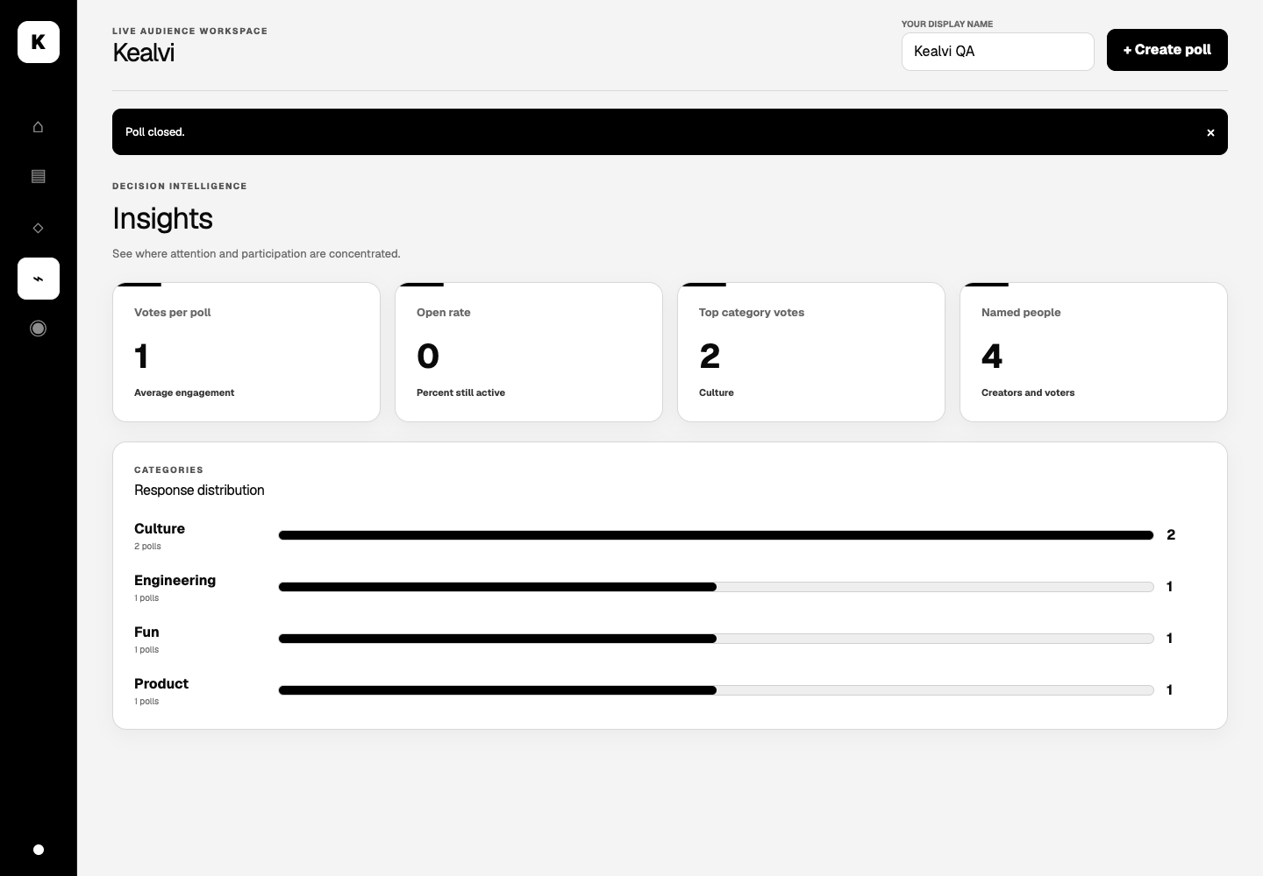
Participation insights
Engagement indicators and category summaries help users interpret participation.
Kealvi / Product walkthrough
19
Notes:
Source: 2403717610421033 - Mrithyunjayan M.pptx, slide 12. Original supplied screenshot. Values describe the captured demonstration state.

Slide 20
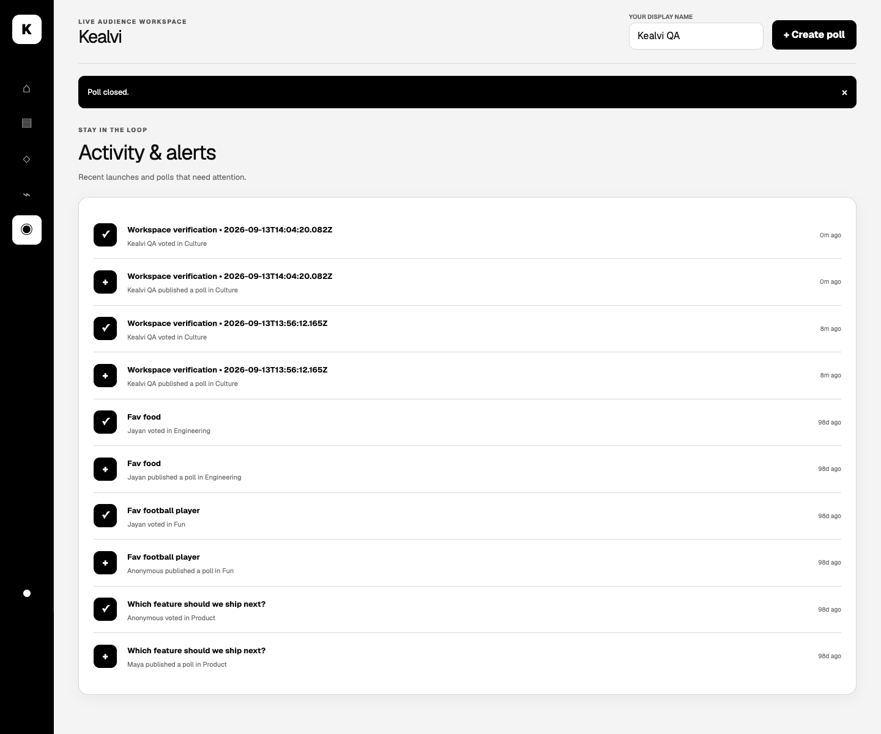
Activity feed
Recent poll launches and votes appear with context and relative time indicators.
Kealvi / Product walkthrough
20
Notes:
Source: 2403717610421033 - Mrithyunjayan M.pptx, slide 12. Original supplied screenshot. Values describe the captured demonstration state.

Slide 21
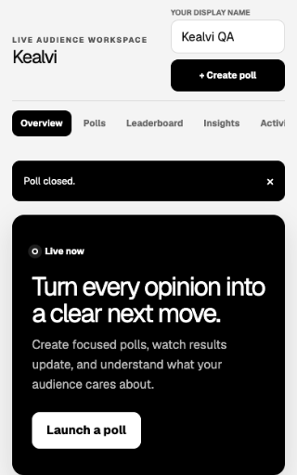
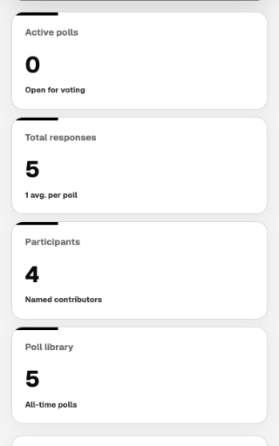
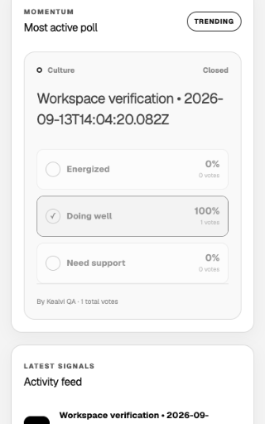
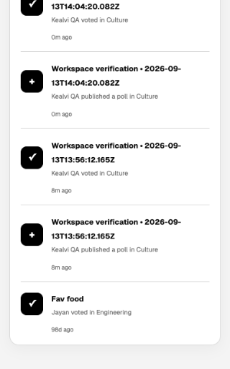
Mobile overview
Page continues from left to right
Kealvi / Responsive design
21
Notes:
Source: 2403717610421033 - Mrithyunjayan M.pptx, slide 13. Original full-page mobile screenshot, divided into consecutive sections for readability. No page content omitted.

Slide 22
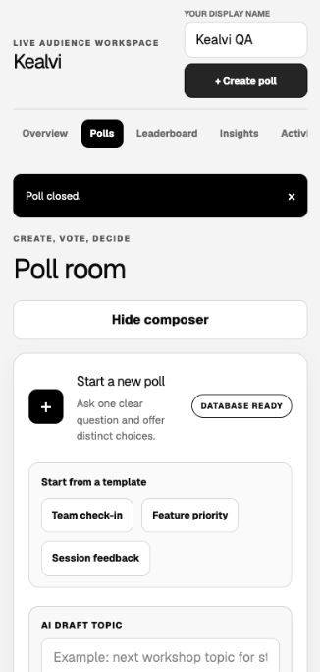
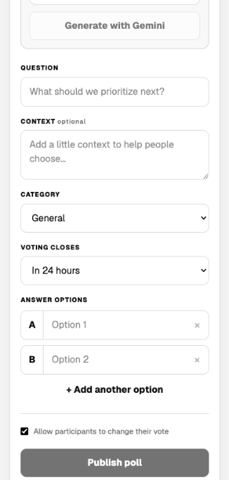
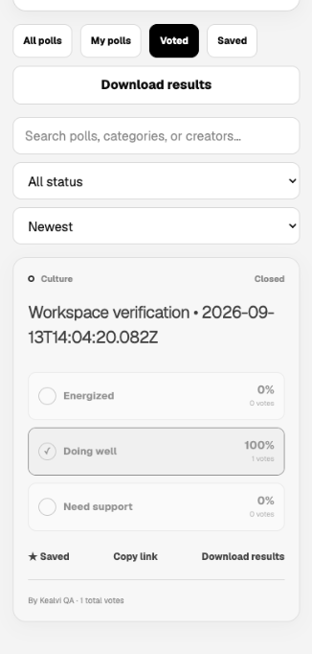
Mobile poll room
Page continues from left to right
Kealvi / Responsive design
22
Notes:
Source: 2403717610421033 - Mrithyunjayan M.pptx, slide 13. Original full-page mobile screenshot, divided into consecutive sections for readability. No page content omitted.

Slide 23
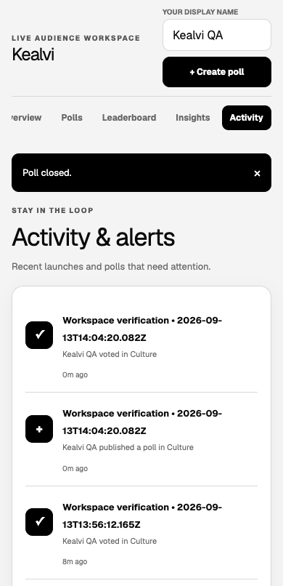
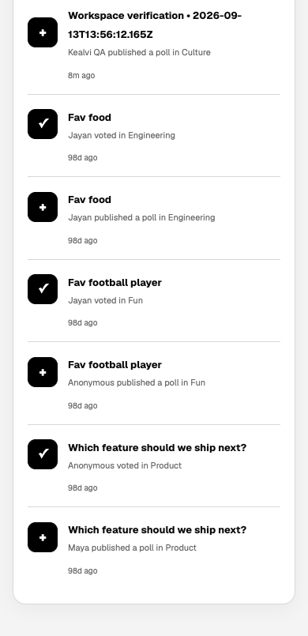
Mobile activity
Page continues from left to right
Kealvi / Responsive design
23
Notes:
Source: 2403717610421033 - Mrithyunjayan M.pptx, slide 13. Original full-page mobile screenshot, divided into consecutive sections for readability. No page content omitted.

Slide 24
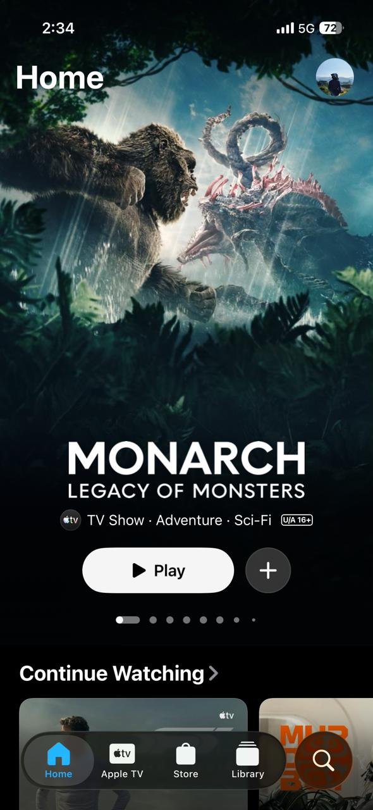
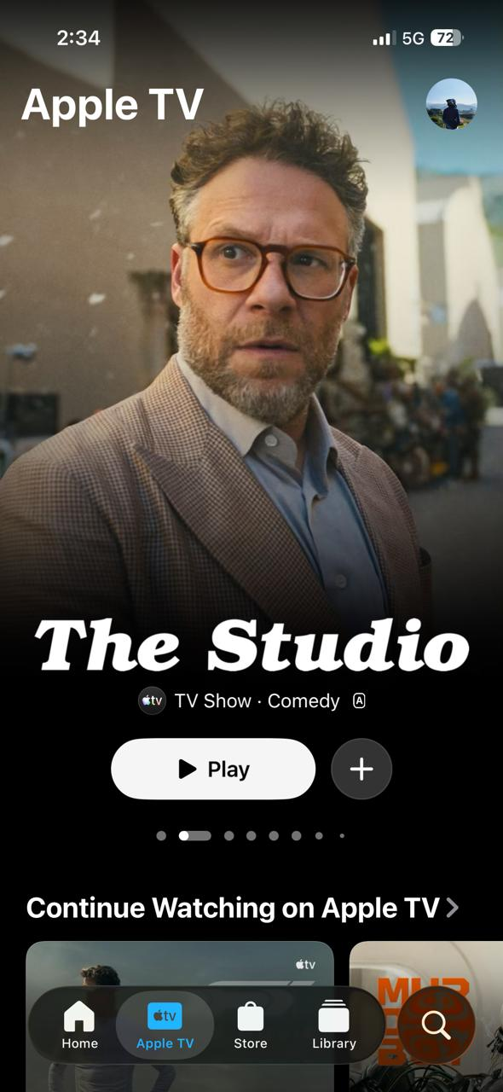
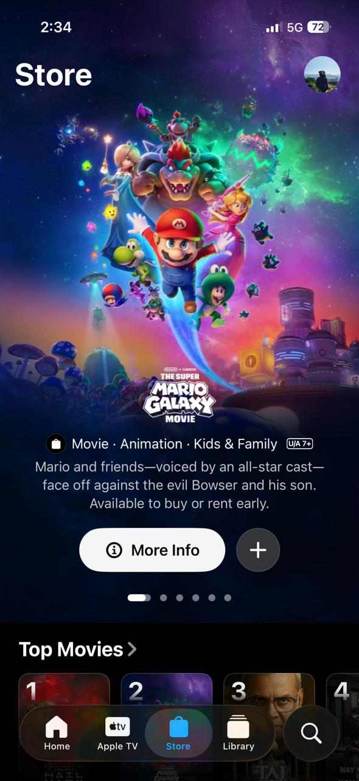
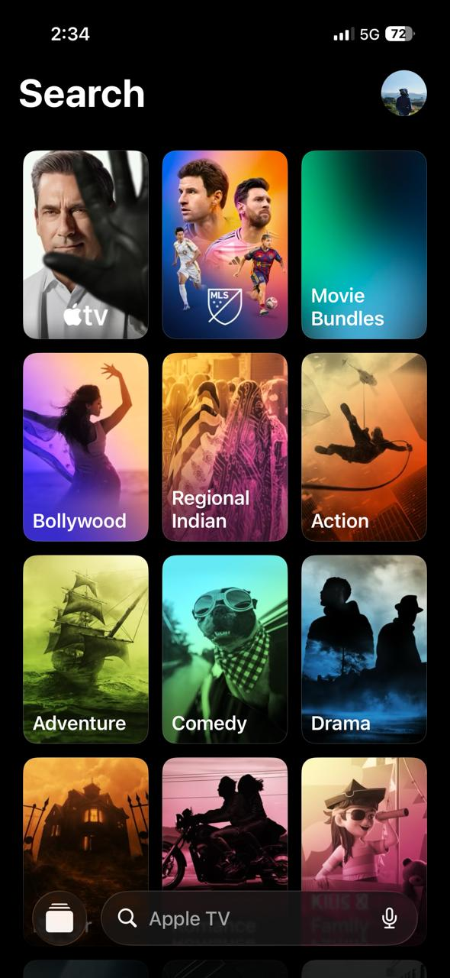
Apple TV: content discovery
Home
Apple TV+
Store
Search
Featured artwork introduces content. Play, save and persistent navigation support the next action.
Apple TV / Interface study
24
Notes:
Source: 2403717610421033 - Mrithyunjayan M.pptx, slide 14. Interface observations relate to the supplied captures, not a current product audit.

Slide 25
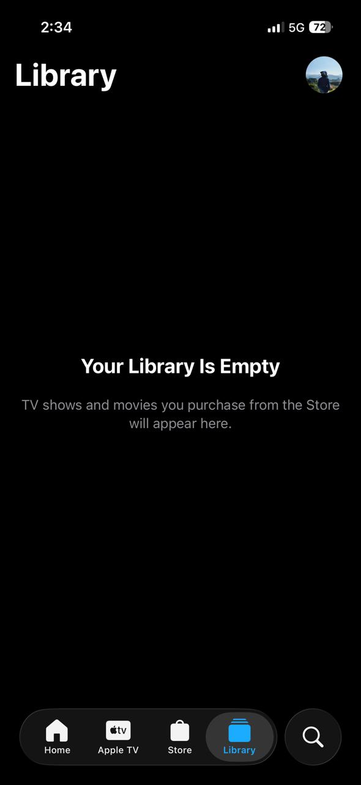
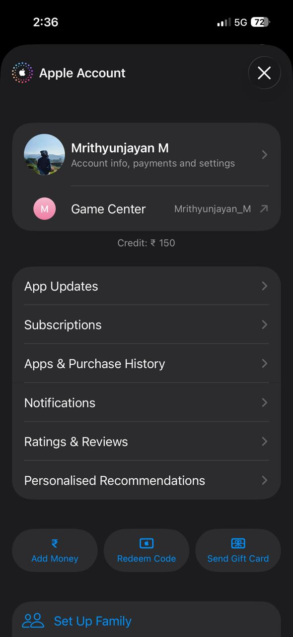
Apple TV: library and account
Library
A dedicated destination for purchased content and an explanatory empty state.
Account
Account settings group subscriptions, purchases and family-related controls.
Apple TV / Interface study
25
Notes:
Source: 2403717610421033 - Mrithyunjayan M.pptx, slide 15.

Slide 26
Apple TV: stakeholders and services
Stakeholders
Supporting services
Viewers and subscribers
Studios and content providers
Purchase and rental operations
Recommendation and analytics teams
Advertising and promotional partners
Support and account teams
Authentication, accounts and family sharing
Subscriptions, payments and purchases
Streaming and content delivery
Search, voice search and recommendations
Watchlists and library management
Notifications and usage analytics
Apple TV / Interface study
26
Notes:
Source: 2403717610421033 - Mrithyunjayan M.pptx, slide 15. Service categories from the supplied analysis, not verified internal Apple architecture.

Slide 27
Design lessons for Kealvi
Visible primary actions
Consistent navigation
Create poll remains easy to find, like prominent playback actions.
Stable destinations help users move between workspace views.
Saved content
Fast discovery
Saved polls and My polls provide familiar ways to return to content.
Search and filters reduce the effort of finding a relevant poll.
Immediate feedback
Personal context
Vote confirmation, closed states and empty states explain what happened.
Display names connect contributions with the activity feed and rankings.
Kealvi
27
Notes:
Source: 2403717610421033 - Mrithyunjayan M.pptx, slide 16.

Slide 28
Conclusion
Kealvi combines the complete polling workflow in one responsive workspace.
Practical full-stack integration
The interface connects poll creation and voting with Supabase persistence.
Clear participation feedback
Results, collections, insights and activity support review and follow-up.
Consistent interaction design
The Apple TV study informs primary actions, navigation and saved-content patterns.
Kealvi
28
Notes:
Source: 2403717610421033 - Mrithyunjayan M.pptx, slide 17. Optional Gemini drafting requires configuration.

Slide 29
Thank you
Questions & discussion
Mrithyunjayan M
Coimbatore Institute of Technology
29
Notes:
Source: 2403717610421033 - Mrithyunjayan M.pptx, slide 18.

