Slide 1



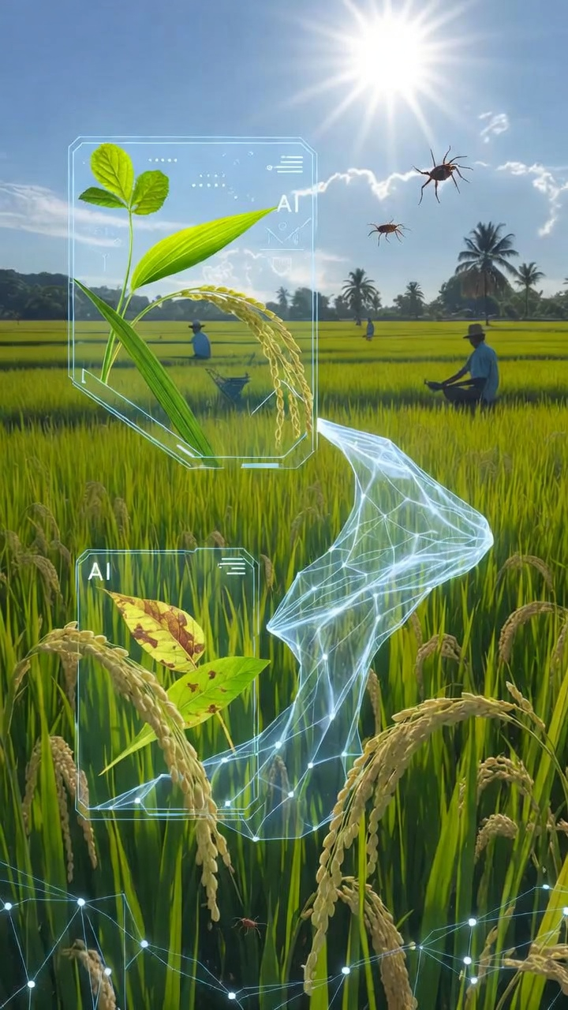
PaddyGuard AI: A Multimodal AI Based System for Rice Leaf Disease And Pest Detection, Treatment Recommendation And Knowledge Assistance
Project ID : R26-SE-015

Slide 2
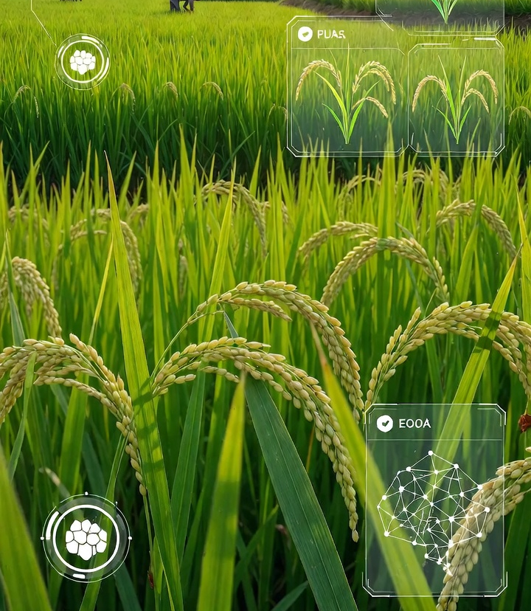
Introduction
Rice importance in Sri Lanka: feeds 21M people; 1.8M households rely on paddy farming.
Challenges: diseases like Bacterial Blight, Rice Blast, Brown Spot can destroy 30% - 80% of harvest; limited access to experts.
Existing tools limitations: mostly image-based, English-only, not farmer-friendly, require good cameras.
PaddyGuard AI solution:
Voice & image-based disease detection.
Treatment recommendations & pest identification.
Sinhala-compatible advisory chatbot.
Easy-to-use, mobile-friendly platform.
Impact: supports SDG 2 (Zero Hunger) and SDG 9 (Innovation & Infrastructure) by protecting crops and empowering farmers.

Slide 3
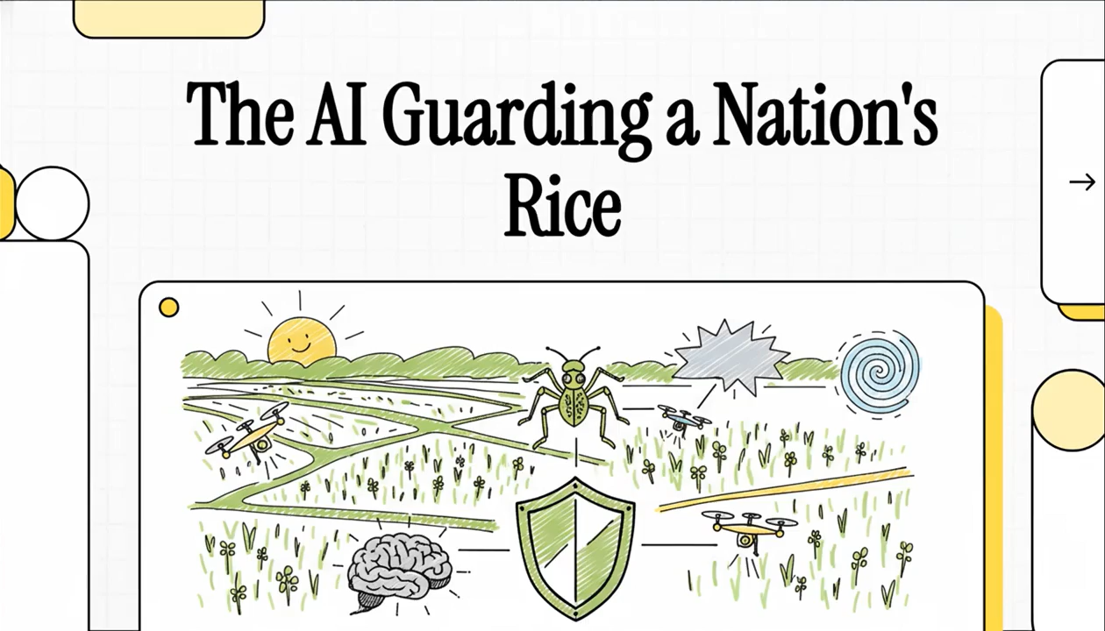
Problem Definition

Slide 4
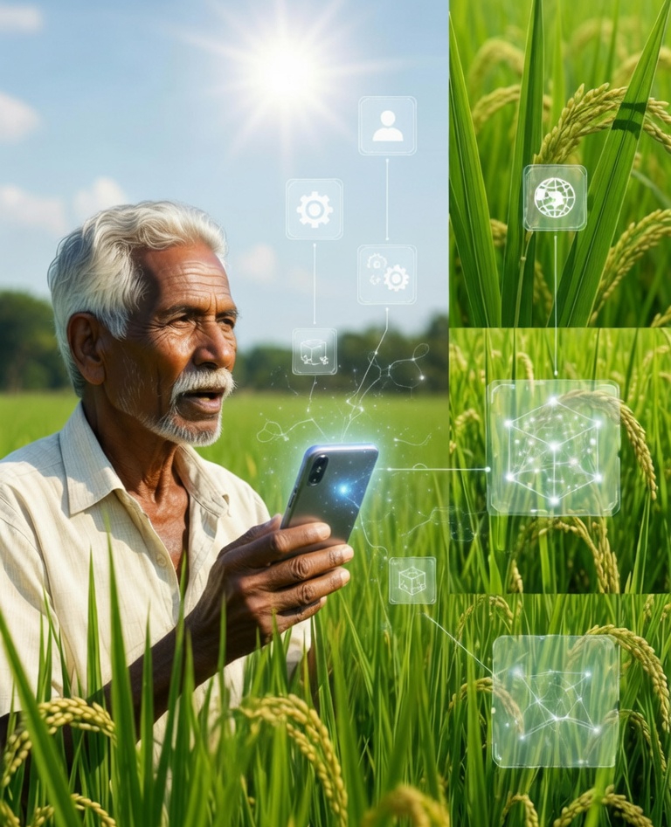
Problem
Late Disease Identification – Farmers rely on experience or delayed expert advice, causing wrong treatments and 30% - 80% crop losses.
English-Only Systems – Most tools support only English, making them difficult for Sinhala-speaking farmers.
Image Dependency – Existing tools require clear leaf photos, but many farmers lack smartphones with good cameras.
Fragmented Solutions – No single platform integrates disease detection, pest identification, and treatment advice.

Slide 5
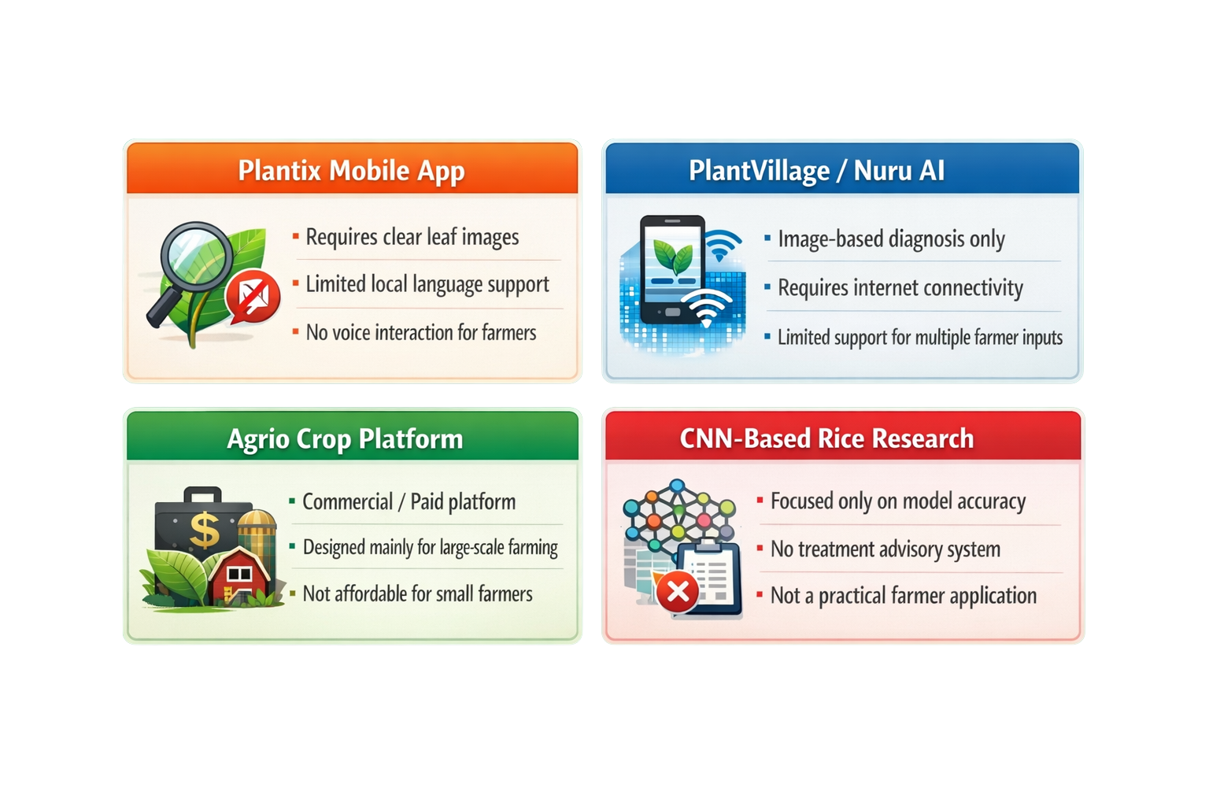
Limitations of Existing Agricultural AI Systems

Slide 6
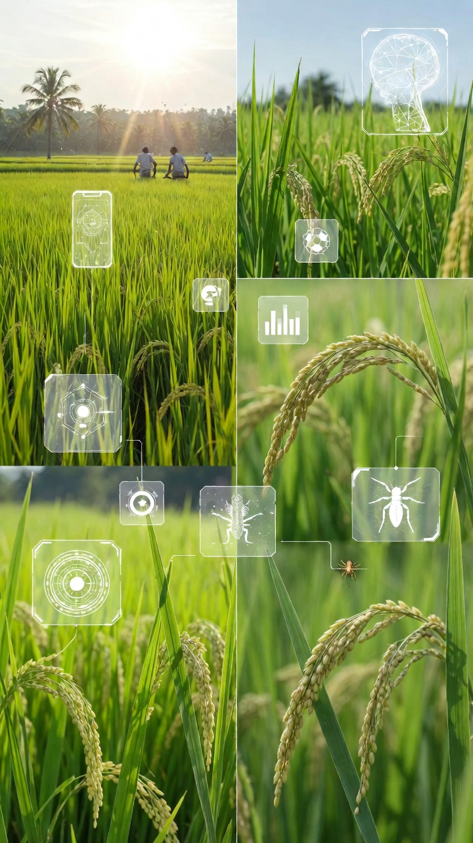
Our Approach
Voice-Based Disease Diagnosis
Farmers describe crop symptoms in Sinhala voice. The system converts speech to text, analyzes symptoms using NLP models, and provides voice and text diagnosis.
Image-Based Disease Classification
Farmers upload leaf images. Deep learning models detect diseases such as Bacterial Blight, Rice Blast, and Brown Spot, with OOD detection to avoid incorrect predictions.
Treatment Advisory Chatbot
A hybrid AI + knowledge-based system provides treatment recommendations, pesticide dosage guidance, and farmer-friendly advisory through a chatbot.
Rice Pest Detection
YOLO/CNN models identify common rice pests from images, with OOD detection to flag unknown insects and provide proper treatment advice.

Slide 7
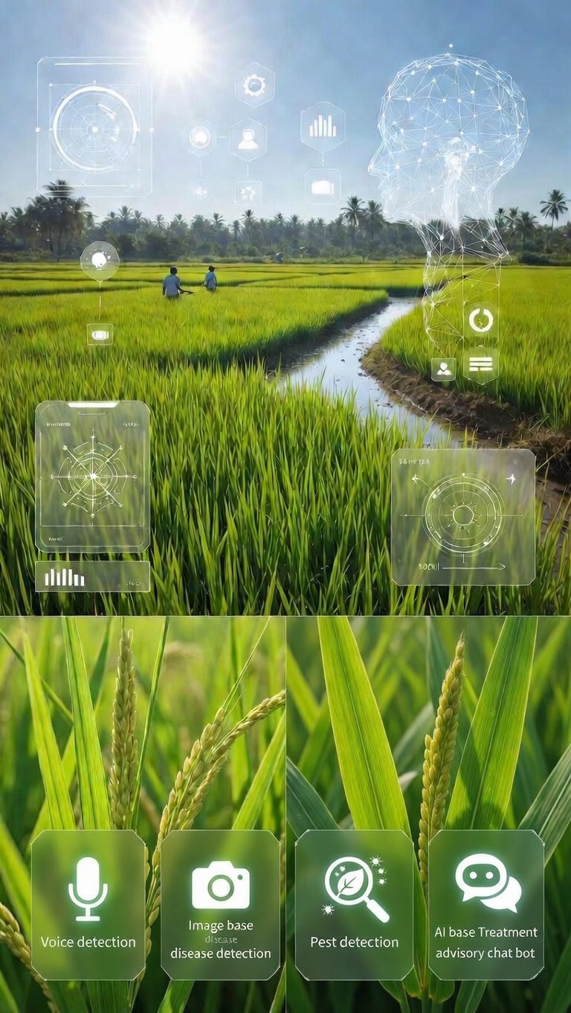
Solution Overview
What It Is?
PaddyGuard AI is a mobile-friendly AI system for Sri Lankan paddy farmers.
Combines voice diagnosis, image disease detection, pest detection, and treatment advisory.
Designed with Sinhala voice-first support for easy use by rural farmers.
What It Does?
Voice-based disease diagnosis using Sinhala speech.
AI image detection for rice diseases and pests.
Provides treatment advice and pesticide guidance.
Results delivered in Sinhala text and voice.

Slide 8


Voice-Based Rice Disease Diagnosis Using Speech Recognition And Natural Language Processing
IT22273680 | Weerasinghe K G J P
Contribution of your component to the overall solution
Enables Sinhala-speaking paddy farmers to voice-diagnose rice diseases without cameras or technical expertise.
Novelty of your component
First Sinhala-language voice-based rice disease diagnosis using Whisper ASR + BERT/TF-IDF classification with adaptive follow-up questioning.
IT22273680 | Weerasinghe K G J P | R26-SE-015

Slide 9
Voice-Based Rice Disease Diagnosis using Speech Recognition and Natural Language Processing
Problem And Research Objectives.
Problem Definition
Research Objectives.
Existing AI crop disease systems rely on leaf photographs.
Requires smartphones with good-quality cameras.
Rural Sri Lankan farmers often lack such devices.
Most agricultural AI systems support only English.
Creates a significant barrier for Sinhala-speaking farmers.
Farmers cannot easily describe symptoms or understand results
Develop a Sinhala voice-based NLP disease classification system for low-literacy Sri Lankan paddy farmers achieving ≥85% accuracy.
Create a Sinhala agricultural voice dataset.
Design and implement a speech-to-text and NLP pipeline .
Evaluate and compare different text classification models.
Build integration API to sister components. (C2, C3, C4)
Result: Farmers struggle to get quick, accurate disease diagnosis — leading to delayed treatment and crop losses.
IT22273680 | Weerasinghe K G J P | R26-SE-015

Slide 10
Voice-Based Rice Disease Diagnosis using Speech Recognition and Natural Language Processing
Methodology
Methodology
Latest Technologies
Speech Recognition converts Sinhala voice input from farmers into text.
Natural Language Processing (NLP) processes symptom descriptions and extracts important information.
Text classification models analyze the symptoms to predict the most likely rice disease.
The system learns relationships between symptoms and diseases using machine learning and transformer-based models.
The final diagnosis is returned to the farmer using text and voice output.
Whisper Speech Recognition – converts farmer voice into text.
TF-IDF + Machine Learning (SVM / Naive Bayes) – baseline text classification.
BERT Transformer Model – advanced contextual understanding of symptom descriptions.
PyTorch & HuggingFace Transformers – model development and training.
Text-to-Speech (TTS) – converts diagnosis results into Sinhala voice output.
IT22273680 | Weerasinghe K G J P | R26-SE-015

Slide 11
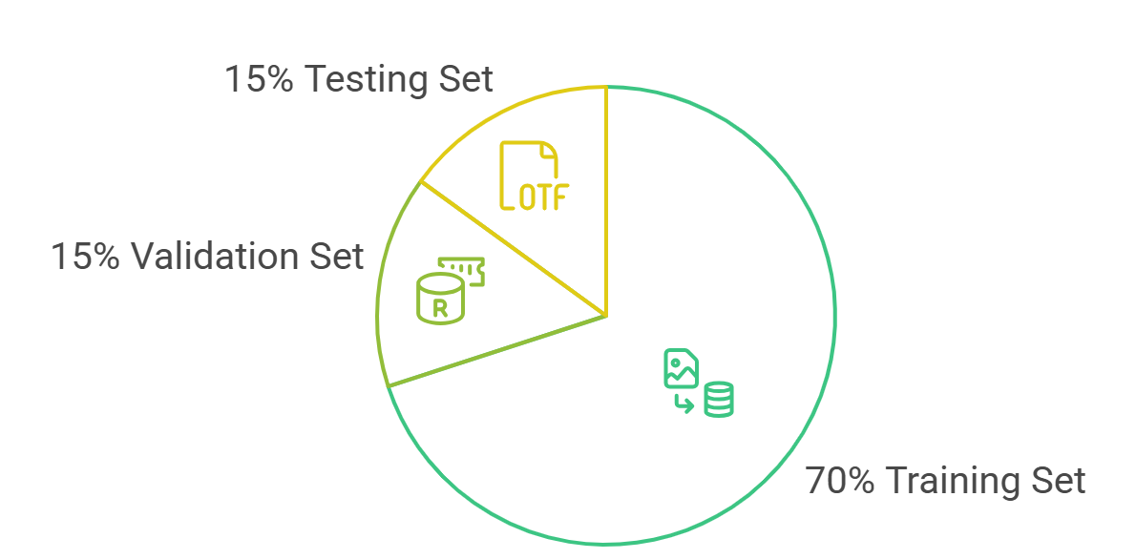
Voice-Based Rice Disease Diagnosis using Speech Recognition and Natural Language Processing
Validation And Data Availability
Validation and Evaluation
Data Availability, Security Clearance
Sinhala agricultural voice dataset will be collected from farmers and volunteers.
Data will be stored securely with restricted research access.
All API communications secured via HTTPS / TLS 1.3
Conducted under SLIIT Research Ethics Committee guidelines.
Participant privacy protected throughout data collection.
Containerized microservices — Docker + Kubernetes horizontal scaling.
Performance evaluated using accuracy, precision, recall, and F1-score.
Compare performance between traditional ML models and transformer-based models.
Conduct real voice input testing with farmers to evaluate system usability and prediction reliability.
IT22273680 | Weerasinghe K G J P | R26-SE-015

Slide 12
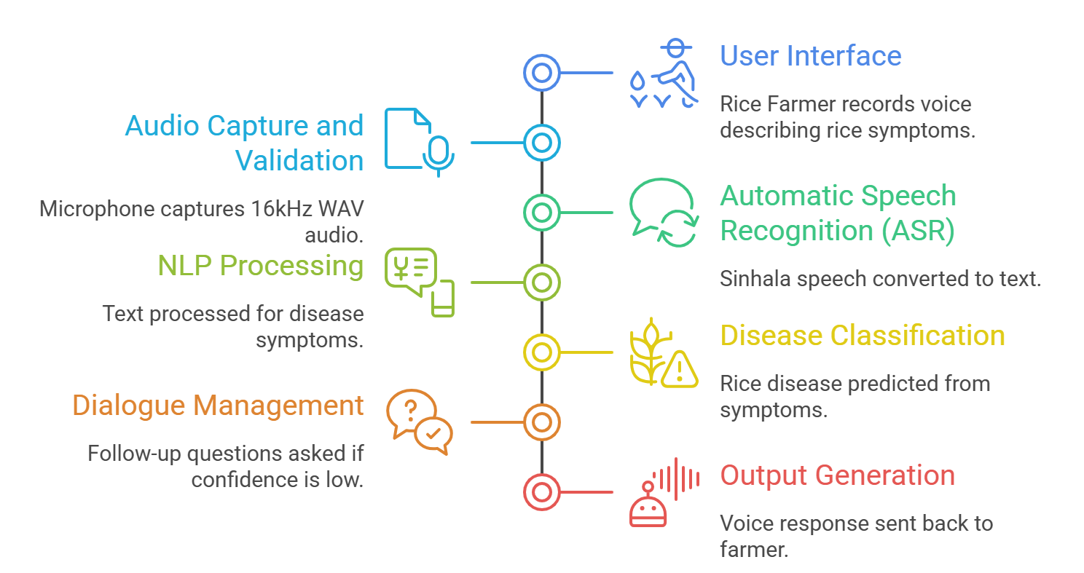
Voice-Based Rice Disease Diagnosis using Speech Recognition and Natural Language Processing
System Overview And Dependencies
The predicted disease output from voice component used by the treatment recommendation component to provide advice to farmers.
Common web User Interface (Web Application)
Shared agricultural datasets used for model training.
Shared backend APIs for communication between components.
Common data storage for symptoms, predictions, and farmer interactions.
Dependencies
Common Components
IT22273680 | Weerasinghe K G J P | R26-SE-015

Slide 13

Rice Leaf Disease Classification with Out-of-Distribution Detection
Hewanayake H.M.L.M | IT22168740
Contribution to Overall Solution
Classifies rice leaf diseases from images, filters out invalid inputs, and explains predictions visually.
Novelty
Integrated OOD detection (ODIN, Mahalanobis, OpenMax) — rejects non-rice/unknown images.
Grad-CAM visual explanations highlighting disease lesion regions.
Multi-architecture CNN comparison: ResNet50, EfficientNetB3, DenseNet121.
IT22168740 | Hewanayake H M L M | R26-SE-015
IT22168740 | Hewanayake H M L M | R26-SE-015

Slide 14
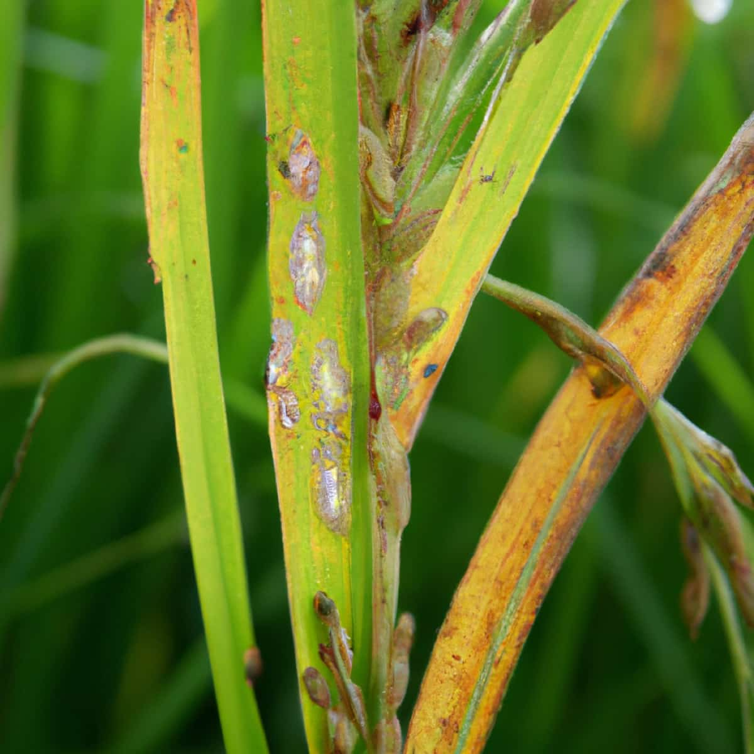
Rice Leaf Disease Classification with Out-of-Distribution Detection
Problem Definition & Research Objective
Problem Definition
AI tools sometimes give wrong predictions for non-disease images.
Wrong diagnosis → wrong pesticide use.
Wastes money and harms the environment.
Current tools lack image validation and clear explanations.
Sri Lankan farmers need a reliable and understandable AI assistant.
Rice Leaf Disease — Field Sample
Research Objectives
Main Objective: Build and test an AI model that correctly identifies rice leaf diseases (Bacterial Blight, Leaf Blast, Brown Spot, or Healthy) — and knows when to say "I don't recognize this image." Target: 92%+ accuracy, 85%+ rejection of invalid inputs.
Sub-objectives:
Compare three methods for detecting unknown/invalid images. (ODIN, Mahalanobis, OpenMax)
Show farmers where on the leaf the AI spotted the disease. (Grad-CAM heatmaps)
IT22168740 | Hewanayake H M L M | R26-SE-015
IT22168740 | Hewanayake H M L M | R26-SE-015

Slide 15
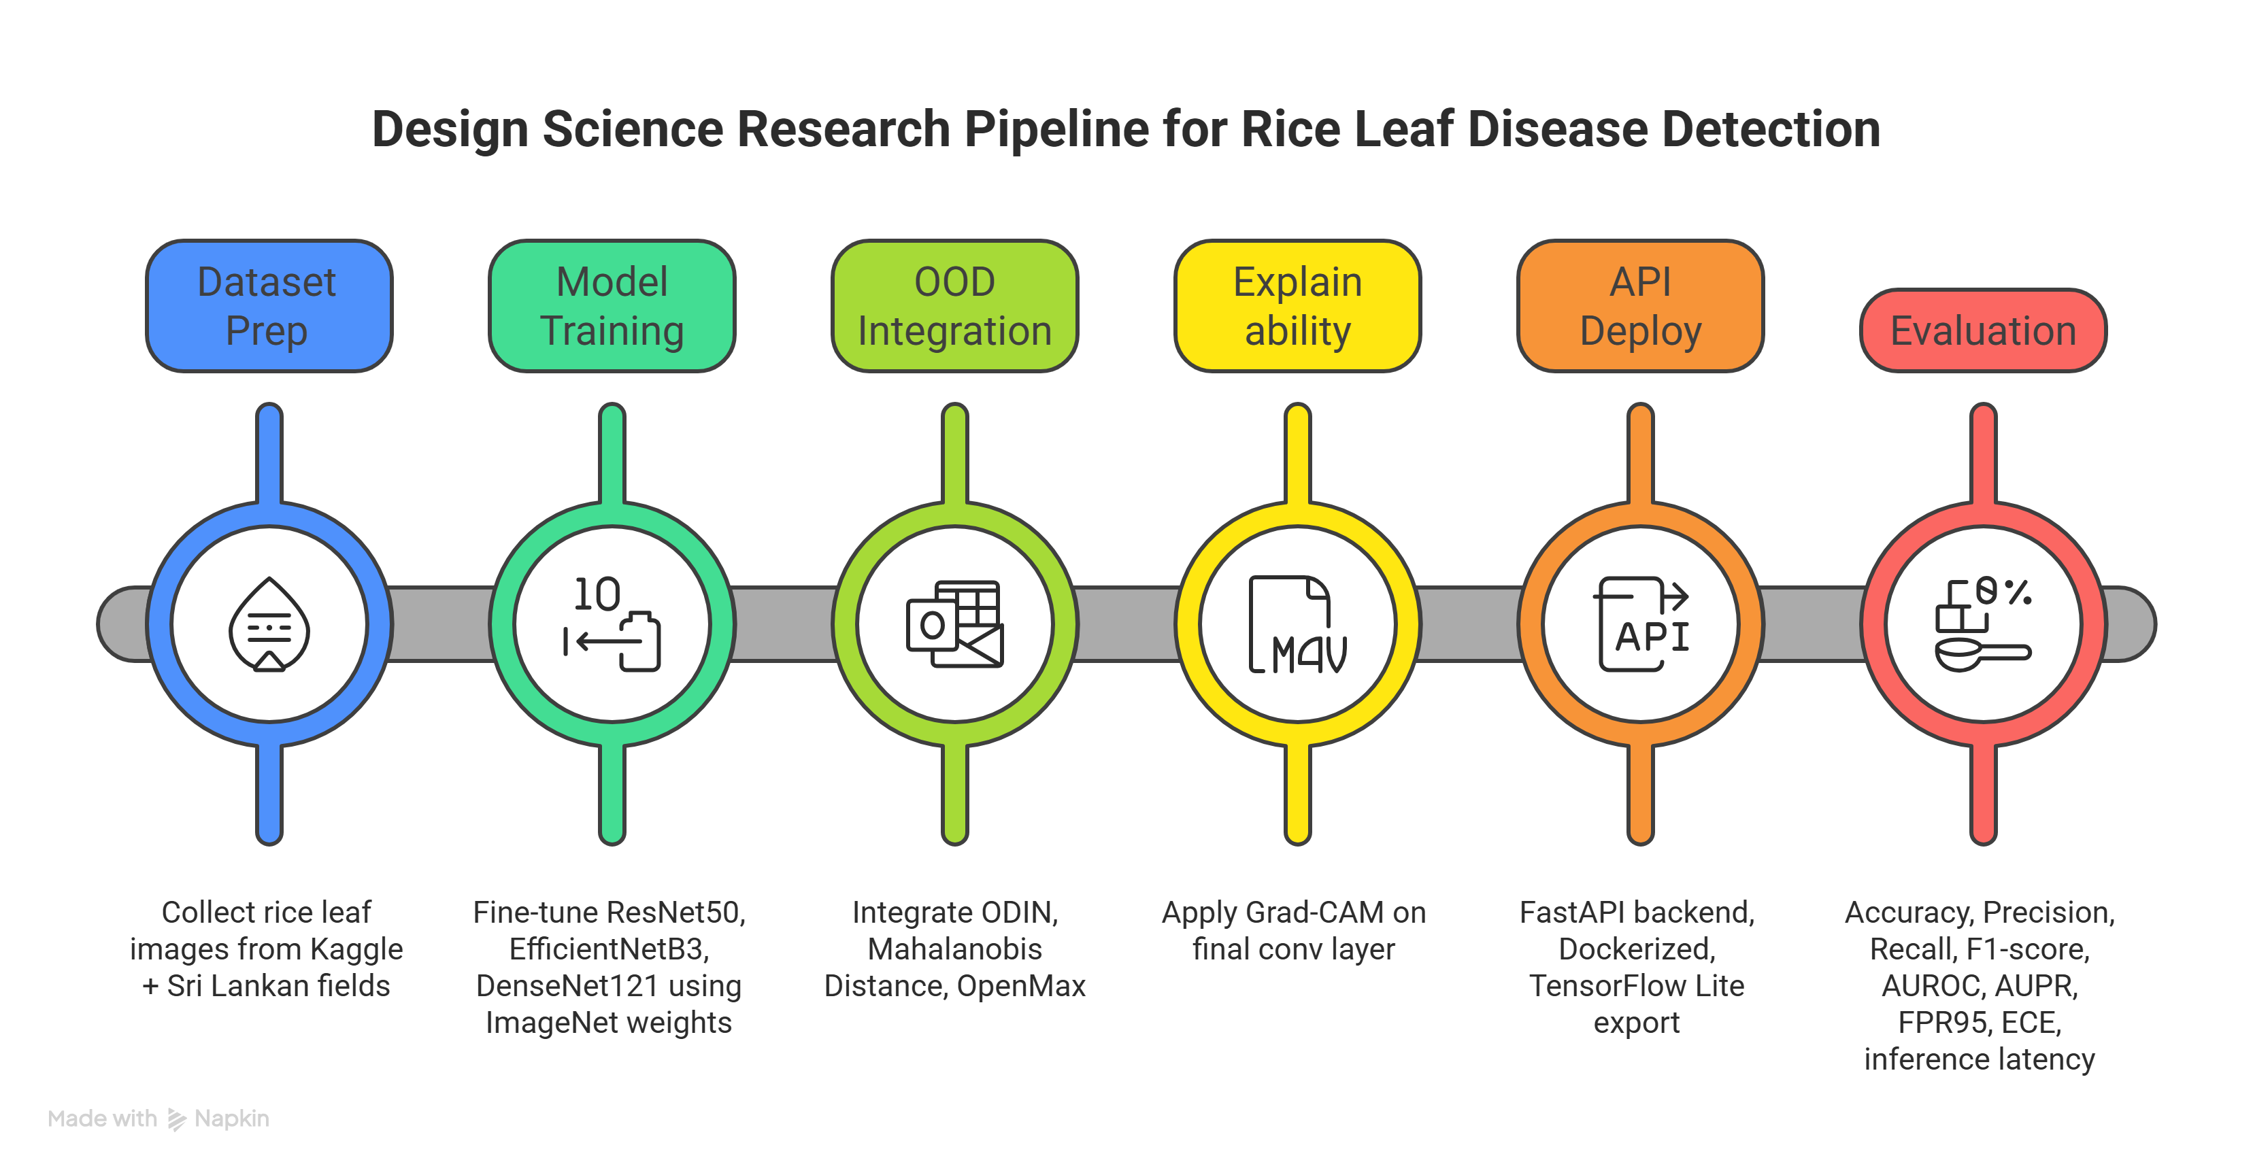
Rice Leaf Disease Classification with Out-of-Distribution Detection
Methodology & Latest Technologies
Research Methodology:
DSR — Build → Test → Refine (6 Phases)
Dataset Preparation — Collect & clean rice leaf images
Model Training — Train 3 CNN models
OOD Integration — Add rejection capability
Explainability — Add Grad-CAM heatmaps
API Deploy — Package & deploy to mobile
Evaluation — Measure accuracy & performance
Latest Technologies:
Disease Detection (CNN)
ResNet50, EfficientNetB3, DenseNet121
Transfer Learning from ImageNet
Unknown Image Rejection (OOD)
ODIN, Mahalanobis Distance, OpenMax
No retraining needed
Explainability
Grad-CAM — shows where disease is on the leaf
Deployment Stack
FastAPI + Docker + TensorFlow Lite (mobile)
React.js frontend + MongoDB + TLS 1.3 security
IT22168740 | Hewanayake H M L M | R26-SE-015
IT22168740 | Hewanayake H M L M | R26-SE-015
IT22168740 | Hewanayake H M L M | R26-SE-015
2

Slide 16
Rice Leaf Disease Classification with Out-of-Distribution Detection
Methodology & Latest Technologies
APPLICATION OF DOMAIN KNOWLEDGE — Continued
Validation & Evaluation
Data, Security & Ethical Clearance
Data Availability
Disease Classification — target above 92%
Unknown Image Rejection— target above 85%
Grad-CAM heatmaps validated by an agricultural domain expert to confirm disease region accuracy
Inference latency benchmarked below 500ms for real-world mobile deployment
Primary: PlantVillage, Kaggle rice disease datasets. (public domain)
Secondary: Locally collected Sri Lankan field images (farmer consent. obtained)
OOD probe set: non-rice plants, insects, soil backgrounds, unseen diseases.
Security
TLS 1.3 encryption for all client-server communication.
Images not permanently stored without explicit user consent.
Ethical Clearance
No personally identifiable information (PII) collected in image dataset.
Compliant with Sri Lanka Personal Data Protection Act. (PDPA)
Approved by SLIIT Faculty Research Ethics Committee.
IT22168740 | Hewanayake H M L M | R26-SE-015
IT22168740 | Hewanayake H M L M | R26-SE-015

Slide 17
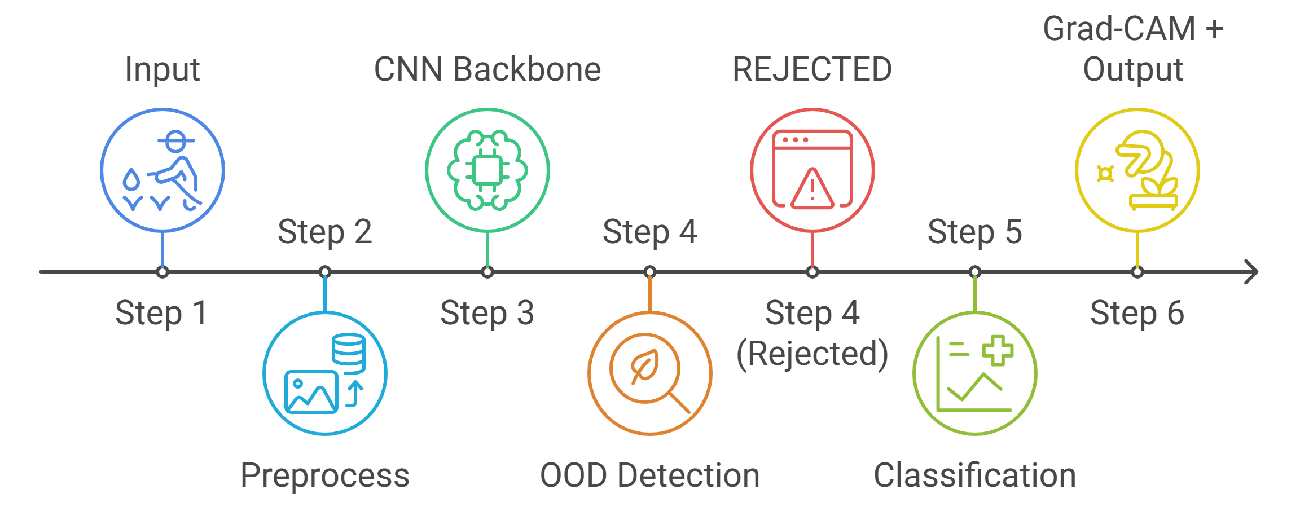
Rice Leaf Disease Classification with Out-of-Distribution Detection
System Overview & Dependencies
System Overview of the Individual Component
Dependencies and Common Components
Component 1 — Voice Diagnosis
Component 1 and my component share the same backend server and database.
Component 3 — Treatment Chatbot
my component identifies the disease, it sends the result directly to Component 3, which then gives the farmer the treatment advice.“
Component 4 — Pest Detection
Component 4 and my component use the same mobile app screen and the same image upload button so the farmer only learns one interface.
IT22168740 | Hewanayake H M L M | R26-SE-015
IT22168740 | Hewanayake H M L M | R26-SE-015

Slide 18

A Multimodal AI System for
Rice Pest Detection
With Out-of-Distribution Detection
IT22065858 | KALHARA E P K
IT22065858 | E P K KALHARA
Contribution of component to the overall solution
Automatic detection of rice pests from images, helping farmers identify pest infestations early.
Novelty of component
Integration of deep learning–based pest detection with Out-of-Distribution (OOD) detection to identify. unknown insects and Combination of CNN and YOLO detection models for improved pest recognition accuracy.
Department of Information Technology | Sri Lanka Institute of Information Technology
IT22065858 | KALHARA E P K | R26-SE-015

Slide 19
Problem Definition & Research Objective
Problem Definition
Research Objectives
Rice pests destroy up to 40% of harvest if unmanaged.
Small farmers don’t have access to agricultural experts.
Misidentification leads to wrong pesticide use.
Causes economic loss & environmental damage.
Existing AI apps give wrong answers for unknown insects.
Main Objective:
Develop a deep learning–based system to detect rice pests from images accurately
Collect and prepare a rice pest image dataset for model training.
Train and evaluate CNN and YOLO models for pest detection.
Integrate Out-of-Distribution (OOD) detection to identify unknown insects.
Evaluate model performance using accuracy, precision, recall.
Target Pests: Brown Planthopper • Stem Borer • Leaf Folder • Rice Hispa • Gall Midge
IT22065858 | KALHARA E P K | R26-SE-015

Slide 20
Methodology & Latest Technologies
Methodology
Latest Technologies :
Use Deep Learning and Computer Vision techniques for pest image analysis.
Train and compare CNN models for pest classification.
Apply image preprocessing and data augmentation to improve robustness.
Integrate Out-of-Distribution (OOD) detection to identify unknown insects.
Disease Detection (CNN) Models
ResNet50, EfficientNetB0, MobileNetV2
Object Detection
YOLO v8 for small insects in field images
Data Augmentation
Rotation, flipping, brightness adjustment
Unknown image detection (OOD Detection)
ODIN / Mahalanobis / OpenMax
Dataset Preparation -> Model Training -> OOD Intergration -> explainability -> API Deploy -> evaluation
Tools
Python / PyTorch / Docker / Google Colab GPU/mongoDB
IT22065858 | KALHARA E P K | R26-SE-015

Slide 21
Data Collection & Security, Ethical Considerations
DATASET COLLECTION
Data Security
Image data processed securely within the PaddyGuard AI system using protected cloud environments and secure API communication (HTTPS).
Ethical Considerations
Only publicly available datasets are used with proper acknowledgment, and no personal or sensitive user data is collected.
DATASET COLLECTION
IP102 – Large Scale Insect Pest Dataset (GitHub)
Kaggle Agricultural Image Repositories
Local Sri Lankan Paddy Field Images
Dataset Split:
70%
Training
15%
Validation
15%
Testing
IT22065858 | KALHARA E P K | R26-SE-015

Slide 22
System Overview & Dependencies
System Overview
Dependencies
1
Farmer uploads pest image JPEG/PNG
Shared dataset preparation.
Google Colab GPU for model training.
Integration with PaddyGuard AI system.
2
Image preprocessed (OpenCV)
3
Deep learning model analyzes
common components
Shared agricultural datasets used for model training.
Shared backend APIs for communication between components.
Common data storage for symptoms, predictions, and farmer interactions.
4
OOD check: known or unknown?
5
Result shown: pest name + score & Clasification
IT22065858 | KALHARA E P K | R26-SE-015

Slide 23

Treatment Advisory System and Agricultural Chatbot
IT22303820 | Keshan B K
Contribution of your component to the overall solution
Provides farmers with accurate treatment recommendations, pesticide dosage guidance, and preventive farming advice after rice disease or pest diagnosis using a knowledge-driven advisory system.
Novelty of your component
Introduces a RAG-based agricultural chatbot integrated with agricultural knowledge sources (IRRI, FAO) and rule-based validation to deliver safe, context-aware, and explainable treatment recommendations.
IT22303820 | Keshan B K | R26-SE-015

Slide 24
Treatment Advisory System and Agricultural Chatbot
Problem And Research Objectives.
Problem Definition
Research Objectives.
Existing agricultural AI systems mainly focus on disease detection rather than treatment guidance.
Farmers must search multiple sources to find the correct treatment methods.
Incorrect pesticide usage can cause crop damage and environmental risks.
Many systems provide generalized recommendations without considering crop conditions.
Develop a knowledge-driven treatment advisory system and agricultural chatbot that provides accurate treatment recommendations for rice diseases and pest infestations.
Build a structured agricultural knowledge dataset from IRRI, FAO, and PlantVillage sources.
Design and implement a knowledge-based treatment recommendation module.
Develop an NLP-based agricultural chatbot for farmer queries.
Integrate RAG to generate accurate advisory responses.
Result: Farmers receive reliable treatment guidance and preventive farming advice, enabling faster and safer crop management decisions.
IT22303820 | Keshan B K | R26-SE-015

Slide 25
Treatment Advisory System and Agricultural Chatbot
Methodology
Methodology
Latest Technologies
Farmers submit queries or receive diagnosis results from disease or pest detection modules.
Natural Language Processing (NLP) processes farmer queries and identifies important agricultural keywords.
Semantic search and knowledge retrieval are used to find relevant treatment information from the agricultural knowledge base.
A rule-based advisory engine validates treatment recommendations based on agricultural guidelines.
The final treatment advice and preventive farming guidance are delivered to farmers through the chatbot interface.
React.js Web Interface – allows farmers to interact with the advisory chatbot.
Node.js & Express.js Backend API – manages system communication and query processing.
LangChain / HuggingFace Transformers – used for natural language processing and chatbot development.
Retrieval-Augmented Generation (RAG) – retrieves relevant agricultural knowledge to generate accurate responses.
MongoDB Atlas – stores agricultural knowledge datasets and treatment guidelines.
IT22303820 | Keshan B K | R26-SE-015

Slide 26
Treatment Advisory System and Agricultural Chatbot
Validation And Data Availability
Validation and Evaluation
Data Availability, Security Clearance
System performance evaluated using response accuracy, recommendation relevance, and response timeCompare performance between traditional ML models and transformer-based models.
Compare chatbot responses with agricultural guidelines from IRRI and FAO knowledge sources.
Conduct query testing using predefined agricultural questions related to rice diseases and pest management.
Evaluate the usability of the chatbot interface to ensure farmers can easily understand treatment recommendations.
Agricultural knowledge datasets collected from IRRI Rice Knowledge Bank, FAO Crop Protection Guidelines, and PlantVillage metadata.
Knowledge base stored securely using a MongoDB database with restricted research access.
All system communications secured through HTTPS and secure API protocols.
Conducted under SLIIT Research Ethics Committee guidelines.
Farmer queries used for evaluation will be anonymized to protect user privacy.
IT22303820 | Keshan B K | R26-SE-015

Slide 27
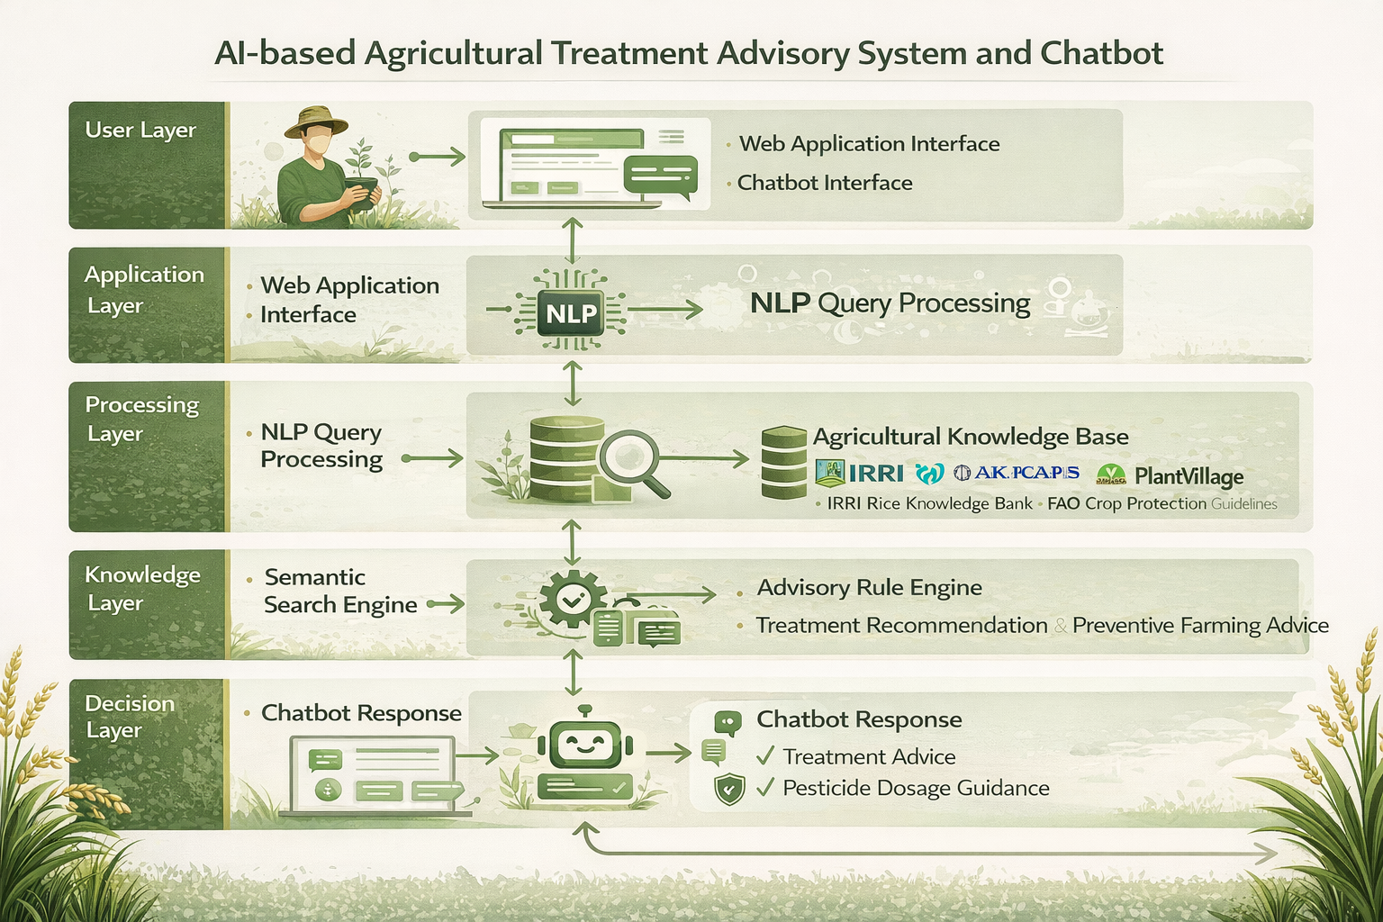
Treatment Advisory System and Agricultural Chatbot
System Overview And Dependencies
Dependencies
Rice Disease Detection Module provides disease prediction results to the advisory system.
Rice Pest Detection Module sends pest identification outputs for treatment recommendation.
Voice-Based Symptom Analysis Module supplies symptom descriptions from the farmer’s voice input.
Backend API Server connects the advisory system with other PaddyGuard AI components.
Shared agricultural datasets used for model training.
Shared backend APIs for communication between components.
Common web UI & data storage for symptoms, predictions, and farmer interactions.
Common Components
IT22303820 | Keshan B K | R26-SE-015

Slide 28
Market, Value Proposition And
Commercialization
Target Market
Primary: Department of Agriculture & extension services.
Secondary: Agricultural cooperatives, crop insurance, agri-input companies.
End Users: ~1.8M paddy farming households in Sri Lanka.
Commercialization
Government licensing as national agricultural advisory tool.
API integration for agri-input companies.
Grants & SaaS analytics for cooperatives and regional expansion.
Value Proposition
Farmers: Instant Sinhala voice-based disease diagnosis & treatment advice.
Government: Scalable digital advisory for rural farmers.
Agri Companies: Targeted product recommendations at diagnosis stage.
Society: Reduced crop losses and improved food security.

Slide 29
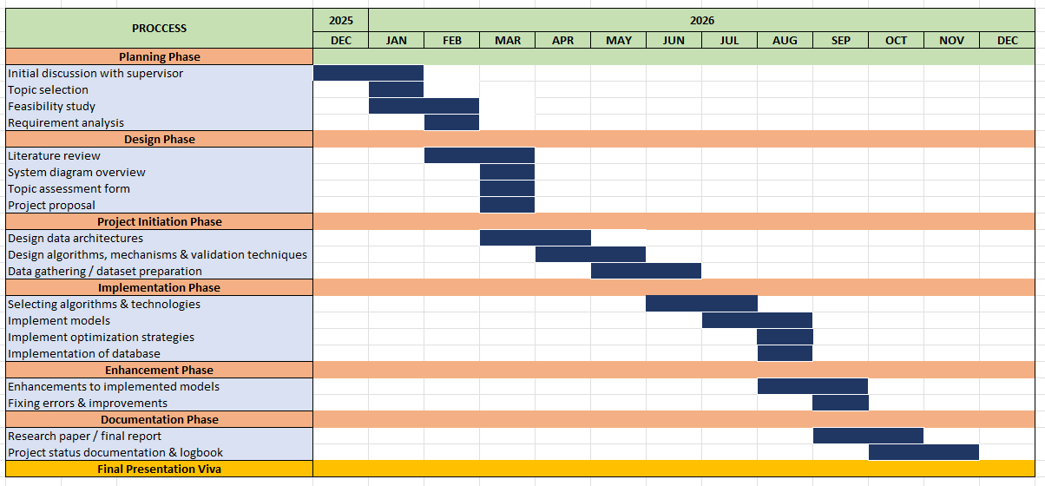
Gantt Chart

Slide 30
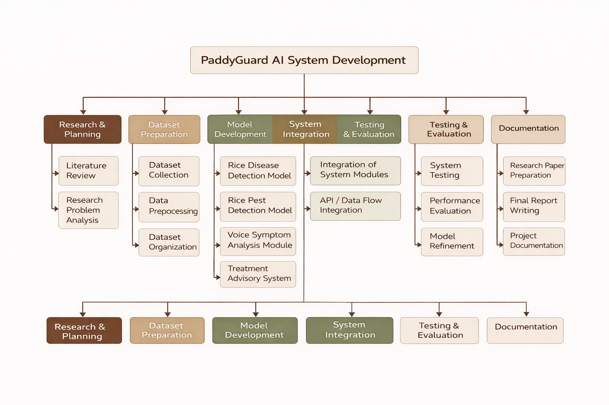
Work breakdown structure

Slide 31
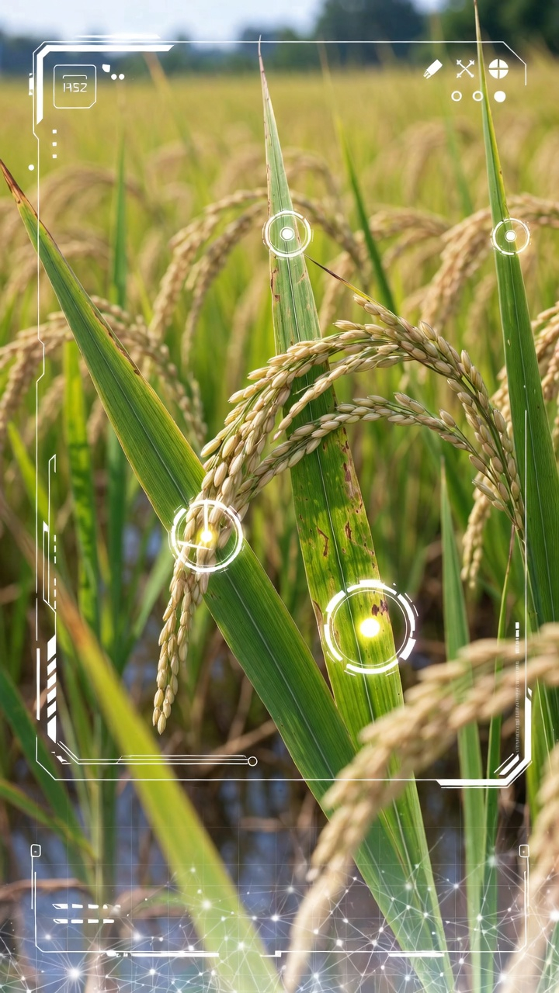
Thank You

