Slide 1

Blood Donation Website
Minor Project
Bachelor of Computer Application
Submitted By:
Name: Jayant
Roll No:2020397
OCT,2022
Under the Guidance of:
Mrs . Ruchi
Department of Computer Application , CGC Jhanjeri Mohali-140307

Slide 2
Table of Contents or Index
S.No | Particulars/Content
1. | Introduction
2. | Brief description of project
3. | Problem Formulation
4. | Objectives
5. | Facilities
6. | References

Slide 3
Introduction What is Blood donation Blood donation is a medical procedure for giving the blood. If any people want to donate blood ,so it can easily donated. It is beneficial for those people have need blood in any problem like: Accident in road. This situation is created during the accident when blood is lose in body. If people , donate few liter blood ,their occurred no problems in body and also not decrease the blood in body because in our body few liters blood are extra present in body. Blood donation is very important for patients have lack of blood in body.

Slide 4
Brief Description of Project
1.My project is on Blood Donation.
2.It is a dynamic website which includes multiple webpages.
3.In this project, I used multiple programming ,scripting and query languages.
Like: HTML , CSS , PHP, Javascript and DataBase.
4.First , I made Registration page and Login page for user who has successfully registered in our website.
5.Second, I made home page for giving details of blood donation and giving necessary information.
6.Third, made another form and took the data from the ones who are willing for donating blood.

Slide 5
7. In fourth step, if the user wants to contact me then he will have to fill the form by giving necessary details.
8.Lastly I made a webpage for showing the details of user.
9.Database connectivity for storing data is also available in my website
10. It is also a responsive website.

Slide 6
Hardware and Software Requirements
Hardware:
1.Ram=512MB and 1GB expected
2.CPU=i3 processor is expected
3.Graphics=No need of Graphics Card
Software:
1.VS Code
2.Xampp
Server:
1.Apache
OS:
Windows

Slide 7
Use of Languages
This Website is covered two ends:1.FrontEnd and 2.Backend
Frontend
1.HTML
2.CSS
3.JavaScript
Backend
1.PHP
2.MYSQL using Xampp Server

Slide 8
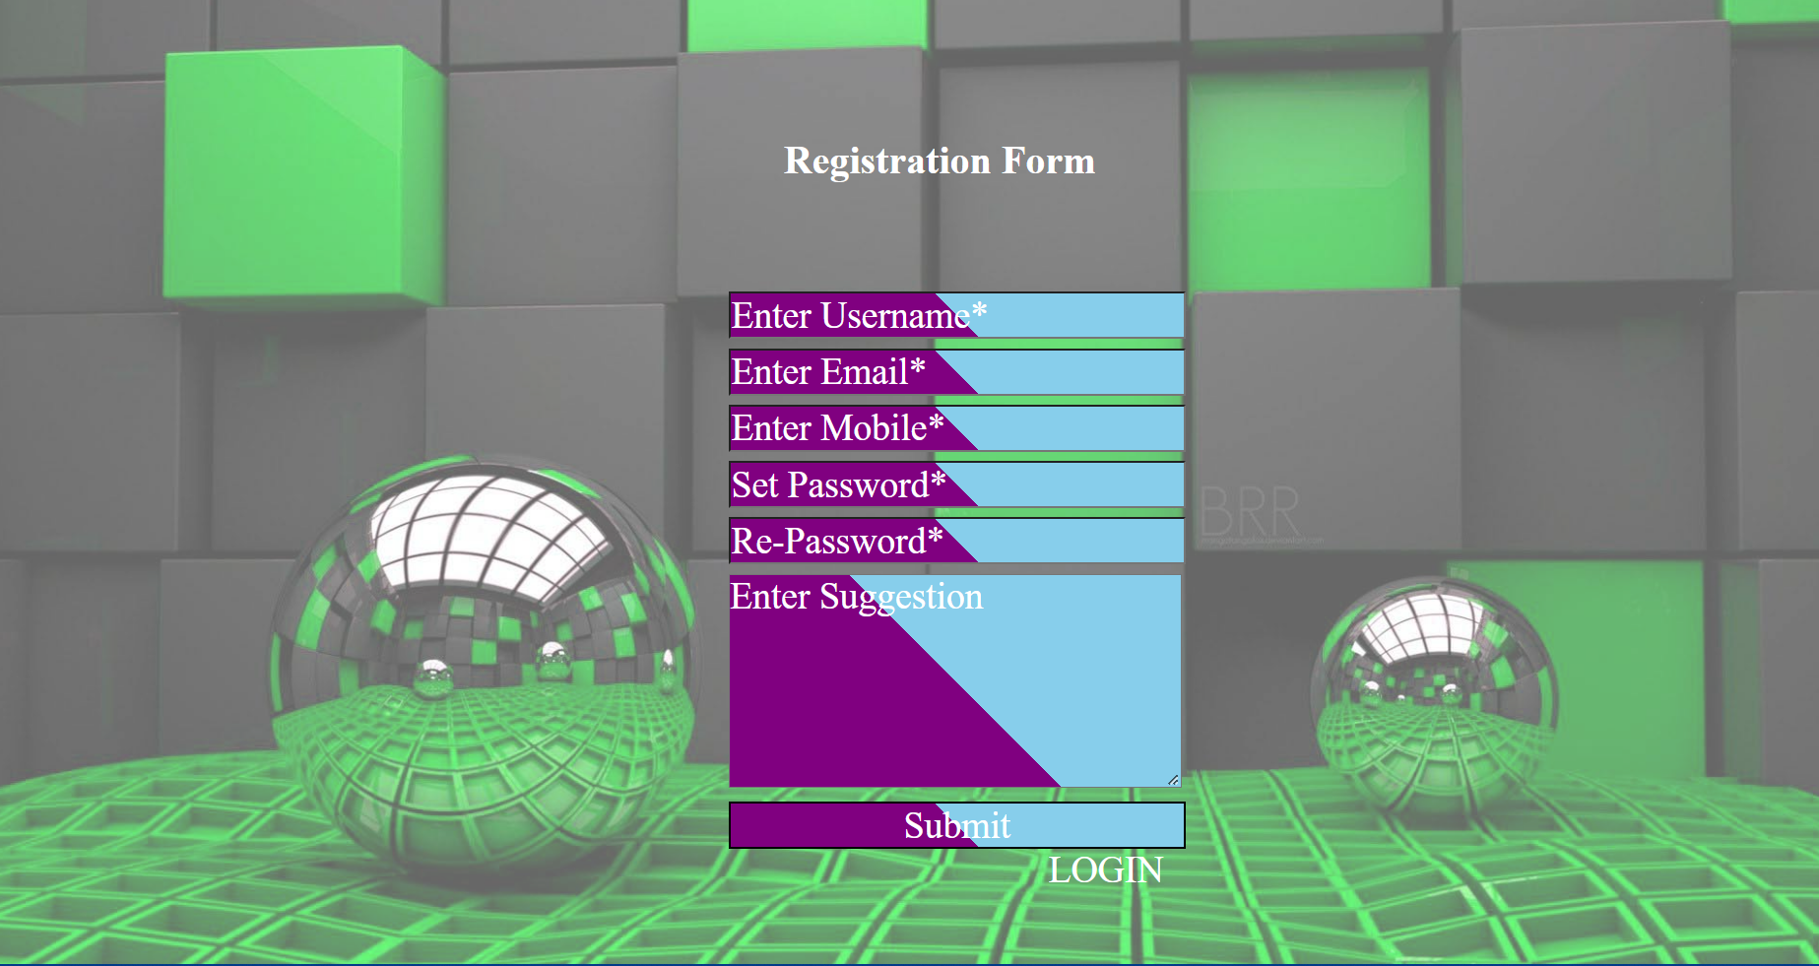
Modules and Charts
1.Registration Page:
Registration Page is used to register the user in our website , which means after registration user have permission for using this website.

Slide 9
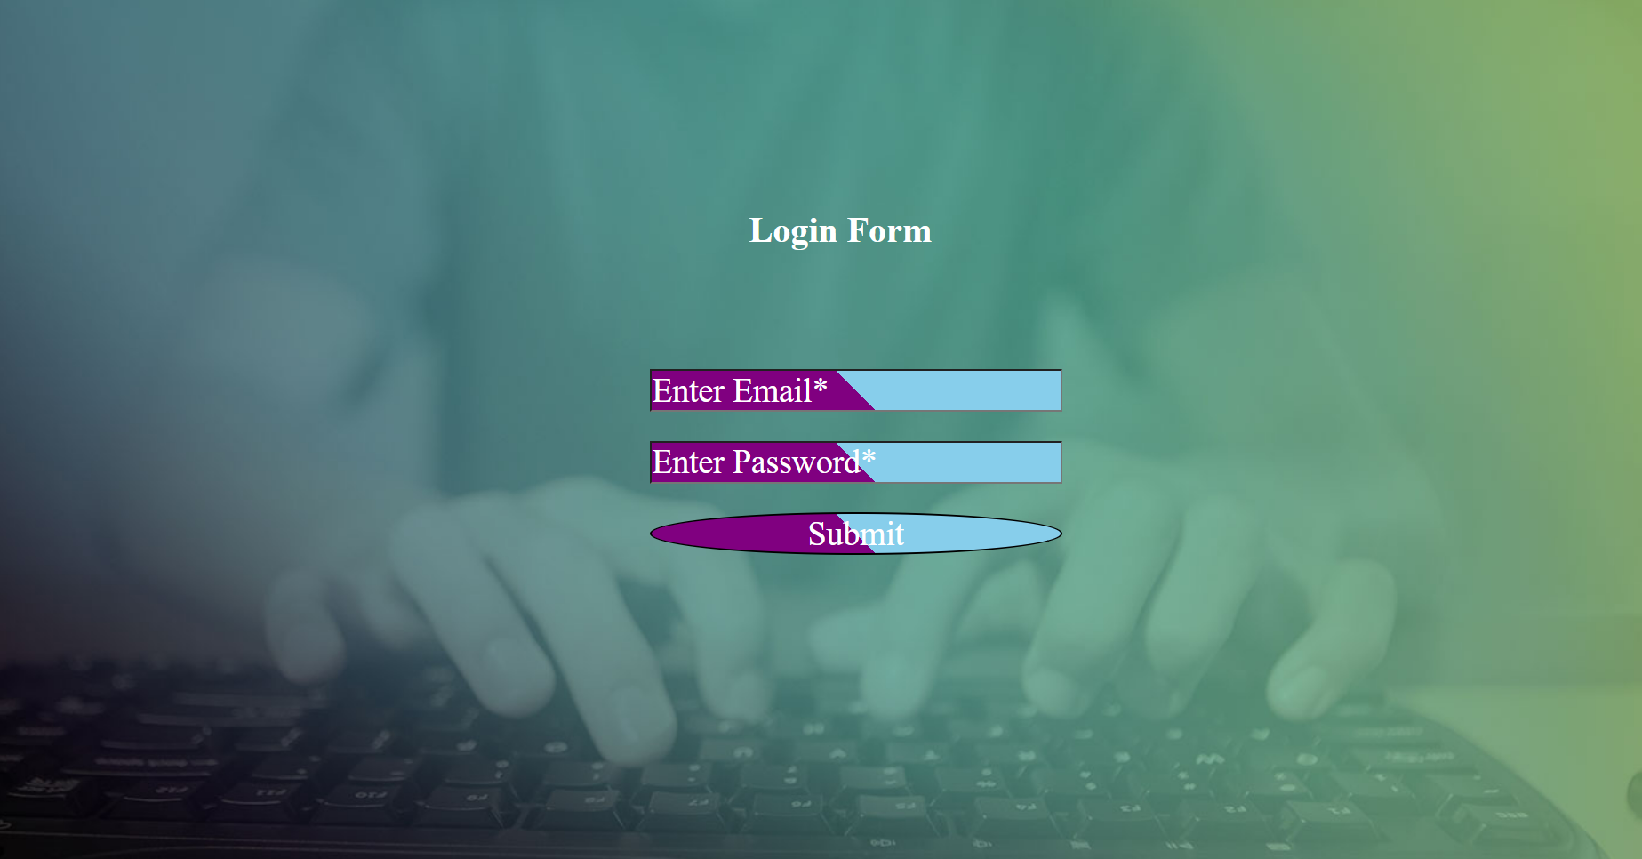
2.Login Page:
Login Page is used to enter the login details of the user which means after filling email and password it will take us to the home page and then we can visit the website in detail. It is also used to remove unauthorised person.

Slide 10
Problem Formulation
1. Due to unavailability of blood in blood banks many people die. Some blood groups are not easily available because people do not donate blood time to time.
2.Some people lose blood during an accident.
3. Many times there are no blood matches in the hospital.

Slide 11
Objectives
1. For Solving blood problem.
2. On Time give blood for patients.
3. For Saving Maximum life.
4. Possible proper treatment.
5. Proper usage of blood.
6. low death rate.

Slide 12
Facilities required
2. No Amount for registration fees.
3. Less time consuming procedure.
4. Safe for use.
5. Simple Structure for use.
6. Contact Details and help section for donating blood is also available.
7. Also check own Details , successfully applied or not
8. Responsiveness is also available.

Slide 13
References
https://www.medindia.net/patients/patientinfo/blooddonation-references.htm
(4882) How to Make Login Form in PHP and MySQL – YouTube
(4882) User Registration Form with PHP and MySQL Tutorial 1 - Creating a Registration Form - YouTube

Slide 14
Thank You

