Slide 1

Project Presentation
On
Integration of 32-bit RISC-V ALU and ARM via Simple Bus with Scan Testability
Presented by :
Nishanth Lazar Mohan
Omkar Nimith Muthabyraiah
Tejaswi Satish
Jayant Patil
Tsedalu Fentaw Mekonen

Slide 2
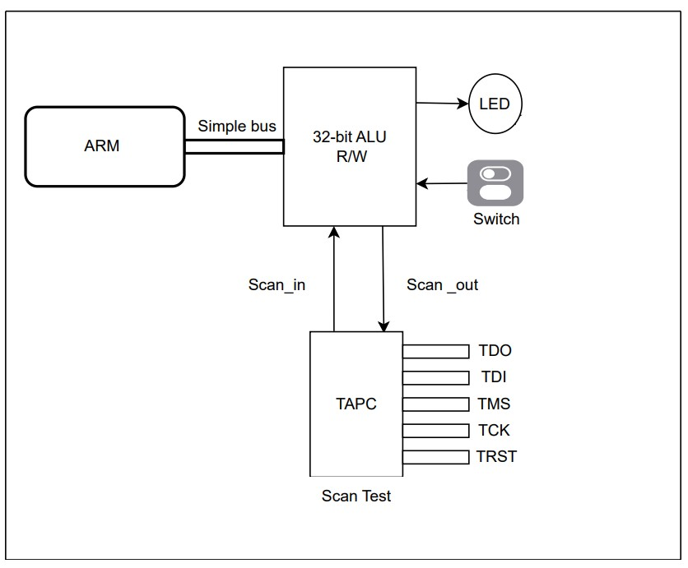

Top Level

Slide 3
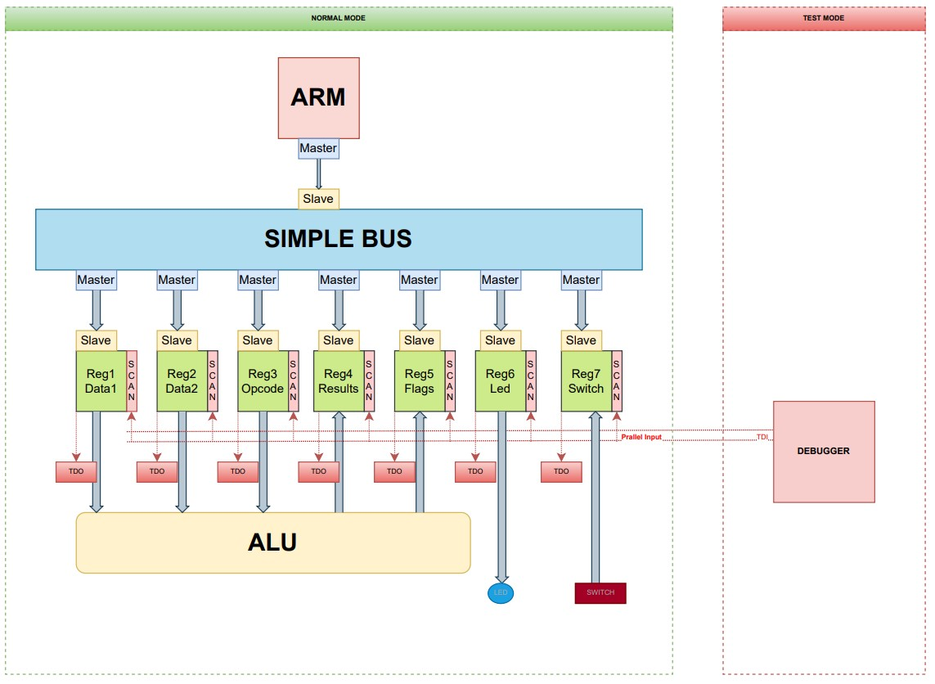
Top Level View :
Tejaswi Satish
Functional Block Diagram

Slide 4
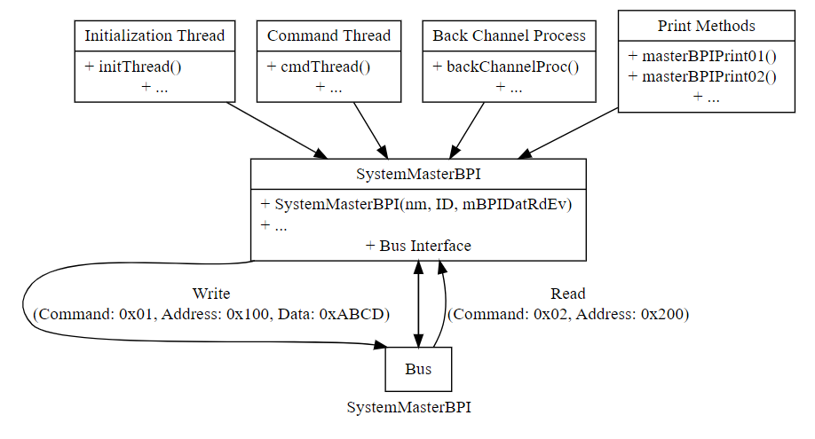
Master BPI

Slide 5
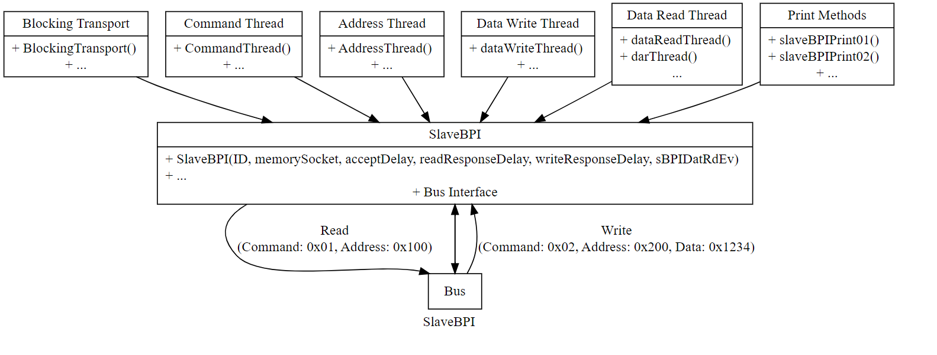
Slave BPI

Slide 6
Register Operation
The class employs three threads to handle various aspects of register operations concurrently.
getCmdThread monitors events related to write operations and GPIO changes, providing a mechanism for notifying transactions.
wrtDatThread manages write operations on the register, considering GPIO input and output conditions.
putDatThread handles read operations on the register, writing data to an output and notifying when read data is ready.
The class includes helper functions (registerFuncPrint01, registerFuncPrint02, registerFuncPrint03) for printing debug information during read and write operations.

Slide 7
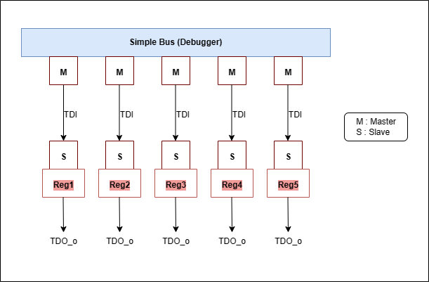
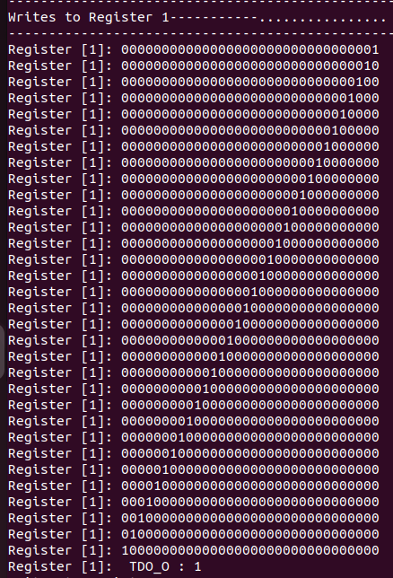
Scan Chain
Scan Chain Algorithm
Simulation Output

Slide 8
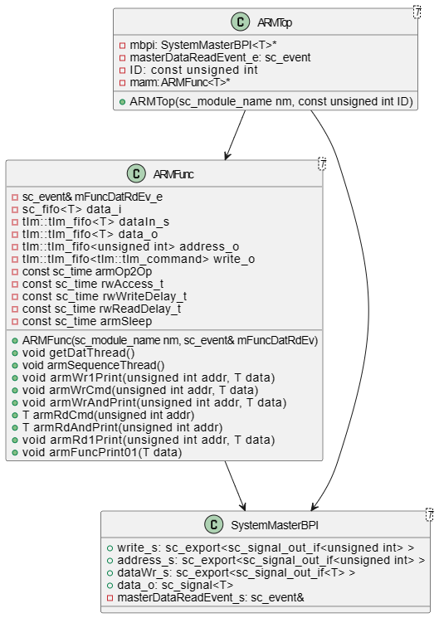
ARM Algorithm

Slide 9
ALU Operation
ALU is a critical component of the ARM system responsible for performing arithmetic and logical operations
Read two 32 bit inputs and opcode from register
Write the result back in to register
Display the status of flag in register

Slide 10
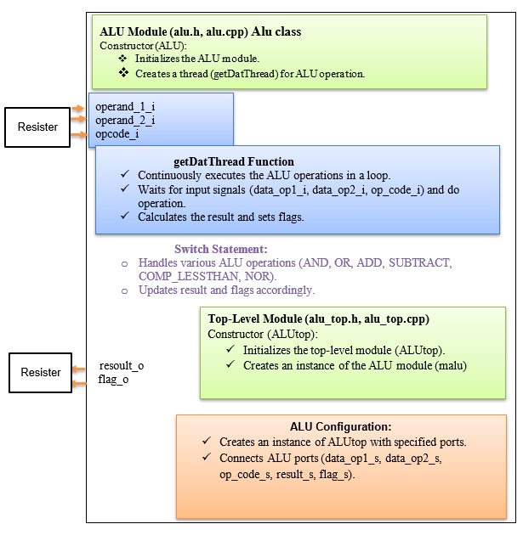
ALU Design Elements

Slide 11
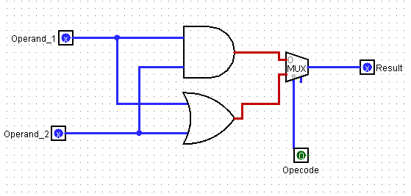
A 1 Bit ALU AND & OR
Takes the inputs from the ARM and performs the operation of operand 1 AND operand 2 or operand 1 OR operand
Depending on whether the value of operation is 0 or 1.

Slide 12
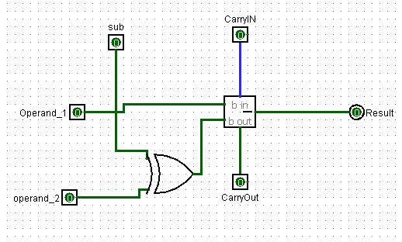
Addition and Subtraction of ALU

Slide 13
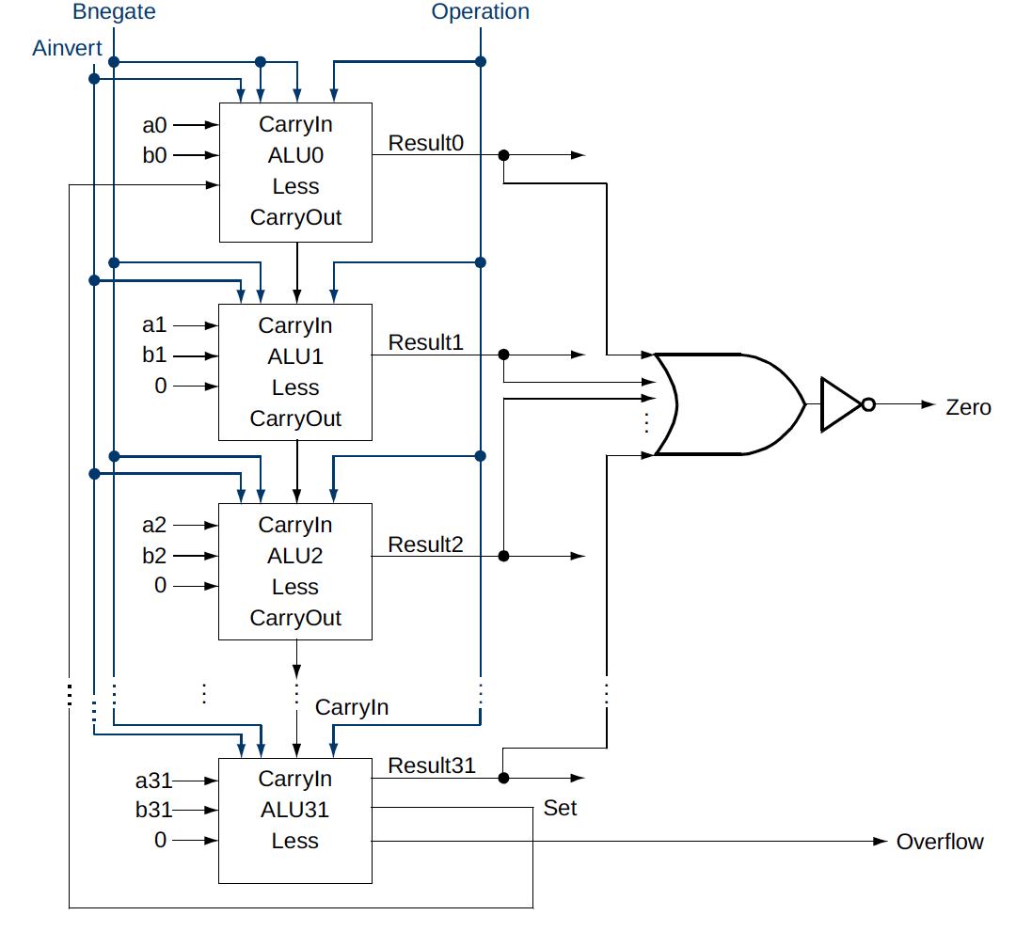
A 32 Bit ALU Operation
AND
OR
ADD
SUB
STL
NOR

Slide 14
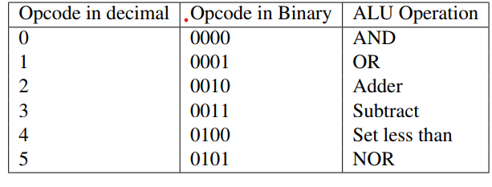
ALU Control Lines

Slide 15
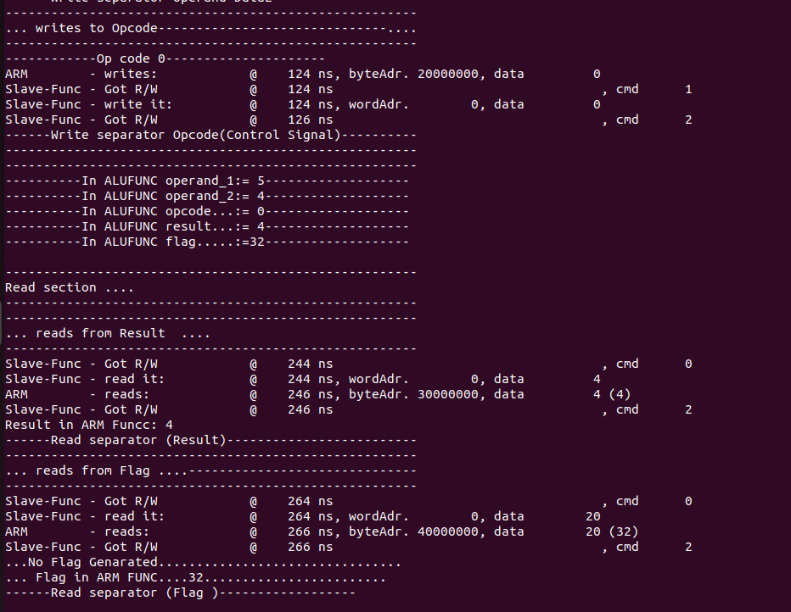
Simulation Result of AND

Slide 16
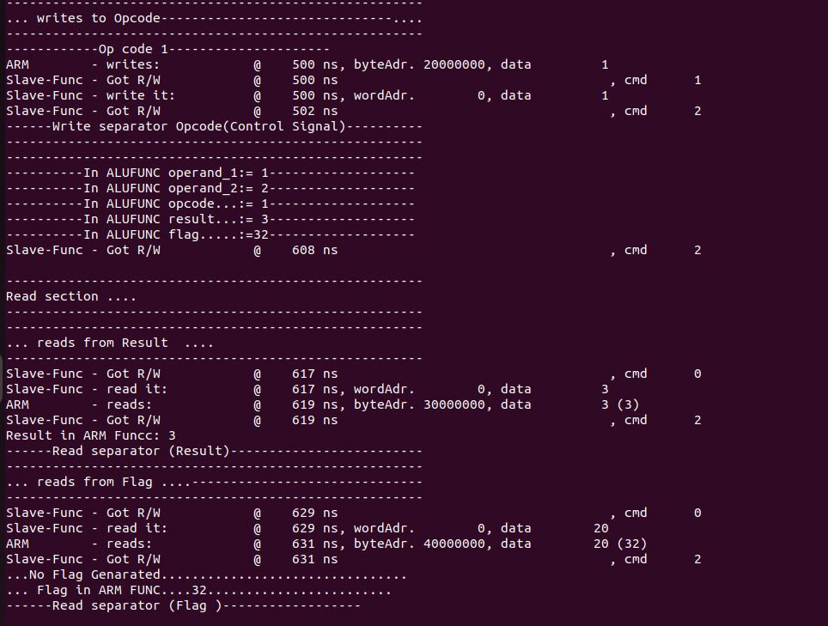
Simulation Result of OR

Slide 17
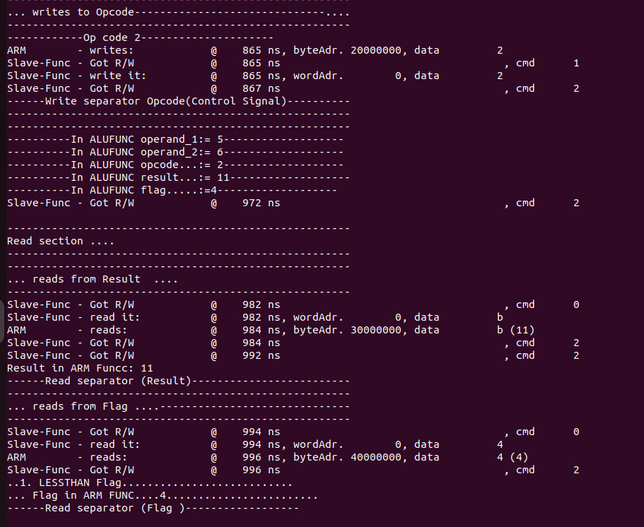
Simulation Result of Addition

Slide 18
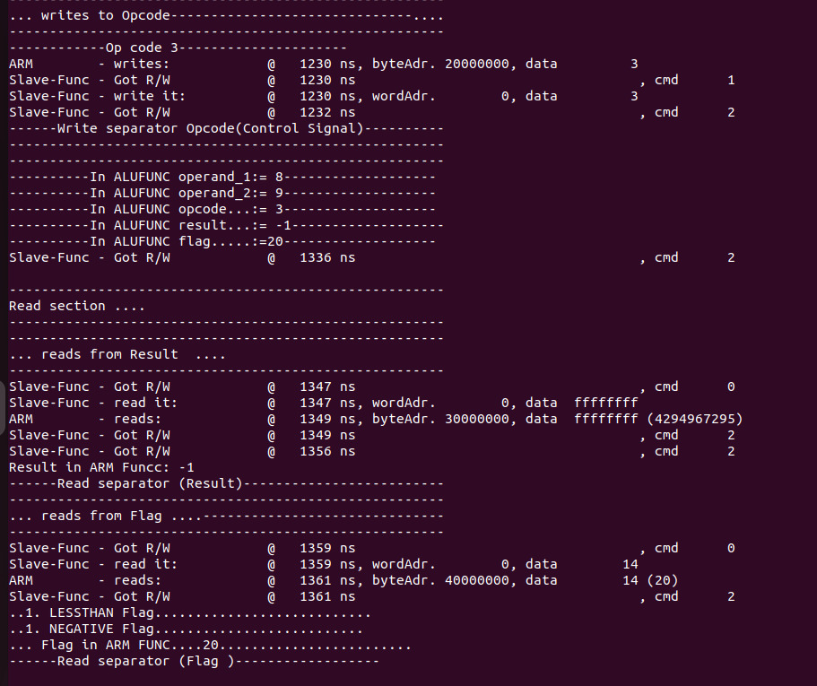
Simulation Result of Subtraction

Slide 19
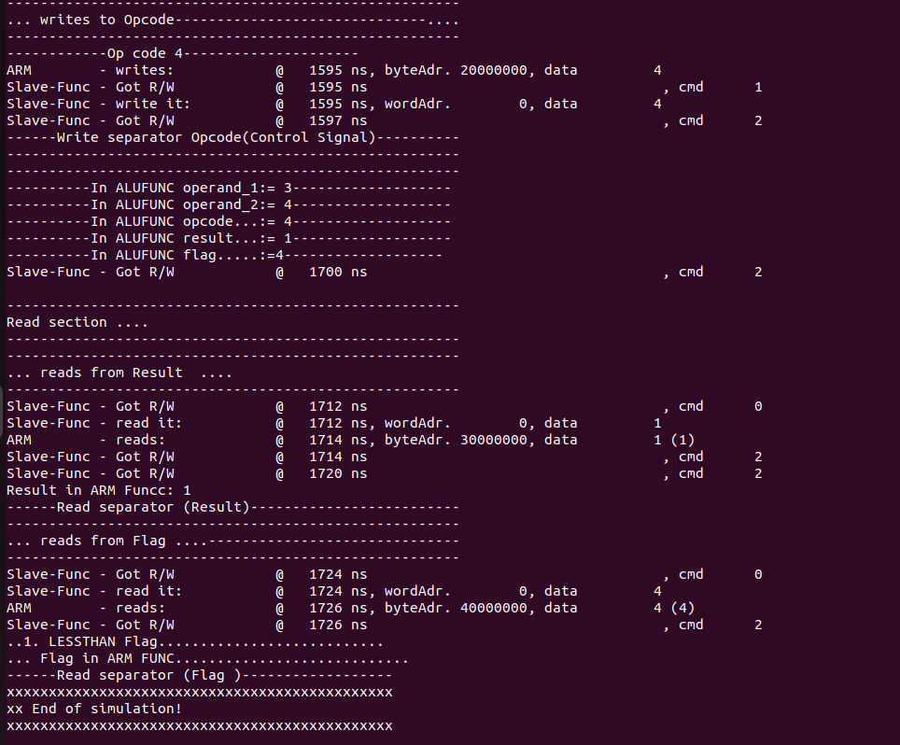
Simulation Result of Set less than input

Slide 20
Thank You

